Slide 1
Metal Reactivity Lab Set-up
Teacher Tips
CHEM.3.2
Analyze data to identify patterns that assist in making predictions of the outcomes of simple chemical reactions. Emphasize patterns based on the outermost electrons of atoms, trends in the periodic table, and knowledge of chemical properties.

Slide 2
Part 1: Anchor Phenomenon Set-Up (Teacher Demo)
Goal: Create three visually identical "mystery gases" for the hook.
Materials Needed:
3 Erlenmeyer flasks or large test tubes (labeled A, B, C)
Rubber stoppers (loose fitting) or glass plates to cover mouths
Wooden splints and a lighter/burner, or BBQ lighter, or tea candles
Safety: Goggles and a safety shield are recommended, especially for the H2 and O2 generation.
The "Recipes" & Instructions:
Flask A: Hydrogen (H₂) - The "Pop"
  Pre-load: Add 2-3 pieces of Mossy Zinc to the flask.
  Action: Add approx. 10-20mL of 3M-6M Hydrochloric Acid (HCl).
  Tip: Cover loosely for 30-60 seconds to let the gas displace the air. Light a splint and bring it to the mouth. Expect a loud "bark" or pop.
Flask B: Carbon Dioxide (CO₂) - The "Extinguisher"
  Pre-load: Add 1 scoop (approx. 5g) of Sodium Bicarbonate (Baking Soda).
  Action: Add approx. 20mL of Vinegar (Acetic Acid) or dilute HCl.
  Tip: This reaction froths rapidly. Wait for the bubbles to subside slightly. Insert a burning splint into the flask (don't touch the liquid). The flame should die immediately.
Flask C: Oxygen (O₂) - The "Reigniter"
  Pre-load: Add a pinch of Manganese Dioxide (MnO₂) or Potassium Iodide (KI) as a catalyst. (Yeast also works, but is messier).
  Action: Pour in approx. 20mL of Hydrogen Peroxide (H₂O₂). (Drugstore 3% works, but salon-grade 6-12% is more dramatic).
  Tip: Light a splint, let it burn for a moment, then blow it out so it is a glowing red ember. Insert the glowing ember into the flask. It should burst back into flame.

Slide 3
Part 2: Student Reactivity Lab Set-Up (Teacher Prep)
Goal: Students compare reactivity rates of different metals with acid. To save time and reduce waste, pre-load the metals.
Preparation Tips for the Teacher:
Pre-Loading Strategy: Place a small amount of each metal into the labeled test tubes before class. Students only need to grab the rack of tubes and add the acid.
Acid Station: Since you are using 3M-6M HCl, consider setting up a central dispensing station or providing small dropper bottles at student tables to prevent large spills. Note: 6M is quite strong for general observations; ensure ventilation is good as acid fumes may accumulate.
The "Iron Warning": Iron filings often come with an oil coating to prevent rust. This oil blocks the acid from reaching the metal, resulting in a “no reaction” that confuses students.
  The Quick Test: Mix a pinch of your iron filings with a small amount of Copper Sulfate (CuSO₄) solution. If the iron turns copper-colored almost immediately, it is clean and reactive. If not, the oil is blocking it, and you may need to rinse the filings with acetone or use steel wool instead.
Grease pencils are nice to use for labeling, it washes off easily.

Slide 4
Part 3: Student Station Set-Up Instructions (Per Group):
1. The Metals (Pre-loaded in Test Tubes): Ensure the "chunk" size is relatively consistent, but note the surface area differences.
Tube 1: Magnesium (Mg) - Use ribbon (cut into 1cm pieces). Reactions are vigorous/hot.
Tube 2: Zinc (Zn) - Use mossy zinc or granules. Good steady bubbles.
Tube 3: Iron (Fe) - Use filings or steel wool. (See warning above).
Tube 4: Copper (Cu) - Use shot, turnings, or wire. (Used as a control—should show no reaction with HCl).
Tube 5: Aluminum (Al) - Use foil or shot. Note: Al has an oxide coating. It may take a minute of "doing nothing" before the acid eats through the coating, and the reaction suddenly starts vigorously. Tell students to be patient!
Tube 6: Calcium (Ca) - Use turnings. Warning: Calcium reacts very violently with acid. Use a very small piece, or consider having students do this one with water only, as listed in your slides.
2. The Reaction:
Instruct students to add enough acid to completely cover the metal by about 1 cm depth.
Surface Area Note: Remind students that powders (like Iron filings) have massive surface area compared to ribbons or mossy chunks. They should look for instant reaction speed vs. sustained bubbling when comparing.

Slide 5
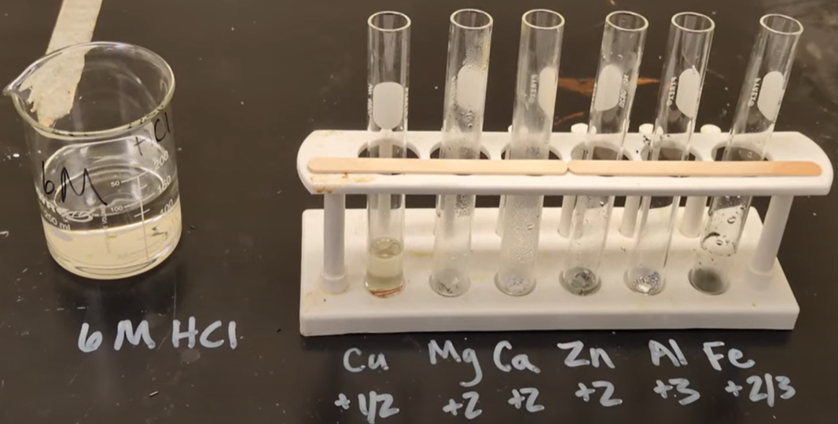

Slide 6
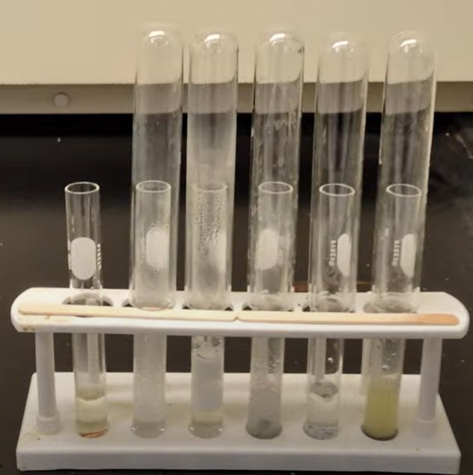
Tips
3M HCl works and is recommended for the lab. It does take a little more time for some elements.
Use a larger test tube that can go over the top of the one with the metal. The H₂ gas will rise and be captured better.
Small pieces of aluminium foil will work, but it will take longer due to the film they use.

Slide 7
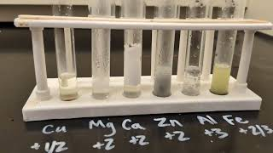

Slide 8
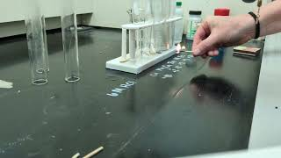

Slide 9
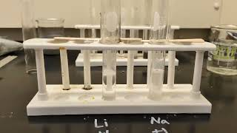
With Lithium and Sodium

Slide 10

3D-RST is supported by the NSF under grant number #DRL-2101383

