Slide 1
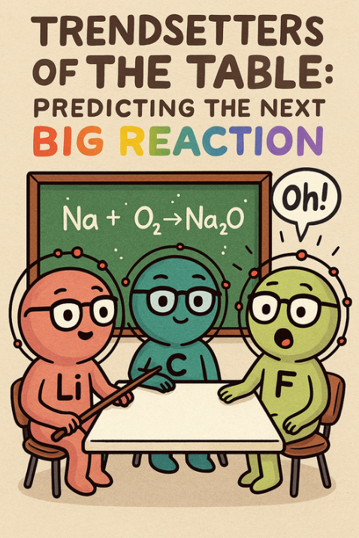
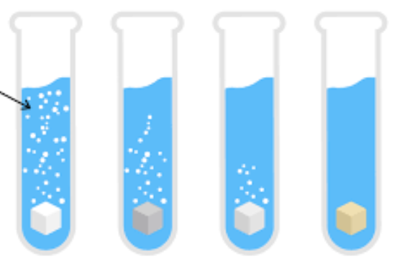
CHEM.3.2

Slide 2
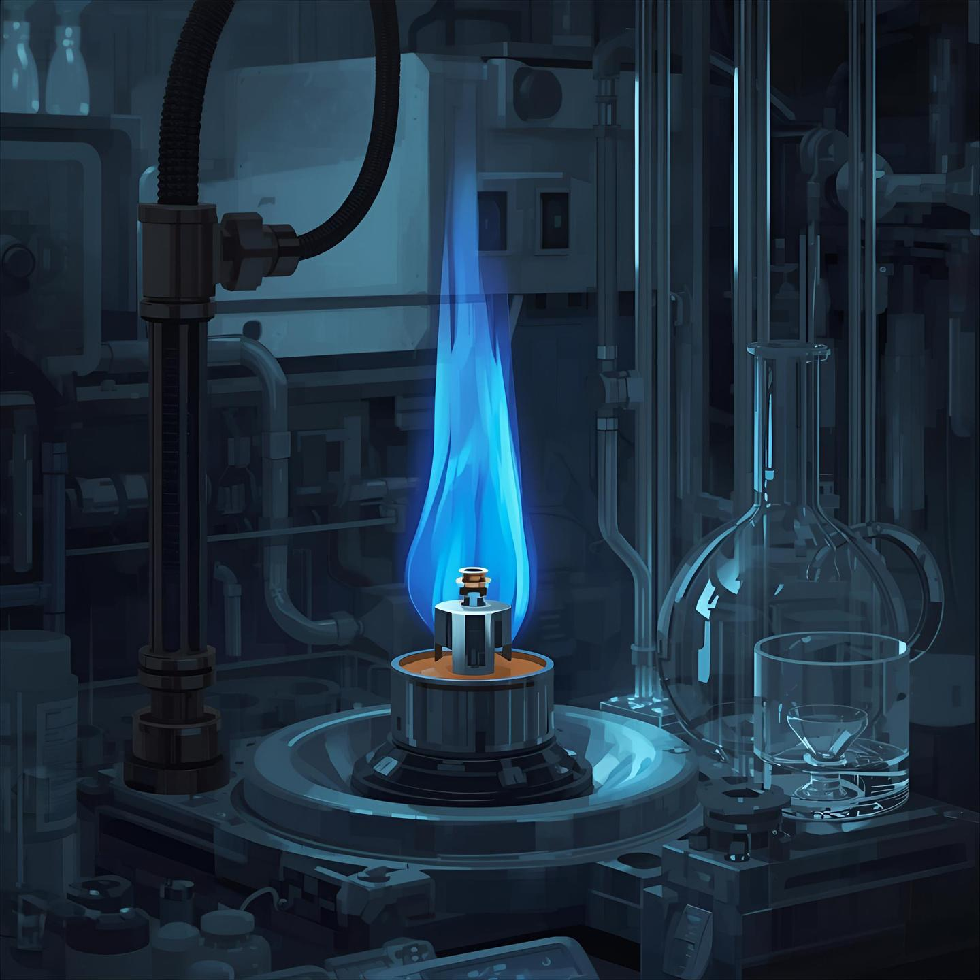
CHEM.3.2
Analyze data to identify patterns that assist in making predictions of the outcomes of simple chemical reactions. Emphasize patterns based on the outermost electrons of atoms, trends in the periodic table, and knowledge of chemical properties.

Slide 3
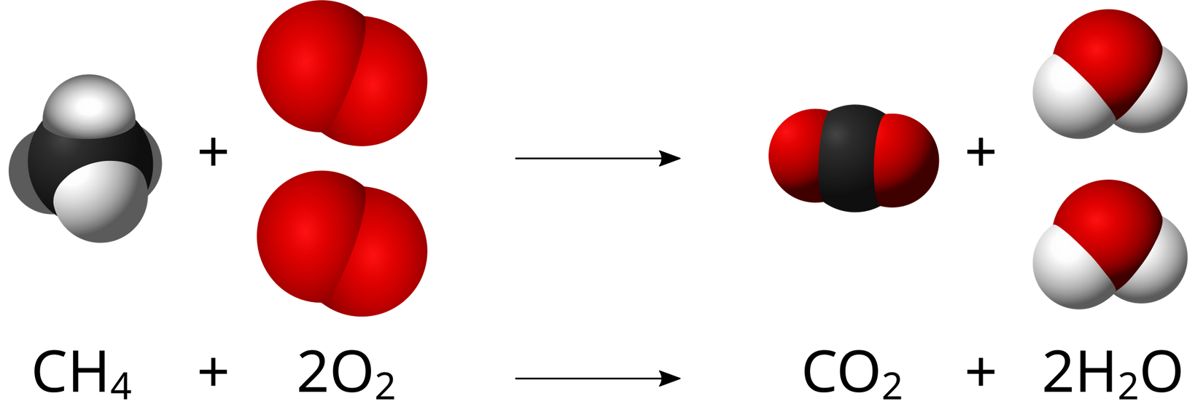

Review: Chemical Reactions
Reactants
Products

Slide 4


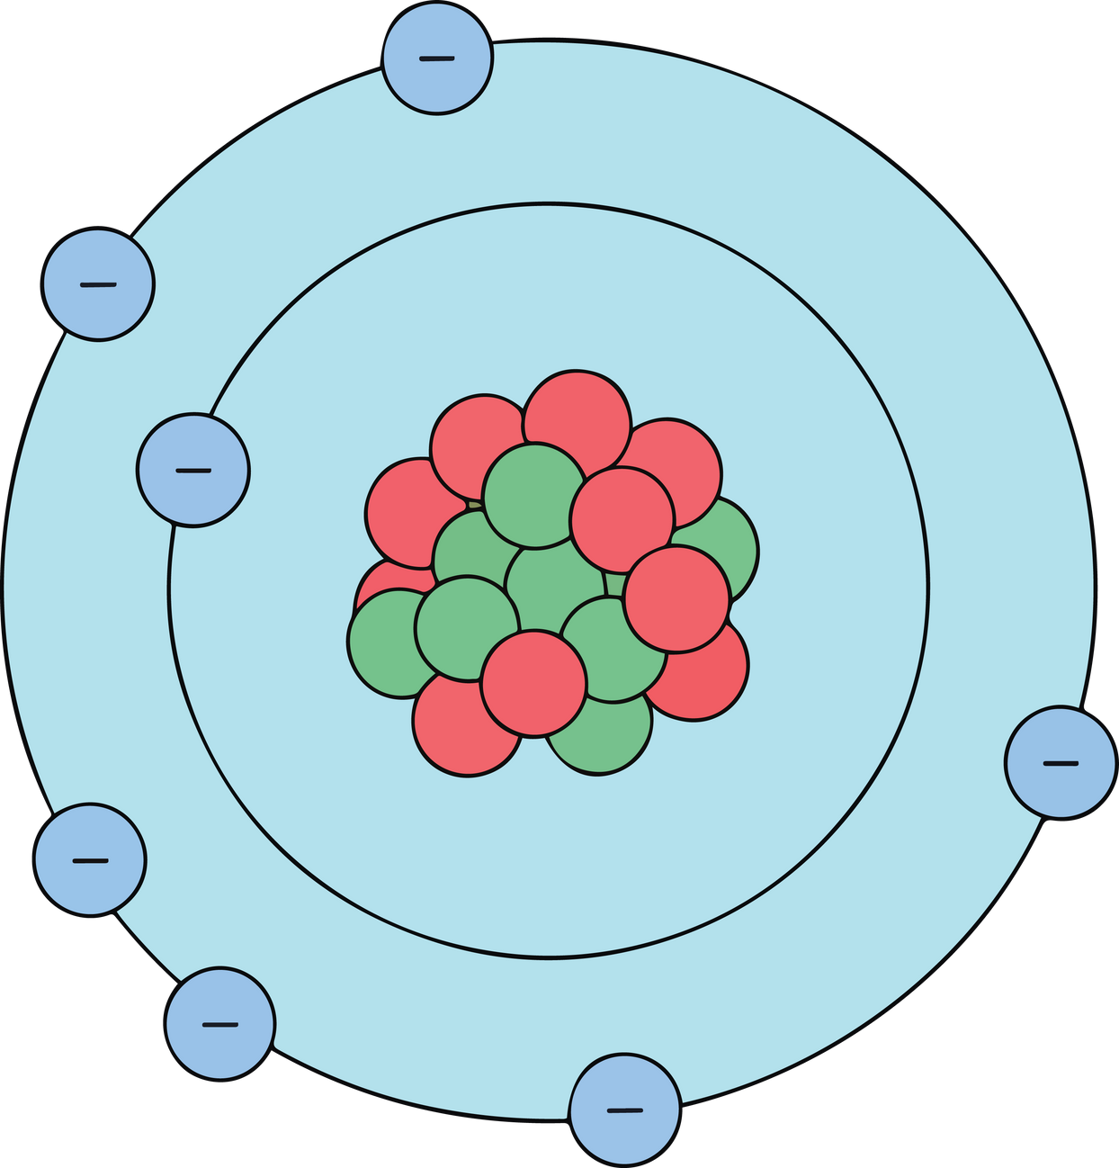
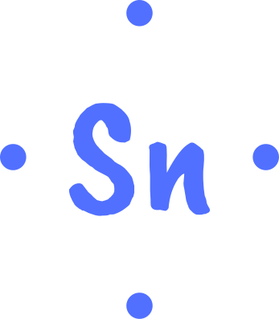

What are Valence Electrons?

Slide 5






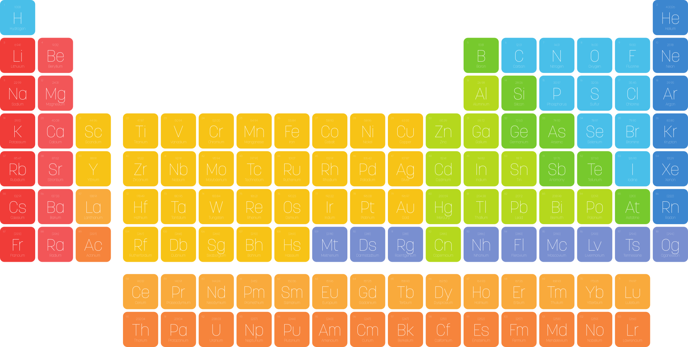
How to find Valence Electrons

Slide 6
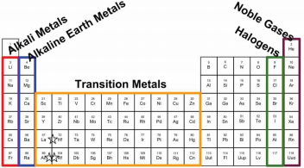

What patterns do you notice with where the valence electrons are located on the periodic table and the different families in each column?
How could that relate to how they react?

Slide 7
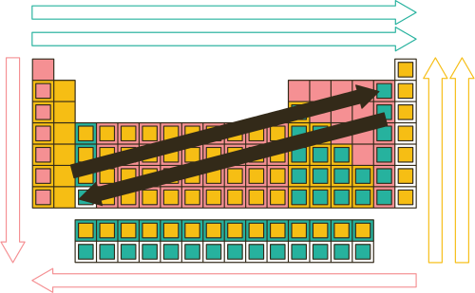
Periodic Trends: Which do you think relates to reativity?
Electronegativity & Ionization Energy
Electronegativity &
Ionization Energy
Atomic Radius
Atomic Radius

Slide 8
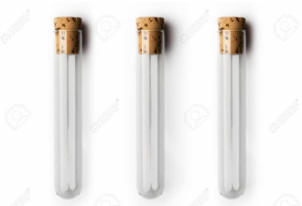
Brainstorm with your group
You have three test tubes of colorless, odorless gasses that the labels fell off of. How do you know what gases they are?
O₂ H₂ CO₂

Slide 9

https://www.youtubeeducation.com/watch?v=V7jhc_S5WL0

Slide 10
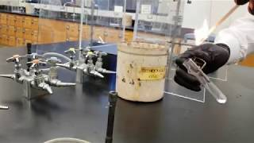

Slide 11


Phenomenon
Discuss as a group: What happened to the flame in each scenario?
Were any sounds produced?
Oh, that’s what you mean by reaction!

Slide 12
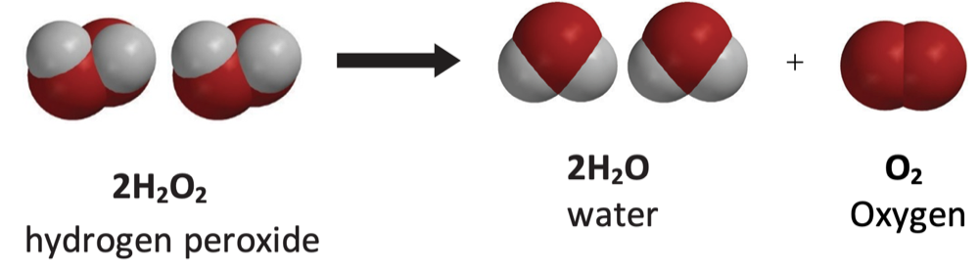

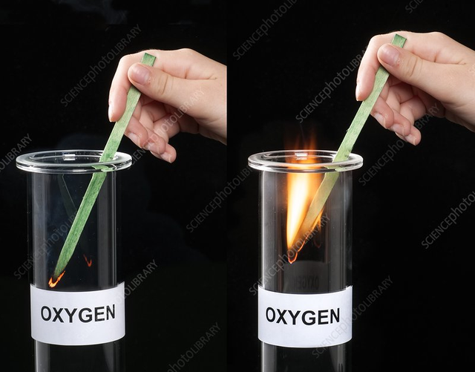


Slide 13
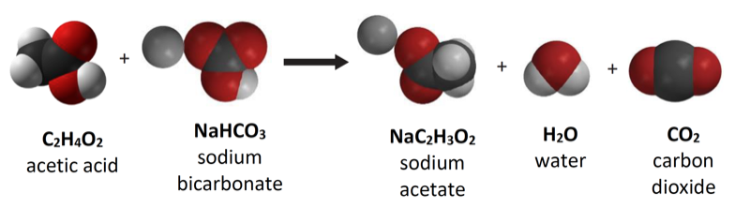

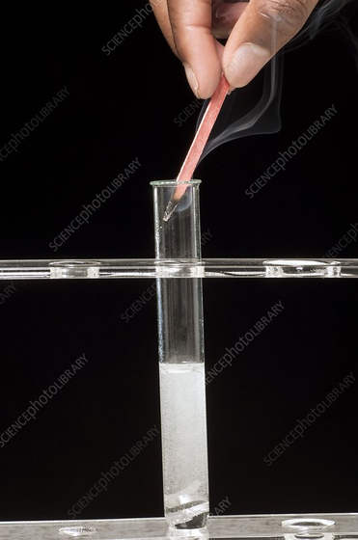

Meh

Slide 14
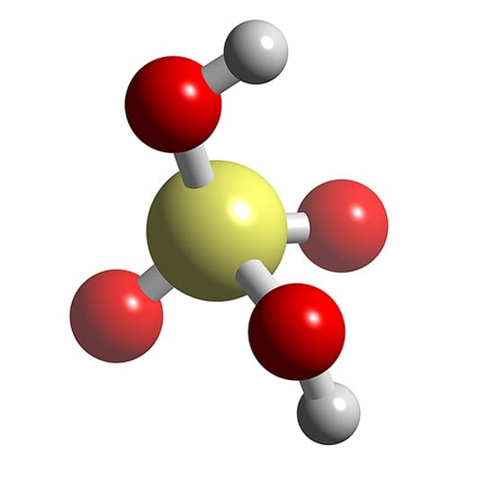
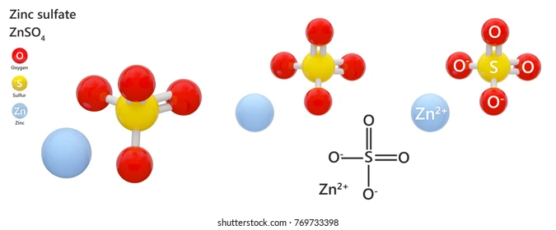


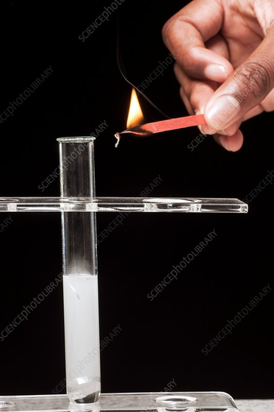


H₂SO₄
H₂
ZnSO₄
Zn

Slide 15

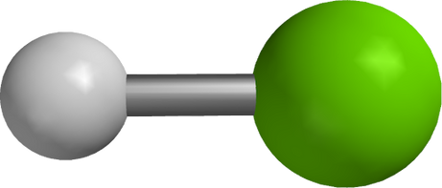
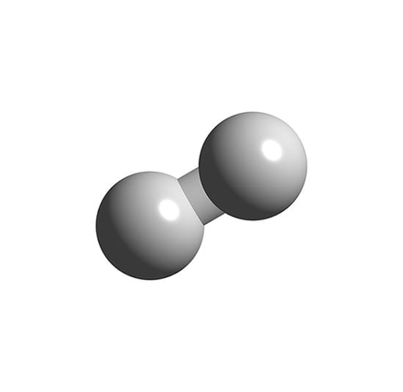

Metal
Acid
Metal+Nonmetal
Gas
X
HCl
XCl
Gas
Single Replacement or Displacement Reaction
What gas is produced when a metal reacts with acid?

Slide 16

Hydrochloric Acid (HCl)
HCl is a strong, corrosive acid that can irritate skin, eyes, and lungs, so it must be handled carefully.
  Wear goggles and gloves any time you work with HCl.
  Use only small, teacher-approved amounts of acid.
  If HCl gets on your skin or clothes, rinse with water immediately
  Never smell the acid
  Add acid slowly to test tubes to avoid splashing.
  Keep all test tubes pointed away from yourself and others.
  Do not mix HCl with anything unless the teacher instructs you to.
  Follow the teacher’s directions for cleaning up

Slide 17
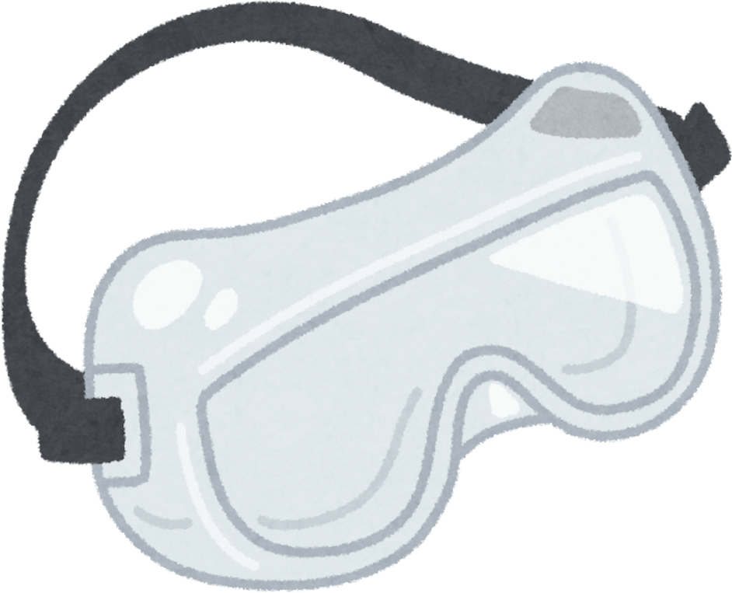
  Test only small amounts of gas and point the test tube away from people.
  Light the wooden splint at the flame station and hold it at arm’s length.
  Bring the splint to the test tube slowly, keeping goggles on at all times.
  Extinguish the splint safely and never ignite gas directly from the reaction container.

Slide 18
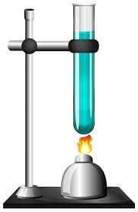
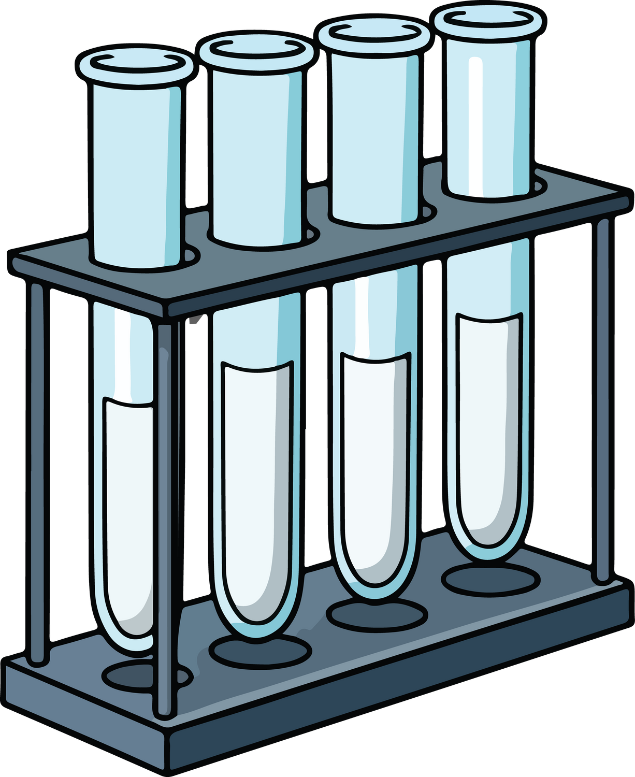
Directions
  Place metal shavings into each test tube.
  Add acid (HCl) to one test tube at a time to ¼ full or about 3-5mL.
  Place the inverted test tube above the tube with the acid. Make observations and notice bubble. Record ranking (1-5)
  Perform the splint test in both the bottom and top test tube.
  Record gas results.
ooo
Yo

Slide 19


Reactants | Bubbles (1-5) | Wood Splint (1-5) | Reactivity Rank(1-5) | Gas Produced
Mg + HCl
Ca+HCl
Al + HCl
Zn+ HCl
Cu+HCl
Fe+HCl

Slide 20
Element | Symbol | Valence Electron | Family/Group | Chemical Equation Reactants→ Products X + HCl → XCl + H₂ (g)
Sodium
Lithium
Zinc |  | 2
Magnesium
Aluminum
Calcium
Iron |  | 2-3
Copper | Cu | 2

Slide 21
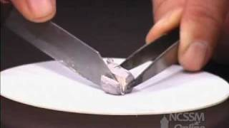
https://www.youtubeeducation.com/watch?v=dmcfsEEogxs
Notes:
Show this video if unable to conduct the lab in your classroom.

Slide 22
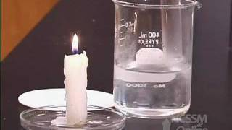
https://www.youtubeeducation.com/watch?v=Vxqe_ZOwsHs

Slide 23
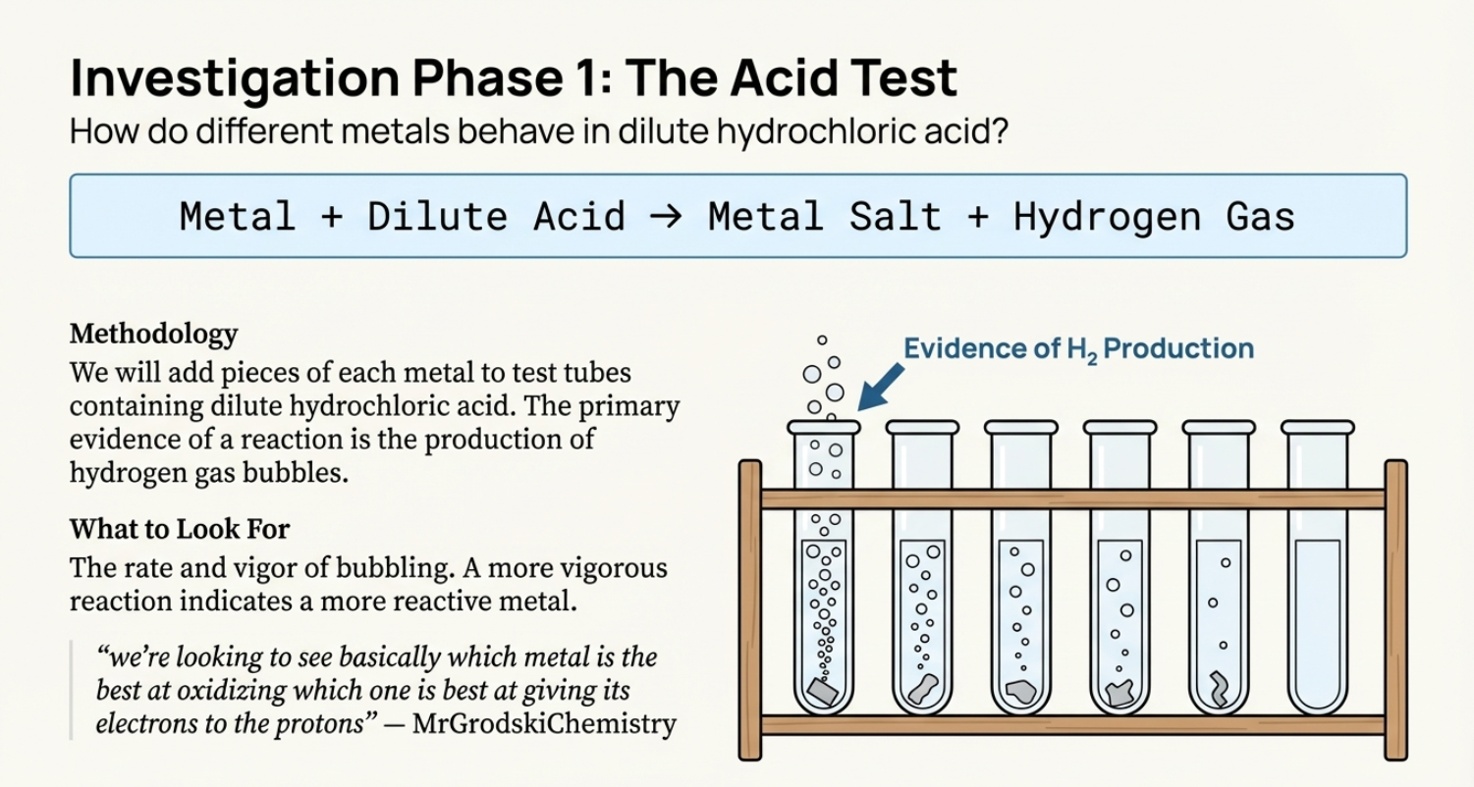

Slide 24
What patterns do you notice with where the valence electrons are located on the periodic table and the different families in each column?
How could that relate to how they react?
Notes:
Show this video if unable to conduct the lab in your classroom.

Slide 25
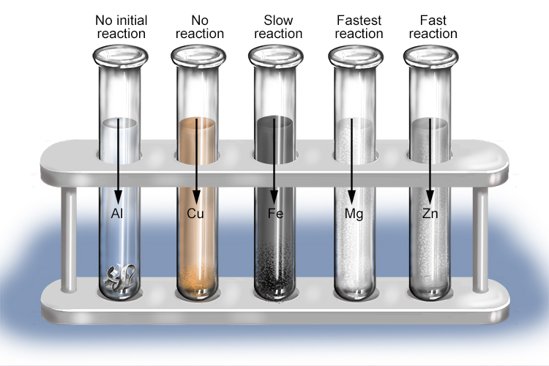

Slide 26
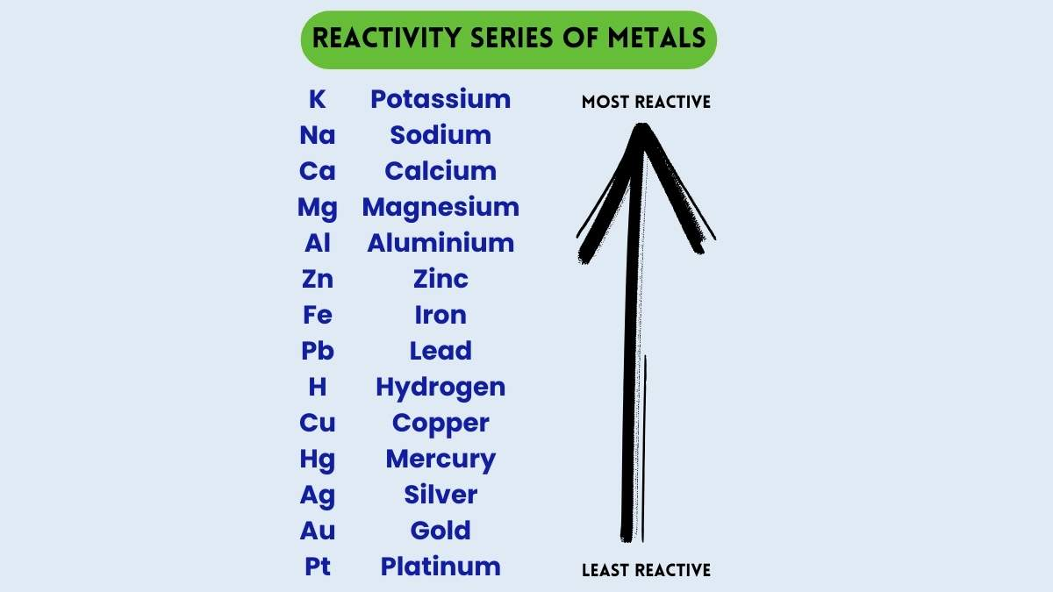

How close
were you?

Slide 27
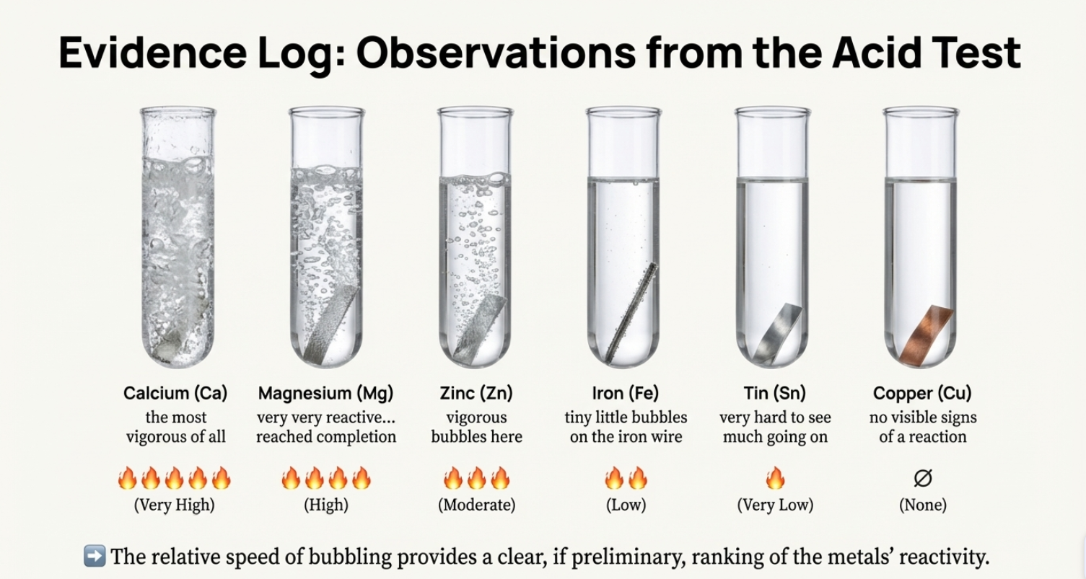

Slide 28
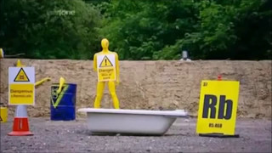
https://www.youtubeeducation.com/watch?v=jx0eQbBDeG8

Slide 29
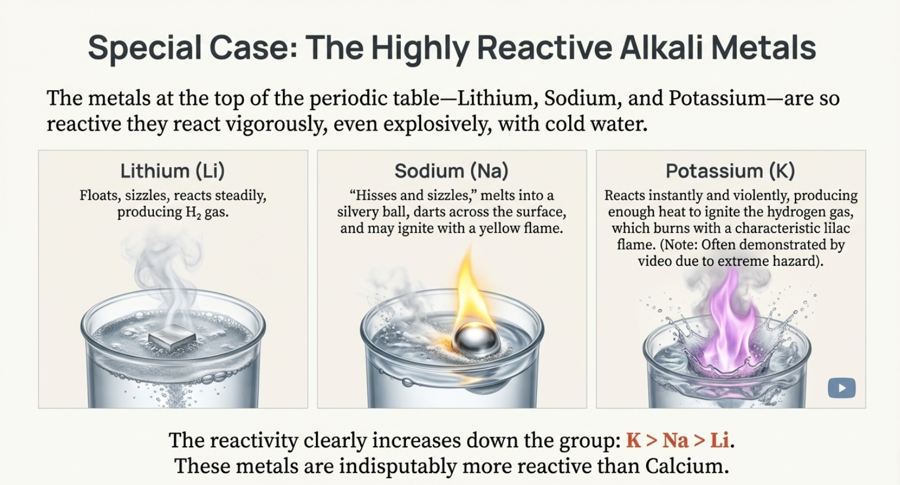

Slide 30
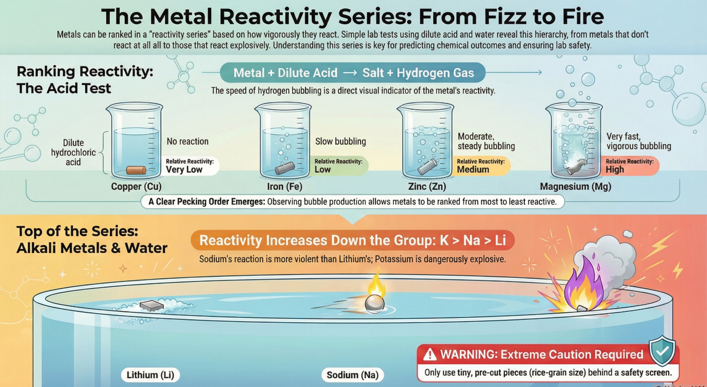

Slide 31

3D-RST is supported by the NSF under grant number #DRL-2101383

