Slide 1
Riding the Currents
Patterns of Matter and Energy in Ocean Current

Slide 2
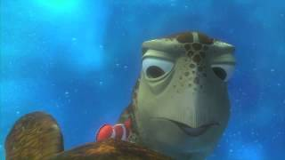
Guiding question- Why do turtles and sharks follow patterns in the ocean instead of moving randomly?

Slide 3
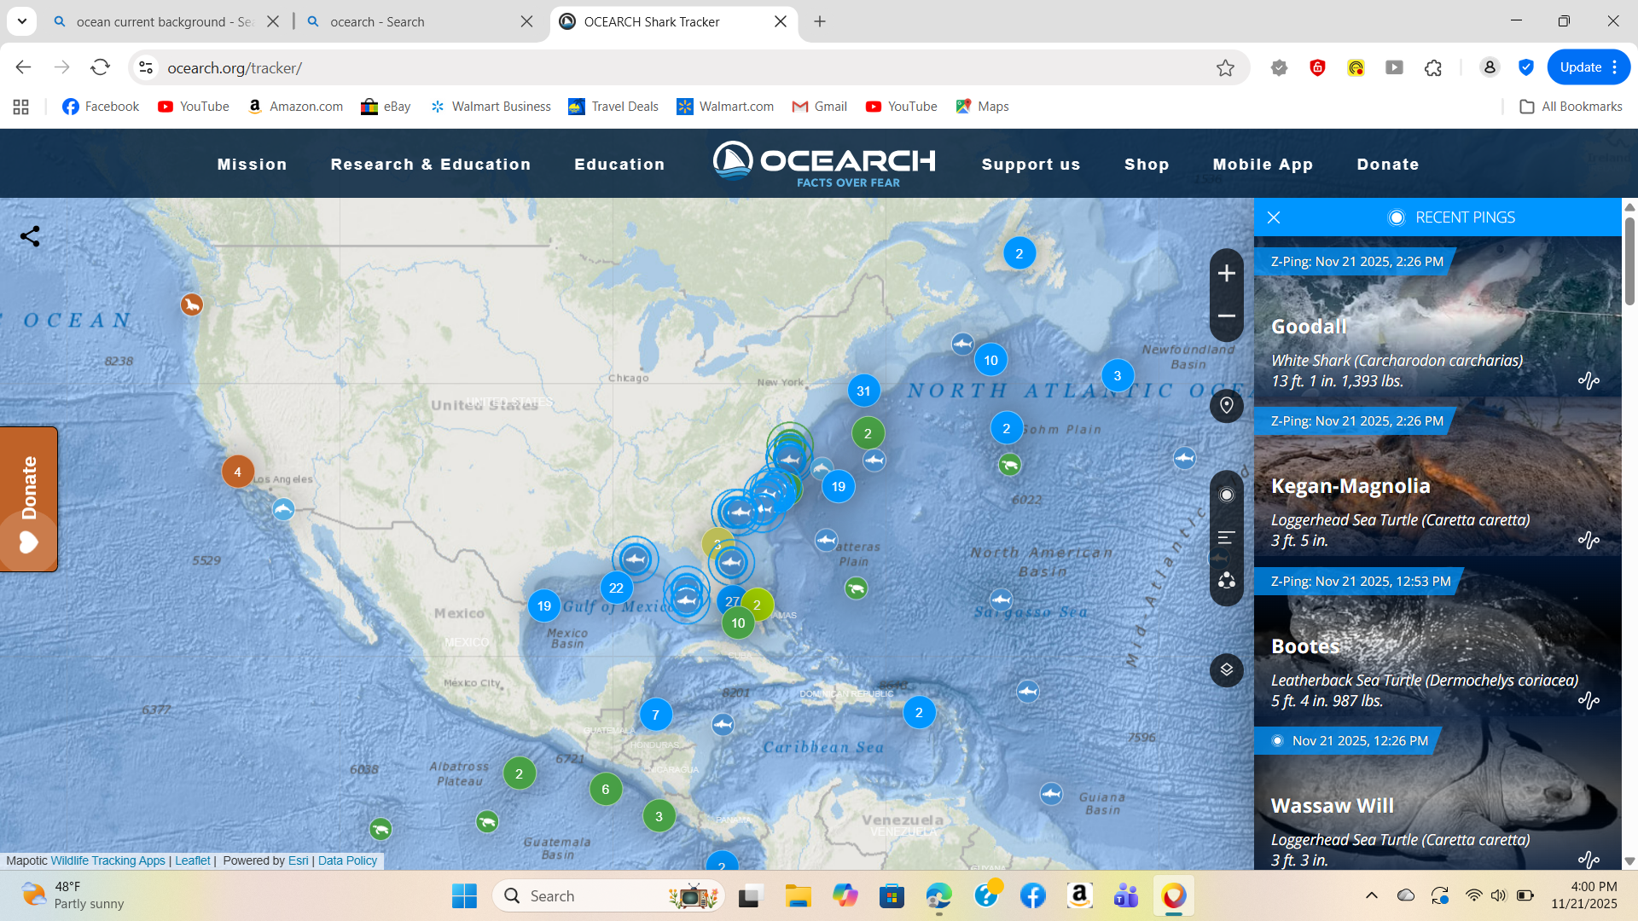
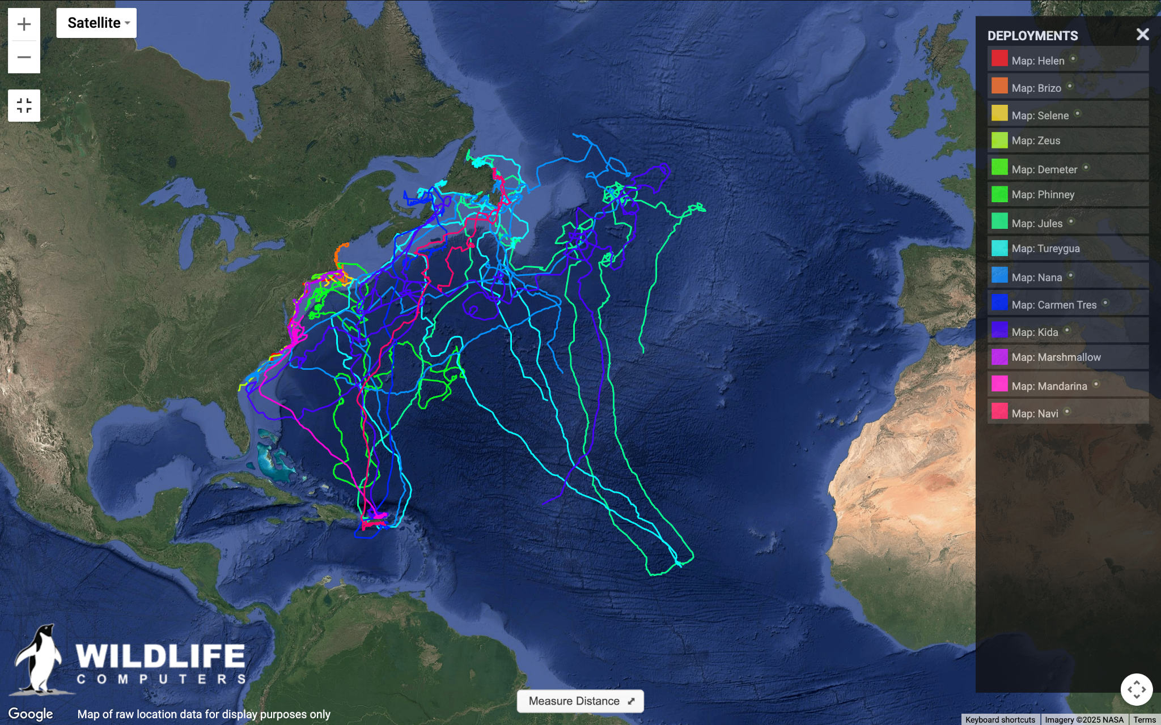
INVESTIGATE Turtle and shark trackers !
Draw the path for a turtle and a shark (all on the left map)
What patterns do you see? What do you wonder?
Notes:
Teacher: Look for students noticing paths that match currents

Slide 4
How might the movement of turtles and sharks be connected to ocean water movement?

Slide 5
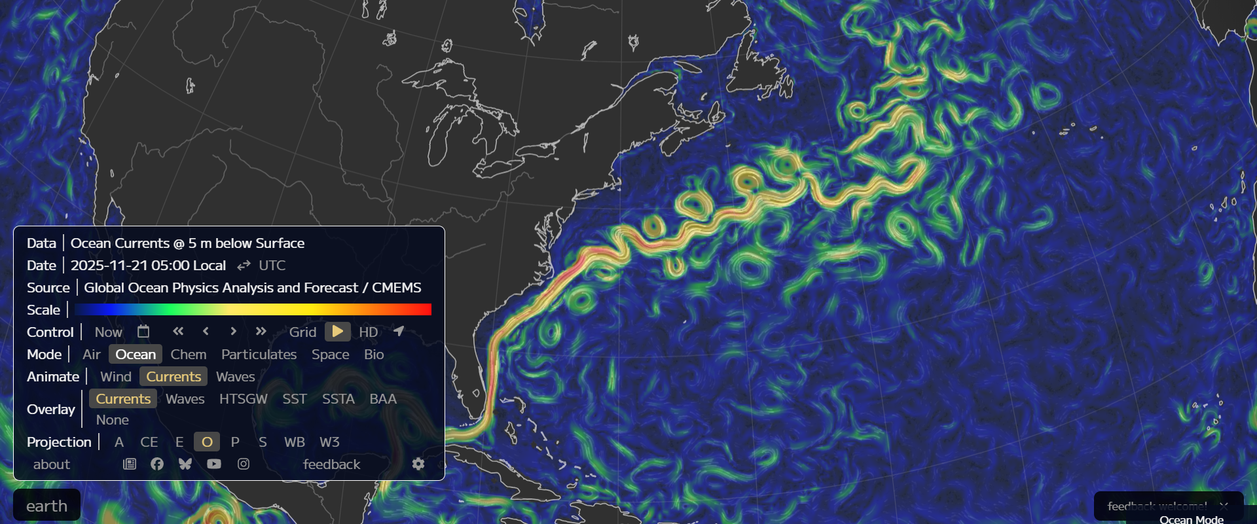
INVESTIGATE Ocean currents!
Draw the path of the currents along the E. coast
Draw the winds in a separate color
How do the patterns of wind and currents compare to the paths of turtles and sharks?

Slide 6
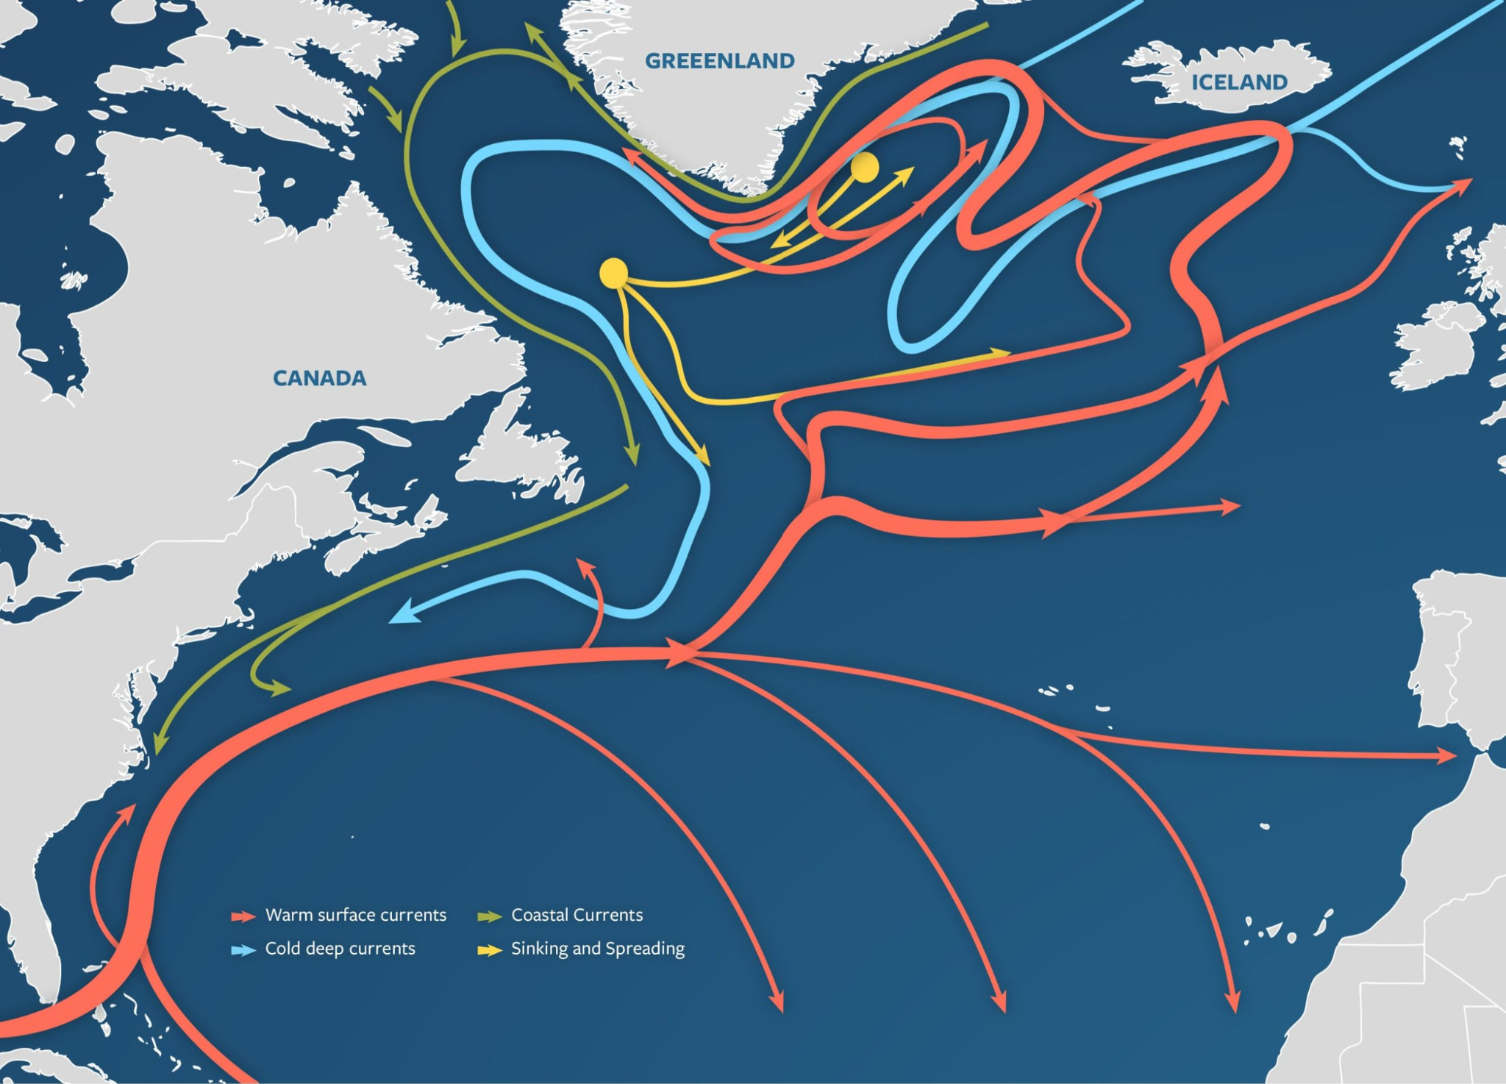
What patterns did you notice? What might be causing these patterns?

Slide 7
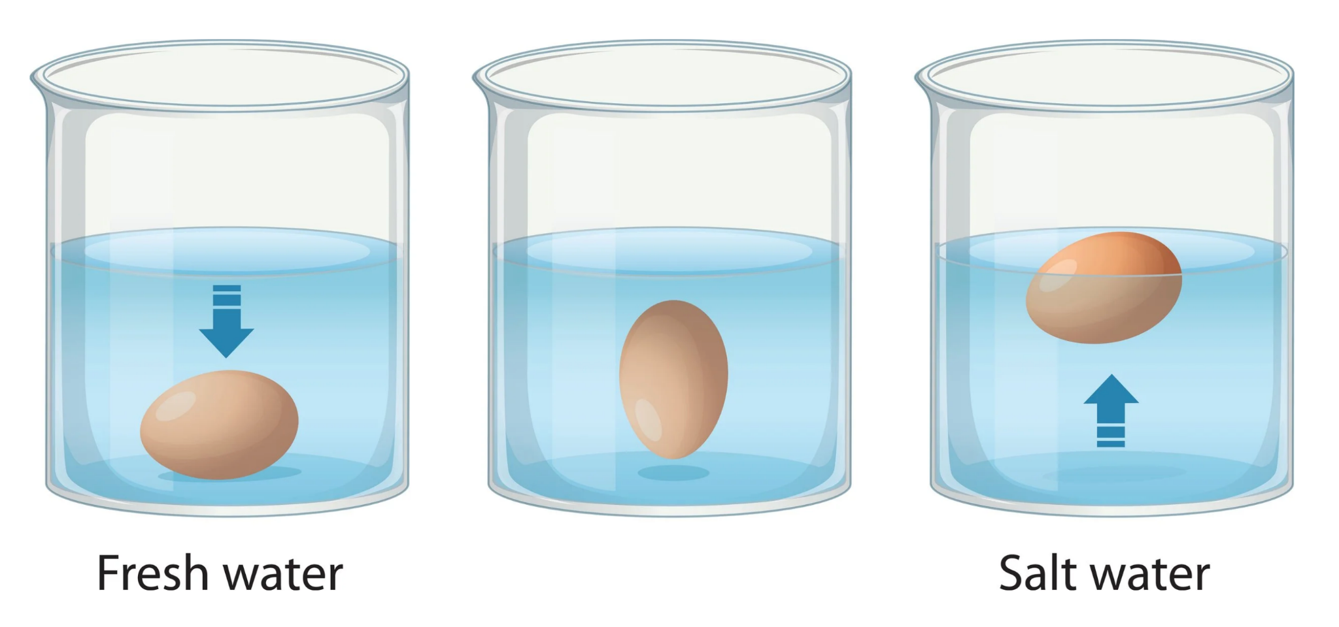
Make predictions - what will happen to each egg?
Fresh water Medium Salt Extra salty
Medium salt level
What does this tell us about how density affects water movement?

Slide 8
THINK-PAIR-SHARE
How could differences in salinity affect how ocean water moves?

Slide 9
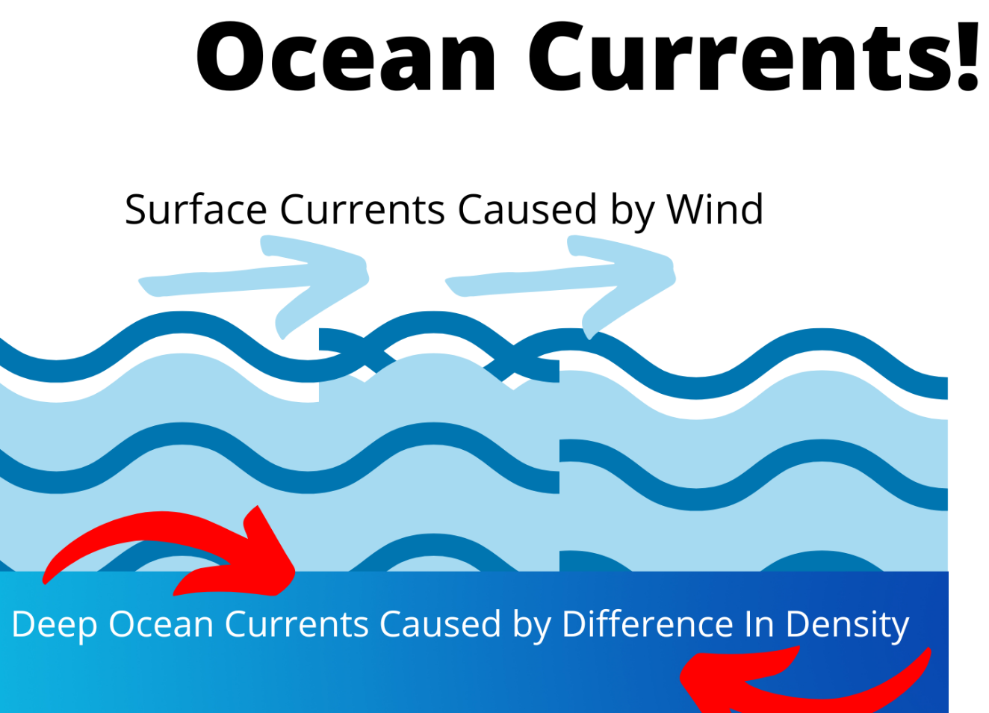
Ocean currents are caused by multiple interactinb factors:
Wind (moves surface water)
Density differences (moves deep water)

Slide 10
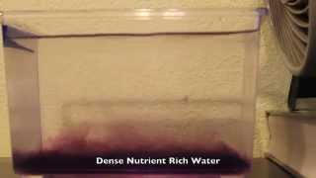
UPWELLING DEMO
Write your observations and explain it in your own words
What is causing the water to move upward?
Why is upwelling important to other living things?
How does this relate to the patterns you made with the shark, turtle, and currents?

Slide 11
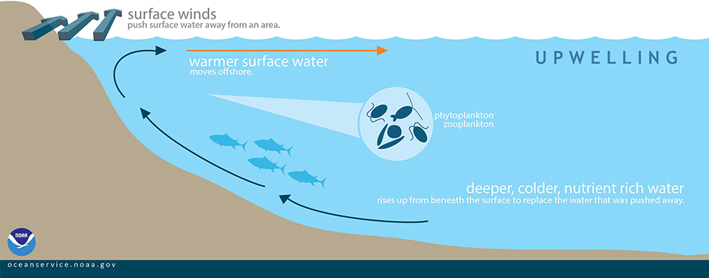

Slide 12
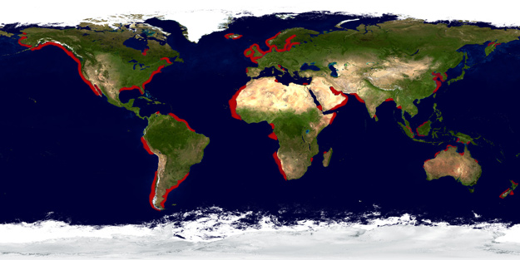
Upwelling Zones
What patterns do you notice in where upwelling occurs?

Slide 13
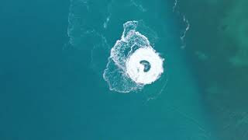
Notes:
https://www.youtube.com/watch?v=XNc6qwkLTUs

Slide 14
How is energy (wind) moving water, and how is that water movement transporting matter (nutrients and organisms)?

Slide 15
Putting it all together
How do these ideas connect?
  Wind → moves surface water
  Density → moves deep water
  Currents → Move organisms

Slide 16
Claim: What causes the patterns in turtle and shark movement?
Evidence: Use your map and demos
Reasoning: Explain how:
1. Wind (energy) moves water
2. Density differences move water
3. Currents move organisms

Slide 17

3D-RST is supported by the NSF under grant number #DRL-2101383

