Slide 1
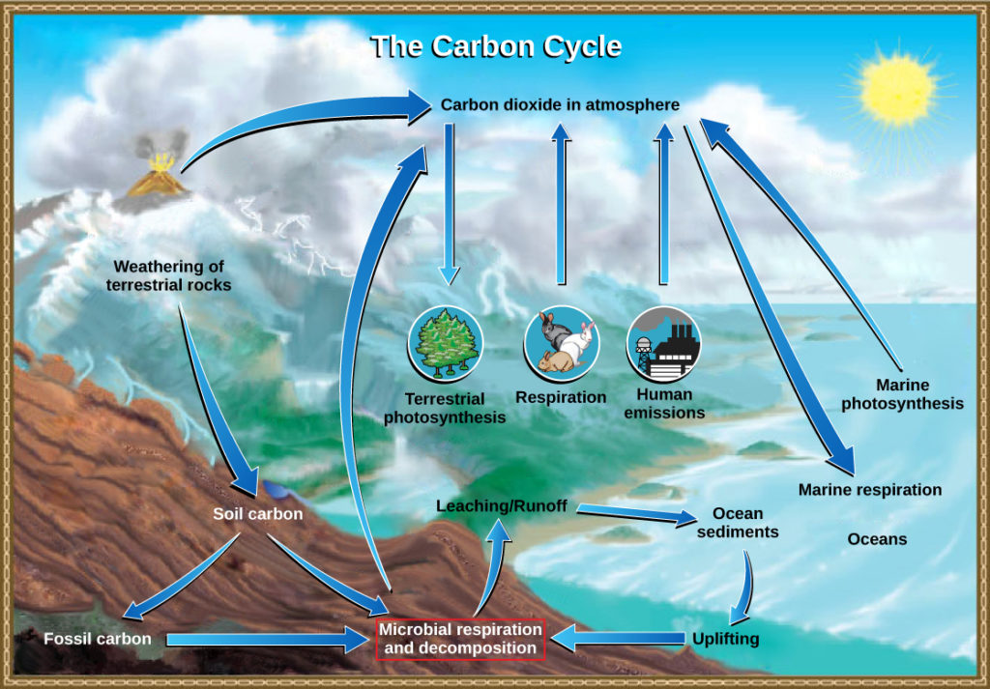
Carbon Cycling – Carbon’s Travel Itinerary: A

Slide 2
Objective: Write a complete explanation of how photosynthesis and cellular respiration impact the cause of carbon in the different Earth systems (biosphere, atmosphere, hydrosphere, and geosphere), using accessible data to support your explanation.

Slide 3
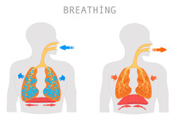
Take in a deep breath and hold it...
Notes:
Take a deep breath and hold it. That air you just inhaled? It might have once been part of a dinosaur's fart, a medieval campfire, or even a volcano millions of years ago.
Welcome to the carbon cycle — the ultimate recycling system of planet Earth. Carbon’s been everywhere, done everything, and now it’s hanging out with YOU. Let’s find out how."

Slide 4

Carbon Cycle
The carbon cycle is nature’s way of reusing carbon atoms, which travel from the atmosphere to organisms on Earth and then back into the atmosphere again. It's a continuous process in which carbon atoms move between different reservoirs, such as the atmosphere, oceans, land, and living organisms.

Slide 5
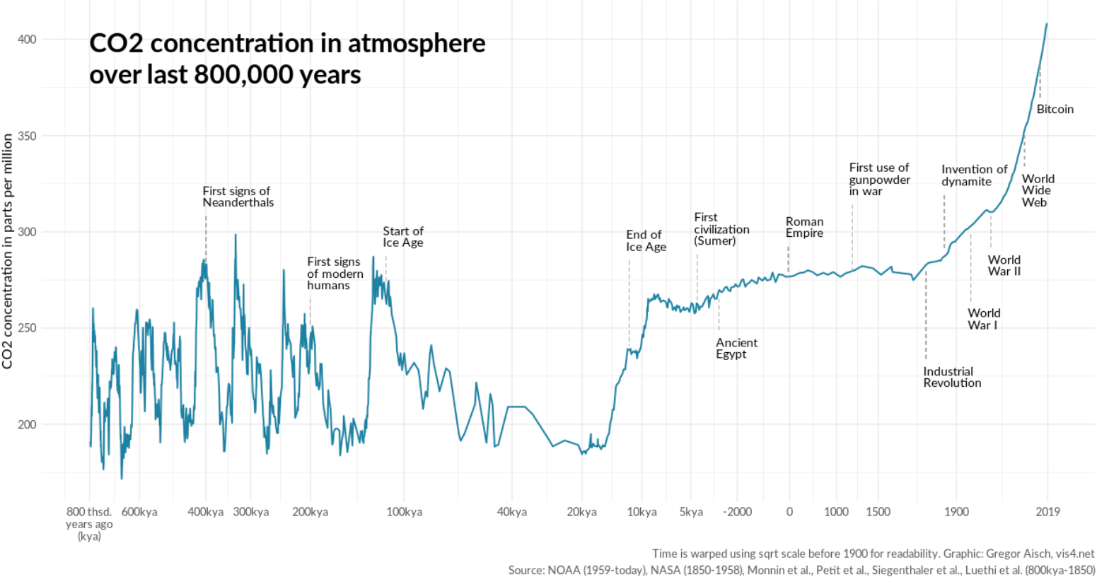
A graph of atmospheric carbon dioxide (CO2) levels over the last 800,000 years shows a relatively stable period until the late 18th century, followed by a sharp, unprecedented increase, particularly during and after the Industrial Revolution.

Slide 6
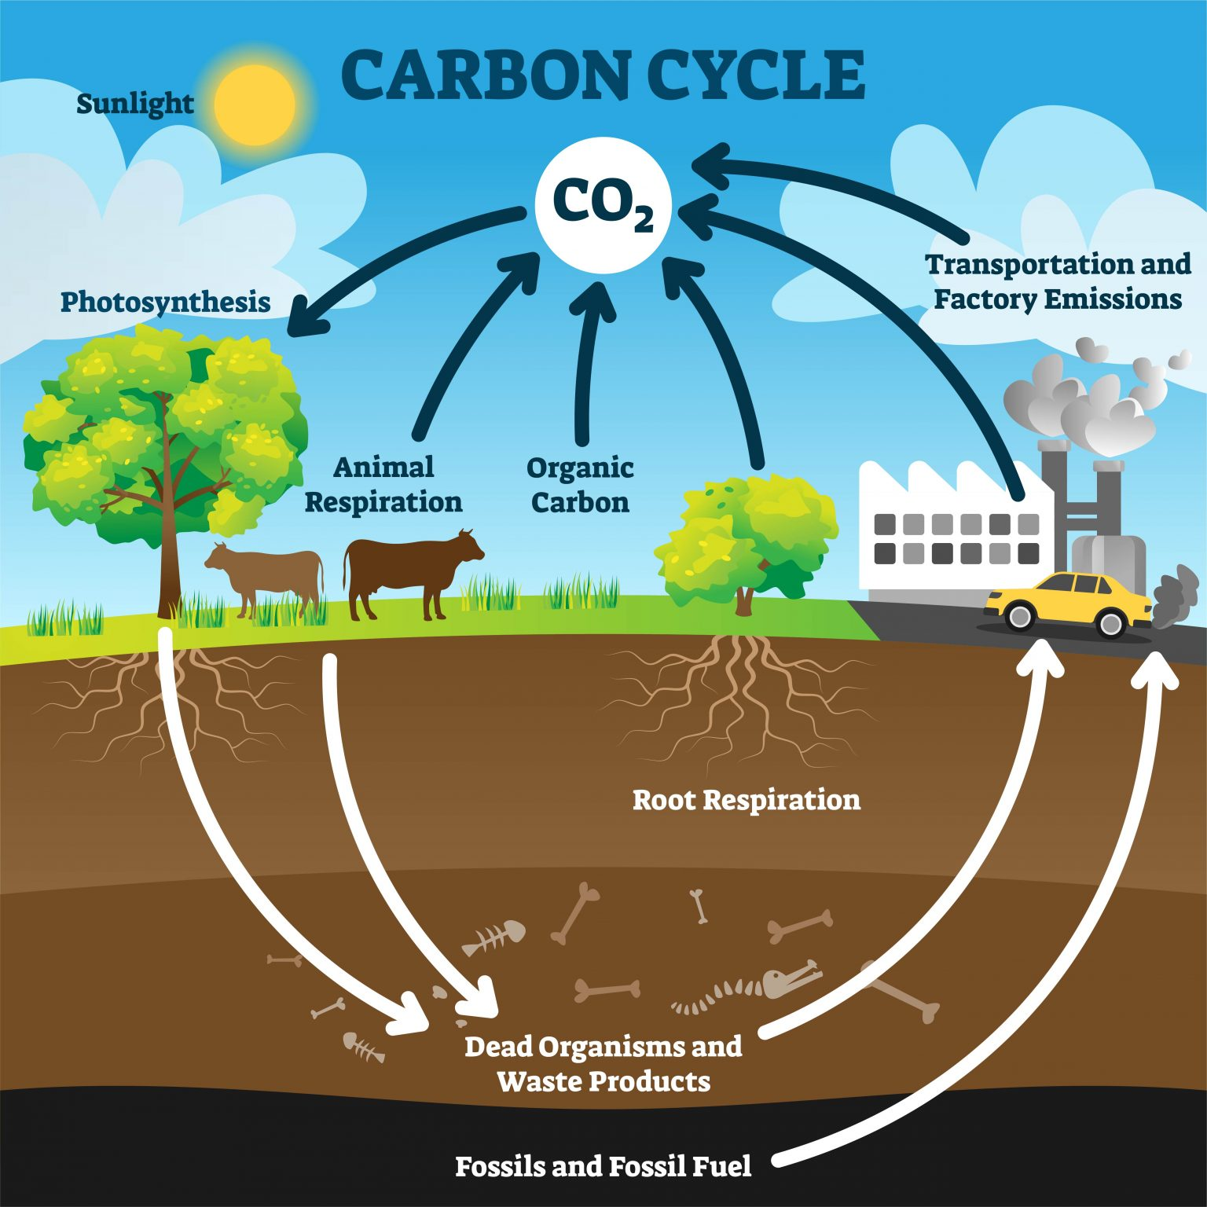
Carbon Reservoirs
Carbon reservoirs are places where carbon is stored for short or long periods of time. In the carbon cycle, carbon constantly moves between these reservoirs through processes like photosynthesis, respiration, and combustion.
This Photo by Unknown Author is licensed under CC BY-SA-NC

Slide 7
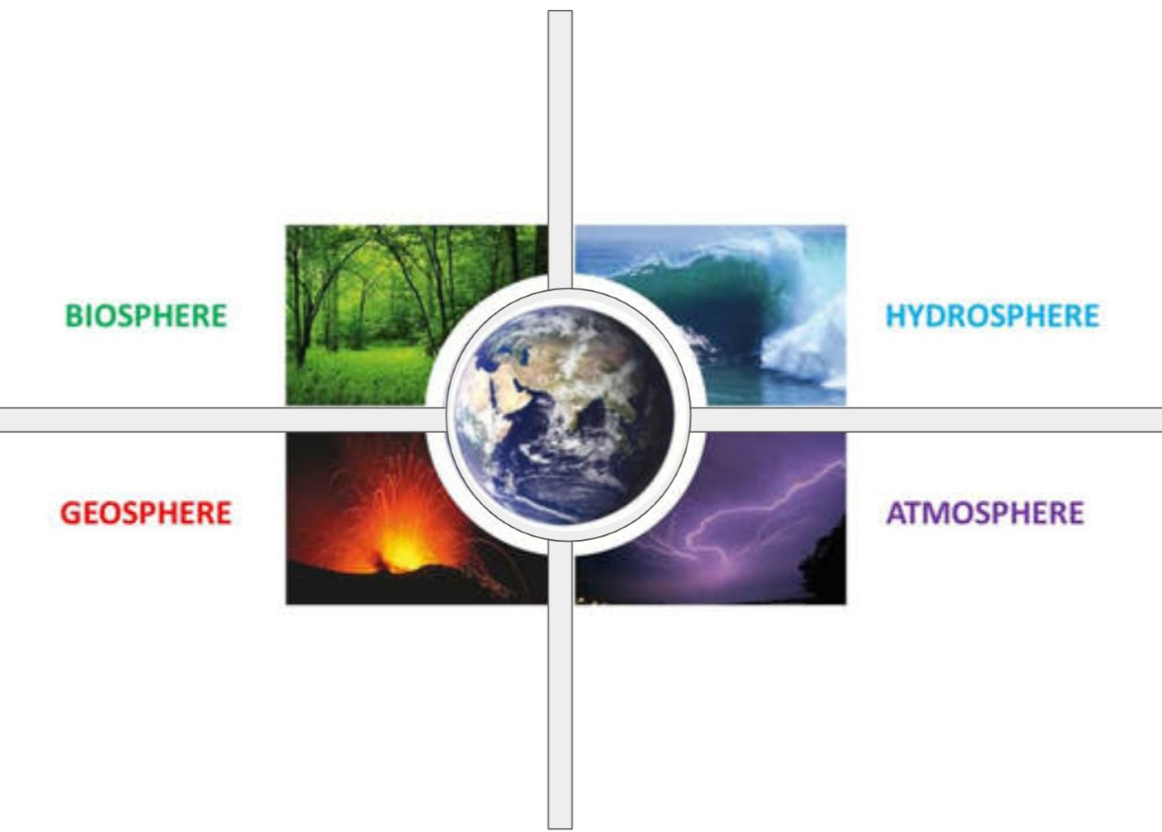
Carbon is stored in living things (trees, grass, animals, people).
Comes from photosynthesis (plants absorb CO₂ and make sugars).
Leaves via respiration (breathing out CO₂), decay after death, or being burned.
Oceans absorb CO₂ from the air.
Carbon is stored as dissolved CO₂ in water.
Oceans also release CO₂ back to the atmosphere.
Carbon is stored as carbon dioxide (CO₂).
Comes from respiration, combustion (burning fuels), and volcanic activity.
Leaves via photosynthesis (plants take in CO₂).
Carbon is stored in:
Soil (from dead plants and animals).
Limestone (calcium carbonate).
Fossil fuels (coal, oil, natural gas).

Slide 8
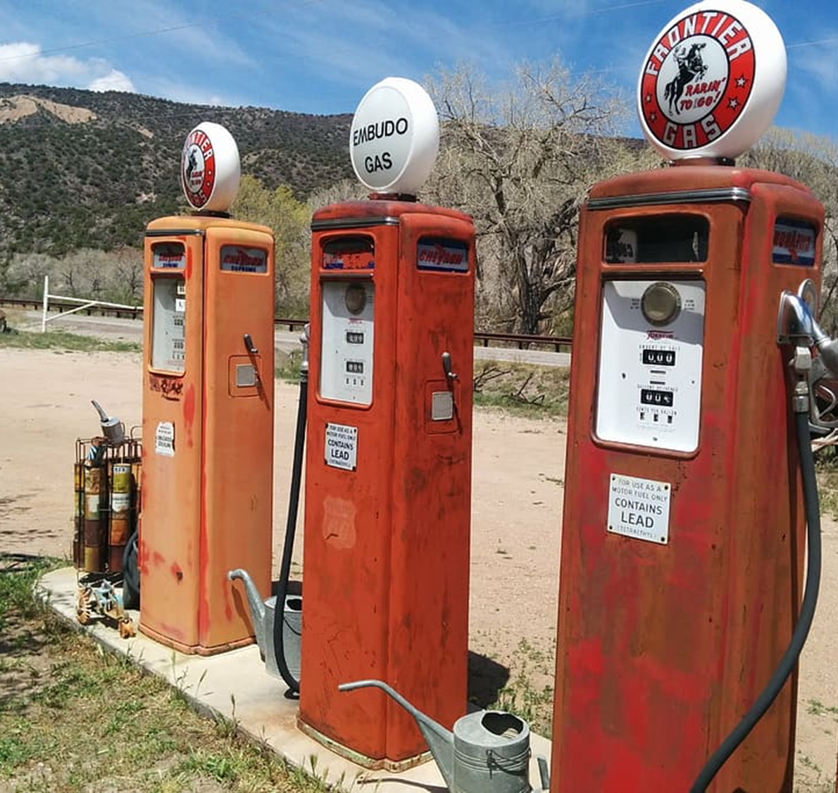
Geosphere:
Fossil Fuels
Made from ancient organic material under pressure for millions of years.
Store carbon long-term.
Burning them (combustion) releases CO₂ into the air.
Place FOSSIL FUELS in the geosphere section on your sphere notes.
(This is a carbon reservoir in the geosphere)

Slide 9
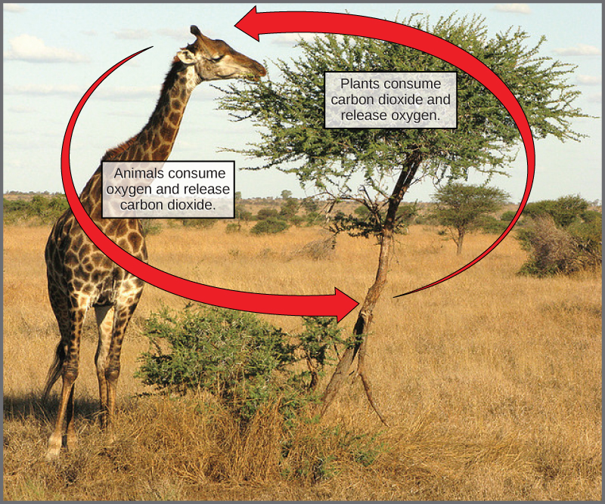
Carbon Flux
🌿 Photosynthesis:
Plants take in carbon dioxide and water to produce glucose, releasing oxygen.
atmosphere → biosphere.
🧬 Cellular Respiration:
Plants, animals, and humans release carbon dioxide when they break down food for energy.
Carbon moves from the
biosphere → atmosphere.
This movement is called a carbon flux.

Slide 10
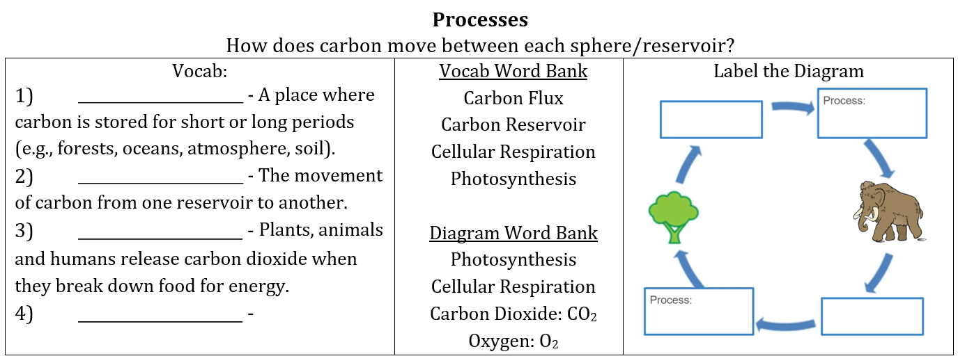
Check Point
You should be able to:
  Complete the vocab fill-in-the-blanks.
  Label the diagram with the correct process and products.

Slide 11
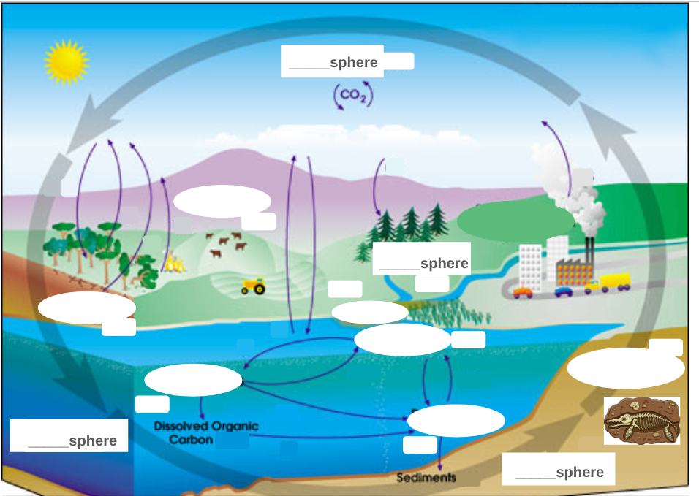
Analyze how each carbon flux causes changes in the atmosphere, and what effects those changes produce.
You will be filling in this graphic organizer with the information we cover.

Slide 12
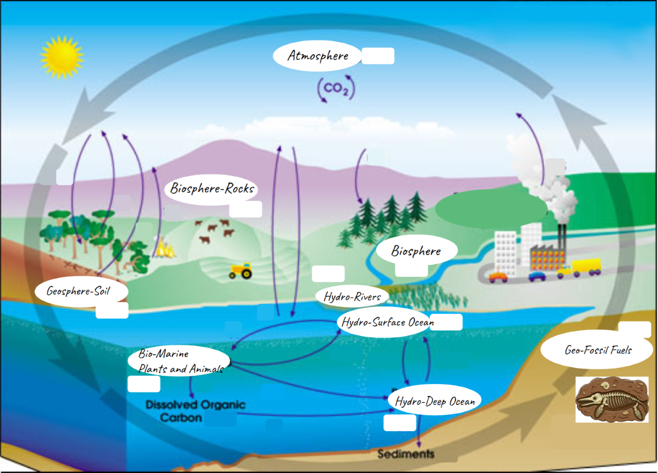
Using the vocab sheet and a neighbor, place arrows connecting the appropriate reservoirs in the connecting spheres.
Carbon moves from the
biosphere → atmosphere.
This movement is called a carbon flux.

Slide 13
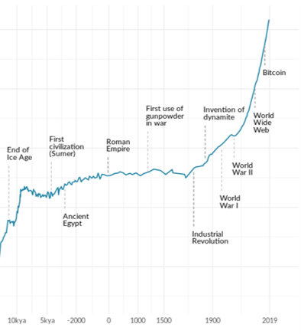

0-1700
Predictions
https://mynasadata.larc.nasa.gov/basic-page/about-earth-system-background-information

Slide 14
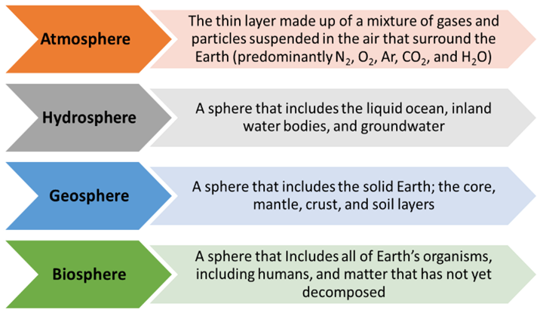
Round 1 - Data Predictions
Using the data presented in the graph earlier, make some predictions.
Predict which sphere your carbon atom will journey to (rolls).
Round 1 Journey (rolls): ______________________________. The number of reservoirs you go to (or get stuck at) is an example of what a carbon atom might experience in the carbon cycle over its lifetime.
https://mynasadata.larc.nasa.gov/basic-page/about-earth-system-background-information

Slide 15
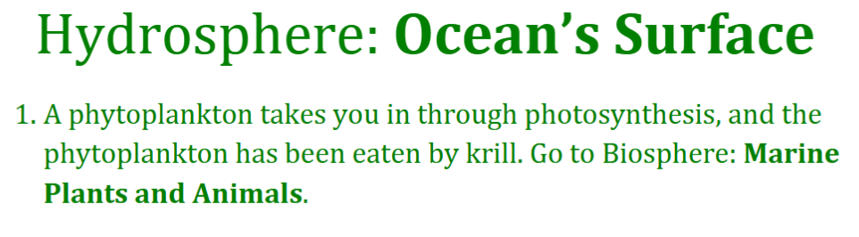
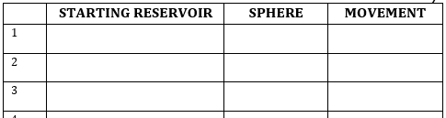

Carbon Cycle Game
Supplies needed: Worksheet, Pencil, 1 Dice
Instructions:
Your STARTING RESERVOIR will be the paper you grabbed.
Find the reservoir.
Roll the dice.
Record your data from that station:
  Starting Reservoir
  Sphere
  Flux Movement
Find the next reservoir.
Repeat steps 2-5 until you have reached the end of the data table.
Ocean's Surface
Hydrosphere
Photosynthesis
Marine Plants and Animals
Biosphere

Slide 16
Carbon Cycle Game
Data Interpretations: Pre-Industrial
Record Data and Map Data
Sphere | Round 1 (Your results) | Round 1 (Class totals) | Global
Atmosphere |  |  | 590 GtC
Hydrosphere |  |  | 38,000 GtC
Biosphere |  |  | 100,000 GtC
Geosphere |  |  | 2,000 GtC
Notes:
Pre & Post Industrial Carbon Totals help included with teacher materials explains the global numbers.

Slide 17
Carbon Cycle Game
Data Interpretations
Record Data and Map Data

Slide 18

1700-2023
Predictions
https://mynasadata.larc.nasa.gov/basic-page/about-earth-system-background-information

Slide 19
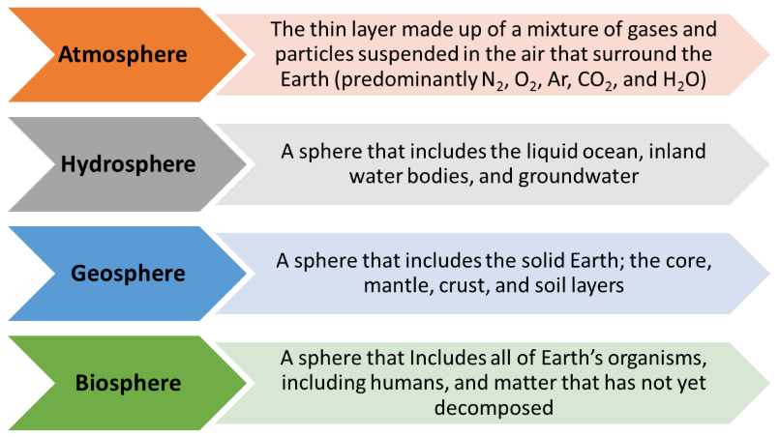
Round 2 - Data Predictions
Using the data presented in the graph earlier make some predictions.
1- Predict which sphere your carbon atom will journey to the most during the carbon cycle game during
  Round 2: 1700-2030 ___________________________ b. ...
https://mynasadata.larc.nasa.gov/basic-page/about-earth-system-background-information

Slide 20
Carbon Cycle Game
Supplies needed: Worksheet, Pencil, 1 Dice
Instructions:
Your STARTING RESERVOIR will be the paper you grabbed.
Find the reservoir.
Roll the dice.
Record your data from that station:
  Starting Reservoir
  Sphere
  Flux Movement
Find the next reservoir.
Repeat steps 2-5 until you have reached the end of the data table.
Ocean's Surface
Hydrosphere
Photosynthesis
Marine Plants and Animals
Biosphere

Slide 21
Carbon Cycle Game
Data Interpretations: Post-Industrial
Record Data and Map Data
Sphere | Round 2 (Your results) | Round 2 (Class totals) | Global
Atmosphere |  |  | 590 GtC
Hydrosphere |  |  | 39,000 GtC
Biosphere |  |  | 99,700 GtC
Geosphere |  |  | 2,000 GtC
Notes:
Pre & Post Industrial Carbon Totals help included with teacher materials explains the global numbers.

Slide 22
https://mynasadata.larc.nasa.gov/basic-page/about-earth-system-background-information

Slide 23
kya = thousand years ago
110kya-11kya
Predictions
https://mynasadata.larc.nasa.gov/basic-page/about-earth-system-background-information

Slide 24
Effect on Proportion Changes
Carbon is stored in living things (trees, grass, animals, people).
Comes from photosynthesis (plants absorb CO₂ and make sugars).
Leaves via respiration (breathing out CO₂), decay after death, or being burned.

Slide 25
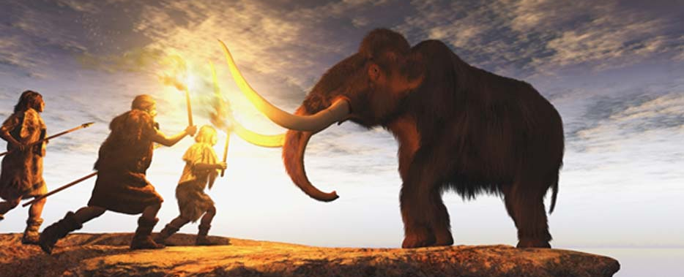
Ice Age
An Ice Age is a long period of time when the Earth's temperature was much colder than normal, and vast sheets of ice (glaciers) covered large parts of the land.
The most recent Ice Age ended about 11,000 years ago, and during that time, animals like mammoths lived, and early humans had to survive in very cold climates.
_____________________________________________
Restoring the Arctic Landscape to a Time When Mammoths Roamed Could Protect Thawing Permafrost | Opinion https://tinyurl.com/48d2d33f​
Could resurrecting mammoths help stop Arctic emissions? https://tinyurl.com/39hb4h46​
Reading
Notes:
Quick review of the ice age for the assessment piece.

Slide 26

3D-RST is supported by the NSF under grant number #DRL-2101383

