Slide 1
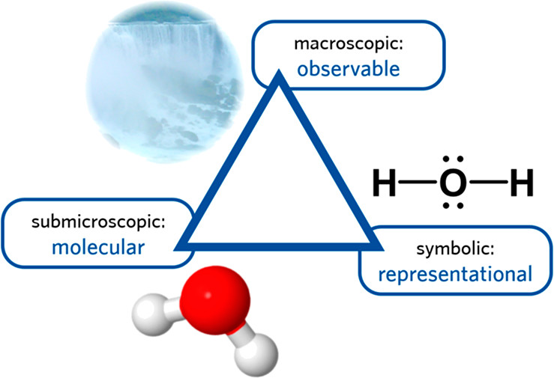

Slide 2
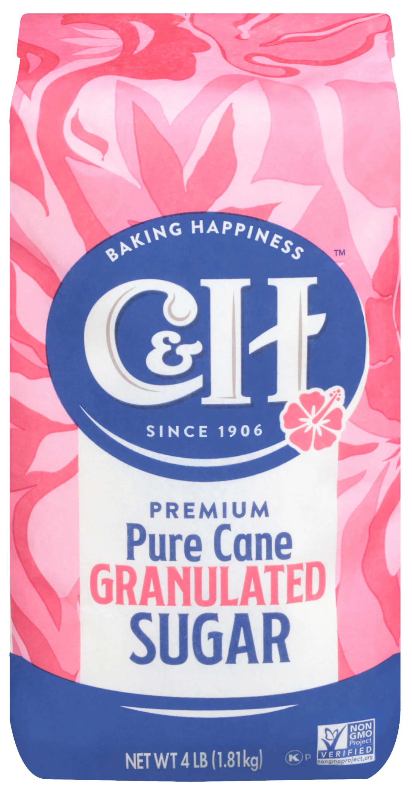
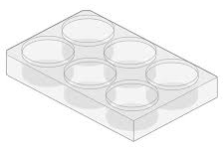
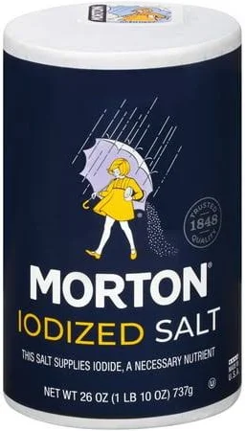
Test
Molecular Scale Model
H₂O +
Large Scale Observable Notes
Macroscopic
What do you observe during the test?
How does the material behave?
How is salt different than sugar?
How are the two chemicals similar?
Microscopic
Use symbols or images to depict what you believe is occurring on a microscopic level.
Sugar
Symbolic Structures
How are you representing the molecules at play in this test?
H₂O +
Microscopic
What is happening to the atoms/molecules at this level based on your test results?
Symbolic Structures
Use lewis dot or ball and stick, chemical formulas to depict your substances.
Salt

Slide 3


How to Print
Print the model on one side and the corresponding information on the other. This will help students understand and diagram the structures revealed during the test.
3D-RST is supported by the NSF under grant number #DRL-2101383

Slide 4

Conductivity
Molecular Scale Model
H₂O +
Large Scale Observable Notes
-
Conductivity
meter
Sugar
Symbolic Structures
+
H₂O +
-
Conductivity
meter
Symbolic Structures
Salt
+

Slide 5
Conductivity Results and Meaning
Substance Property | Expected Results | Forces Revealed by the Results
Salt (NaCl) (Ionic) | Causes a significant elevation in the boiling point of the water. | Bond Dissociation (Ionic) & Particle Count: When dissolved, the ionic compound dissociates into two separate particles (Na+ and Cl-. The high number of dissolved particles for a given concentration causes a maximum disruption to the water's ability to boil (a strong colligative effect).
Sugar (C₁₂H₂₂O₁₁) (Covalent) | Causes a moderate elevation in the boiling point of the water (about half the effect of salt). | Molecular Integrity (Covalent) & Particle Count: When dissolved, the covalent molecule remains intact as one single particle (C₁₂H₂₂O₁₁). The lower number of dissolved particles for a given concentration causes less disruption to the water's ability to boil (a weaker colligative effect).

Slide 6
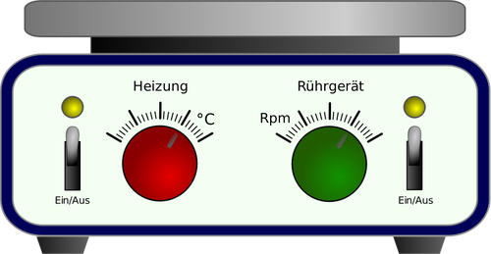
Melting
Molecular Scale Model
Large Scale Observable Notes
Before
Sugar
Symbolic Structures
After
Before
Symbolic Structures
Salt
After

Slide 7
Melting Point Results and Meaning
Substance Property | Expected Results | Forces Revealed by the Results
Salt (NaCl) (Ionic) | Very High Melting Point (Difficult to melt, often requiring over ~800). | Strong, Long-Range Ionic Bonds: Melting requires supplying enough energy to break the extremely strong, uniform electrostatic forces that hold the entire 3D crystal lattice structure together. This requires a vast amount of thermal energy.
Sugar (C₁₂H₂₂O₁₁) (Covalent) | Low Melting Point (Melts easily, typically around ~186). | Weak Intermolecular Forces: Melting only requires supplying enough energy to overcome the weak intermolecular forces (like Hydrogen Bonds and London Dispersion Forces) that hold the individual molecules next to each other. The strong covalent bonds within the molecule remain intact.

Slide 8

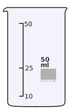
Boiling
Molecular Scale Model
Large Scale Observable Notes
Before
Sugar
Symbolic Structures
After
Before
Symbolic Structures
Salt
After

Slide 9
Boiling Point Results and Meaning
Substance Property | Expected Results | Forces Revealed by the Results
Salt (NaCl) (Ionic) | Causes a significant elevation in the boiling point of the water. | Bond Dissociation (Ionic) & Particle Count: When dissolved, the ionic compound dissociates into two separate particles (Na+ and Cl-). The high number of dissolved particles for a given concentration causes a maximum disruption to the water's ability to boil (a strong colligative effect).
Sugar (C₁₂H₂₂O₁₁) (Covalent) | Causes a moderate elevation in the boiling point of the water (about half the effect of salt). | Molecular Integrity (Covalent) & Particle Count: When dissolved, the covalent molecule remains intact as one single particle (C₁₂H₂₂O₁₁). The lower number of dissolved particles for a given concentration causes less disruption to the water's ability to boil (a weaker colligative effect).

Slide 10
Solubility
Molecular Scale Model
H₂O +
Large Scale Observable Notes
Before
Sugar
Symbolic Structures
After
Before
H₂O +
Symbolic Structures
Salt
After

Slide 11
Solubility Results and Meaning
Substance Property | Expected Results | Forces Revealed by the Results
Salt (NaCl) (Ionic) | High Solubility (Dissolves readily in water). | Ionic Forces & Ion-Dipole Attraction: The strong, local attraction between the polar water molecules (H2O) and the charged ions (Na+ and Cl-) is strong enough to pull the rigid crystal lattice apart.
Sugar (C₁₂H₂₂O₁₁) (Covalent) | High Solubility (Dissolves readily in water). | Polar Covalent Forces & Hydrogen Bonding: The large sugar molecule contains many highly polar OH- groups. These groups allow the neutral molecule to form multiple strong hydrogen bonds with water molecules, overcoming the weak intermolecular forces that held the sugar solid together.

Slide 12

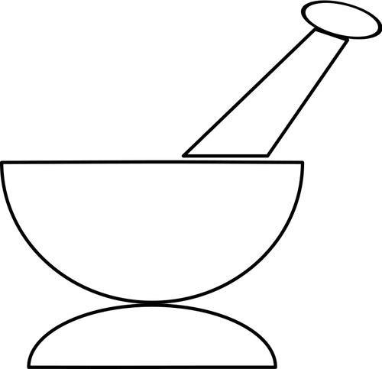
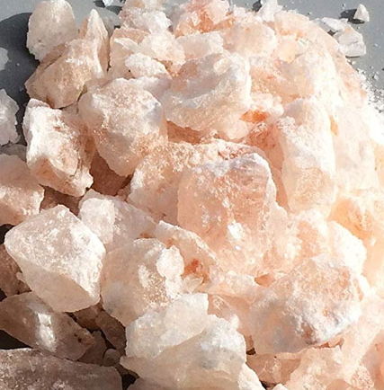
Brittle
Molecular Scale Model
Large Scale Observable Notes
Before
Sugar
Symbolic Structures
After
Before
Symbolic Structures
Salt
After

Slide 13
Brittleness Results and Meaning
Property | Observation | Molecular Attraction Revealed
Salt (Brittle) | Shatters cleanly along defined planes (cleavage) when hit. | Ionic Bonds & Lattice Repulsion: The structure is held by extremely strong, fixed electrostatic attractions (ionic bonds). When force is applied, one layer of ions shifts slightly, causing ions with the same charge (Na+ next to Na+) to temporarily align. This creates a massive, instantaneous force of electrostatic repulsion, which overcomes the surrounding attractions, causing the entire crystal to cleave and shatter along a plane. The brittleness confirms the presence of strong, full charges in a highly ordered, rigid lattice.
Sugar (Malleable) | Crumbles or powders when hit; deforms rather than shattering cleanly. | Weak Intermolecular Forces (IMFs): Sugar molecules are neutral and held together by weaker, less-directional forces (hydrogen bonds, London dispersion forces). When force is applied, the layers of molecules can shift and slide without encountering the catastrophic, repulsive forces seen in the ionic lattice. The structure deforms and crumbles because the forces are weak and do not result in the layer-by-layer alignment of like charges.

Slide 14

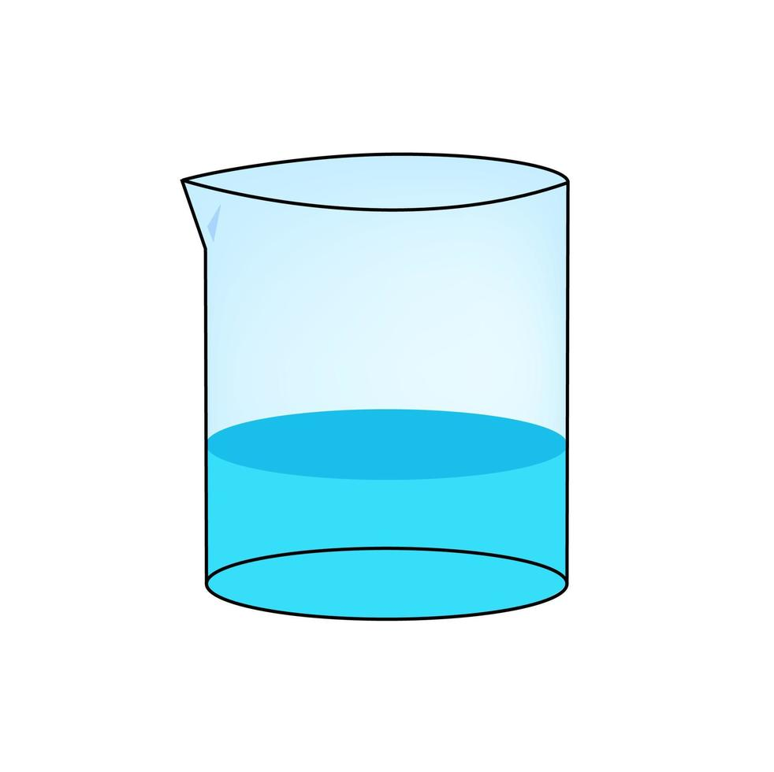
Molecular Scale Model
Crystallization
Large Scale Observable Notes
Before
Sugar
Symbolic Structures
After
Before
Symbolic Structures
Salt
After

Slide 15
Crystallization Results and Meaning
Property | Observation | Molecular Attraction Revealed
Salt (Defined Crystals) | Forms clearly defined, symmetrical cubic crystals (or similar precise shapes) relatively quickly. | Strong, Directional Ionic Forces: The powerful, uniform electrostatic forces between the small, spherical Na+ and Cl- ions dictate a highly efficient and ordered arrangement. As the solvent leaves, the strong, predictable attraction pulls the ions instantly into a precise, repeating, three-dimensional geometry (the crystal lattice). The simple, strong nature of the ionic attraction leads to rapid, highly ordered crystallization.
Sugar (Amorphous/Slow) | Often forms a glass-like or waxy solid (amorphous) that lacks defined crystal faces in a short timeframe. | Weak, Complex Intermolecular Forces: Sugar molecules are large, complex, and asymmetrical. They are held together by weaker, less directional intermolecular forces. While these forces can eventually organize the molecules, the complexity of the molecular shape and the relative weakness of the forces make the self-assembly process slow and chaotic. Without precise, strong organizing forces, the structure often solidifies quickly into a disordered, non-crystalline (amorphous) state, like glass.

