Slide 1
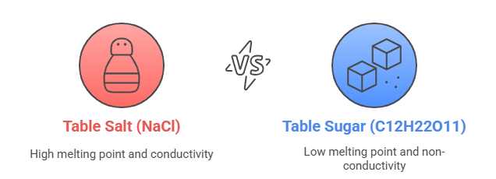

Slide 2
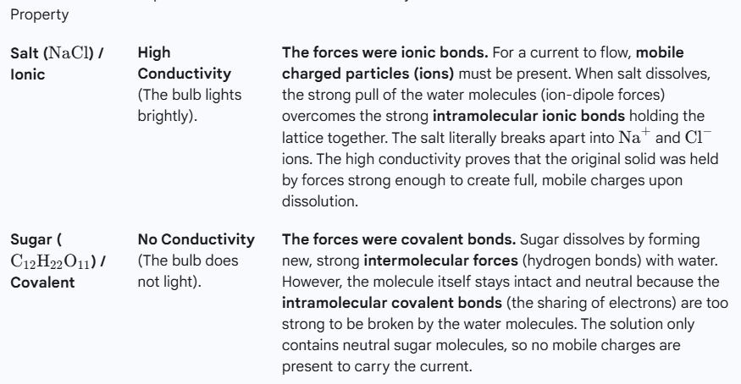
Conductivity Results and Meaning

Slide 3
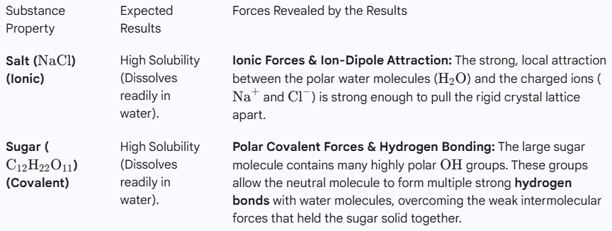
Solubility Results and Meaning

Slide 4
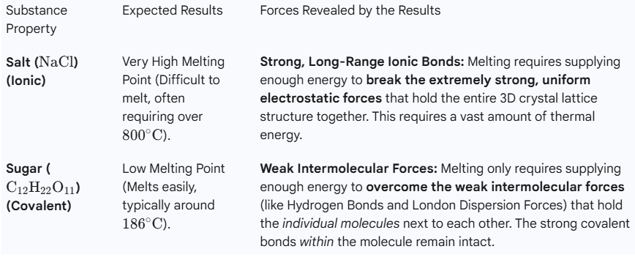
Melting Point Results and Meaning

Slide 5
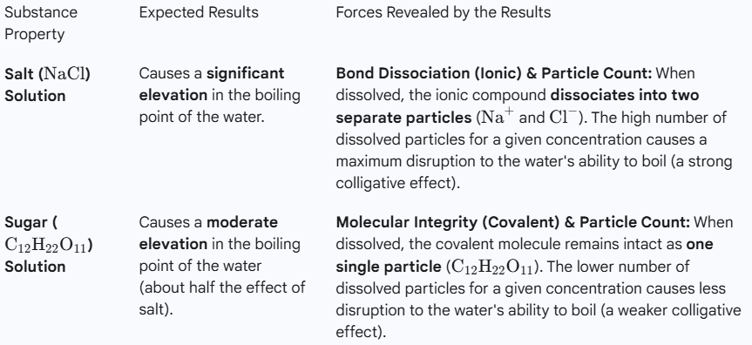
Boiling Point Results and Meaning

Slide 6
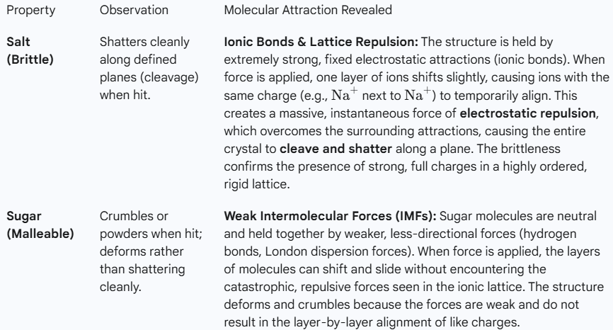
Brittleness Results and Meaning

Slide 7
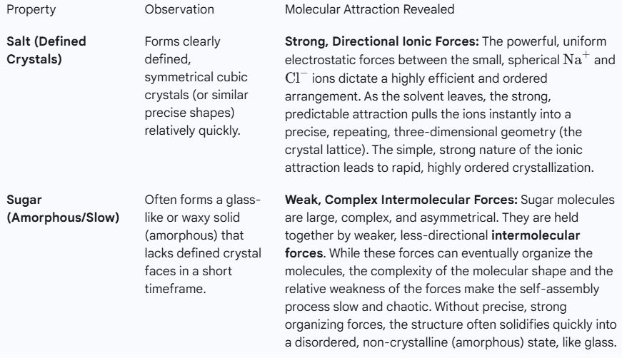
Crystallization Results and Meaning

Slide 8
Solubility Tests
Conductivity Tests
Melting Point
Bulk Structures
Observe-
Electrical Forces
Solubility occurs when attractions between solvent particles and solute particles are stronger than the attractions holding the solute (salt/sugar) particles
together.
Soluble- substance is attracted by electrical forces to the liquid more than itself.
Observe-
Electrical Forces
Detects presences of mobile charged particles like “+” or “-” . If there is a current then we know the molecule/compound has either broken down to an atomic level and now is charged or has a charged end.
Conducts- substance is held by Strong electrostatic forces.
Observe-
Electrical Forces
Melting is the process of transitioning a substance from a rigid solid phase to a fluid liquid phase. For this to occur, enough thermal energy must be added to overcome the attractive forces holding the particles in their fixed positions.
Melts fast- Weak intermolecular forces
Observe-
Electrical Forces
Breaking (brittleness) or Crystallizing both show how eager the substance is to break or reform. If it crystallizes in uniform repeating patterns it shows strong forces. If it breaks easy and takes longer to reform it shows weaker intermolecular forces.

Slide 9
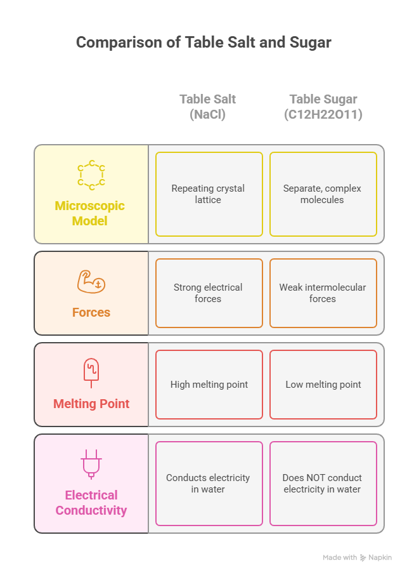
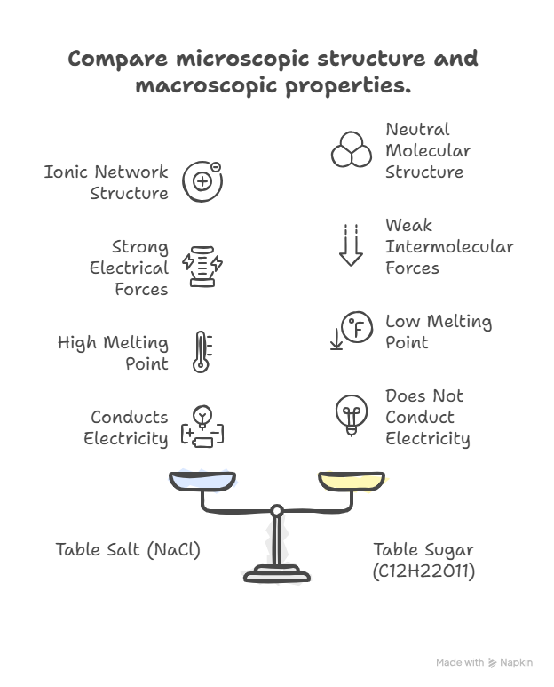

Slide 10
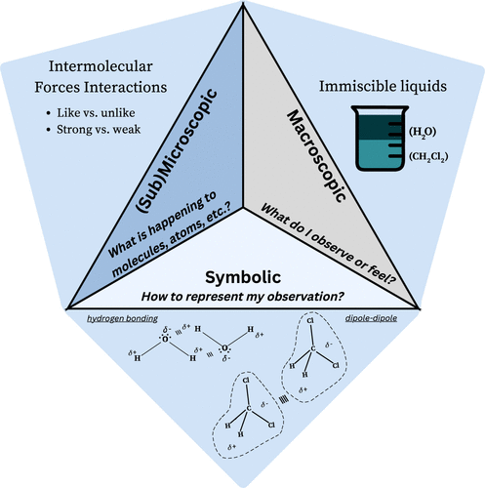

Slide 11
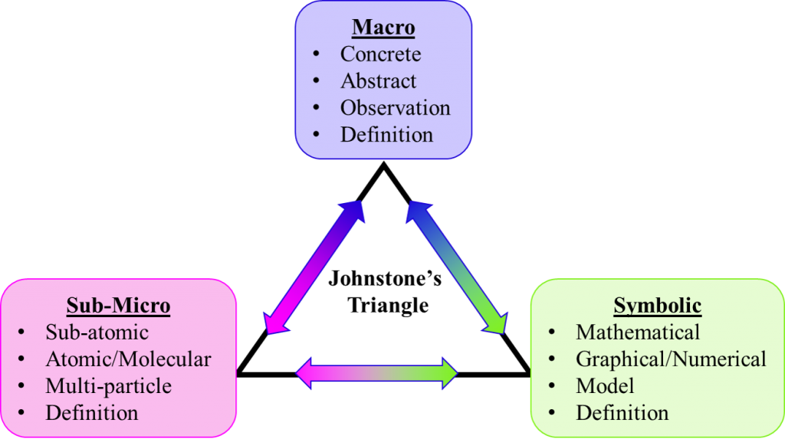

Slide 12
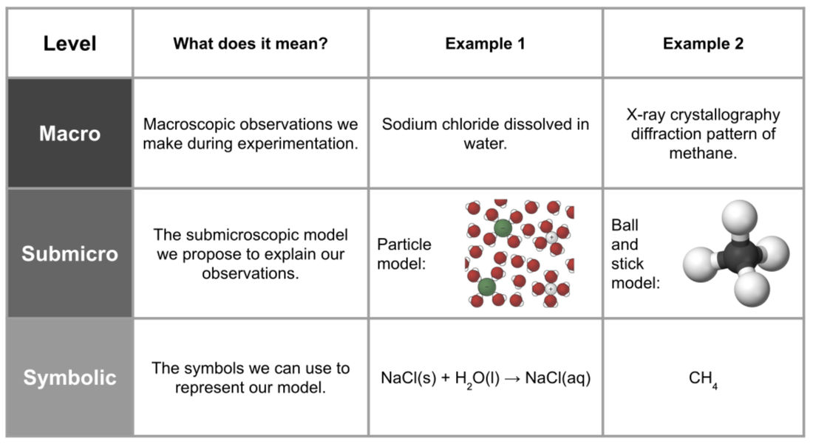

Slide 13

3D-RST is supported by the NSF under grant number #DRL-2101383

