Slide 1
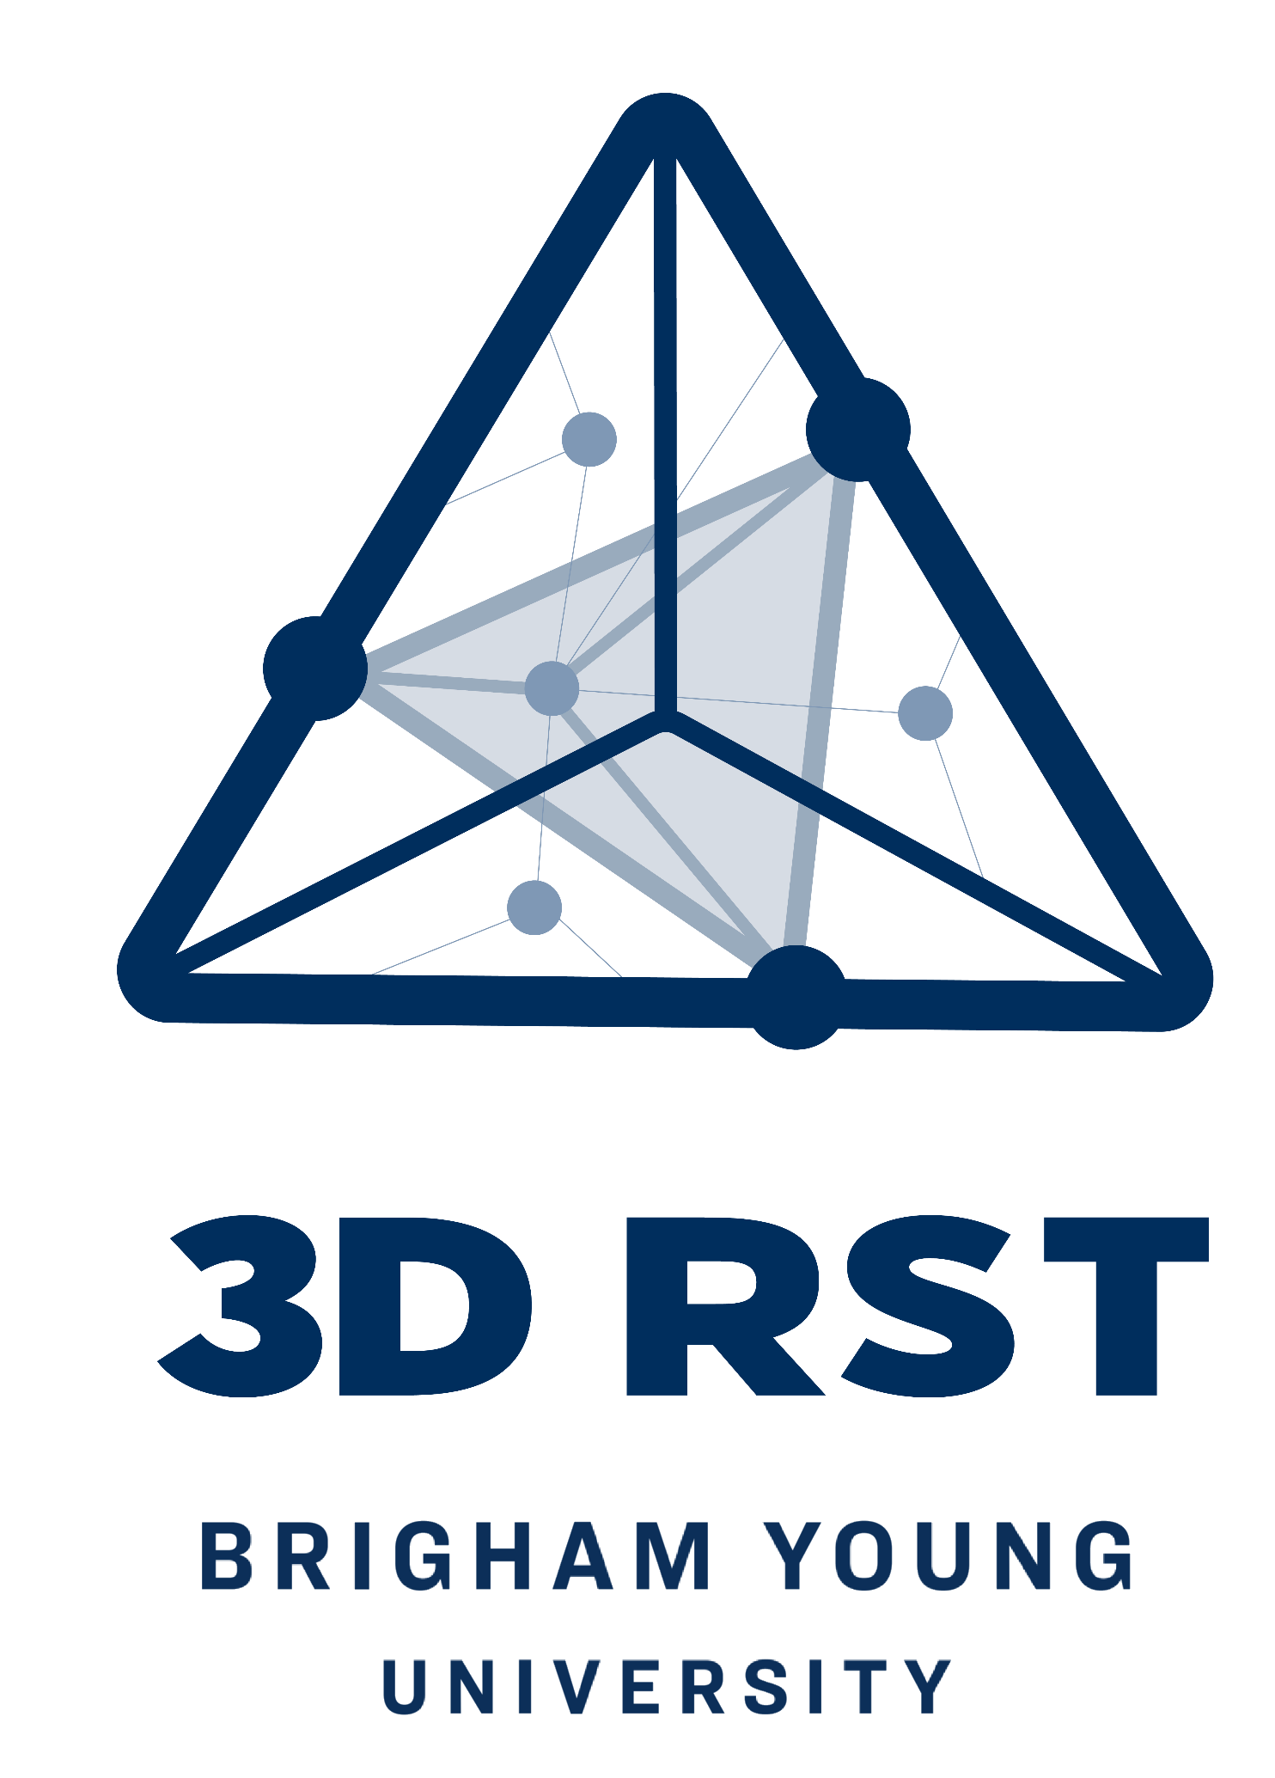

Conductivity Procedures (in liquid)
Put a small amount of liquid (distilled water or tap water) in a well of the well plate.
Test the conductivity without adding any sugar or salt.
Add a small scoop (about 1-2 grams) of sugar to the liquid.
Stir the contents.
Test the conductivity and record your results.
Clean off the electrodes of the conductivity tester with water. Dry and repeat the procedures using the salt.
Concepts: Conductivity; electrical charges in a liquid state; Ionic vs. covalent compounds; electrolytes.
If it conducts in the liquid, there are charges in the liquid that are coming from the atoms. The atoms have broken apart and are now more attracted to the water than to the atoms in the substance.
3D-RST is supported by the NSF under grant number #DRL-2101383

Slide 2
Conductivity Procedures (dry)
Put a small amount (about 1-2 grams) of sugar in a well of the well plate.
Insert the conductivity tester into the dry sugar and record the results.
Clean off the electrodes of the conductivity tester with water. Dry and repeat the procedures using the salt.
Concepts: Conductivity; electrical charges of the molecules in a dry solid state.
If it conducts electricity, it shows that the substance contains free electrons. If it does not, there are no free electrons, and the substance has a neutral charge.
3D-RST is supported by the NSF under grant number #DRL-2101383

Slide 3
Solubility Procedures (in water)
Add water (tap or distilled) to the well in a well plate until it is about half filled.
Add a small scoop (about 1-2 grams) of sugar into the water.
Stir the contents.
Record the solubility by describing how well the substance dissolved in the water.
Concepts: Solubility; intermolecular forces; like dissolves like.
If it dissolves easily, it shows low intermolecular forces for water (a very polar molecule). If it dissolves, it “likes” water or is attracted to water more than the bonds between other molecules of the same substance.
3D-RST is supported by the NSF under grant number #DRL-2101383

Slide 4
Solubility Procedures (in ethanol)
Add ethanol to a well in the well plate until it is about half filled.
Add a small scoop (about 1-2 grams) of sugar into the ethanol.
Stir the contents.
Record the solubility by describing how well the substance dissolved in the ethanol.
Concepts: Solubility; intermolecular forces; like dissolves like.
If it dissolves, then it’s similar to the liquid; if it doesn’t, it resists breaking apart (strong intermolecular forces).
3D-RST is supported by the NSF under grant number #DRL-2101383

Slide 5
Melting Point Procedures
Plug in the hot plate and warm on medium heat.
Add about 2-5 grams of sugar and salt to separate foil squares and carefully put them on the hot plate.
Adjust the heat as needed to get it hot enough.
As soon as either substance starts to melt, take the foil off the burner using the tongs. Turn off the hot plate and unplug it.
Concepts: Thermal decomposition
Shows solid turning to liquid, indicating weaker intramolecular forces.
3D-RST is supported by the NSF under grant number #DRL-2101383

Slide 6
Brittleness (crush test)
Add about 2-5 grams of sugar to the mortar.
Use the pestle to grind the sugar for a very small amount of time (about 3 turns).
Remove some of the broken sugar and view the crystals in the microscope. Describe how the crystals changed.
Clean out the mortar and pestle by rinsing in water and drying thoroughly.
Repeat the procedures using the same amount of salt.
Concepts: brittleness, shapes at a bulk scale vs a smaller scale.
Cleaving in straight lines indicates stronger forces holding molecules together.
3D-RST is supported by the NSF under grant number #DRL-2101383

Slide 7
Evaporation and Crystal Formation
Examine how salt and sugar recrystallize from solution.
Use an eyedropper to squirt a little bit of supersaturated solution onto a black paper.
Heat the paper on a hot place.
Take off the heat after 10 seconds.
Let it evaporate. Blow on it to speed up the process or re-heat. Do not overheat the paper and burn it.
View under a microscope and record observations.
Concepts: Crystallization, structure of solids, strong intramolecular forces if they reform fast and in repeating patterns.
3D-RST is supported by the NSF under grant number #DRL-2101383

Slide 8
Boiling Point of Solutions
Examine how salt and sugar compare in the solution.
Place equal amounts of salt and sugar into two separate small beakers.
Add the same amount of water to each. (25 mL )
Stir and heat till it boils.
Record boiling point for each.
Concepts: Colligative properties.
Shows that phase change from liquid to gas occurs differently due to more particles elevating the boiling point of water.
3D-RST is supported by the NSF under grant number #DRL-2101383

