Slide 1
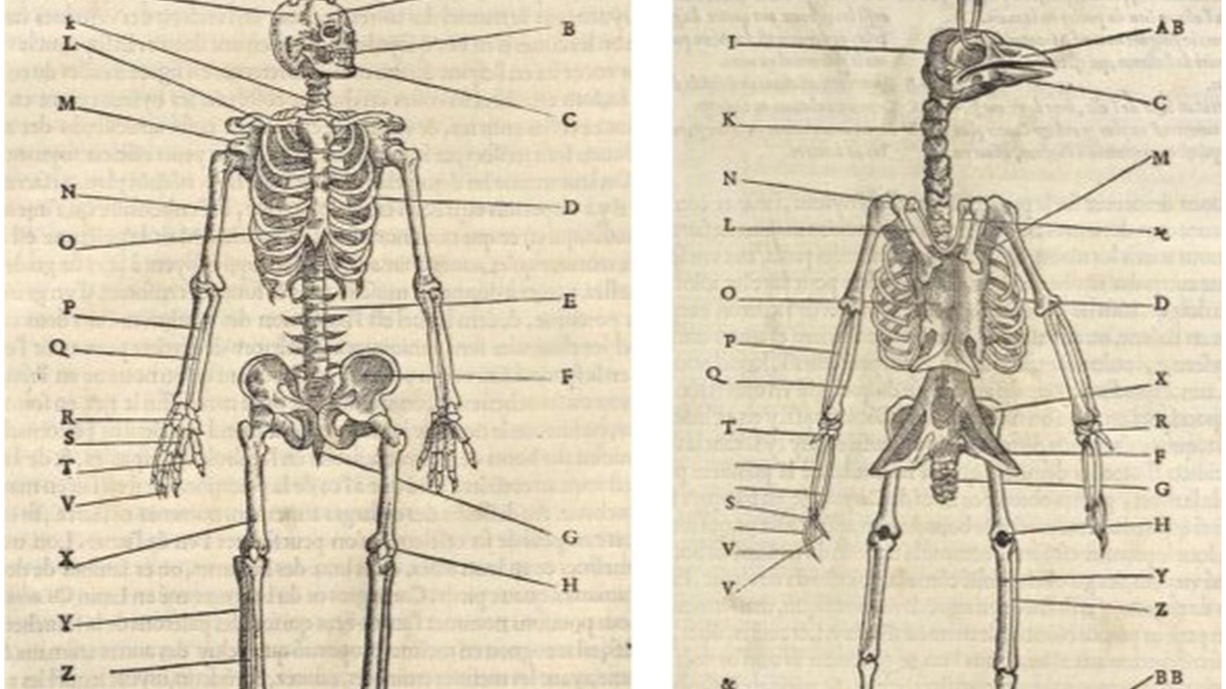
Evolutionary Structures

Slide 2
Objective
Students should be able to:
Obtain, evaluate, and communicate information describing how anatomical similarities and patterns in various organisms provide evidence for evolutionary relationships.

Slide 3

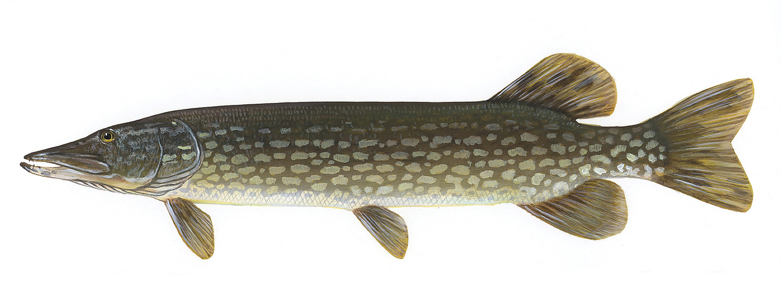
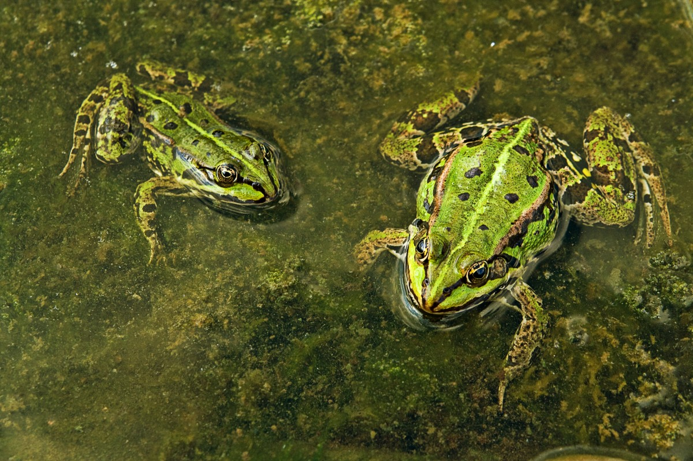
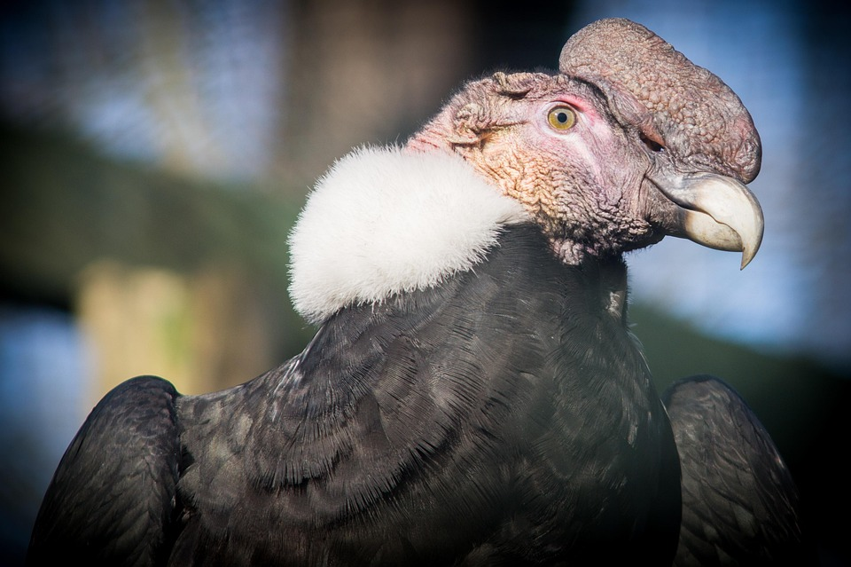
What is similar between all of these organisms?
What are 3 similarities between these images?
ThePhoto by PhotoAuthor is licensed under CCYYSA.

Slide 4
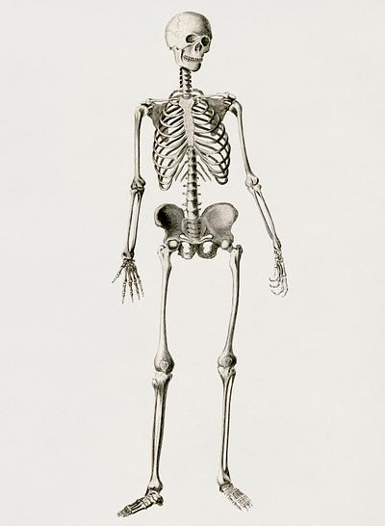
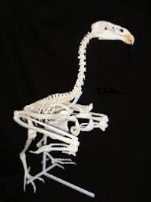
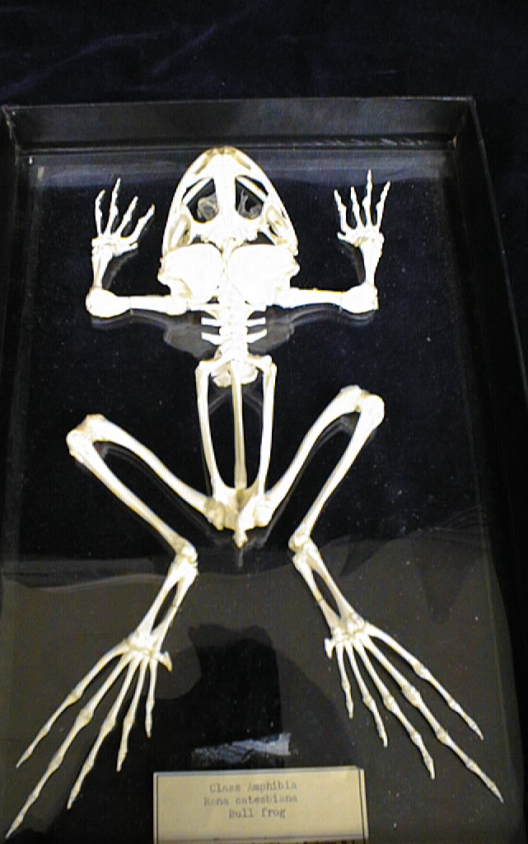
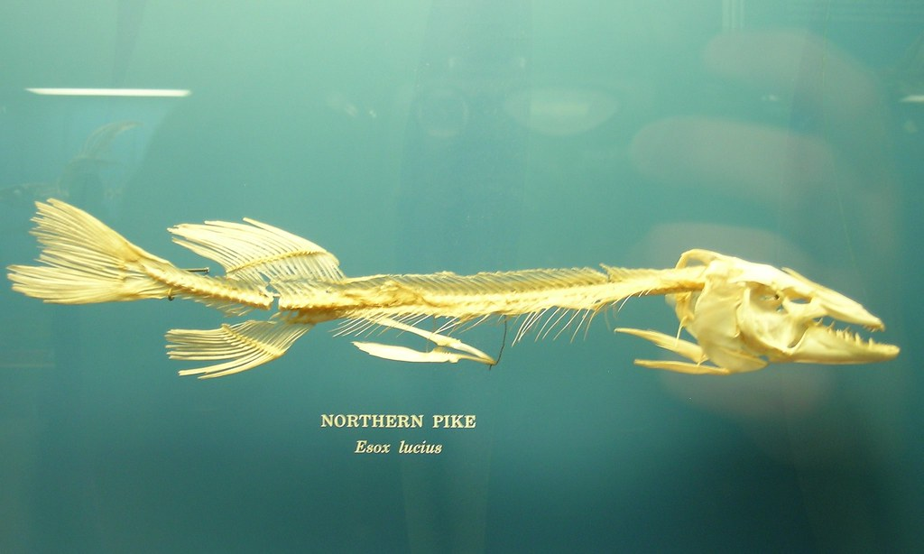
What do you notice about these organism's skeletal structure?

Slide 5
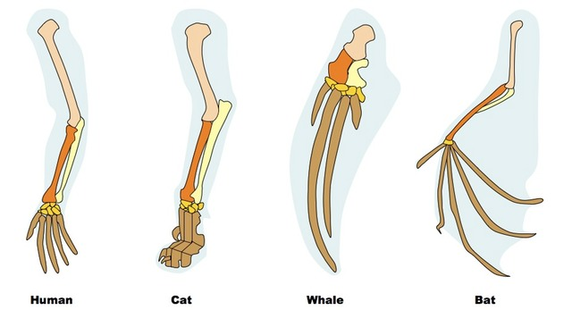
Homologous Structures

Slide 6
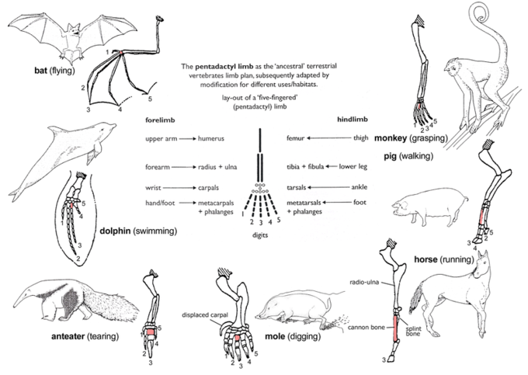
Homologous Structures
A body part or organ that shares a common ancestry across different organisms. Although they may perform different functions.

Slide 7
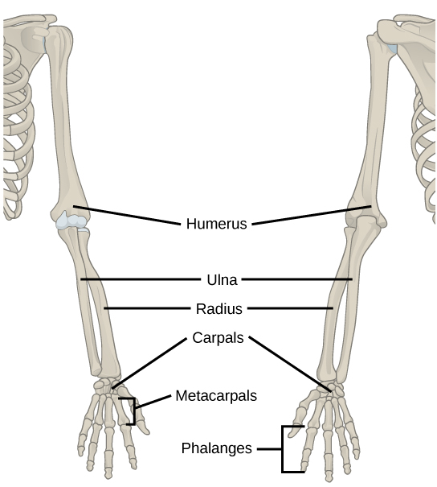
Homologous Structures
Many vertebrates share a similar limb bone structure.
Cats and dolphins share the same bones as listed in this diagram.

Slide 8

Presentation
Once you have been assigned a number, get into groups.

Slide 9
Group Assignments
1- DNA Sequences
2- Amino Acid Sequences
3- Anatomical Structures
4- Fossil Record
5- Embryological Development

Slide 10
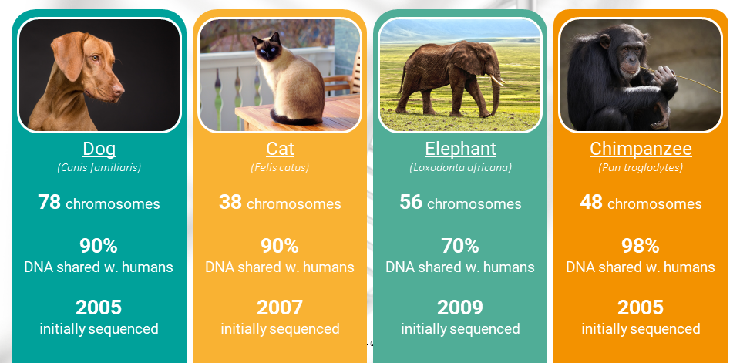
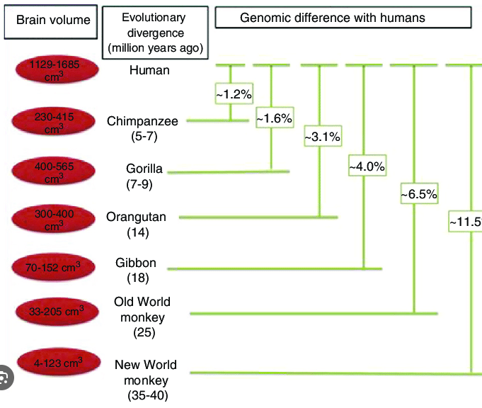
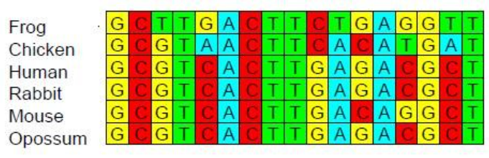
DNA Sequences
DNA codes for structures. How does DNA change from one organism to another?
Evidence for evolution- Khan Academy

Slide 11
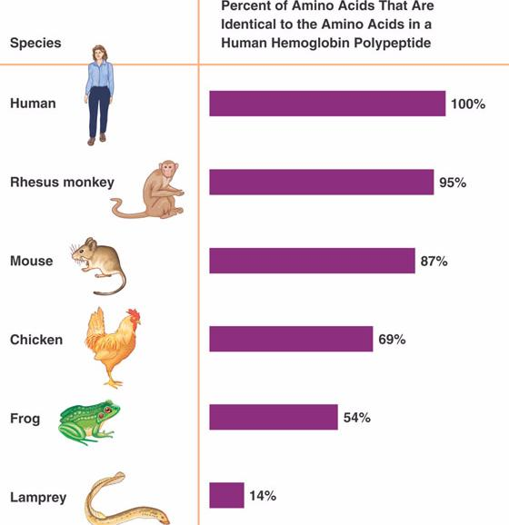
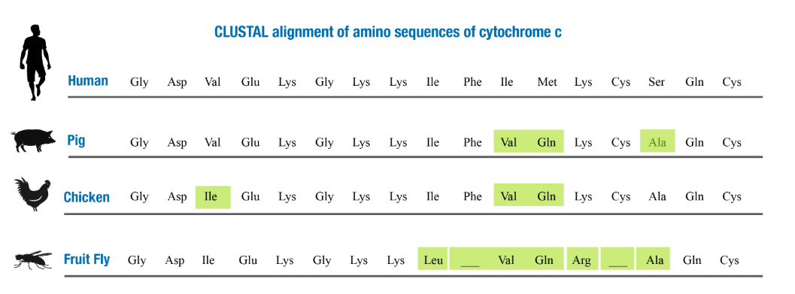
Amino Acid Sequence
Start Here:
https://evolution.berkeley.edu/ Molecular homology
https://evolution.berkeley.edu/ Lines of evolution
https://www.ck12.org/student/ Molecular evidence
https://www.khanacademy.org Evidence for Evolution

Slide 12
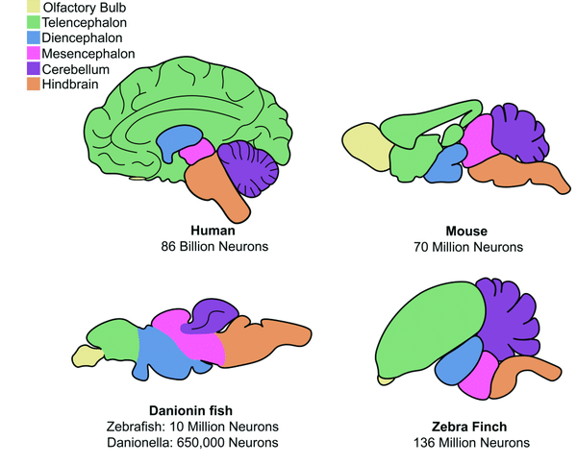
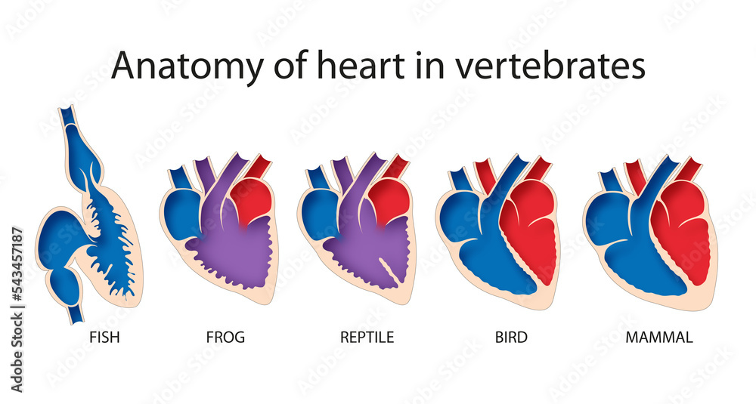
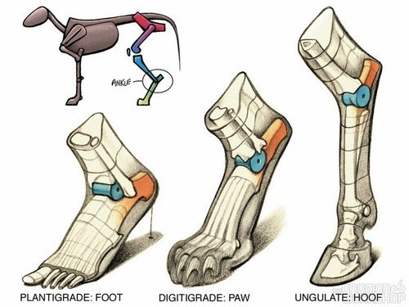
Anatomical Structures

Slide 13
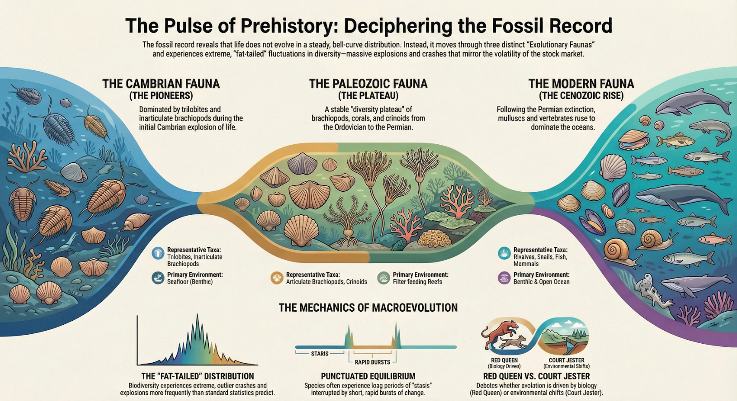
Fossil Record

Slide 14
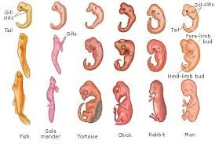
Embryological Development
Did you know that Human embryos have gill slits and tails?
How do the similarities between species during embryological development provide patterns that support the idea of evolutionary relationships between them?
Search Tip: Khan Academy is helpful! Search for evidence of how embryology supports evolution. Or how embryology provides evidence that organisms are related.

Slide 15
Poster Requirements
Title
Real World Example
Proof of Evolutionary Patterns/Evidence
Explain Evolutionary Pattern
Brief Description of How Pattern Supports Evolution
Picture of Evidence
Cite Your Sources!

Slide 16

3D-RST is supported by the NSF under grant number #DRL-2101383

