Slide 1
Mutations:
Shake Them Dice and Roll 'Em!

Slide 2

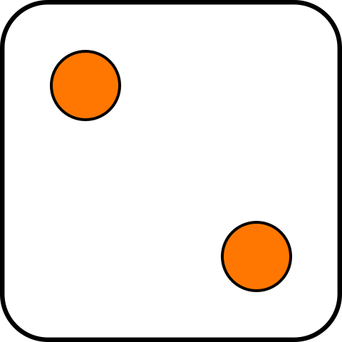
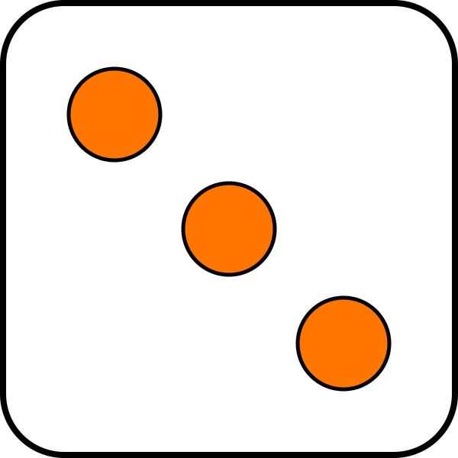
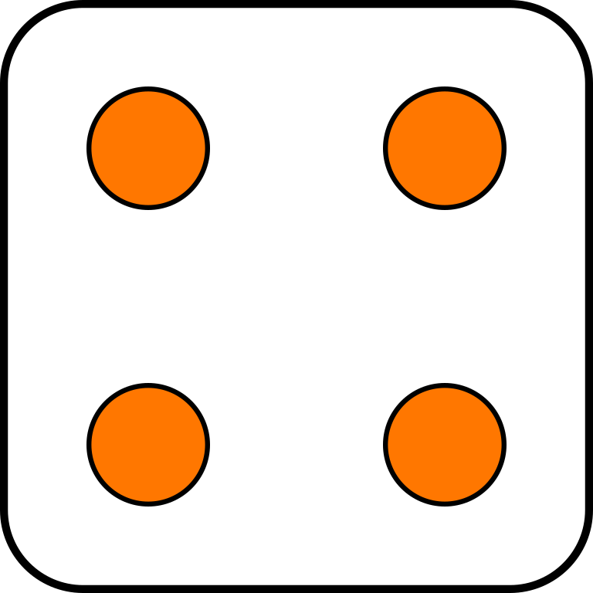
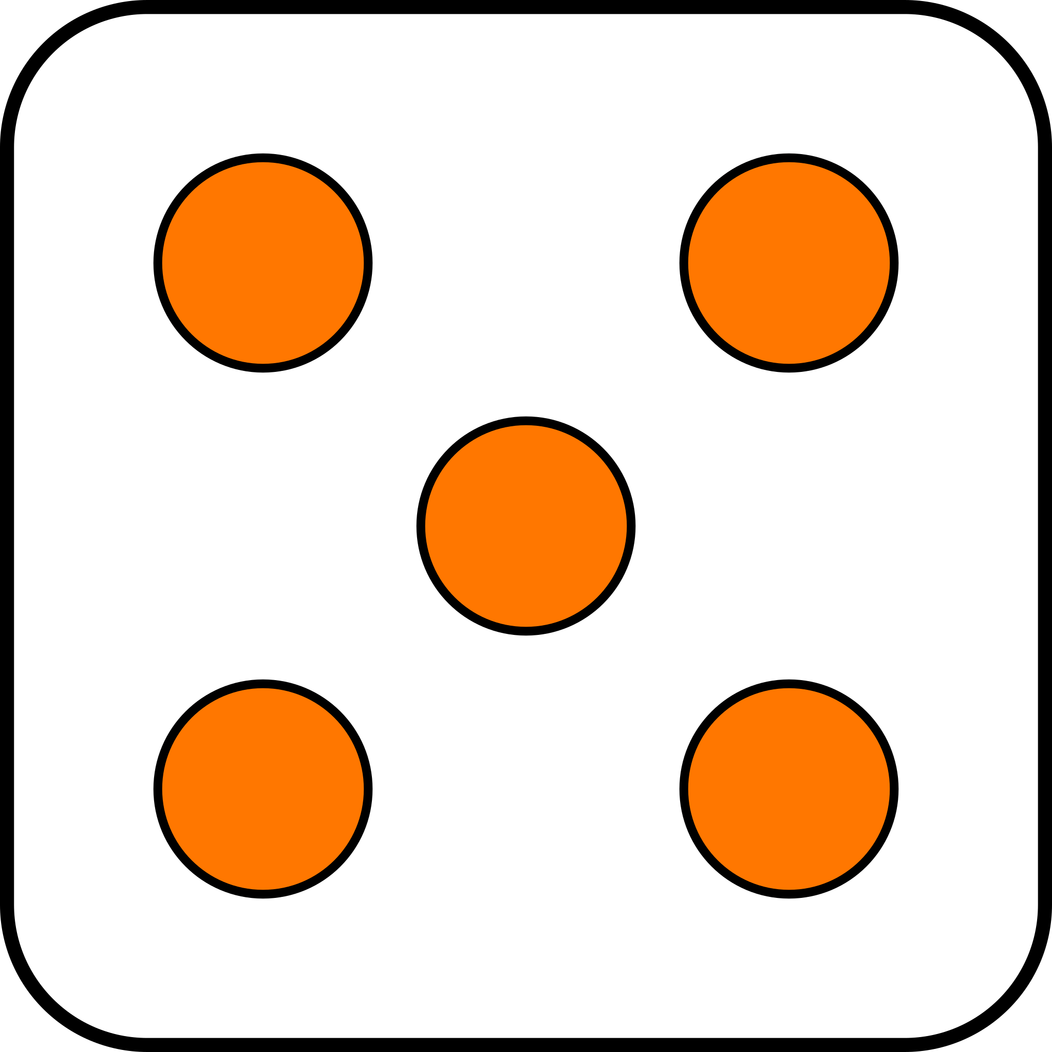


Slide 3

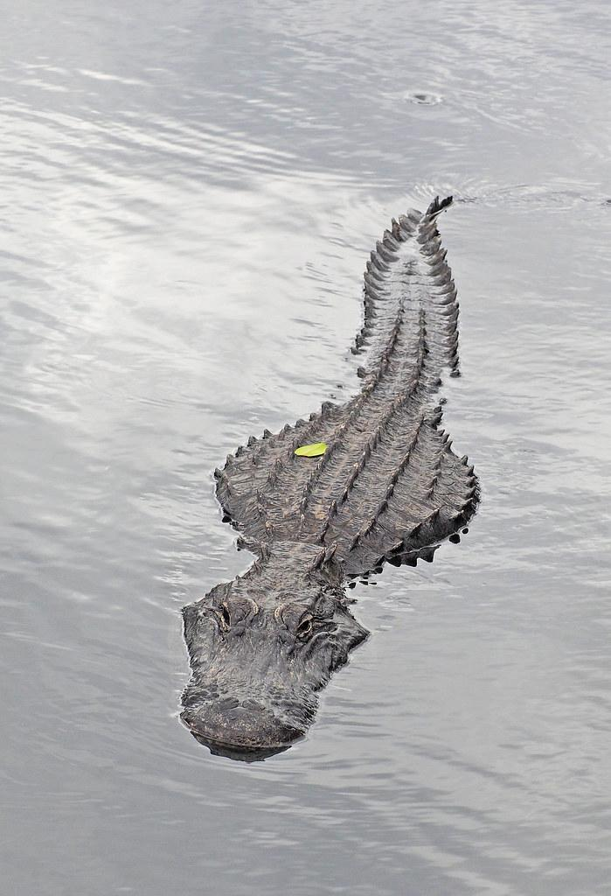
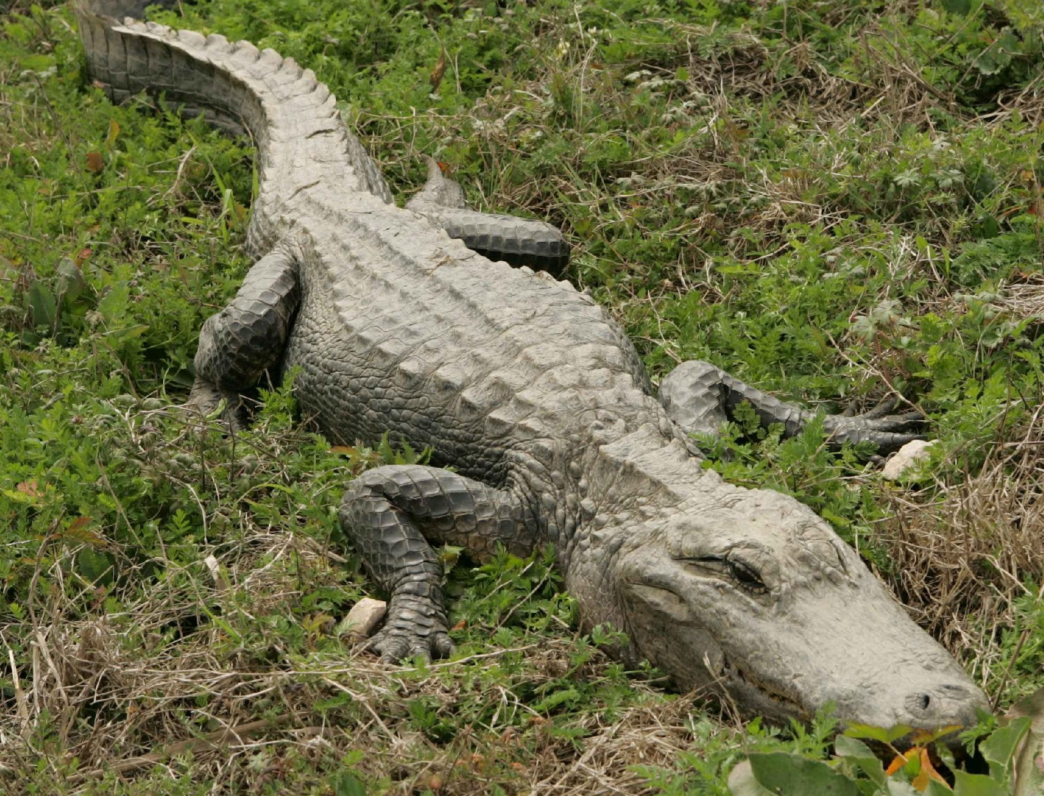

American Alligator
The American alligator is a large, powerful reptile with a wide, rounded snout and rough, scaly skin. It has a dark green or black body that helps it blend into the water. Alligators have strong tails for swimming and short, sturdy legs for walking on land. Their sharp teeth help them catch fish, birds, and other animals.
Alligators live in swamps, rivers, and lakes in the southeastern United States. They are cold-blooded, which means they need the sun to warm up. Even though they look scary, they are important for their habitat because they help control other animal populations and create homes for other creatures by digging holes in the water.

Slide 4
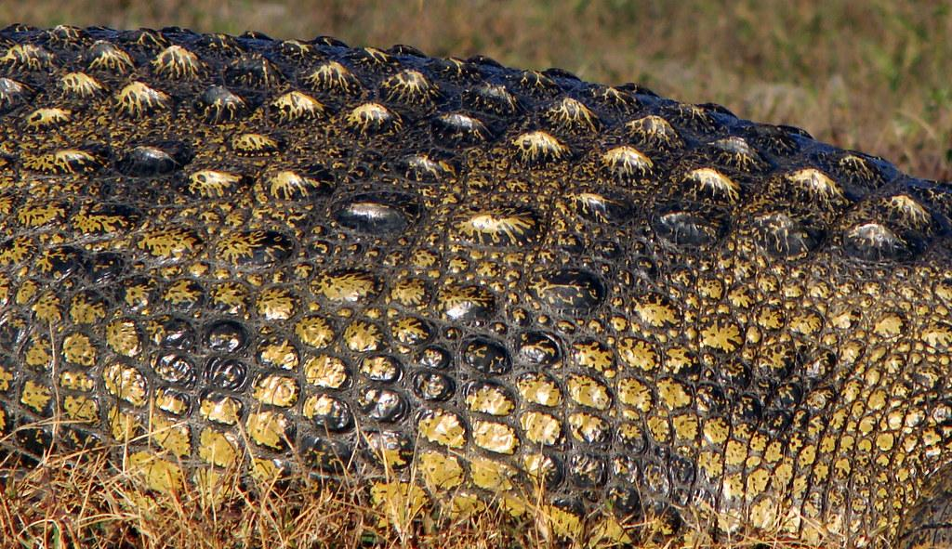
American Alligator Mutation #1
An American alligator's skin is very tough and covered with hard, bony plates called scutes. These plates act like armor, protecting the alligator from getting hurt and from predators. The skin also has tough scales that help keep the alligator safe from scratches and cuts. It also helps the alligator stay hydrated by preventing too much water from leaving its body.
A new American alligator has a mutation that causes it to have tougher and thicker scales.
Home

Slide 5
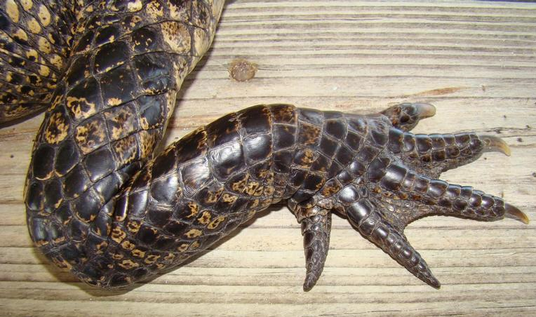
American Alligator Mutation #2
American alligator feet are perfectly adapted for their swampy homes. Webbed back feet make them powerful swimmers for hunting and escaping. Strong feet and claws also allow them to walk on land, hunt, and bask in the sun.
A new American alligator has a mutation which causes it to have extra toes.
Home

Slide 6
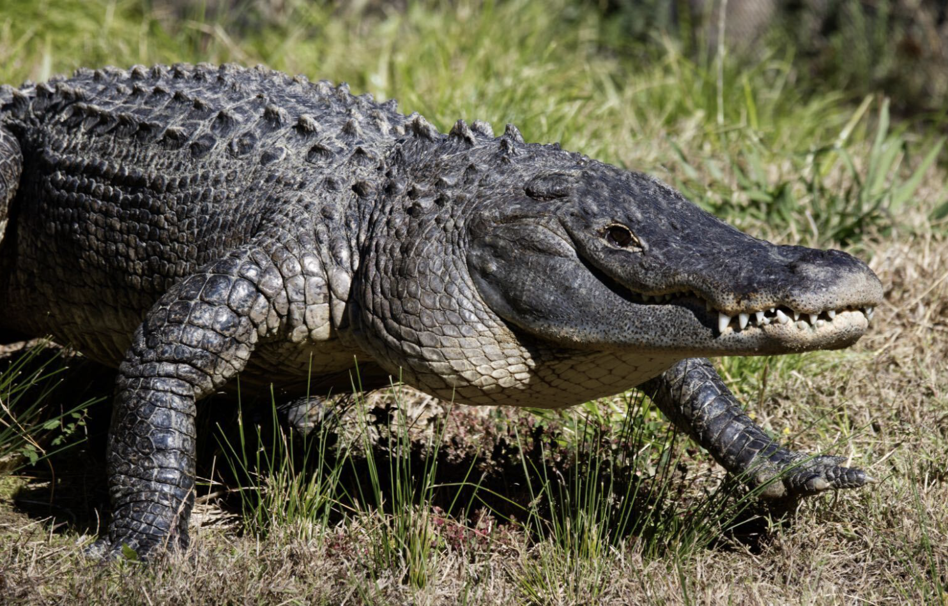
American Alligator Mutation #3
An American alligator’s eyes are specially designed to help it see well both above and below the water. The eyes are positioned on top of its head, so the alligator can stay mostly underwater and still see what's happening around it. This setup helps the alligator hunt for food, watch out for predators, and stay hidden in the water. It can keep its eyes above the surface while the rest of its body stays hidden, making it easier to sneak up on prey or avoid danger.
A new American alligator has a mutation which causes it to have eyes that are on the side of its head instead of on top.
Home

Slide 7
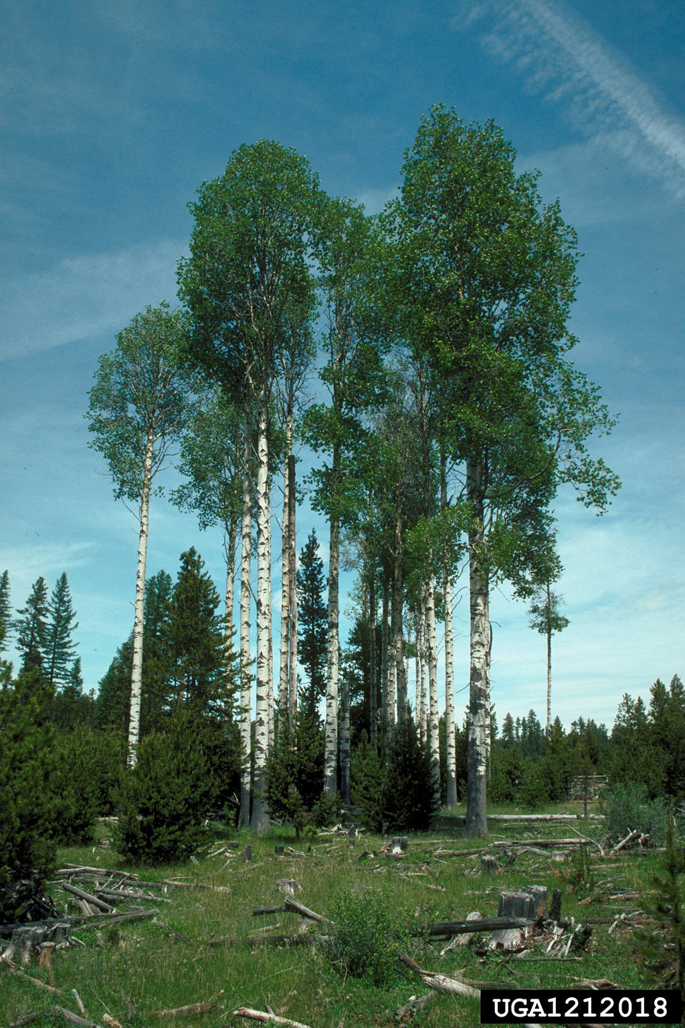
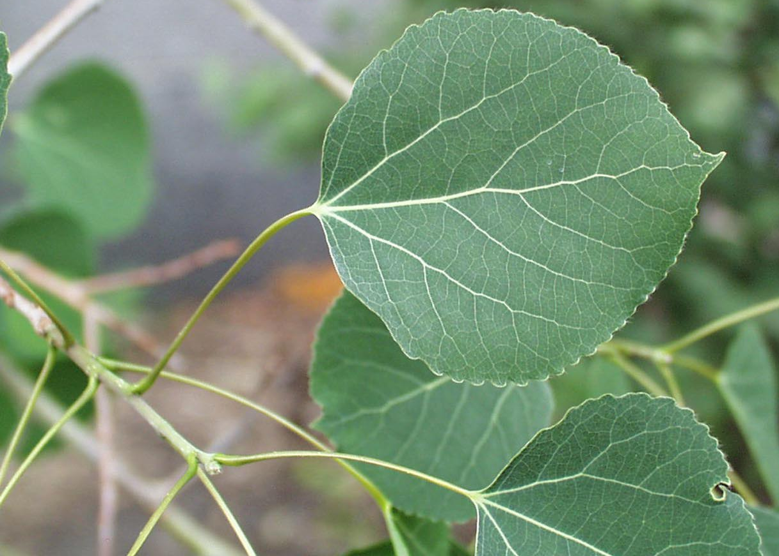

Quaking Aspen
Quaking Aspen grow naturally in cooler areas of North America.
The quaking aspen is a medium-sized tree with smooth, pale bark that sometimes has black marks. Its round leaves have finely serrated (toothed) edges and a flat stem, which makes them shake or "quake" in the wind. This is how the tree got its name!
In the fall, the leaves turn bright yellow. Young trees have smooth, light-colored bark, but as they grow older, their bark gets darker and rougher. Quaking aspens often grow in groups because their roots
spread underground and create new trees.
This helps them regrow quickly after fires or
logging.

Slide 8
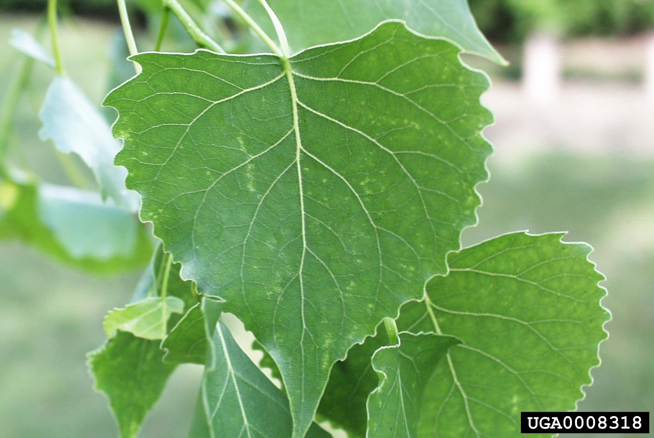
Quaking Aspen Mutation #1
Quaking aspens make their own food through photosynthesis. Their leaves take in sunlight, which helps them turn water from the roots and carbon dioxide from the air into sugar. This sugar gives the tree energy to grow. The tree also spreads food and water through its roots, which connect to other aspens in a group. This helps the trees stay strong and grow together!
A new Quaking Aspen has the mutation which causes it to have larger leaves.
Home

Slide 9
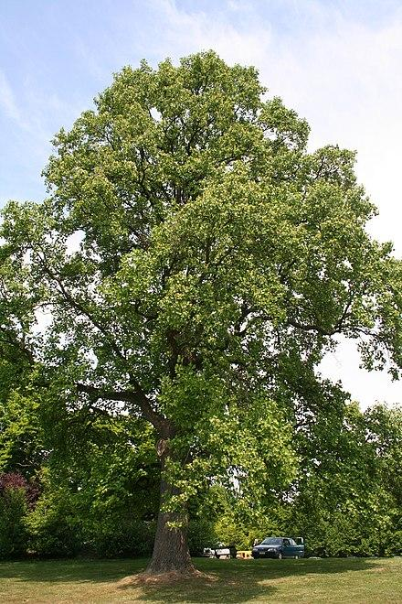
Quaking Aspen Mutation #2
Quaking Aspen trees have tall, straight trunks with smooth, white bark. Their branches spread out near the top, forming a rounded or oval shape. Aspens grow this way because they need lots of sunlight. Their tall trunks help them reach the light, while their wide tops catch as much sun as possible.
A new Quaking Aspen has a mutation which causes it to have tall and bushy growth.
Home

Slide 10
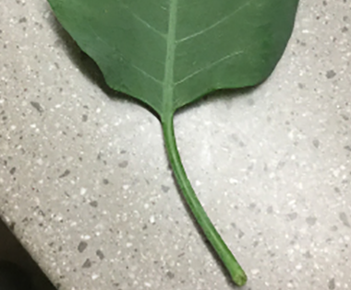
Quaking Aspen Mutation #3
The leaves of Quaking Aspen are small, round, and have flat stems, which make them tremble or "quake" even in the slightest breeze. The trembling leaves help reduce wind damage and let light reach lower leaves.
A new Quaking Aspen has a mutation which causes it to have rounded stems.
Home

Slide 11
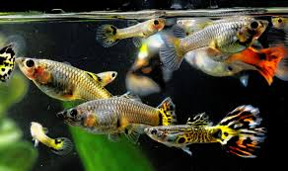
Guppy
Guppies are native to certain countries and islands in South America. They live in either freshwater or brackish water, which refers to areas where salt and freshwater meet, but their habitats can range greatly. They tolerate water ranging from 64.4 to 82.4°F (18 to 28°C) and salinity of up to 150% seawater. They prefer the water to be slightly alkaline, with a pH of 7.0 to 8.0.
Guppies don’t live very long in the wild, an average of two years.
They don’t lay eggs but instead give birth to live young after four to six weeks. Depending on the female guppy’s age and the number of predators around, her litter size can range from one to 100 offspring, but 20 to 40 is average. Female guppies can give birth two to three times a year, and they can continue to reproduce until they are 20 to 34 months old.

Slide 12
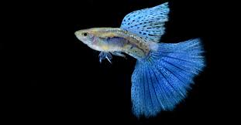
Guppy Mutation #1
Guppies can be many different colors, including green, orange, black, white, and yellow.
Male guppies are smaller than female guppies, but males are much more colorful to attract the females.
A new guppy has a mutation that causes it to be blue in color.
Home

Slide 13
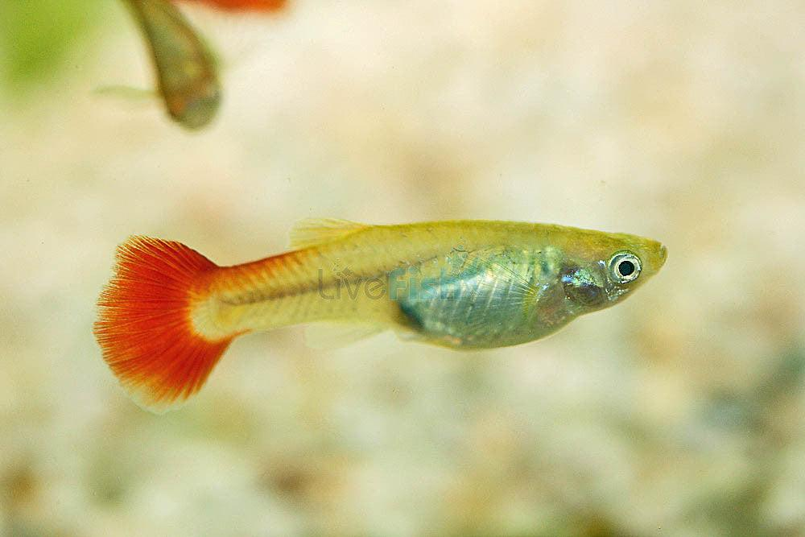
Guppy Mutation #2
Guppies can have bright tails and patterns that help them find friends and sometimes stay safe from danger.
Male guppies sometimes have long tails that help them attract mates,
but these long tails can make it harder for them to swim quickly.
A new guppy has a mutation that causes it to have a smaller tail.
Home

Slide 14
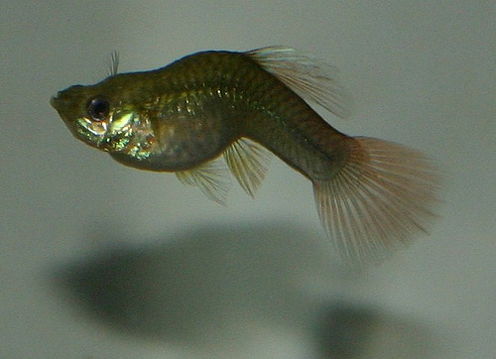
Guppy Mutation #3
A new guppy has a mutation that causes the guppy to have a bent spine.
Home

Slide 15
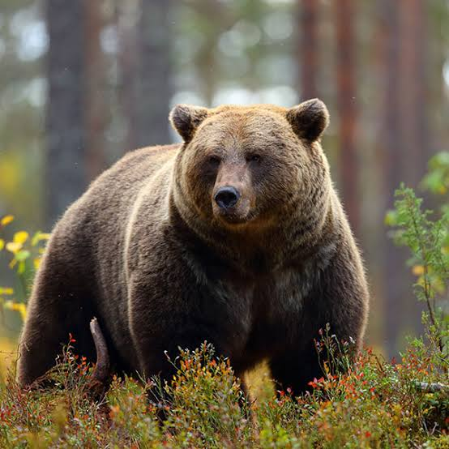
Brown Bear
Brown bears are large mammals that can be found in various habitats. They are known for their powerful build and thick fur, which helps them stay warm in cold climates. Brown bears can weigh between 300 to 1,500 pounds and stand about 5 to 8 feet tall when on their hind legs.
These incredible animals are omnivores, meaning they eat both plants and animals, with a diet that includes berries, fish, and small mammals. During the summer and fall, brown bears eat a lot to prepare for hibernation, a period when they sleep for several months during winter. They are also known for their excellent sense of smell, which helps them find food from miles away.

Slide 16
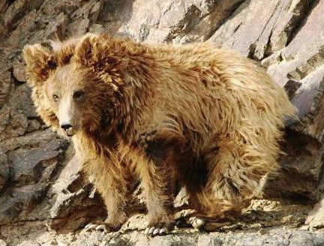
Brown Bear Mutation #1
Brown bear fur is not only warm, protecting them from the cold weather, but it also serves other important purposes. In the summer, the bear’s fur helps keep them cool by reflecting sunlight. The color of their fur can vary from light brown to dark chocolate, which helps them blend into their surroundings, making it harder for predators to spot them. Additionally, the fur is water-resistant, which helps the bears stay dry when they swim or encounter rainy weather.
A new brown bear has a mutation that causes it to have extra thick fur.
Home

Slide 17
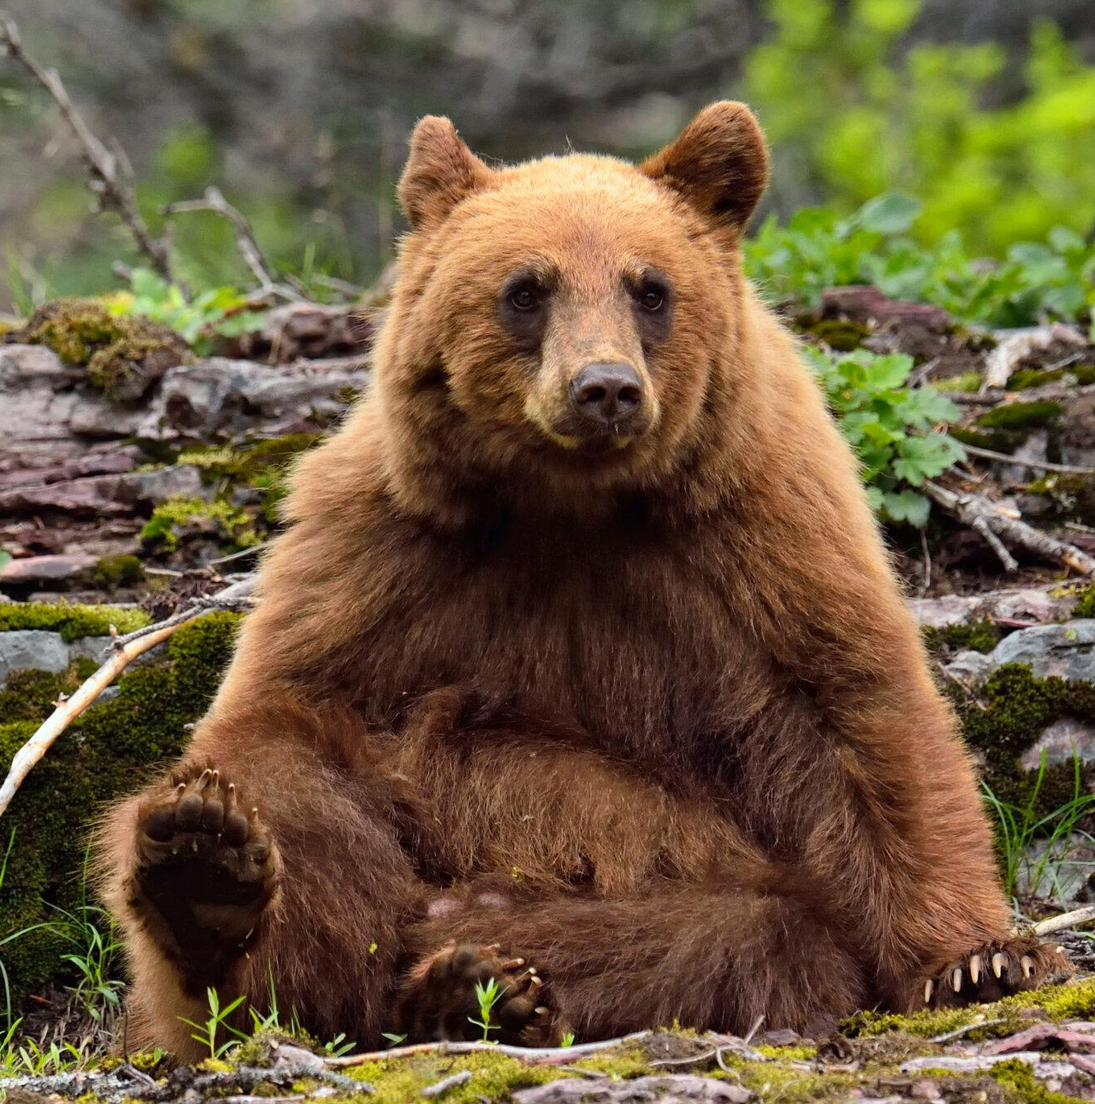
Brown Bear Mutation #2
Mitochondria are often called the "powerhouses" of animal cells because they play a crucial role in producing energy. They convert the food we eat into a form of energy called ATP, which stands for adenosine triphosphate. This energy is essential for the cells to perform various functions, such as moving, growing, and repairing themselves.
A new brown bear has a mutation that causes a decrease in the number of mitochondria in its cells.
Home

Slide 18
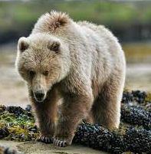
Brown Bear Mutation #3
A brown bear's characteristic color helps it to blend in with wooded environments and not draw attention as it moves about.
A new brown bear has a mutation that causes its fur to be a lighter brown color.
Home

Slide 19
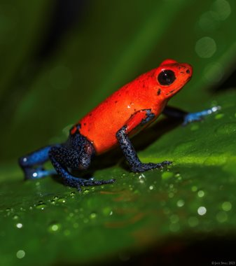
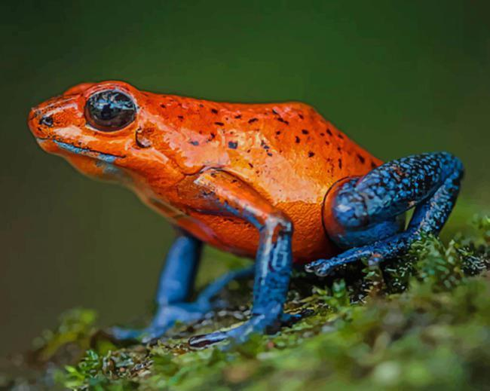
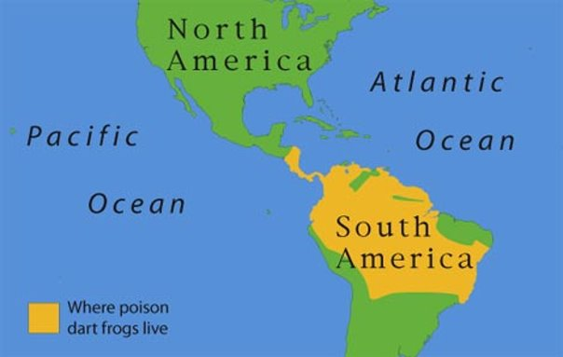
Poison Dart Frog
The poison dart frog is a small but highly toxic amphibian found in the rainforests of Central and South America. These frogs are famous for their bright colors, which serve as a warning to predators that they are poisonous. Their skin contains powerful toxins that can paralyze or even kill animals that try to eat them. Poison dart frogs get their toxins from the insects they eat, and some species raised in captivity without their natural diet are not poisonous. These frogs are excellent jumpers and have sticky toe pads that help them climb plants and trees in their humid environments.

Slide 20
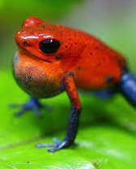
Poison Dart Frog Mutation #1
Poison dart frogs use vocalizations to communicate with other frogs, especially during mating. Males produce trilling or chirping calls to attract females and establish territory. Each species has a unique call, allowing them to recognize their own kind in the dense rainforest environment.
A new frog has a mutation that causes it to have a deeper mating call.
Home

Slide 21
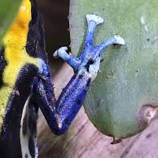
Poison Dart Frog Mutation #2
Poison dart frogs have specialized toe pads that produce a sticky mucus, helping them grip onto leaves, branches, and other surfaces. These pads allow them to climb trees, navigate slippery rainforest foliage, and escape predators by moving quickly through their environment.
A new frog has a mutation that causes it to have larger toe pads.
Home

Slide 22
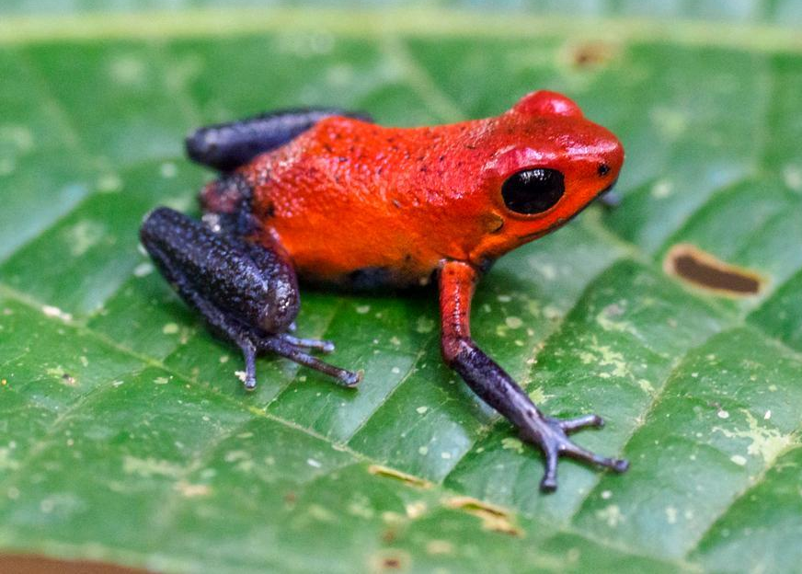
Poison Dart Frog Mutation #3
The bright colors of poison dart frogs serve as a warning to predators, a defense strategy called aposematism. Their vibrant hues signal that they are toxic and should not be eaten. Different species have various colors and patterns, which may also help individuals recognize members of their own species.
A new frog has a mutation that causes it to be green in color.
Home

Slide 23
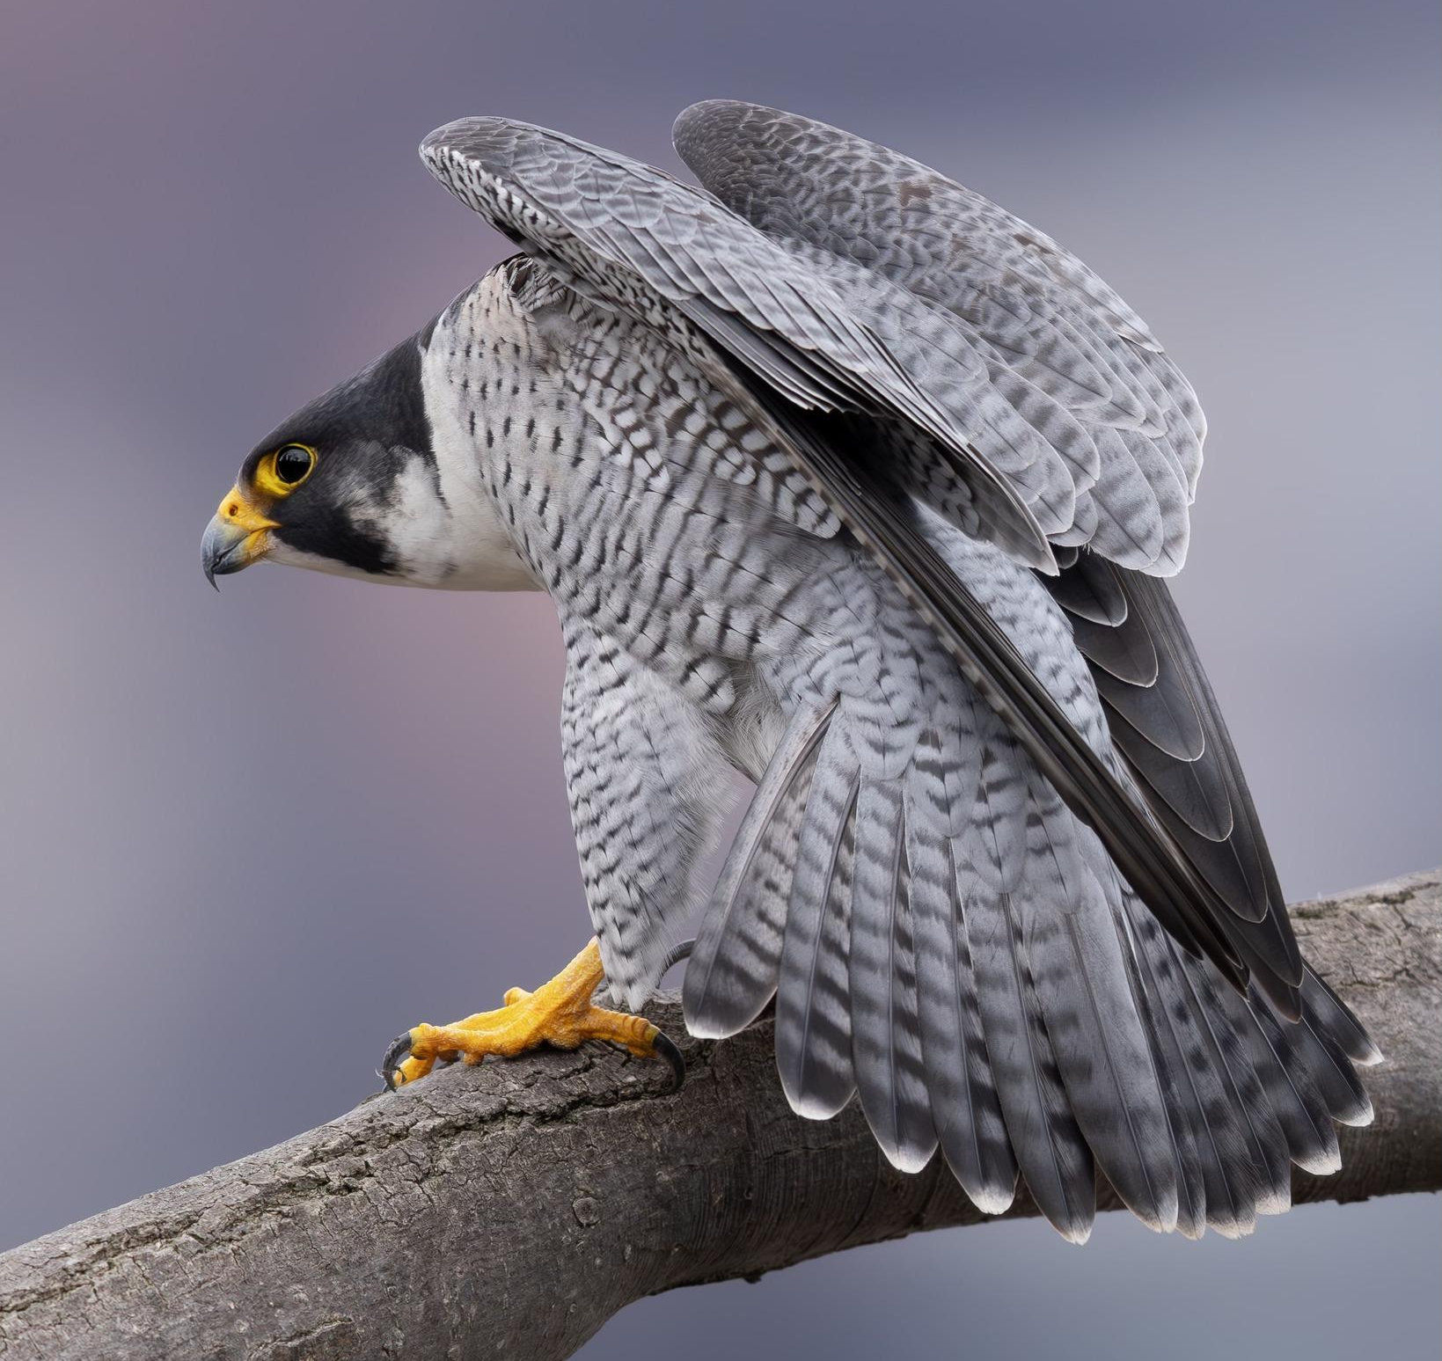
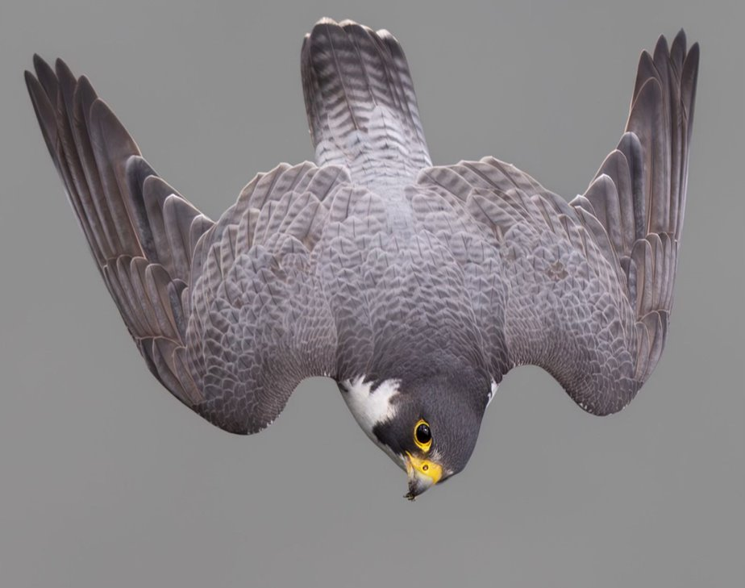
Peregrine Falcon
The peregrine falcon is the fastest animal on Earth, reaching speeds over 240 mph (386 km/h) during its hunting dives, called "stoops." Found on every continent except Antarctica, these birds of prey have sharp talons, excellent eyesight, and strong, curved beaks designed for catching and eating other birds. Peregrine falcons were once endangered due to pesticide use, but conservation efforts have helped their populations recover. They nest on high cliffs, buildings, and bridges, using their incredible speed and precision to strike prey mid-air.

Slide 24
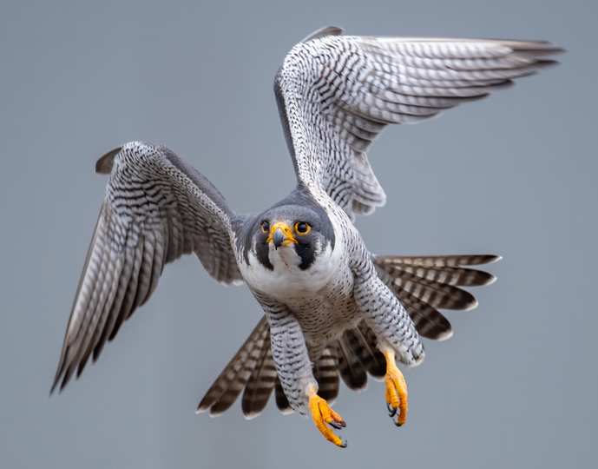
Peregrine Falcon Mutation #1
Peregrine falcons have powerful flight muscles, particularly the pectoralis, which controls the downward wing stroke. These strong muscles allow them to generate the speed and maneuverability needed for high-speed dives and mid-air prey capture.
A new falcon has a mutation that causes the muscles to be weaker and less efficient.
Home

Slide 25
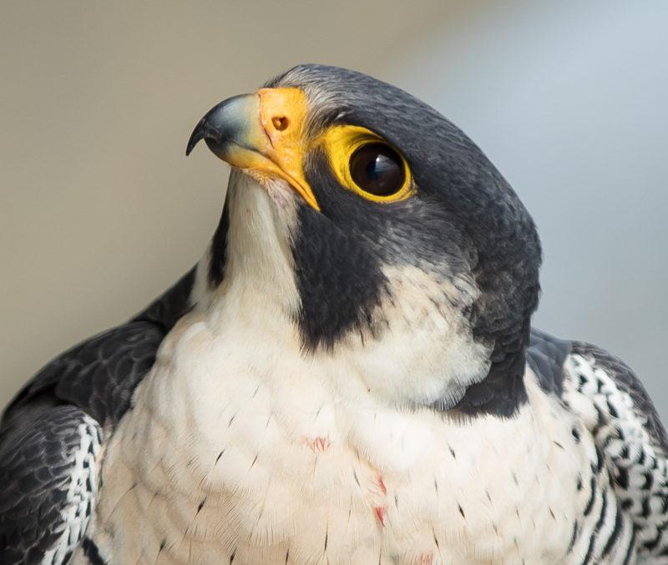
Peregrine Falcon Mutation #2
Peregrine falcons have some of the best vision in the animal kingdom, allowing them to spot prey from over a mile away. Their eyes have a high number of photoreceptor cells, giving them sharp detail and the ability to detect movement with incredible precision. They also have a special third eyelid, called a nictitating membrane, that protects their eyes and keeps them moist during high-speed dives. This exceptional eyesight helps them track and catch fast-moving prey in mid-air.
A new falcon has a mutation that causes it to see in the dark.
Home

Slide 26
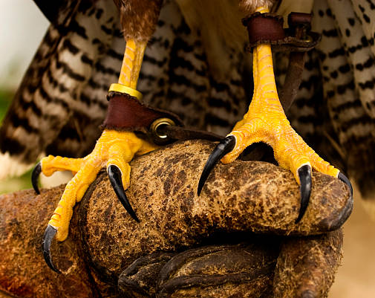
Peregrine Falcon Mutation #3
Peregrine falcons have sharp, curved talons and strong feet designed for gripping and killing prey. They use their feet to strike birds in mid-air, often stunning or killing them instantly. Their hallux talon (the rear claw) provides a powerful grip, allowing them to carry prey back to their perch or nest.
A new falcon has a mutation which causes it to have stronger feet and talons.
Home

Slide 27


3D-RST is supported by the NSF under grant number #DRL-2101383

