Slide 1

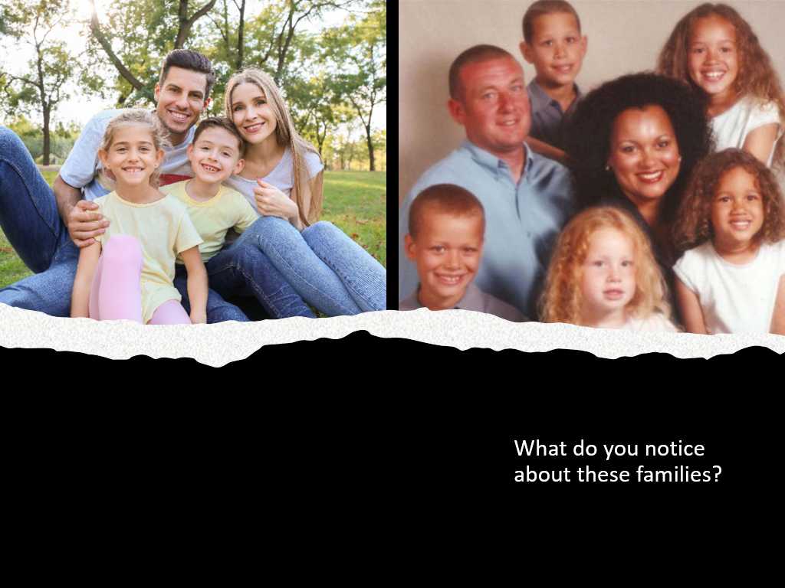
Maria and Lucy Aylmer and family
What did we learn in the previous lesson about why siblings can have such distinct traits?

Slide 2
Chromosome Crossover
Make an initial argument explaining how the twins, Lucy and Maria Aylmer, inherited such different traits from their parents. Use scientific terms, evidence, and reasoning to support your argument.

Slide 3
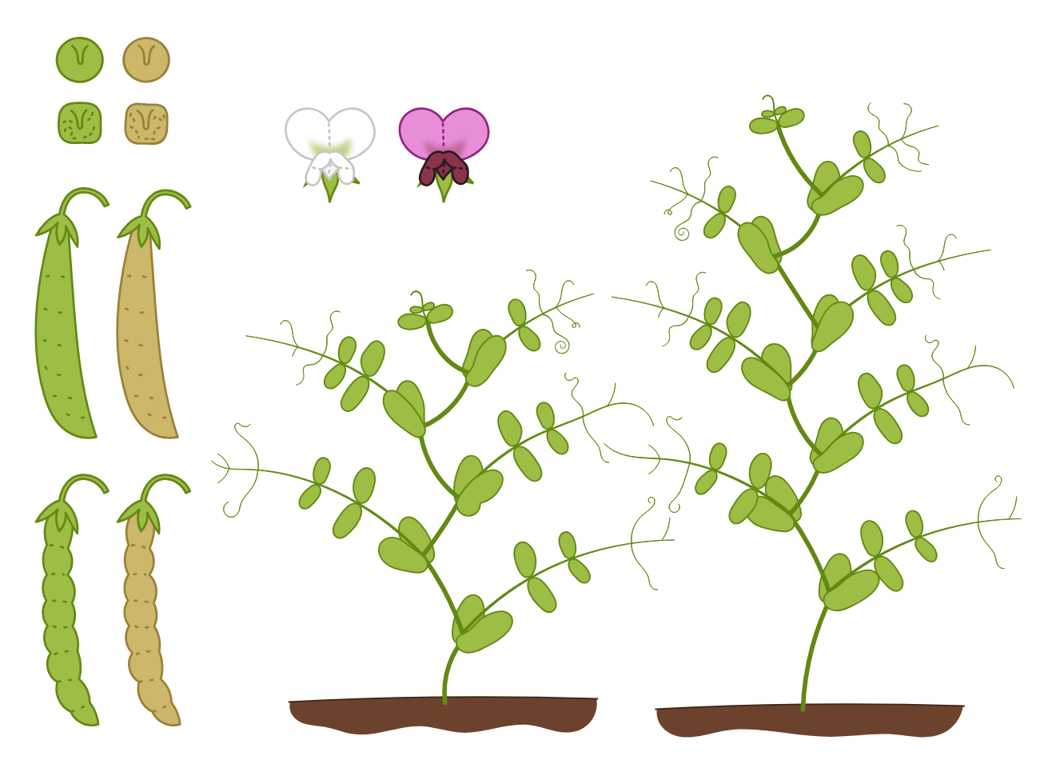
Chromosome Crossover Activity: Pea Plant Traits

Slide 4
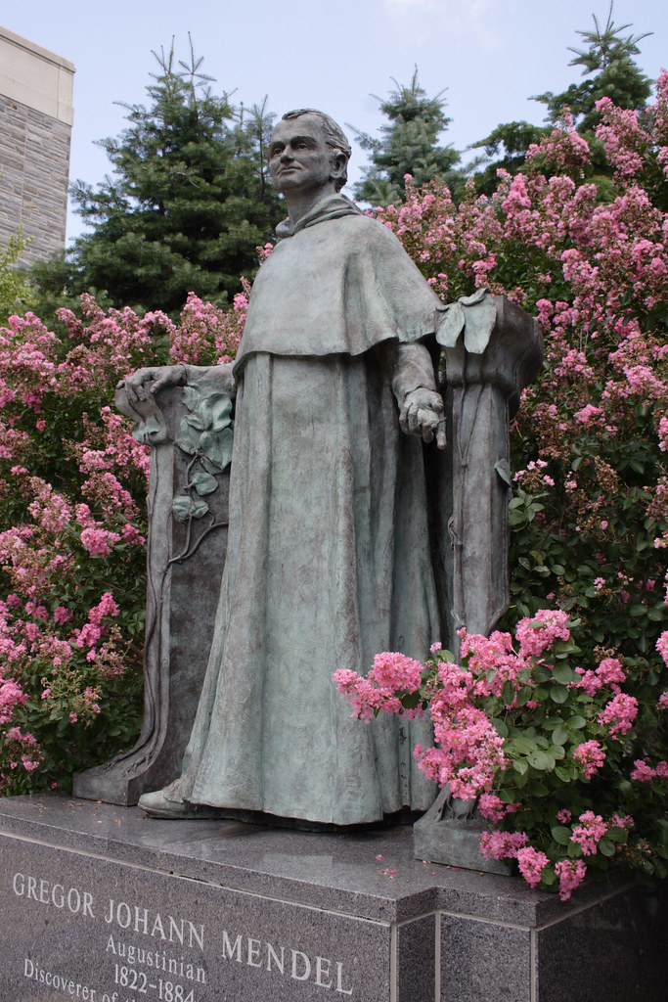
Gregor Mendel - 1857
“Father of Genetics”
Interesting article Johann Gregor Mendel: the victory of statistics over human imagination
Notes:
Question on bottom could help with a discussion on being able to argue from evidence. A good example.

Slide 5
From chatgpt: Gregor Mendel (1822–1884) was an Austrian scientist and monk best known for his foundational work in genetics. His experiments with pea plants established the basic principles of heredity, including dominant and recessive traits, which later became known as Mendelian inheritance.
Early Life and Education
Born on July 20, 1822, in Heinzendorf (now Hynčice, Czech Republic), part of the Austrian Empire.
Raised in a farming family but showed early academic talent.
Studied at the University of Olomouc, where he focused on physics and mathematics.
Became an Augustinian monk at St. Thomas's Abbey in Brno in 1843, which allowed him to pursue his scientific interests.
Experiments and Discoveries
Conducted pea plant experiments (1856–1863) in the monastery garden, breeding thousands of plants to study inheritance.
Identified three key principles of genetics:
  Law of Segregation – Traits are inherited as discrete units (genes), and offspring inherit one unit from each parent.
  Law of Independent Assortment – Genes for different traits are passed independently of each other.
  Law of Dominance – Some traits (dominant) mask the presence of others (recessive).
Published his findings in 1866, but they were largely ignored during his lifetime.
Later Life and Legacy
Became abbot of his monastery in 1868, shifting focus to administrative duties.
His work was rediscovered in 1900 by scientists Hugo de Vries, Carl Correns, and Erich von Tschermak, leading to the foundation of modern genetics.
Died on January 6, 1884, largely unrecognized for his contributions at the time.
Mendel is now considered the "Father of Genetics," and his principles remain fundamental to the field of biology.

Slide 6
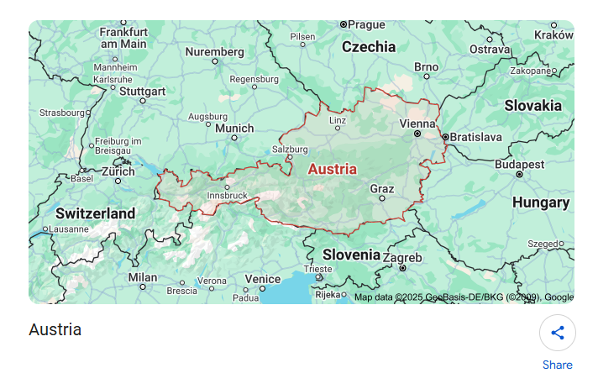

Slide 7
Gregor Mendel - 1857
“Father of Genetics”
A monk who studied pea plants
How many pea plants did he gather data from?
Discovered HOW individuals receive traits from their parents
Genes come in pairs
How did Mendel’s pea plant findings stand the test of time? (i.e., Why is he called the Father of Genetics?
30,000!
Interesting article Johann Gregor Mendel: the victory of statistics over human imagination
Notes:
Question on bottom could help with a discussion on being able to argue from evidence. A good example.

Slide 8
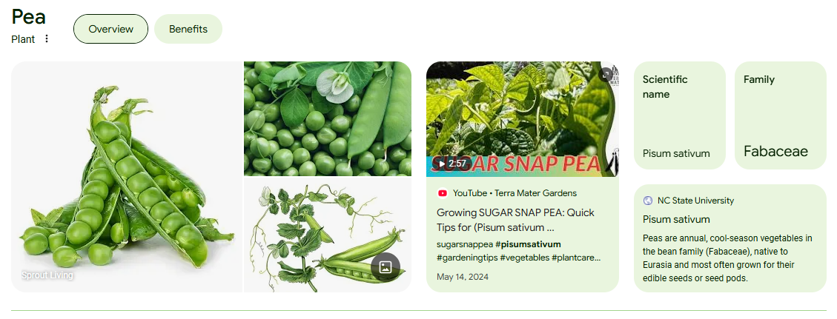

Slide 9
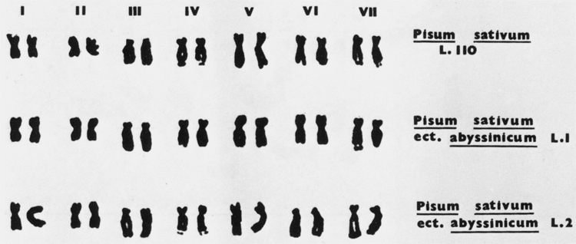
Karyotype of Pisum sativum (pea)

Slide 10
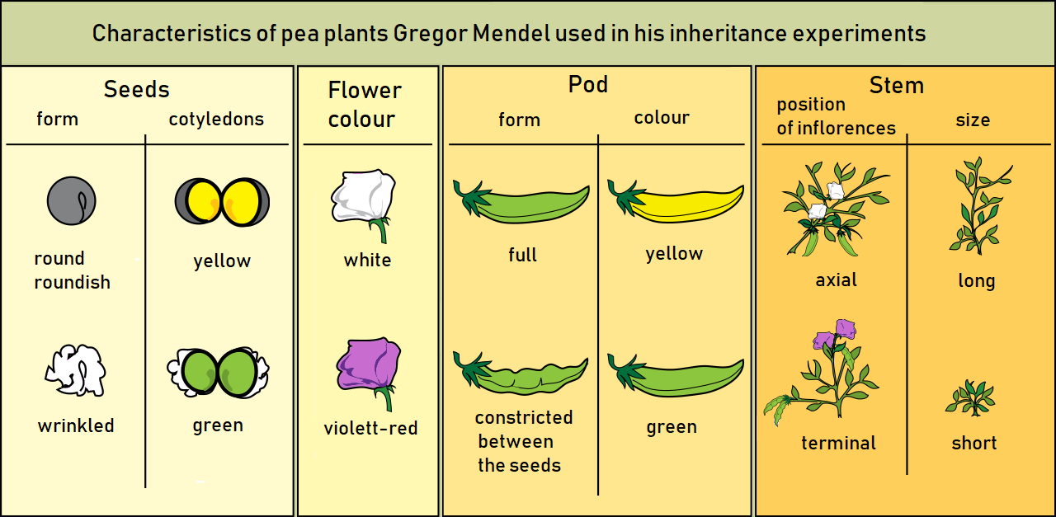

Slide 11
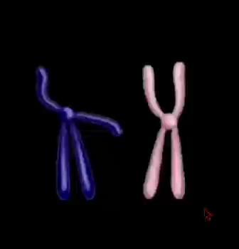
Crossing Over
What is different about the structure of the chromosomes before and after the dance?

Slide 12
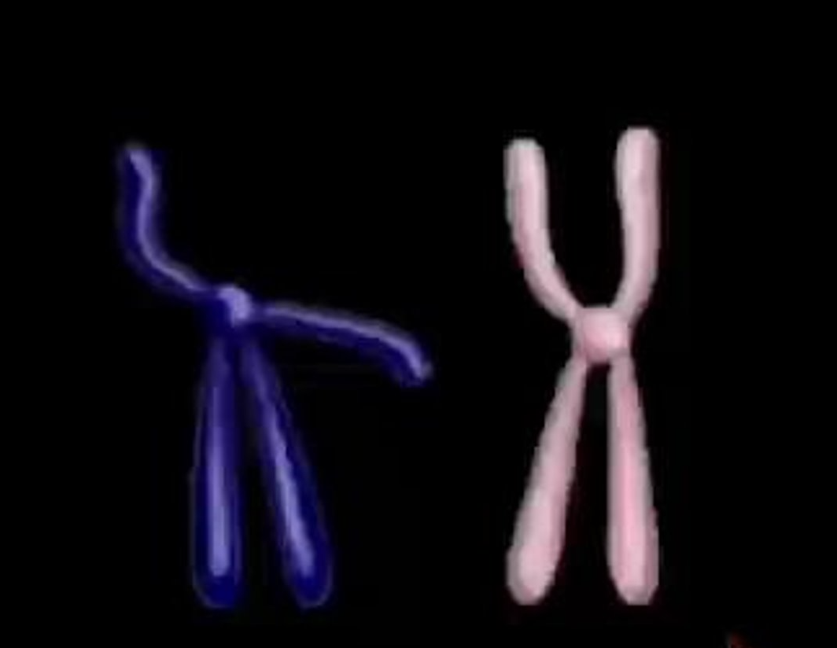
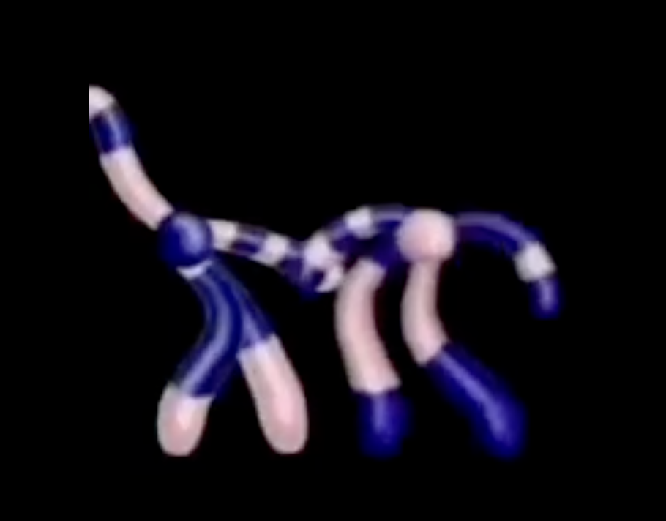
What is different about the structure of the chromosomes before and after the dance?​
Before
After

Slide 13
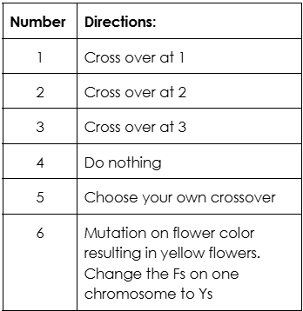
Chromosome Crossover Simulation: Pea Plant Traits
Roll the dice, cut, and swap according to the table. Each student will roll the die 3 times.
After you’ve performed the crossovers, you will now cut apart your chromosomes so that you have four separate chromatids. Glue or tape them into the spaces below. Then fill out the table, using the information about plant height, flower color, and seed covering.

Slide 14
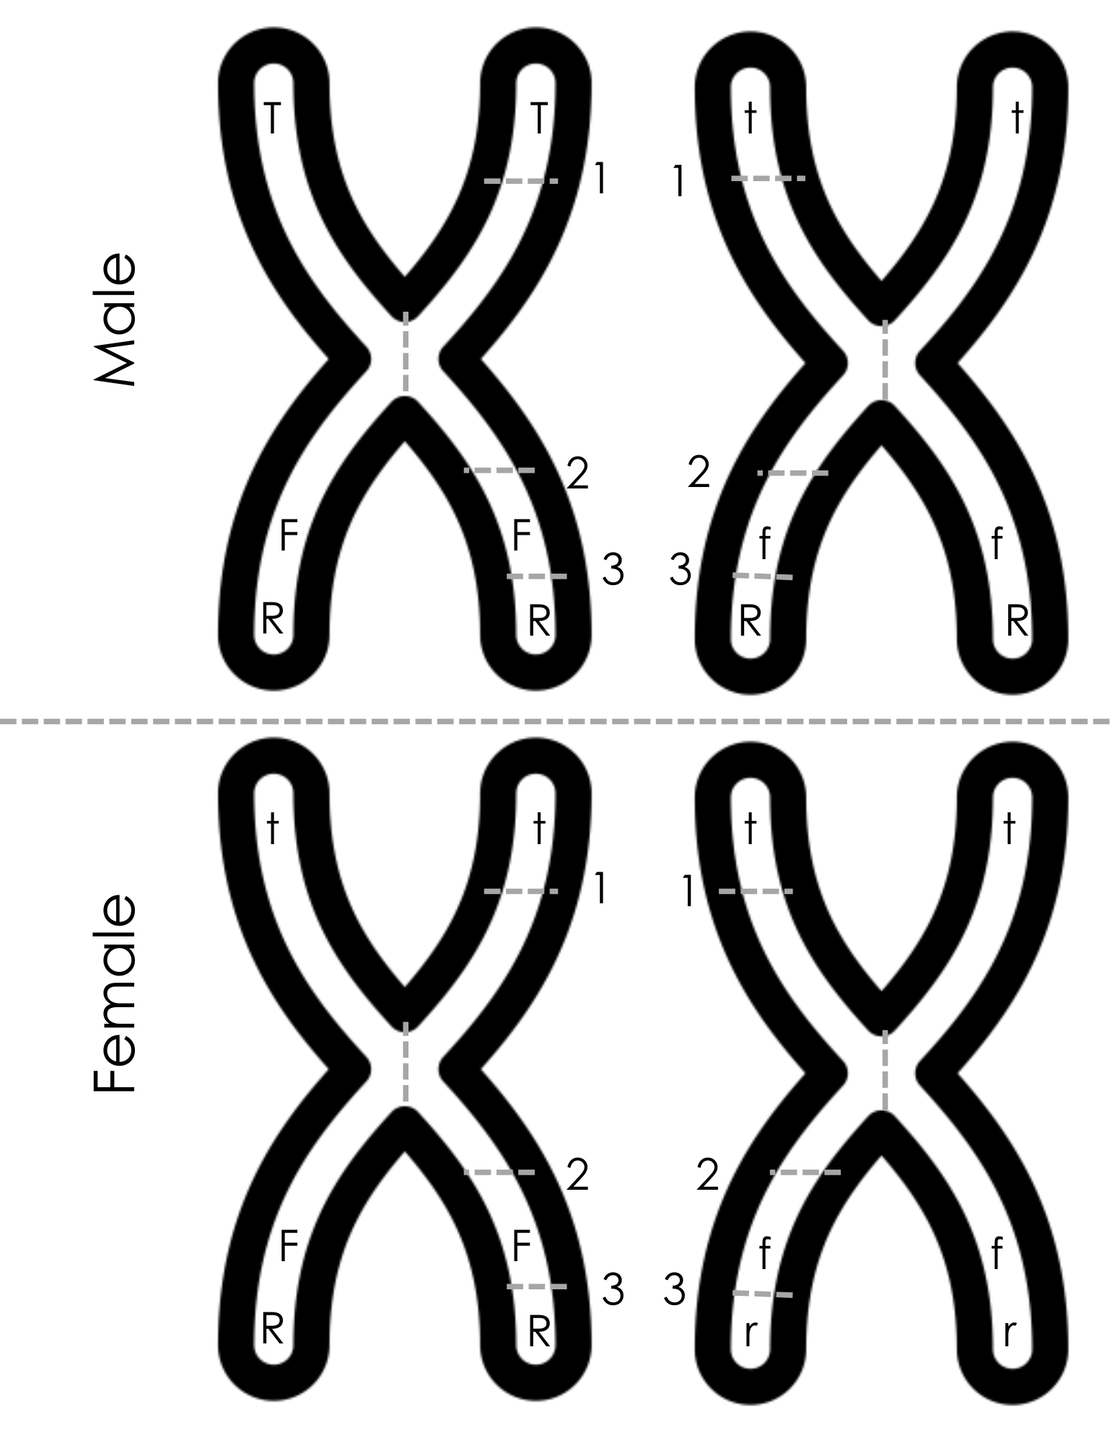
Chromosome Crossover Activity: Pea Plant Traits
Student 1
. Color each entire chromosome a different color - pick your 2 favorites. Cut them out.
Roll ONE die 3 times, record your results on your paper. Roll the same number twice? Roll again.
Rolled a 6? In the table below, write “yellow” for flower color, and change all the Fs to Ys on your chromatids.
Make your cuts and swap, according to what you rolled. The swap is between your own two chromosomes, NOT between male and female. Crossover happens during Prophase I of meiosis - the process to FORM GAMETES. Fertilization comes later!
Once you’ve completed your crossovers, cut the chromosome to separate the chromatids, and glue them to your paper.
Student 2
Notes:
This is a resource slide if necessary

Slide 15
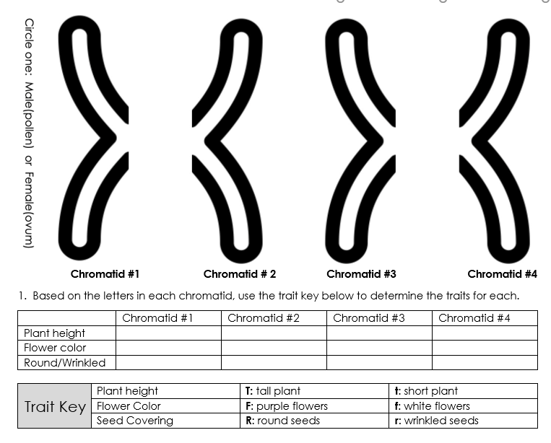

Slide 16
Compare your 4 chromatids with at least three other students. What do you notice?
How is rolling the dice to determine crossover locations related to the actual determination of crossover location during prophase I of meiosis? Hint: Consider what role the dice played in the simulation
What is the result of crossover locations being random?

Slide 17
 | Animals | Plants
Male | Sperm | Pollen
Female | Egg | Ovum
Gametes in Plants
In animals, gametes are sperm and egg cells. In pollinating plants, gametes are pollen and ovum cells. Each pollen and ovum cell contains chromatids that have undergone crossover during prophase I and are therefore unique. Every time meiosis occurs, 4 haploid gametes are formed from one original diploid cell. Pea plants have a haploid number of 7 and a diploid number of 14.
How many chromatids will be in each pea pollen cell?
How many chromatids will be in each pea ovum cell?
After pollination, how many chromatids will be in each pea seed or resulting pea plant?

Slide 18
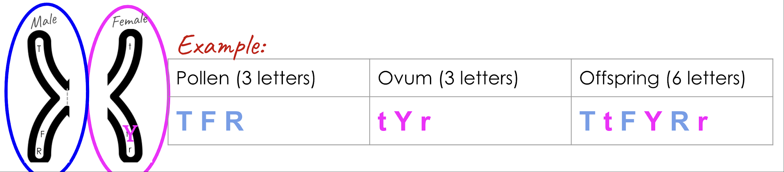
Simulating Pollination with your partner - Question 8
You and your partner will each choose one chromatid to simulate pollination. Remember, there is more than one chromosome in each of the 4 gametes formed, but for this activity, we are just using one chromosome. Write down the traits (3 letters) carried on that chromatid.
If you have the “male” chromosomes, your letters will go in the pollen box.
If you have the “female” chromosomes, your letters will go in the ovum box.
To determine the offspring, you will combine the letters from pollen and ovum, keeping like letters together.

Slide 19
Maria and Lucy Aylmer and family
Which characteristics of the Aylmer twins are the most similar? Which traits are the most different?

Slide 20
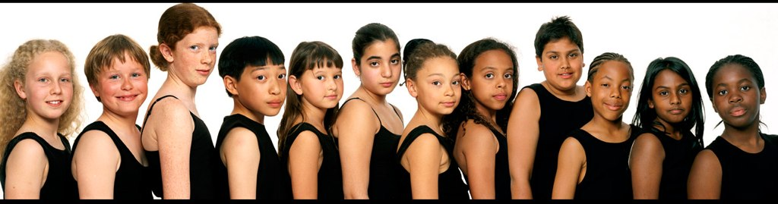
Melanin
Melanin is produced within special structures called melanosomes. Melanosomes are found inside melanin-producing pigment cells called melanocytes. Although all humans have the same number of melanocytes, the amount of melanin they produce differs and gives rise to the variation in human skin color.
Researchers found 169 functionally diverse genes that impacted melanin production. Of those, 135 were not previously associated with pigmentation.
From: https://phys.org/news/2023-08-melanin-genes-responsible-pigmentation.html

Slide 21
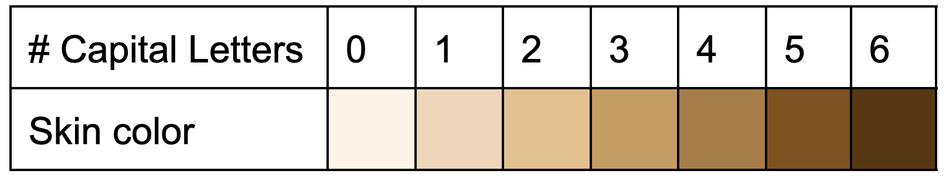
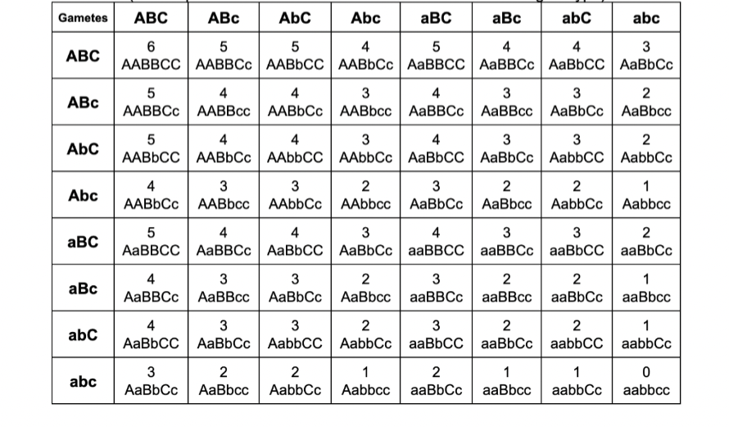
The chart on the right is called a Punnett Square. Along the top and left are possible genes carried by the parents (in sperm and egg cells). The other boxes show the outcome of different gamete fertilization, based on which sperm and egg come together to form the zygote.
Possible traits from mother
Possible traits from father

Slide 22
Writing an Argument from Evidence
Make an argument from evidence explaining how the twins, Lucy and Maria Aylmer, inherited such different traits from their parents.
Possible traits from mother
Possible traits from father

Slide 23


