Slide 1
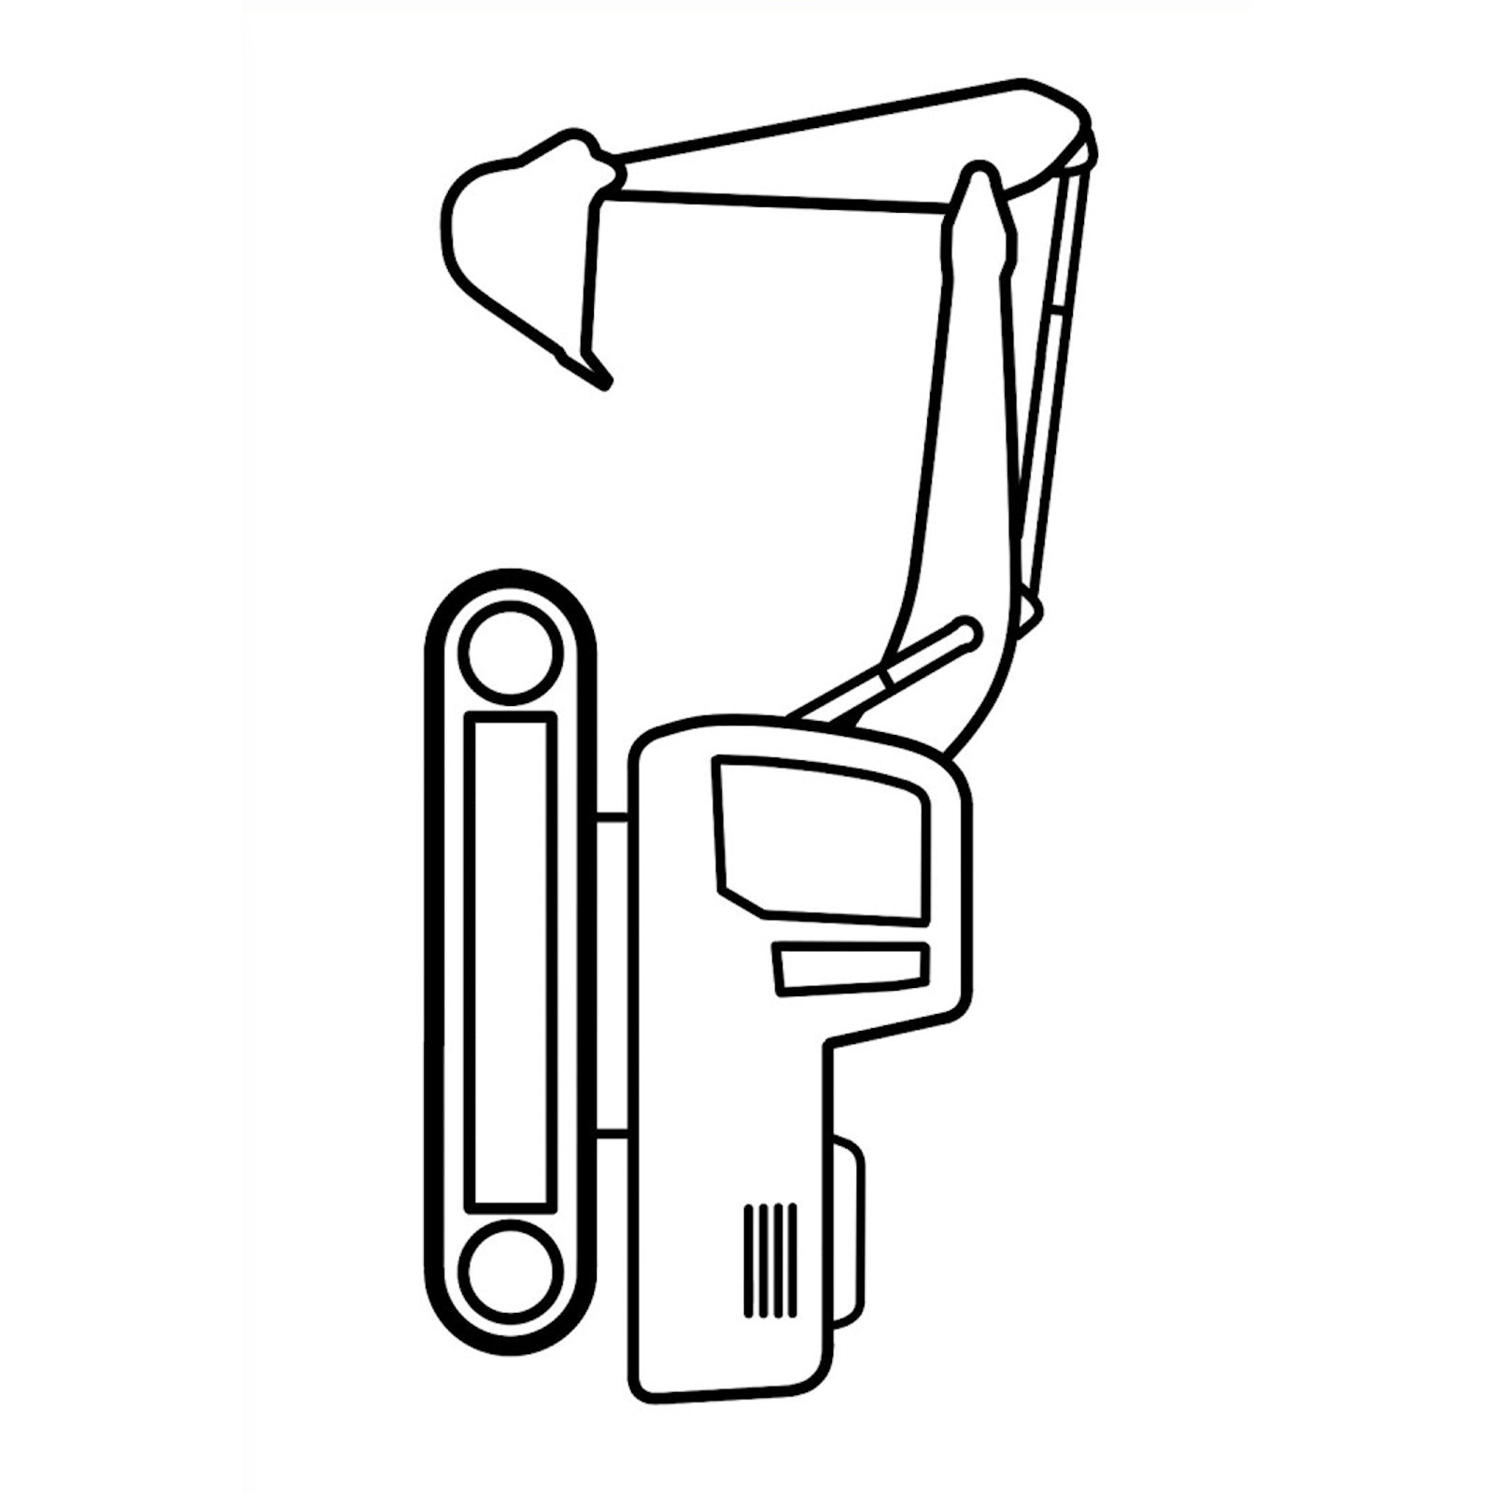
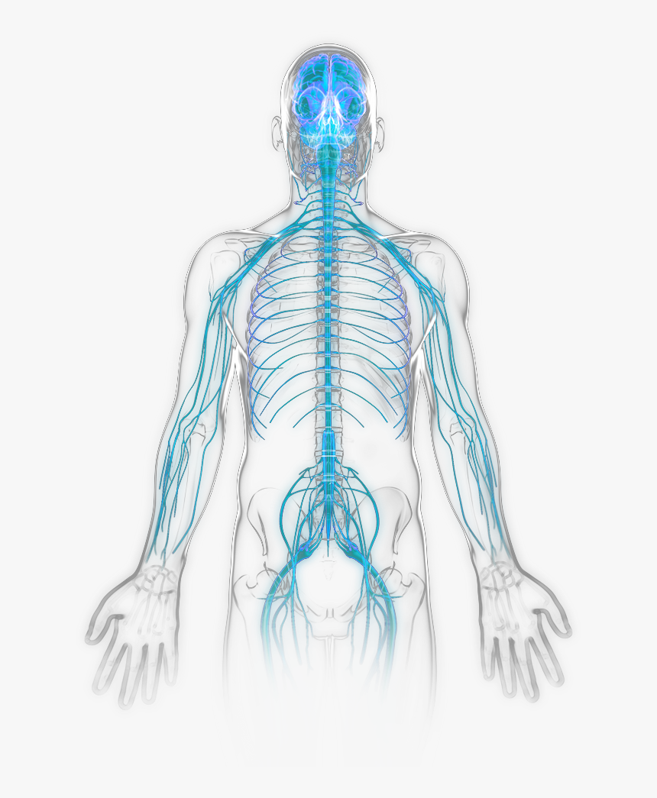
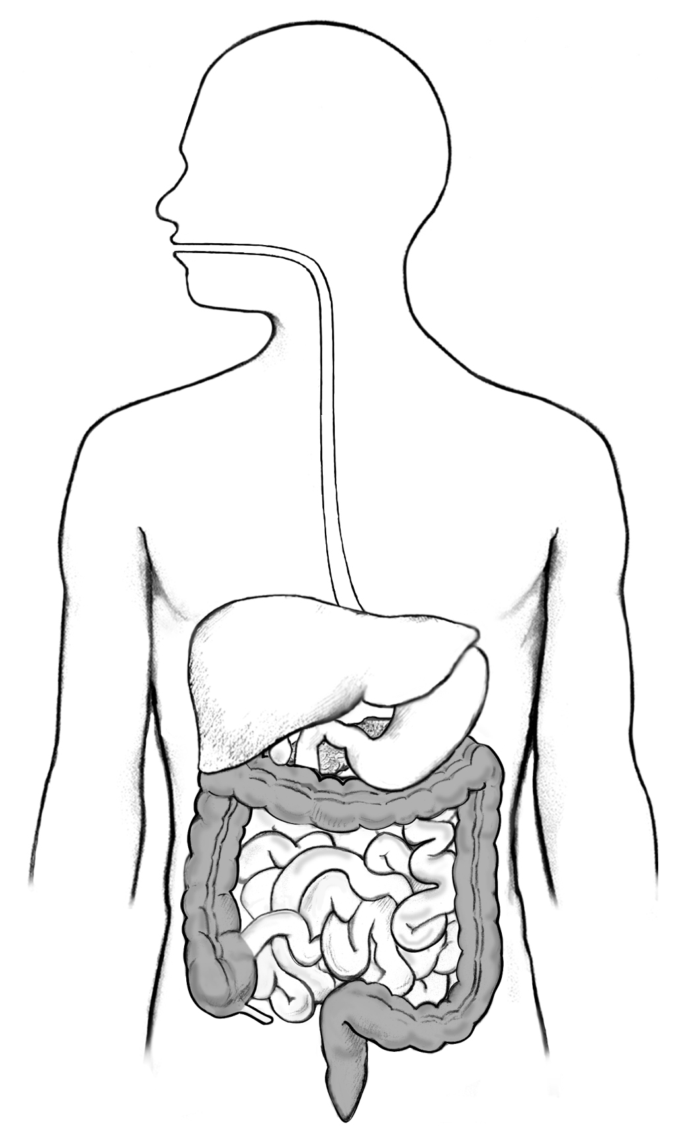
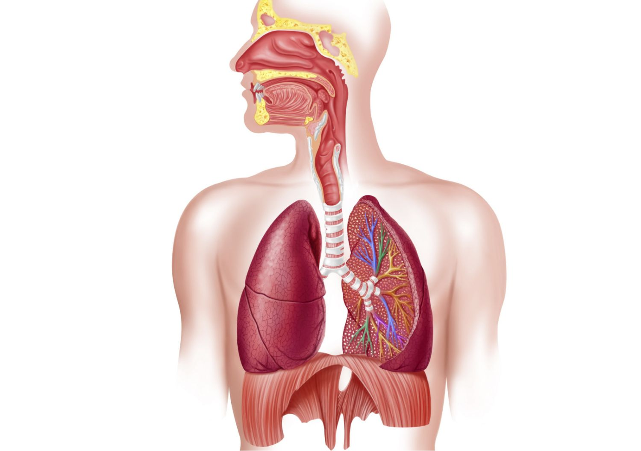
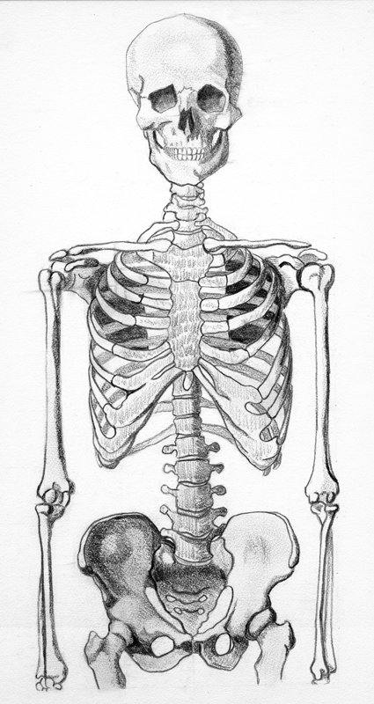
Body Systems
7.3.3

Slide 2
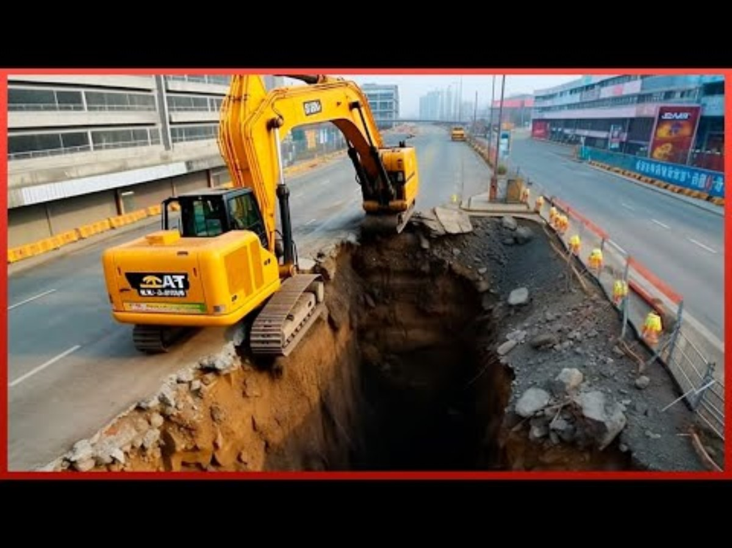
Phenomenon
https://youtu.be/jJK7pjiJE8c

Slide 3
Group Activity Checklist
Make sure that you have completed all three tasks so that you can present to another group on your organ system.
Diagram of the organ system
Function of the organ system
Organs in the system

Slide 4
Respiratory System
What is the function of the system?
Exchange of gases - brings oxygen into the body, takes CO₂ out of the body
What are some of the main organs?
Nose, lungs, trachea

Slide 5
Skeletal System
What is the function of the system?
What are some of the main organs?

Slide 6
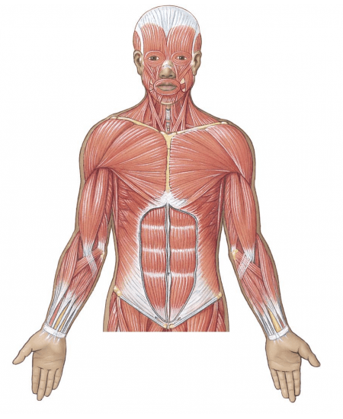
Muscular System
What is the function of the system?
What are some of the main organs?

Slide 7
Nervous System
What is the function of the system?
What are some of the main organs?

Slide 8
Digestive System
What is the function of the system?
What are some of the main organs?

Slide 9
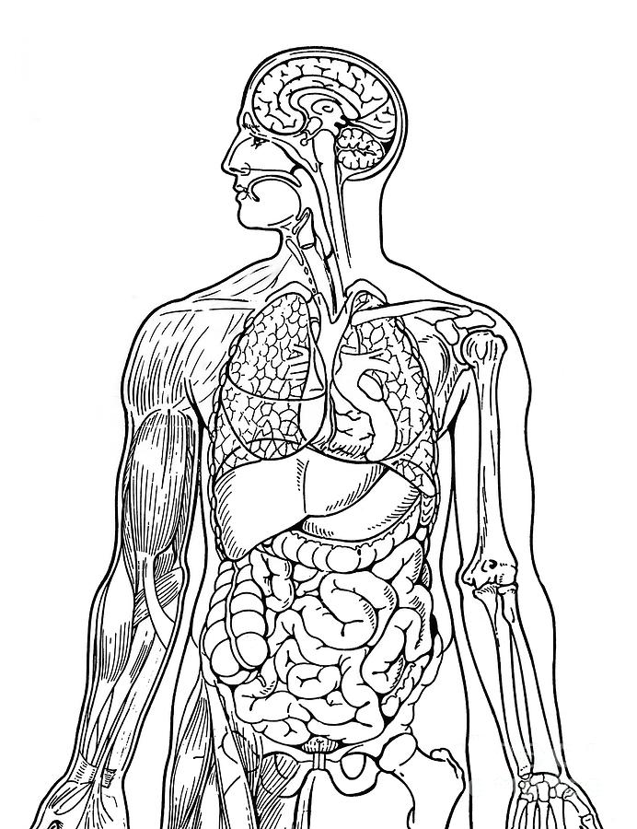
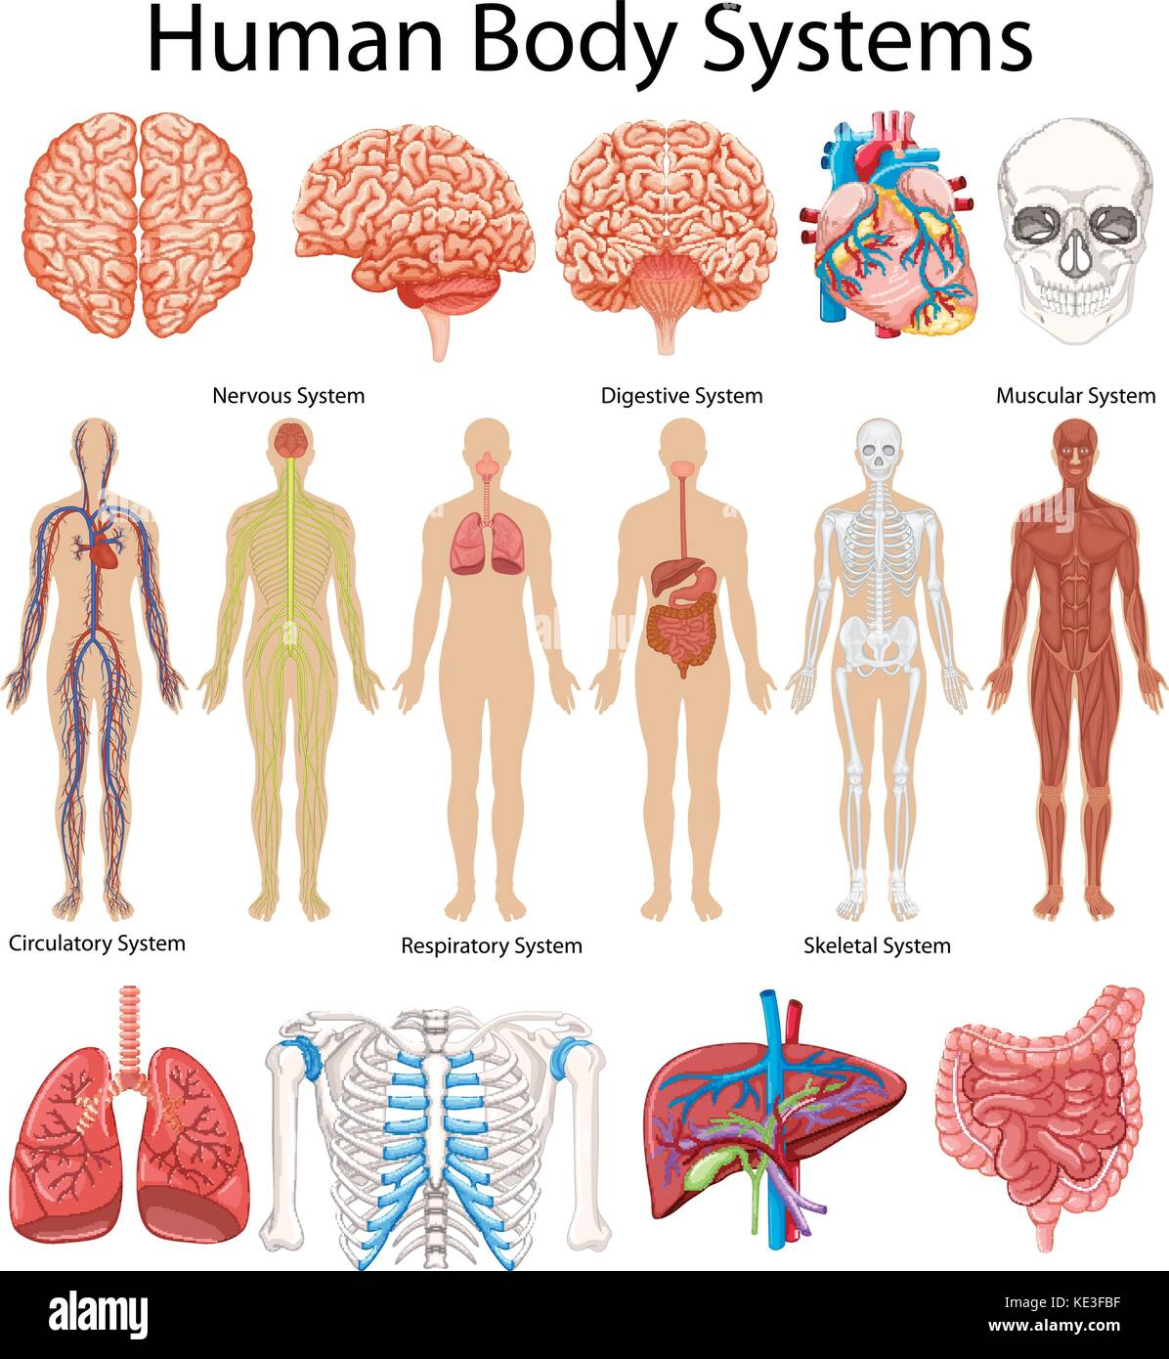

Slide 10
Skeletal

Slide 11
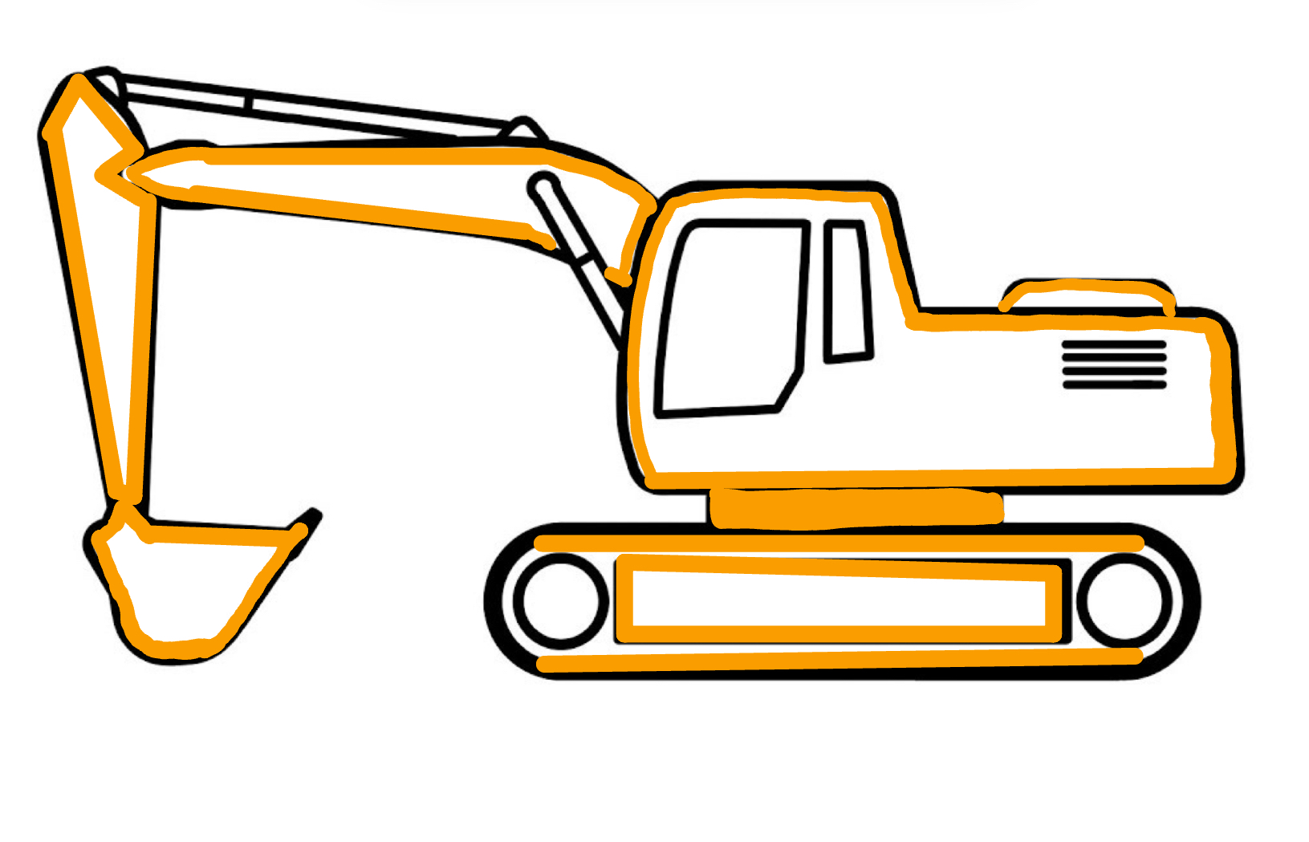

Slide 12
Frame

Slide 13
Muscular

Slide 14
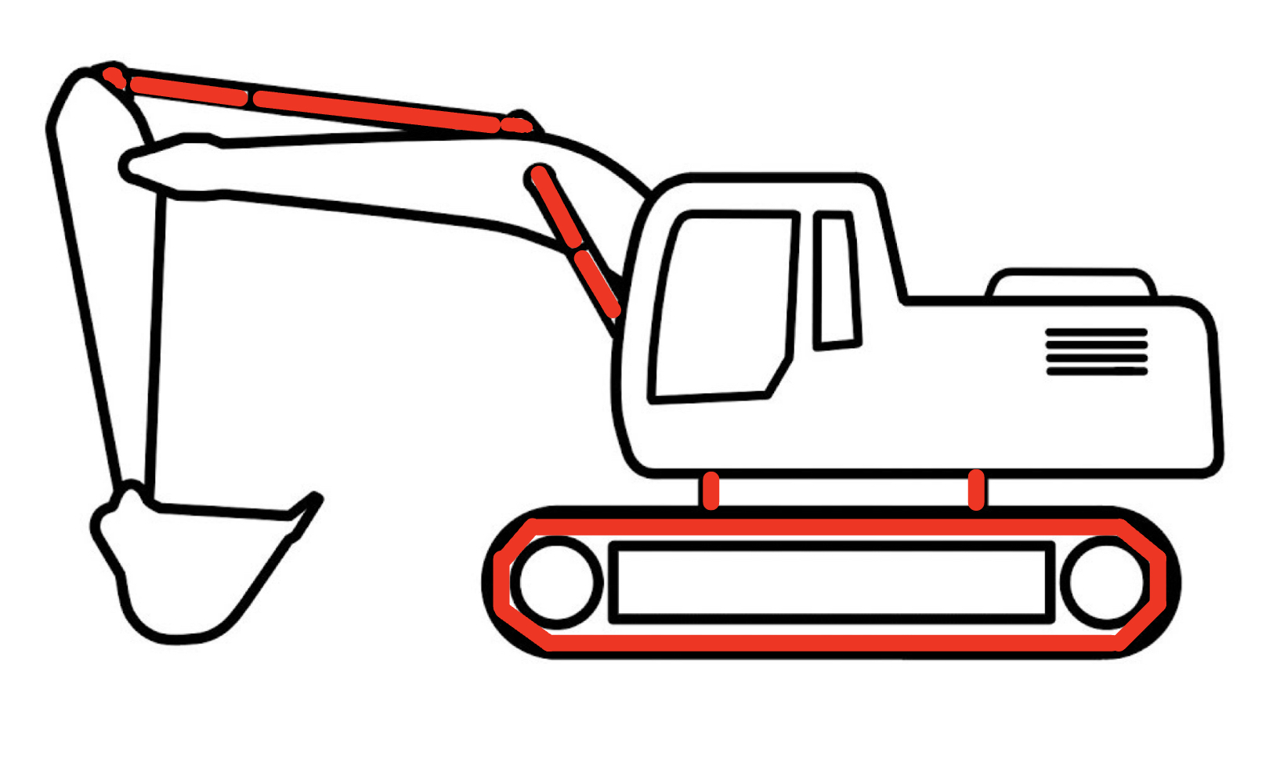

Slide 15
Rams

Slide 16
Nervous

Slide 17
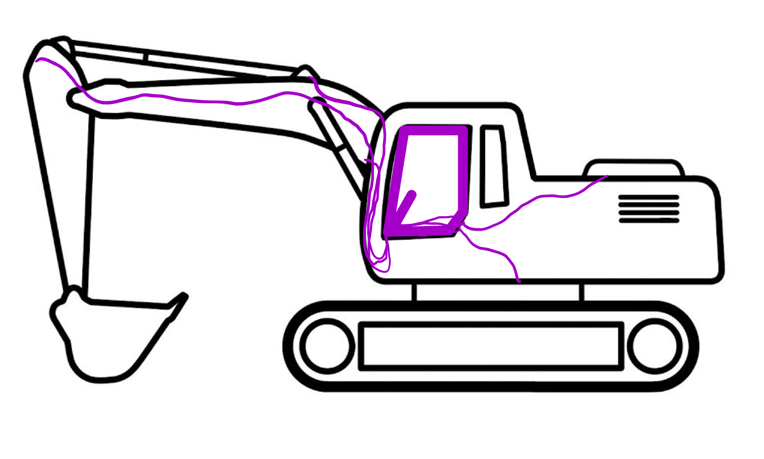
Controls

Slide 18
Controls

Slide 19
Digestive

Slide 20
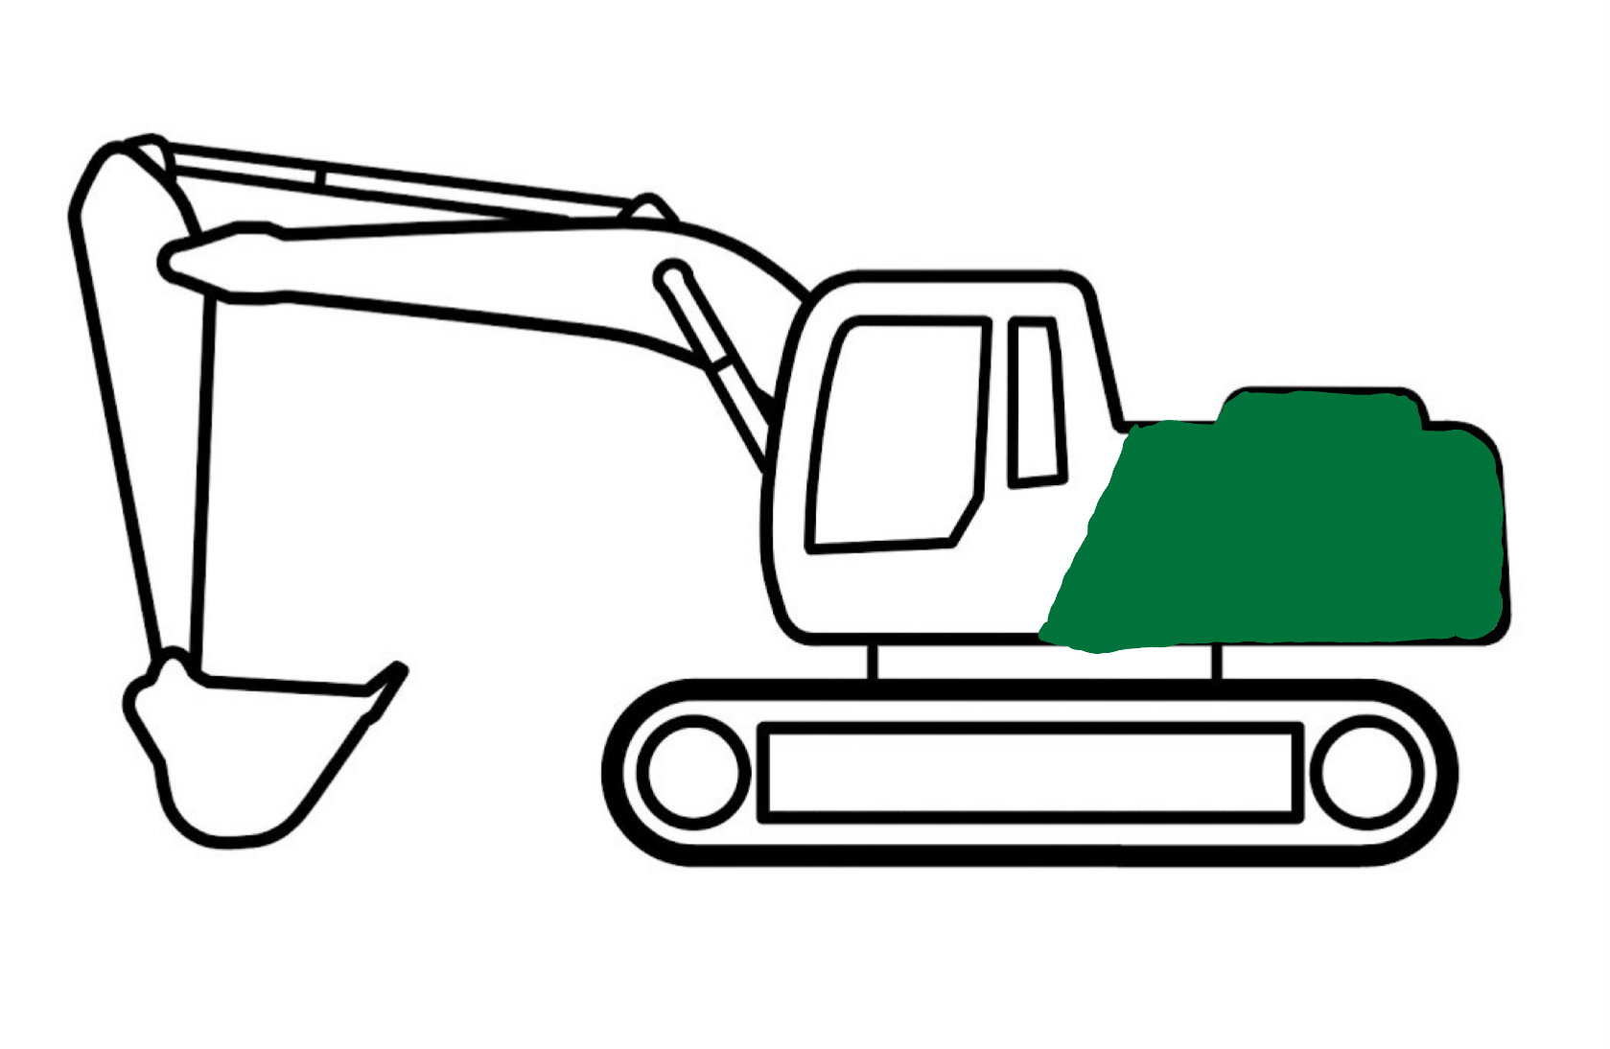




Slide 21





Engine

Slide 22
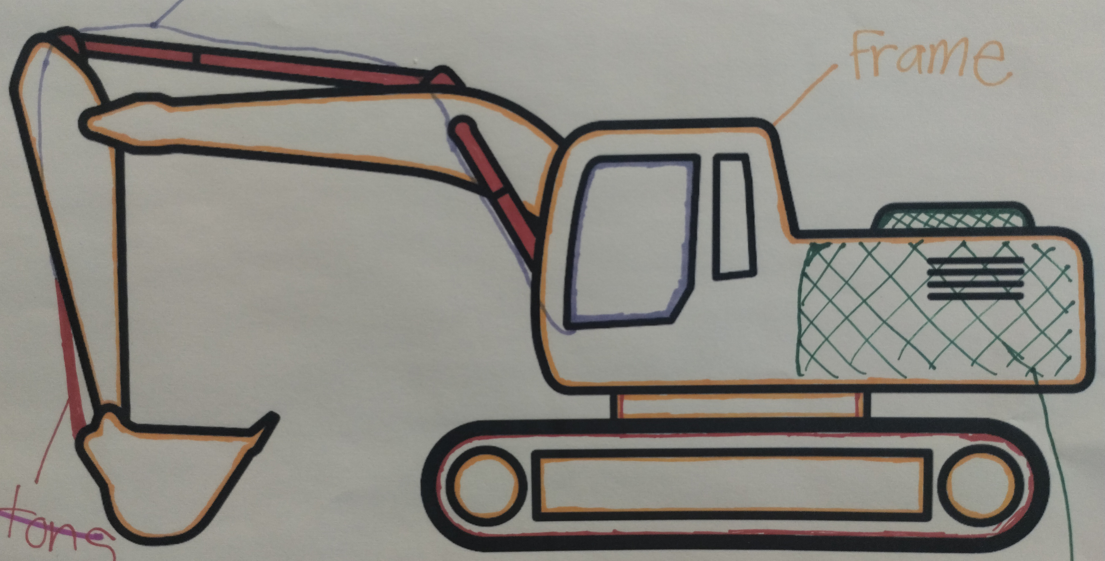



Controls & wires
Frame
Rams
Engine

Slide 23
Worksheet Questions
Explain the two assessment questions with comparing the excavator arm and a human arm.
Why isn't it working?

Slide 24
Assessment Questions
How do the four parts of the excavator work together to make it function?
How do the four organ systems work together to make the human body function?

Slide 25

3D-RST is supported by the NSF under grant number #DRL-2101383

