Slide 1

Species Showdown: Designing Innovative Solutions for Invasive Species Management
SEEd Standard 6.4.5
NGSS Correlation: MS-LS2-5

Slide 2

Today you will....
Evaluate competing design solutions for preserving ecosystem services that protect resources and biodiversity based on how well the solutions maintain stability within the ecosystem.

Slide 3


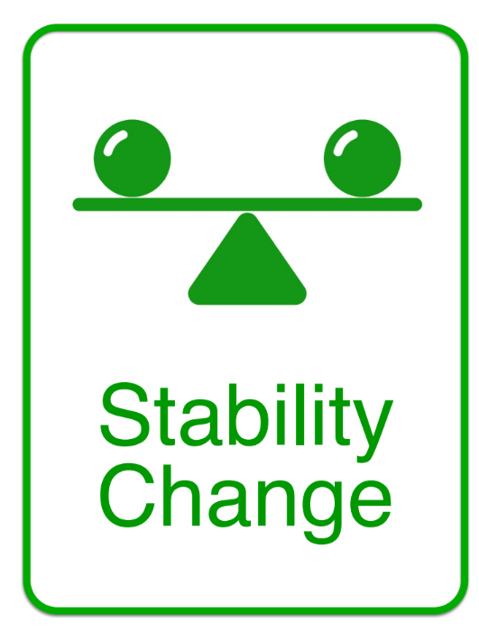
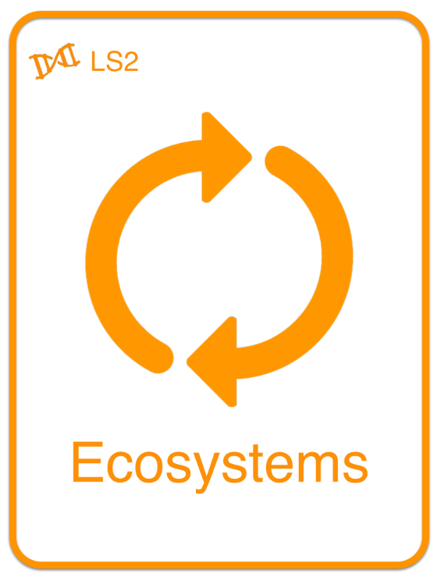
SEP
Science and Engineering Practice
CCC
Cross Cutting Concept
DCI
Disciplinary Core Idea
Notes:
Stability versus instability in the ecosystem. Are some of the solutions students will read about causing instability to the ecosystem, or don’t cause instability, so nothing is done with the invasive species?

Slide 4
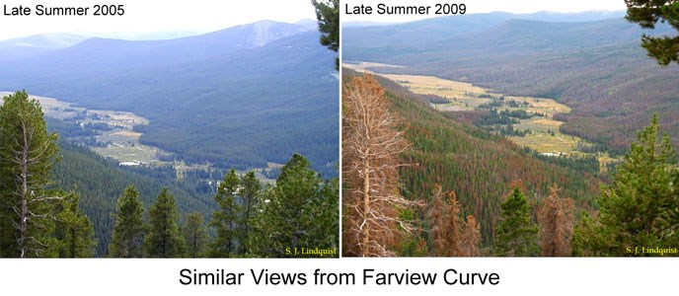
Phenomenon
Image by John Arroyo
August 8, 2019
Notes:
Driving question: Over the last 4 years, what happened to the stability of the ecosystem as an invasive species was introduced?
Make observations, ask questions.
Is there a solution that was designed to manage the mountain pine beetle? If so, what do you think it is?
The bark beetle primarily attacks coniferous trees, such as pine trees, that have been weakened by years of drought. One of the first signs of infestation is the fading or browning of the tree’s foliage. Upon closer inspection, you can actually see pitch tubes caused by boring in the bark by this pest.
The pictures above show the destruction the bark beetle caused in a 10-year span.

Slide 5
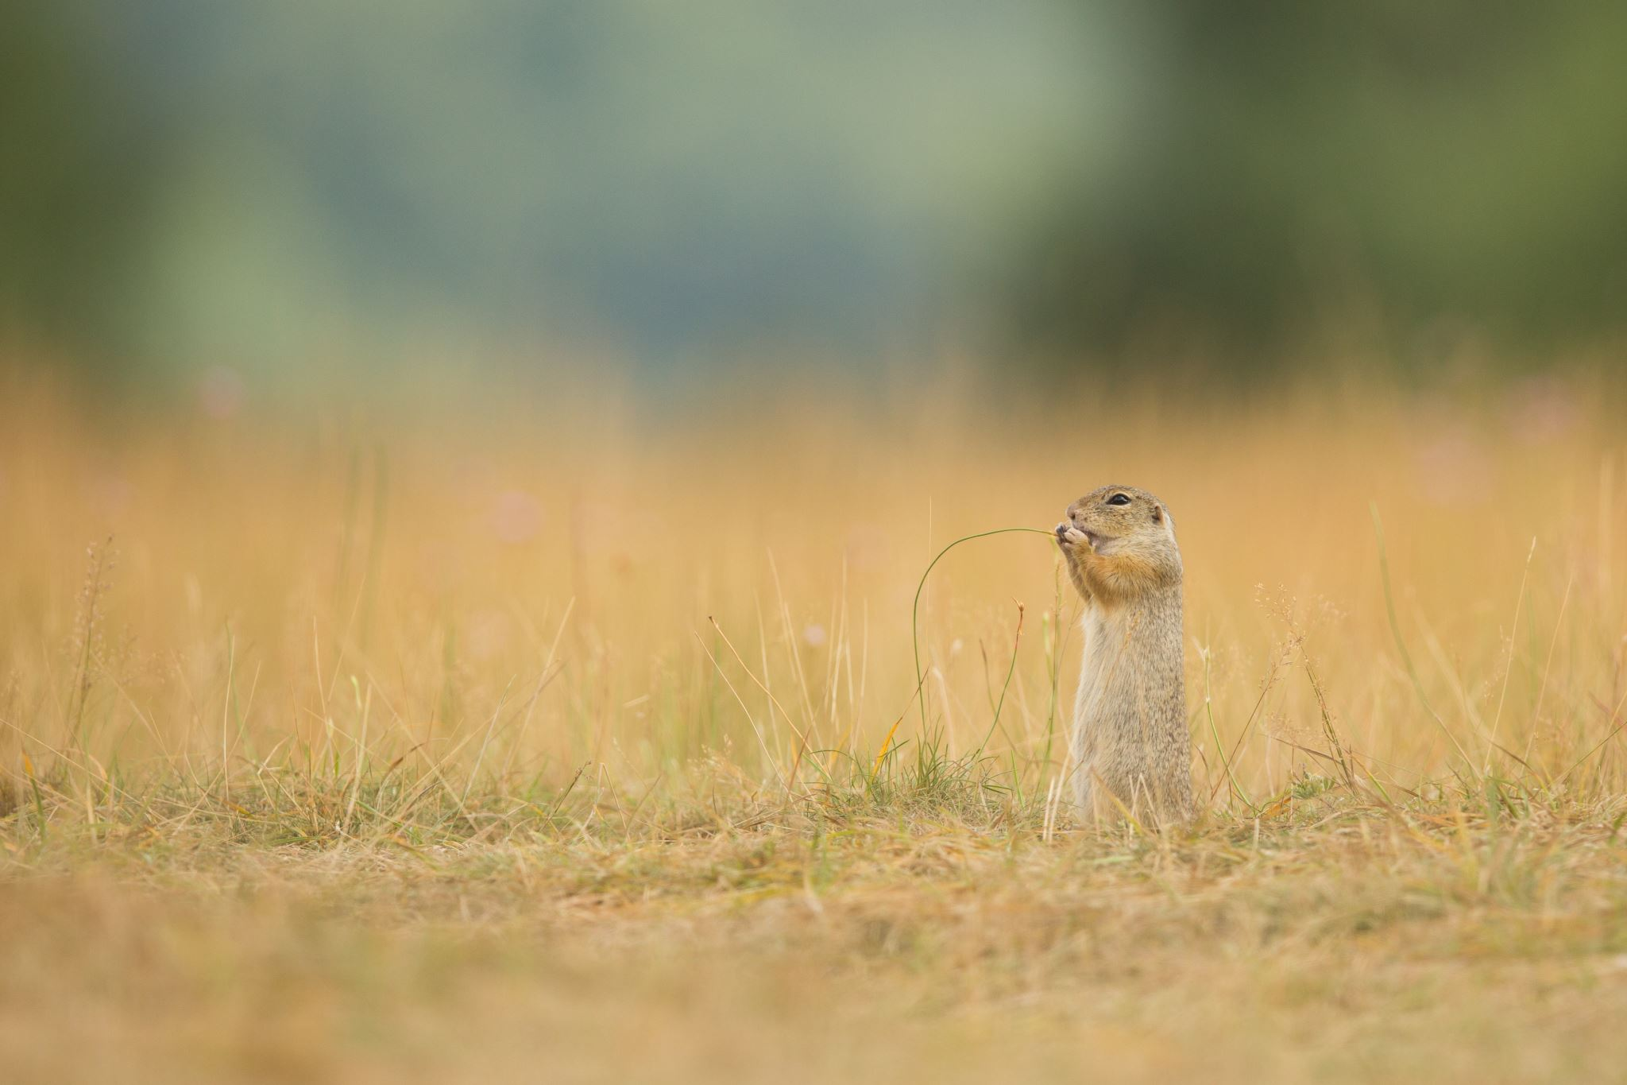
Invasive Species article
What is the invasive species?
How does the invasive species cause instability or change?
What solutions are presented?
Share out and Jot Notes in table on worksheet.

Slide 6
Phenomenon
Image by John Arroyo
August 8, 2019
Notes:
Review Phenomenon:

Slide 7
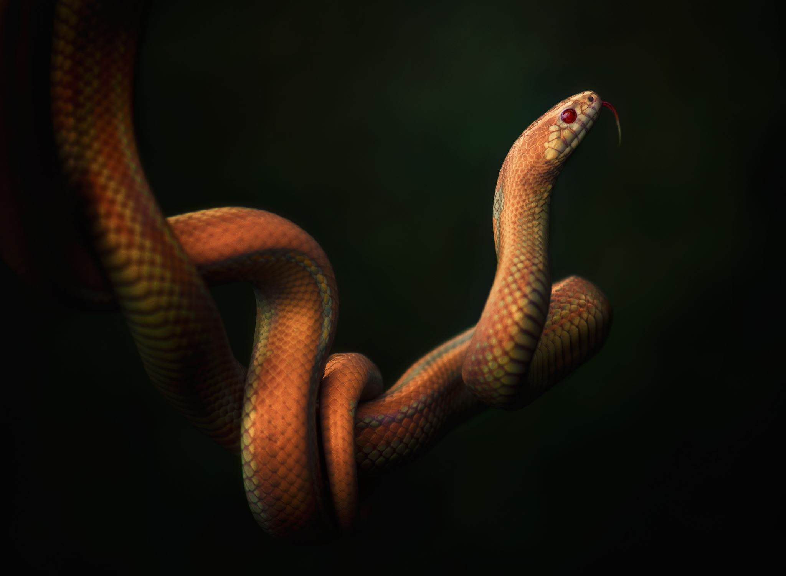
New (make-believe) Utah Invasive Species
Shimmering Thorn Viper
Video: Shimmering Thorn Viper
Define the problem.
Design two solutions.
Notes:
https://ai.invideo.io/watch/jTNYLLH82S6

Slide 8
New (make-believe) Utah Invasive Species
Evaluate competing design solutions for preserving ecosystem services that protect resources and biodiversity based on how well the solutions maintain stability within the ecosystem.
Will use Rubric to evaluate 3 other groups design.
Remember to have your solution show stability within the ecosystem.

Slide 9
I can successfully
Evaluate competing design solutions for preserving ecosystem services that protect resources and biodiversity based on how well the solutions maintain stability within the ecosystem.

Slide 10

3D-RST is supported by the NSF under grant number #DRL-2101383
2025 by Westen Miller, Kaylei Jones, and Jan Hermansen

