Slide 1
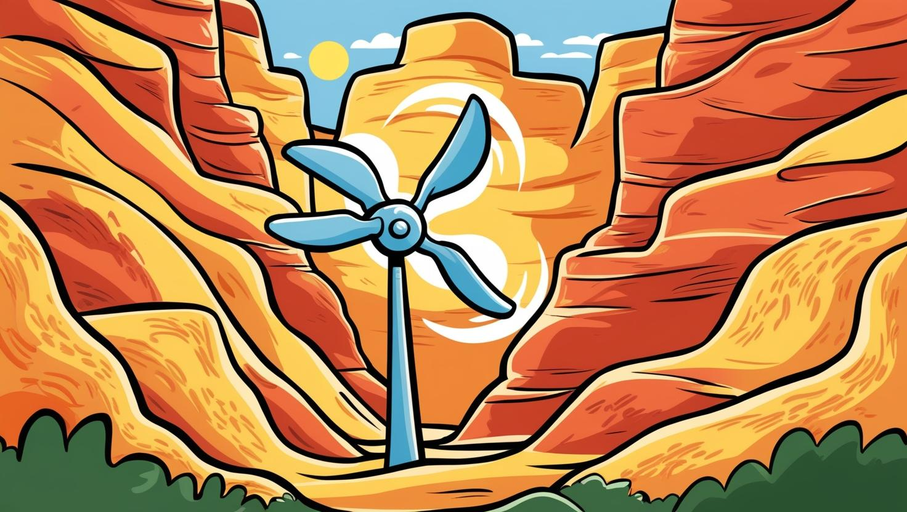
Wind Energy
Harnessing the Power of the Wind
8.4.3

Slide 2



DCI | SEP | CCC

Slide 3
Standard 8.4.3
Design a solution to monitor or mitigate the potential effects of using natural resources.
Evaluate competing design solutions using a systematic process to determine how well each solution meets the criteria and constraints of the problem.
Learning Objective:
Students will be able to design and construct a wind turbine that converts wind energy into electricity, powering a light bulb.
Students will use the defined criteria and constraints while designing their wind turbine.
Students will use the Engineering Design Process to determine which structure functions the best.

Slide 4
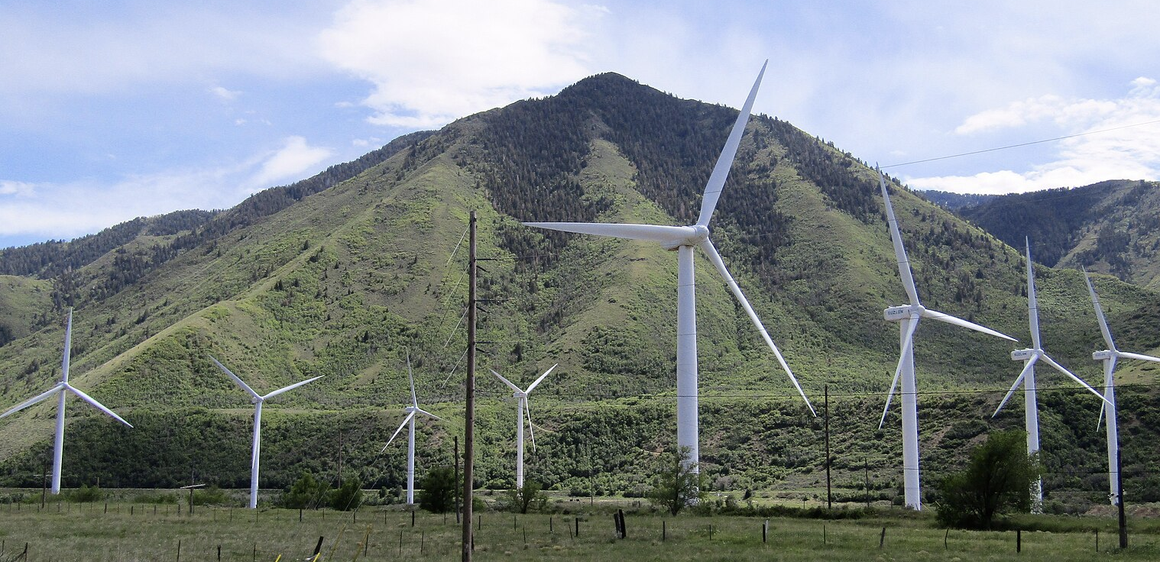
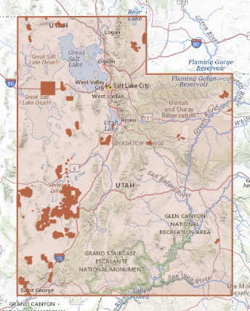
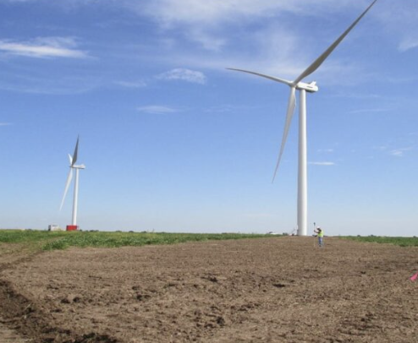
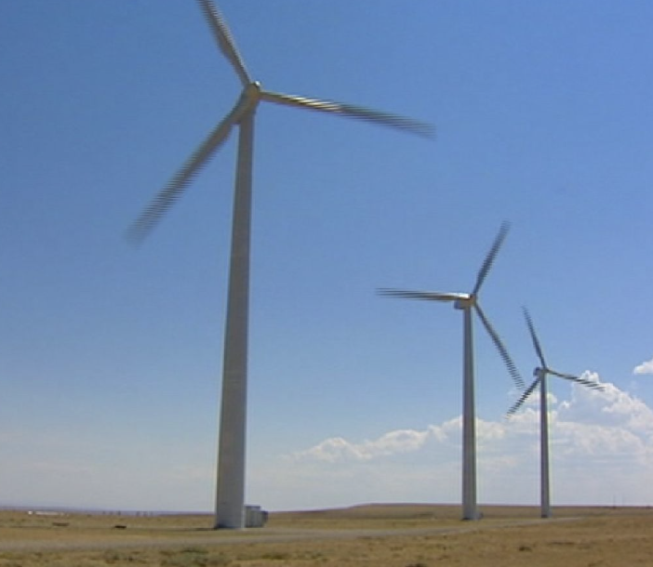
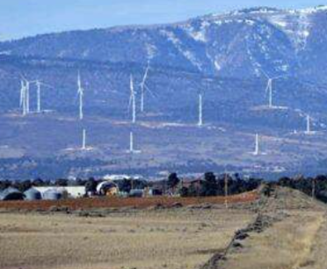
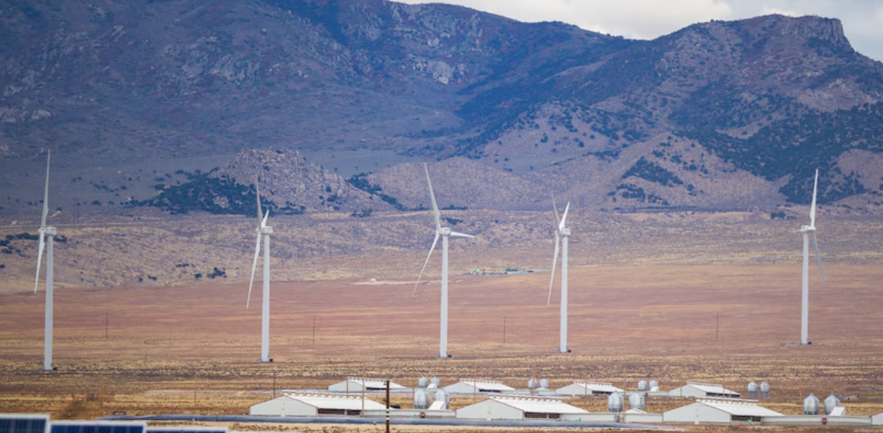
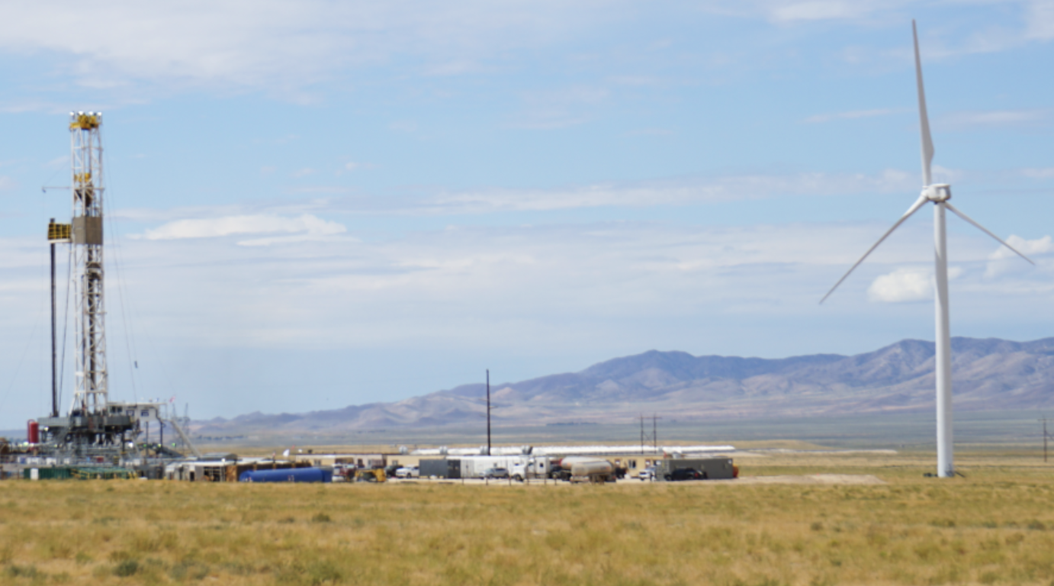
Turn to your neighbor and talk about whether you’ve seen a wind farm in Utah. Where was it?
Spanish Fork Canyon Wind Farm
Uintah Wind Farm
Tooele Army Depot Wind Farm
Monticello Wind Farm
Milford Wind Farm
Fervo Wind Farm

Slide 5
Pros and Cons of Wind Energy
PRO’s
$700,000 revenue per year
Renewable & clean source of energy
Low operating cost
Efficient use of land space
Wind energy is a job creator
Technology is making them more efficient
If it is built on the farmland, they pay the owner
Reduces dependence on the use of fossil fuels
Con’s
2-4 million dollars
Intermittent
Noise and visual pollution
Some adverse environmental impact
Wind power is remote
Birds

Slide 6
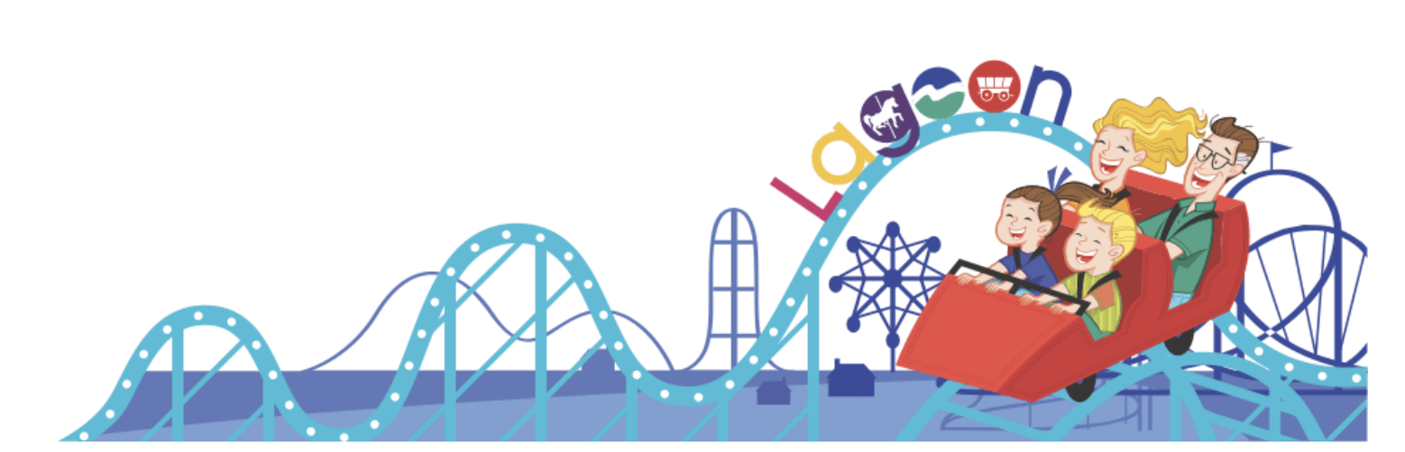
https://www.mylocalutah.com/historical-business/lagoon-americas-largest-family-owned-amusement-park/
Phenomenon
A “prototype” is a physical model of a machine that can be adjusted and changed to meet needs.
The average turbine would generate over 10.1 billion kilowatt-hours (kWh) per year. Theme parks consume roughly 27.4 billion kWh of electricity per year. If your turbine can generate 2V, it would be equivalent to the kWh generated by one wind turbine.
The theme park Lagoon has seen an increase in energy costs and wants to find a way to save money by using green energy, so they don’t need to raise ticket prices.
Your Engineering Firm has assigned your team to design and create a prototype using wind to generate electricity for the corporation.

Slide 7

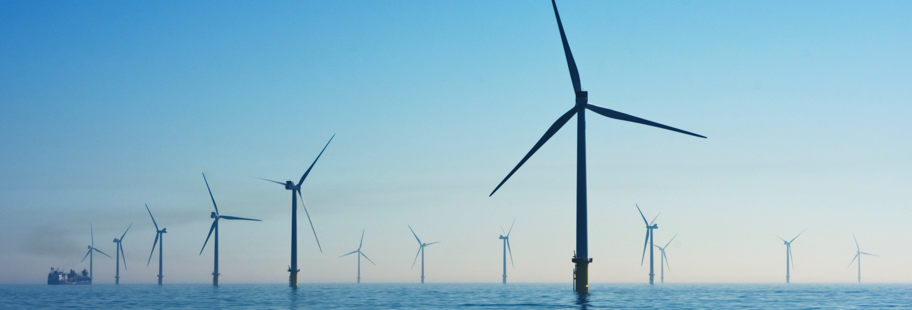
In this lab, the hobby motor is used in reverse, producing electricity by being moved rather than moving by consuming electricity. The blades capture the wind and move the motor, so it works like a generator. The lit LED shows that current is flowing.

Slide 8
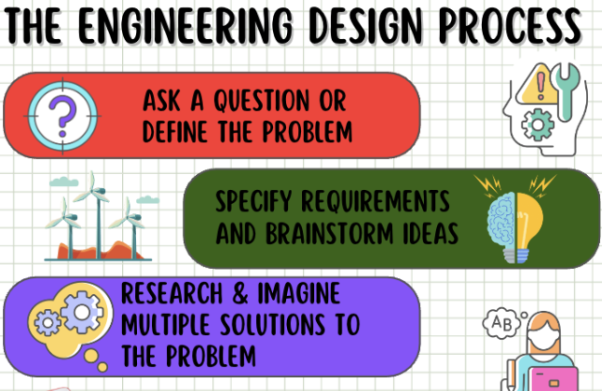
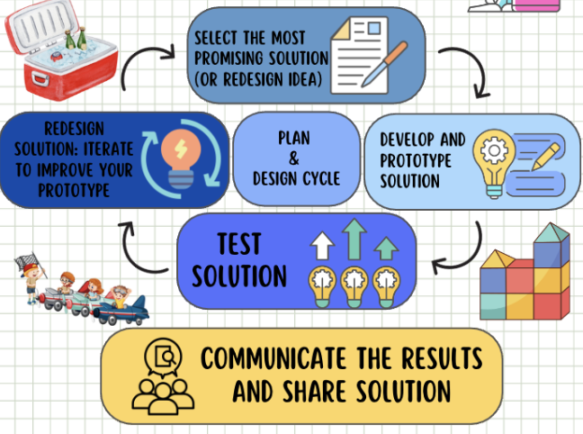

Slide 9
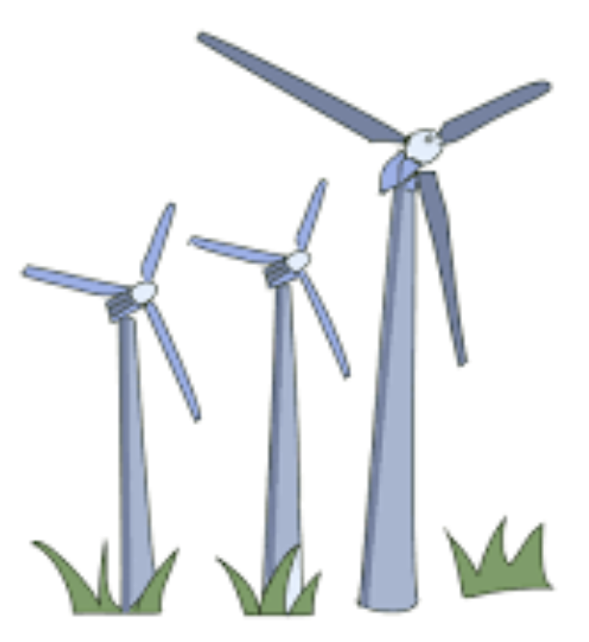
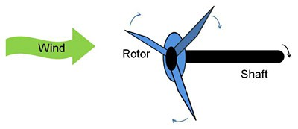
Criteria: Create a windmill that can generate at least 2.0 volts of electricity on a voltmeter using only the materials provided by your teacher. **Test your Motor to make sure it works**
Constraints: Use the supplies sparingly
Cardstock/Paper (max 3)
Small popsicle sticks (max 4)
Propellers
Large plastic cups (max 1)
Small paper cups (max 1)
List of supplies your group chose:
Testing: Place your windmill in front of the fan.
Tape (Just what you need)
Hot glue gun and/or Glue sticks (max 1 glue stick)
Multimeter
Extension: 3d print fans (max 1)

Slide 10
Procedure:
Create your first fan blade following the directions on the template. (Reinforce the blades with craft sticks, if needed.)
Drill a hole in your fan blade that fits the shaft of your motor.
Attach the motor to the blade.
Attach the motor to the plastic cup.
Attach the light bulb to the motor wires. (The motor is working in reverse, so make sure your wires are connected in reverse – red to black rather than red to red)
Place your turbine in front of the fan to see if the bulb lights up. If it doesn’t light up, check to make sure your wires are correct. Try a different fan blade design.

Slide 11


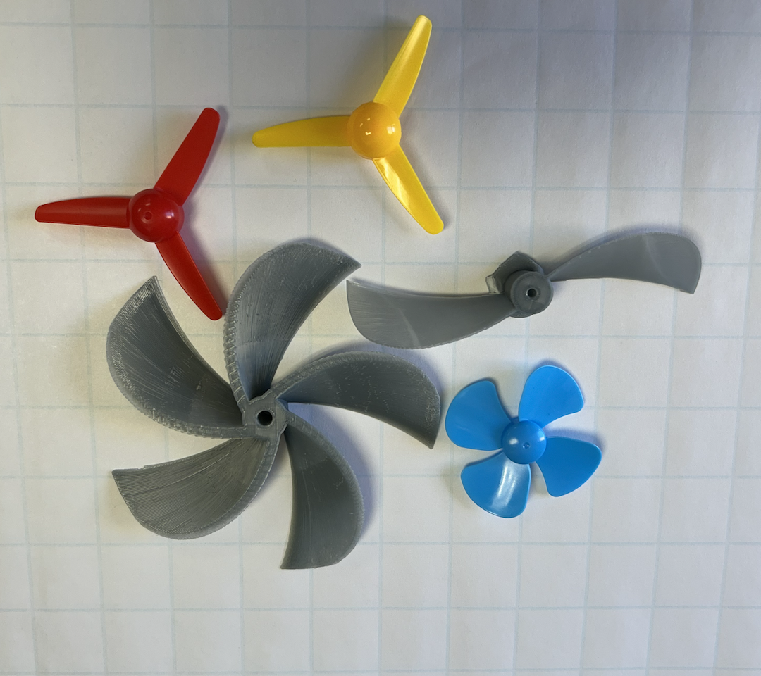
Possible Windmill Designs
(You can also invent your own)
Paper cup blades
Pinwheel blades
“8” Blades
“3” Blades
Bent Triangle Blades
Bent Rectangle Blades
3D “2” Blade
3D “5” Blade
Red or Yellow Plastic Blade
Blue Plastic Blade

Slide 12
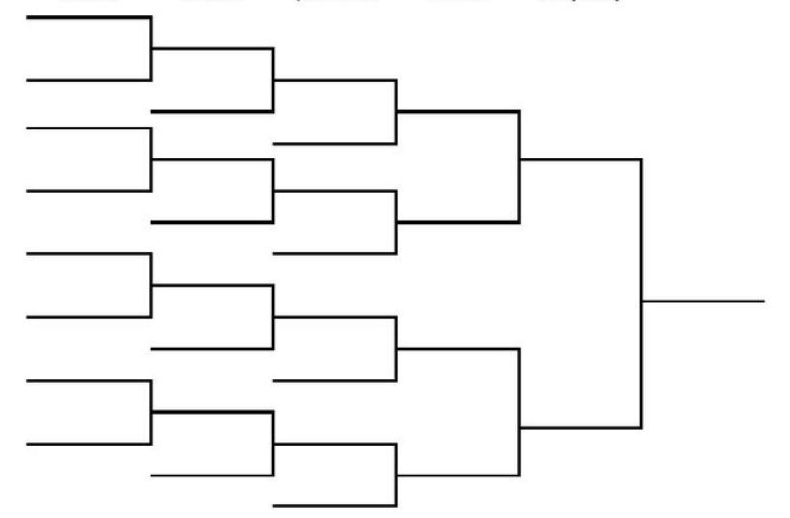
If your light doesn’t turn on, optimize your design so that you can get the most voltage on your voltmeter. Which group can win?

Slide 13
Test #1 | Observations | Picture of your structure | Voltage on the Multimeter
Analysis: Answer the following questions.
How well did your windmill function?
What changes do you need to make to the structure of the windmill to optimize it or fix issues during testing?
Redesign: Redesign your windmill by making changes to improve or meet the criteria. Then retest your design and record the results in the table below.
Test #2 | Observations | Picture of your structure | Voltage on the Multimeter

Slide 14
Analysis: Answer the following questions.
3. What part of the structure of the windmill did you change? How well did your new windmill function?
4. What changes do you need to make to the structure of the windmill to optimize it or fix issues during testing?
Redesign: Redesign your windmill by making changes to improve or meet the criteria. Then retest your design and record the results in the table below.
Test #3 | Observations | Picture of your structure | Voltage on the Multimeter
5. Did your redesign meet the criteria? Why or why not? Describe your observations.
6. What changes do you need to make to the windmill to make it more efficient or fix issues during testing? Use the space below to show any redesigns.

Slide 15
Interpretation or Conclusion: Answer the following questions about your project.
Did your prototype meet the criteria? Why or why not?
Did your group succeed in creating wind power?
How did the redesign changes help your project?
Did your group work together successfully? What is your evidence?
What other changes in the design could you make in the project?
What did you learn in the process of designing and testing your project?
Which design should Lagoon use?

Slide 16
Remediation Activities

Slide 17

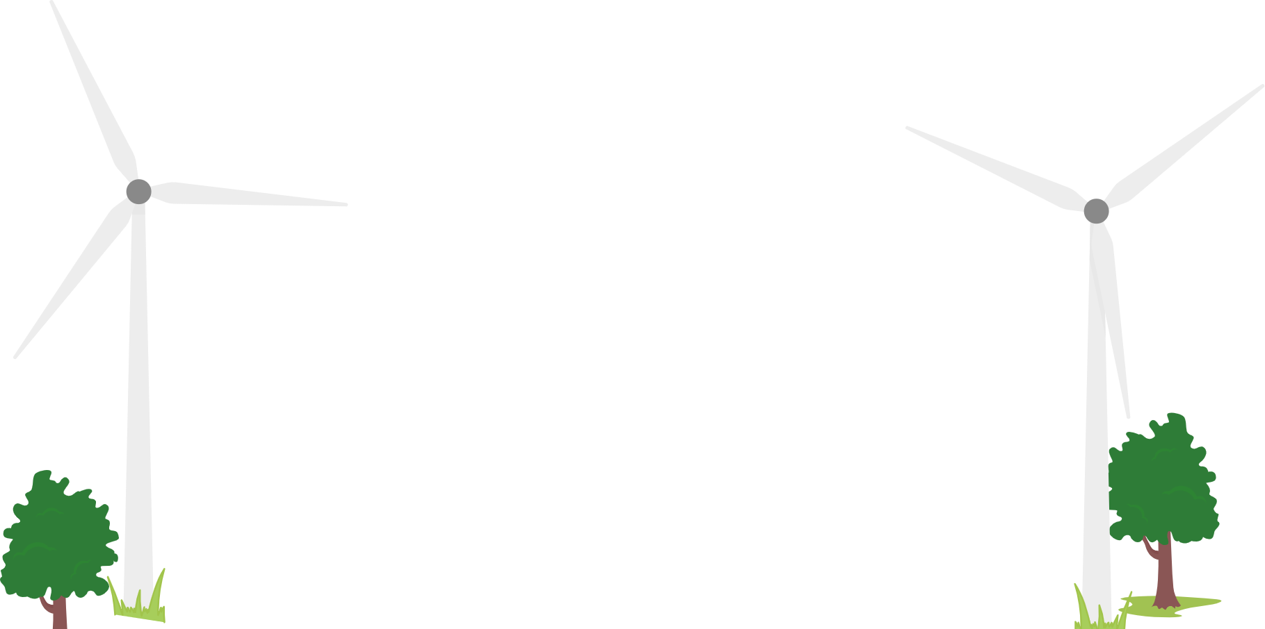
Vocabulary:
Criteria: The requirements or standards that a solution must meet
Constraint: The limitations that restrict possible solutions (supply list)
Competing Designs: A design process where multiple designers work independently to create a product

Slide 18
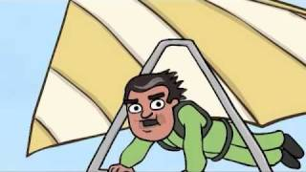
How does wind power produce electricity?
As the wind blows over wind turbine blades, it causes the blades to lift and rotate. The rotating blades turn a shaft that is connected to a generator. The generator creates electricity as it turns.
Complete the questions on the next slide

Slide 19
1. How do wind turbines convert wind energy into electrical energy?
A) Through solar panels absorbing sunlight
B) By burning fossil fuels
C) Through blades turning a drive shaft that powers a
generator
D) By collecting heat from the ground
4. As of 2010, what percentage of total U.S. electricity was generated by wind power?
A) 10%
B) 5%
C) 2%
D) 15%
2. What causes the wind turbine blades to move?
A) Motor-powered rotation
B) Lift created when air moves over the blades, similar to
airplane wings
C) Magnetic forces pulling the blades
D) Heat from the sun directly pushing the blades
5. Where can wind farms be built to capture wind energy?
A) Only on land
B) Only offshore
C) Both on land and water
D) Only in deserts
3. What is the main function of multiple wind turbines connected together?
A) To look more attractive
B) To reduce noise pollution
C) To generate electricity on a large scale
D) To slow down strong winds

Slide 20
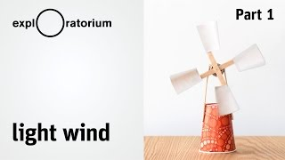
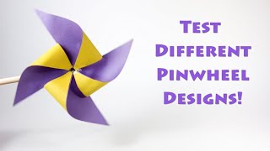
Remediation: Tutorial Videos for students who are confused.

Slide 21

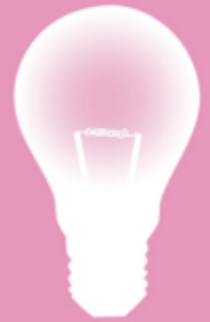
Designing Solutions
4 | The student proposes a design plan and evaluates the sustainability of the design to address the criteria, constraints, AND intent of the problem. The student: Uses all appropriate steps of the engineering design cycle, AND Meets all criteria within the defined constraints, AND Uses a combination of scientific concepts, data, and trial and error, AND Communicated the process followed to optimize the design.
3 | Proposes a design plan with detailed explanation that completely addresses the criteria, constraints, and intent of the problem. The student: Uses all steps of the engineering design cycle, AND Meets all criteria within the defined constraints, AND Uses a combination of scientific concepts, data, and trial and error.
2 | Proposes a design plan and provides a general description that addresses the criteria, constraints, or intent of the problem. The student: Uses some of the steps of the engineering design cycle, AND Meets all criteria within the defined constraints, AND Uses a combination of scientific concepts, data, and trial and error.
1 | Proposes a design plan and description that misses one or more important aspects of the criteria, constraints, OR intent of the problem. The student uses some of the steps of the engineering design cycle, BUT the design does not meet any of the criteria.

Slide 22
Supply Links:
Hobby Motors and Fan Blades: https://www.amazon.com/Sntieecr-Electric-Propeller-Experiment-Engineering/dp/B086WCVB12/ref=asc_df_B086WCVB12/?tag=hyprod-20&linkCode=df0&hvadid=693601911085&hvpos=&hvnetw=g&hvrand=5184682701385918470&hvpone=&hvptwo=&hvqmt=&hvdev=c&hvdvcmdl=&hvlocint=&hvlocphy=1026990&hvtargid=pla-909305656203&mcid=bb79b94f5c1939429339b2797dd54c1d&gad_source=1&th=1
Craft Sticks:
https://www.amazon.com/Sticks-Natural-Popsicle-Length-Crafts/dp/B07F367TCK/ref=sr_1_6?crid=2UEY67KPD51ZR&dib=eyJ2IjoiMSJ9.qwpP1PKXNu5yTgtrOeb6tNbGjsK3h7CGSTHkbPJT8Uwh6abZgrED54-kCbe67ILkDGRuC1NhA81dg-X3OXXzMaJcJxtFkg8vIQ3LGl-d0Leb9R7hnnP4qAvi6aWWb801RHnd3AowpzgPZ9rsjC7_iI-tihScOv9Qhl00_Ai-SN9mPzYrO8S1JFZRlQ-4jx18K3tNdifE5pEA061-arlvZiJZ3YqWvBeJYN_84OxWDFjGmts_d_UG69t9jjrNoXMrLjWHCTlGxVgL0gDPrRONAusZW1GYRWDtQwtQBllV9-N0PXBWmXwLM6EareTJSpC0wb8z2Nrx2tKaPjEamRW2gjZZ8Ozz5R-SdW0BkNFPRNiuAqwirfIybf4aFcGabpnHcJpJt1lVBzCNB_TheA2Hr_mDo5PjlrAKOqrM3LVwfQgbqYETKzFBIGWdwgIL9Fwr.gbnzwf-JJ1LOhk803fTyJ1VDmaS6PEv9MyGbm4r8qeI&dib_tag=se&keywords=craft+sticks&qid=1734626191&sprefix=craft+sticks%2Caps%2C159&sr=8-6
Hot Glue Sticks:
https://www.amazon.com/AdTech-Glue-Sticks-Full-Clear/dp/B000PCY91O/ref=sr_1_5?crid=C1R4988FBTH5&dib=eyJ2IjoiMSJ9.qBP5orq4dZhYrhqOfSE0mksU-p4IKLMNzG1LvjKlrrX_Lbp59tXNby25MssoY4Ppzp1tjTSLuD0MkINgdlF2RayJXty59psCpJ7e7bBuK_d1_vQkGWZStELGM8NalE82PxjBZYoH7FpHVmW7DNk444KVHRry9Ka7GZEPgjBqZfhsTCrvkLsdtvBWlrZey9XwNQiJGz7bbVmAyJjOx6zxGGAezbwREX01T_9TAXXB1_4aJWGVSocLLVeRy67wX344L6zluMJ8L-EVz5qfS9iMDZlIVm4rcrcMUlSH9MMKFDFhs7bsUUU8MB7fydTPA_t8TDqd8n8il_uJTtDmf0kv-v-IOtTBYe6XEHmzFhcXh9tpANrxlVSXGTlc65QOBFI9EGl9bq11JwdkZFLFtbvIGfRMlUyAqMwjhoEKbSTSjqP4j0tXX5yMWhZZgWO5XST0.bJjJbh-VVUGeII0_kQx7oc-ju1j3k-CXG8Q_EX_7GMU&dib_tag=se&keywords=hot%2Bglue%2Bsticks&qid=1734626227&sprefix=hot%2Bglue%2Bsticks%2Caps%2C160&sr=8-5&th=1
Plastic Cups: https://www.amazon.com/Amazon-Basics-Disposable-Plastic-Party/dp/B0D6SMHQKN/ref=sr_1_8?crid=1DYLXT6ZLYLOL&dib=eyJ2IjoiMSJ9.o-xvanuxu-ZzR8HpNnvgK5x7ukfT5wArOXK_43e1Rlhslprbs4L3IDJ90Q08PloVwC1niE_TlHu_hA8Z5Y40zqrbfsZmU5vbgpMF-p7M03Ug4VUxx-he3xPUSzvIwjUDnh8A8J4QXvqx8_zP8MlEQ8u9Y48DHgA8eZPr6ZuT6TWfHQo1TOVuKNN2gTG4Dr83_XtXbpzpY3I5sz9NxXtXYbRXFhSML5_pUJwGKjYRxaMyNmqjqHlXAKUzqx_nn1HEHhReOc1TSPkdyQbnG9eTLP-sZ0sWqHsvneHESMhB5znk5DEMf9lX9iuWmxmF8zWUspgl6wVm8olv3pggVBUioE0U0Q1waK7v218QRSEFmLZQKhXXxJFjV20sIo_Z37wy_rJKNH7OWTOW_EHX-KJgaJ9ZfdheaGTpnoATqe1jlIn0zsKpYrhGma6tQSkkkAb5.ByVRr6V-dNVBu5oR3MXOnyc9-bH3Hk2K-9b0Ld0mYac&dib_tag=se&keywords=red%2Bsolo%2Bcup&qid=1734626360&sprefix=red%2Bsolo%2Bcup%2Caps%2C186&sr=8-8&th=1
Paper Cups
https://www.amazon.com/BIOZOYG-Disposable-Coffee-Cups-Black/dp/B081D3QSG9/ref=sr_1_1?crid=1C6YLSTRVULZN&dib=eyJ2IjoiMSJ9.FNCqKGc2gP1pRPSronXUSwVNbKuboAunzqAb_USIUBzQS5--M_F9n4juRpONsUyJ3tQPpKJwXsPyfFPqiWye3HWti1KH-NsI-nlzFX52_8ctPYvj6YlxHHD-Bkavkhm7WjcdebbQJo9jlQ_IS1Vc-OnwCjTuryvWS221BCRQndysC5l9oDfTTElIpjGK90NfTWg2DuHwbuA05FNmUyScXLqJBI0o_IGCdQMm9V28gK4ODg_1wHOCb2Z4Tp5ZYVMVzqalFqaLCgCIURuHgqgRVr6K1t-j3FMhst2JtTVx4M-bt8HizTdOH3ShVTR9v83yZOVvcmPXNTNmtJW3SnSXROyvo2inSQAIT68NX4N1LSOk5TzZnzCf9xkf-wu_pT72siwvvBYHQQgjtXnAKpyJQz5PKuMfG2bIV0RuQFuXAX32BXbPD482OuMhqC3tstfr.MgxOcKhYrK8RMB045RaS3RCxubv_YeW2k-6vx5oxY3o&dib_tag=se&keywords=4%2Boz%2Bpaper%2Bcups%2Bdisposable&qid=1734632531&sprefix=4%2Boz%2Bpaper%2Bcup%2Caps%2C160&sr=8-1&th=1
Card Stock
https://www.amazon.com/Neenah-80944-01-Astrobrights-Colored-Cardstock/dp/B01LX0UJBN/ref=sr_1_6?crid=1Z0634JTD73CS&dib=eyJ2IjoiMSJ9.rHl9PyZ8eehKll28SnkeuN_2HJu7p8jhW6CShONMwfVH3yC7yAbqVA7pnJ9mf_4x9YhhoXZqIH9cpfdDT3vRBMz9bU8AmUYRbuJyIz98fTshJTEKY1HfJpJzaCDFTdDYrho5pAwjfmMmdV3gN0wBjGJF8WeVbjAL3SjuhSAtkkG94N_EdaTMu2s1RsRsrZTX5RbPjoV-qsyNyQrZnDdX61ByseHi6mTFd5O-B3ECYpjCHhD8-QGLBFAe4wR_dabw7xndmFibKR_OOIskLn5O5k4nQ_az1RA0mvnR2s-lmaKjlLj3c90g_99XCm3PHqwLo-EFVAFyvFcd4ZYQan428KxbjpcRta0oYMNKuYI_Fefnq1yP3FAYwDp9gazYUlbbu_vRxPkN9jHyR_AU8xg-dPj8cYbktrqEnOoTtk9JkPdxAT4YrEgBQ-tcWoagBhaL.iWZE2Hf0Y-GJrnVZhSxmtJSfUiOyDBlBLiKvNZsIcXA&dib_tag=se&keywords=ream+colored+card+stock+printable+variety&qid=1734626787&sprefix=ream+colored+card+stock+printable+variety%2Caps%2C166&sr=8-6
Hot Glue Gun
https://www.amazon.com/Assark-Sticks-School-Repairs-20W/dp/B09FYWQ44L/ref=sr_1_7?crid=35O2CQ5YK2QTW&dib=eyJ2IjoiMSJ9.4XQ5ZC91OMSN2e0ykixncd1_LatJsxTpPmNwtZr9H_506ZE0ApNy_LUvloH6qRGPFEUAuaqZ_IH3h7pAN_NSmhPt6Ovufjk3nDsL_91QadQYcHMsoqgf8svKna6dbO_xIohV8llMO6MVftKojUz80XTWjL9pRGcTbHJl9RYu3xsilGIOlD140UYe0_3-Bvko6i2gA4ab-k1UIKgRFNPlhOMLLyPQlw4_N2DRuRBiP8Qx0XaqSfyVvg6o-UnZkKiPWFetBE9Cp4BqQER3oL4YguuFrfwve3VVgsqu1SPiVrJlfPUftY2J86HxOxAaS3xLJADrphT1d0bpIPtKqAnZiVZJgrI1n0N65fF8bYJY80s2tNAWbW80gIU3j6AxJMigFcISOjjohVsreVJqiuiM5wAPwmoJ7gl78Hsu_KFS9DoasZAOBInTmuwL-tS3o6Fb.M1_-BDQep2PPb4kI75Crn3sLl3Hr85s89_KuFgRugX8&dib_tag=se&keywords=hot%2Bglue%2Bgun&qid=1734631860&sprefix=hot%2Bglue%2Bgun%2Caps%2C158&sr=8-7&th=1
Hand Drill
https://www.amazon.com/Vise-Hand-Drill-Jewelry-Making/dp/B09TT6964Q/ref=sr_1_6?crid=51L65O50B22R&dib=eyJ2IjoiMSJ9.1XV7j38VZ7xiV2k3UhlbG95dUFUVvSVplJhtiorF8uZ8yiF8R2Aj-f8PmJgn8fcUS7COSQLPRgvFfhTp7375PgoRgLSpX2sJ2Oi4sZdooKZ6wxo5eQdi_JUWJ-K2ZILX2200CxfruPHSEDgwSZ8jPQGde7Y9Djqhfdpn8hXQfFSCMvxJZcAKWGislRKnmeas-sbg7vfYg-v4x-bVa4avSg1Qo44jrJpZ65ooSMZ4v1wd0JWossT3mHuFXIk-B5wF-GcCKwHou4qRZh3818VNq7V7jrIeNsLj066t7p8JFAdknV7fYEDcHDJ5Hkke-39bR1zoH-CkB3m2O9zzgCiKy1Zcv6Pl1kVzs2pYWgEL1BSkHfgZNUsp1DwhmCpSFG9VlB0zb1Od-GM_7y2i4c3d8HI4nOOUcWG_VDdCMtETrGHFAho4DdxwTo3eTxjKGSLv.5irXoy80LbFikrtSW4TSI300ufELggmKpUApyG1QHf0&dib_tag=se&keywords=hand%2Bdrill%2Bfor%2Bcrafts&qid=1734631910&sprefix=hand%2Bdrill%2Caps%2C172&sr=8-6&th=1
LED Lights: https://www.amazon.com/Diffused-Lighting-Electronics-Components-Emitting/dp/B01C3ZZT2I/ref=sr_1_3?crid=F4ASTTJ0DEJD&dib=eyJ2IjoiMSJ9.qyf6gT3NEiZ7BN_IrMyA-3NFEKd5v8Lx-koKnp_f2TsG0C21XSVWTowEKm45jnD0J4_DHQIXB8onTOvzLrH0UZwItImeu7AqXtGctl6Y55o6B1CWcIT5whmWYE2EmJwRSFef0C3TQ5oo9bGwuVLVxou3OUl-Z_Th8v6P7GuuC8IPbA9wP1PstvOE46Upp7702g5sEyXhdPBg66HtfSGNSLV6D_i-bkfCaeo1igtBXgl5sgF6D-HdbzYMLOGuAel-4UYc6j5LjgA1A8naNNfr5xDSDSdT7gG03sVYnaGEWyU.ZBg2GSnc5bWsXcXXrxkGKz5x37Q5bFdDKaEunCPkrU0&dib_tag=se&keywords=led%2Blight%2Bbulbs%2Bhobby%2Bsmall&qid=1720990719&sprefix=led%2Blight%2Bbulbs%2Bhobby%2Bsmall%2Caps%2C206&sr=8-3&th=1
Extension: 3D Printer Designs
https://www.thingiverse.com/thing:4942677#google_vignette
https://www.thingiverse.com/thing:3506692
https://thangs.com/designer/Dudeman/3d-model/FanBlade.stl-38645

Slide 23


