Slide 1
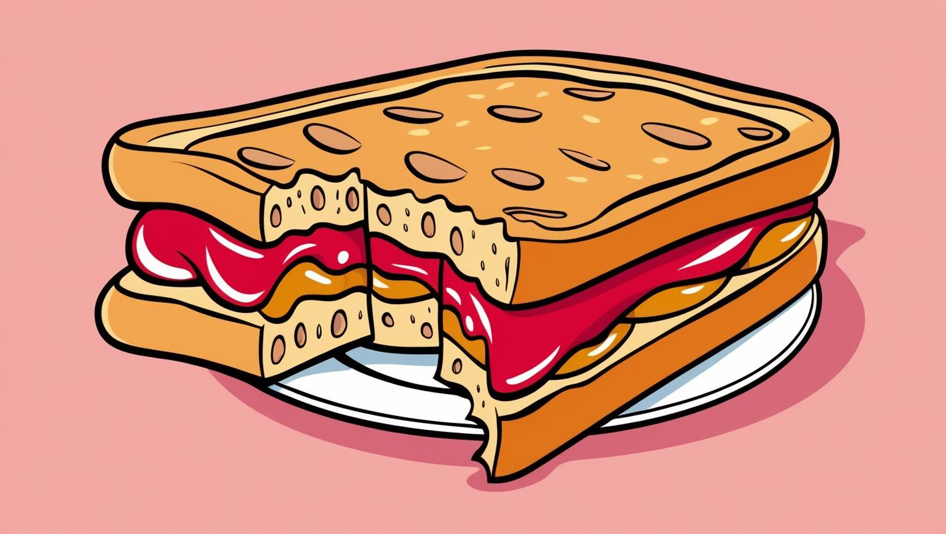
Standard 8.3.2
Develop a model to describe how food is changed through chemical reactions to form new molecules that support growth and/or release energy as matter cycles through an organism. Emphasis is on describing that during cellular respiration molecules are broken apart and rearranged into new molecules, and that this process releases energy.
After the Bite
How is the energy from food changed through a chemical reaction so that the body can use it?

Slide 2
Science and Engineering Practice | Crosscutting Concept | Disciplinary Core Idea
Developing and Using Models: Students develop and use a model to show how food is changed during the process of cellular respiration. | Energy and Matter: The transfer of energy drives the cycling of matter in organisms through the process of cellular respiration. | Organization for Energy and Matter Flow in Organisms: Within individual organisms, food moves through a series of chemical reactions in which it is broken down and rearranged to form new molecules, to support growth, or to release energy.

Slide 3
Necessary Vocabulary
Chemical Reactions
Cellular Respiration
Molecule
Rearranged
Transform
Energy
Reactants
Products
Energy Transfer
Carbon Dioxide
Glucose

Slide 4
Learning Objective:
Create and utilize models to represent chemical reactions in food processing.
Show the stages of cellular respiration where molecules are broken down and rearranged.
Explain the relationship between chemical reactions and energy release in organisms.

Slide 5
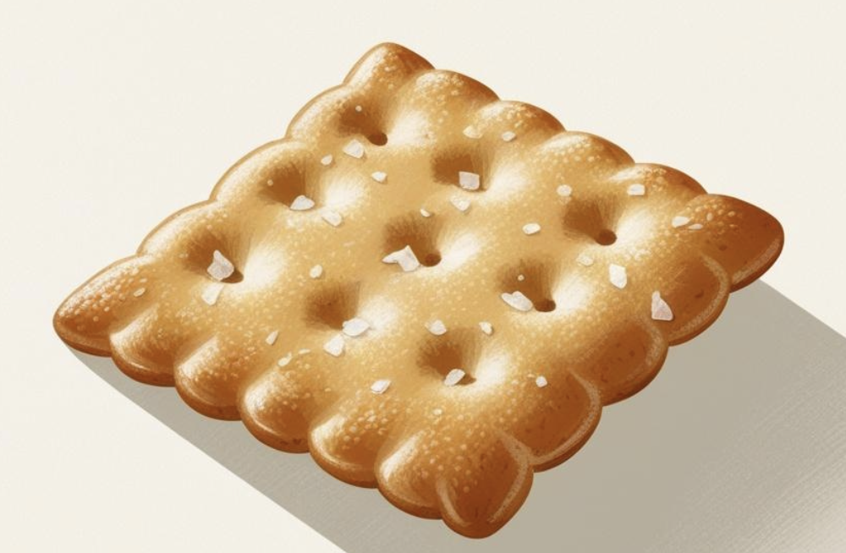
Phenomenon
Questions for discussion before eating the cracker:
What is the first step to eating food?
Procedure:
Take one Saltine each and begin to chew it.
Try to chew it for as long as you can. Pay attention to the taste.
Don’t swallow the cracker until you are instructed to do so.
Questions to consider while chewing the cracker:
What type of energy are you using while chewing this cracker?
Does the taste of the cracker change at all as you are eating it?
What do you think is happening inside your mouth to make it so that the cracker flavor changes?
An average American eats 2,000 pounds of food every year. Consider this: why don’t you gain 2,000 pounds every year?
Notes:
Teacher Notes:
Mechanical breakdown is the physical breaking of food into smaller pieces.The cracker will begin to taste sweet as the molecules that make up the saltine start to be chemically broken down in the mouth.
Chemical breakdown is the breaking down of food into nutrients and chemicals.

Slide 6
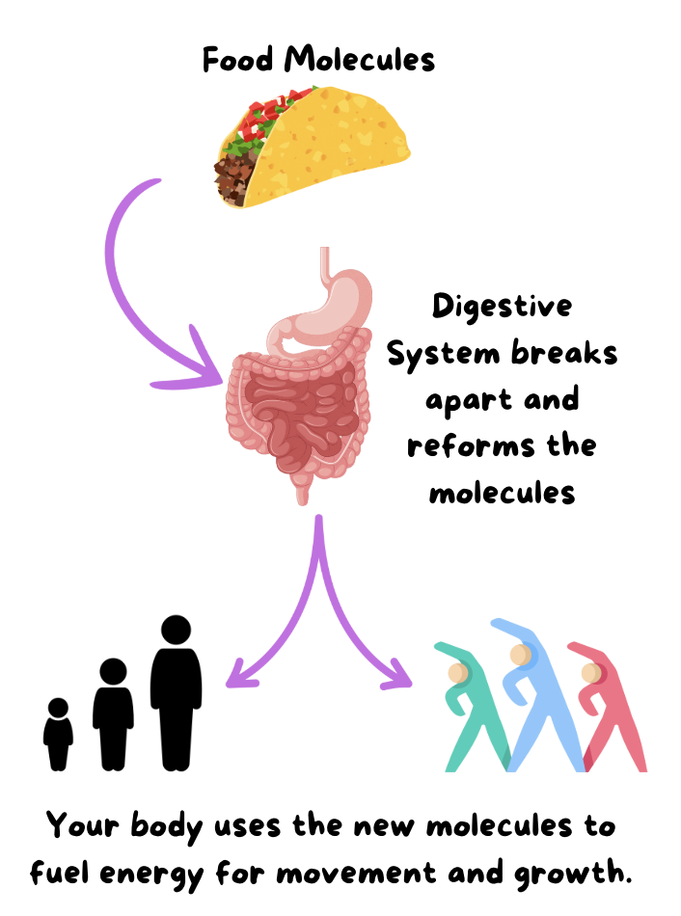
GROWTH Living things grow, and to grow, organisms must get energy and matter. Plants make their own food using the sun’s energy, as well as build their bodies from the sugar/glucose they produce during photosynthesis. Consumers are organisms that must eat to obtain energy and mass. Animals are consumers. The food consumers eat is used both as energy for the body to move and function, as well as to grow and build their bodies. | How do consumers get their energy? _____________________ How do consumers get the matter they need to grow? _____________________ What are the 2 ways your body uses the food you eat? _____________________ _____________________
Notes:
Have the students highlight or underline the important information.

Slide 7

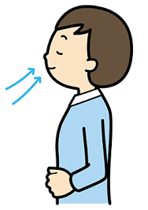
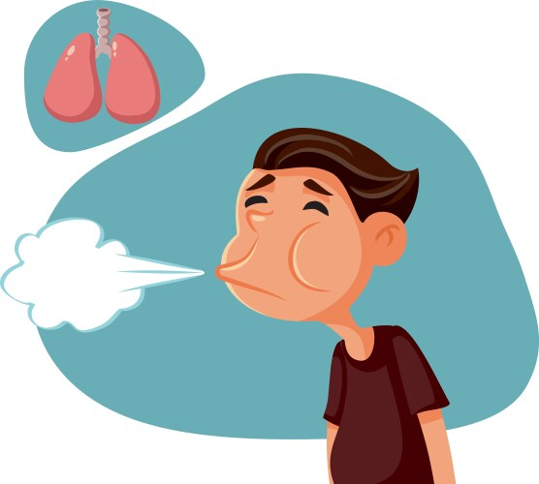

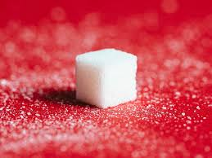
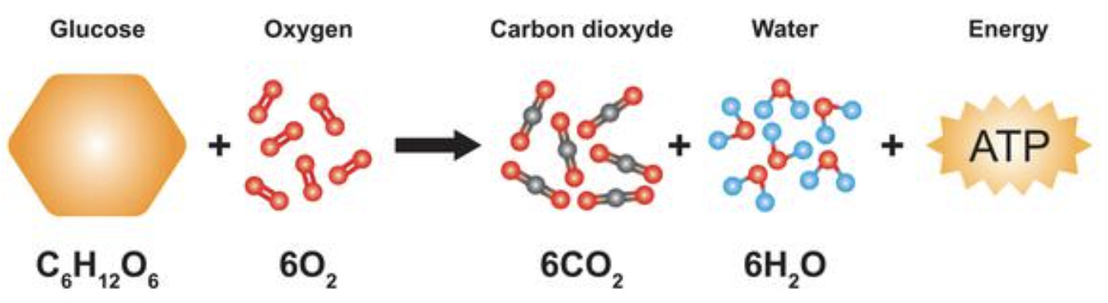
Carbohydrates
6
6
Reactants
Products
Notes:
TEACHER NOTES: ATP Energy is considered released energy. Carbohydrates start converting into glucose once the saliva enzymes make contact. Glucose is considered stored energy.

Slide 8
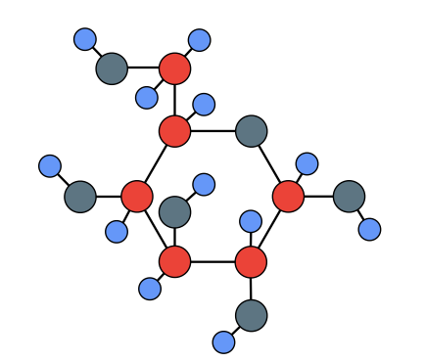
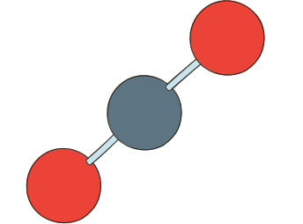
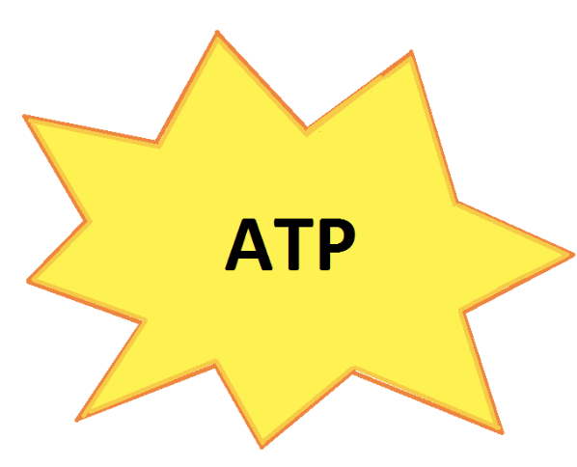


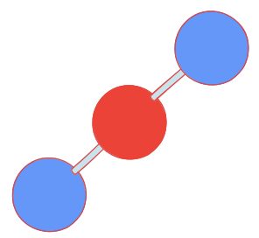
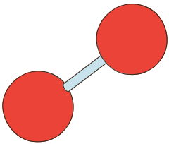
During the digestive process, cellular respiration breaks down O2 gas and complex glucose molecules, which are then converted into energy (ATP) and the simpler molecules of CO₂ and H₂O.
CO₂
Glucose
O₂
Molecules Broken Down
H₂O

Slide 9
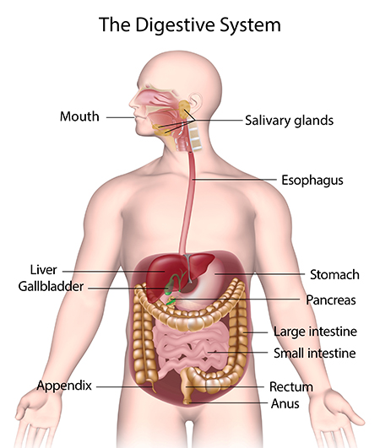
DIGESTIVE SYSTEM When you eat, the molecules in your food are not in a form that your body can use. They are too big to be absorbed by the blood. The main purpose of the digestive system is to break down food into simple molecules so that the body can absorb them. For this process to occur, food enters through the mouth, is stored in the stomach, and then moves on to the small intestine. These three organs, the mouth, stomach, and small intestine, break down the food both by physically smashing it and, through chemical reactions, breaking down the molecules. The small intestine also absorbs the nutrients from the food, and it is absorbed into the bloodstream. The food then travels into the large intestine, where it takes out water, which is then absorbed into the bloodstream. | What is the main purpose of the digestive system? ________________________________________________ Why does your body need to break down the food you eat? _____________________________ Where does food enter the body? ____________________________ Which organs help break down the food? (There are 3) 1. _____________________________ 2. _____________________________ 3. _____________________________ Which organ stores the food for a period of time? ________________ Which organ absorbs the particles of food into the bloodstream? ______________________________ Which organ absorbs the water from your food into the bloodstream? ______________________________
Notes:
Have the students highlight or underline the important information.

Slide 10
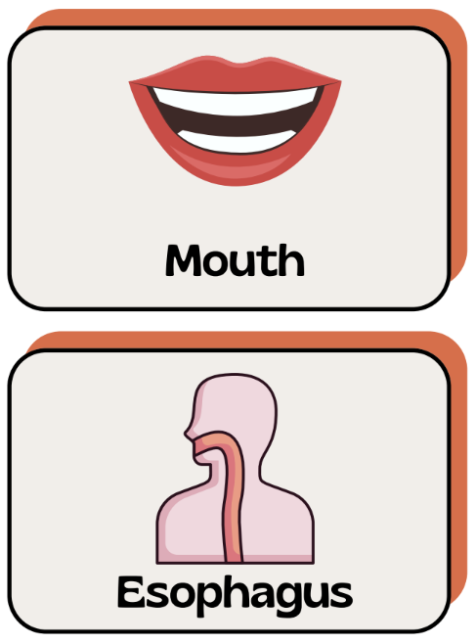
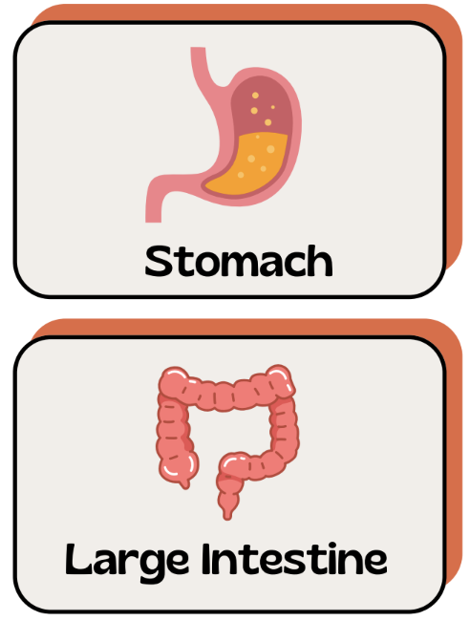
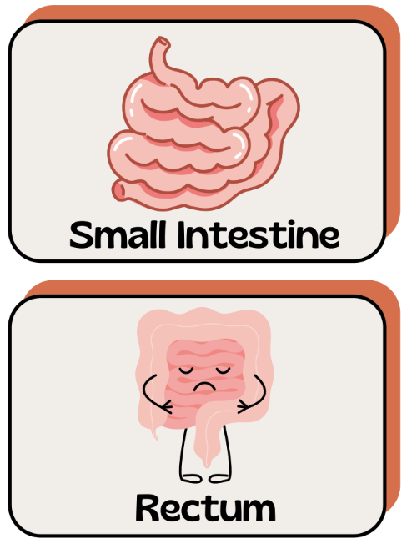
The basic function of your digestive system is to break down food into smaller pieces so that
your body can absorb the nutrients. The outline below shows the journey food takes from when it enters your mouth to when it exits your body.

Slide 11
1.________
2.________
3.________
4._________
5._________
6._________
A. The chyme enters this organ, which is a 7-meter-long tube. This organ has villi and microvilli, which create a very large surface area for digestion. In fact, 90% of all nutrient absorption occurs here. Once the food molecules are broken down even further by various chemicals, they move into the bloodstream. The molecules that came from the cracker are absorbed as energy.
B. This organ (also called the colon) is a 1.5-meter-long tube. Its main function is to absorb water and any remaining nutrients from the food before sending the undigested food to the rectum. The body absorbs the last remaining energy-rich molecules.
C. The large intestine ends with this organ. The excess waste is tightly packed and stored. When full, a muscle called the anal sphincter loosens and the waste (feces) passes out of the body through the anus. Any cracker molecules that were unusable by the body are now expelled from the body’s systems.
D. This organ is a 20 cm long tube that connects your mouth to your stomach. When you swallow food, a small flap called the epiglottis closes, preventing food from entering your trachea (windpipe) and lungs. It has muscles that move in a wave and push the food down into the stomach. The liquified and partially digested cracker pieces are moved along in the digestive system.
E. This is a J-shaped sac that stores and helps further break down food. It will physically churn the food, which helps break it into smaller pieces. It also releases acids and enzymes that break down food into a partially digested mixture called chyme. Acids finish breaking the molecules down and rearrange into nutrients, ATP energy, and waste.
F. Your teeth help grind up food into smaller pieces. Saliva contains an enzyme called amylase, which breaks down starches into sugar. Your tongue is a muscle that pushes food into your throat, where it travels to the esophagus. In this step of its journey, the cracker becomes more liquid and begins to taste sweet.

Slide 12
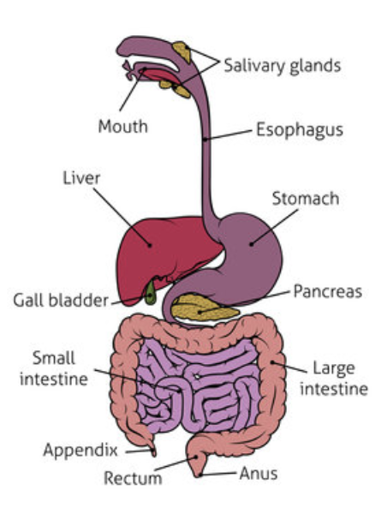
8.3.2 The Journey of Energy through the Digestive System
Create a Comic Strip
You will be doing the following:
Use the information from the worksheets on Digestion.
Your comic should illustrate the path food (energy) takes as it goes through the human digestive system. Each panel should represent one step of the process and should include a caption that tells the reader what step you are on. (For example, your first caption could be “Mouth,” or any fun comic-style title of your choice that fits the description. If your comic panel has more than six panels, the other panels can be used to add to your story.)
Your comic must contain illustrated scenes and dialogue, within comic bubbles, that match your storyline.
Your illustrated scenes should be labeled where appropriate. Proper spelling and grammar should be used, and all wording should be legible (easy to read).
Your comic should be creative, neat, colorful, and scientifically appropriate.
You will illustrate what happens to your favorite food (energy) as it passes through the various steps of the digestive system. Remember that the format is a comic, so it can be silly, but it also should be informative. Have Fun!
Develop a Comic Strip (model) to describe how food is changed through chemical reactions to form new molecules that support growth and/or release energy as matter cycles through an organism. This illustration demonstrates how energy flows through the Digestive system. Emphasis is on describing that during cellular respiration, molecules are broken apart and rearranged into new molecules, and that this process releases energy. Utilize the sentence stems on the next slide to help you create your comic strip

Slide 13
8.3.2 Sentence stems that utilize academic language: (Make sure to include one of these in your comic)
_______ happens to matter as it moves within the system.
The energy is leaving the system by _______.
In this system, energy is entering by _______, doing _______ in the system, and leaving the system by _______.
The energy for _______ is from _______.
When you put energy into this system, _______.
The flow of energy causes _______ to occur in the system.
The energy is entering the system by _______.
In the system, the cycling of matter _______.
The matter in the system enters from _______.
When the matter leaves the system, it goes _______.

Slide 14
Scoring Rubric
Category | Points Possible | Points Earned
Content The comic accurately explains how food is broken down and absorbed during the process of digestion. Use 5 of the vocabulary words from slide 3 and underline them. Chemical Reactions, Cellular Respiration, Molecule, Rearranged, Transform, Energy Reactants, Products, Energy Transfer, Carbon Dioxide, Glucose | 10
Illustrated Scenes Each comic panel has colored, somewhat detailed illustrations that match the scene. | 5
Scientific names and appropriate pictures Pictures included must be scientific and appropriate. | 5
Dialogue The story includes dialogue, within comic bubbles, that is well-matched to the storyline. | 10
Spelling & Grammar No spelling, punctuation, or grammar errors are present. | 5
Clarity & Neatness The comic is legible and easy to understand. Labels are included where appropriate. | 10
Creativity The comic is not purely informational. The story is told in a comic-style format, combining words and illustrations to create a fun and informative narrative. | 5
Score Total: | 50

Slide 15
Learning Objective: Check off which ones you were able to understand and do.
Create and utilize models to represent chemical reactions in food processing.
Show the stages of cellular respiration where molecules are broken down and rearranged.
Explain the relationship between chemical reactions and energy release in organisms.

Slide 16
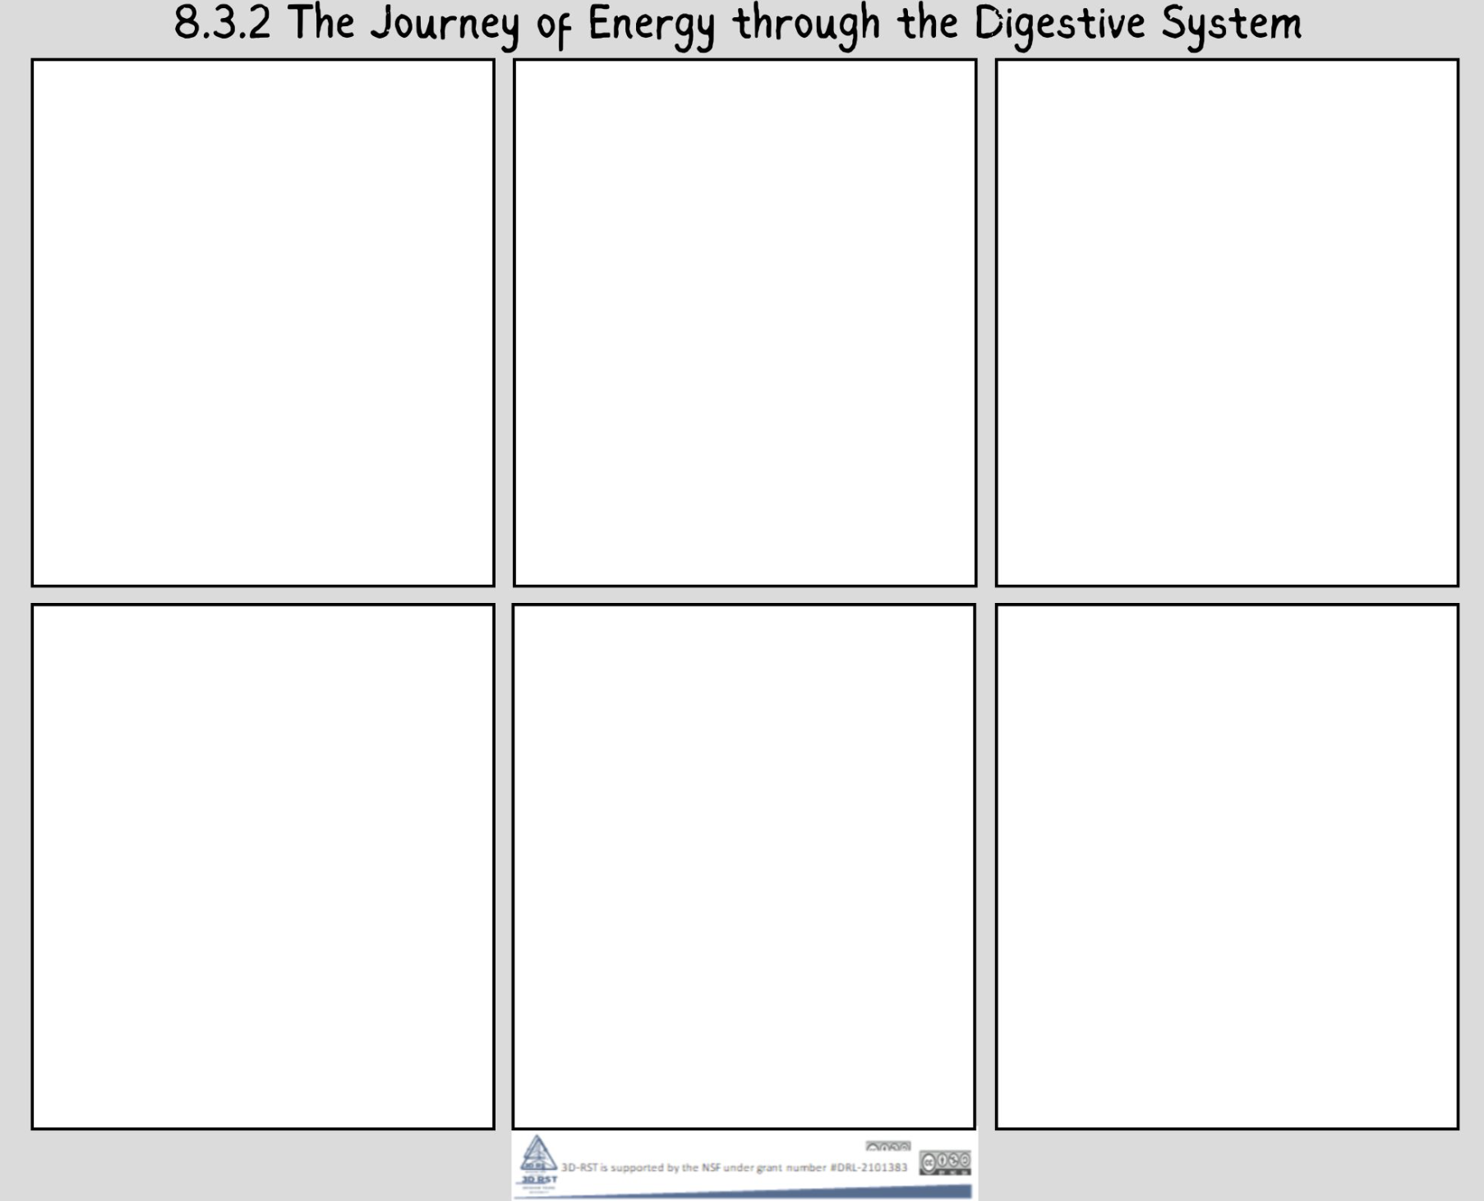
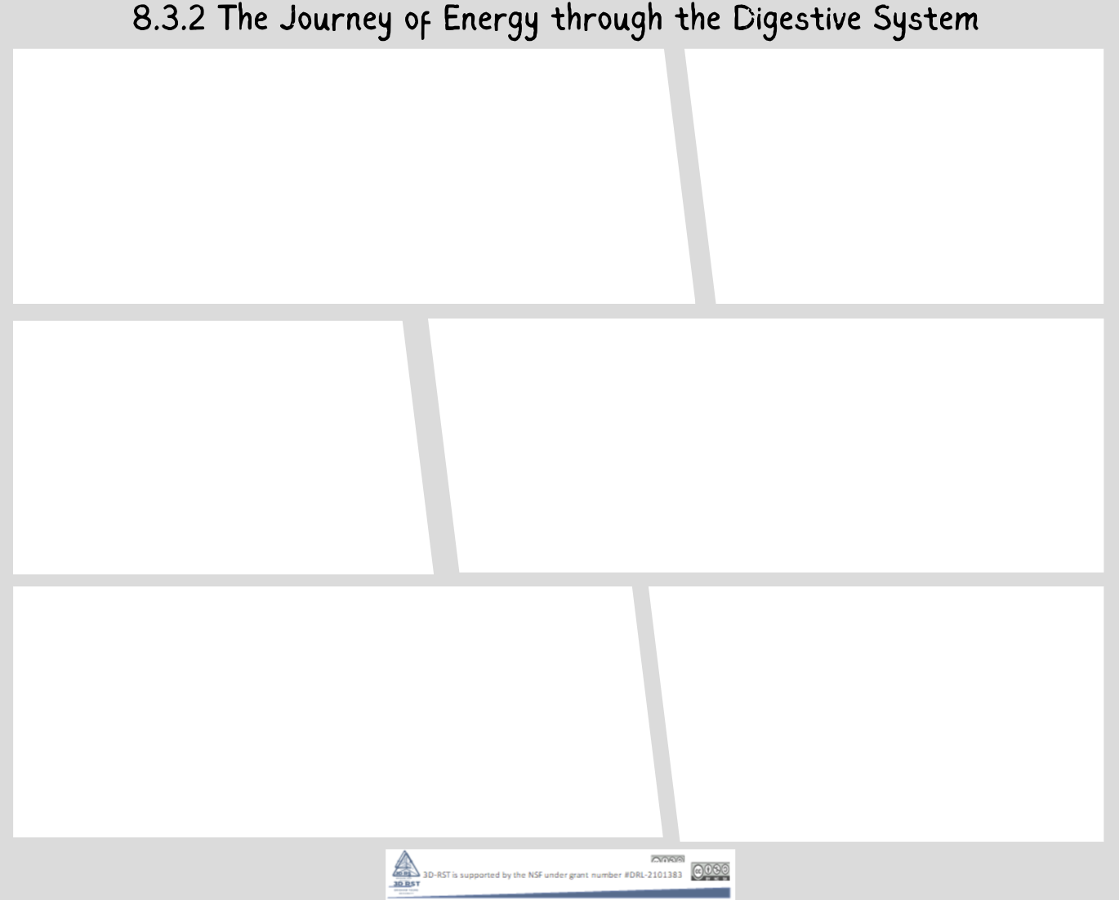

Slide 17
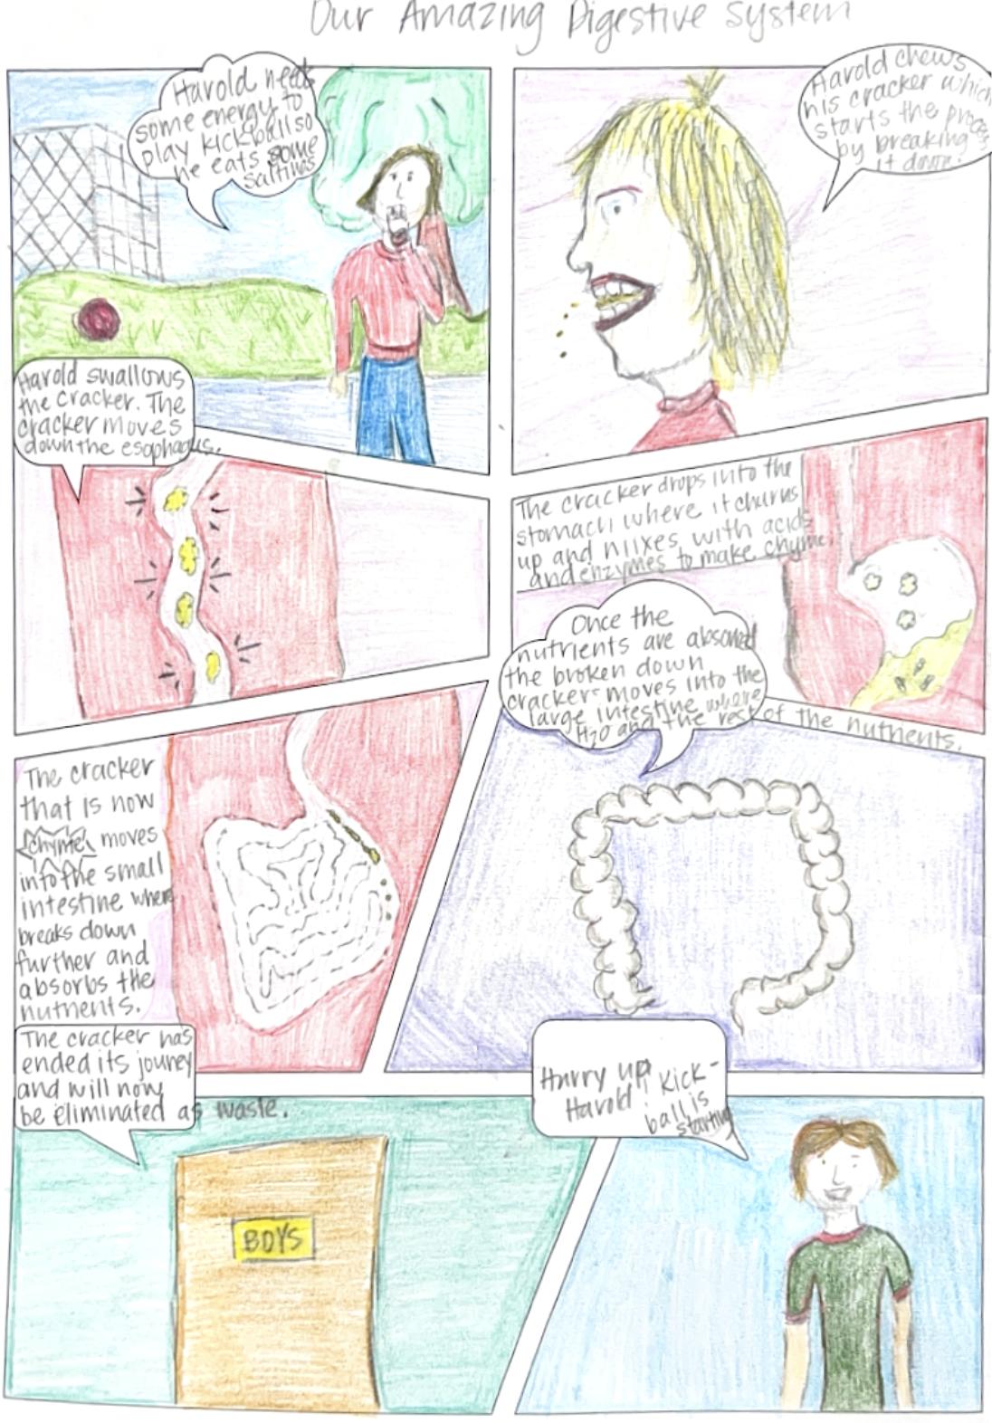
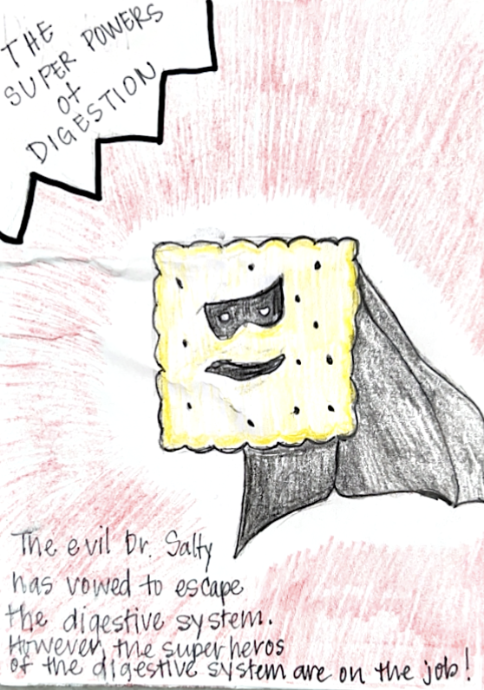
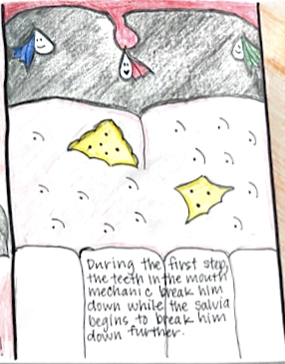
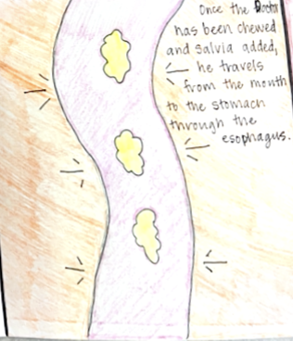
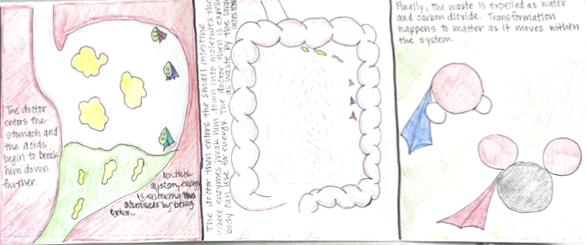

Slide 18
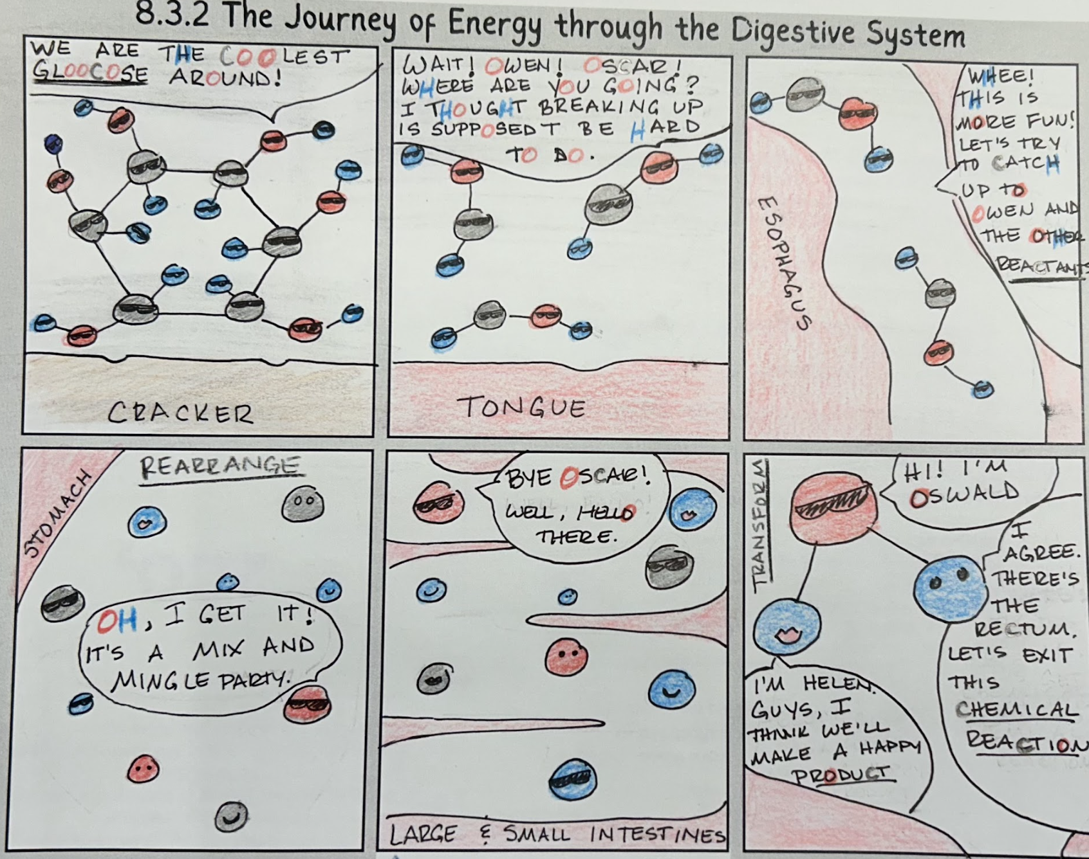

Slide 19
Necessary Vocabulary
Chemical Reactions
Cellular Respiration
Molecule
Rearranged
Transform
Energy
Reactants
Products
Energy Transfer
Carbon Dioxide
Glucose

Slide 20
