Slide 1
Print slides 2-4 on paper for group phenomena investigation Slides 5-8 are for enrichment Slides 9-10 are for the overlay showing the temperature relation to H/L pressure

Slide 2
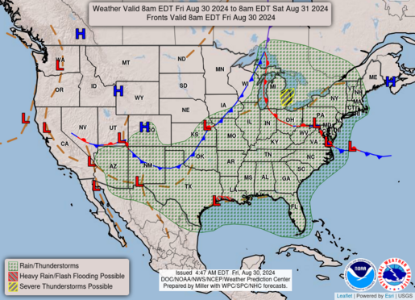

Slide 3
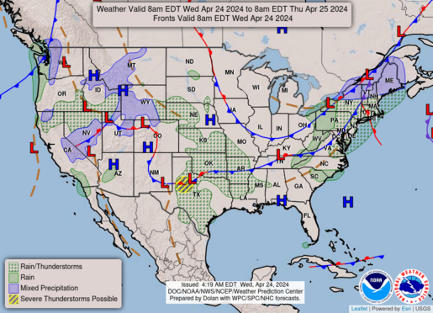

Slide 4
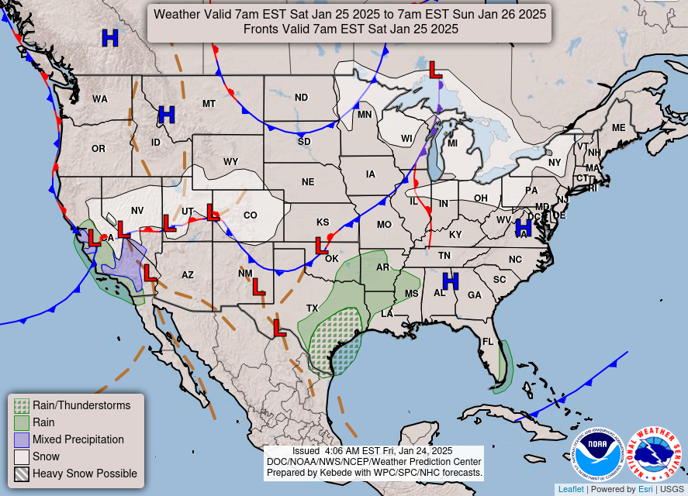

Slide 5
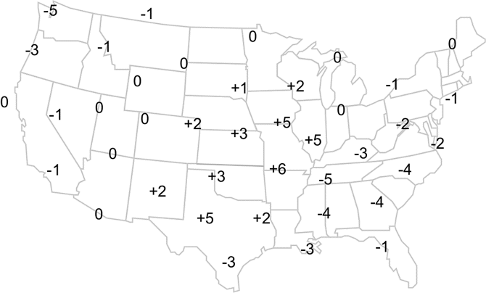
Air Pressure map

Slide 6
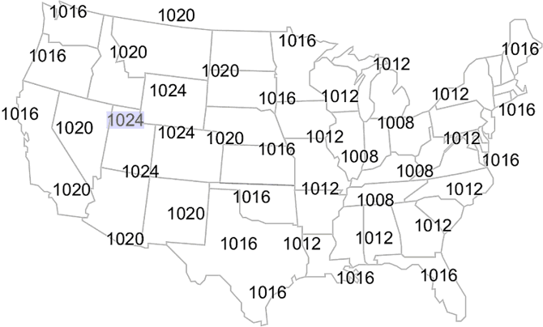
Surface air pressure

Slide 7
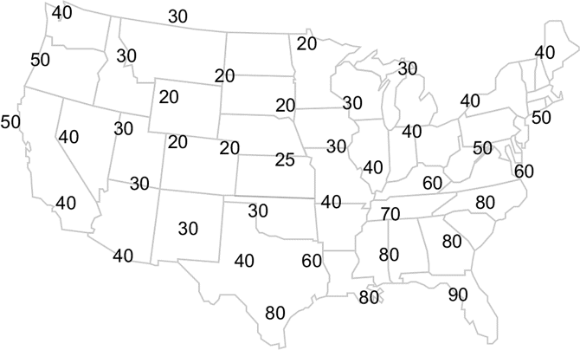
Surface Temperature

Slide 8
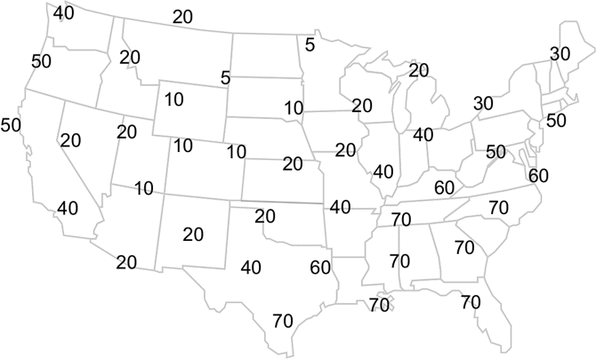
Dew point pressure

Slide 9
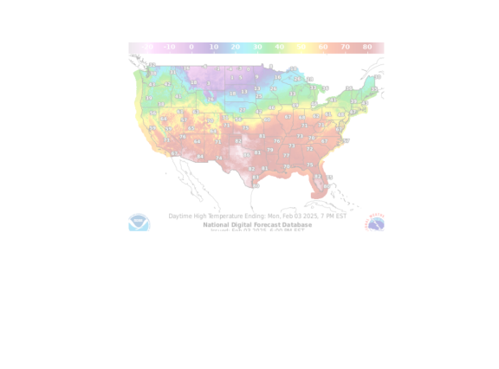

Slide 10
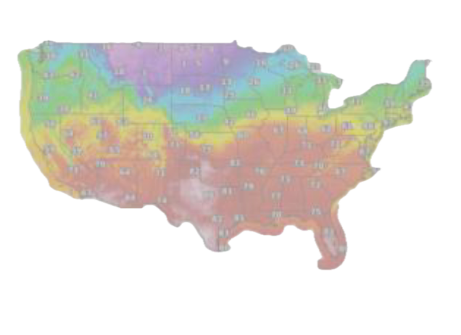

Slide 11
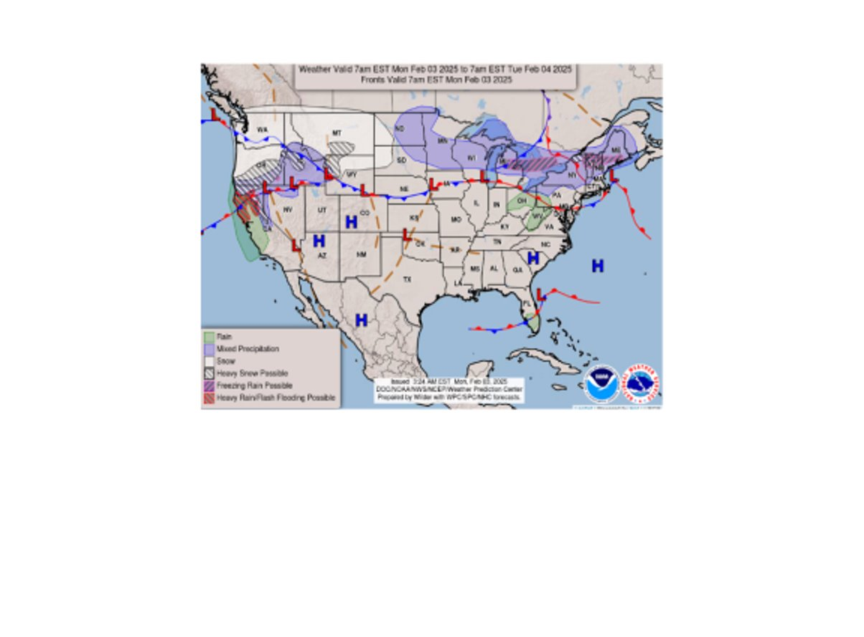

Slide 12
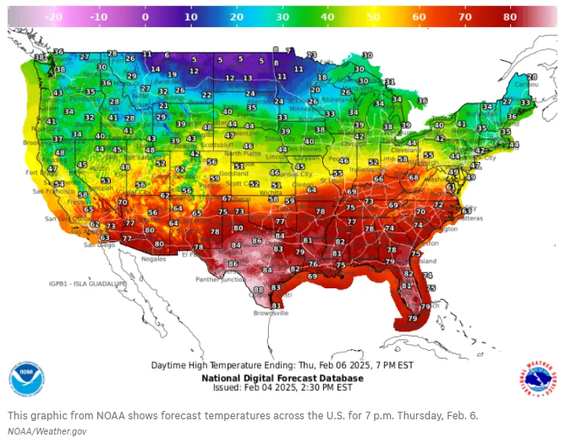

Slide 13

3D-RST is supported by the NSF under grant number #DRL-2101383

