Slide 1

The Pressure's On:
How Air Mass Movement Shapes Our Weather
Utah SEEd 6.3.2
NGSS Correlation: MS-ESS2-5

Slide 2

Today, you will investigate the interactions between air masses that cause changes in weather conditions by analyzing data.
I will be able to investigate data to explain how the interaction of air masses causes changes in weather.

Slide 3




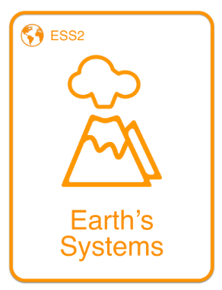
SEP
CCC
DCI
Science and Engineering Practice
Cross Cutting Concept
Disciplinary Core Idea

Slide 4
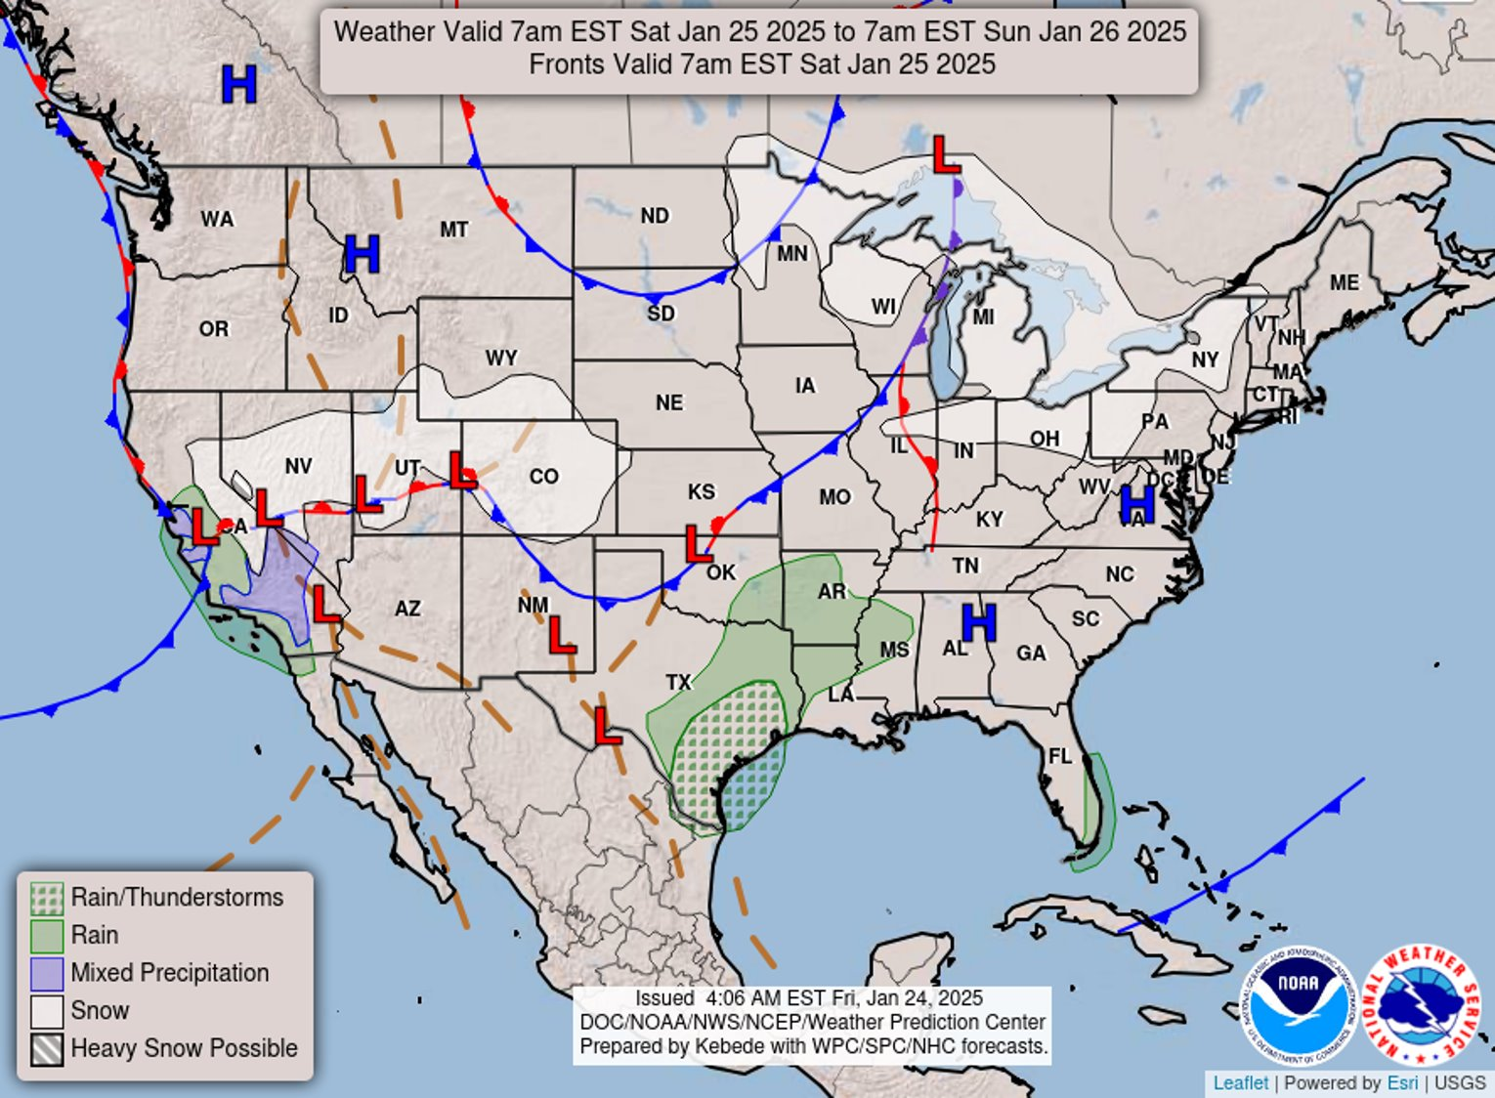
PHENOMENON
Fill in 3 observations and ask 3 questions.
Notes:
Phenomena: Have students look at their maps IN groups: and make 3 observations and 3 questions.
Students will hopefully notice the weather patterns in the key for rain, thunderstorm, mixed precipitation, snow, etc. Main one is L/H lines.
Have students share out their observations and their questions. (Some questions will be answered in future lessons using the same phenomena.)

Slide 5
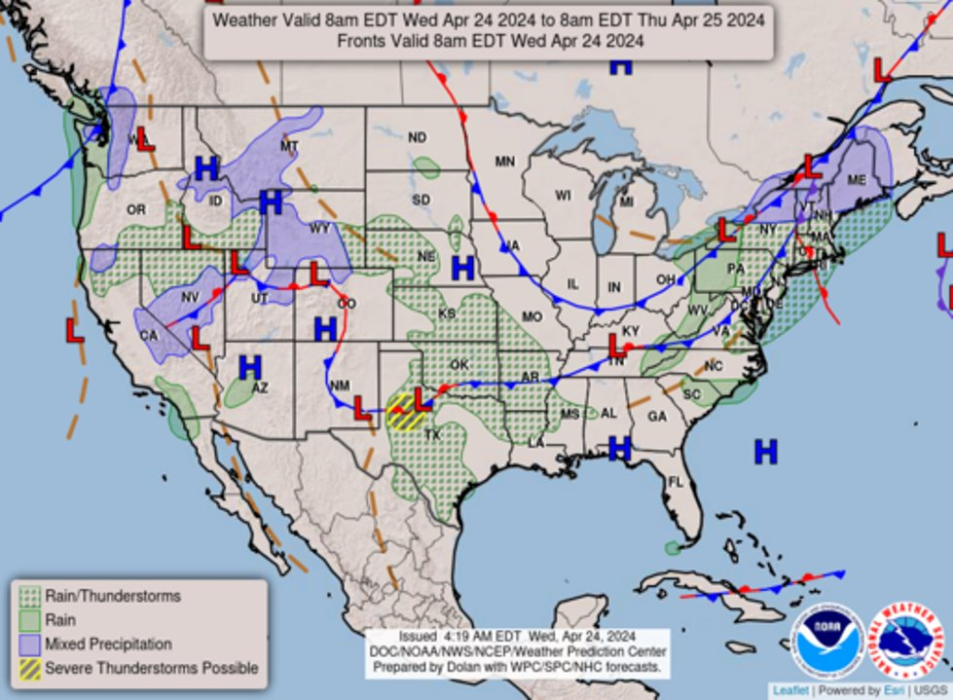
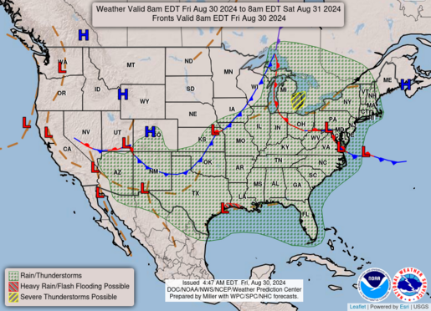

Share Out
Notes:
Phenomena: Have students look at their maps IN groups: and make 3 observations and 3 questions.
Students will hopefully notice the weather patterns in the key for rain, thunderstorm, mixed precipitation, snow, etc. Main one is L/H lines.
Have students share out their observations and their questions. (Some questions will be answered in future lessons using the same phenomena.)

Slide 6
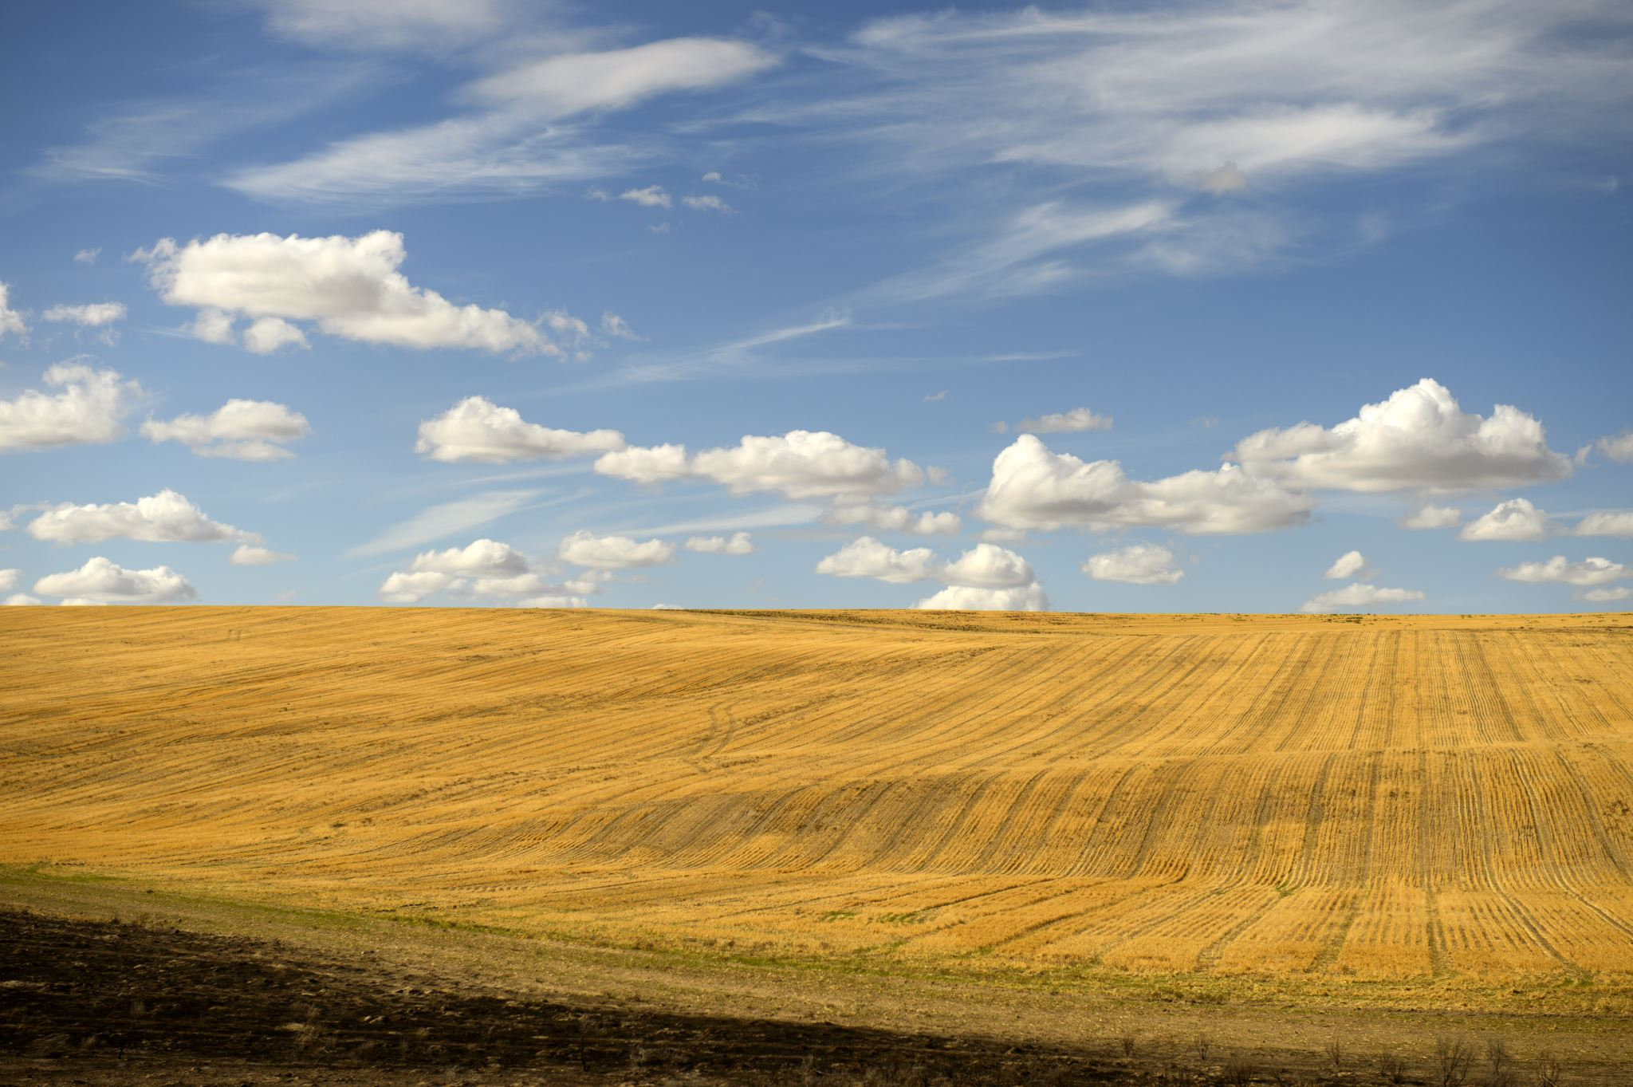
Reading article
Read the article.
Answer questions 1-3.

Slide 7

Turn and Talk:
Share your results of the investigations of the maps and the article to explain how low or high air pressures cause changes in weather.
Turn and Look at your partner
Eyes on each other
Listen as your partner talks
Take turns sharing

Slide 8
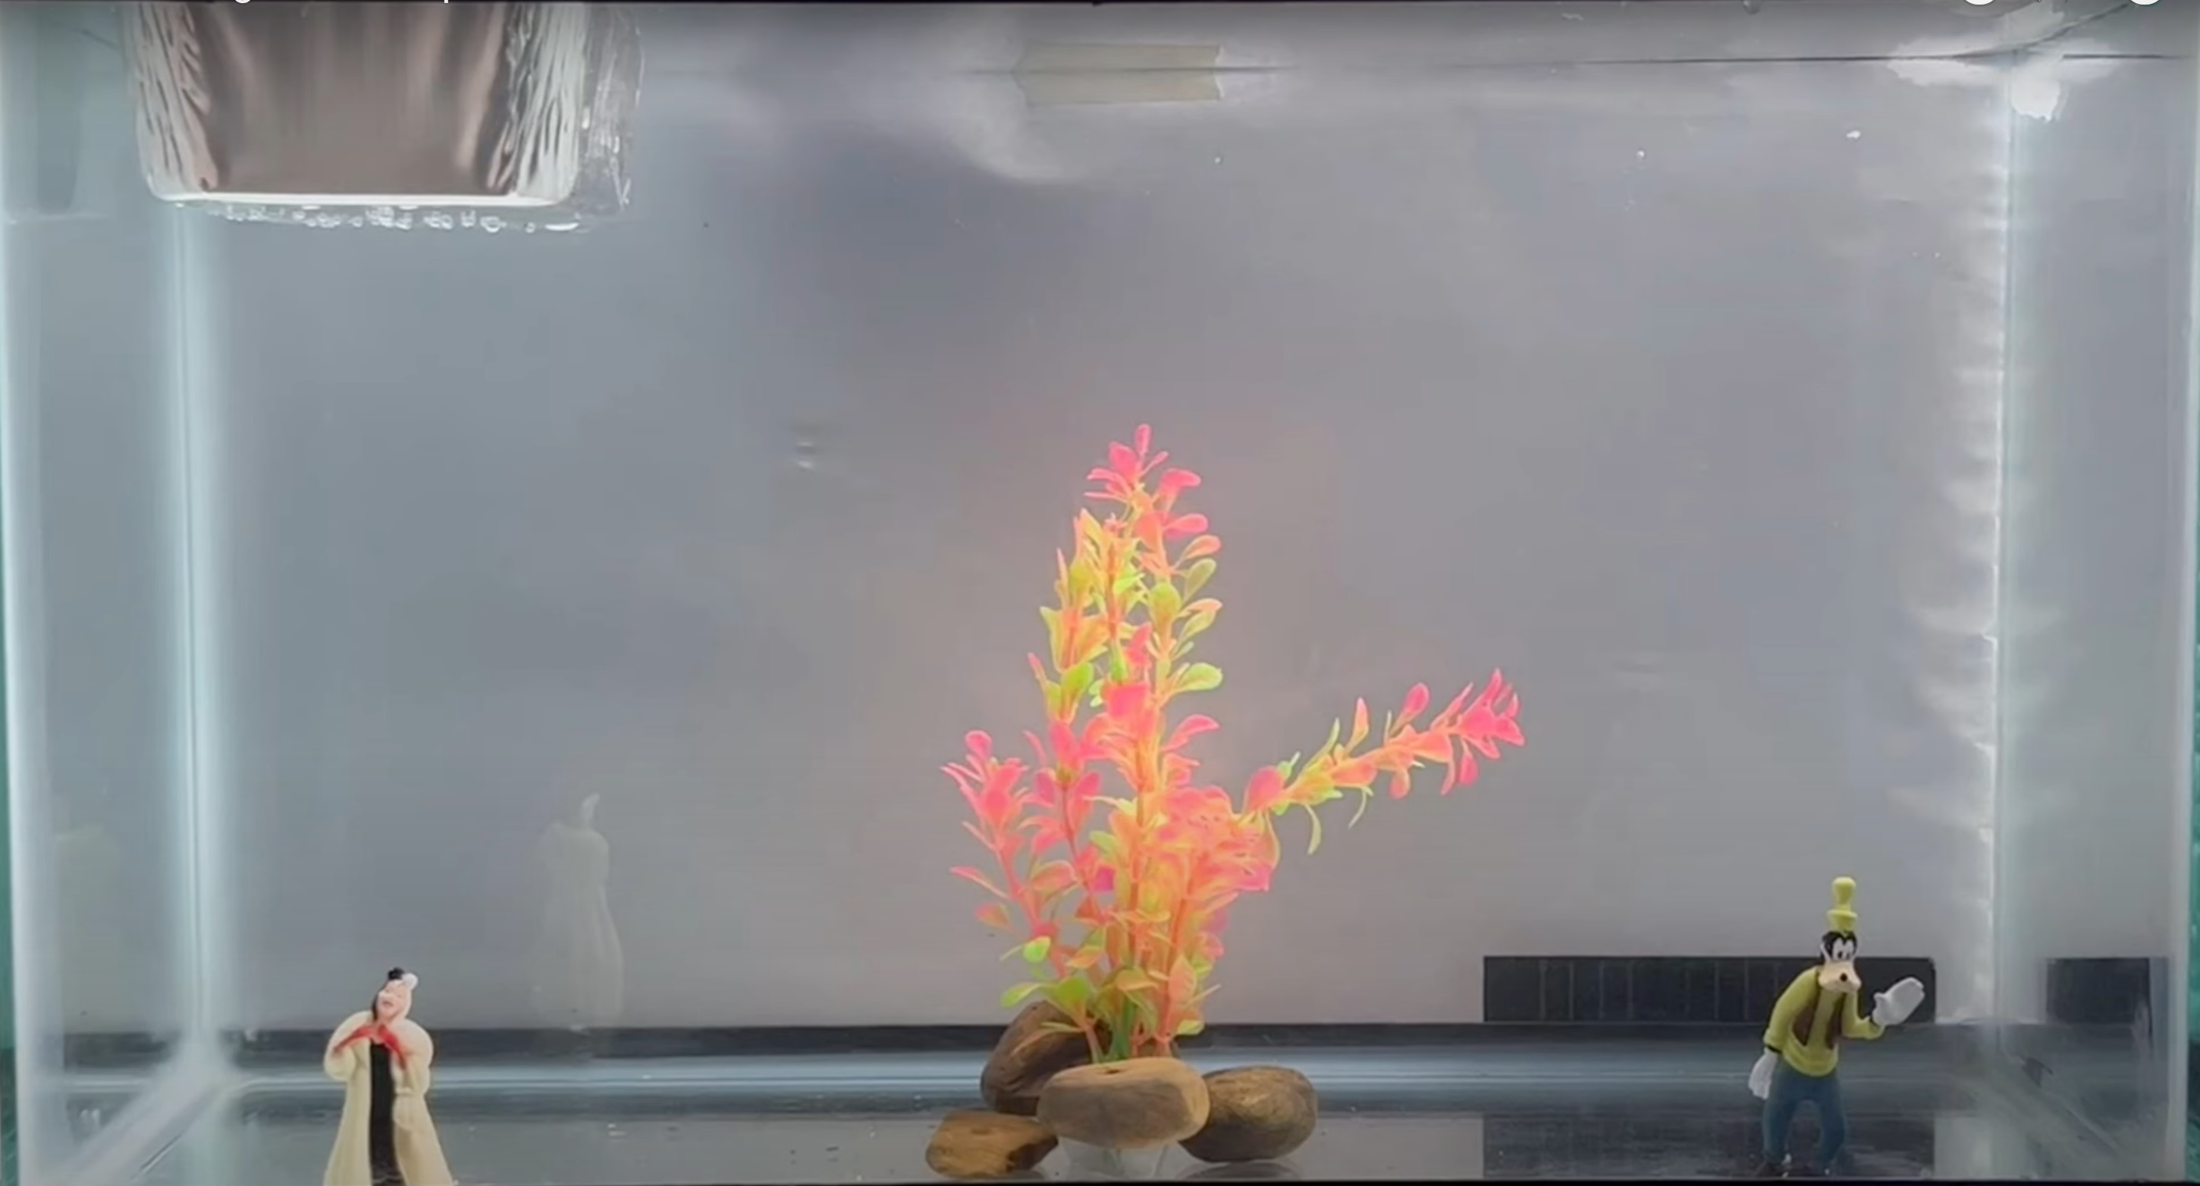
Question 4: Make observations, collect data, and write questions.
Then answer questions: 5, 6, 7
Notes:
Mark molecules; density with markers; let students observe the rotation of the food coloring;
Ask students where the low and high pressure would go.
Low pressure (less dense - there isn't pressure keeping the hot water down): molecules are farther apart
High Pressure (more dense - there is pressure keeping the cold water down) molecules are closer together at the bottom for cold.
Mark moleculess; density with markers; let students observe the rotation of the food coloring;
Mark High and Low pressure;
Low pressure (Stormy weather; Lousy)
High Pressure (Sunny weather; Happy)
Draw in the sun and clouds;

Slide 9
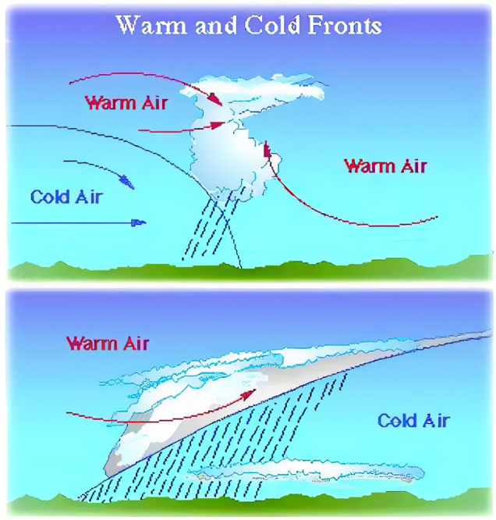

Slide 10
Can you investigate data to explain how the interaction of air masses causes changes in weather?
Notes:
Phenomena: Have students look at their maps IN groups: and make 3 observations and 3 questions.
Students will hopefully notice the weather patterns in the key for rain, thunderstorm, mixed precipitation, snow, etc. Main one is L/H lines.
Have students share out their observations and their questions. (Some questions will be answered in future lessons using the same phenomena.)

Slide 11
Assessment
Explain how the movement of air masses causes changes in weather.

Slide 12
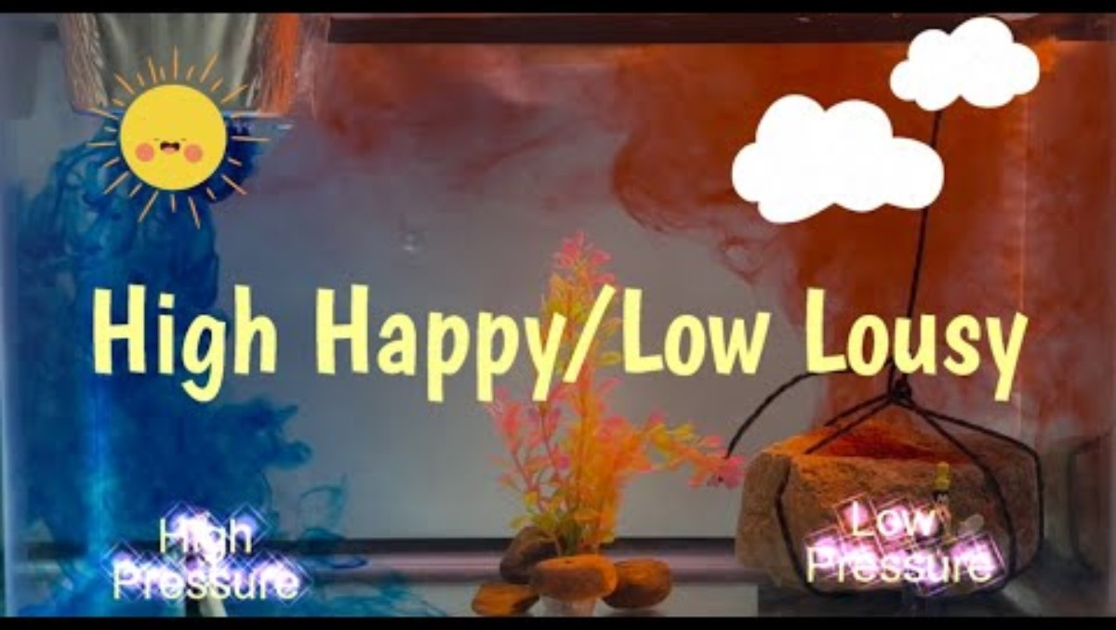

Slide 13

3D-RST is supported by the NSF under grant number #DRL-2101383

