Slide 1
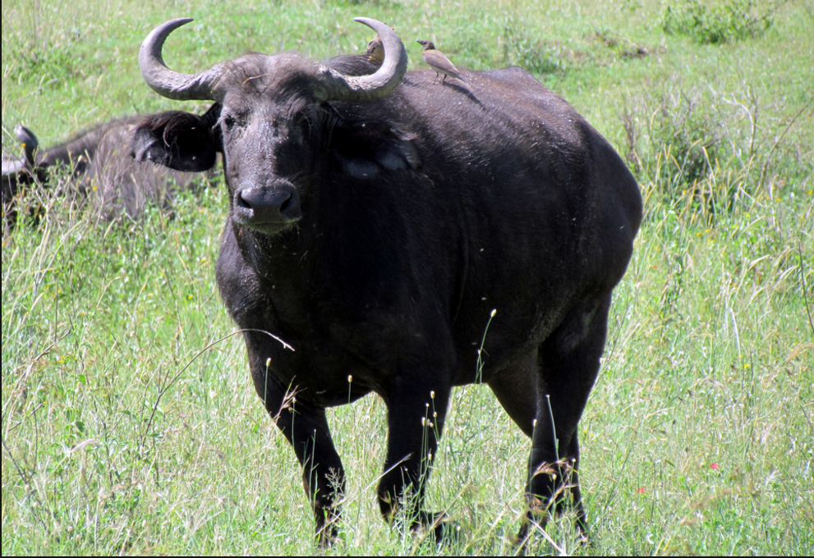
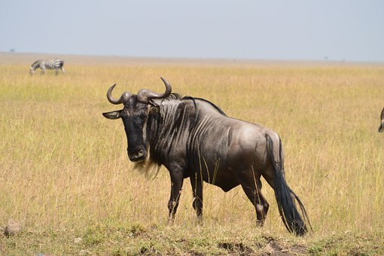
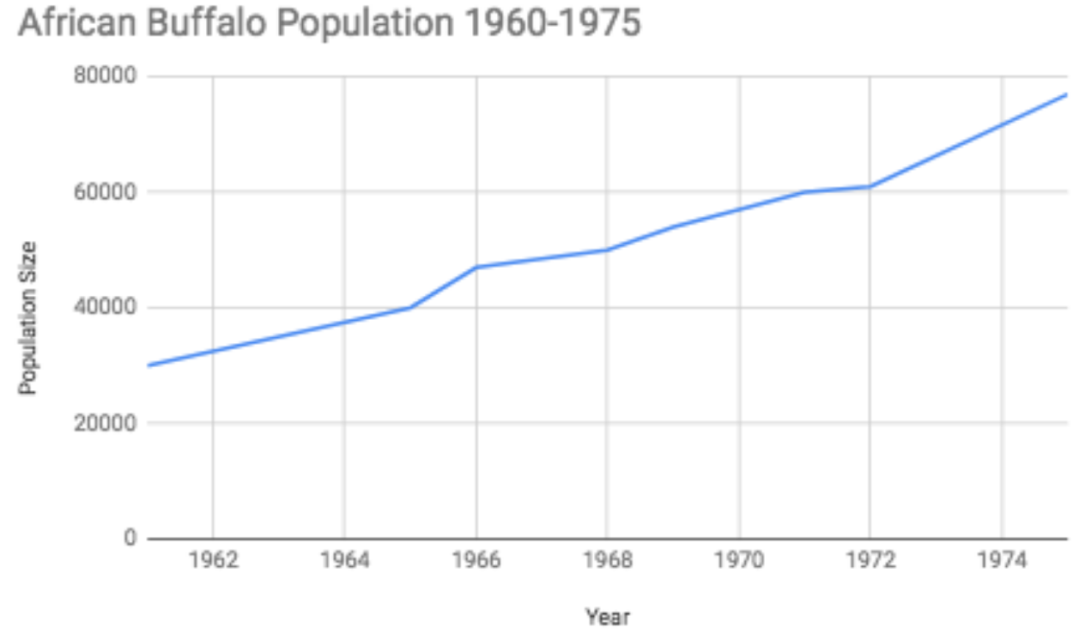
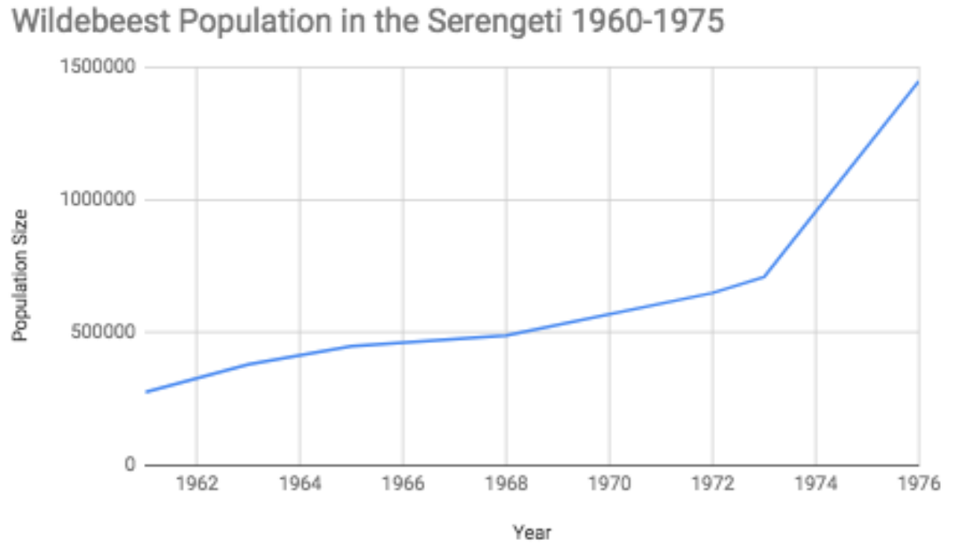
“What could have caused the population change
in the two populations?”

Slide 2
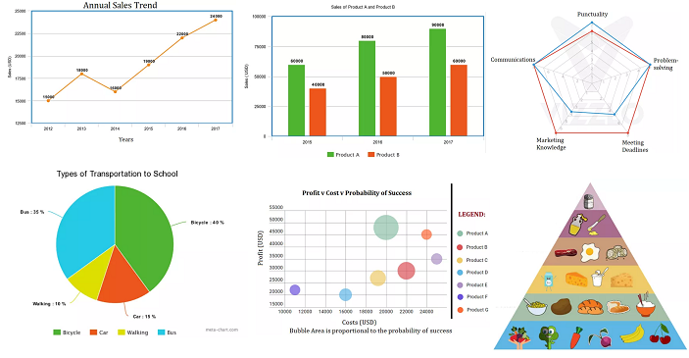
Creating Initial Models
What ideas do you have to explain why the two populations increased so rapidly?
Draw an initial model in your journal:
Models could be graphs, descriptions, diagrams with labels, comic strips…
Notes:
https://www.google.com/url?sa=i&url=https%3A%2F%2Fwww.intellspot.com%2Ftypes-graphs-charts%2F&psig=AOvVaw0gXbE2UZ4vtdfK4_gAaU78&ust=1723672452641000&source=images&cd=vfe&opi=89978449&ved=0CBQQjRxqFwoTCOiEoPz68ocDFQAAAAAdAAAAABAK

Slide 3
Based on the models, what do we need to investigate to explain the change in the buffalo and wildebeest populations?
Notes:
We hope the students will come up with the ideas listed on slide four. An opportunity to discuss real science, analyzing data and deciding what needs further research.

Slide 4
Diet
Disease
Climate
Predation
Hunting
Serengeti Information Index
Reproduction

Slide 5
Diet

Slide 6
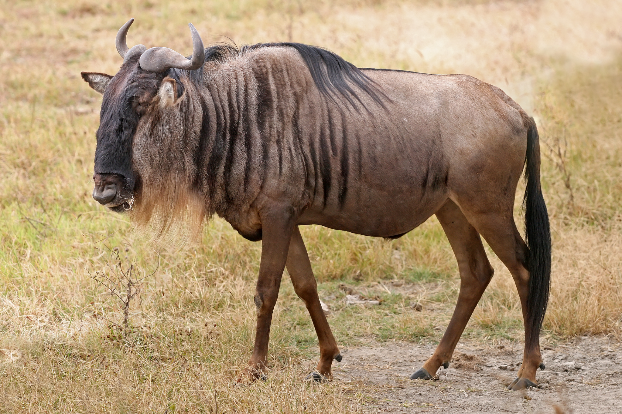
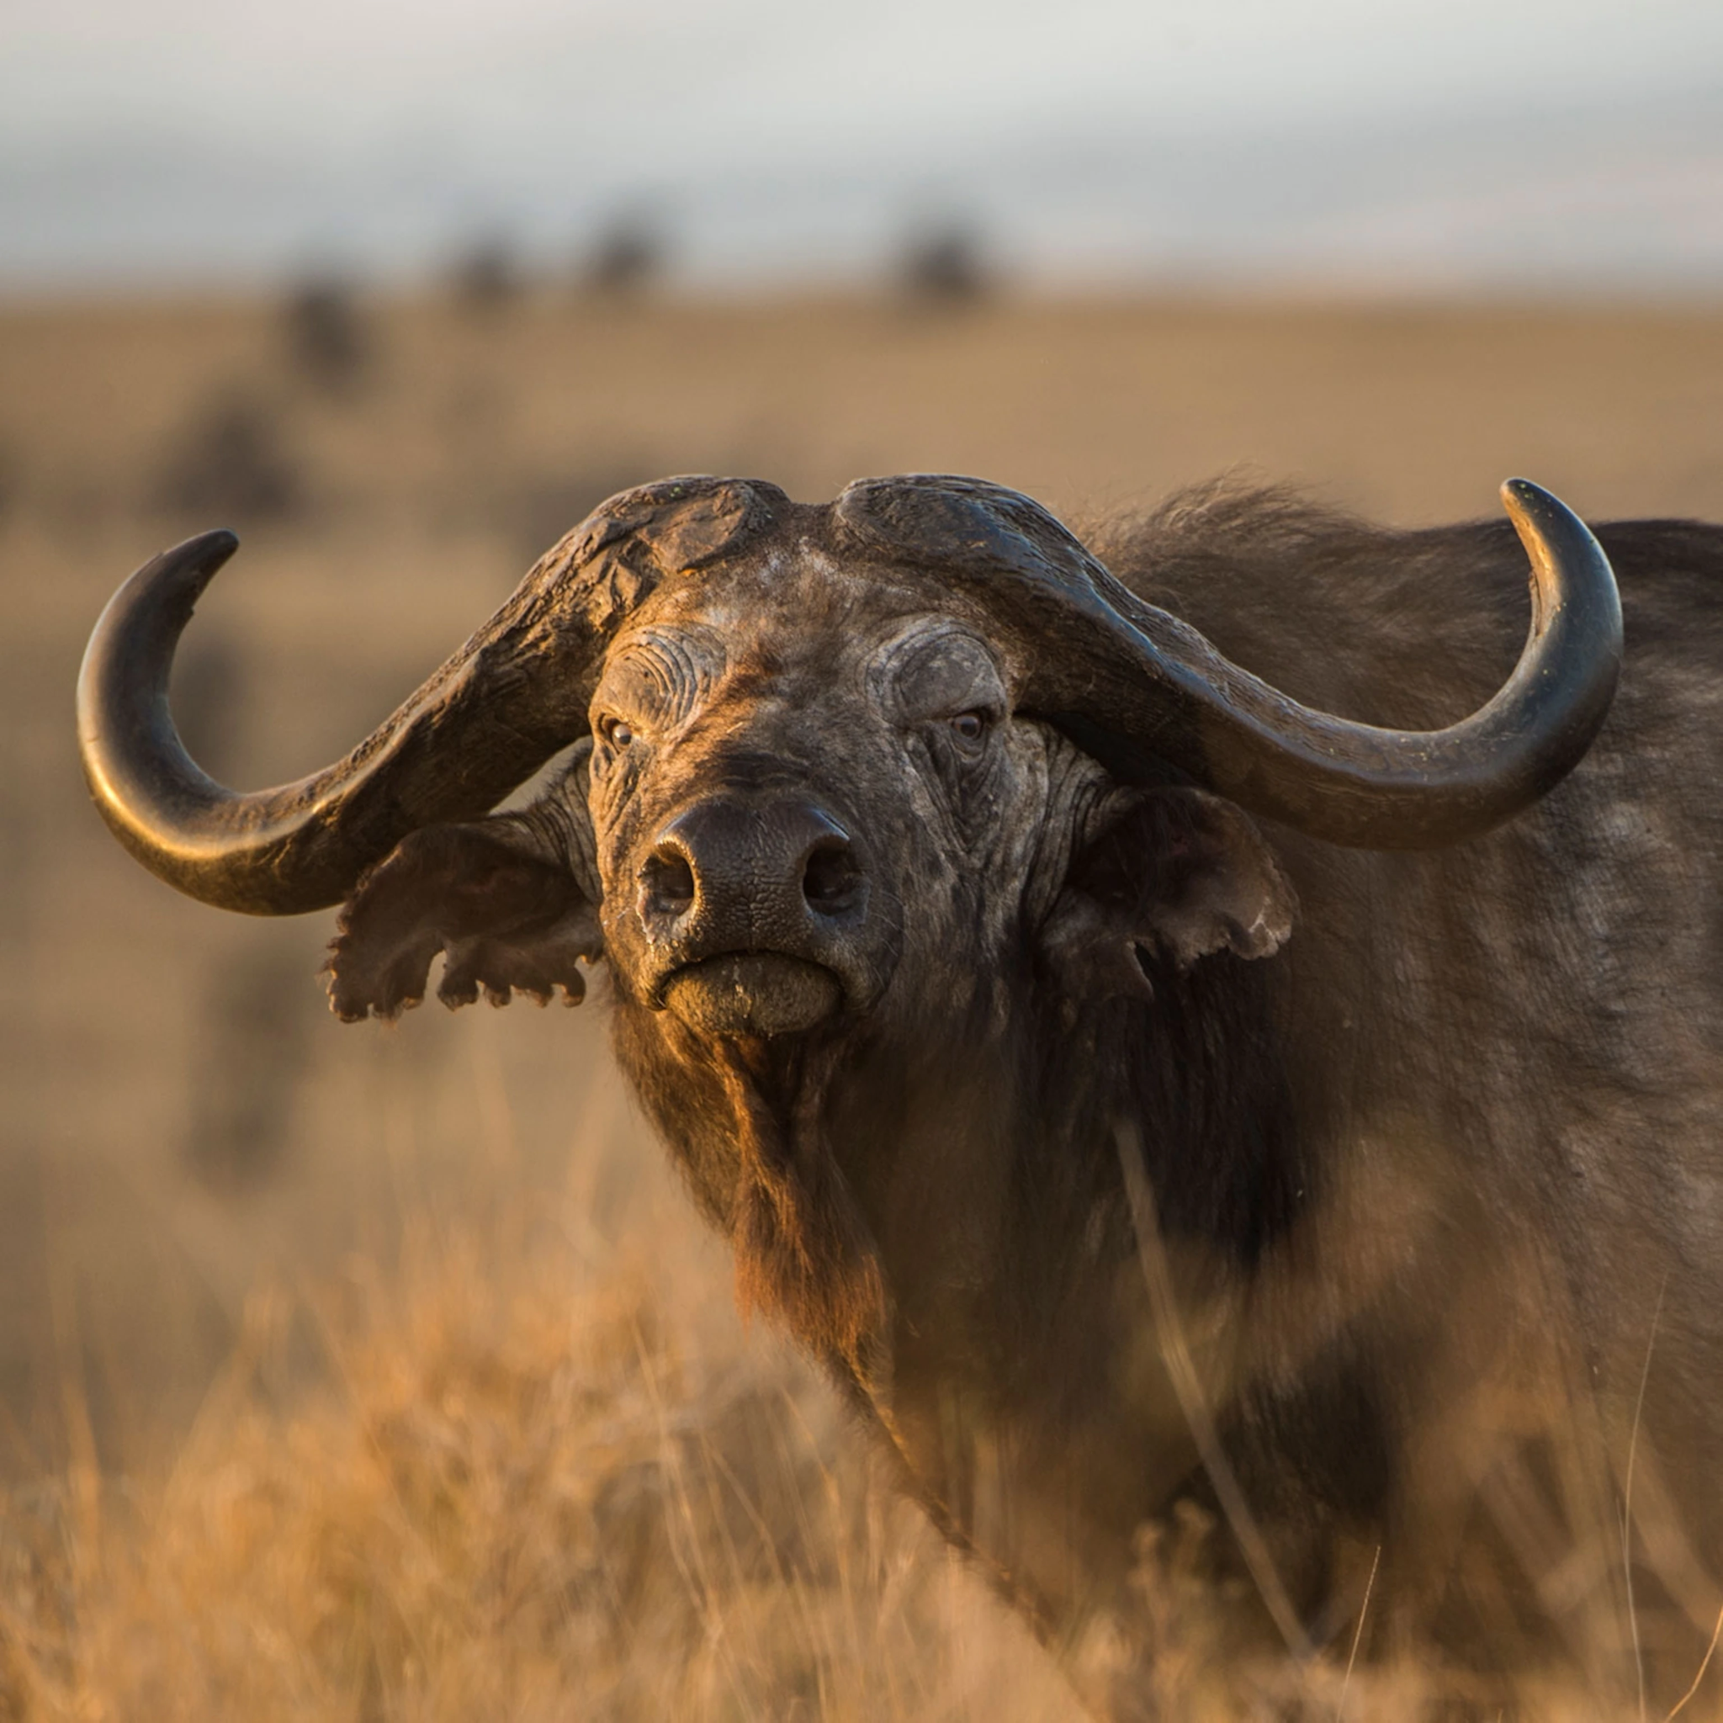
Buffalo and Wildebeest Diet
Could an increase in food availability be affecting the population size?

Slide 7
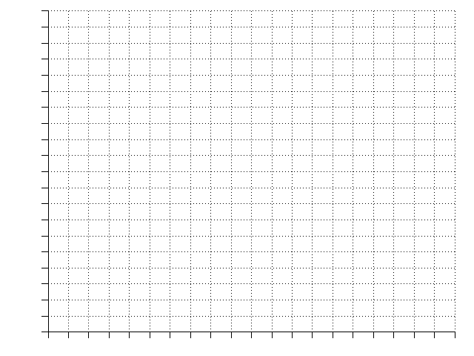
Making a Prediction
Predict: If the food source is affecting the buffalo and wildebeest population, what do you predict the graph of the food source would look like? Either draw a graph or write a prediction in your journal.

Slide 8
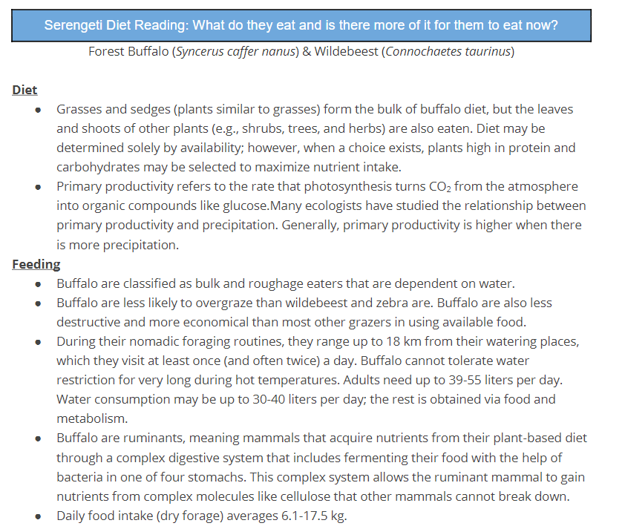
Obtaining Information about Buffalo Diets
Close read the information and analyze the graphs found in
Diet of the Serengeti Grazers

Slide 9
Obtaining Information about Buffalo Diets
Identify factors in the ecosystem that affect the wildebeest and buffalo diet.
How does the data/information compare to your prediction from the graph?
After reading through the data, what claim can you make about how diet affects the stability of buffalo and wildebeest populations?
Diet of the Serengeti Grazers
Notes:
Ask the students the questions in this slide so they can begin thinking about the stability and change of the populations.
We want the students to learn that there is competition for food sources, diets shift depending on the season and the effect of abiotic factors such as temperature and precipitation.

Slide 10
Reproduction

Slide 11
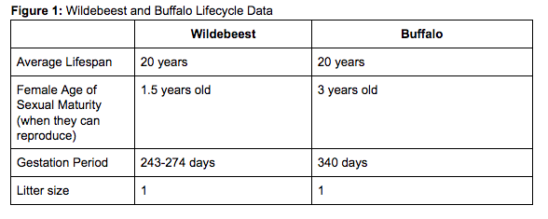
Notes:
Guiding questions: Do these herds have a breeding season? Do they ever have more than one litter size?

Slide 12
Reproduction
Would these species be able to reproduce at a quicker rate? Explain why or why not.
Would these species be able to have more offspring per pregnancy? Explain why or why not.
Is reproduction solely responsible for the population growth in the 1960s and 1970s in the Serengeti?
Diet of the Serengeti Grazers
Notes:
Ask the students the questions in this slide so they can begin thinking about the stability and change of the populations.
We want the students to learn that there is competition for food sources, diets shift depending on the season and the effect of abiotic factors such as temperature and precipitation.

Slide 13
Predation

Slide 14
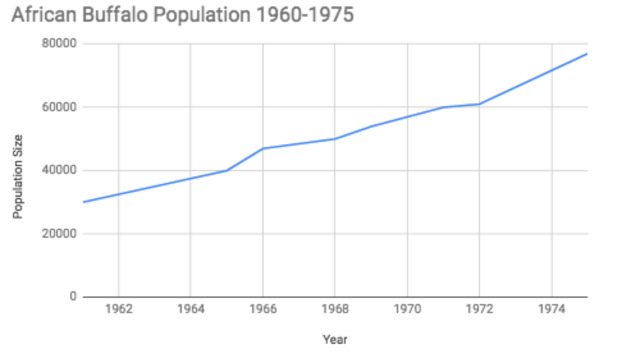
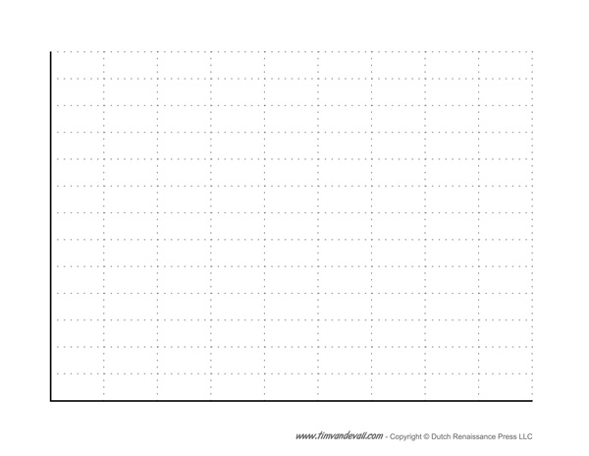

Predicting Size of Lion Population
What do you predict is happening to the lion population between 1960 and 1975?
If predators are affecting the wildebeest and buffalo populations, what would you predict the graph of the predator population would look like?
African Lion Population

Slide 15
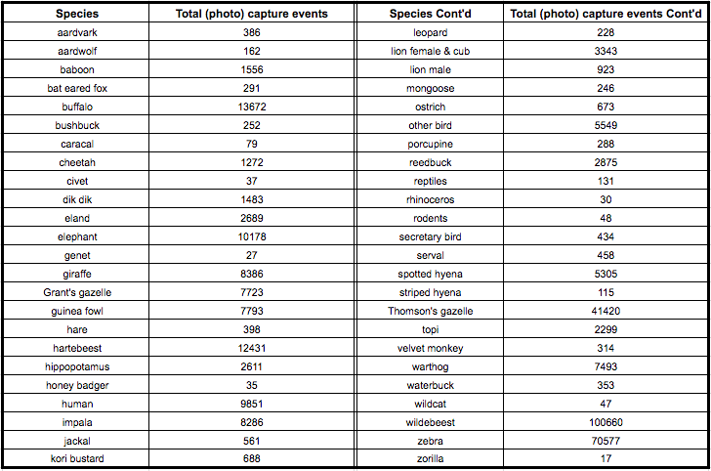
Finding the Predators
Refer back to the Camera Trap data we looked at during the Serengeti Virtual Field Trip
What species regularly hunts African buffaloes in this environment?

Slide 16
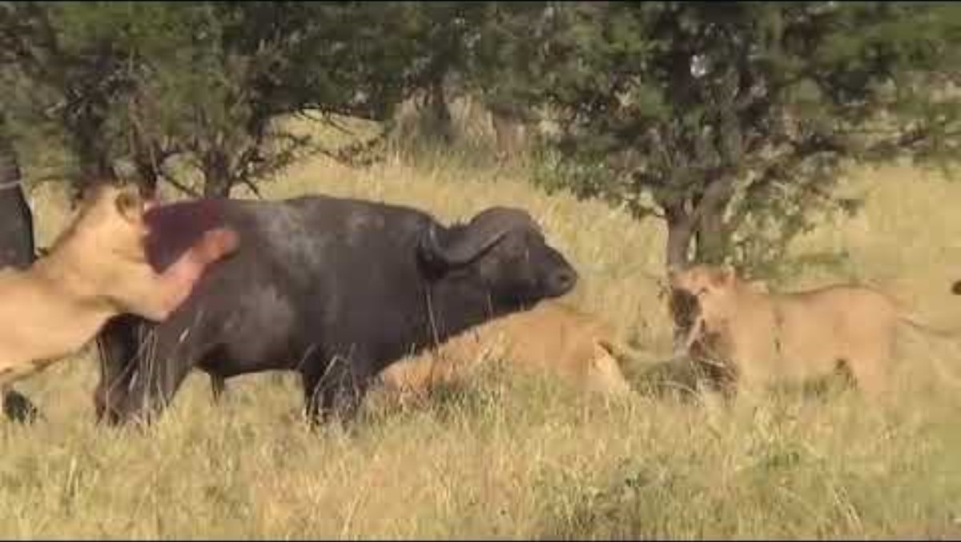
Possible Predator: The African Lion
Notes:
(5 min) Students watch a YouTube video to see if the lion is the predator of the African buffalo. The YouTube video is https://youtu.be/yHLTpjm0zFY (embedded in slides)

Slide 17
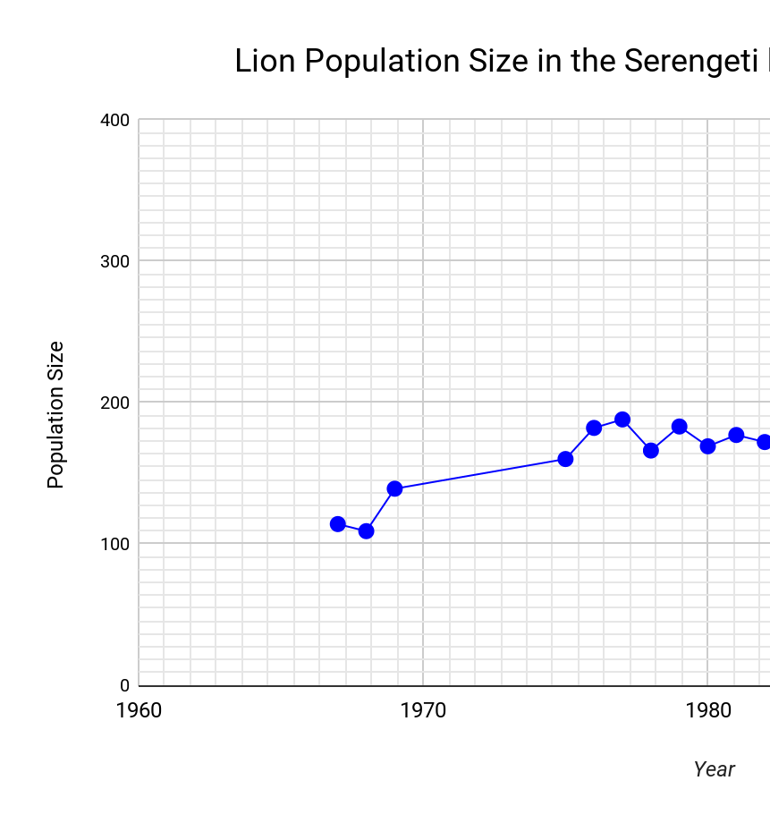
Lion Population Graph
What actually happened to the lion population during the time in question…….

Slide 18
Predation
How does the data/information compare to your prediction from the graph?
After analyzing the data, what claim can you make about how predators affect the stability/change of wildebeest and buffalo populations?
Notes:
Ask the students the questions in this slide so they can begin thinking about the stability and change of the populations.
We want the students to learn that there is competition for food sources, diets shift depending on the season and the effect of abiotic factors such as temperature and precipitation.

Slide 19
Climate

Slide 20
Predicting Climate
Make a prediction about any effects on the herd populations (if any) that may be caused by climate factors (rainfall, temperature) and list them in your journal.

Slide 21
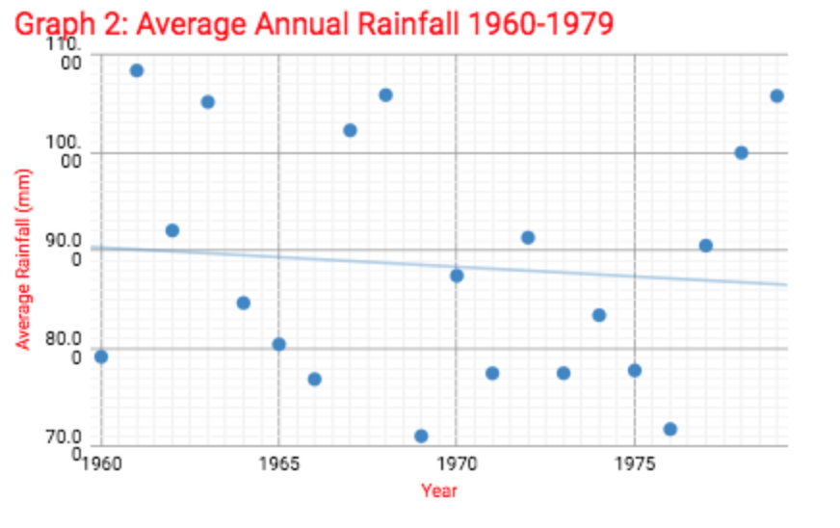
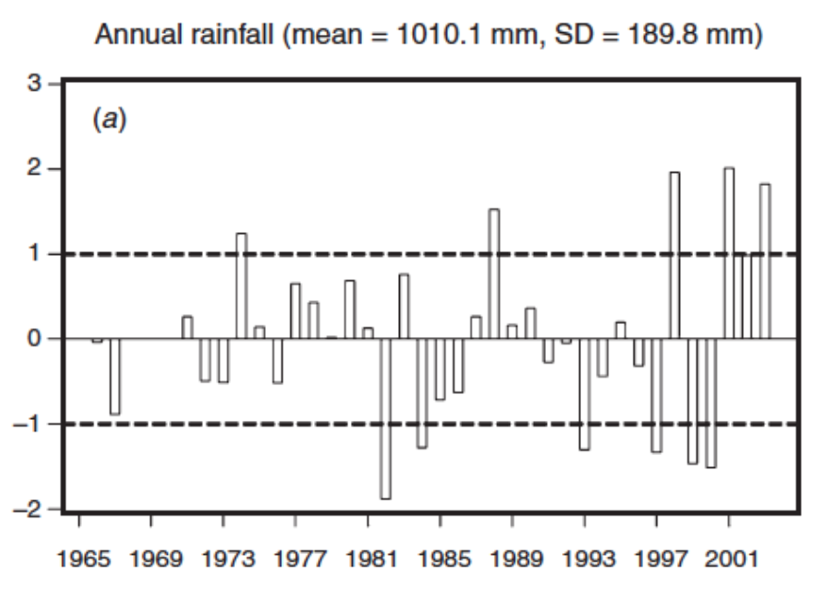
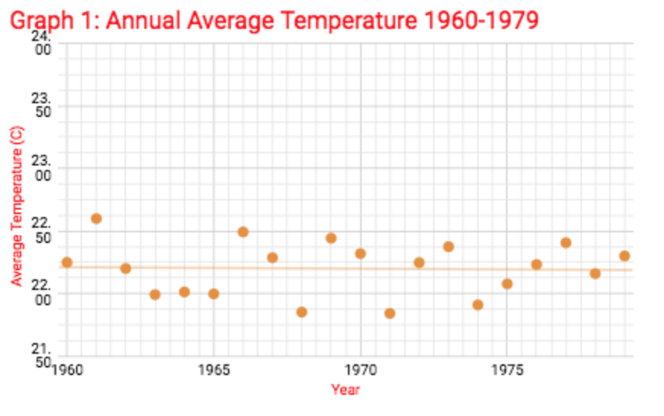
Read & Analyze Climate Data
Precipitation
Temperature
The graph above shows total annual rainfall between 1965 and 2001. The line in the middle shows the average amount of rainfall. When a bar goes above the line, it means that the annual rainfall was higher than average. When a bar goes below the line, it means that the annual rainfall was lower than average.

Slide 22
Compare and contrast the climate data with the population data. Do you find evidence of any correlation between the two?

Slide 23
Climate
After analyzing the climate data compared with the original graph data from the wildebeests and buffalo, is there anything to indicate that climate caused an increase in the number of buffalo? Explain. Illustrate a model if this helps in your explanation.

Slide 24
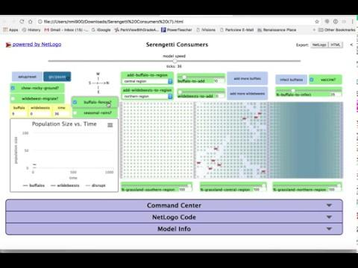
Is there enough evidence to indicate that climate was the cause of the buffalo population increase? Explain.
Complete the computer simulation to see how climate can effect population size.
Simulation
Instruction Page

Slide 25
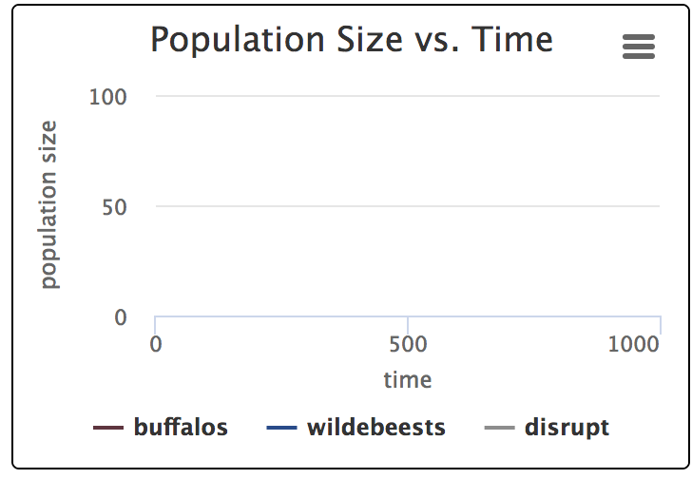
Ecosystem Simulation
Investigation 1 & 2 Computer Simulation
200
Draw the resulting graph in your journal.
(Remember all essential labels)
100
1000
2000

Slide 26
Hunting

Slide 27
Predicting the Effect of Hunting on Buffalo & Wildebeest Populations
If hunters are affecting the wildebeest and buffalo populations, what would you predict the graph of the hunting taking place in the Serengeti would look like?
Amount of Hunting in the Serengeti

Slide 28
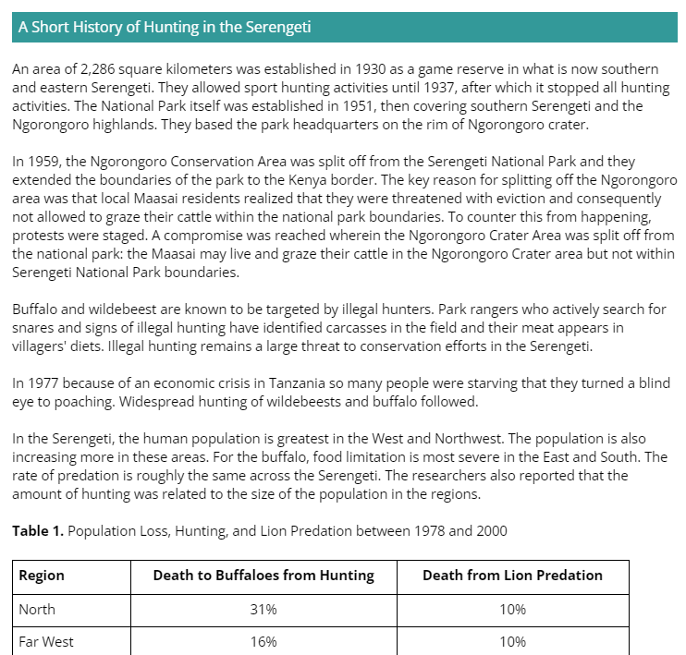
Hunting in the Serengeti
Read the Short History of Hunting in the Serengeti

Slide 29
After reading the Short History of Hunting in the Serengeti, describe the amount of hunting that occurs in the Serengeti. Has it increased or decreased? During what time periods? Based on what evidence?
How does the data/information compare to your prediction from the graph?
After reading through the data, what claim can you make about how hunting affects the stability of wildebeest and buffalo populations?

Slide 30
Document your findings in your student note guide.

Slide 31
Disease

Slide 32
Comparing Buffalo and Wildebeest
Was there a disease that affected the population of buffalo and wildebeest?

Slide 33
Making a Prediction
Predict: If a disease is affecting the buffalo and wildebeest population, what do you predict the graph of the buffalo and wildebeest population would look like if it infected them? If it was eradicated?

Slide 34
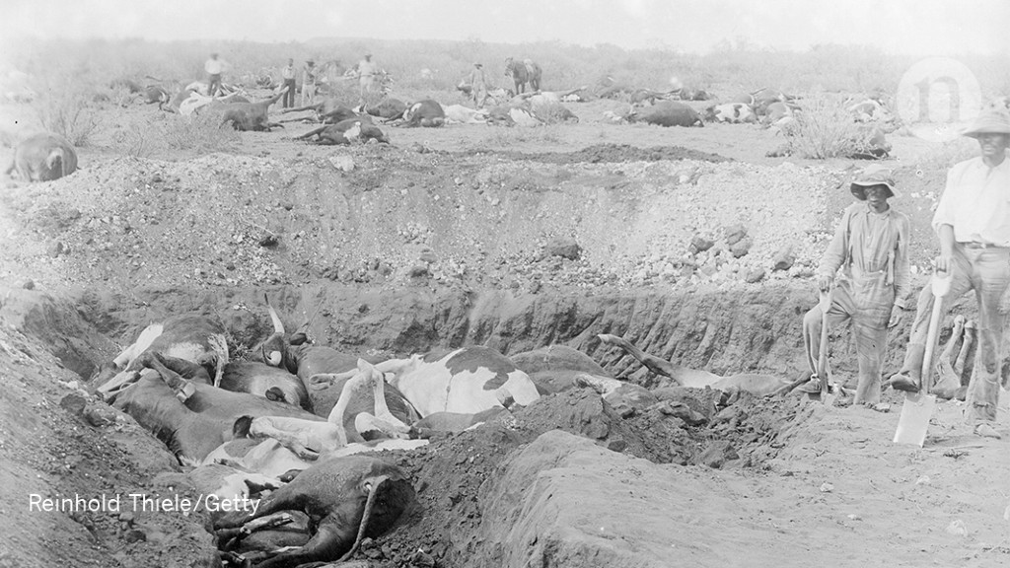
Reading about Diseases
NY Times Article “Rinderpest, Scourge of Cattle, Is Vanquished”
As you read, underline or highlight key evidence that help you make a claim. Cross out with a pen or pencil any information that doesn’t assist you in making your claim.

Slide 35
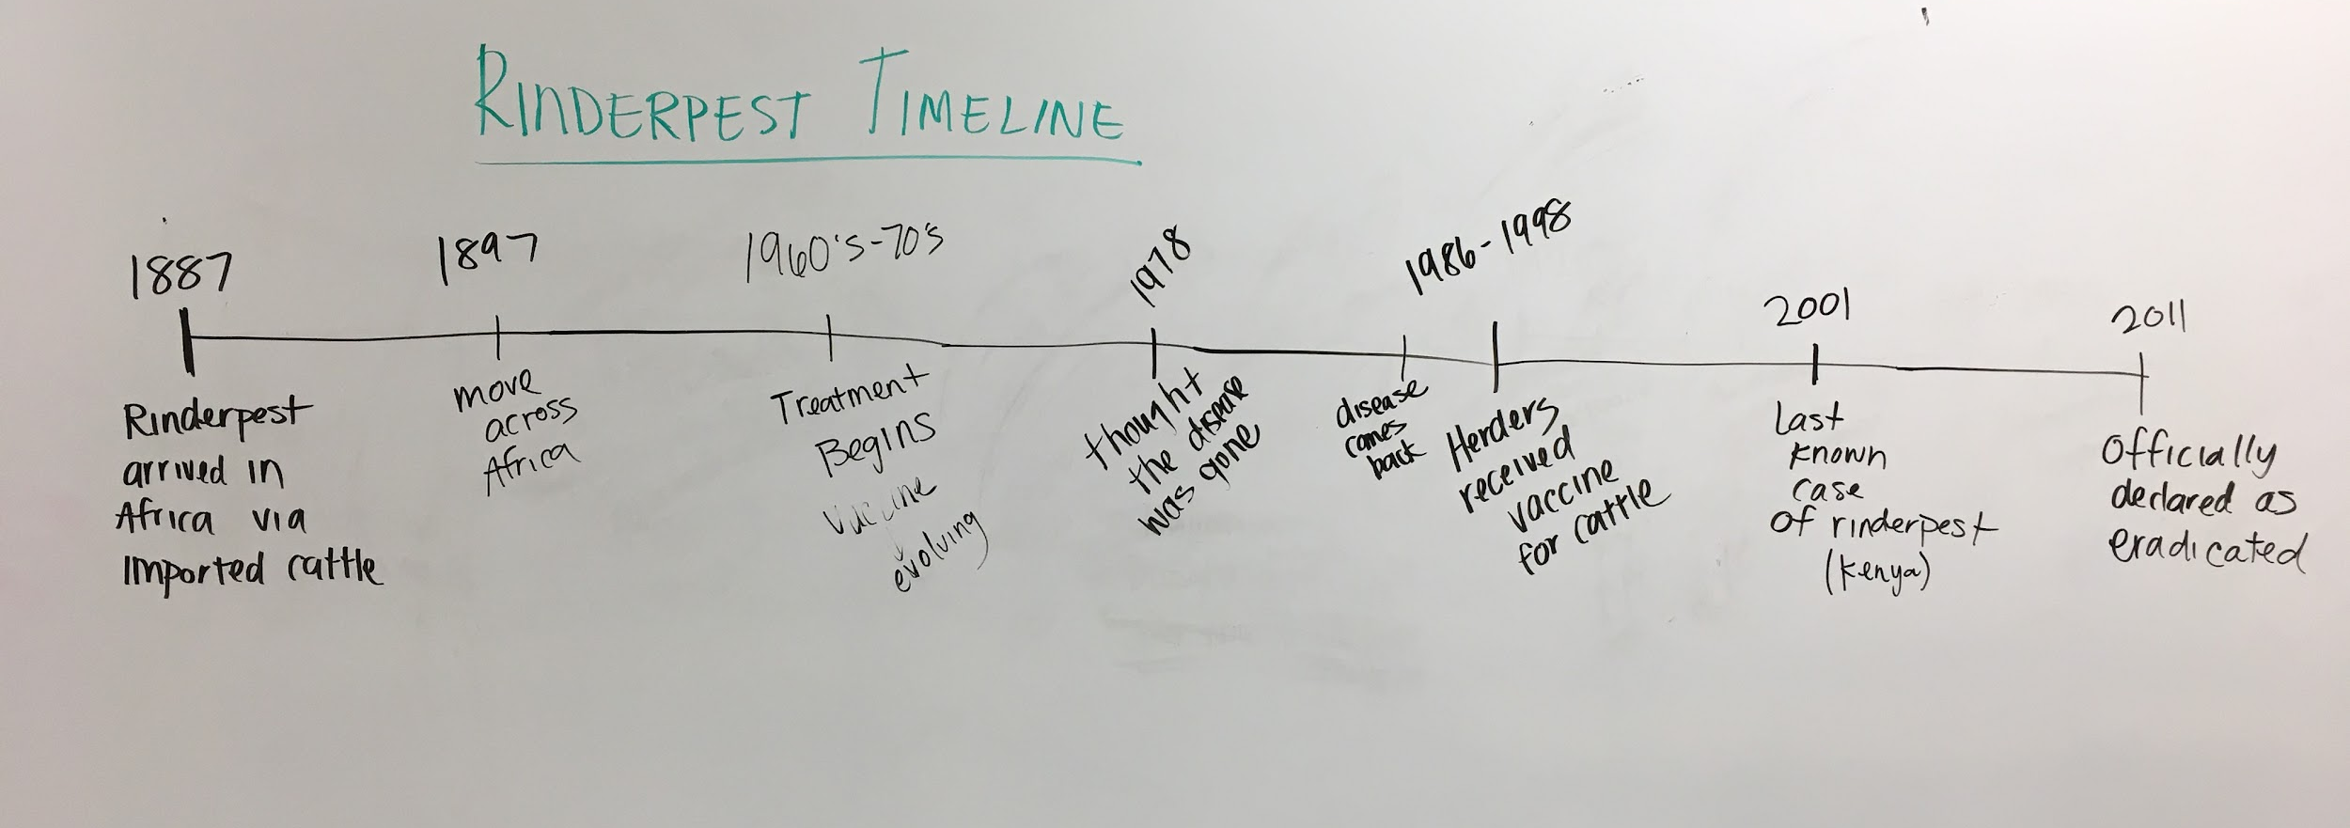

Slide 36
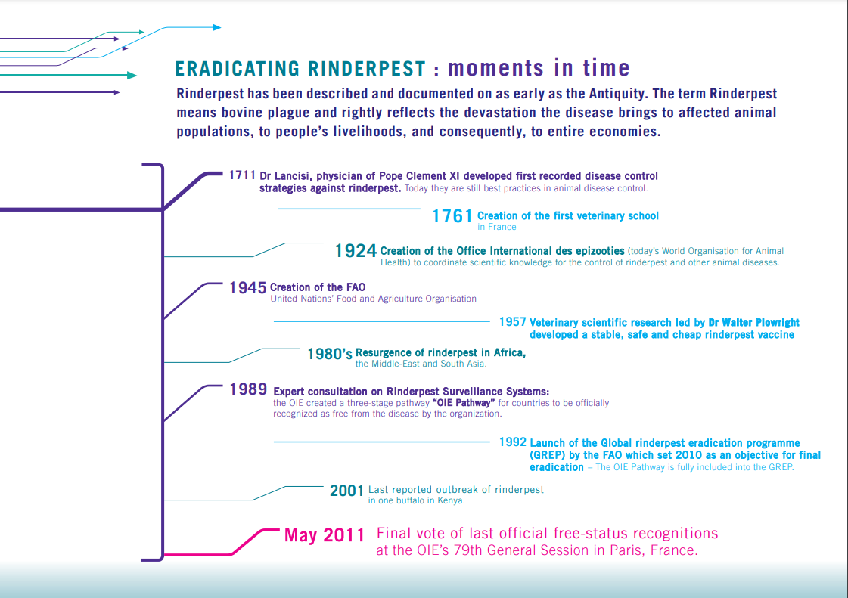
Eradicating Rinderpest: moments in time

Slide 37
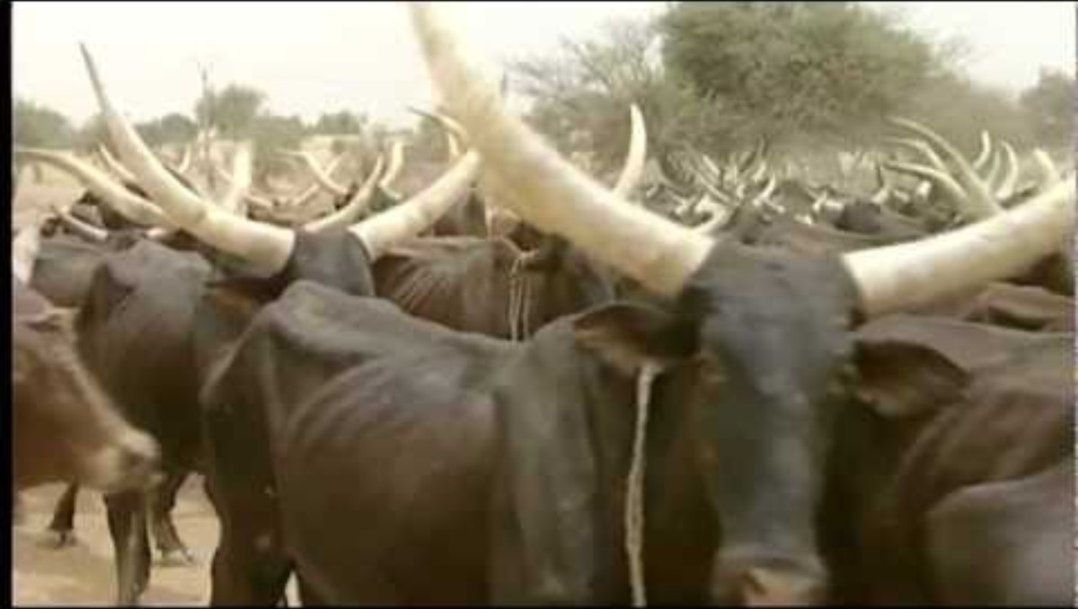
Maasai Elders Remember Rinderpest
Notes:
https://www.researchgate.net/publication/233689164/figure/fig1/AS:300067744436224@1448553133093/Trend-of-cattle-meat-production-in-Uganda-Tanzania-and-Kenya-Source-FAOSTAT-2007.png

Slide 38
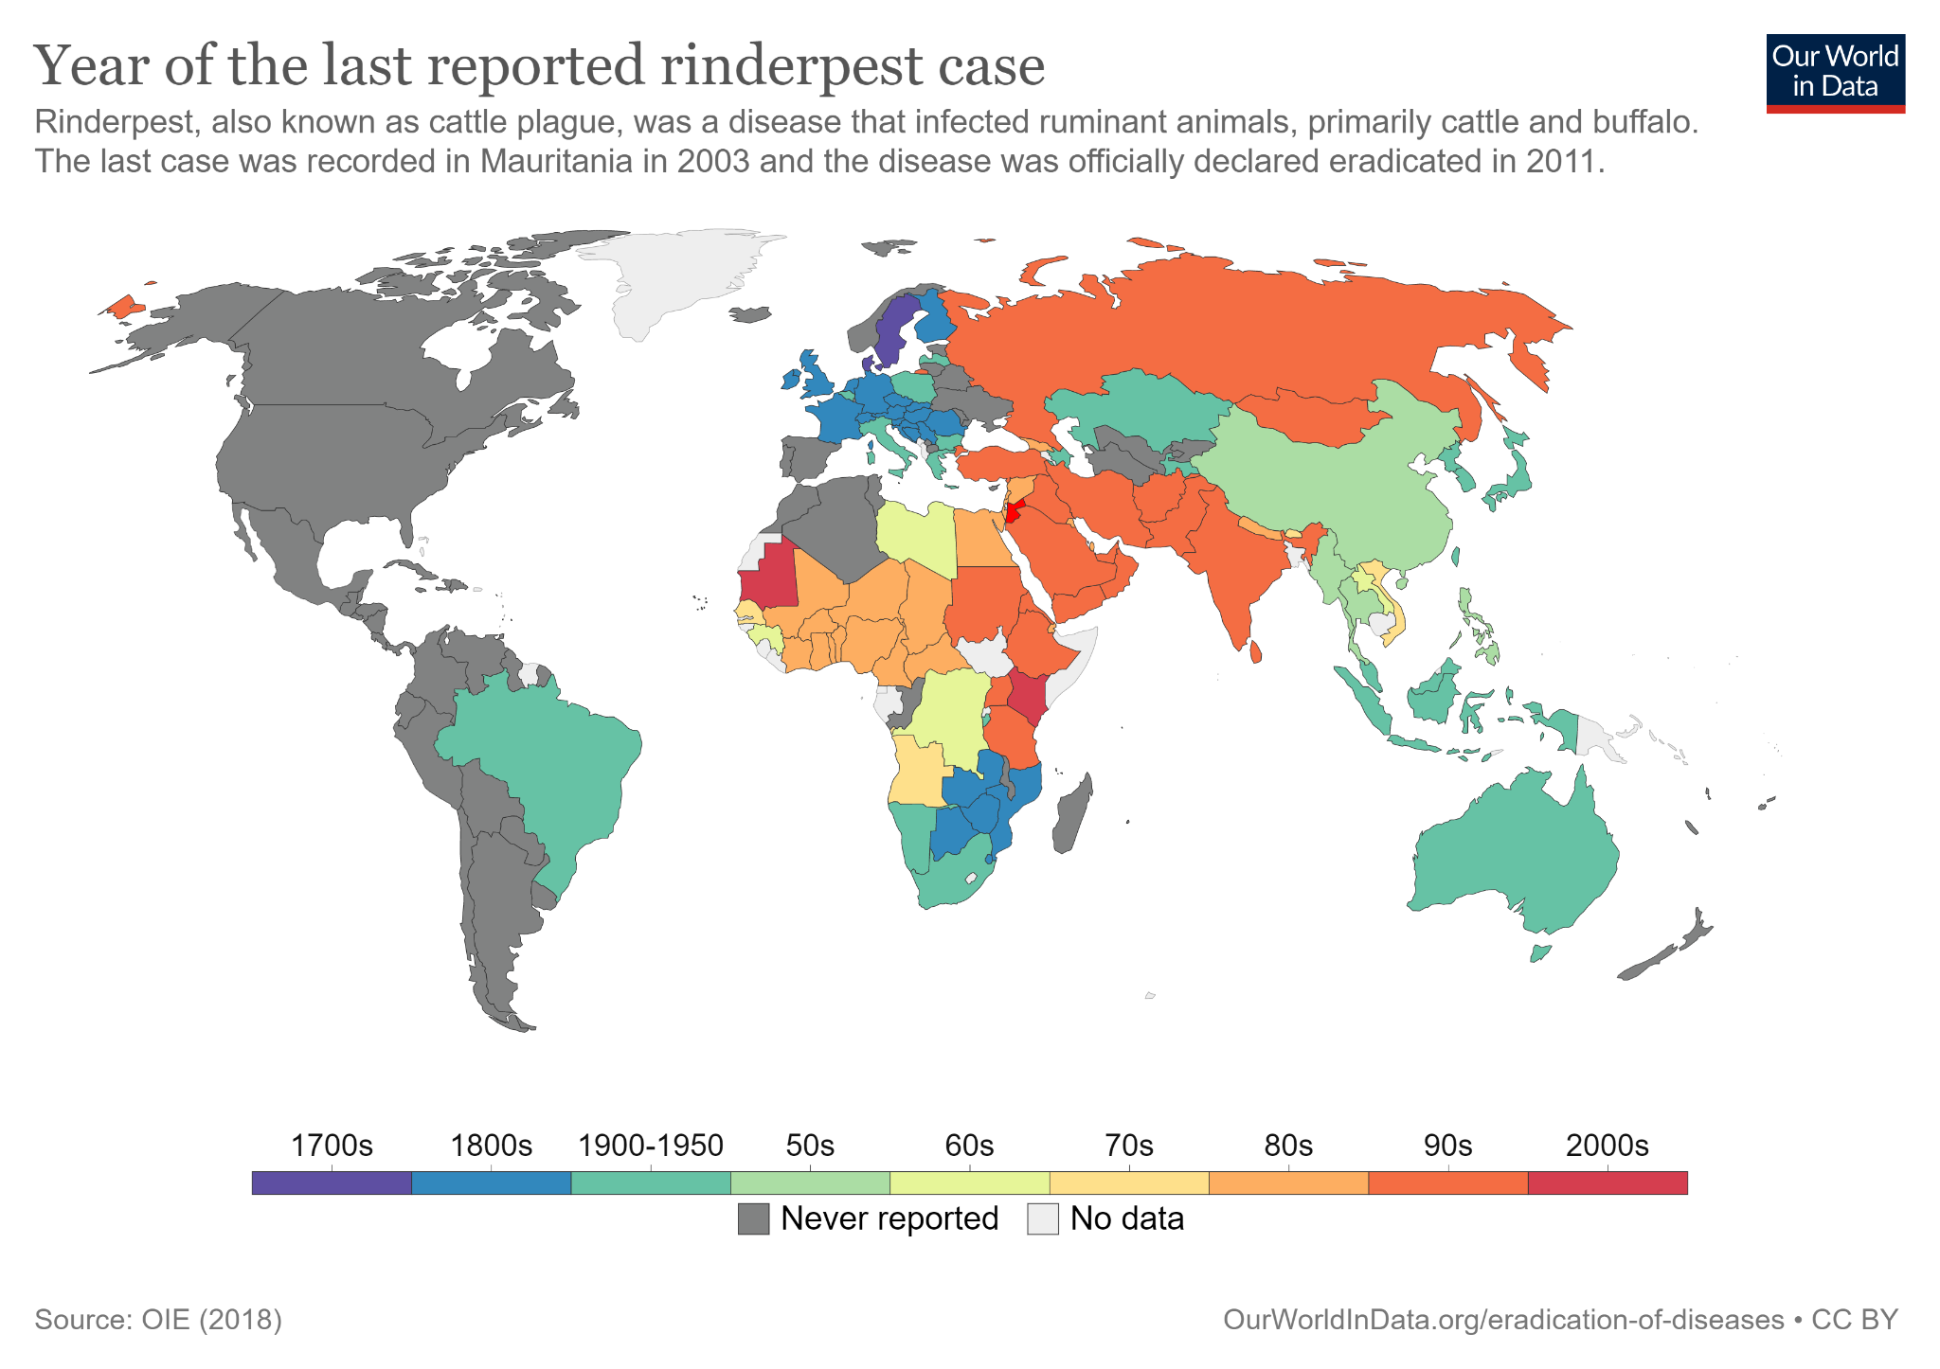

Slide 39
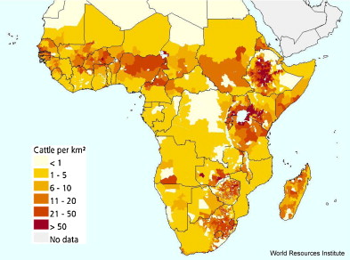
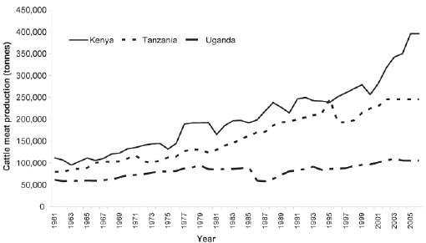
Cattle Production in Eastern Africa

Slide 40
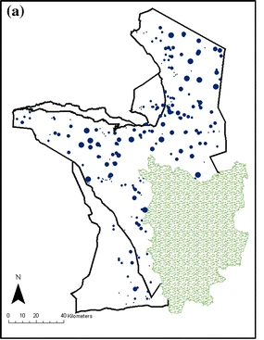
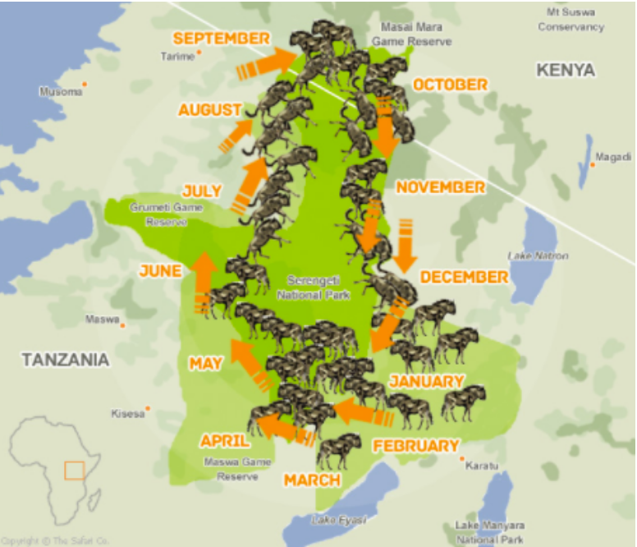
Buffalo and Wildebeest Herds in the Serengeti
The location of all buffalo and wildebeest herds in the 1970s

Slide 41
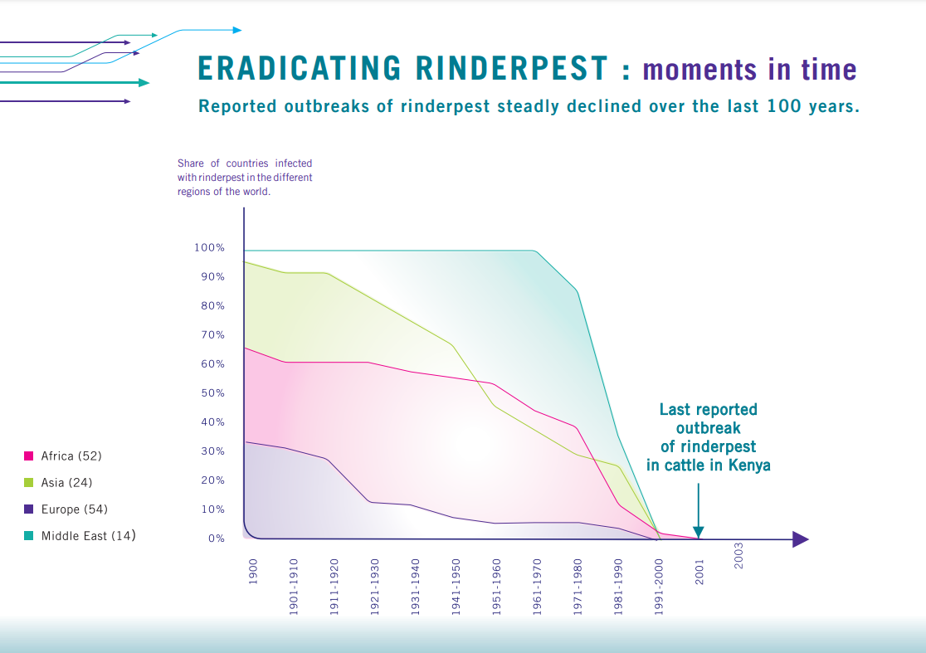
Eradicating Rinderpest: moments in time

Slide 42
Obtaining Information about Disease
Explain how Rinderpest affected the cattle population before vaccination.
Explain how cattle may be involved with buffalo and wildebeest.
After reading through the data, what claim can you make about how vaccination of cattle affects the stability of wildebeest and buffalo populations?
Notes:
Ask the students the questions in this slide so they can begin thinking about the stability and change of the populations.
We want the students to learn that there is competition for food sources, diets shift depending on the season and the effect of abiotic factors such as temperature and precipitation.

Slide 43
Create a Final Model – Two Parts
Part 1:
Demonstrate what you learned about Rinderpest and its effect on the population. This model should include cattle, wildebeest, buffalo, vaccination, and disease.
For BOTH models: Include relevant labels and keys. Include any of the following that apply to your model:
Biotic
Abiotic
Producer
Consumer (primary, secondary, tertiary)
Autotroph
Heterotroph
Predator
Prey
Photosynthetic
Herbivore
Omnivore
Carnivore
Buffalo vs. Bison
ecosystem

Slide 44
Create a Final Model – Two Parts
Part 2:
Create a model to show how one of the following affects the stability and change in the Serengeti populations: diet, reproduction, predation, climate, or hunting.
For BOTH models: Include relevant labels and keys. Include any of the following that apply to your model:
Biotic
Abiotic
Producer
Consumer (primary, secondary, tertiary)
Autotroph
Heterotroph
Predator
Prey
Photosynthetic
Herbivore
Omnivore
Carnivore
Buffalo vs. Bison
ecosystem

Slide 45
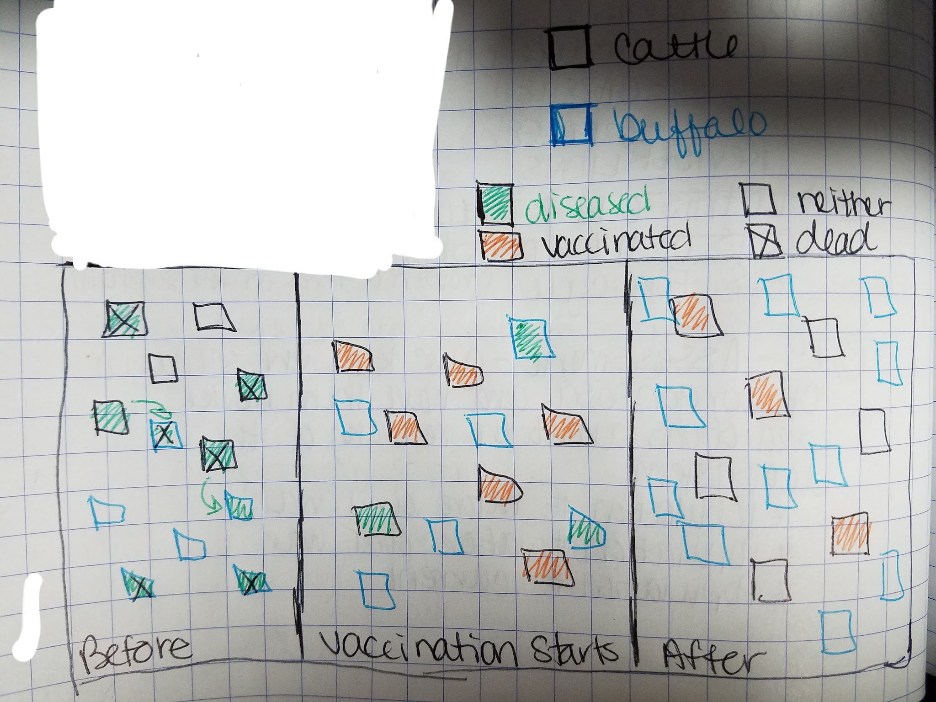
A student example modeling the vaccination of cattle for Rinderpest

Slide 46
Did you include…?
Healthy animals
Diseased animals
Death
Vaccination
Buffalo, wildebeest and cattle

Slide 47

Comparing Buffalo and Wildebeest
What are your initial ideas for why the trends in the buffalo population numbers look similar to the trends in the wildebeest populations?
Now look at the years between 1970 and 1975. What do you notice about the different populations?
What could explain the dramatic jump in the wildebeest population?

Slide 48
Extensions

Slide 49
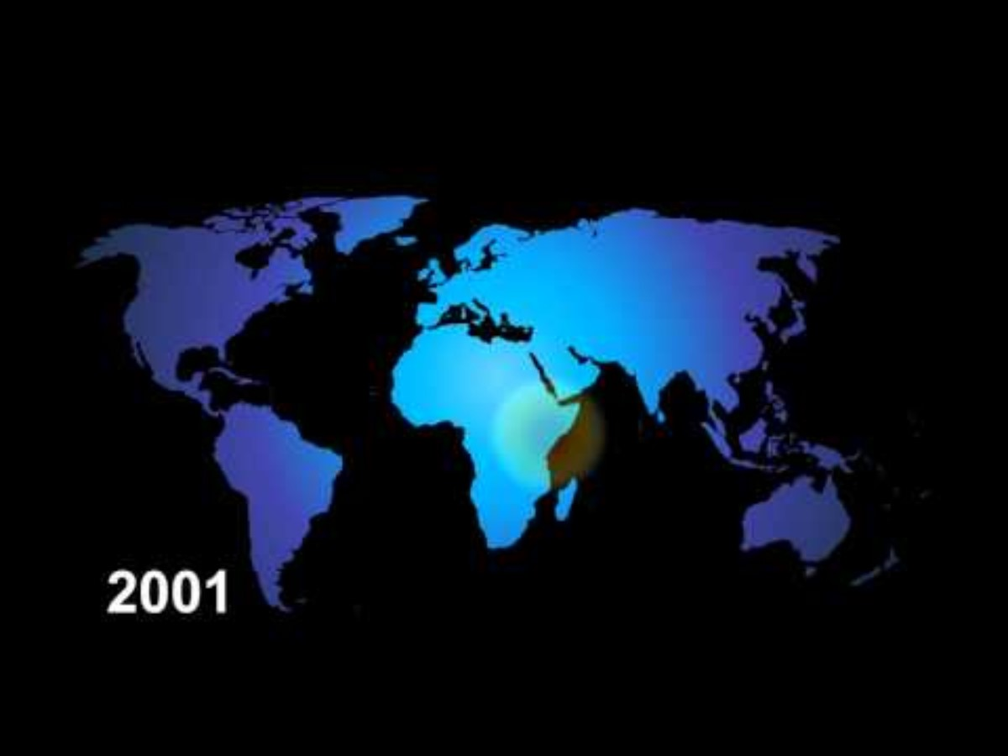

Slide 50
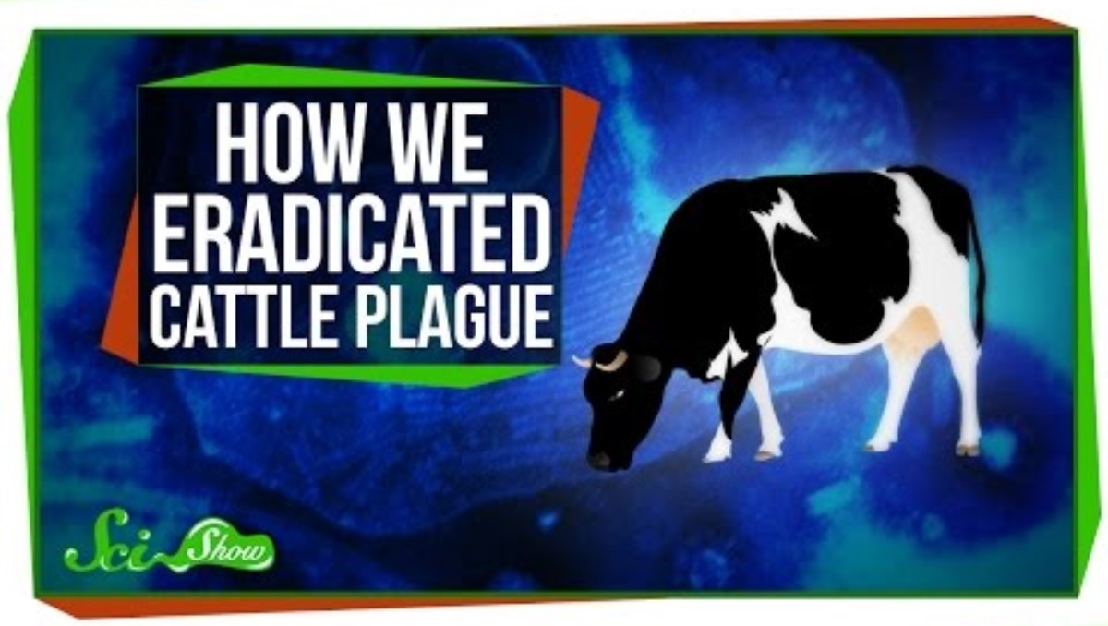

Slide 51
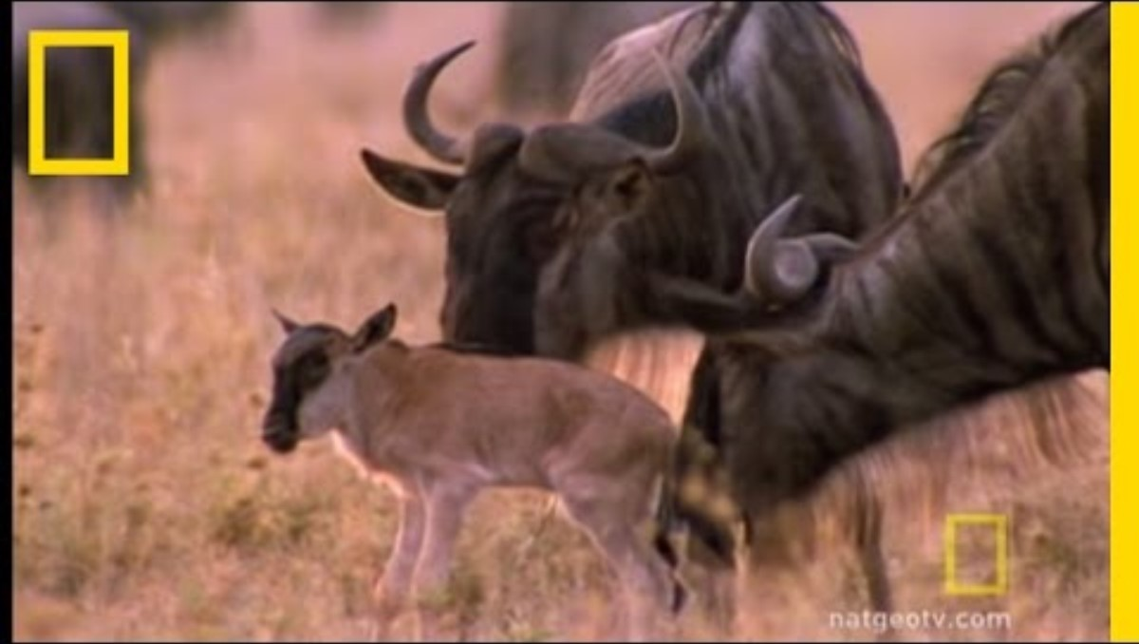
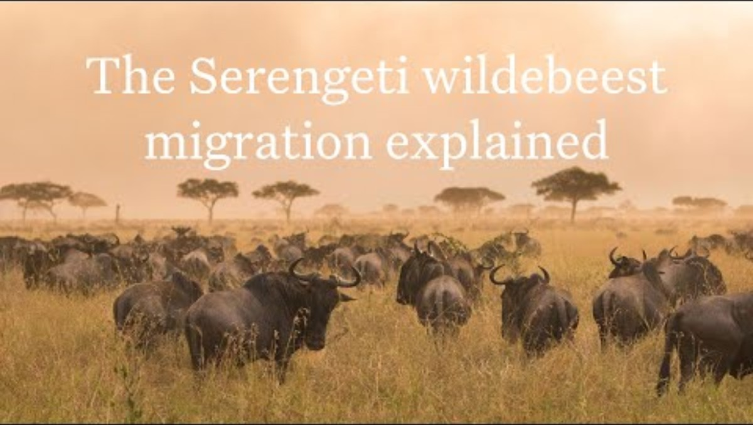
Migration videos
National Geographic: 2:39 min
Wildebeest migration explained: 4 min

Slide 52
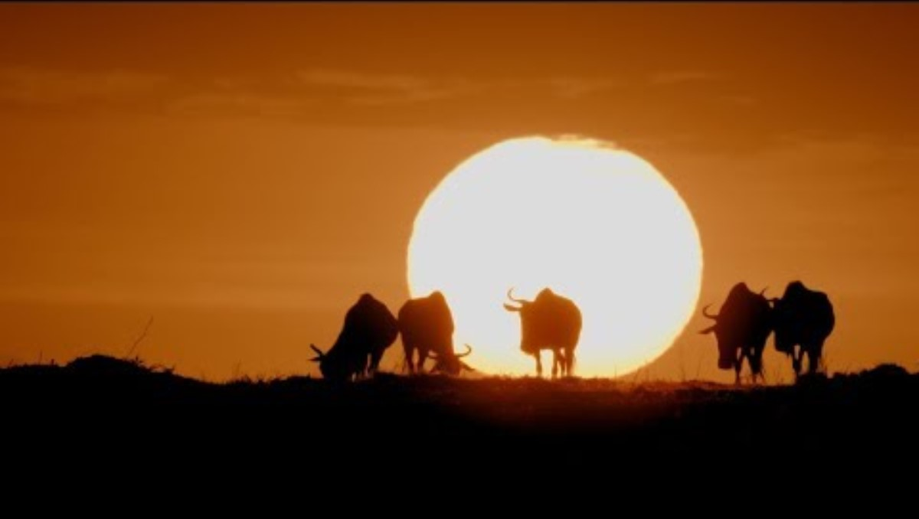

Slide 53

How do Vaccines Work?

Slide 54

3D-RST is supported by the NSF under grant number #DRL-2101383

