Slide 1
Objectives
Interdependent Relationships in Ecosystems
Obtaining, Evaluating, and Communicating Information
Systems and System Models

Slide 2
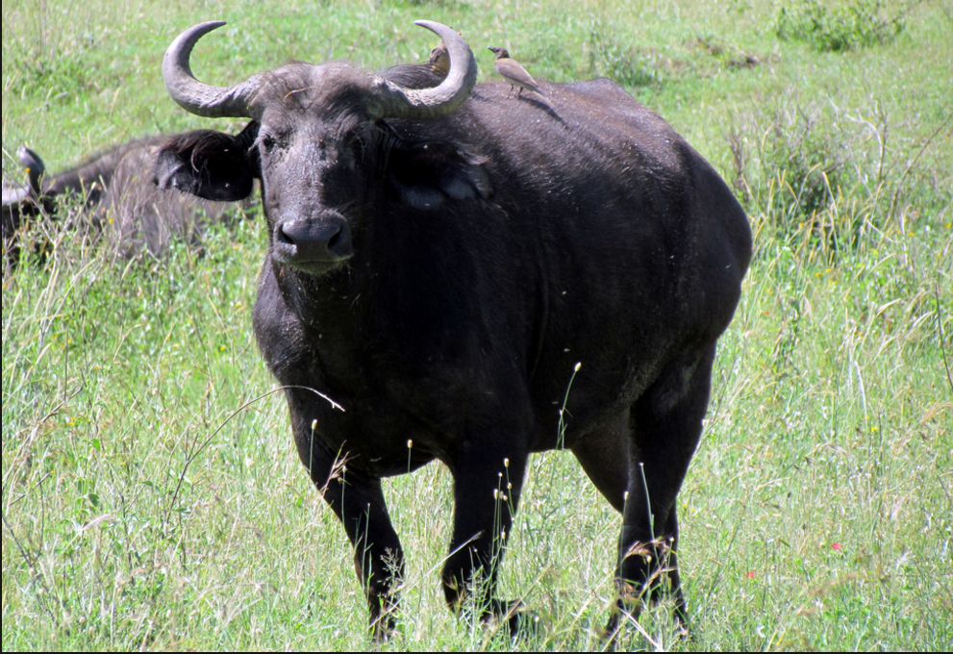
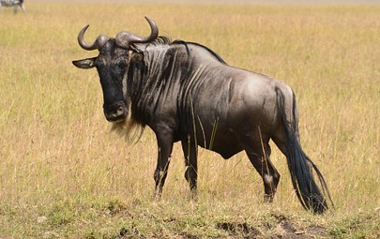
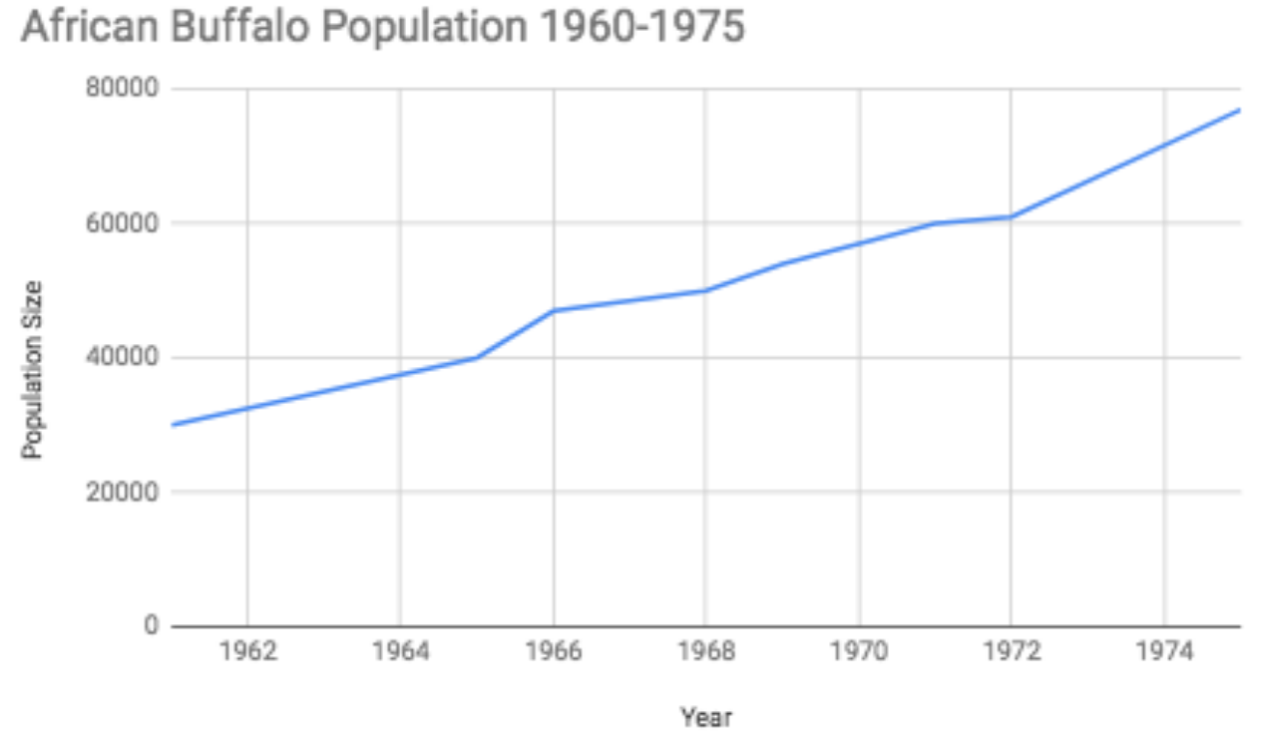
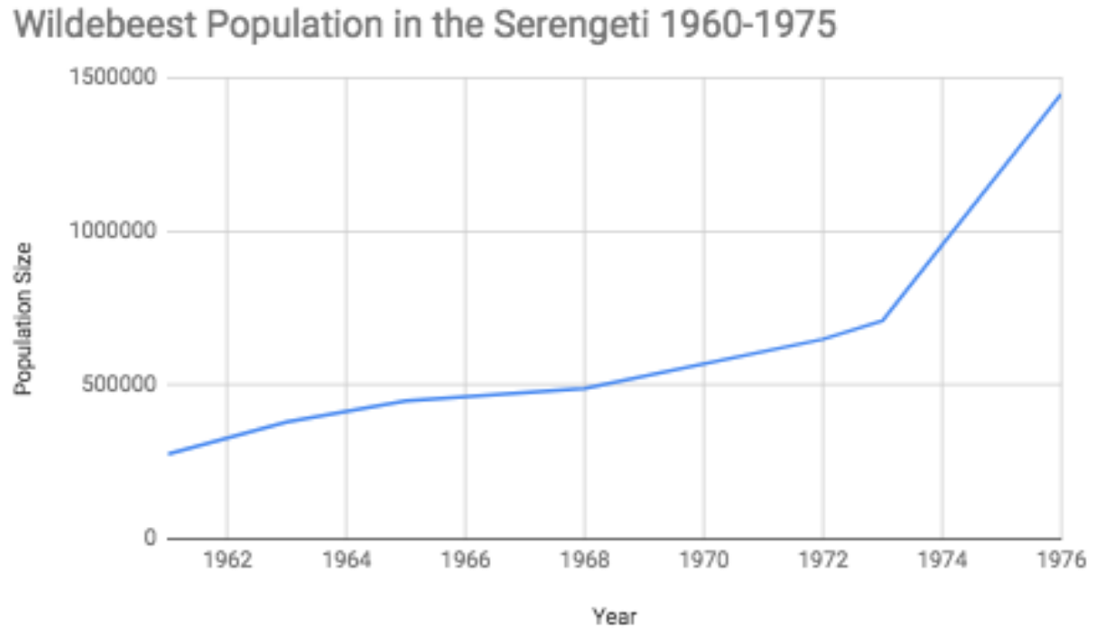
What do you notice? What do you wonder?
Notes:
(20 min) Present the students with the buffalo and wildebeest population data taken from the Serengeti over the same time frame.
“Fortunately, I was able to find a lot of data about the wildebeest population in the Serengeti during this time so that we can compare and figure out what might be going on with the wildebeest.”
Refer to the Part 1 Procedure section of the Student Activity Sheet. Provide students time to analyze the data (item #3), make observations (item #4) about the data patterns and to answer the initial ideas question (item #5).
Next, shift to a Sharing Initial Ideas Discussion.
Suggested Prompts:
What are some similarities in the two graphs?
What are some differences in the two graphs?
What patterns do you notice in the buffalo graph after rinderpest?
What patterns do you notice in the wildebeest graph after rinderpest?
Listen for student responses that mimic the next step in the story line, such as
There are a lot more wildebeests than buffalo.
After rinderpest the buffalo went up.
After rinderpest the wildebeest went up.
Suggested Prompts:
What are some ideas you have about why the population numbers are different between the buffalo and wildebeest?
Why are the trends in the buffalo populations different than the patterns in the wildebeest population?
What should we look up to figure out why the wildebeest population show such a sharp spike in population?
What factors affect whether a populations can grow?
Listen for student responses that mimic the next step in the story line, such as
Maybe how many babies each group is having.
How much food they can eat.
How much space they have to eat from like migration.
When do they die? Like does 1 species live longer than the other?
We should look up how many offspring each buffalo has compared to wildebeest.
We need to know more about where they live and if they have more food or space.
We still have a lot of questions like:
Which live longer, buffalo or wildebeest?
Which have more babies?
Which have more food to eat?

Slide 3
System
Interdependent or interrelated objects comprising and functioning as a whole.

Slide 4
Ecosystems
What terms do we use to describe parts of an ecosystem?
Draw and label a model of our local ecosystem.
Compare your model with students around you.

Slide 5
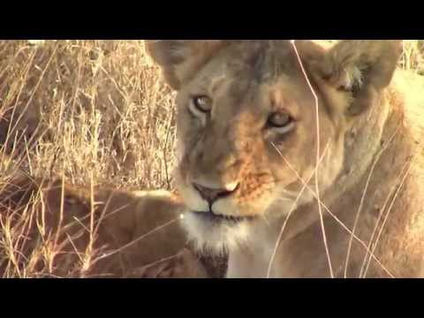
Welcome to the SERENGETI Ecosystem
Write at least 5 observations from the video in your science journal.
Notes:
(5 min) Watch and discuss the Short Serengeti Video (embedded in slides) and answer question 7.
“I found this video clip that I think could help us out. It’s only about a minute, but I think it will give us some helpful images of the wildlife in the Serengeti. While you are watching, record at least 3 observations in question 7 of the Student Activity Sheets so that we can share out any ideas and patterns.
After the clip, give students a moment to turn and talk about their observations and takeaways or patterns with people nearby.
Suggested Prompts:
What did you notice?
What did your noticings have in common?
What is one takeaway from the video?
Are most of the animals in the video big or small?
What species were interacting?
Who was eating who?
What did the environment look like?
Ask students to make sure they are writing down all their observations in question 7 so that we can discuss them. Listen for student responses that refer to their observations and key takeaways from the video, such as:
I saw a lot of big animals.
I saw some baby animals with adult animals.
I saw a lion chasing zebra or something.
I saw a lot of mammals.
There was a lot of grass, but I saw some trees with monkeys.
I saw rhinos, monkeys, lions, giraffes, zebra, etc.
We still have a lot of questions like:
What other animals are in the Serengeti?
What is the climate like there?
Do any animals move around or do they all stay in the same place?
Where does the park end?

Slide 6
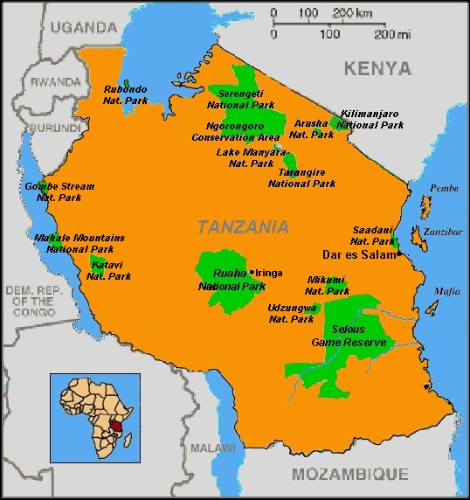
Where is the
Serengeti?
Draw a quick map in your journal of the location of the Serengeti.
Google Maps link to Serengeti

Slide 7
What information do we need to evaluate about the Serengeti ecosystem to help us understand why the buffalo and wildebeest populations increased?

Slide 8
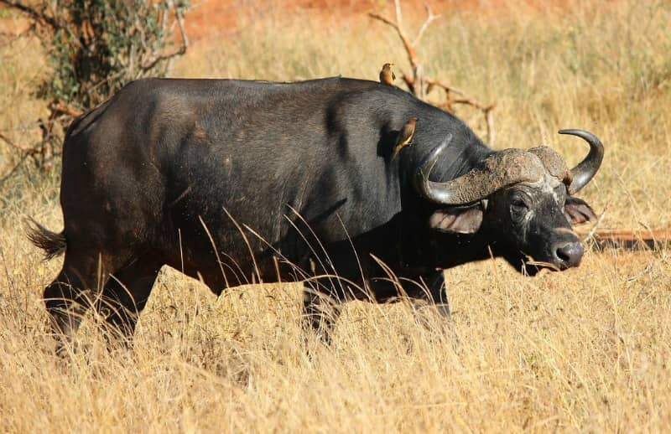
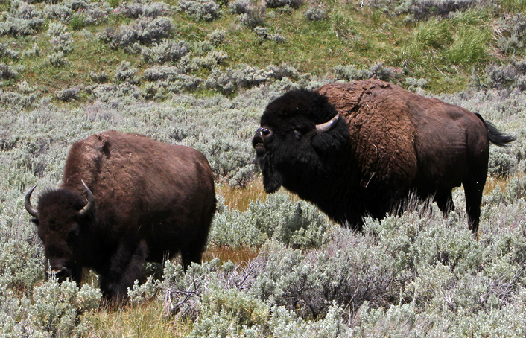
Buffalo vs. Bison
What are the differences between these animals?

Slide 9
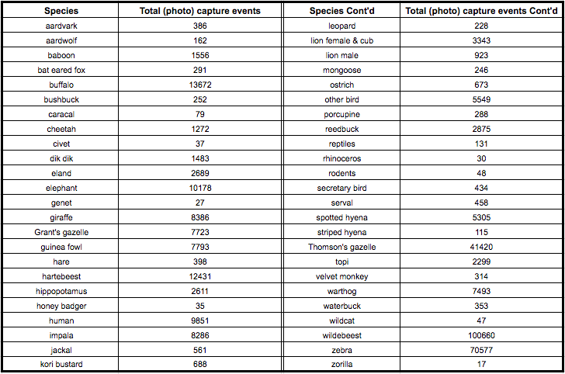
Trail Cam Data

Slide 10
Complete the organism card
Evaluate each of your organism cards with your team
Gallery walk of all organism cards:
Find an organism for each term on your gallery card.
You may not use an organism more than once.

Slide 11
I know some of these words…
Color code your terms according to your understanding.
Green: I know it.
Yellow: I partially understand.
Red: I don’t understand.

Slide 12
Abiotic vs. Biotic Serengeti
Abiotic
Biotic

Slide 13

3D-RST is supported by the NSF under grant number #DRL-2101383

