Slide 1
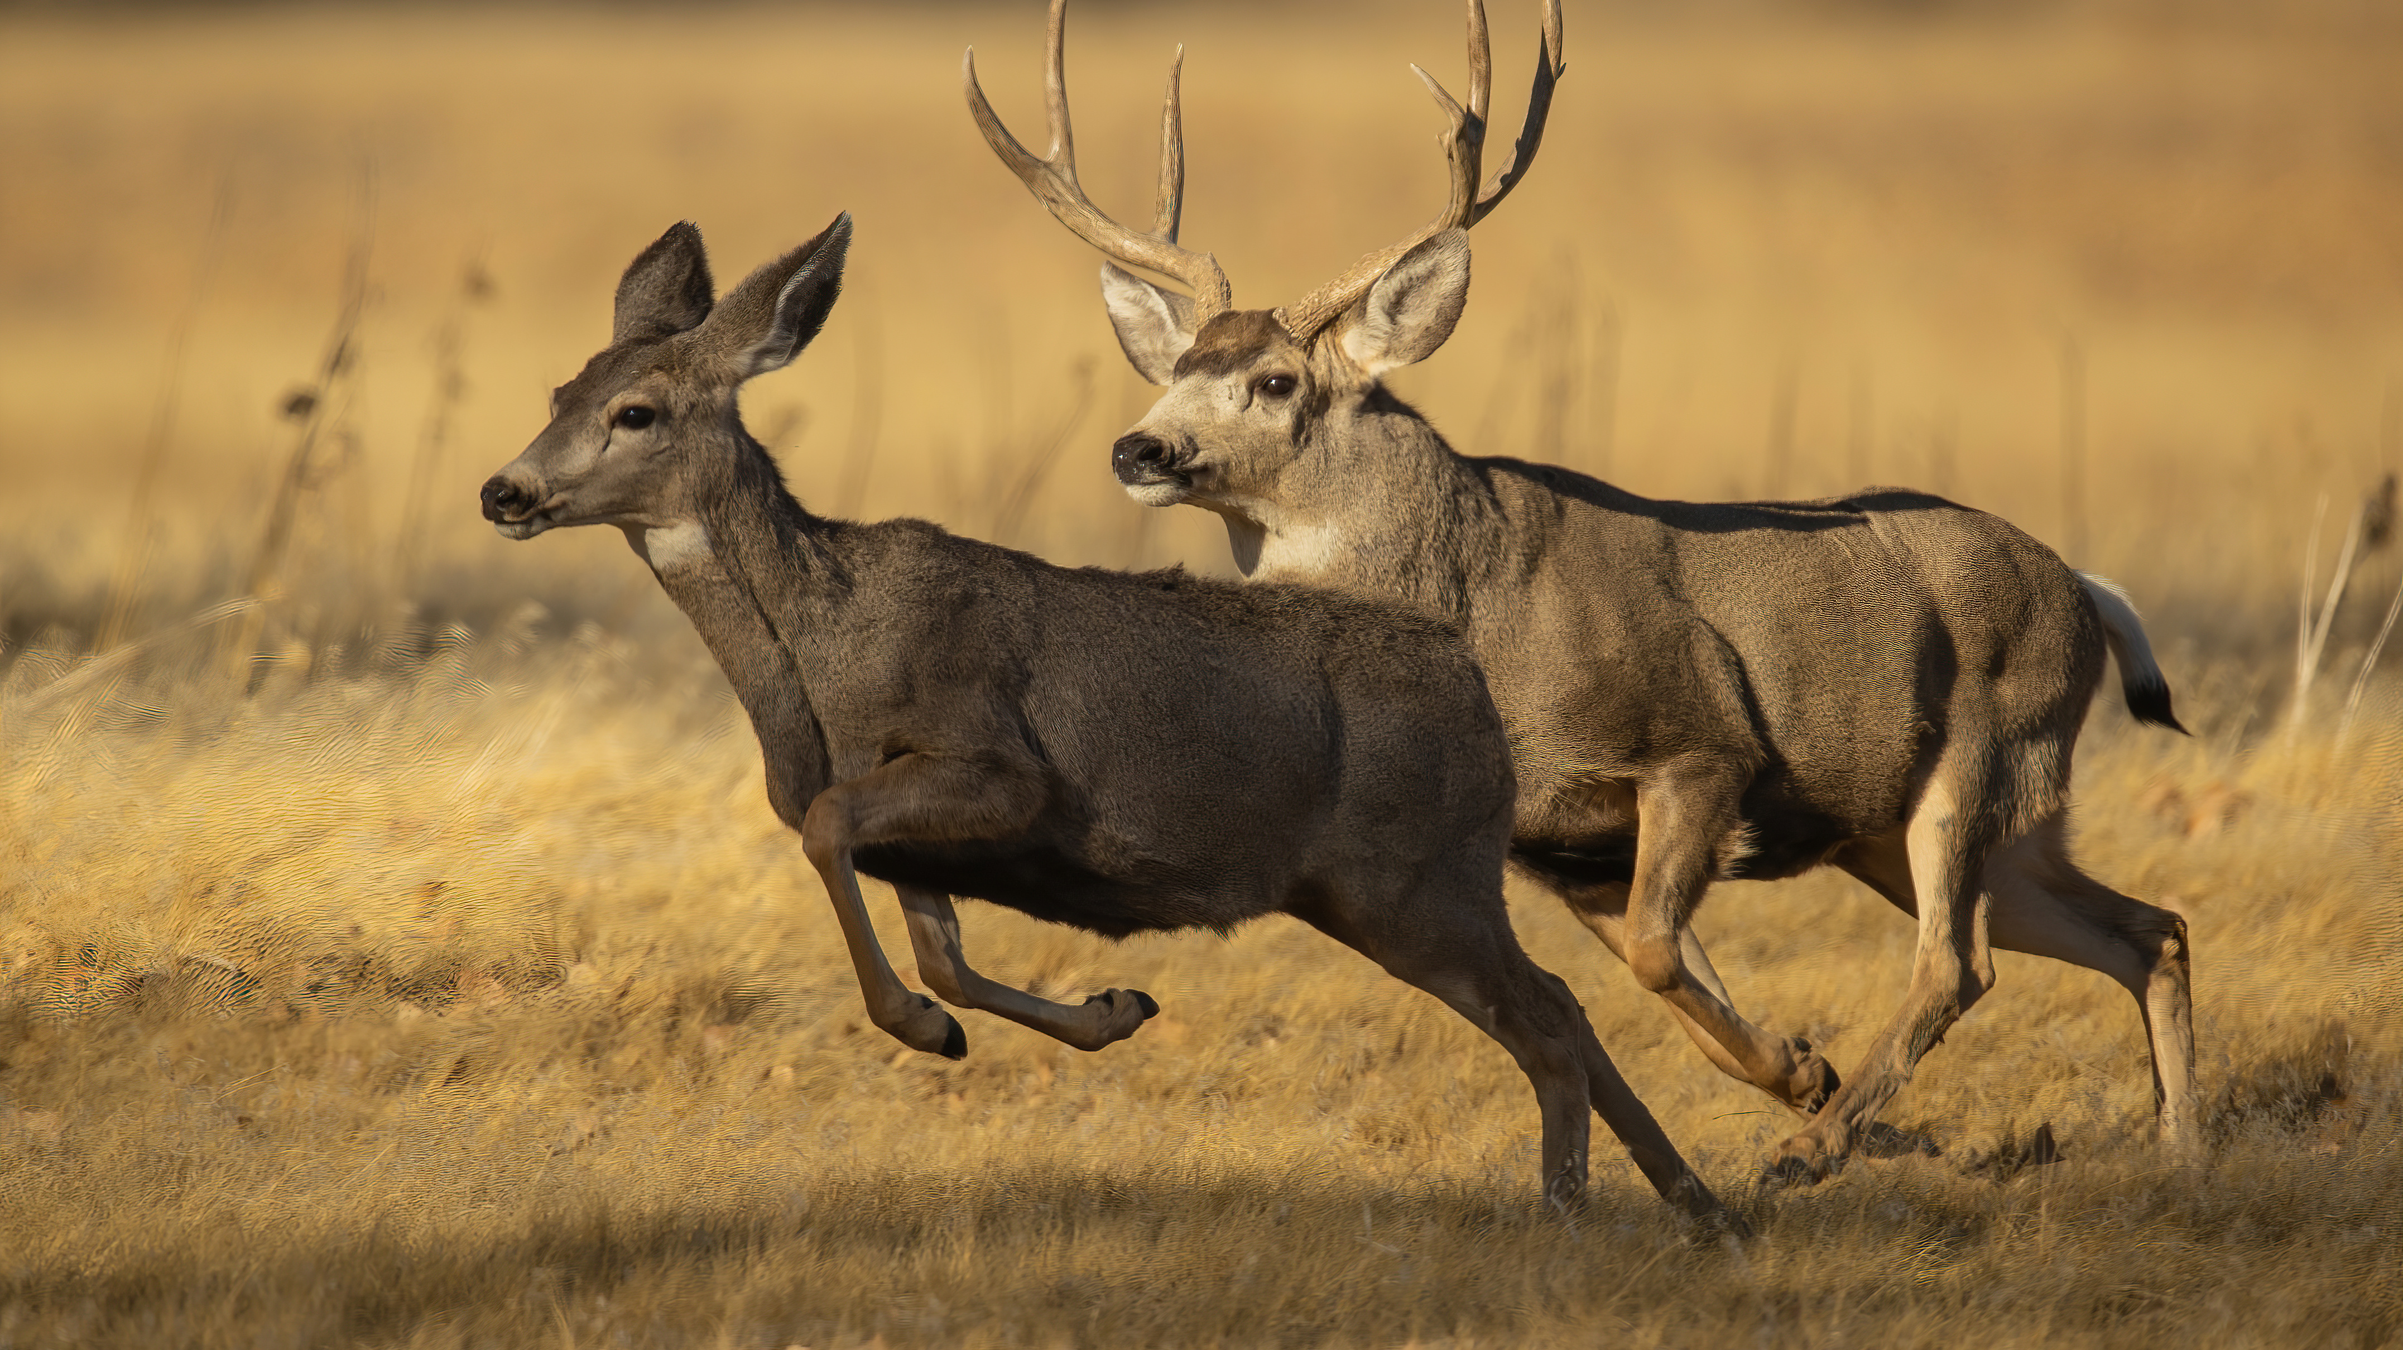
Stability of Local Populations
https://www.youtube.com/watch?v=DnSurR0Y9x4

Slide 2

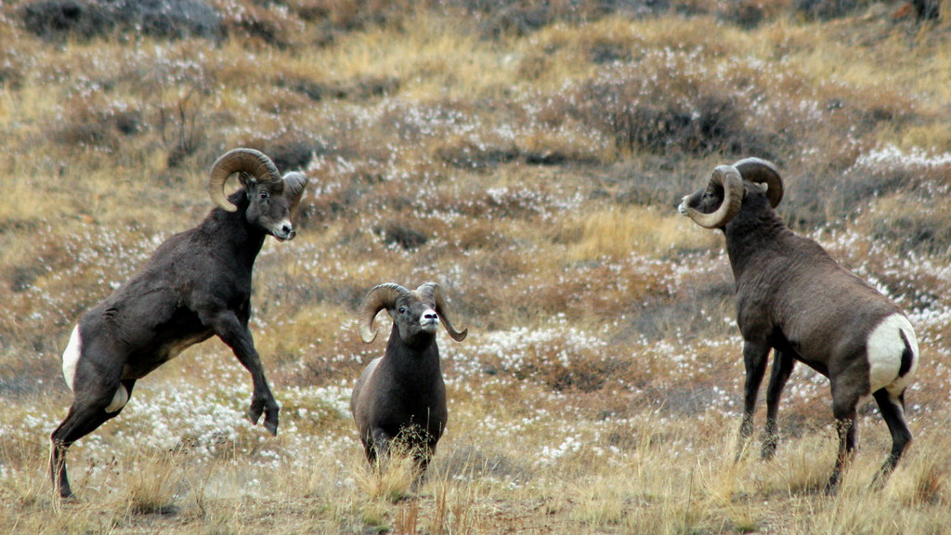
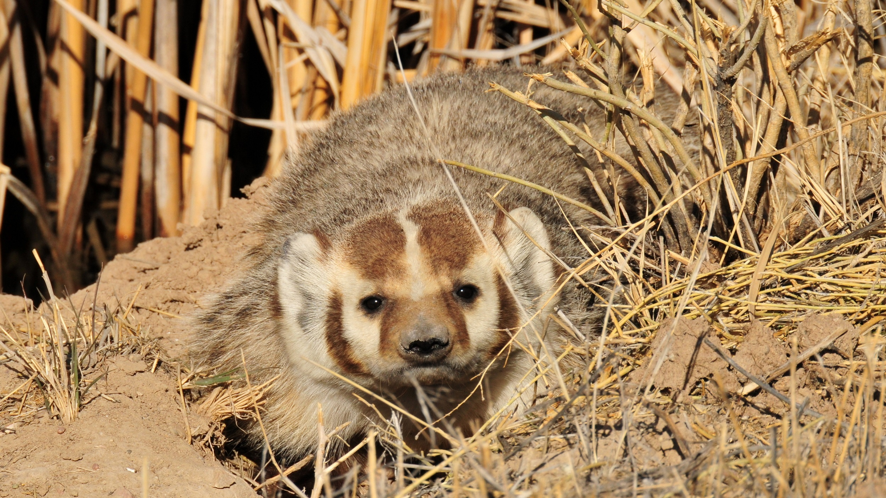
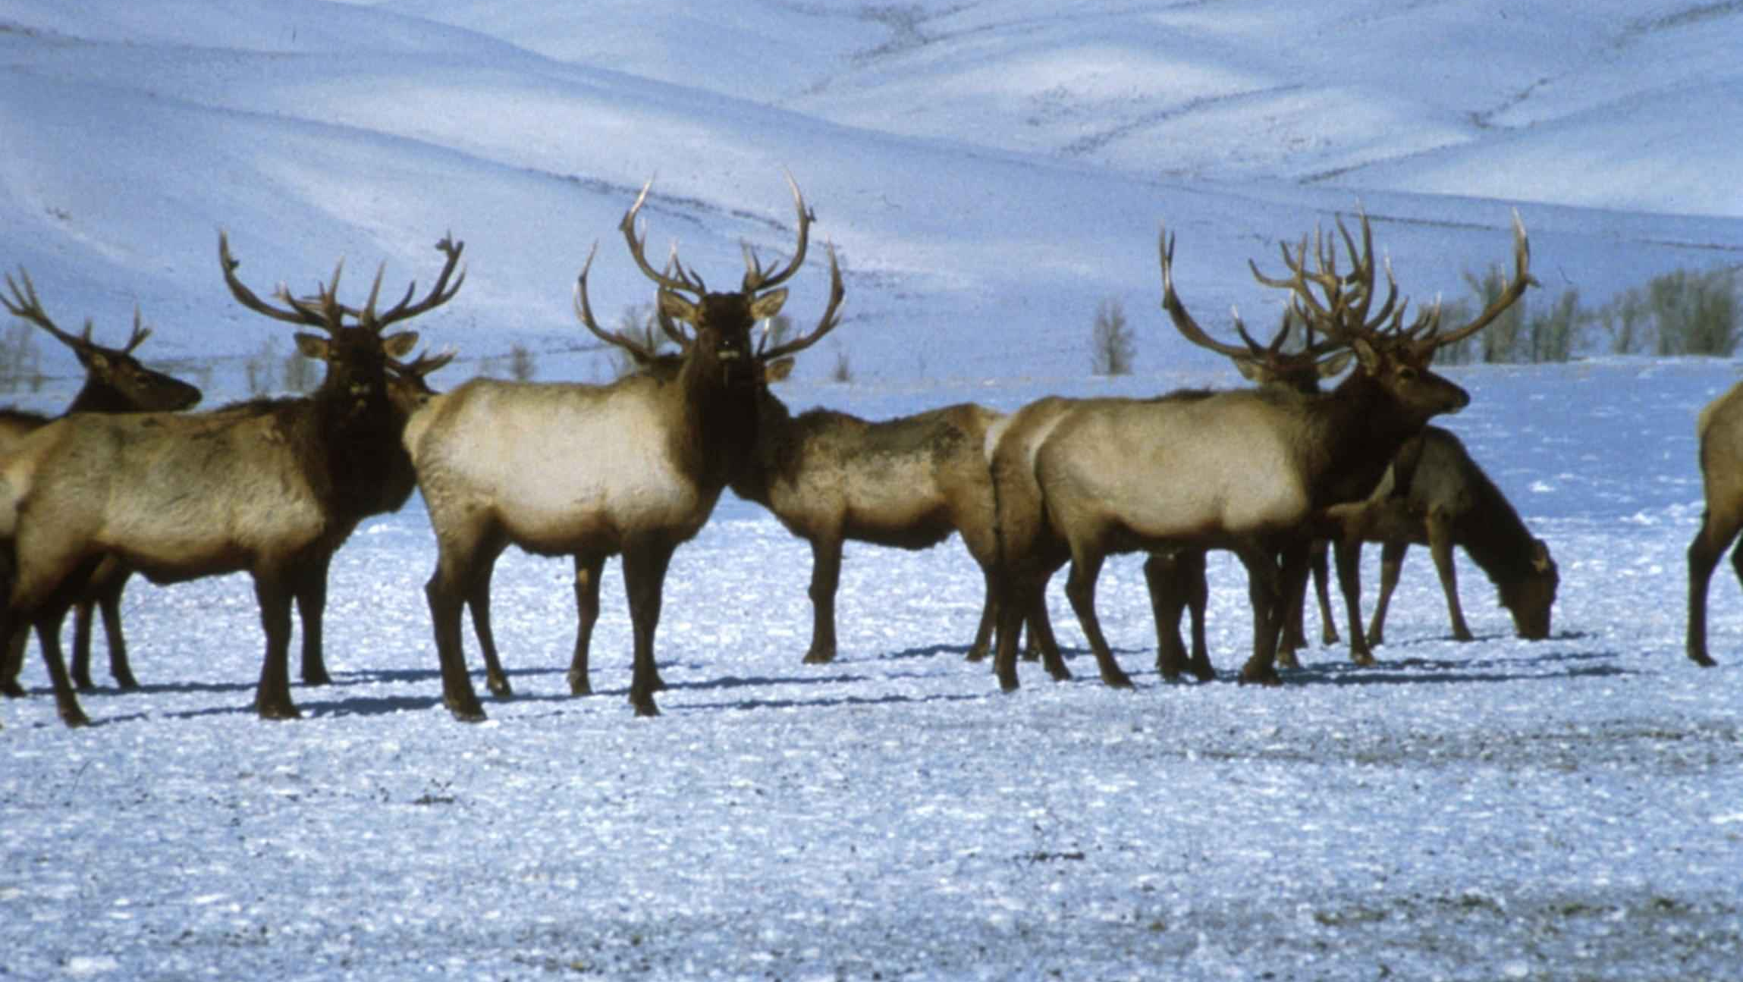
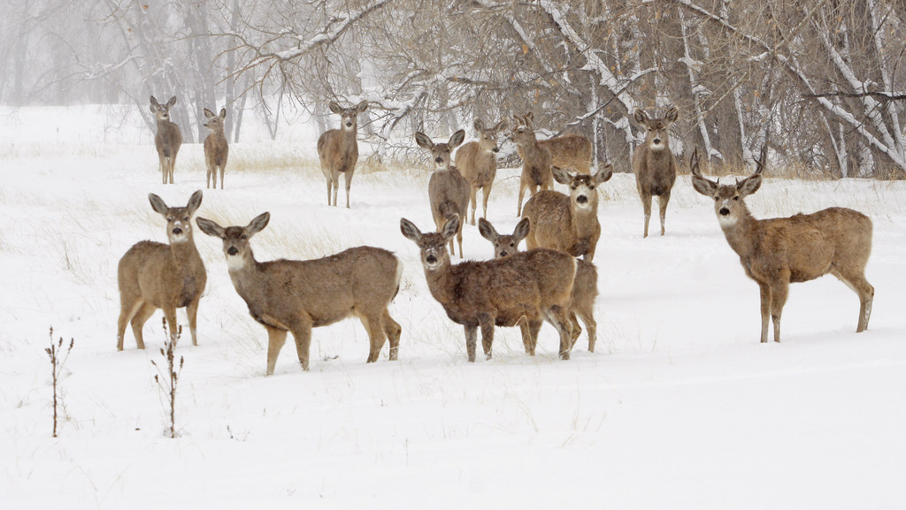
List as many animals that live in Utah as you can.
Notes:
Question 1

Slide 3
Compare your list to your neighbor's
Notes:
Question 1

Slide 4
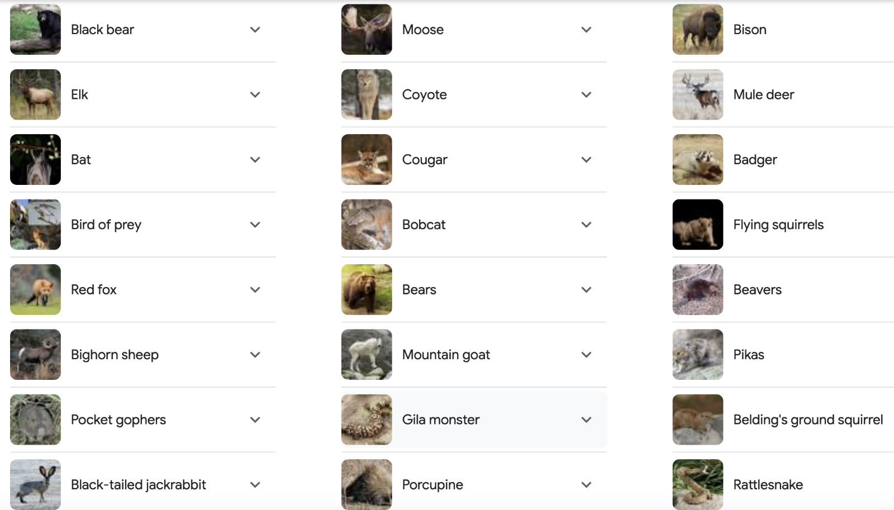
Notes:
Question 2-4
Do nature walk after question 3

Slide 5
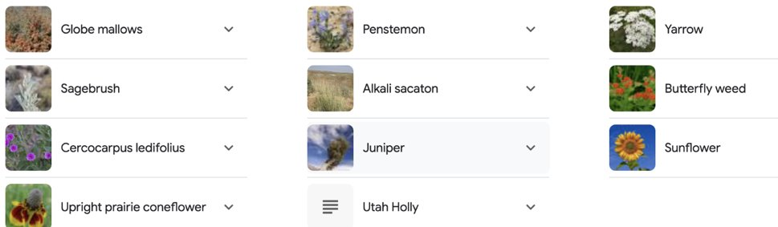
Utah Plants

Slide 6
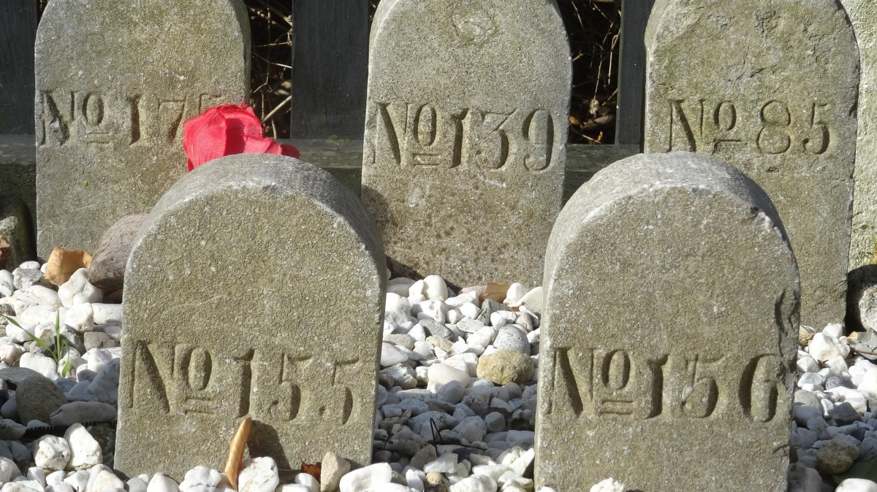
What if . . .
Explain what would happen to the ecosystem if your organism was no longer present.
Notes:
Question 5

Slide 7
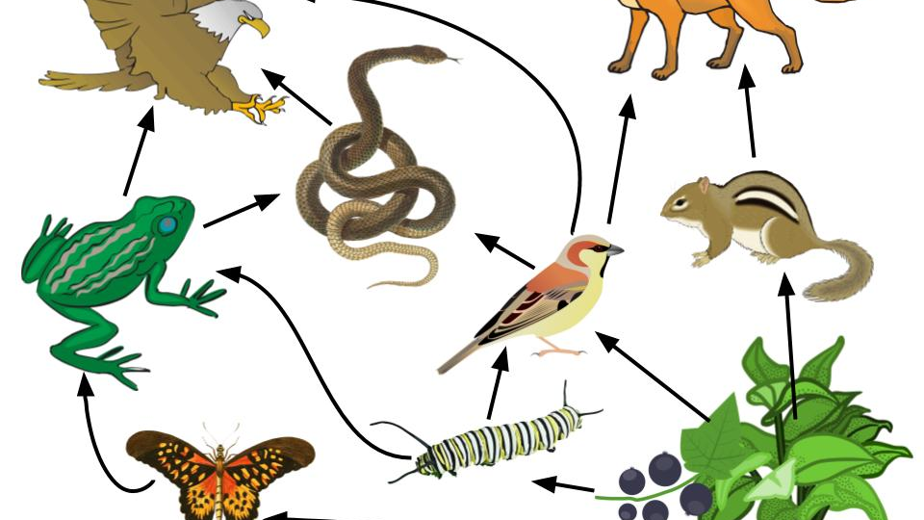
Stability
Explain would happen to the ecosystem if your organism were no longer present?
What factors would allow the population to remain stable?
Notes:
Question 6-7

Slide 8
Change
What evidence would you look for in an ecosystem that shows that it is unstable?
How would a natural disaster change the population of your animal?
Notes:
Question 6-7

Slide 9
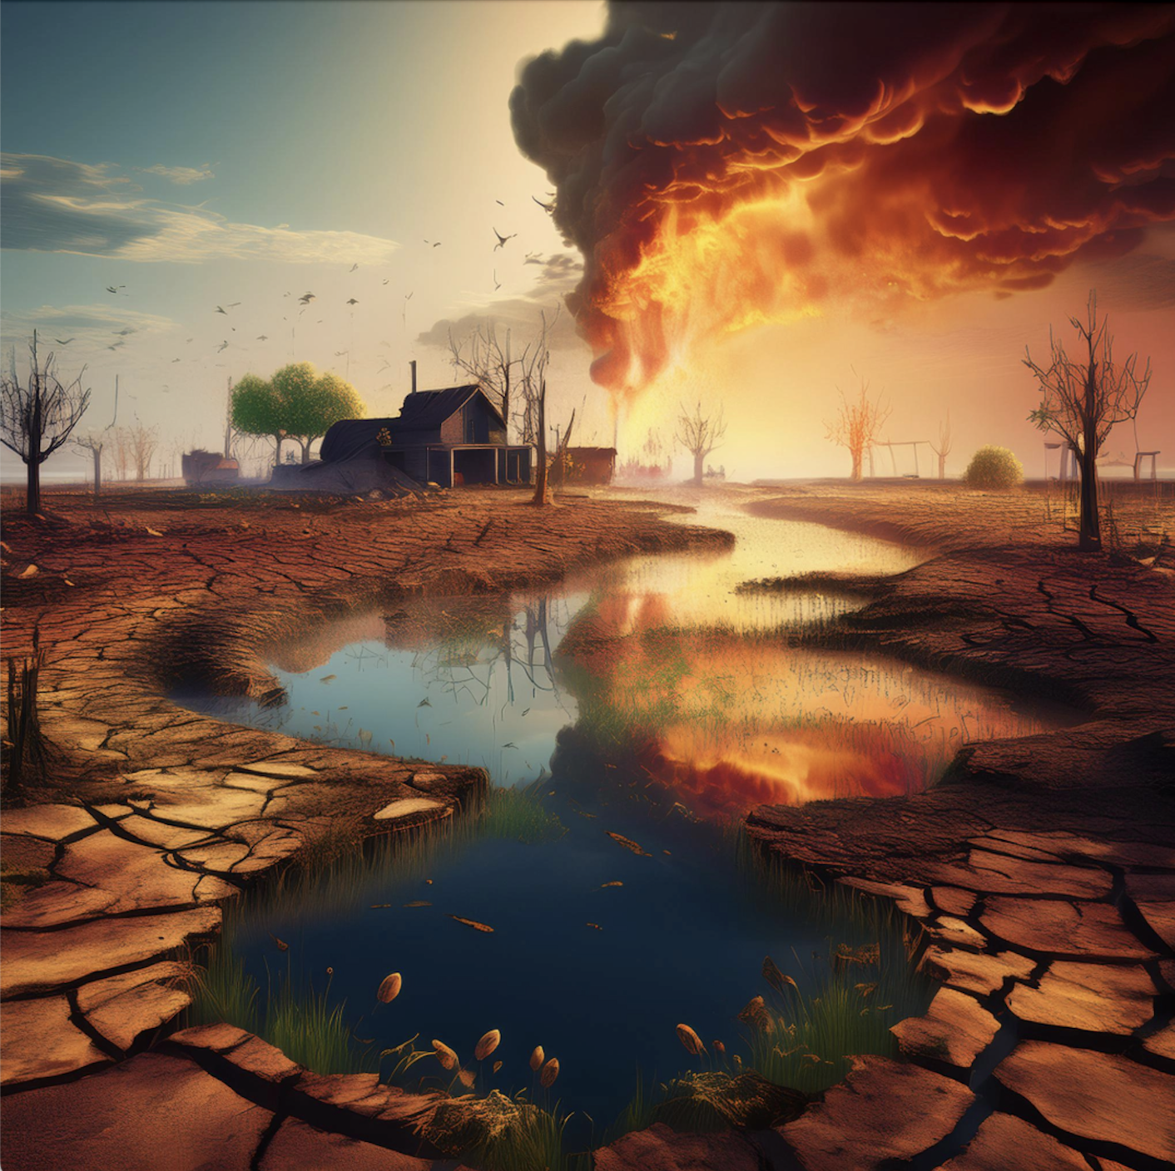
Let's Talk About Your Answers!!
    Predation
    Hunting
    Drought
    Urbanization
    Disease
    Weather
    Water Increase
    Reproduction
    Seasonal Weather Change
    Wildfires
    Floods
    Invasive species
    Carrying Capacity
Did you come up with.....?

Slide 10
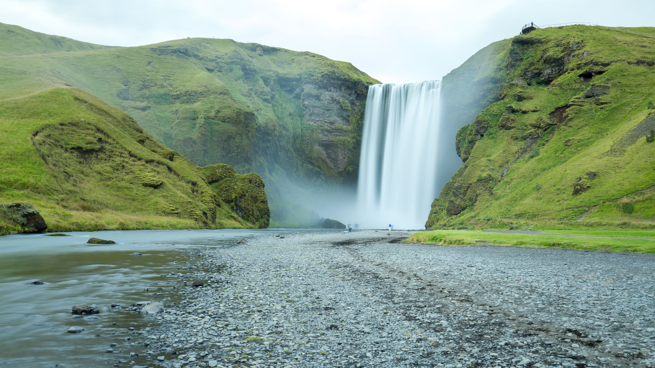
Time for some research!
In your tables of 2, you will be assigned 1 of these factors we identified.
You have 15 minutes
  What is the definition of your word?
  In your opinion, why or why not would this be the greatest reason for affecting stability in a populations or change in a population?
  Take a vote of what ones you feel are going to be the most effective.
    2 votes each
    Top 5-vote for 1

Slide 11
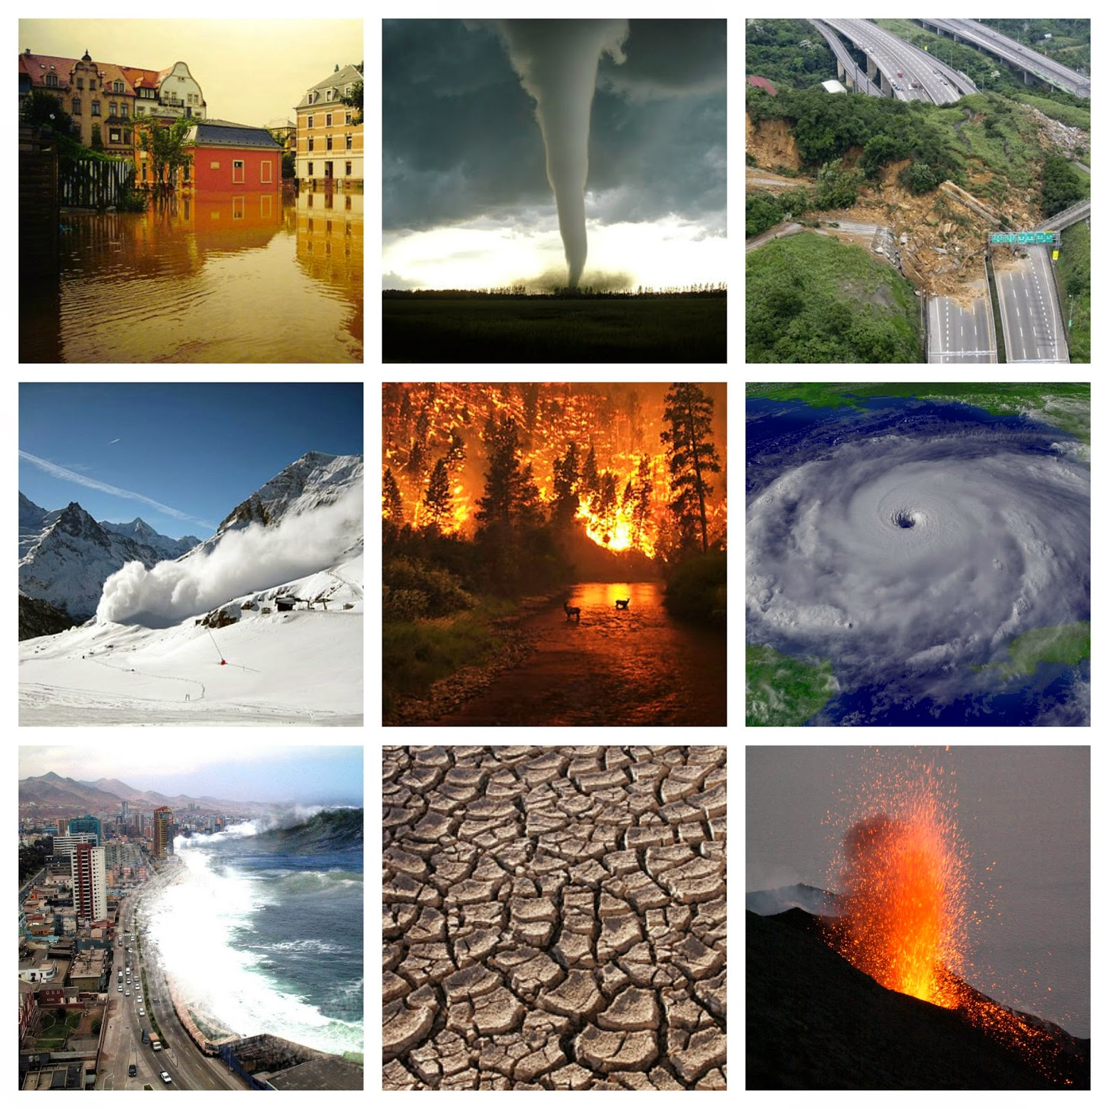
Part 2
Notes:
Start part 2

Slide 12

3D-RST is supported by the NSF under grant number #DRL-2101383

