Slide 1
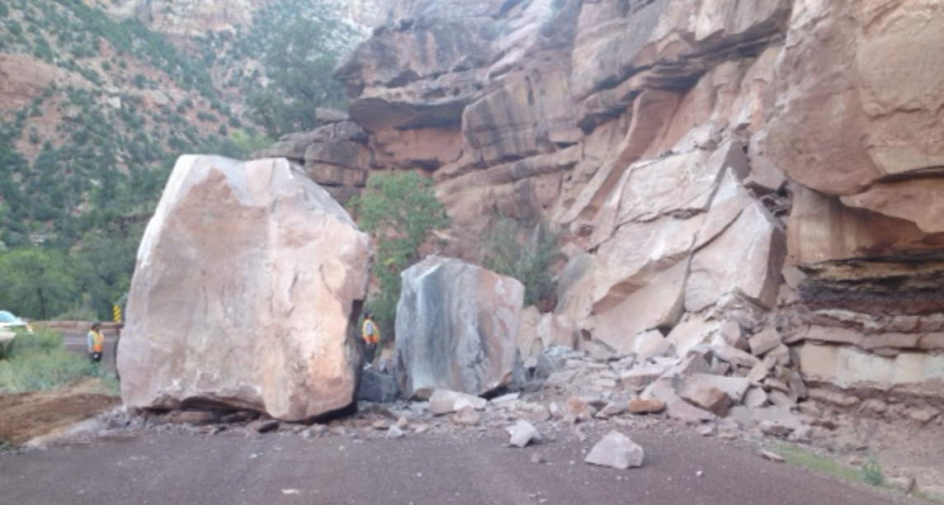
How Does Oxidization Occur?

Slide 2
Standard 8.1.3
Plan and conduct an investigation and then analyze and interpret the data to identify patterns in changes in a substance's properties to determine if a chemical reaction has occurred. Examples could include changes in properties such as color, density, flammability, odor, solubility, or state.
Science and Engineering Practice (SEP)
Planning and Carrying Out Investigations: Students plan and conduct an investigation to determine if a chemical reaction has occurred.
Students do and use the Science and Engineering Practice (SEP) by:
Conducting an investigation to produce data to serve as the basis for evidence that meets the goals of the investigation.
Collecting data to produce data to serve as the basis for evidence to answer scientific questions.
Crosscutting Concept (CCC)
Patterns: Macroscopic patterns seen in chemical reactions are related to the nature of microscopic and
atomic level structure.
Students think and connect through this Crosscutting Concept (CCC) to reason that:
Patterns can be used to identify cause and effect relationships.
Graphs, charts, and images can be used to identify patterns in data.

Slide 3
Lesson Objective:
Using patterns in the data from the investigation that you will plan and conduct, you will explain what you expect to see that show that two substances combine to make a new substance through a chemical reaction.

Slide 4
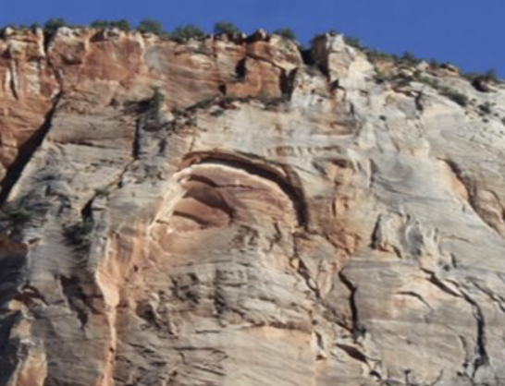
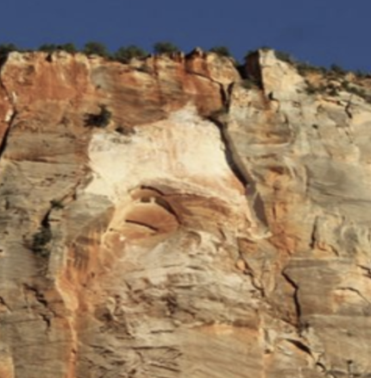
Phenomenon
AFTER
https://ksltv.com/421447/before-and-after-zion-national-park-shares-photos-of-rockfall-site/
BEFORE
Notes:
Students look at the two pictures of Zion National Park, notice the before and after landfall. The students will observe a video of the event happening.
Students will then read the USGS article about what happens to cause rocks to oxidize and gain the red color.

Slide 5
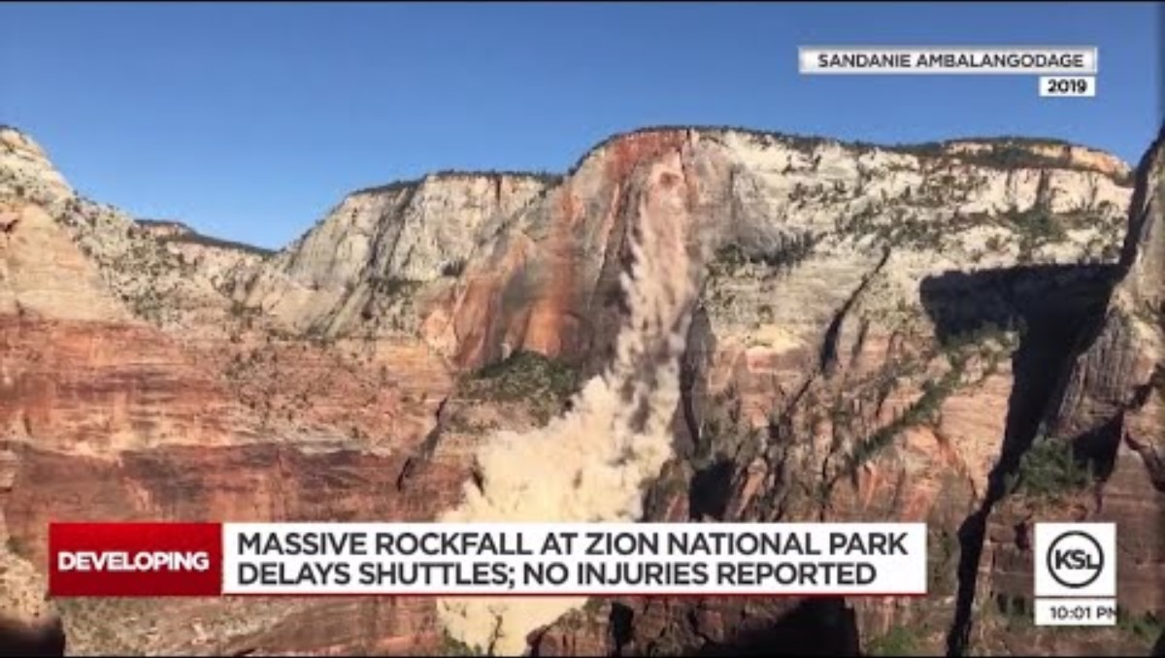

Slide 6
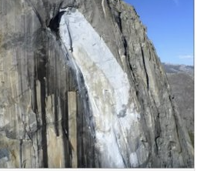
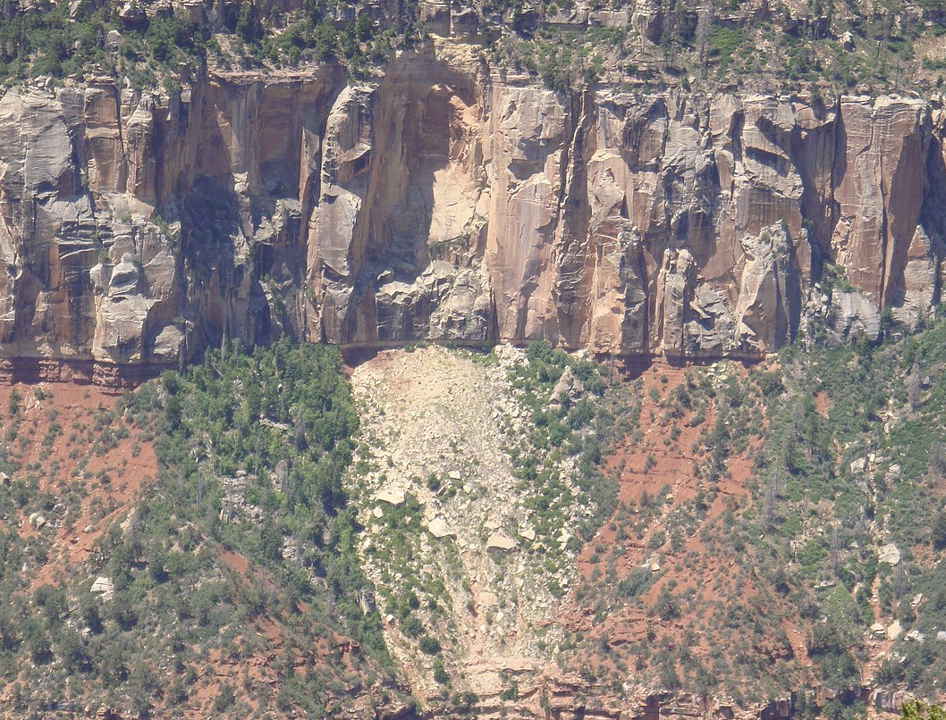
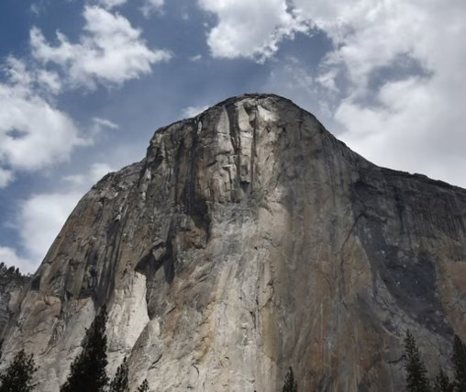
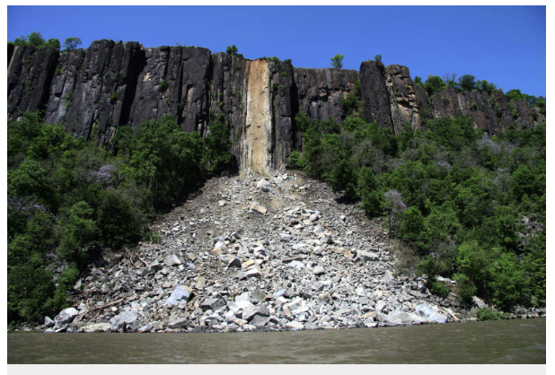
What pattern do you see in every one of these rock fall examples?
What is the difference between the "old" rock and the "new" rock exposed by the rock fall?
Notes:
What pattern do you see in each of these rockfalls?

Slide 7
Properties of Matter
Properties of Matter can be separated into two categories
Physical Property | Chemical Property
Can be observed without changing the identity of the substance | Describes the ability of a substance to undergo changes in identity. A new substance is produced.
Color Texture Density Viscosity State (or phase) Solubility Malleability Mass Volume | Reactivity Toxicity pH Conductivity Tarnishing Fermenting Oxidation
Notes:
Define a “chemical change”, and signs of chemical change.
Briefly mention that the reactants and the products are balanced.

Slide 8
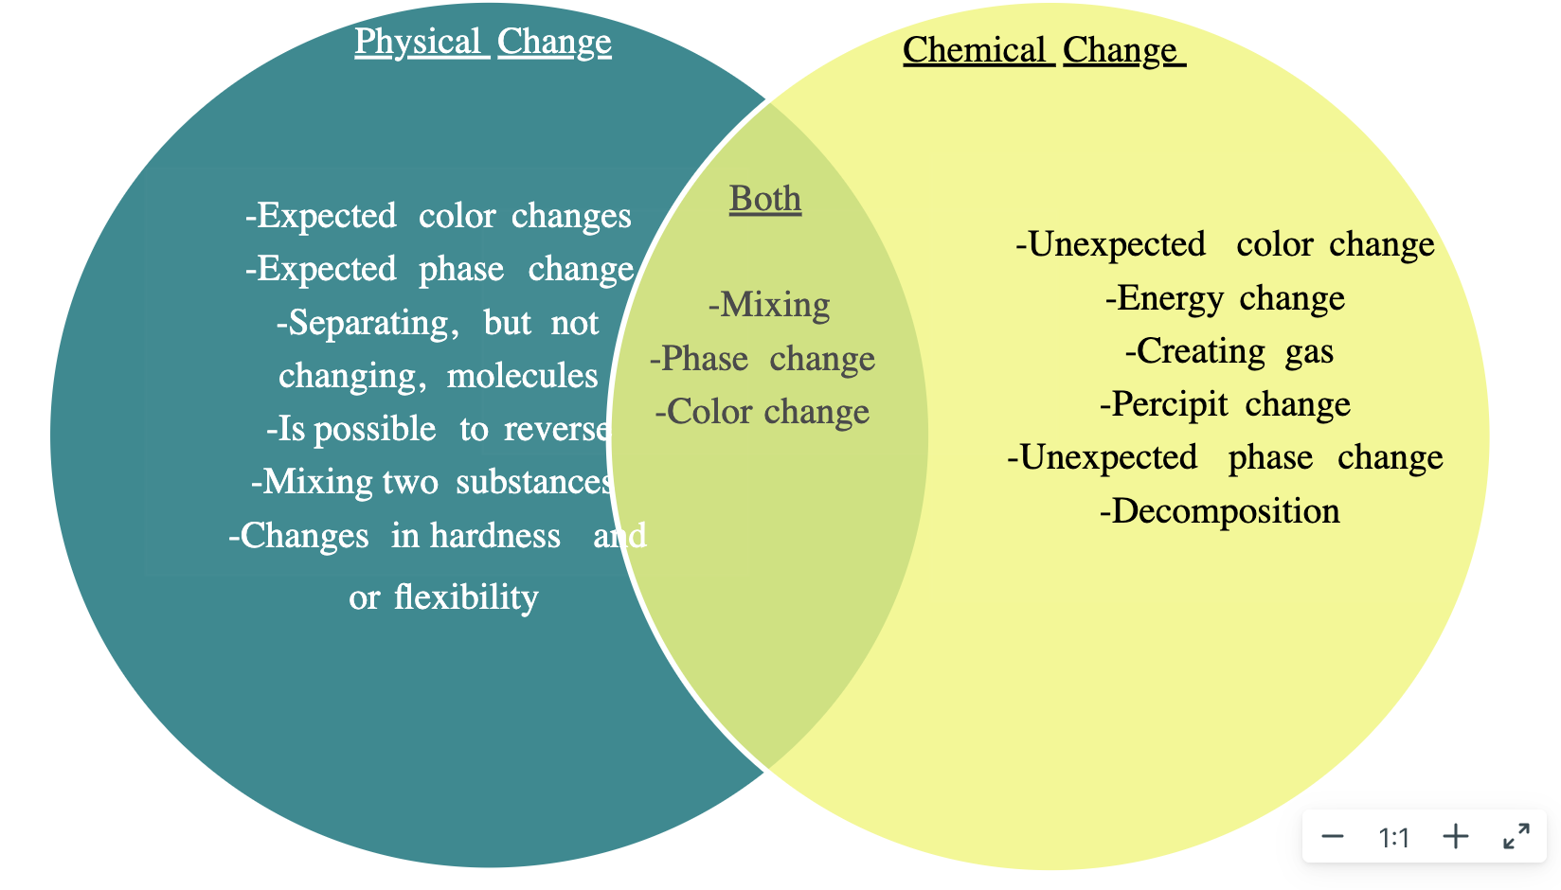
When physical properties change,
it can sometimes be evidence to show chemical changes.

Slide 9
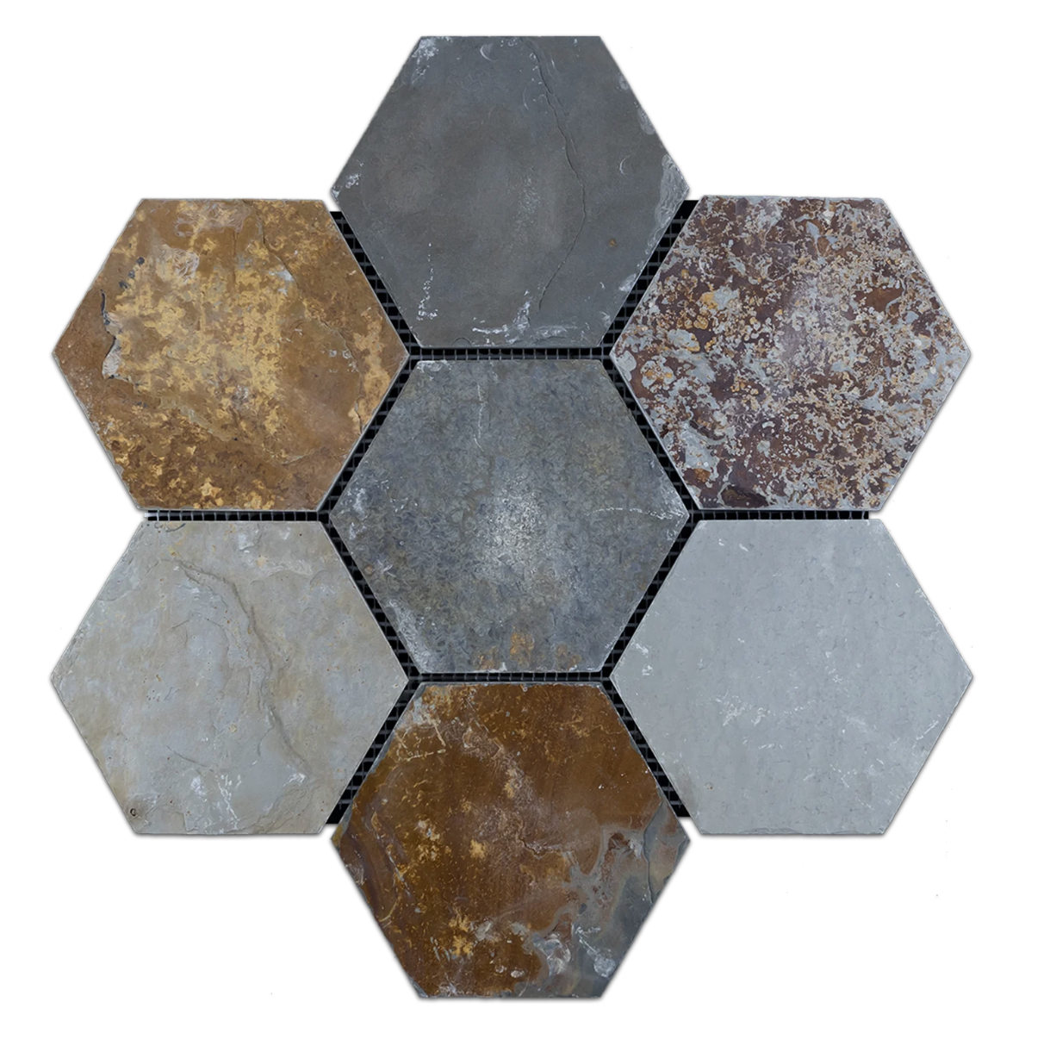
Note: A chemical change will also need another chemical change to reverse it, so you can’t easily “undo” it.
Change in Color
Change in Taste
Change in Odor
Signs of a Chemical Reaction
Change in Temperature
Produces a Precipitate
(two liquids
Form a solid)
Produces
a Gas
(not related
to boiling)

Slide 10
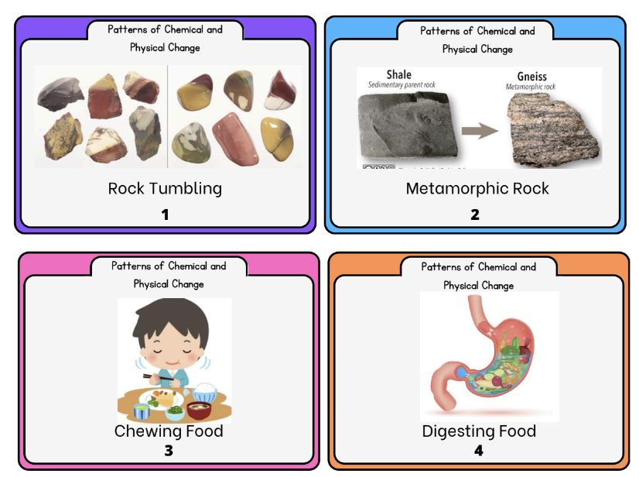
Chemical and Physical Changes Card Sort
Chemical Change | Physical Change
Notes:
Card Sort: https://byu.box.com/s/7h9gdo4gzfpni5r4j38epjjga5soaryc

Slide 11
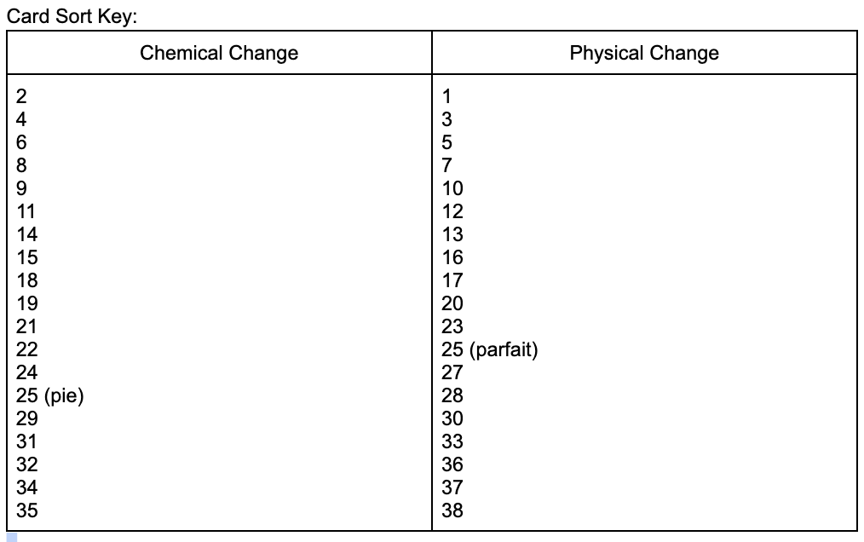

Slide 12
So, what is a “chemical change”?
In simplest terms, a chemical change (or chemical reaction) is when two substances are mixed together and transform into a NEW third substance.
What is the third substance we see in our rock fall phenomenon? (Hint: you see it on the OLD rocks on the outside of the rockfall but not on the new rocks exposed by the rockfall.)

Slide 13

Why are some rocks reddish in color? The rust-colored grains within rock likely contain minerals made up of iron and oxygen, called iron oxides. One example of an iron oxide is hematite (Fe₂O₃), which is abundant in Earth's crust. Hematite is in rocks, too, and is also in much of the clay that is used to make bricks. Iron in the hematite (or other iron-containing minerals) rusts when exposed to oxygen and water.
https://www.usgs.gov/educational-resources/find-feature-red-rocks .
Notes:
Introduce students to what a chemical change is and how they can recognize if a chemical change has happened.

Slide 14
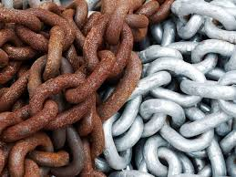
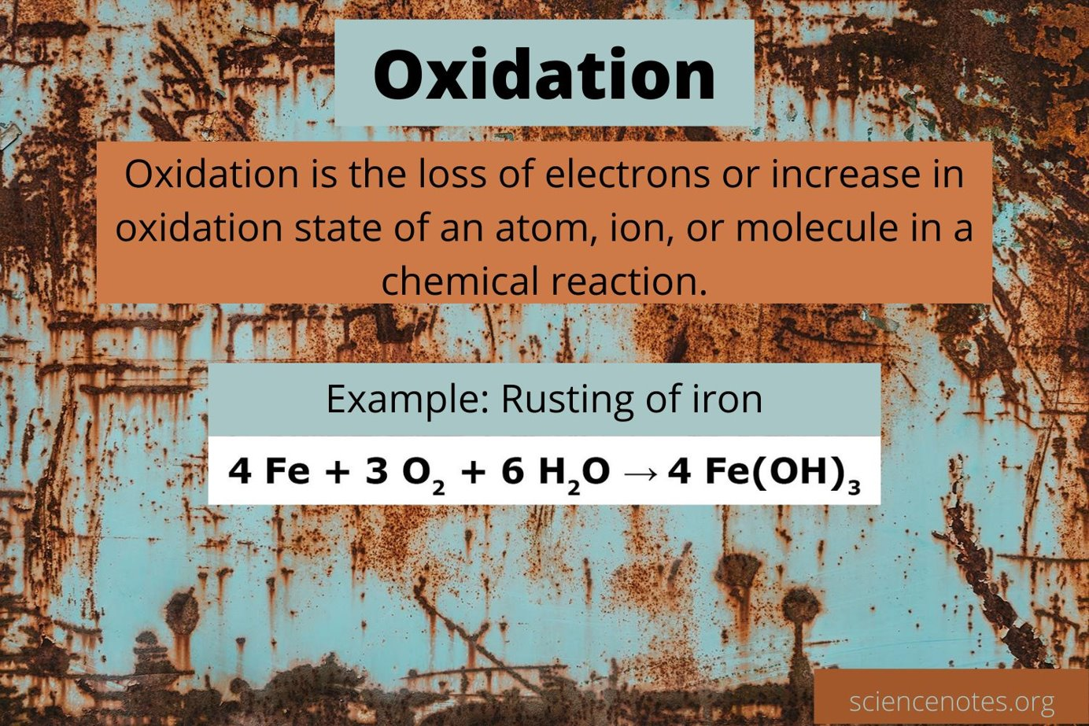
Notice the pattern from our phenomenon? Iron (Fe), when exposed to oxygen (O) and water (H₂O), forms a NEW substance. What pattern do you see between the elements and quantities of the reactants (left of the arrow) and product (right of the arrow)?
Notes:
Student’s will then view a picture of a chain that is rusted. They will answer questions about the patterns they see and if they think there is chemical equations. Briefly mention that the reactants and the products are balanced.
Did a chemical reaction occur? How do you know?
What three molecules were the reactants? What molecule is the product? Do you see anything common about the molecules in the reactants and the products?
https://encrypted-tbn0.gstatic.com/images?q=tbn:ANd9GcTbyvpmIG0Eo2Ci9nwGyoqENS1_8u2PsC6SXQ&s

Slide 15
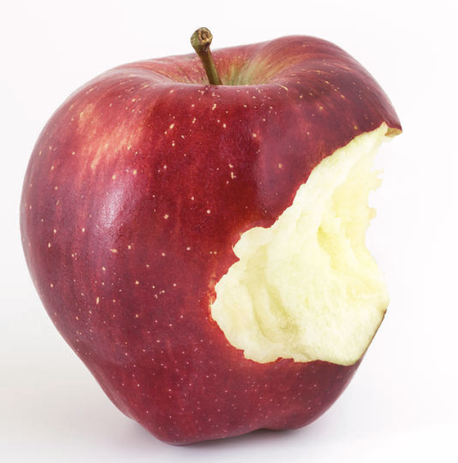
Have you ever noticed when you're eating an apple that the inside part, usually white, starts to turn brown after a while?
This is because of what apples have inside of them. Apples have a lot of iron in them. It's the iron in the apple that makes it turn brown. When you bite into the apple, oxygen in the air touches the iron in the apple. When this happens, the apple starts to turn brown. Some people call this 'rusting' -- you know, just like the rust you might see on old bicycles or old metal tools. These things get rusty for the same reason – oxygen in the air touches the iron in the metal. Now, for an apple, the skin protects the inside from touching the air. Once you take a bite and break the skin, the iron and oxygen begin to react with each other.
Notes:
Read this little information to see another example of oxidization.

Slide 16
Why do fruits change color?
Guiding Question: What is the best way to slow down the reaction between iron and oxygen?
Hypothesis:
Variables:
Independent:
Dependent:
Control:
Materials: (See lab sheet)
Procedures: (See lab sheet)
What do you predict will happen to the oxidation of your fruit in the future? Based on the patterns we’ve seen with the rockfall?
Notes:
What is the independent variable? Dependent variable? Control?
What tools will we need to gather data?
How will we record our observations?
How is your investigation going to generate relevant evidence to answer your guiding question?
Does the pattern in your data support the conclusion that oxidation is related to oxygen and iron coming into contact with each other? Why or why not?

Slide 17
DAY TWO

Slide 18
Standard 8.1.3
Plan and conduct an investigation and then analyze and interpret the data to identify patterns in changes in a substance's properties to determine if a chemical reaction has occurred. Examples could include changes in properties such as color, density, flammability, odor, solubility, or state.
Science and Engineering Practice (SEP)
Planning and Carrying Out Investigations: Students plan and conduct an investigation to determine if a chemical reaction has occurred.
Students do and use the Science and Engineering Practice (SEP) by:
Conducting an investigation to produce data to serve as the basis for evidence that meets the goals of the investigation.
Collecting data to produce data to serve as the basis for evidence to answer scientific questions.
Crosscutting Concept (CCC)
Patterns: Macroscopic patterns seen in chemical reactions are related to the nature of microscopic and
atomic level structure.
Students think and connect through this Crosscutting Concept (CCC) to reason that:
Patterns can be used to identify cause and effect relationships.
Graphs, charts, and images can be used to identify patterns in data.

Slide 19
Lesson Objective:
Using patterns in the data from the investigation that you planned and conducted, explain how you know that two substances combine to make a new substance through a chemical reaction.

Slide 20
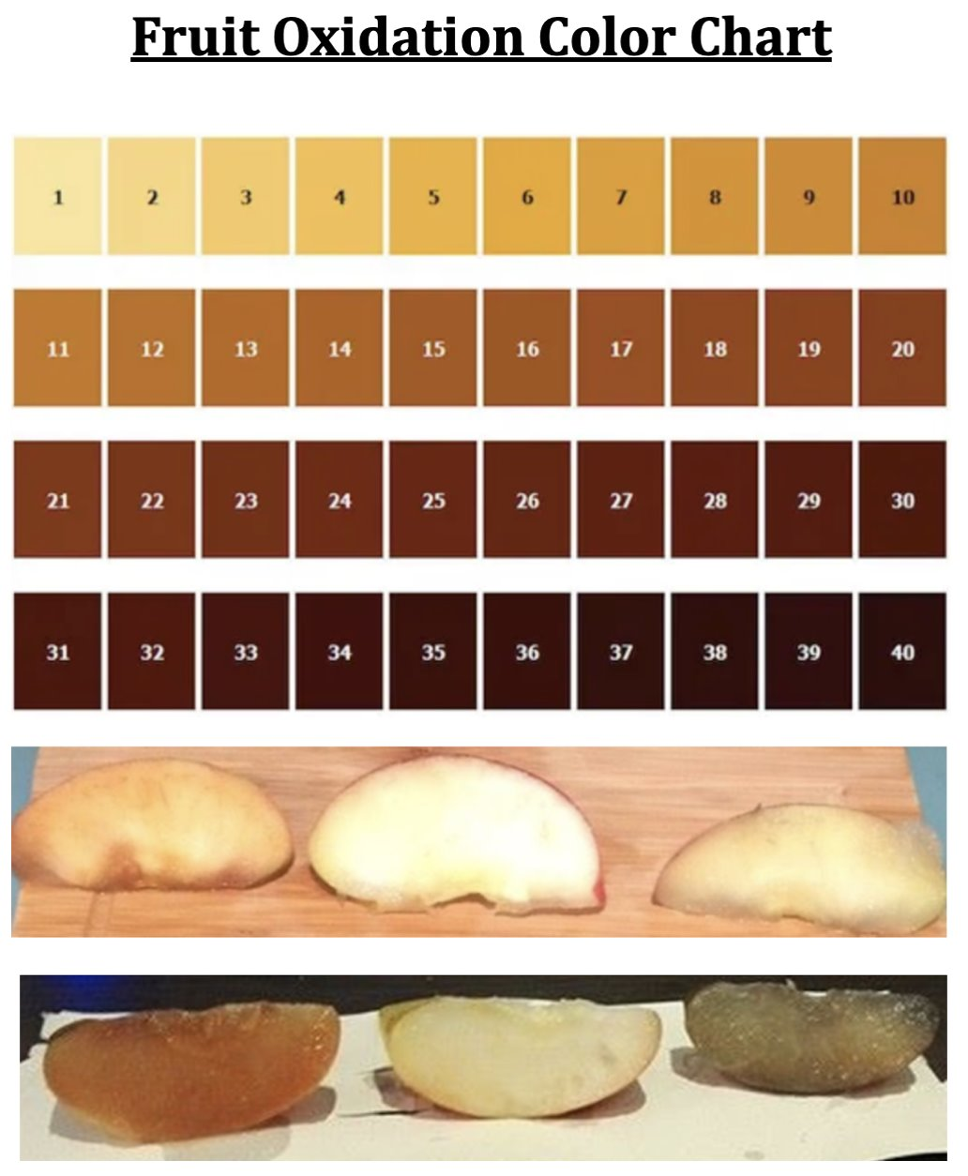
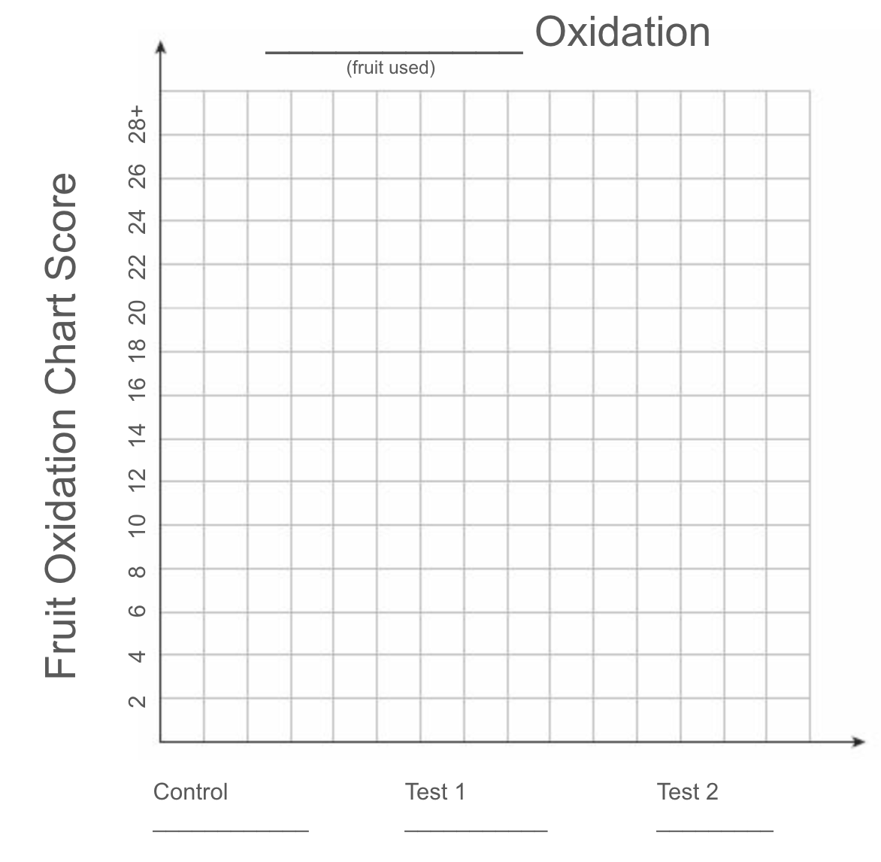
Fruit Oxidation Color Chart
Notes:
Students will compare their oxidized fruit with the Fruit Oxidation Color Chart to gather their data. They will complete a bar graph to convey their results from the experiment.

Slide 21
Chemical Reactions
Change in Color
Change in Odor
Change in Taste
Change in Temperature
Produces a Gas
Produces a Precipitate
Cannot easily “undo”
If we didn’t check ALL the boxes, how do we know that the apple follows the pattern? How do we know it is a NEW substance?
Notes:
What predictable patterns occur during a chemical reaction?
Answer:
You cannot easily undo it.

Slide 22
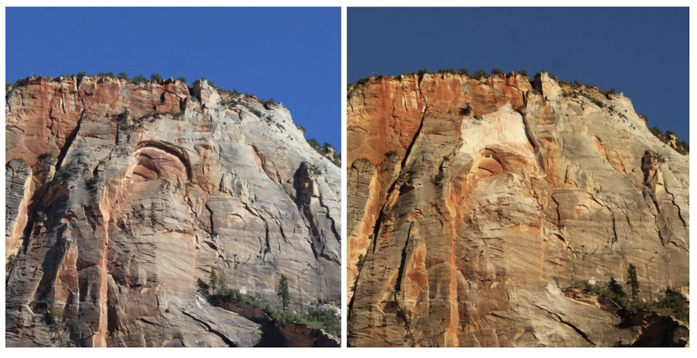
2Fe + 3CO₂ Fe₂0₃ + 3CO
4Fe + 30₂ 2Fe₂0₃
How do we know that the 'combination of two substances' pattern (exposure to oxygen in this case) is what caused the chemical change?
Remember the rockfall?
What do you think the inside of the apple will look like if we cut a slice off of it?
Notes:
Answer: The iron and air combine and make the oxidization which is a new substance. Products show the substance being combined and the reactant shows that the
Combination has changed the substance.
Do you notice the pattern in the chemical equation? Iron, when exposed to oxygen and water, forms and NEW substance that has all the same molecules.

Slide 23
Modeling Oxidation
2Fe + 3CO₂ Fe₂0₃ + 3CO
4Fe + 30₂ 2Fe₂0₃
1.With your lab group, choose which oxidation chemical reaction you would like to model.
2. Create a model of the reactants (left of the arrow).
3. Pull apart your model and create a model of the product (right of the arrow).

Slide 24
What do the apples, the sandstone, and the chain all have in common?
2. Which evidence of chemical change did we see in each of these instances?
Change in color
Change in odor
Produces Gas
3. Why is the skin of the apple important?
It keeps air inside the apple
It protects the inside of the apple from the air
It holds all of the apple’s iron
4. When you compare your group’s data with the results from another group that used either a different fruit or different liquids, how does it compare to your group’s patterns? List at least 3 similarities or differences between the data sets.
5. From what you observed during your investigation (experiment), could you think of other ways to observe oxidation? How could this new way help you explain the patterns you observed in your data?
6. In your investigation, you combined oxygen and iron. List the patterns of chemical reaction that prove a new substance was formed from those two substances.
Post Lab:
Notes:
Through teacher discussion, students will look for a pattern in their results and also determine whether the combination of substances caused the chemical change. They will slice their fruit to see that the inside of the piece of fruit is still “unoxidized”.

Slide 25


