Slide 1
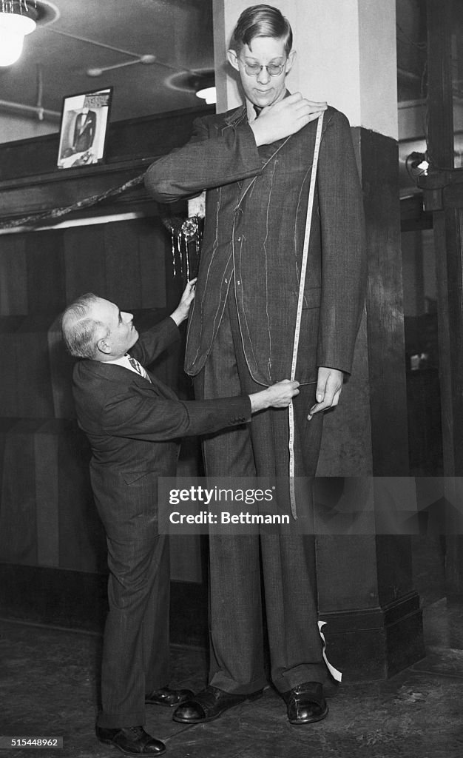
Comic Strip
Check off each box of instructions as you work
Instructions and criteria are on the BACK SIDE
Tailor With Tallest Man, Robert Wadlow.
(Original Caption) 12/15/1936-Chicago, IL- Business is looking up. Chicago, IL. Soaring 8 feet, 5 inches above the Earth, Robert Wadlow, 18, tallest human being, provides a real job for tailor Sol Winkelman, of Chicago. 12/15/36.

Slide 2
checklist for cartoon strip
select at LEAST ONE endocrine gland
What is the name of the gland?
Where is it found?
What is the name (or names) of the hormone(s) it produces?
What do these hormones do for the body?
How do these hormones maintain a balance?
What other organs and systems do these hormones affect, either directly or indirectly?

Slide 3
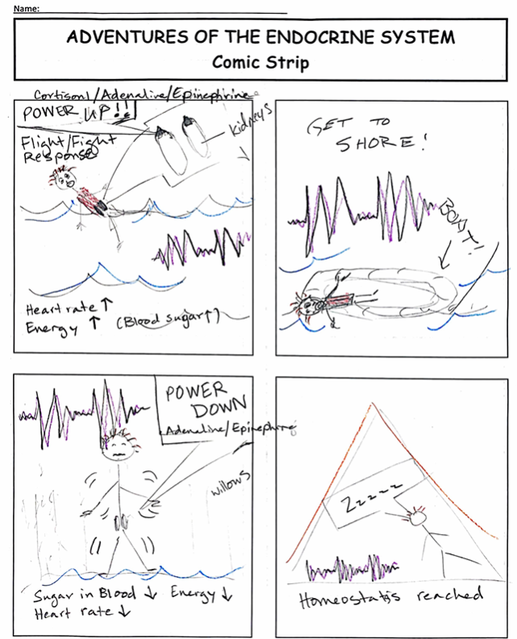
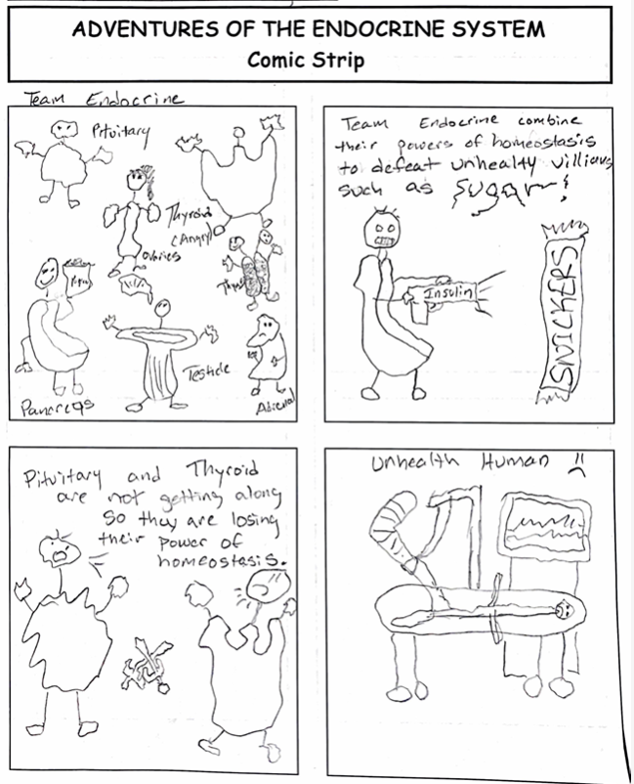
Comic Strip Design Examples

Slide 4

3D-RST is supported by the NSF under grant number #DRL-2101383

