Slide 1
Today's Objective:
Obtain and evaluate information to communicate how the different structures and functions of organs and organ systems in multicellular organisms maintain balance and stability, or homeostasis, within the body.
Communicate how the endocrine system functions with other organs and organ systems to keep the organism healthy.

Slide 2
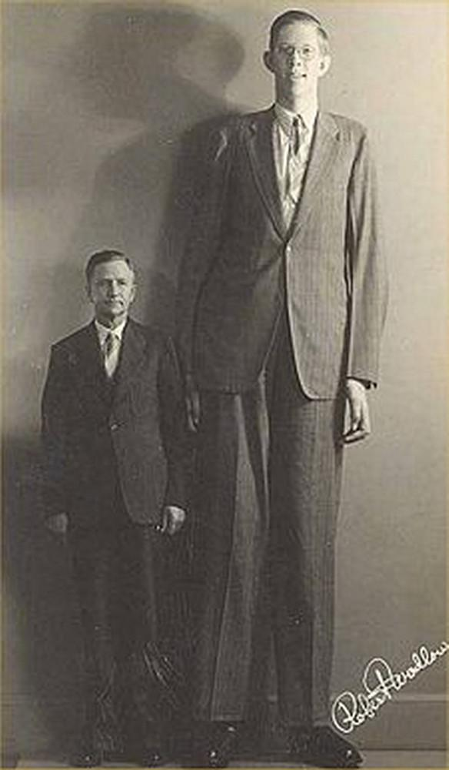
Robert Reached New Heights!
Robert Wadlow, known as the "Alton Giant," is famous for being the tallest man ever recorded, standing at 8 feet 11 inches (272 cm) at the time of his death in 1940. His rapid growth began at a young age and continued throughout his life.
Despite his impressive height, his health was affected by his condition, and he required leg braces to walk. Sadly, he passed away at just 22 years old due to an infection caused by a leg brace injury.
… but why was he so big?

Slide 3
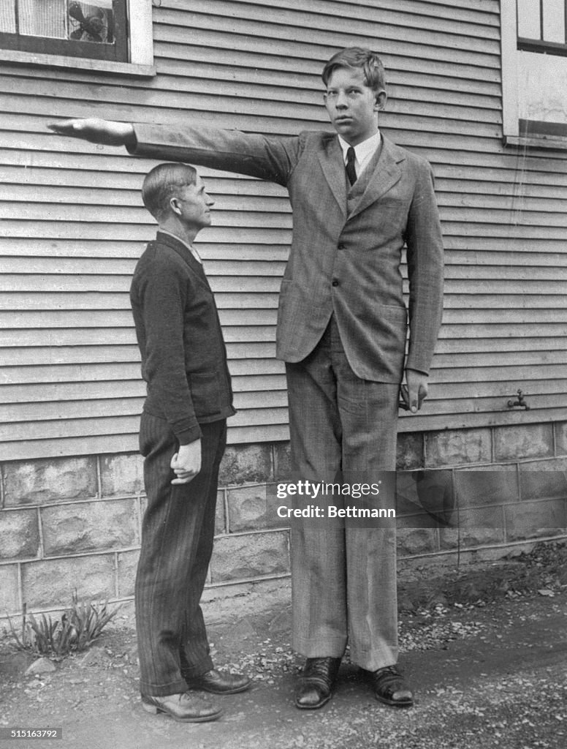
Obtain New Information
Endocrine System Reading
  Read and underline information that you have obtained that will help you communicate the function of the endocrine system.
Robert Wadlow, a giant from Alton, Illinois, is shown at age 13 with his father, Harold Wadlow. The father is five feet, eleven inches tall, and the son stands seven feet, four inches.

Slide 4
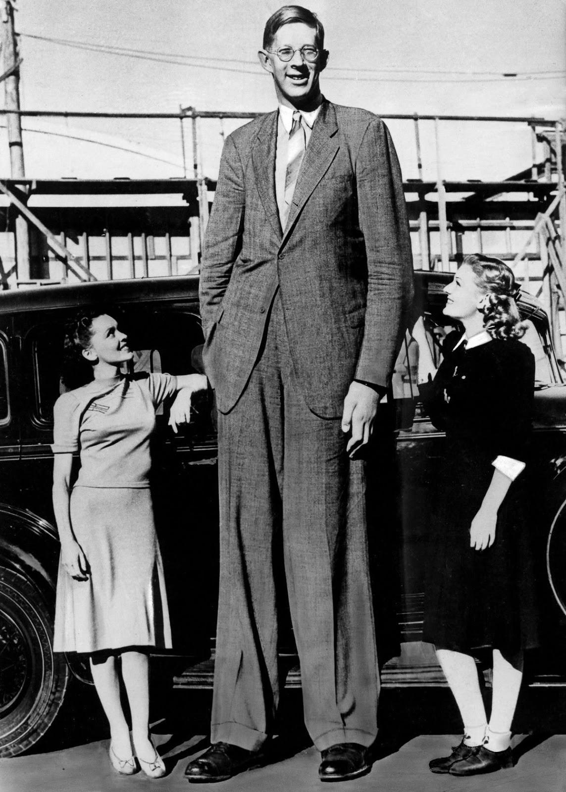
Experience the Phenomenon
In addition to his 8 ft. 11 in. record height, he also holds the title for the World’s Largest Hands at 12.75 inches, and the World’s Largest Feet at 18.5 inches. Wadlow’s ring size was 25, about the size of a quarter, and his shoe size was a 37 AA men’s, which had to be custom-made.
Multiple organ systems work together to maintain homeostasis. Typically, we grow taller, but growth stops at a certain age. Robert Wadlow showed no signs of stopped growth.
Which organ system is responsible for the regulation of growth?
Which gland do you believe wasn’t functioning normally to cause this lack of homeostasis?

Slide 5
Spin the Gland Wheel
Obtain and Communicate
Each group gets 1 gland to research and design a yearbook page to communicate information.
https://wheelofnames.com/2zv-2kv
Begin thinking of which gland seems most likely to be the cause of Wadlow's growth.

Slide 6
Yearbook Design
Obtain all the necessary information about how your assigned gland is structured and how it functions in order to effectively communicate creatively.
Use the Gallery Walk Fact Sheet to ensure you have all the information others will need to fill out their fact sheets.

Slide 7
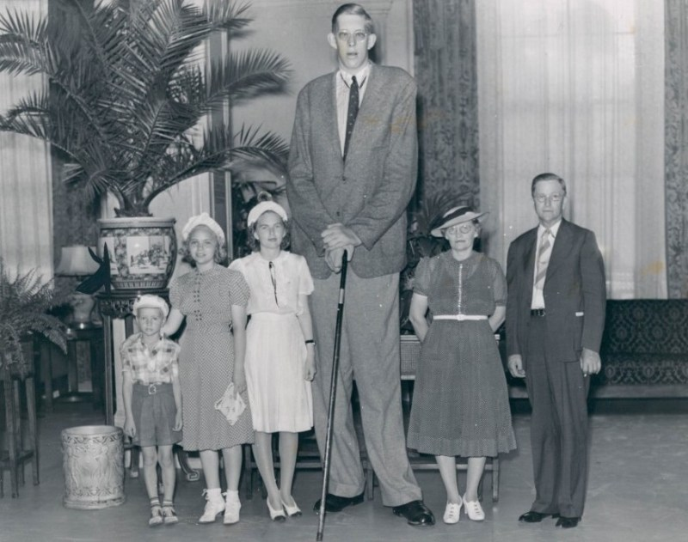
Gallery Walk
Fill out your Gallery Walk - Fact Sheet as you go to evaluate all the parts of the Endocrine System.
Speaking of walking: Robert's stride was about 3.7 feet.
8ft 11.1in (2.72m) tall Robert Wadlow posing for a family photograph, 1939.

Slide 8
Wrap Up!
Put your name on the top of your sticky note, answer the two questions, and put your sticky note on the door as you leave class.
Sticky Note Item 1: Rate yourself on your ability to communicate the function of the endocrine system. ​
1 – Little to no explanation ​
2 – Can explain parts, but not all​
3 – Confident in my knowledge​
4 – Confident enough to explain to others​

Slide 9
Wrap Up!
Multiple organ systems work together to maintain homeostasis. Typically, we grow taller, but growth stops at a certain age. Robert Wadlow showed no signs of stopping growth.
Sticky Note Item 2: In the example of Robert Wadlow, communicate which organ system(s) were not functioning normally to cause this lack of homeostasis?
  Robert Wadlow was so big due to a rare medical condition called gigantism, which was caused by an overproduction of growth hormone. Specifically, he had a tumor on his pituitary gland—the part of the brain that regulates growth hormone levels. This tumor caused his body to produce abnormal amounts of the hormone, leading to excessive and continual growth throughout his life. Even into adulthood, his bones and tissues kept growing, which is not typical for most people whose growth slows and stops after puberty.

Slide 10

3D-RST is supported by the NSF under grant number #DRL-2101383

