Slide 1
Roads vs Floods 7.2.3

Slide 2
Objective:
Students will test different road materials to see which one withstands the best under flooding conditions.

Slide 3
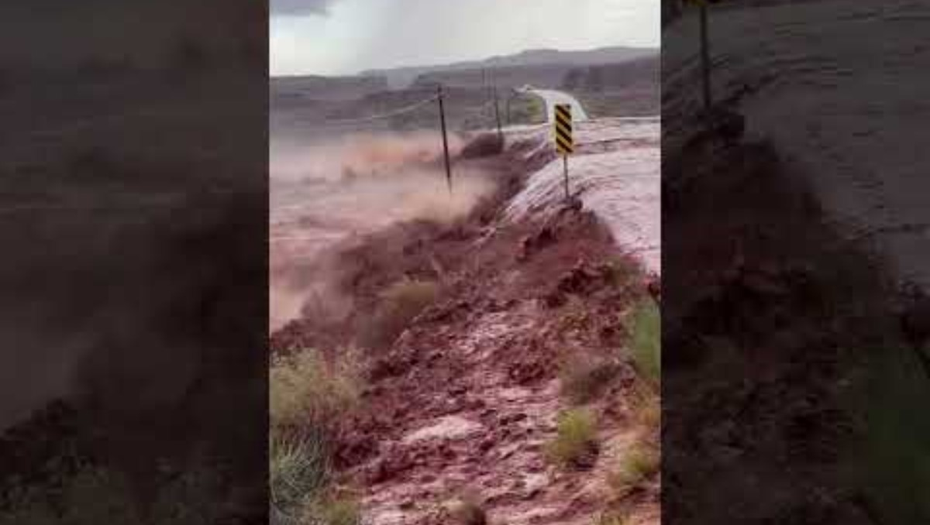
Phenomenon

Slide 4
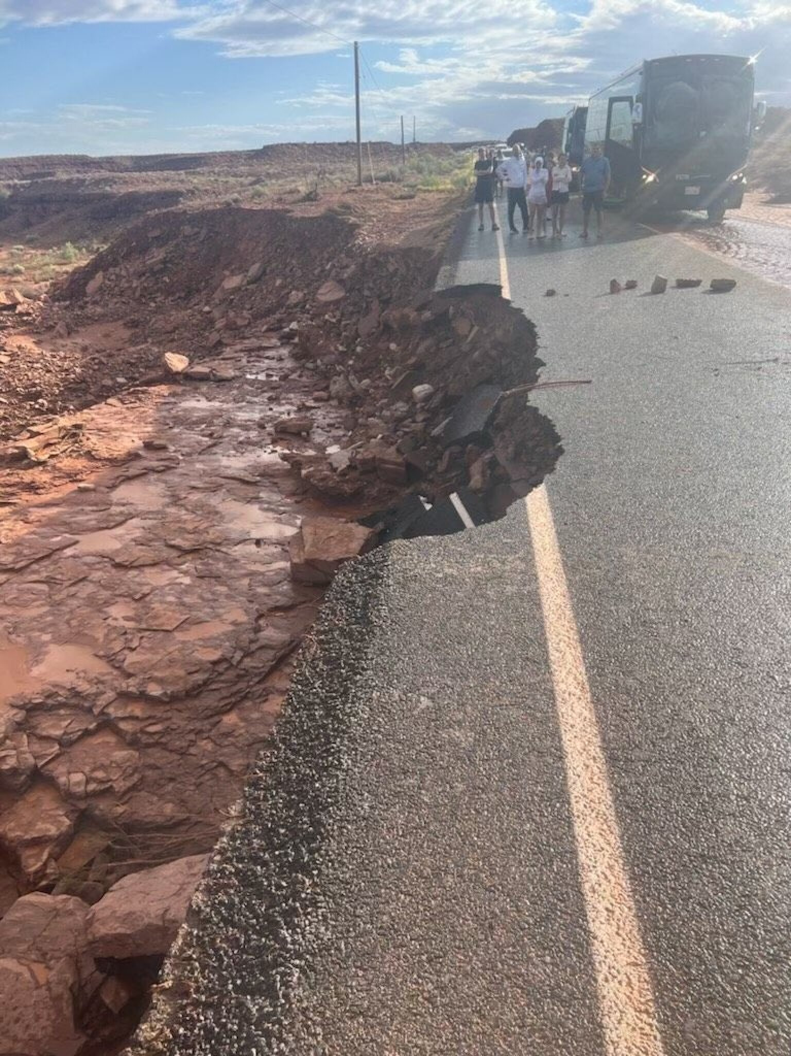

Slide 5
Your experiences with floods
Turn and talk to your neighbor about your personal experiences with floods.

Slide 6
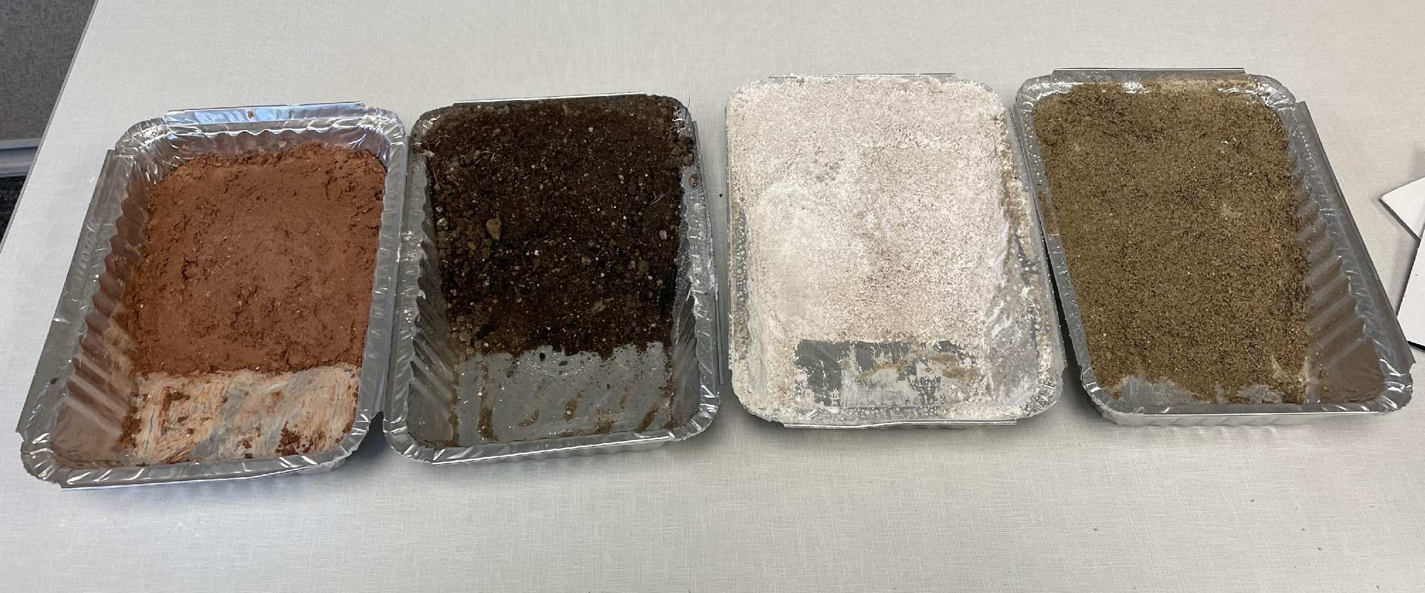
Base Layer Test (Soil Technicians)
-Dirt -Sand
-Clay -Rock
Lab steps:
Cut out a section for the slope for each material for a flat, level road to go across. You can use your finger or a screwdriver.
Pour 100 ml of water in a cylinder and slowly pour the water in 5 ml increments until the road shape is deformed.
You will need to determine which material holds its road shape the best and which material is easiest to work with or is best to manipulate into the road shape.

Slide 7
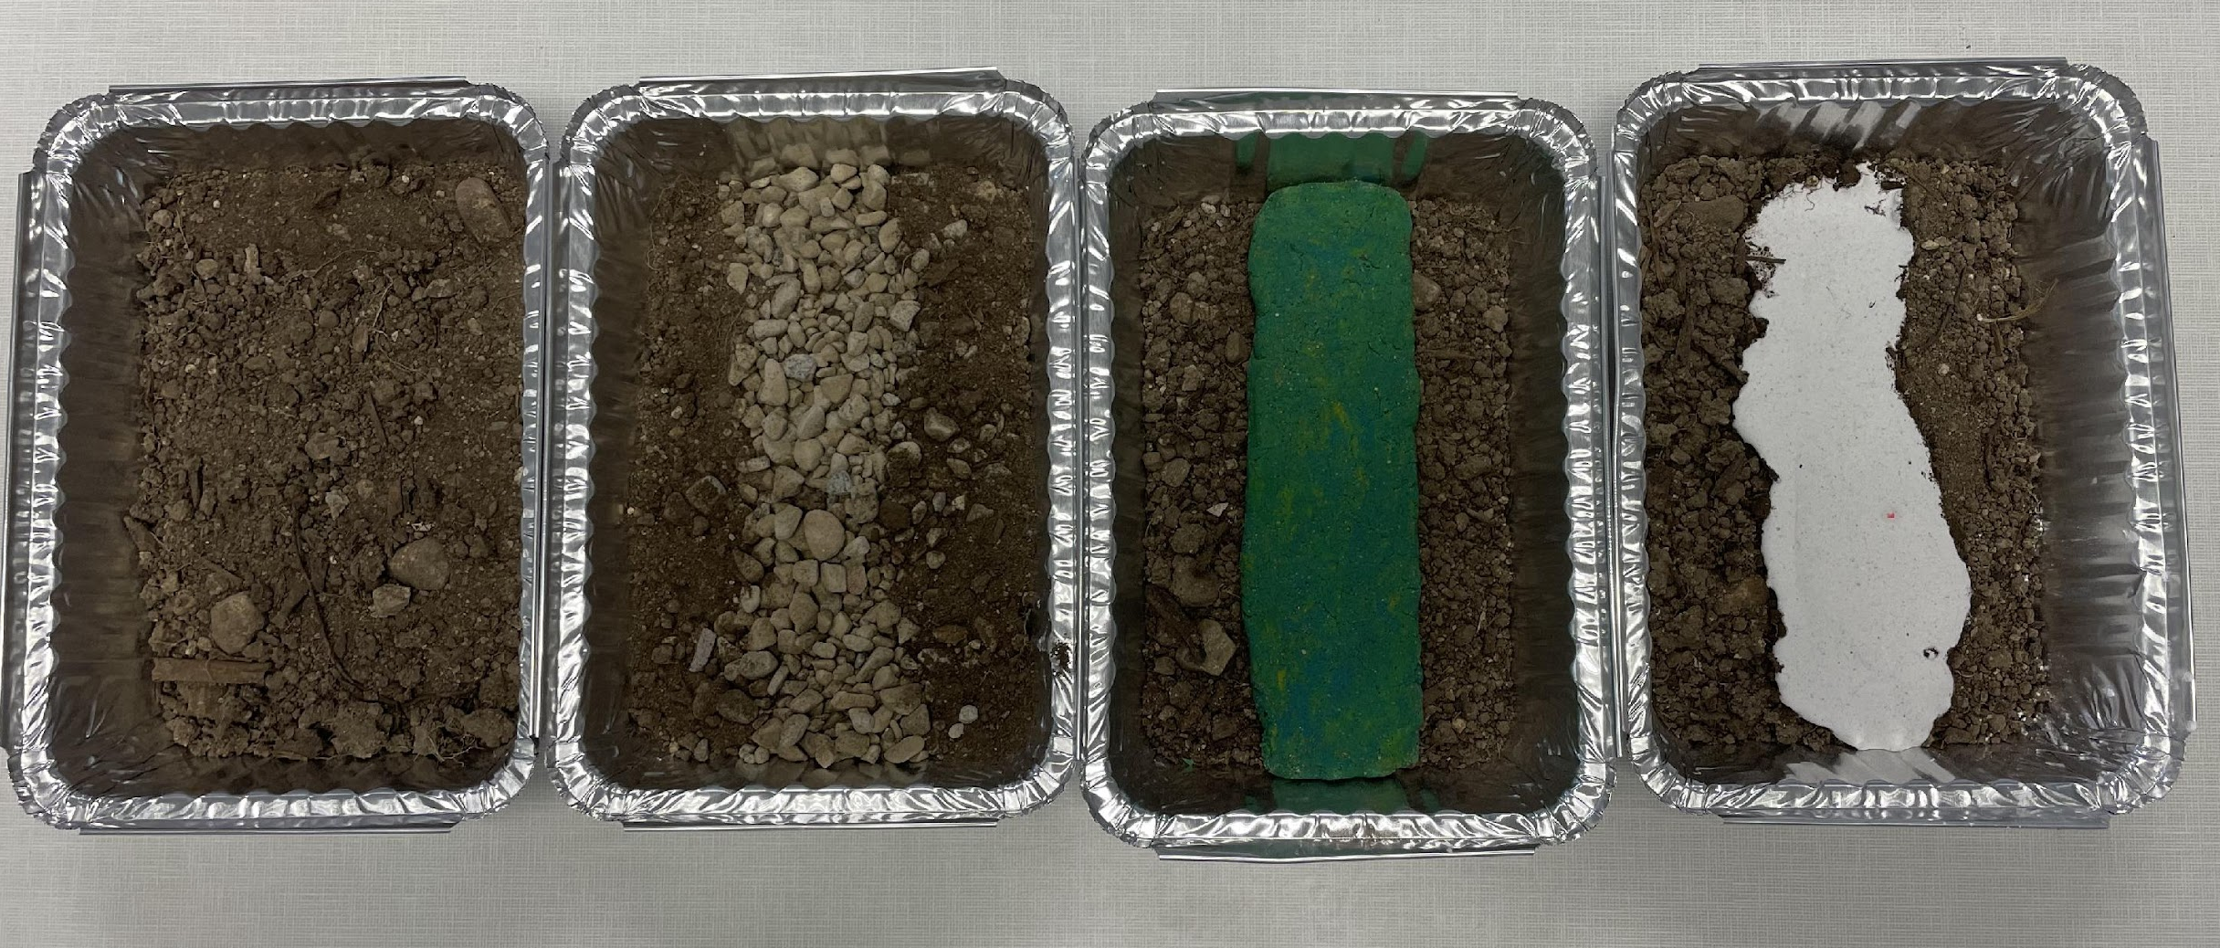
Road Test Material (Pavement Engineers) -Dirt -Asphalt -Concrete -Gravel
Lab Steps
Use the spray bottle to simulate rain on each road material (10 sprays).
Use a toy care or golf ball to go back and forth on the road about 20 times.
Keep track of the road condition and the smoothness of the road.

Slide 8
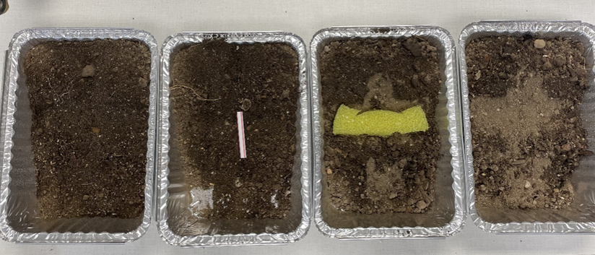
Drainage Test (Hydrology Engineers) -Dirt -Culvert - Absorbent - Lanscape Shape
Tray 1 - Make no change
Tray 2 - Use straws to create a culvert that diverts the water underground. You may need to dig out the road and put it back.
Tray 3 - Use the given tools to shape the surrounding landscape to divert the water the best way you can.
Tray 4 - Use the filter to divert water under the road. You may need to dig out the road and put it back.

Slide 9
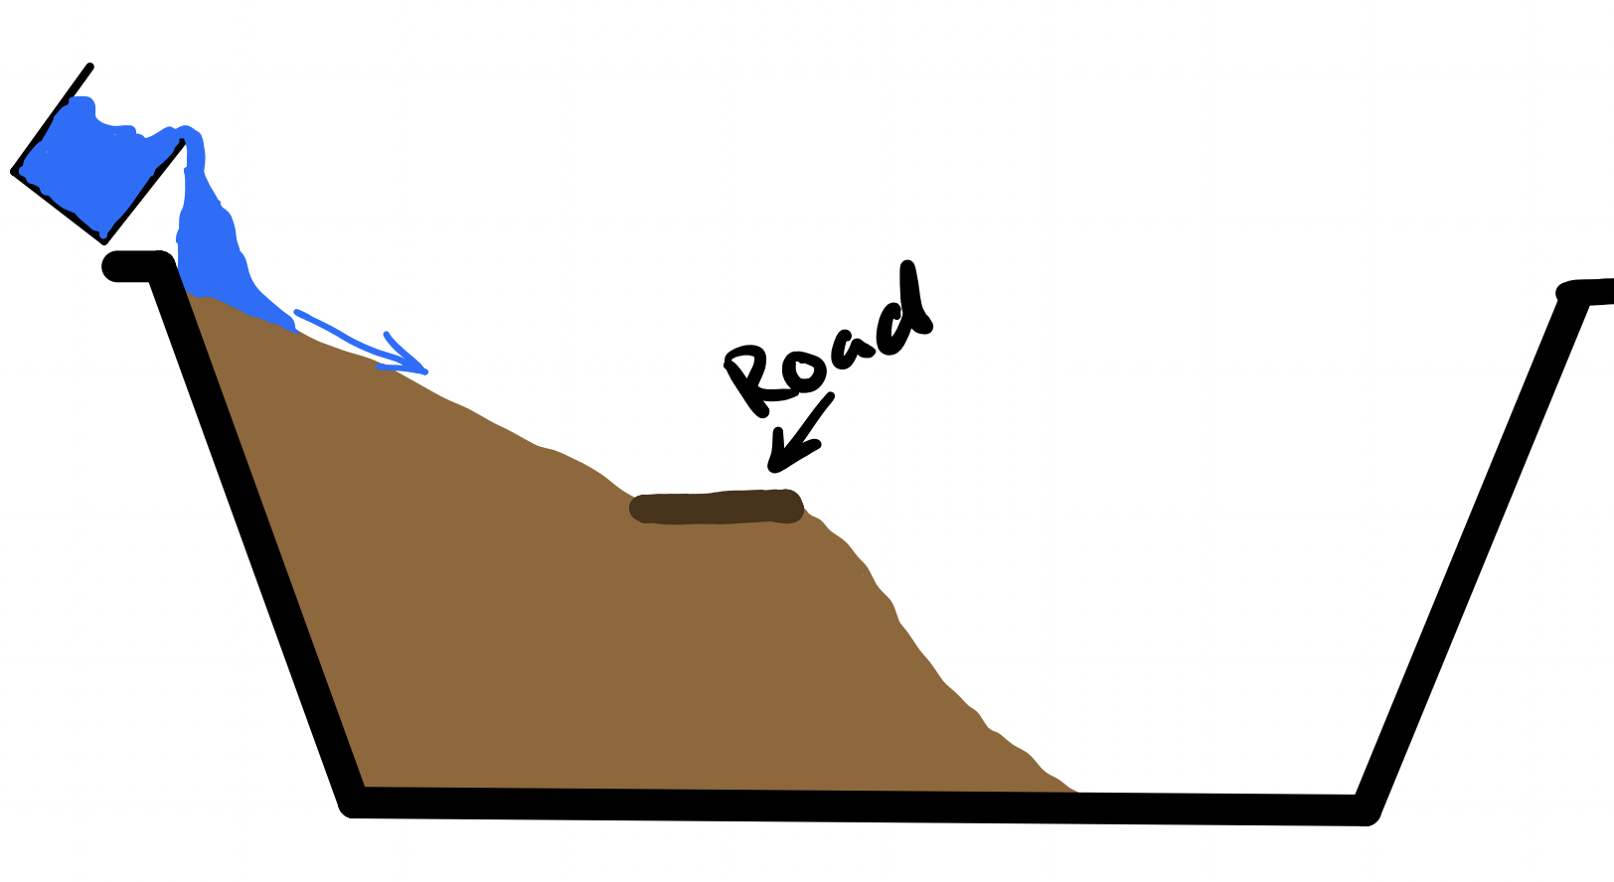
Cross Section

Slide 10
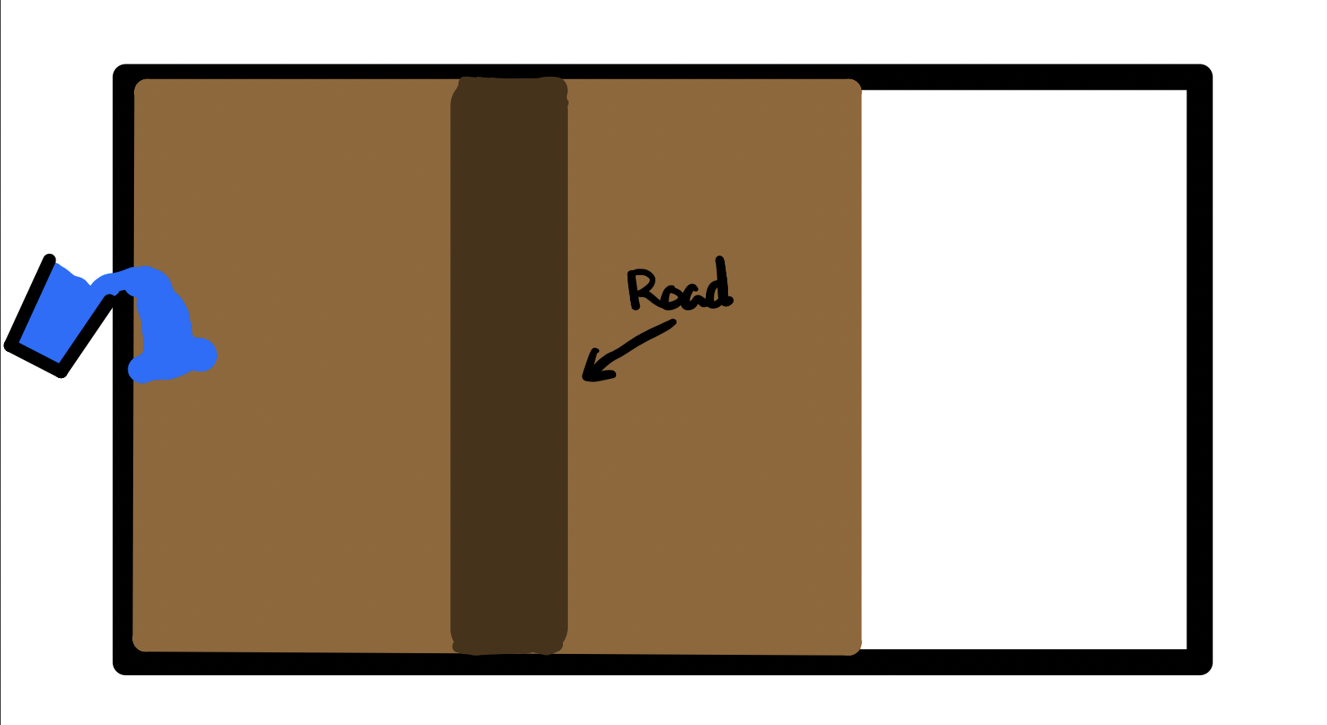

Slide 11
Post Lab Questions
What solutions can you come up with to create a stable road if the base has poor quality?

Slide 12
Post Lab Questions
What other methods could be tested with drainage?

Slide 13
Post Lab Questions
What upkeep and maintenance would be required for those to maintain their long-term structure and function?

Slide 14


Road Scenarios

Slide 15


Slide 17


3D-RST is supported by the NSF under grant number #DRL-2101383

