Slide 1

Objective
Student’s will be able to see how homeostasis works by planning and carrying out their own investigation.

Slide 2
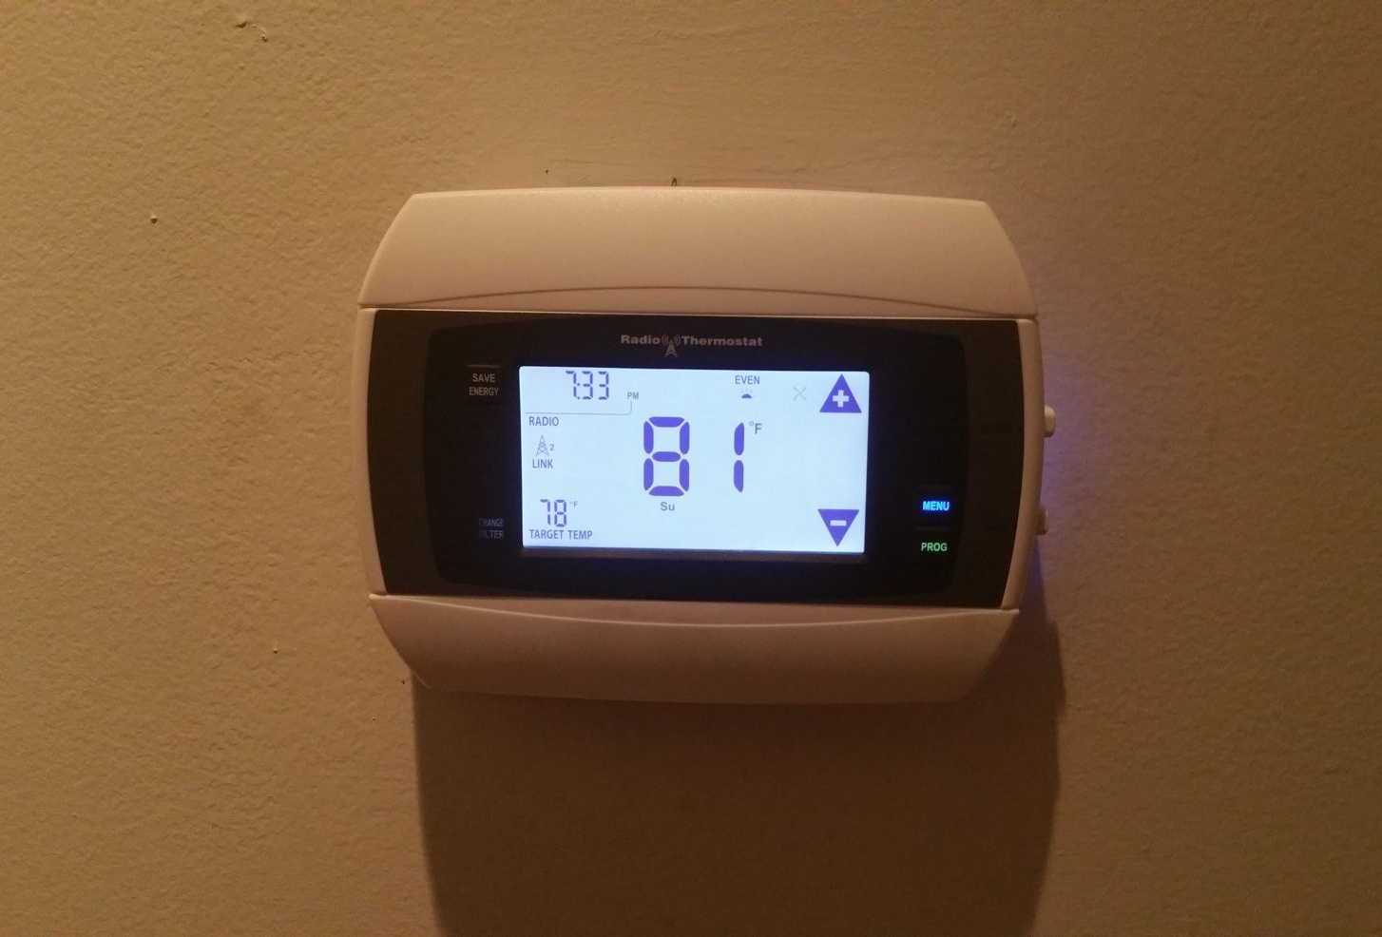
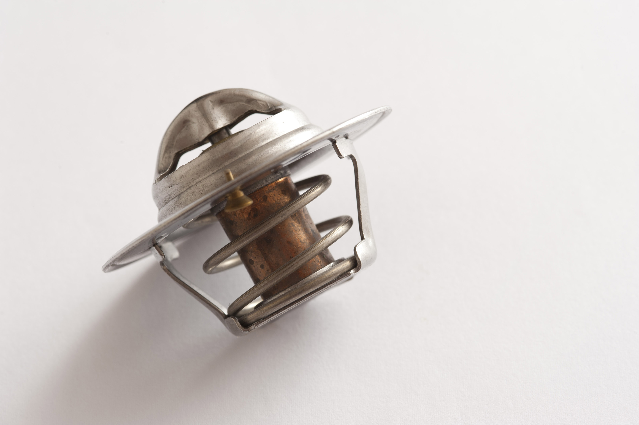
Everyday Examples of Homeostasis
Notes:
Daddy's Home 2 (2017) - Someone Fiddled With The Thermostat Scene: https://www.youtube.com/watch?v=HsH34JIWwn4

Slide 3
How do these things work?
Notes:
Have the students think pair share and come up with basic explanations about how these thermostats work. Use these 2 examples to meet the different demographics of the students.

Slide 4
How does a thermostat work?
Think-Pair-Share
Be prepared to share with the class

Slide 5

Homeostasis
What is an example of homeostasis in our bodies?
Be prepared to share
Notes:
After the class has had time to discuss amongst themselves, call on a volunteer. If no good examples are shared be prepared to share one of your own.

Slide 6

Plan and Carry Out an Investigation
Objective: you are going to plan an investigation to provide evidence of homeostasis and that feedback mechanisms maintain stability.
In groups of 3-4, you will pick one of the provided ideas (or one of your own) from the list.

Slide 7
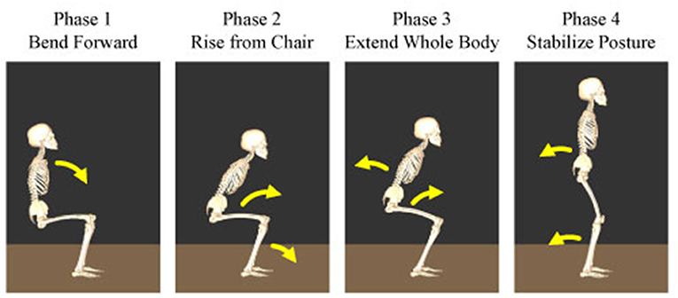
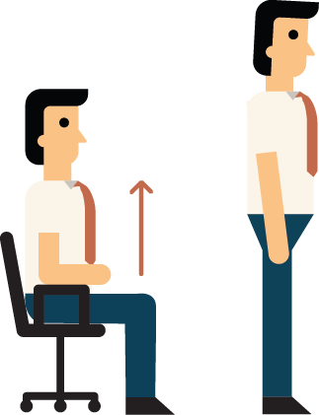
Everyone will….
Establish a baseline
Laying down
Sitting
Standing up
Get in the first position and wait 60 seconds
Place your hand on the 2 fingers on the thumb side of your wrist and press gently till you feel a pulse.
Count your pulse for 60 seconds
Repeat this protocol for all three positions

Slide 8

Everyone will.....
Develop a question for your investigation:
How will your activity answer your question?
Ex: My Activity of_________ will answer the question of how feedback works by doing__________.
Record everything we do in time intervals
Participate; NO exceptions!

Slide 9
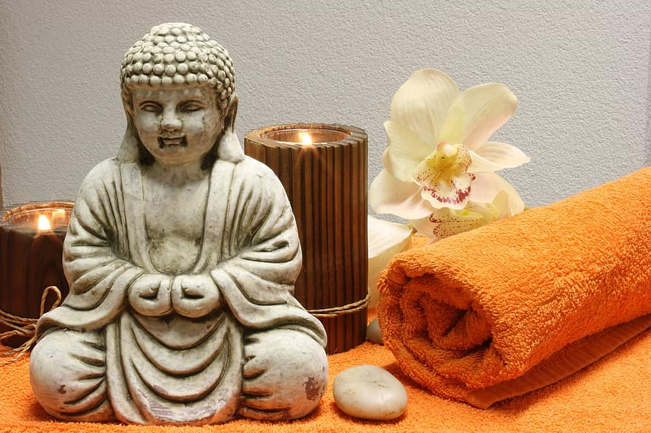
How to Decrease your HR, BP, and Respiration
Intervals of 1, 2, 3, minutes (1, 3, 5 for alternative) unless otherwise specified:
Controlled Breathing
Counting
eyes open
eyes closed
Listing to calming music
Meditation
Sitting outside in the cold (if time of year is permissible)
Yoga

Slide 10

How to Increase your HR, BP, and Respiration
Intervals of 1, 2, 3, minutes (1, 3, 5 for alternative) unless otherwise specified
Walk, Jog, Run (all 1 min)​
Walking​
Jogging​
Runing​
Yoga​
Jumping Jacks​
Wall sits​

Slide 11

3D-RST is supported by the NSF under grant number #DRL-2101383

