Slide 1




ESS.2.1 Modeling Earth’s Interior Energy and Matter
HOT MODELS
Notes:
Source: https://isnap.nd.edu/assets/251824/radioactivity_lecture_11.pdf

Slide 2

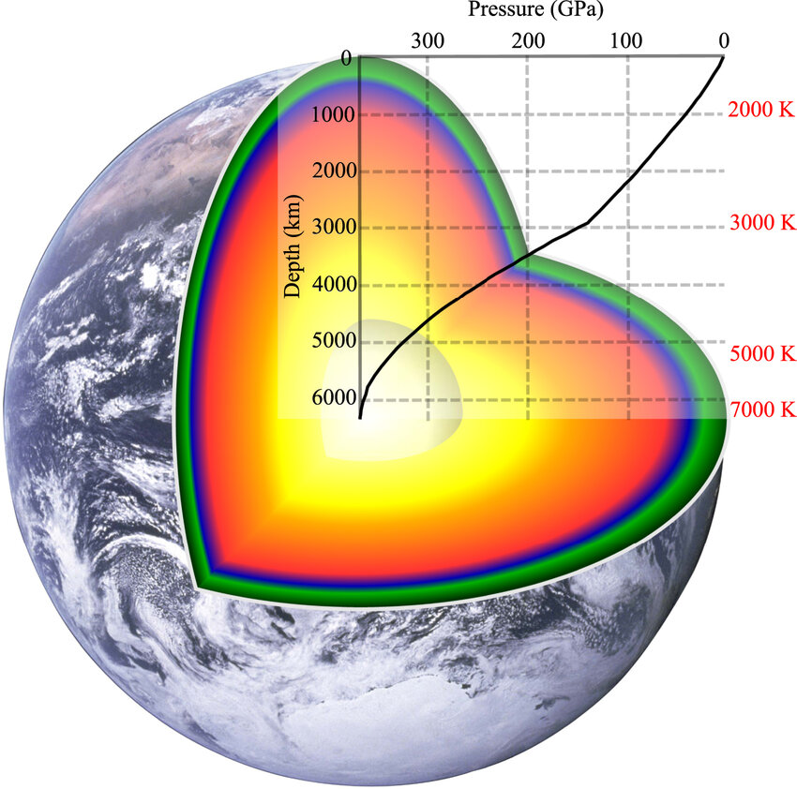
Phenomenon:
What do you notice about the graph?
What are you wondering about or questions you have?
.

Slide 3
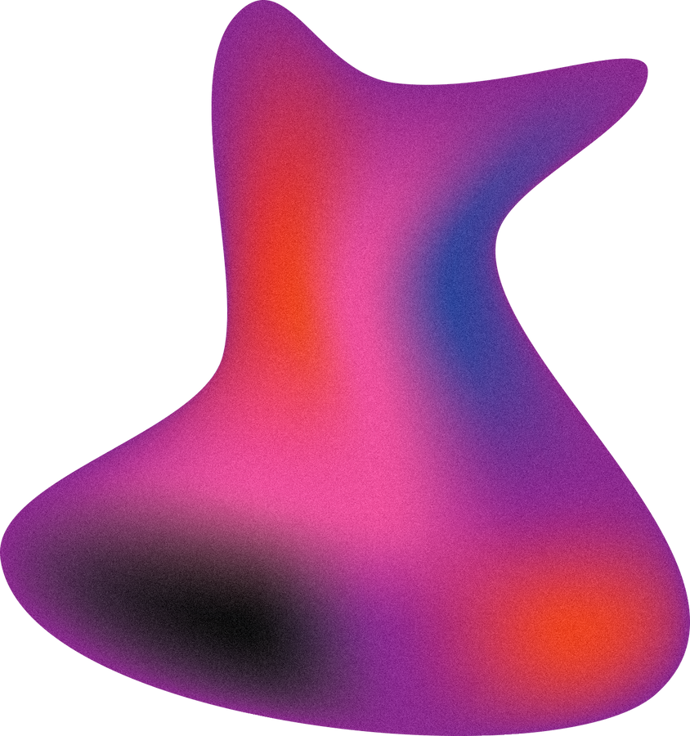
Why is the inside of the Earth hot?
Review: Name Two Reasons

Slide 4
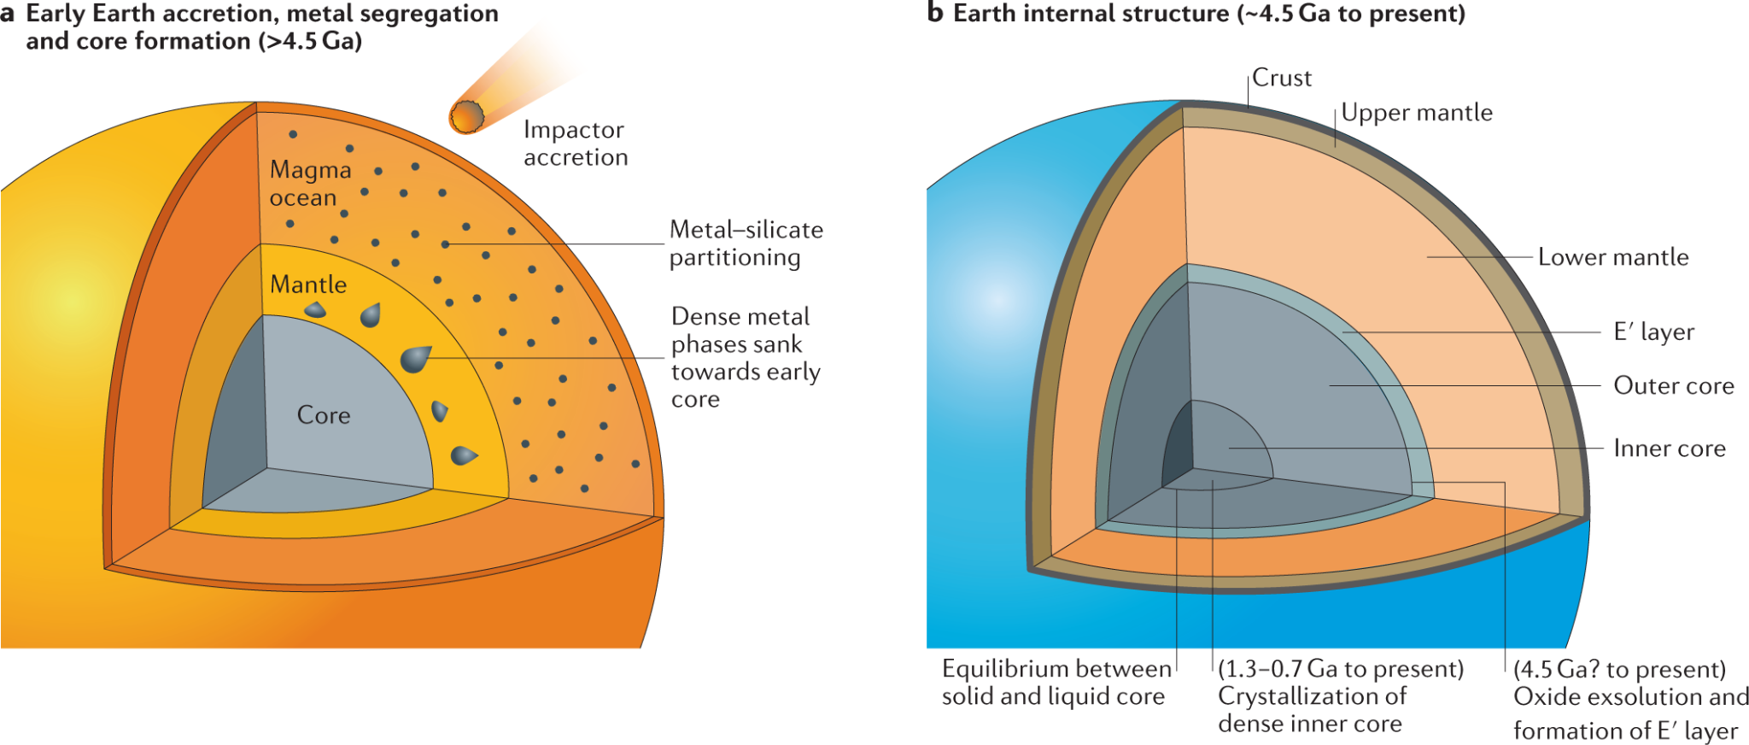
Heat from Differentiation Creating Friction
As the Earth sorted itself out from density, it created lots of frictional heat in the process.

Slide 5
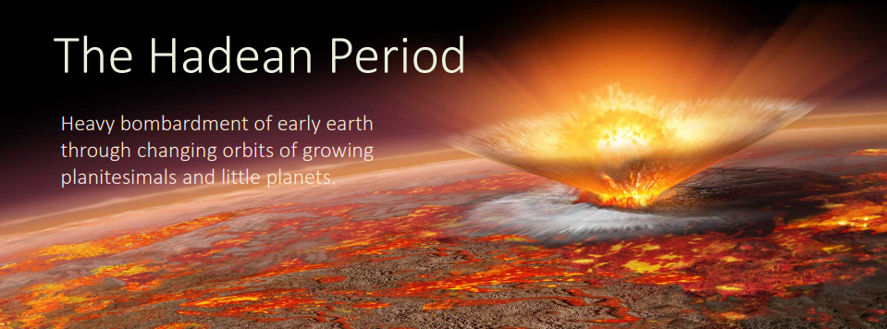
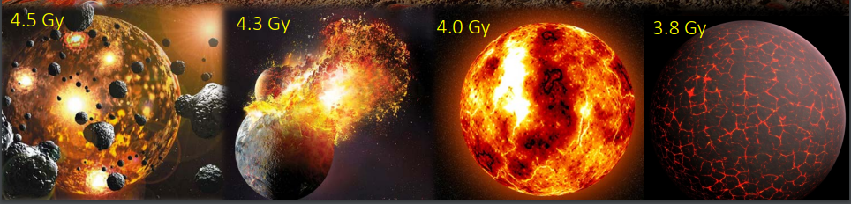
Heat of Formation
Heat from accretion, differentiation, and friction is insulated by the Earth’s mantle and the core is still very hot!

Slide 6
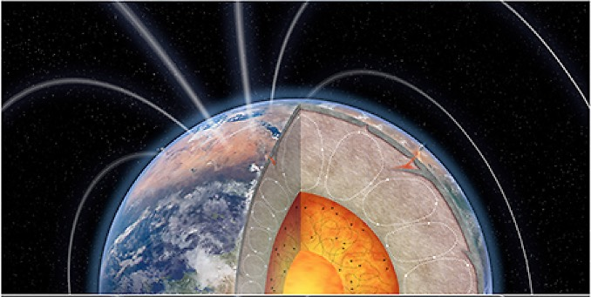
Heat from Radioactive Decay
Thorium and Uranium breakdown and release heat as they decay into smaller atoms.
Th
Th
U
U
Th
Th
U

Slide 7
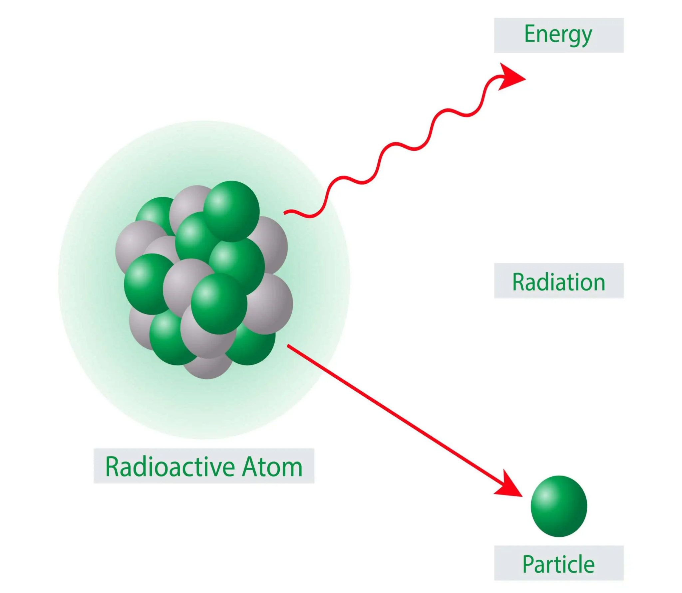
Nuclear Radioactive Decay
Thermal Energy
Heat is constantly being produced by radioactive atoms inside of the Earth.
For example:
Uranium(U-238)
Thorium (Th-232)
Potassium (K-40)
Smaller Elements

Slide 8
How do we know it gets hotter the deeper we go down inside the Earth?
What evidence is there?
How can we collect that evidence?

Slide 9
Evidence #1
Boreholes

Slide 10


Kola Borehole: Temperature Evidence Inside Earth
Notes:
Start at about 6 minutes

Slide 11

Temperature vs Depth
Depth (km) | Temperature (C )
1 | 11
2 | 22
3 | 46
5 | 70
6 | 94
12 | 220

Slide 12
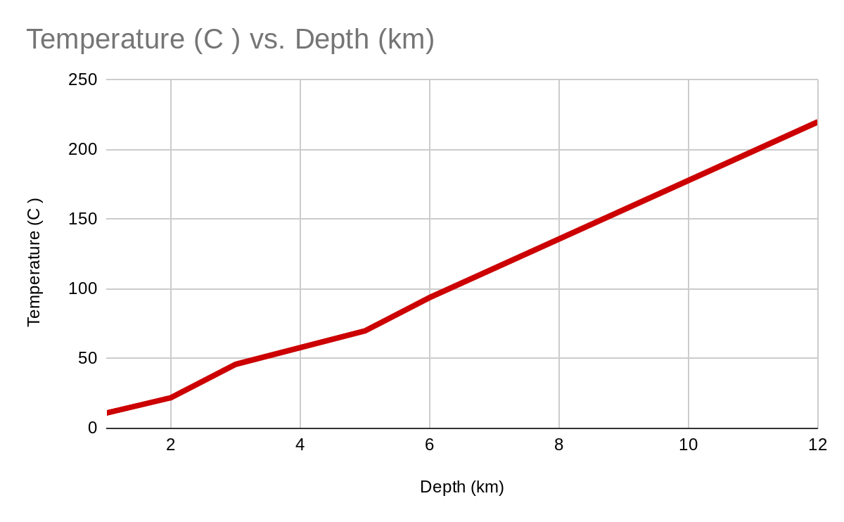
Temperature vs Depth
Depth (km) | Temperature (C )
1 | 11
2 | 22
3 | 46
5 | 70
6 | 94
12 | 220

Slide 13
Evidence #2
Convection Currents

Slide 14
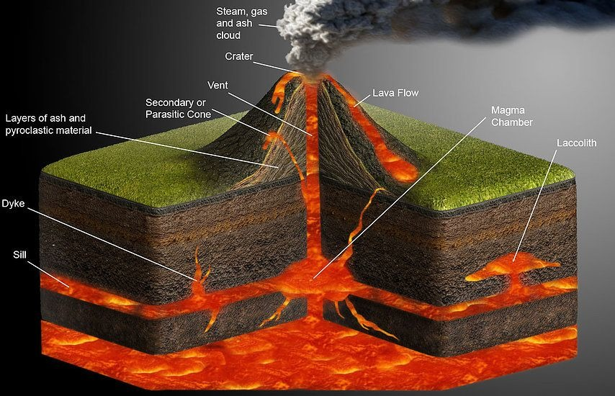
Why does magma rise up and spill out of Earth as lava?
How are these molecules moving compared to others in the Earth?
Magma is 700 to 1300 degrees Celsius

Slide 15


Make observation about each situation. Where does the introduced substance go and why? Which water has more energy?

Slide 16
 | Describe | Model
 | Using the pipet, gently squeeze some hot water into the bottom of one of the beakers of room temperature water. What do you observe? | Using the pipet, gently squeeze some hot water into the bottom of one of the beakers of room temperature water. What do you observe? (Show with arrows.) Model the energy of the molecules. Model the density of the matter.
 | Next, take some colored ice and place it into the other beaker of room temperature water. What do you observe? | Next, take some colored ice and place it into the other beaker of room-temperature water. What do you observe? (Show with arrows.) Model the energy of the molecules. Model the density of the matter.
 | Using the information from the lab, explain how the matter in Earth’s interior would behave if it were near the cooler crust or if it were near the hot core.
HOT
COLD
CONCLUSION

Slide 17
 | Describe | Model
HOT
COLD
CONCLUSION

Slide 18
 | Describe | Model
 | The hot water rises up to the top if you put it in the bottom.
 | The cold water sinks down to the bottom of the glass.
 | The cooler crust material would sink and the hotter core material would rise up.
How can we make it better?
HOT
COLD
How can we make it better?
CONCLUSION

Slide 19
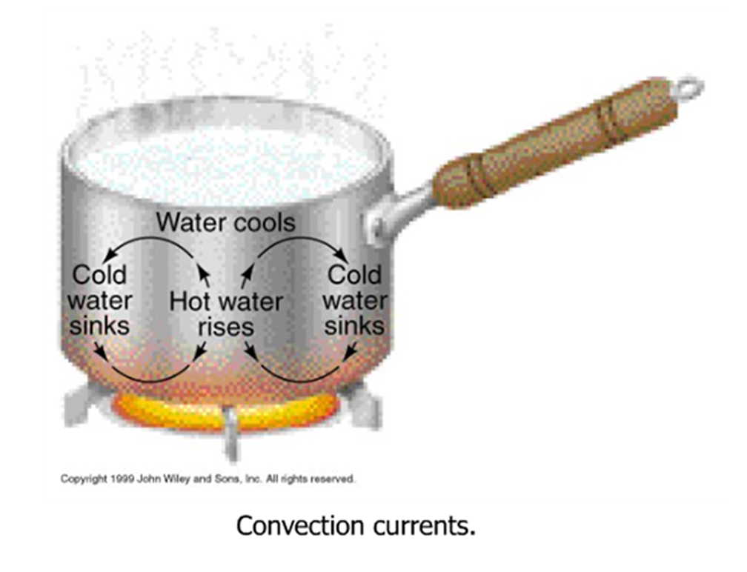
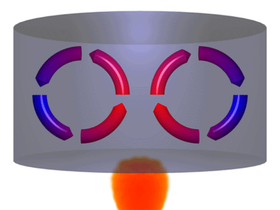
Thermal Convection Currents in the Mantle Transfer Energy Through Matter

Slide 20
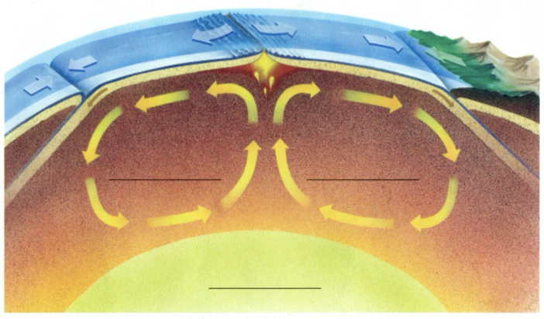
Annotate your models
Explain where it is rising and where it is sinking with words. What is less dense? What is more dense. Label it on your model.
LESS DENSE
Hot stuff is rising
Convection Current
Cooler stuff is sinking
MORE DENSE
Core- Heat Source

Slide 21
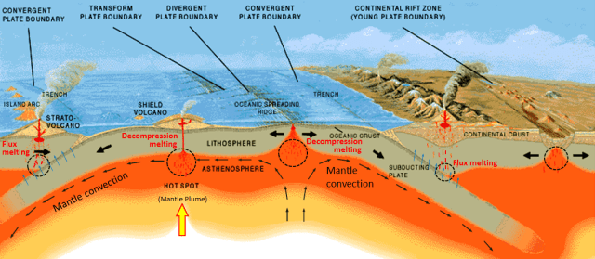
Convection currents - A way that heat is transferred within the Earth’s mantle. As the core heats the bottom layer of mantle material, particles move more rapidly, decreasing its density, and causing it to rise. The rising material begins the convection current. When the warm material reaches the surface, it spreads horizontally. The material cools because it is no longer near the core. It eventually becomes cool and dense enough to sink back down into the mantle.

Slide 22
Evidence #3
S and P waves
Energy moves through the Earth, changing speeds with different matter in each layers.

Slide 23


Slide 24
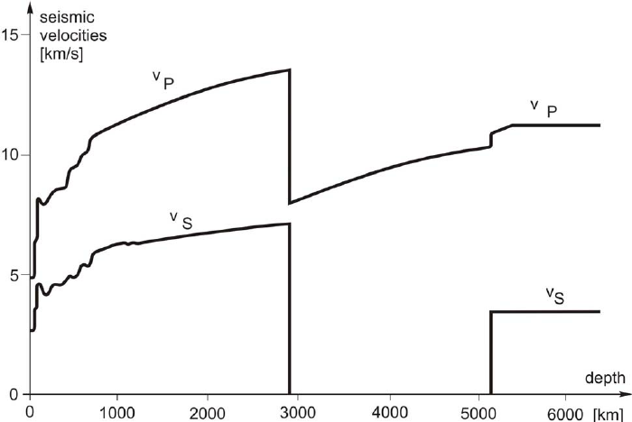
Mantle
Outer Core
Inner Core

Slide 25
Semi-solid
Liquid
Solid

Slide 26
HOT
HOTTER
HOTTEST

Slide 27
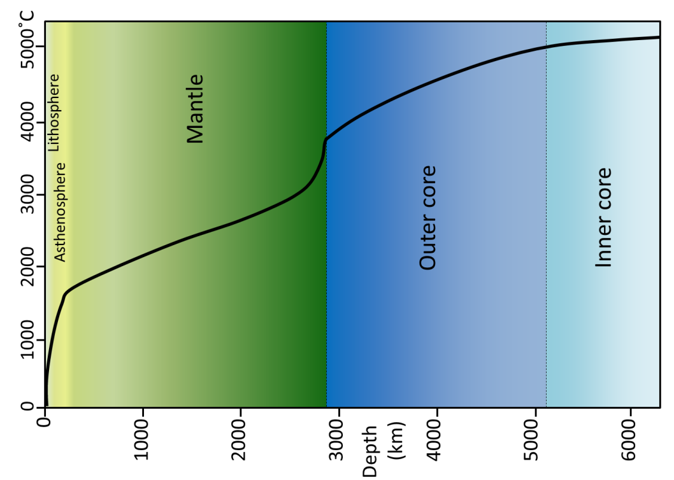

Slide 28
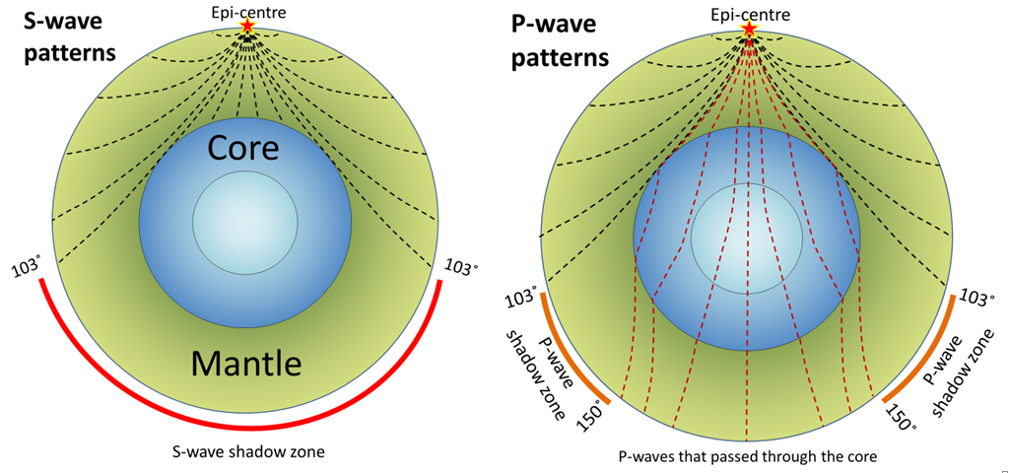

Slide 29
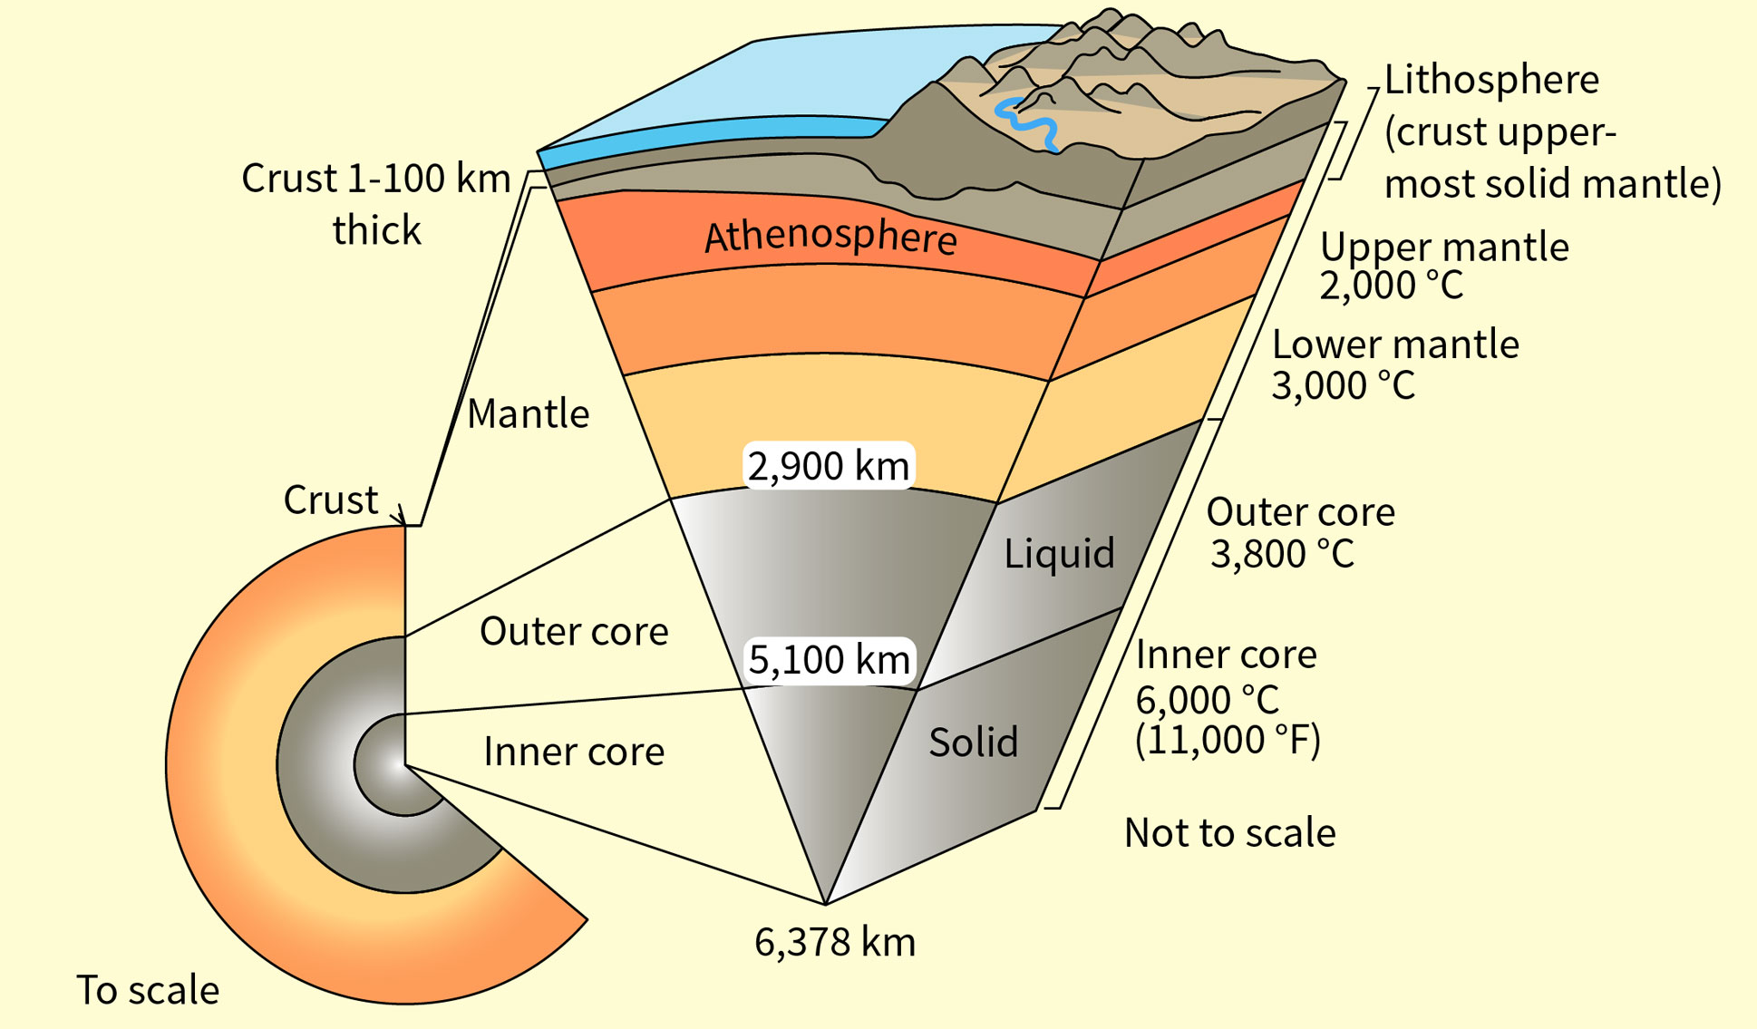

Slide 30
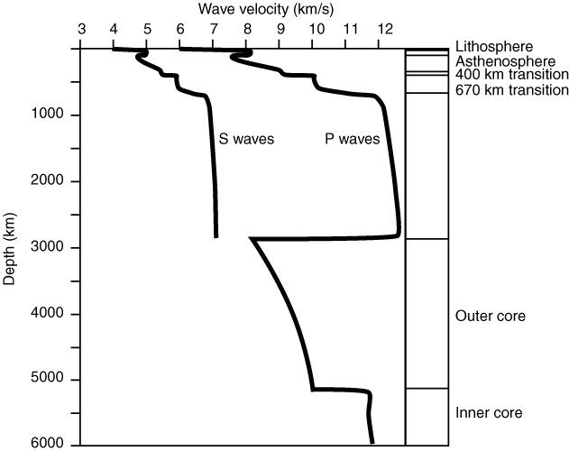
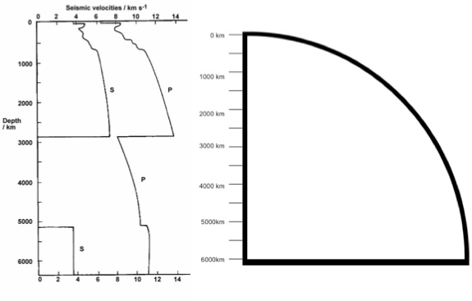

Slide 31
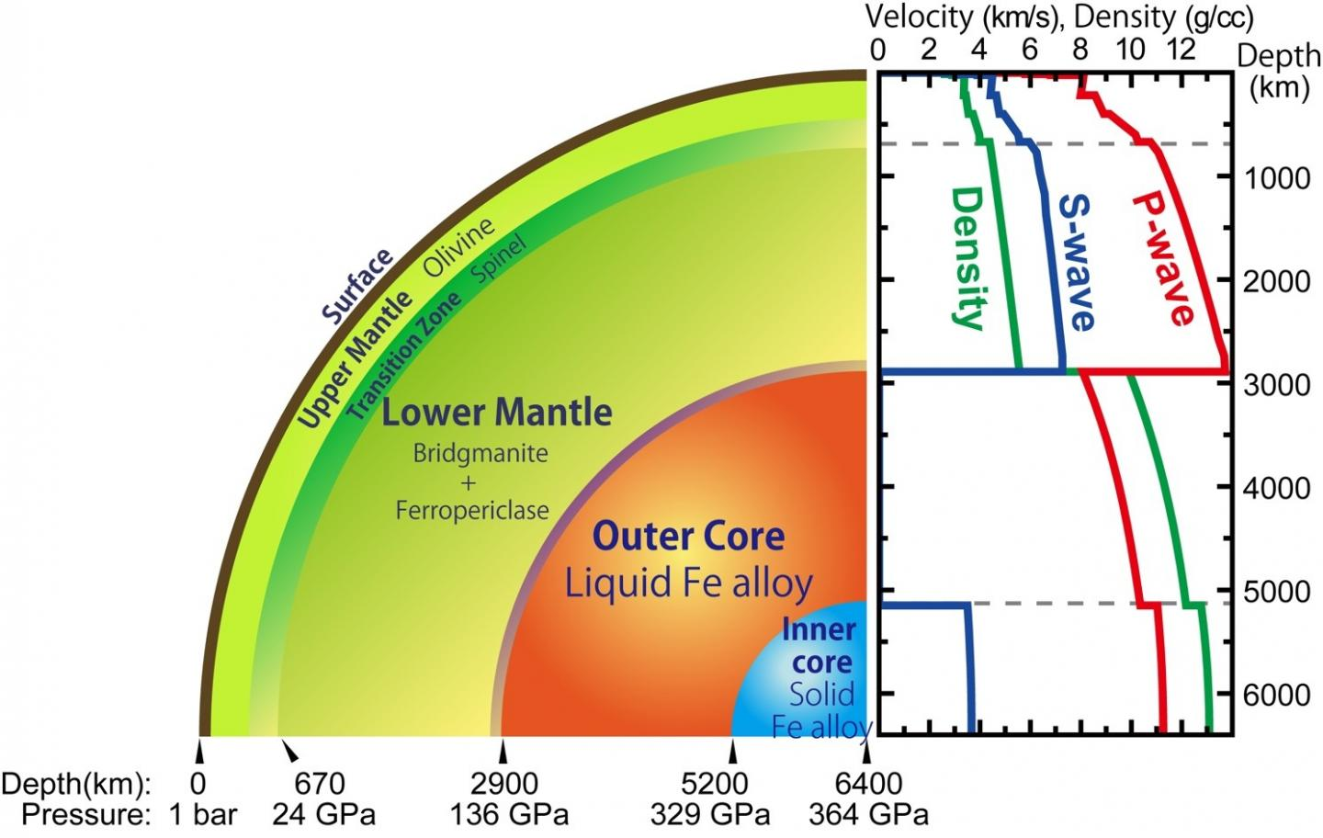

Slide 32
#1 Evidence that the Earth gets hotter closer to the core
Depth (km) | Temperature (C )
1 | 11
2 | 22
3 | 46
5 | 70
6 | 94
12 | 220

Slide 33
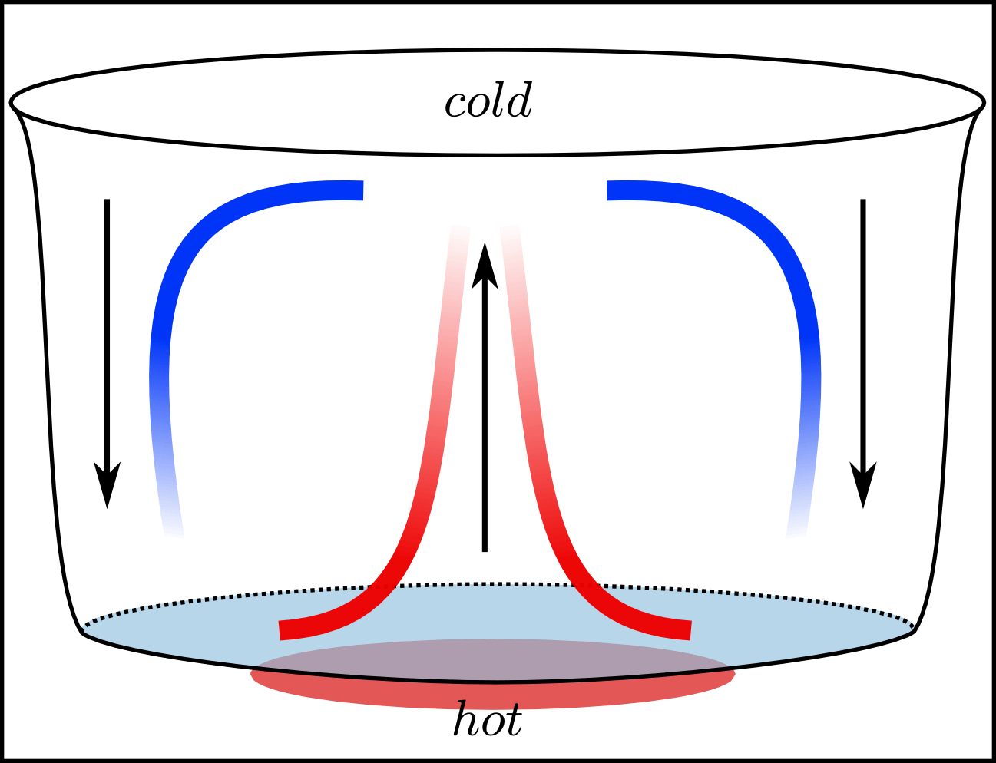
#2 Evidence that the Earth has movement inside due to convection currents

Slide 34
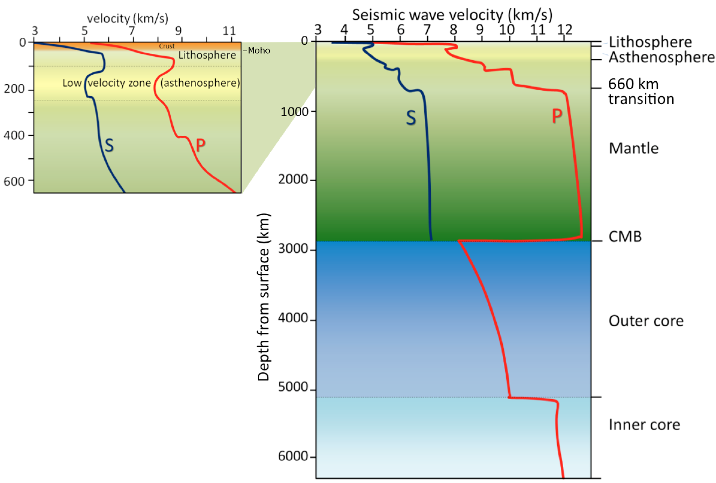
#3 Evidence Earth’s layers from S and P waves.

Slide 35
Check | Model Requirements
 | Identifies crust, mantle, outer core, and inner core layers and labels each in the planets interior.
 | Labels where the new world is the hottest inside and where it is the coolest. Identifies temperature with words like hotter, hot, and hottest.
 | Labels density differences in at least two layers.
 | Model thermal convection currents showing hot materials are rising and cooler materials are sinking due to density.

Slide 40
THANK YOU!
Write a closing statement or call-to-action here.

Slide 41

3D-RST is supported by the NSF under grant number #DRL-2101383

