Slide 1

Matter Matters:
Water's Journey
Utah SEEd 6.2.2
NGSS Correlation: MS-PS1-4

Slide 2
Today, you will develop a model to predict the effect of heat energy on the states of matter and density.
Notes:
Access prior knowledge about matter and density.

Slide 3



SEP
CCC
DCI
Science and Engineering Practice
Cross Cutting Concept
Disciplinary Core Idea
heat energy on states of matter and density

Slide 4
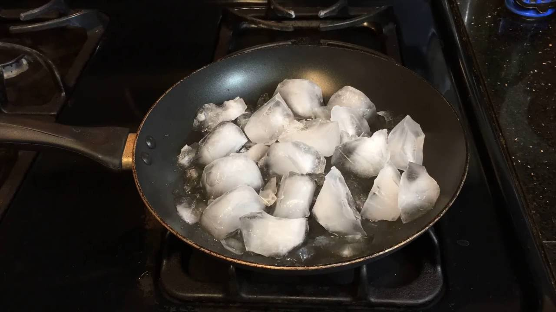
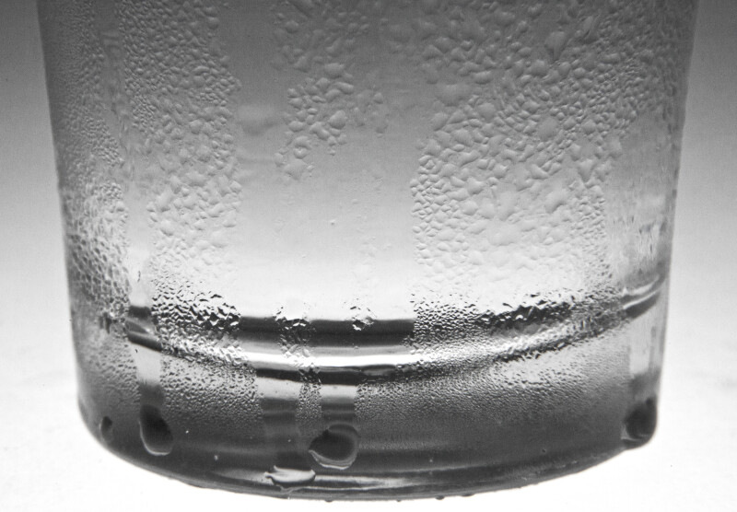
Phenomenon:
Make a Prediction about what you think will happen.

Slide 5
Phenomenon:
What do you observe? What do you wonder?
Notes:
Turn and Talk; Emphasize the Model; and Cause and effect; heat energy;

Slide 6
As you read the article, think about the phenomenon and what drives the changes in the states of matter, the movement of the molecules, and the density in each state.
Annotate
Underline and number the properties of solids, liquids, and gasses.
Circle the effect of heat energy.
Square the effect of density.
Notes:
Encourage annotating; Partner reading – take turns reading paragraphs out loud together – turn and talk to summarize the article; Have a group or two share their summaries. Ask about what they noticed about models in the article? What caused the changes in the states of matter?

Slide 7
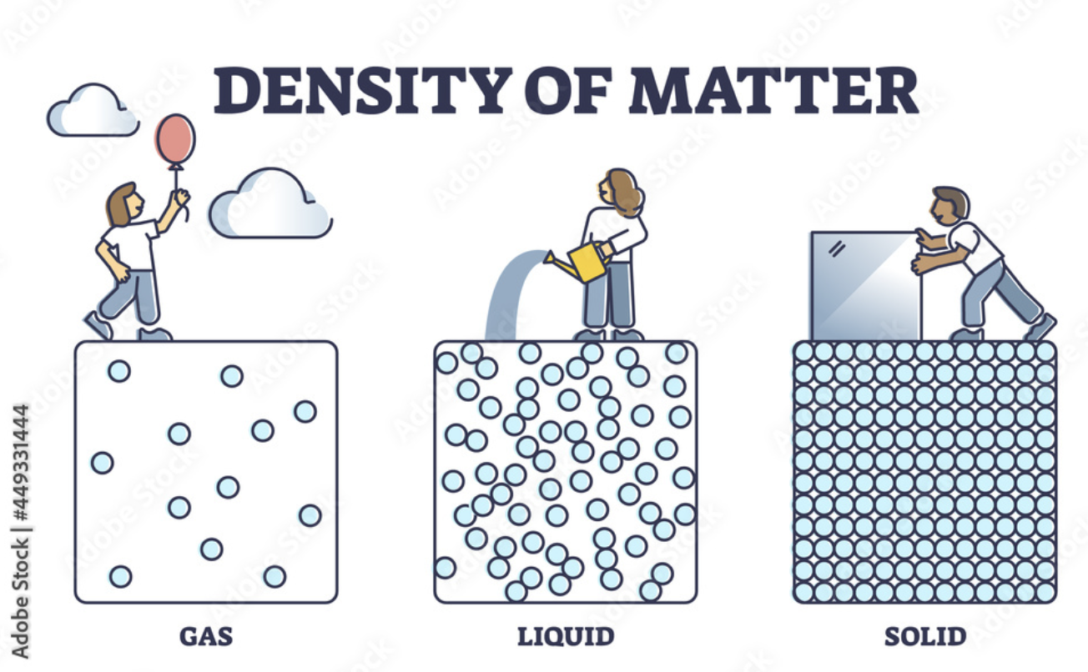
Notes:
As you look at the model, what do you notice about density?

Slide 8
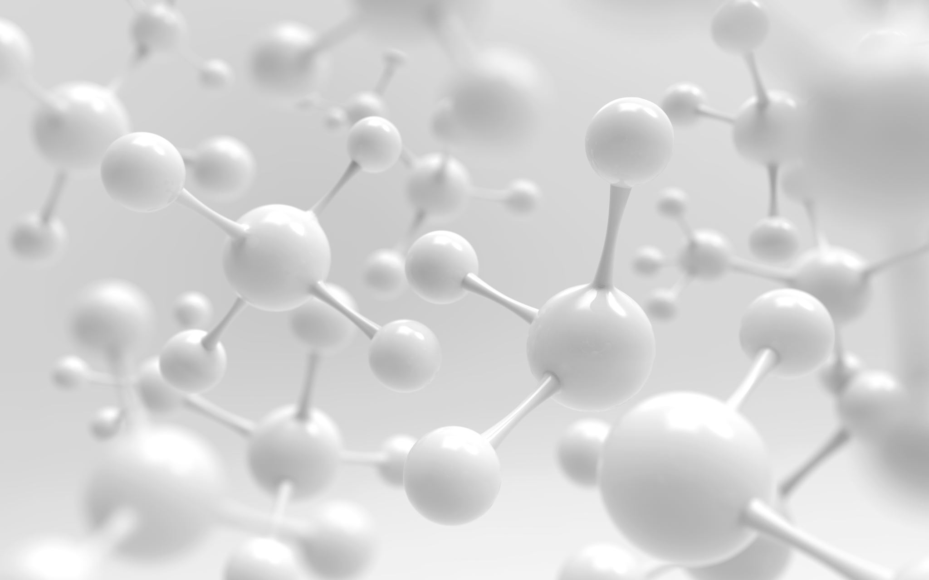
Get Movin' Molecules Activity
Notes:
Have one group model a solid; Ask the students what they would need to do to make a solid. Then have the solid try to move out of the class door?
What caused the molecules to act more like a liquid? If I turn up the heat energy, what effect will happen? Have students create a liquid; rule that students need to touch two people and all be together. Students can change who they are touching, but must quickly touch someone else so they are always touching two people and staying together. Now they move out of the door. Have students come back in.
Now ask what will cause the liquid to become gas? (heat energy). Rule: Students need to have a select area and not go crazy. Students then model gas particles and move out the door.
Now ask about density comparisons between all three.
High energy students to be the gas; move quickly and may bump into each other (gently)

Slide 9
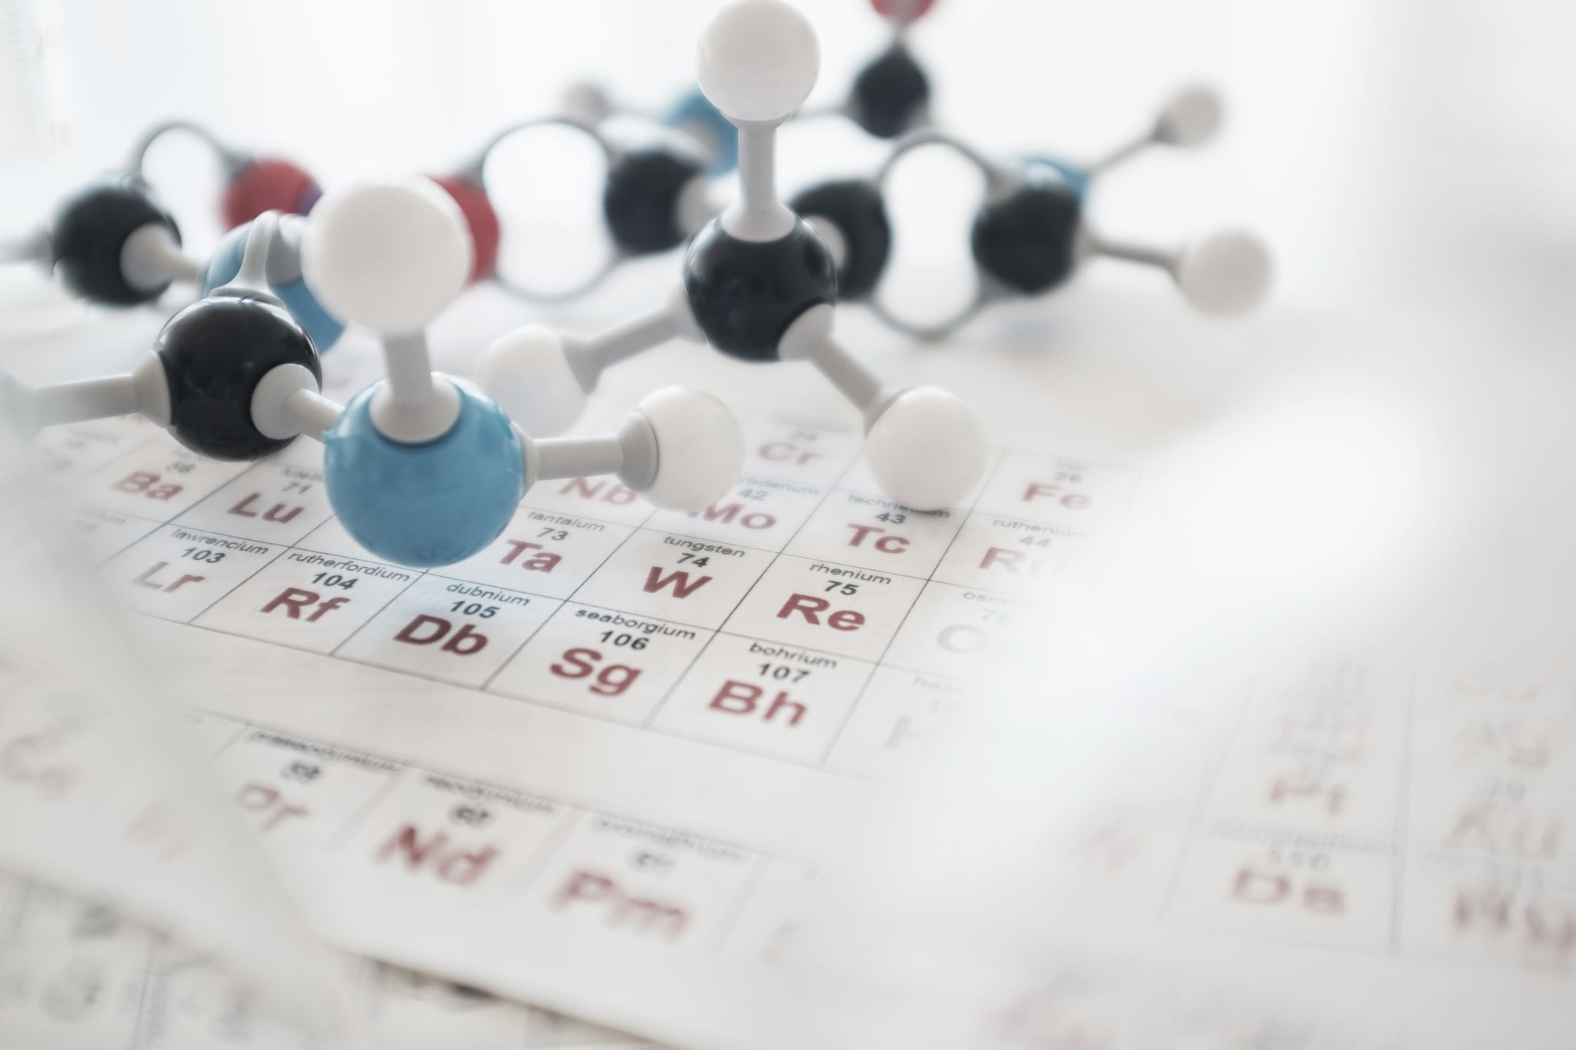
Reflect on the activity:
Complete questions 2-5 on the worksheet.

Slide 10
Phenomenon:
What do you observe? What do you wonder?

Slide 11
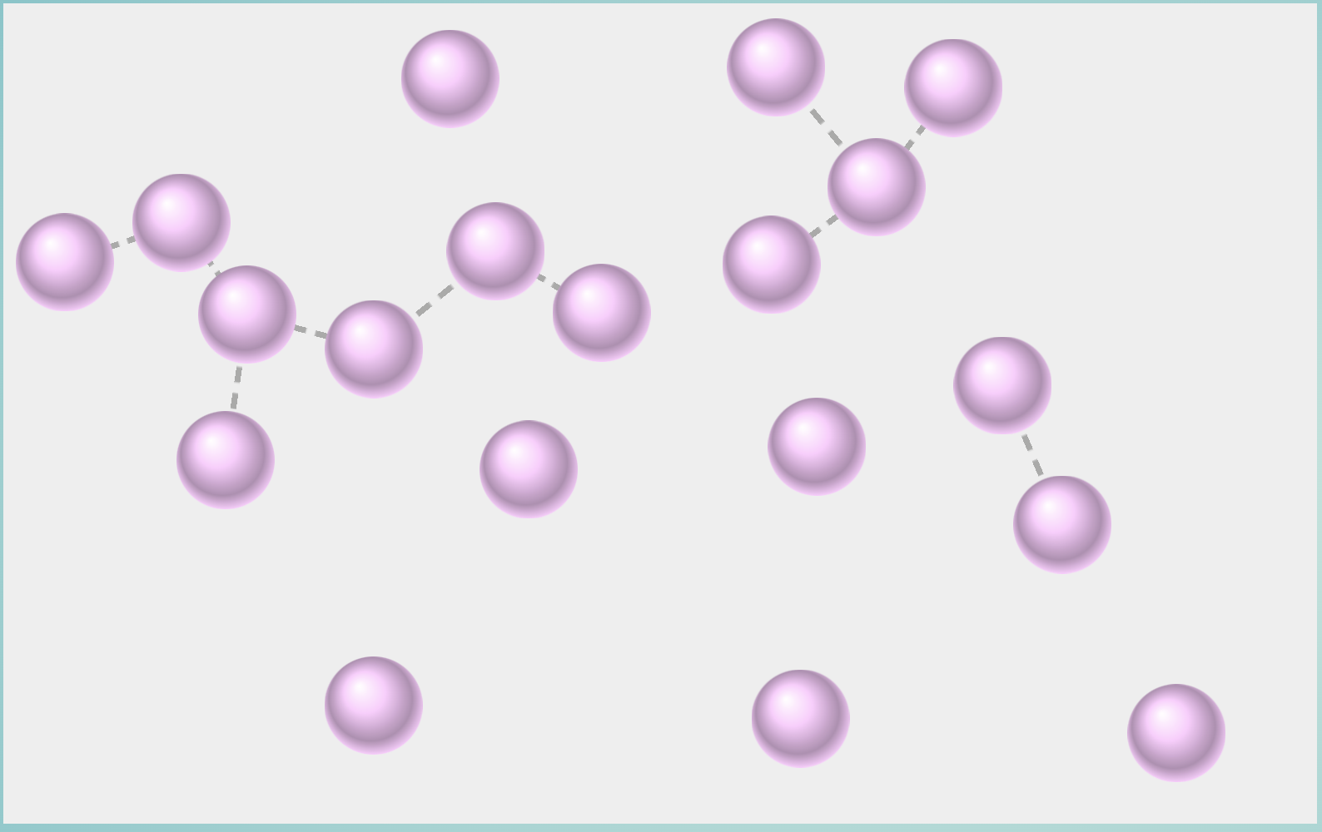
Gas Particles Video Link
Notes:
http://mw.concord.org/nextgen/#interactives/chemistry/phase-change/
Model relates back to phenomena how?
Watch the model of gas particles and ask questions or make statements of what they are observing; Pull in cause and effect; Model; heat energy; density; molecule movement

Slide 12
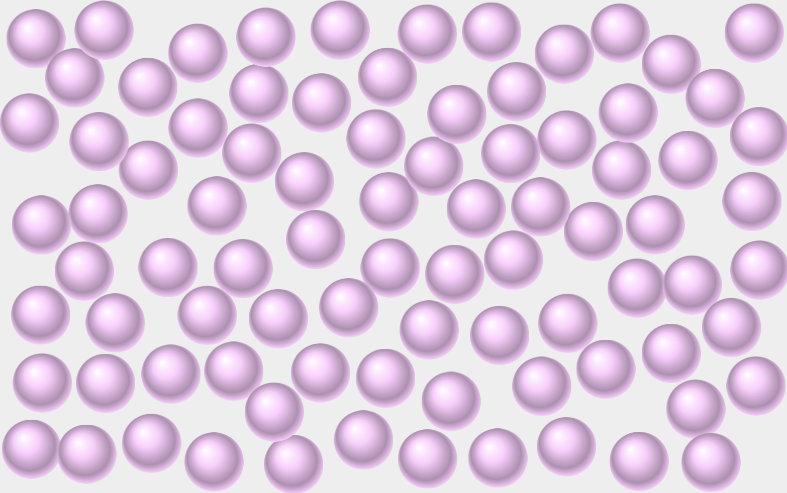
Liquid Particles Video Link
Notes:
Relates back to phenomena how? Pull in cause and effect; Model; heat energy; density; molecule movement

Slide 13
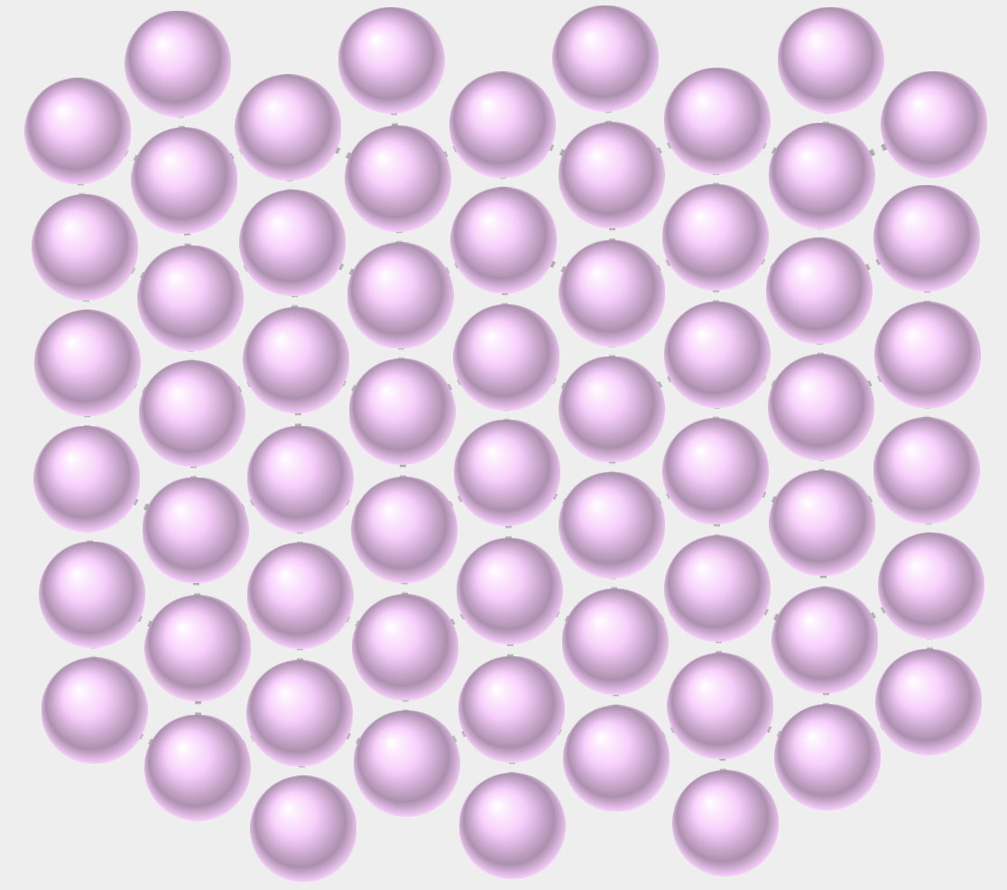
Solid Particles Video Link
Notes:
Relates to Phenomena how? Pull in cause and effect; Model; heat energy; density; molecule movement

Slide 14
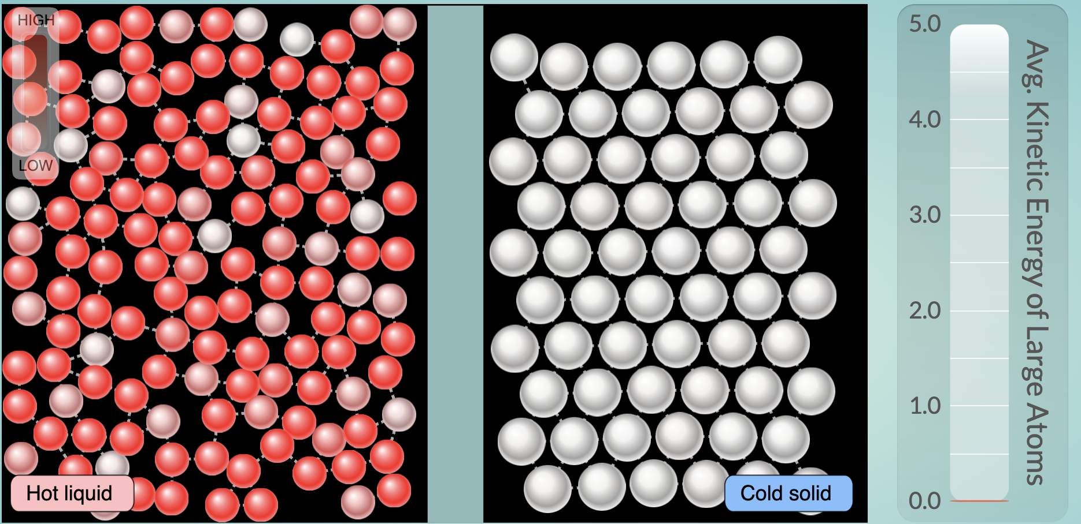
Phase Change Video Link
Notes:
Once barrier is removed, what observation do you notice in the model that causes the heat energy to increase. The hot liquid mixes with the cold solid and the heat energy increases as the hot heat energy causes the cold molecules to spread out more.
Temperature is a measure of the average kinetic energy of particles of matter. The relationship between the temperature and the total energy of a system depends on the types, states, and amounts of matter present.

Slide 15
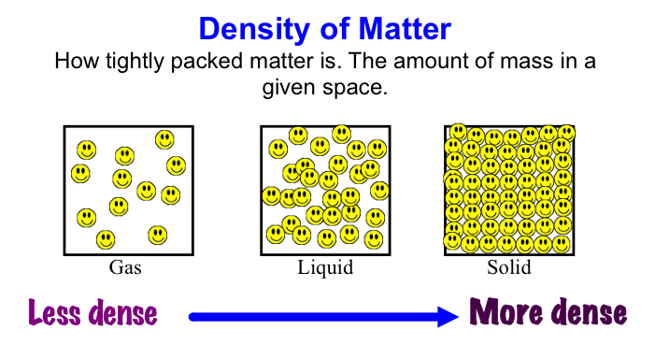
Effects of heat energy on the states of matter and density:
Hotter
Cooler
Notes:
What is the effect of heat energy on density and
states of matter.
Students can summarize and teach the class. Student starts to summarize in 30 seconds stops – another student volunteer to continue for 30 sec – then another adds on for 30 sec.---

Slide 16
Are you able to develop a model to predict the effect of heat energy on states of matter and density?
Notes:
Thumbs up or down if you are ready to answer the questions.

Slide 17
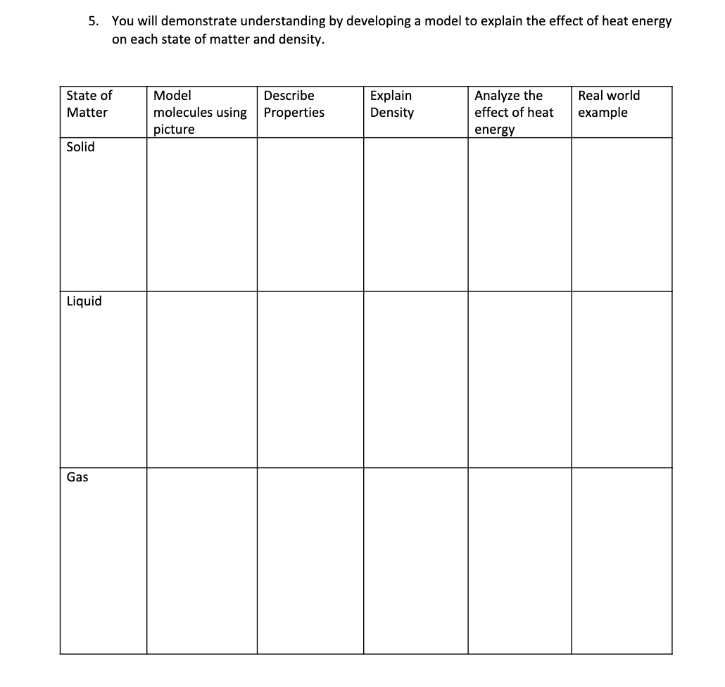
On your worksheet;
#5 You will demonstrate understanding by developing a model to explain the effect of heat energy on each state of matter and density.

Slide 18

3D-RST is supported by the NSF under grant number #DRL-2101383
Lesson Designed by Kaylei Jones, Westen Miller, and Jan Hermansen 2024

Slide 19
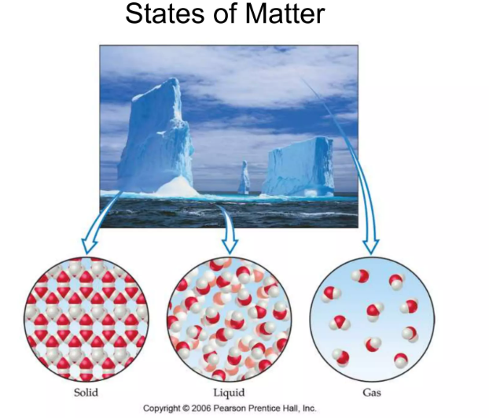
Notes:
Extension: PHET lab.

