Slide 1
Exploring Oxidation
Objective:
Analyze data to predict the rate of oxidation and electron transfer in elements using patterns of reactivity on the periodic table.

Slide 2

Prior Knowledge
Building upon ….
Understanding of predicable trends in reactivity and ionization energy of elements based on their location on the periodic table.
Understanding of basic atomic structure

Slide 3
Bell Work Review Questions
Review ionization energy by describing where ionization energy is the highest on the periodic table. What elements are in that part of the periodic table?
What is ionization energy?

Slide 4

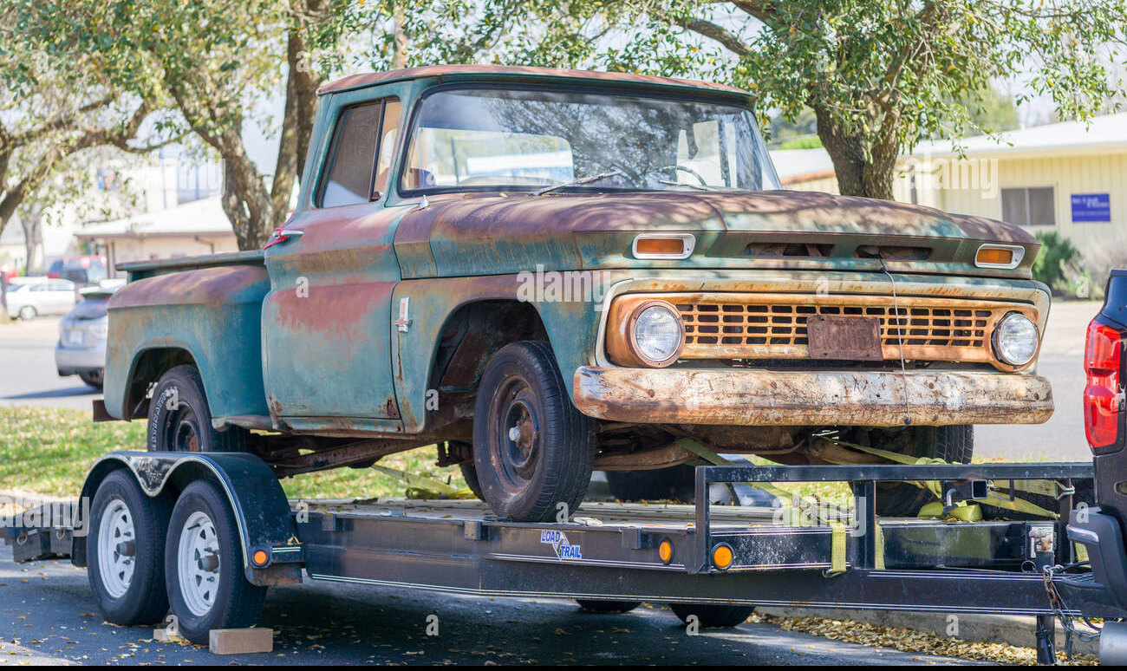
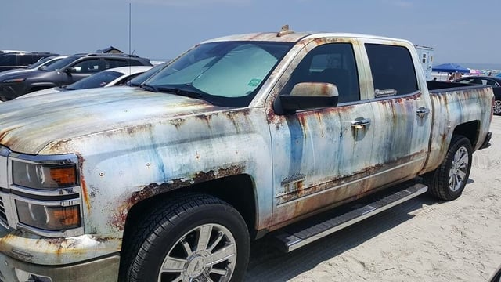
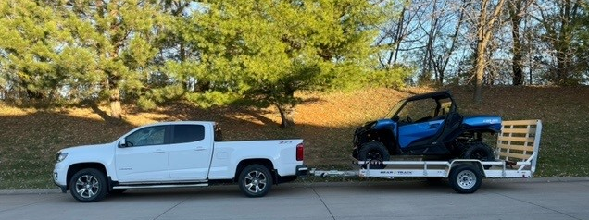
Phenomenon: What differences do you notice in the material these are made from?
Notes:
Early 20th Century:
Steel becomes the dominant material for car bodies and frames due to its strength, durability, and ability to be easily shaped with new manufacturing techniques.
First All-Steel Car:
Dodge produced the first fully steel-bodied car in 1914, marking a major shift in automotive manufacturing.
Post-WWII Development:
As car production boomed, steel remained the primary material, with advancements in steel alloys leading to stronger, lighter options.
Aluminum Enters the Picture:
By the late 1970s, automakers started experimenting with aluminum in car components, primarily due to its weight-saving benefits, initially used in race cars and then gradually incorporated into production vehicles.
Modern Trends:
Today, most cars still primarily use steel for their structure, but aluminum is increasingly used in body panels, engine components, and suspension parts to improve fuel economy.

Slide 5

Explore: Why things rust
You and your partner will analyze the reading about "Electron Transfer".
Draw conclusions to...
Describe oxidation and what occurs to elements to cause rust
Predict which materials in the lab will oxidize.

Slide 6
Data Collection: Reactivity of metals and nonmetals in acid
Confirm your predictions with your teacher
Then collect one sample of each to test.
Read and follow the directions on your worksheet

Slide 7


Lab Instructions
1. Put a small amount of each material to put in each test tube
2. Observe the physical properties of each material.
3. One at a time, add 2 pipette squirts of acid to cover each sample.
4. Categorize the reactions rates of each element as very low (1) – very high (5).
5. Categorize the reactions based on their ionization energy.
LAB SAFETY
LAB CLEAN UP
Using tweezers, remove any solid pieces of materials and place it in the "solid" waste container​
Pour the acid into the "acid waste" container ​
Rinse and clean the test tubes​
Place the test tubes upside down on the test tube rack holders​
Keep Goggles on at ALL times​
Report any damaged test tubes to your teacher​
Use the tweezers to remove solid materials​
WASH your HANDS before leaving lab!

Slide 8

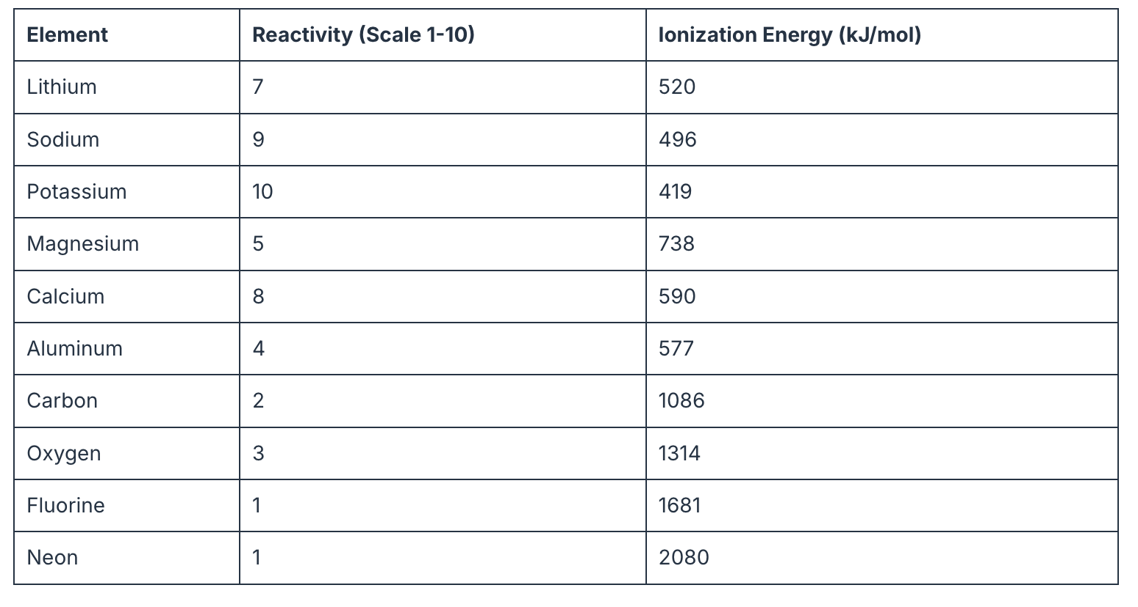
Don't Forget
Reactivity and Ionization Energy have an INVERSE relationship. If there was high reactivity, the ionization energy will be low.

Slide 9
Share your results with another group
Do this after clean up time. Discuss the reason for any differences.

Slide 10
Analyze Data: Why do some materials oxidize (rust) while others do not?
Categorize the elements on your worksheet and explain the reason for the results you saw.
Analyze your data to explain what is occurring that causes some materials to oxidize (rust) and others do not.

Slide 11
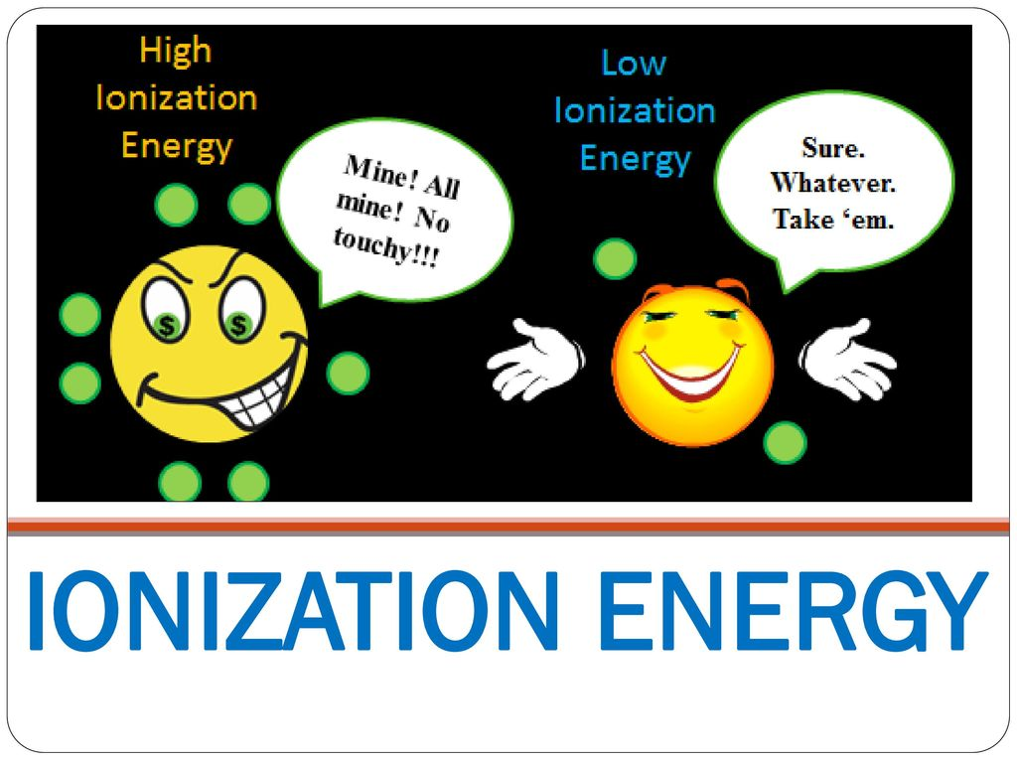
Analyzing Data
Reactivity, Ionization Energy and Electron Transfer
Compare the reactivity rates to the ionization energy of these elements using the periodic trend in the reading
What patterns emerge?
How does this relate to electron transfer in metals vs nonmetals?

Slide 12
Explain:
Compound | First Element Name & Type (metal or nonmetal) | Second Element Name & Type (metal or nonmetal) | Which element will transfer (lose) electrons (if neither element would lose electrons, write ‘none’)
NaCl
SnO₂
CH₄
H₂O₂
KBr₂
A compound is a substance that contains atoms of two or more different elements that are chemically bound together. A chemical bond is a strong attraction between atoms that hold compounds together. One way chemical bonding occurs is by electron transfer (one element loses electrons).
Based on the patterns from the data you gathered in part 3, predict which elements (if any) will transfer (lose) electrons when forming the chemical bond

Slide 13
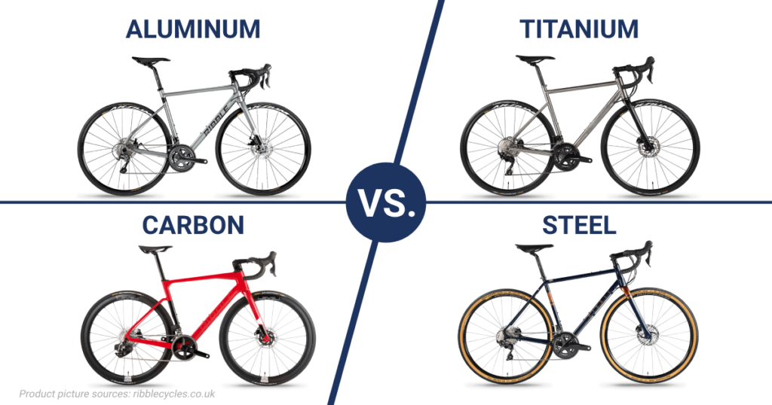
Assessment
You were just accepted to BYU! However, you need to save money for tuition, so you are getting a bike to go around campus.
Based on what you understand about why some things rust, what type of bike would be best to have outside on BYU campus? Explain your reasoning.
IRON alloy

Slide 14

3D-RST is supported by the NSF under grant number #DRL-2101383

