Slide 1
What’s Mass got to do with it?
Standard 8.2.1
Use computational thinking to analyze data about the relationship between the mass and speed of objects to the relative amount of kinetic energy of the objects

Slide 2
DCI
SEP
C C C
Energy & Matter
Energy can be tracked through physical interactions
Analyze & Interpret Data
Cause & Effect
Worksheet for Lab

Slide 3
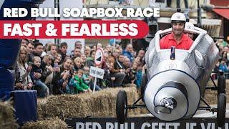
PHENOMENON
DIRECTIONS:
As you watch the video, please pay close attention to how the Mass affects the race and the vehicle. What do you notice?
Watch from 4:10-7:05
On the next slide:
Make at least 3 observations.
Come up with 3 questions about the video.

Slide 4
OBSERVATIONS
QUESTIONS
1.
2.
3.
1.
2.
3.

Slide 5
What is Kinetic Energy?
Which carts move the farthest? (Hint: What does the number of people have to do with distance?)
Do lighter or heavier carts go farther?
How might weight play a factor in who wins the race?

Slide 6
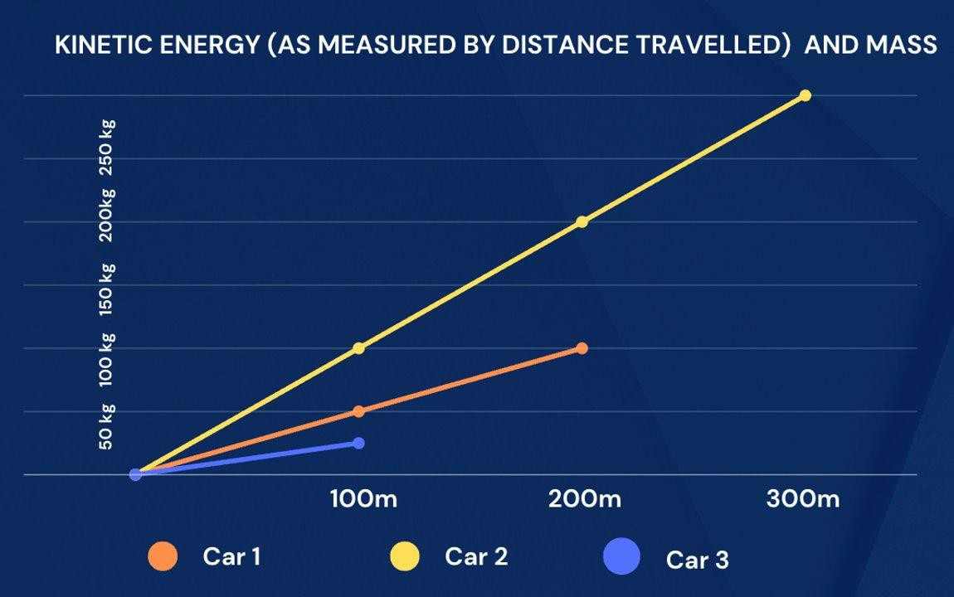
Proportional Example: The steeper the line the more kinetic energy

Slide 7
Learning Objective:
Driving Question:
Student’s will know that mass affects the amount of kinetic energy an object has by providing a claim, evidence, and reasoning from data collected from their investigation
Does the mass of the soapbox car affect the distance traveled? Why?

Slide 8
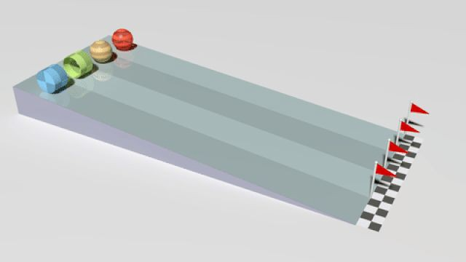
Does Mass Matter?: Mass vs. Kinetic Energy
Important Prior Knowledge
Mass: | The amount of matter in an object.
Kinetic Energy: | The energy an object (mass) has because it is in motion (speed)

Slide 9
Research Question | How does the amount of mass affect the amount of kinetic energy observed?
Hypothesis:
Experiment
Independent Variable | Amount of mass of the sphere
Dependent Variable | The amount of kinetic energy in the sphere is measured by how much the energy moved the container at the end of the ramp.
Control | The container’s movement with 0 grams hitting it (where the container is sitting)
Materials Needed | Container, measuring tape (centimeters), spheres of different masses, ramp
Procedures/Steps | Set up the ramp being sure that there is the same angle each time. Place the container at the bottom of the ramp. Place the measuring tape at the end of the ramp to mark “0” distance Take one sphere and place it at the top of the ramp and let go. Measure from the front edge of the container (end of the ramp) how far it moved from its original control position in centimeters. Record this in your data table. Test 3 times Repeat steps 2-5 with the other masses of spheres. Repeat each test 3 times. Calculate the average distance that each different sphere traveled. (Remember the farther the container traveled the more kinetic energy the sphere originally had).

Slide 10
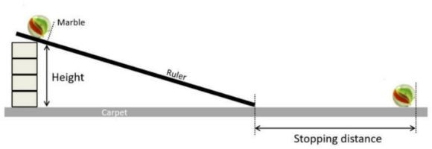

Slide 11
STOP!!! You cannot ﬁll out the remaining sections until you have run the experiment!
Mass of the marble | 2g Styrofoam | 7g Wood | 11g Acrylic (CLEAR) | 20 g Glass Marble | 67 g Steel
1st Trial
2nd Trial
3rd Trial
The average distance the container traveled **THIS IS THE NUMBER YOU WILL GRAPH!! (Add all 3 and divide by 3. Round to the nearest whole number)
Analysis: On a scale of 1-5 identify which marble had the most kinetic energy (5) and which had the least kinetic energy (1)

Slide 12
Title:
Graph
Instructions:
❏ Create a title for the whole graph that describes the experiment (turn your research question into a title)
❏ Number the y-axis (make sure you use increments that will allow you to show all of your data)
❏ Label the y-axis with a title (What did you measure?)
❏ Label the units (i.e., grams, cm, mL)
❏ Drag the black circles where they go on the chart
❏ Check for ACCURACY
❏ Draw a line connecting the dots.
Styrofoam
Wood
Acrylic
Glass
Steel
Mass:

Slide 13
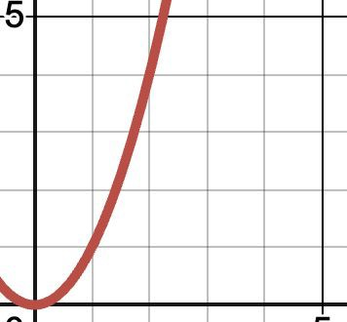
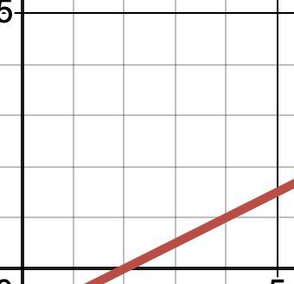
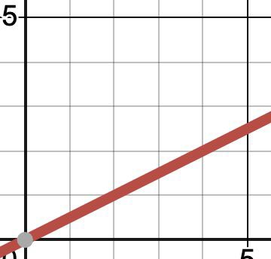
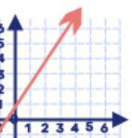
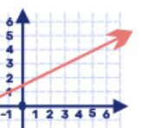
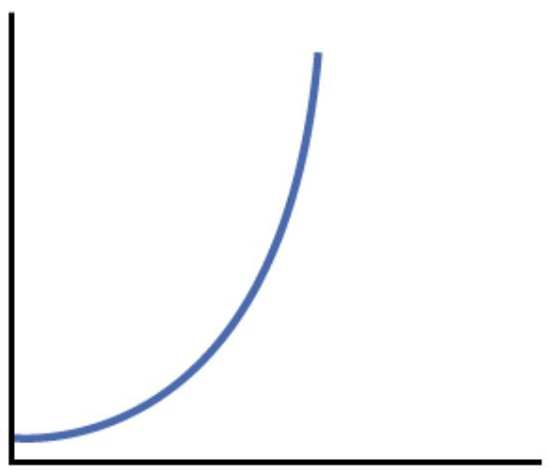
When you draw a line to connect the data points, what pattern do you notice?
Circle the graph that best represents the graph you created.
Based on this evidence, what is the mathematical relationship between kinetic energy and mass?
Exponential
Linear but not Proportional.
Proportional
Analysis
In one sentence explain what the data shows. What kind of mathematical relationship do you see in the data?

Slide 14
Conclusion Paragraph CER
Claim: Restate your hypothesis Claim: Answer the question: How does mass affect the amount of kinetic energy in a moving object? Quantitative Evidence: Give numbers from your experiment data to support your claim. Reasoning: Explain the scientific reason behind the results that you got. Talk about kinetic energy and mass and how they are mathematically related (refer to questions 1 and 2 in your analysis for help). The paragraph must be at least five sentences.

Slide 15
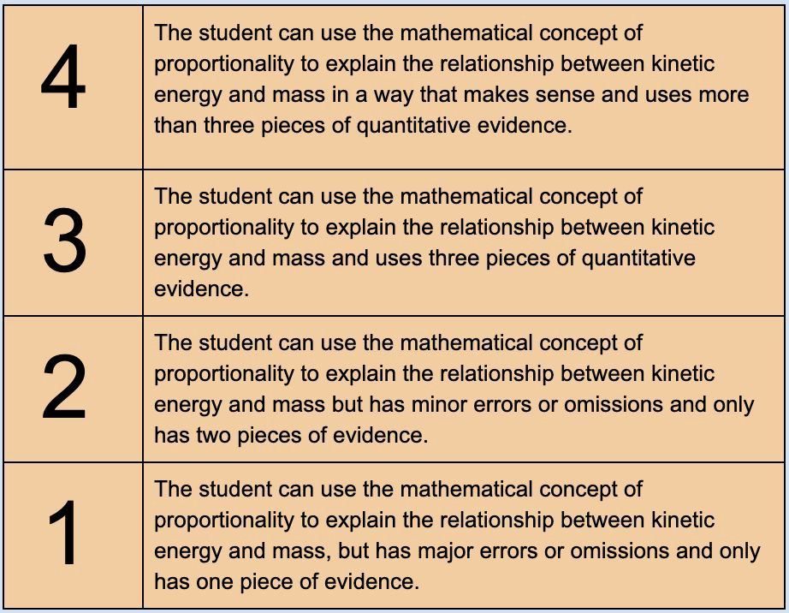


Slide 16
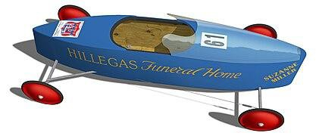
Circle Back to Phenomenon.
Suzanne Miller of Akron, OH, won the 1976 Junior Rally Championship with the above-pictured racer. Based on the results of your investigation, what did Suzanne’s racer most likely have that helped it to go faster and farther than the other racers?

Slide 17
Extension Question
Knowing how mass affects kinetic energy, and recognizing the equation for kinetic energy is K.E. = 0.5m • v² if we were to double the speed of the racer, how would the kinetic energy of the racer increase?

Slide 18


