Slide 1

“Managing the Waste!”
Notes:
Teacher notes: This slide is here just to get students thinking about the problem. NOTE: Even though they cannot necessarily see the problem, it is there in our landfills, on the sides of roads, in our oceans and water sources. Consider asking students where they have seen garbage in their everyday life.

Slide 2
LESSON OBJECTIVE:
Students will design a solution to address the cause and effect of waste on the environment while considering various constraints and criteria.
Notes:
Teacher note: Emphasize that this is the lesson objective students need to begin thinking about as we proceed through the lesson. SEP- blue highlight; CCC- orange highlight; DCI- green highlight

Slide 3

But First…
Notes:
Teacher notes: Students simply need to listen and participate as you, the teacher, facilitate a review discussion that can incorporate whole class involved responses (thumbs up, thumbs down, etc...) For example, what would happen to a fish population if the water quality is poor (increase in #= thumbs up; decrease in #= thumbs down; etc)

Slide 4
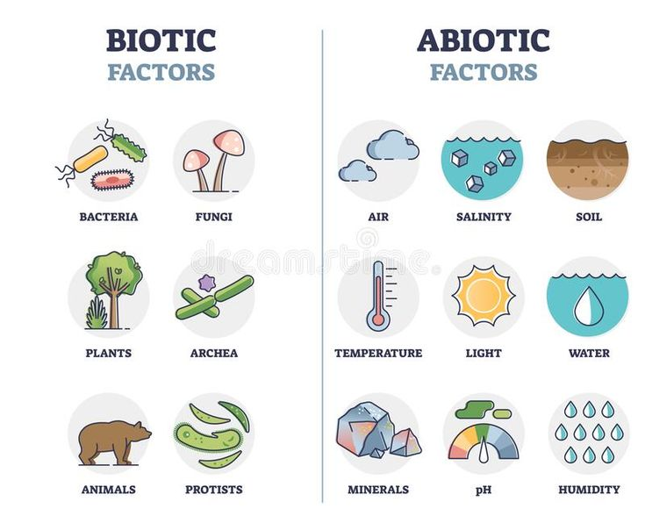
Bio 1.1 - How do abiotic and biotic factors affect the stability and change of a population?
Notes:
Teacher notes: THINK-PAIR-SHARE: Prompt students to discuss with a partner how any one of these biotic or abiotic factors would affect the stability and change of a population or an ecosystem. Discuss this as a class with several student responses followed by teacher clarification and student acknowledgement of comprehension.

Slide 5
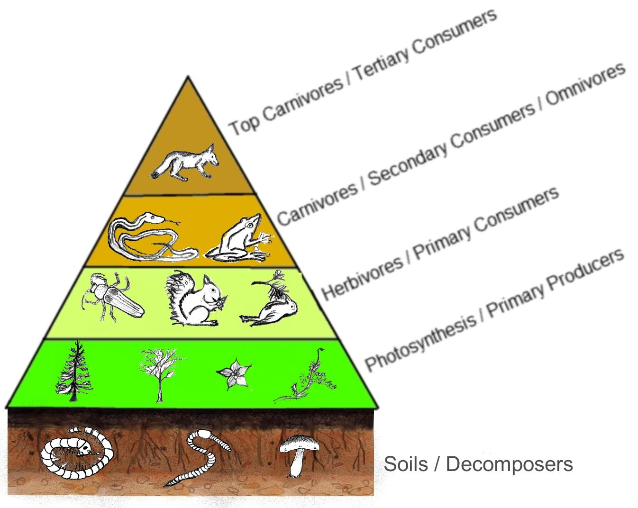
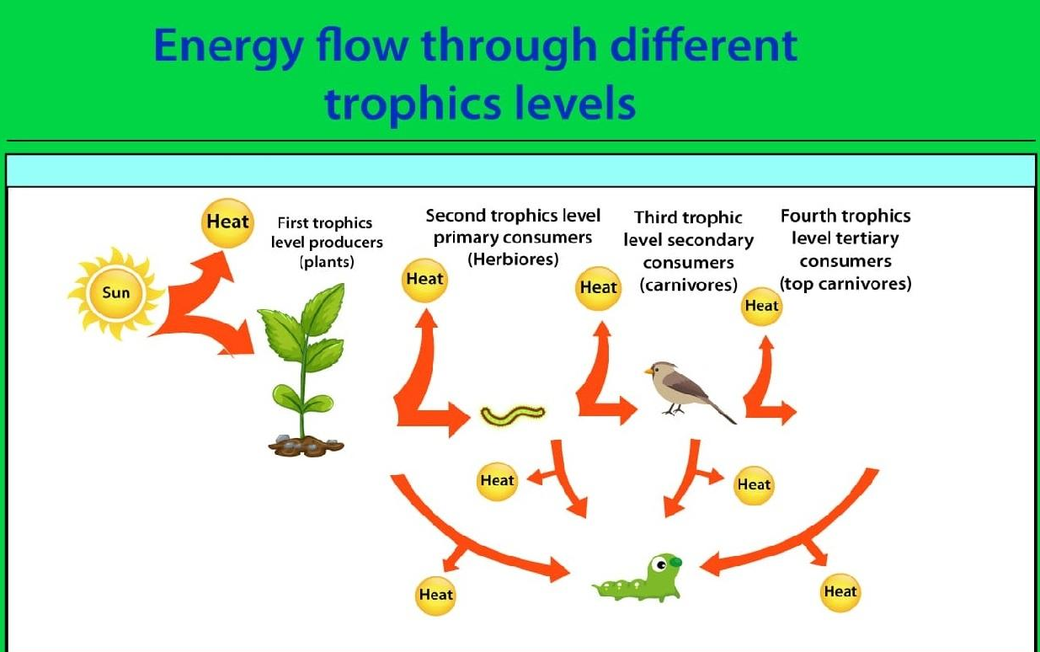
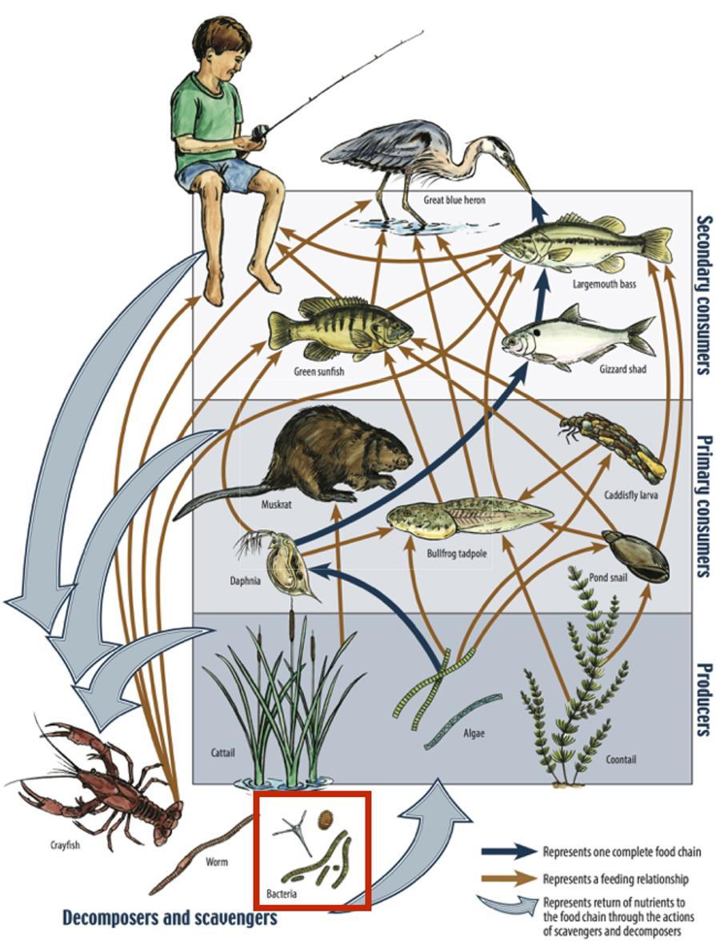
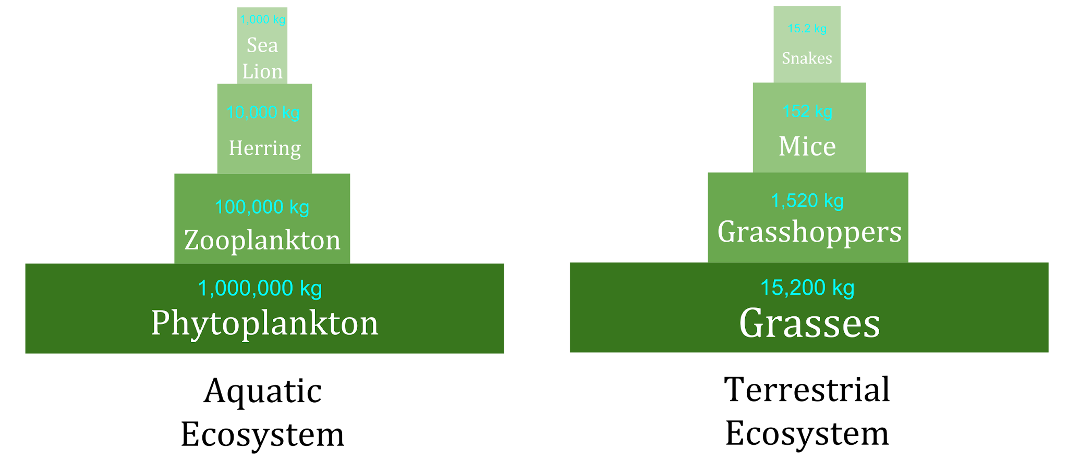
Bio 1.2 Ecosystem Dynamics
Do you remember learning about how matter cycles and energy flows through ecosystems?
Notes:
Teacher notes: THINK-PAIR-SHARE: Have students answer questions like: What do the arrows in a food web represent? Where is there the most energy (in what type of organism)? How much energy goes from one level to the next? Approximately, how much energy is lost to the environment as heat? What happens to the food web if one organism is eliminated or increases drastically in number?

Slide 6
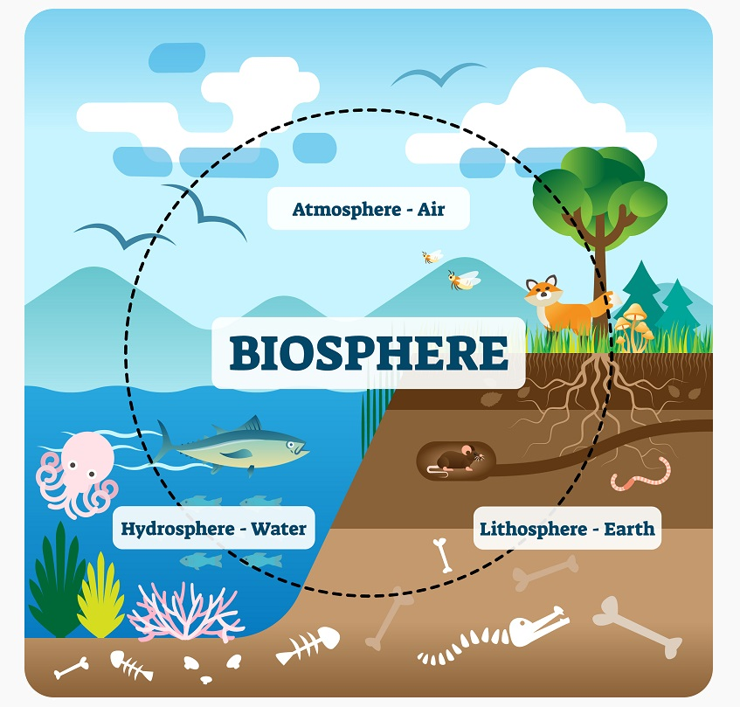
Bio 1.3- How can changes like deforestation, fossil fuel use, and ocean CO₂ uptake affect ecosystem balance and carbon distribution? How are all of these spheres connected?
Notes:
Teacher notes: Discuss this image with the questions above to help students SEE and the explain the connections between all of these spheres? How does a change in one sphere affect the others?

Slide 7
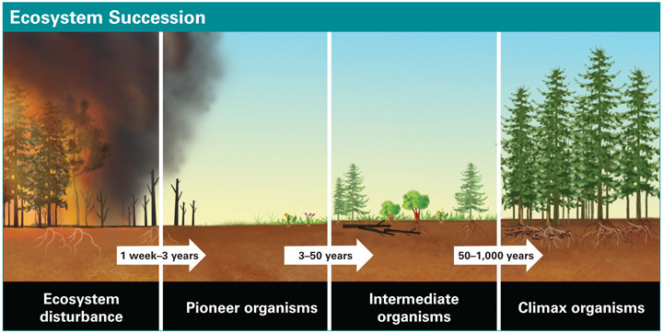

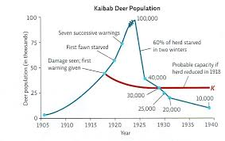
Bio 1.4 Ecosystem Stability and Change
Notes:
Teacher notes: Suggestion...select an image to discuss with your class in reference to the title above. For example: According to the graph above, what cause the deer population to increase from 1905 5o the 1920's? Why did the population decrease drastically? How do these changes relate to the abiotic and biotic factors in the ecosystem?

Slide 8
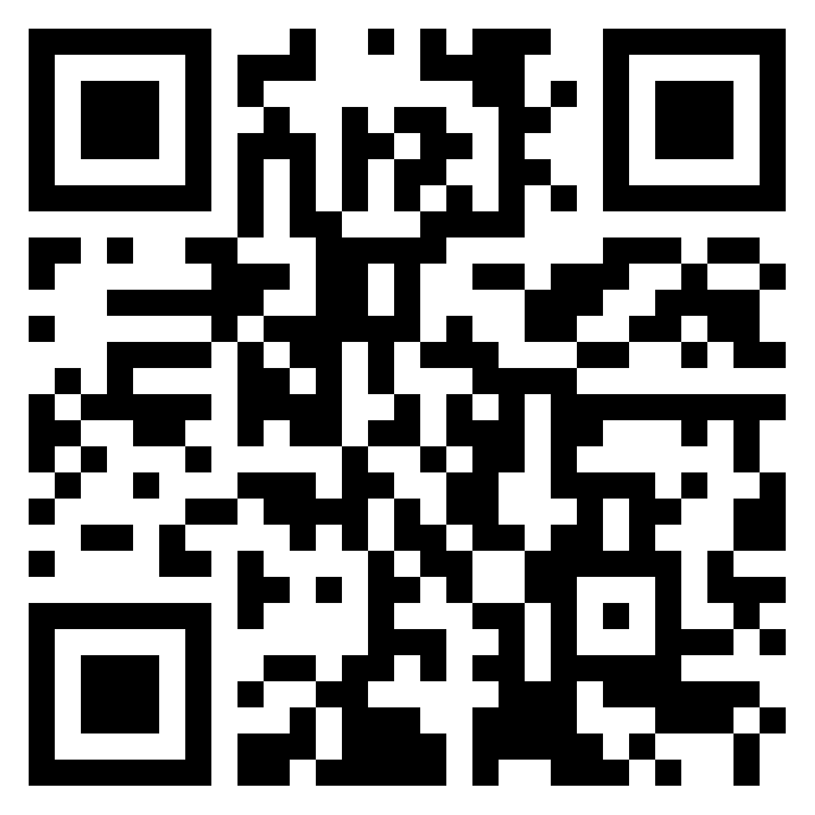
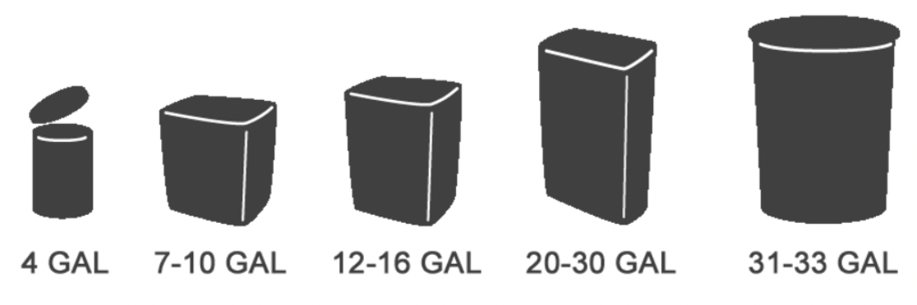
One Day of Garbage
Mental Exercise: Run through what a normal day looks like for you in your head. Think about the garbage you encounter. If you were to compile all of your personal garbage from a day, what size garbage can would you need to contain it?
Notes:
Municipal Waste Fun Facts:
More than half the world’s population does not have access to regular trash collection. (source)
The US creates over 624,000 metric tons of waste per day. (source)
Nevada generates the highest amount of waste per person: 38.4 tons. (source)
The US threw out over 292 million tons of trash in 2018. (source)
The US spends about $200 billion a year on solid waste management and lost energy resources from trash disposal. (source)
The United States Municipal Solid Waste Management Market is expected to surpass $25 billion by 2024. (source)
Annual waste generation is expected to increase to 3.4 billion metric tons by 2050. (source)
The average American produces on average 4.9lbs of garbage a day, that equates to approximately a 13-22 gallon garbage can everyday (depending on type of waste). (source)
Teacher note: Have students select the size can they think that they fill (personal garbage not family); CIRCLE their choice on student handout

Slide 9
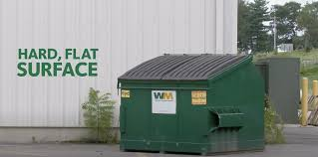
My Garbage!
(Represents 1 day of garbage.)
Notes:
Teacher notes: Discuss other places in our community where we come across garbage (fast food restaurants, grocery stores, etc)
Las Vegas produces more than 5 billion pounds of waste per year
5 billion pounds of waste would roughly equate to a massive pile of garbage, potentially filling up several large football stadiums,

Slide 10
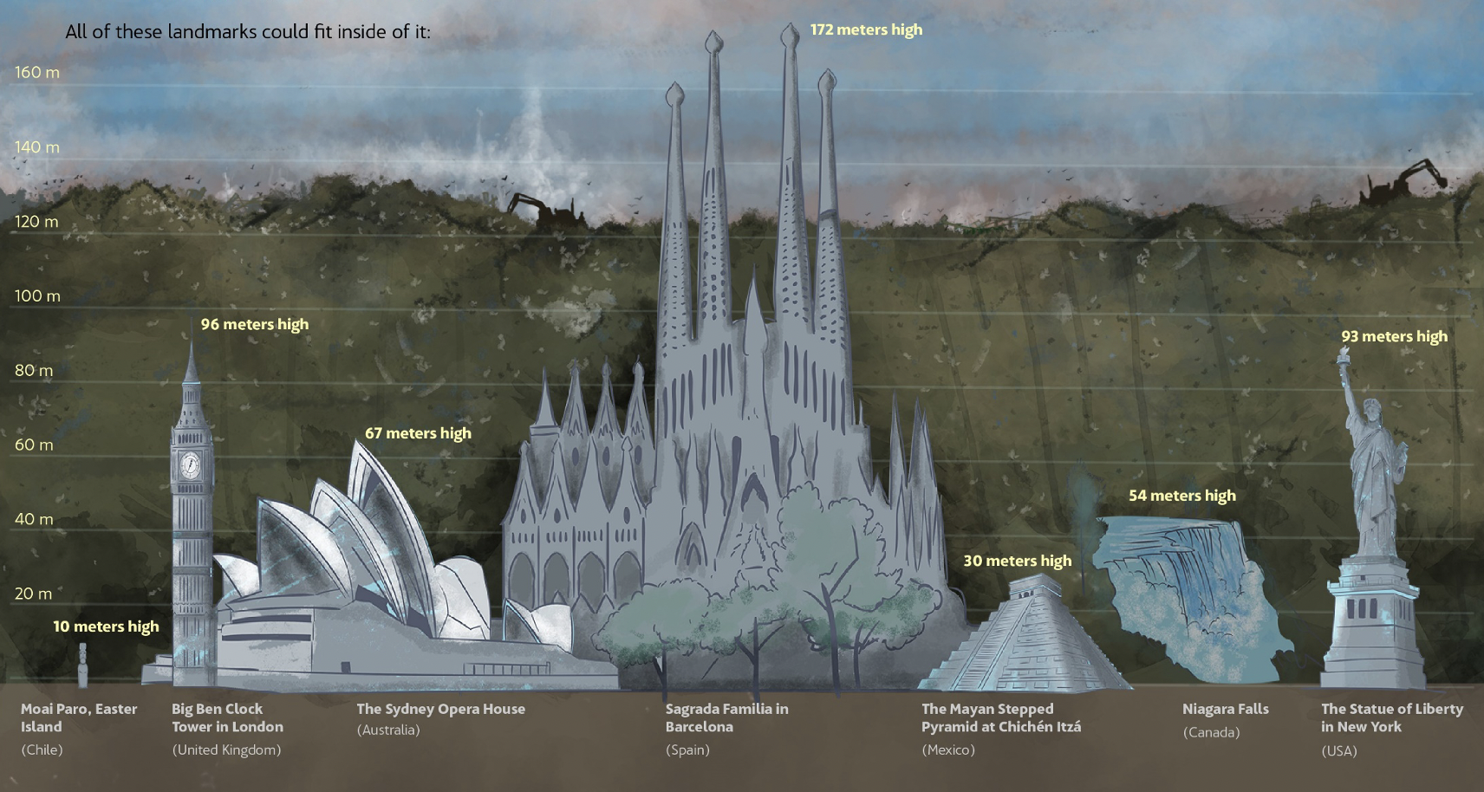
If we were to accumulate the garbage that all the nations generate in just one year, we would have a garbage dump extending over 748 football fields and 120 (394ft) meters deep.
Notes:
Teacher notes: The picture above explains it all!! Really emphasize that is just from ONE year!!

Slide 11
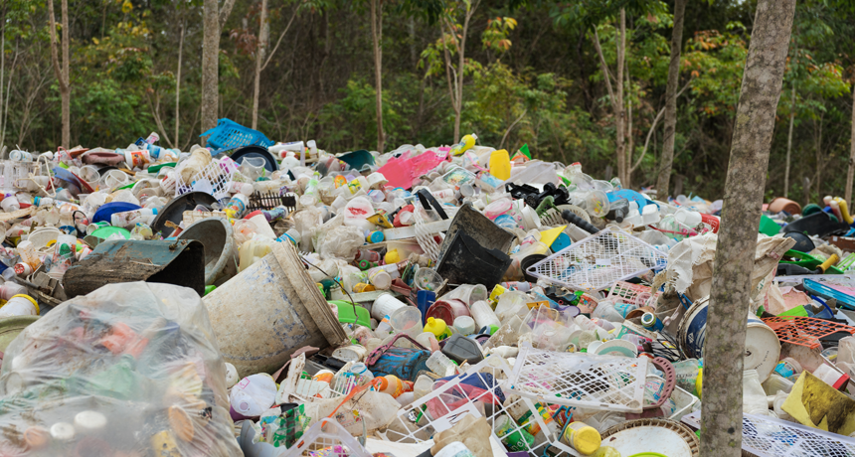
“Technosphere”
The "technosphere" is a conceptual geologic layer that encompasses all human-made structures, systems, and their interactions with the Earth's natural systems. It includes urban areas, infrastructure, agricultural lands, waste deposits, and the vast array of technological artifacts created by human activity. This layer signifies the extensive impact humans have on the planet-altering natural processes and cycles. The "technosphere" interacts with the biosphere, atmosphere, hydrosphere, and lithosphere, often leading to significant environmental changes and challenges.
https://www.snexplores.org/article/meet-our-trashy-technosphere
Notes:
Teacher notes: Suggestion: Have students silently read through this slide then ask for a short summarization of what this means. Ultimately, the technosphere is simply a new potential layer of Earth formed by human trash!

Slide 12
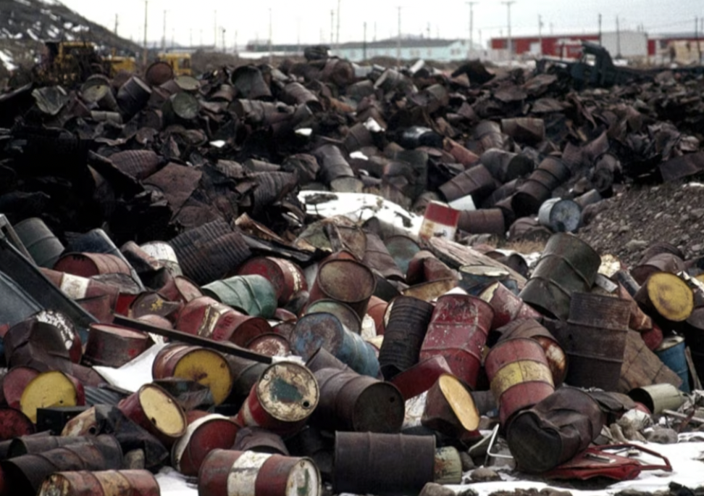
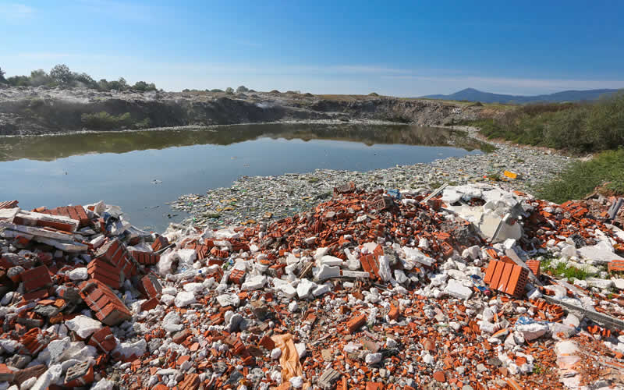
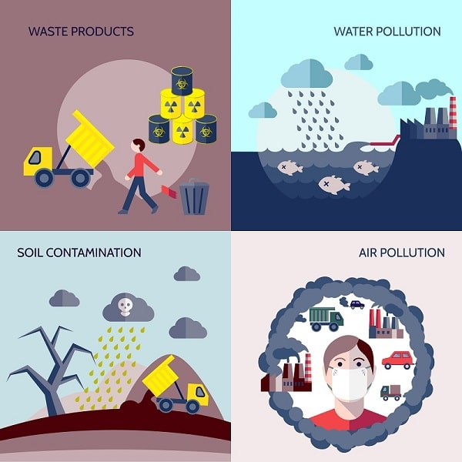
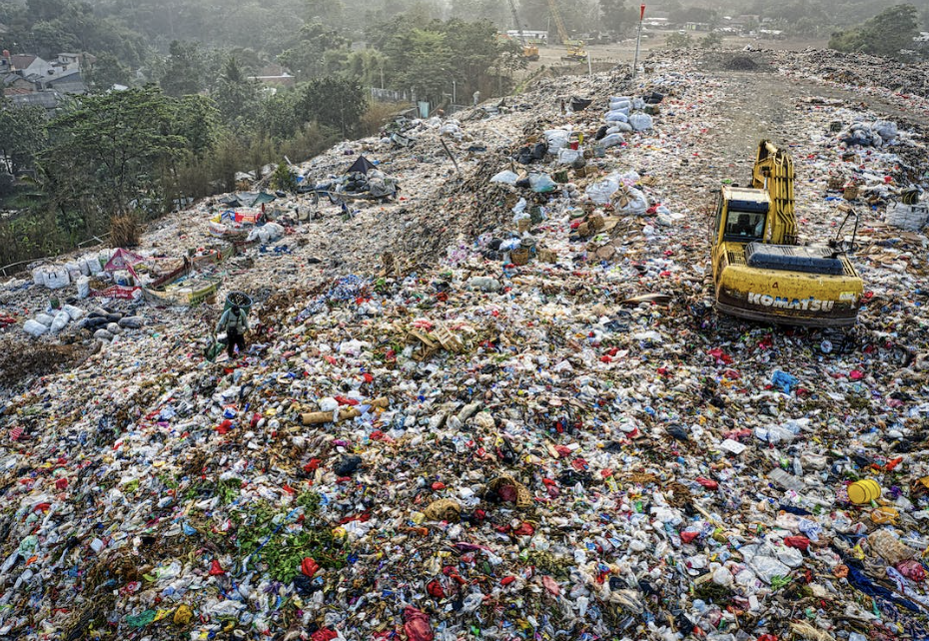
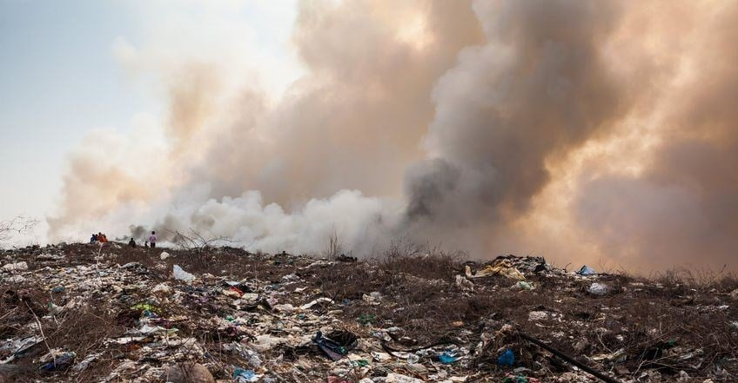
So What?
In what ways does human garbage negatively affect the environment? (Provide examples.)
Notes:
Teacher notes: Have student tell you what the problem is in each section of this image (bottom right corner counter clockwise to bottom left corner)
Bottom right: air pollution- abiotic/biotic? what things might this affect in an ecosystem?
Top right: water pollution- abiotic/biotic? Same question as above
Top left: waste products- Have them describe what they see, are these things abiotic/biotic, what might this affect?
Bottom left- soil contamination- what do you see? What is it covering? How might this stuff affect the area below and surrounding it?

Slide 13
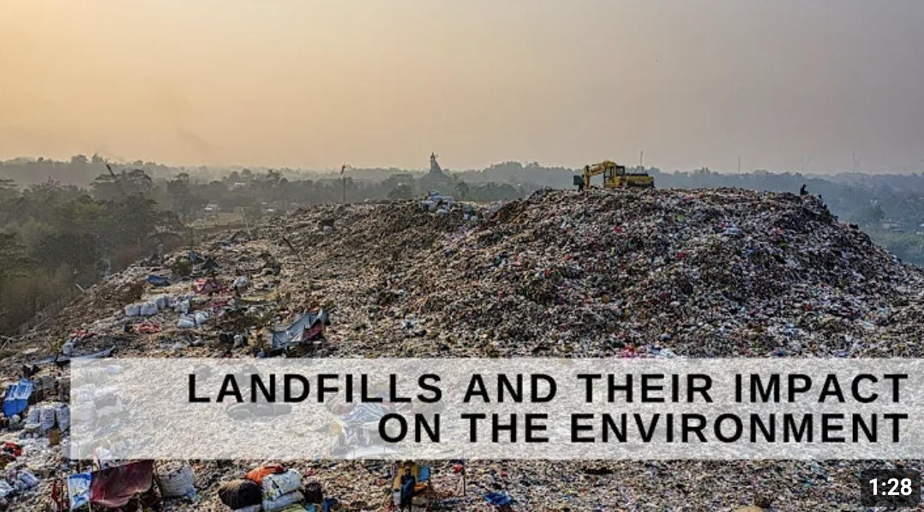
Landfills and their impact on the Environment
Notes:
Teacher notes: As students watch this video they need to document what they SEE, THINK, FEEL, WONDER and be prepared to discuss their findings. It is suggested that you pause the video to discuss parts of the video rather than watching it in its entirety.

Slide 14

What did I SEE-THINK-FEEL-WONDER
Notes:
Teacher notes: Optional- use the QR code to gather students thoughts to display and share as a class OR simply discuss each part (SEE-THINK-FEEL-WONDER)

Slide 15
What is the problem?
Write down 2 problems associated with human garbage disposal you would like to see addressed. (Your problems should be focused on Environmental impacts.)
In your table groups, share your two problems.
As a group, choose 2 from those discussed to share with the class.
As a class, pick one problem to address as a class from all those shared.
Notes:
Teacher notes: Take this ONE step at a time: INDIVIDUALLY then small group then whole class with a class vote

Slide 16
Constraints
Environmental Constraint:
  Definition: Limitations imposed by considerations of environmental impact, sustainability, and conservation.
  Aesthetic Constraint:
  Definition: Criteria related to beauty, design, or artistic appeal.
Economic Constraint:
  Definition: Limitations imposed by financial resources or costs associated with a solution.
Ethical Constraint:
  Definition: Boundaries set by moral principles or societal norms.
Geographical Constraint:
  Definition: Restrictions imposed by physical location or spatial considerations.
Legal Constraint:
  Definition: Requirements or limitations imposed by laws, regulations, or legal standards.
Time Constraint:
  Definition: A limit on the amount of time available to complete a task or activity.
Notes:
Teacher notes: Have students write down THESE definitions ONE at a time while you give an example of a solution that does/does not meet the constraint.
For example: Launching our trash to outer space/the SUN
Environmental- carbon dioxide emissions from launch and rocket construction; no trash on Earth; how might trash burning in the Sun affect us here on Earth (temps, etc?)
Aesthetic- no garbage on Earth but may create more space trash (if it doesn't reach the Sun)
Economic- very costly to construct and launch; who will pay for this
Ethical- is it ethical to just send our trash to the Sun?
Geographical- where would places like NY or LA launch their trash; would all countries be able to do this?
Legal- is it against the law to send our trash to space? If there are no laws, should there be laws?
Time- How much time would it take to build, gather trash, and launch it to the Sun? How much time for the rocket to return to repeat the process?

Slide 17
Questions to Keep in Mind
Time Constraint:
  What resources and materials are readily available in our community that can be utilized to create a sustainable waste management solution within a 3-month to 1-year timeframe?
  What specific steps can be taken to ensure the solution can be implemented quickly and effectively, including timelines for each phase of the project?
  How will you measure the effectiveness and impact of your solution within the first year, and what adjustments might be necessary based on initial outcomes?
Notes:
Teacher notes: Print out these last few pages for students to use as they consider the selected constraints for their solution.

Slide 18
Questions to Keep in Mind
Environmental Constraint:
  "Does your solution minimize carbon emissions or environmental footprint?"
  "Have you assessed potential impacts on local ecosystems or biodiversity?"
  "How does your solution contribute to long-term environmental sustainability?"
Economic Constraint:
  "Does your proposed solution fit within the allocated budget?"
  "Have you considered the economic feasibility and cost-effectiveness of your solution?"
  "What are the projected financial implications or benefits of implementing your solution?"
Notes:
Teacher notes: Print out these last few pages for students to use as they consider the selected constraints for their solution.

Slide 19
Questions to Keep in Mind
Aesthetic Constraint:
  "Is your design visually appealing and harmonious with its surroundings?"
  "Have you considered the cultural or historical context of your solution's aesthetics?"
  "How does your solution contribute to enhancing the aesthetic quality of its environment?"
Legal Constraint:
  "Does your solution comply with relevant local, national, and international laws?"
  "Have you identified any legal risks or liabilities associated with your solution?"
  "Are there any permits, licenses, or legal approvals required for implementing your solution, and have you obtained them?"
Notes:
Teacher notes: Print out these last few pages for students to use as they consider the selected constraints for their solution.

Slide 20
Questions to Keep in Mind
Geographical Constraint:
  "Does your solution account for the local terrain and climate?"
  "Have you considered the accessibility and logistics of implementing your solution in this specific location?"
  "How does the geography of the area influence the design or implementation of your solution?"
Ethical Constraint:
  "Does your solution respect the rights and dignity of all stakeholders involved?"
  "Have you considered the potential ethical implications or conflicts of interest associated with your solution?"
  "Is your solution aligned with ethical standards and principles applicable to the situation?"
Notes:
Teacher notes: Print out these last few pages for students to use as they consider the selected constraints for their solution.

Slide 21

3D-RST is supported by the NSF under grant number #DRL-2101383

