Slide 1

Introduction to Electromagnetism

Slide 2
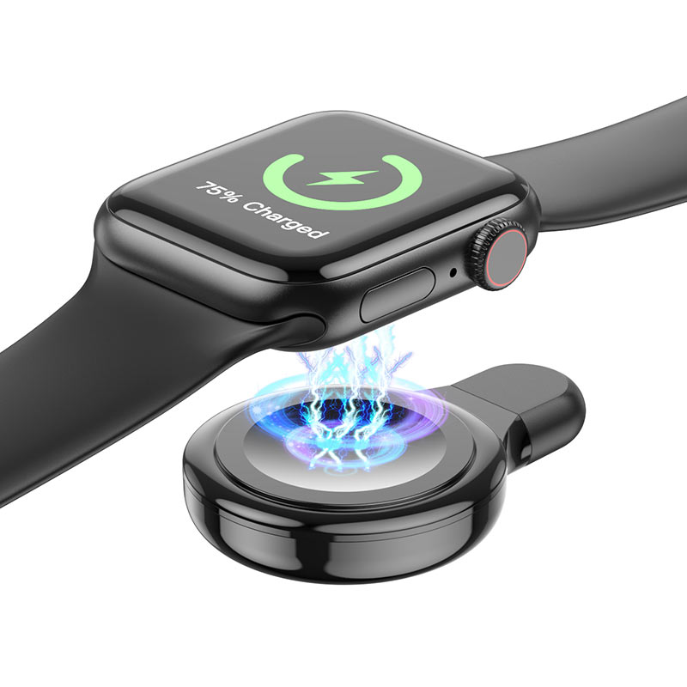
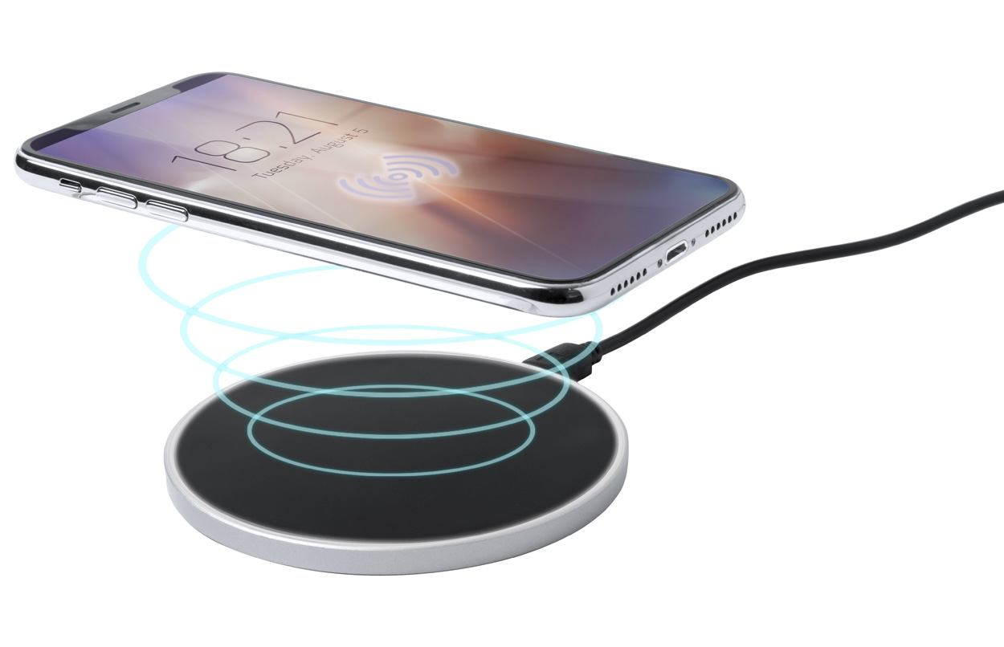
Phenomenon
What factors affect the strength of electric or magnetic attraction?

Slide 3
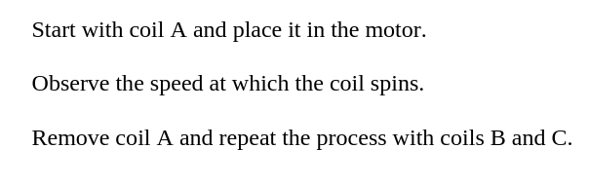
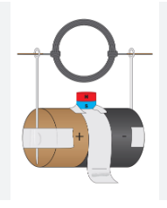
Station 1: Electric Motor

Slide 4
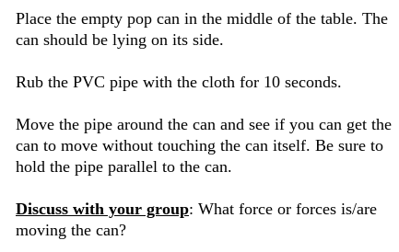
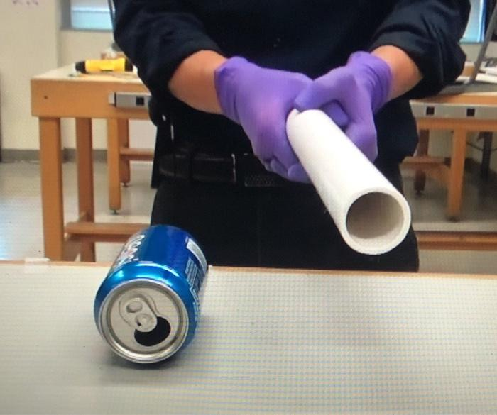
Station 2: Magic Pop Can

Slide 5
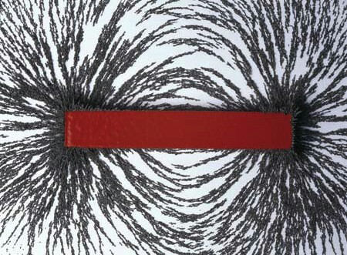
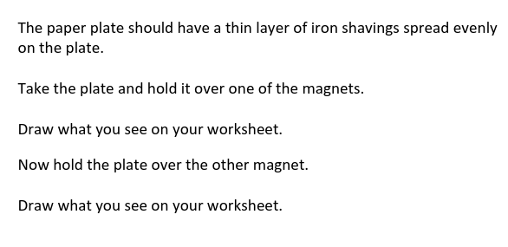
Station 3: Iron Shavings

Slide 6
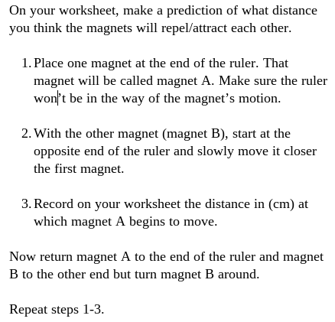
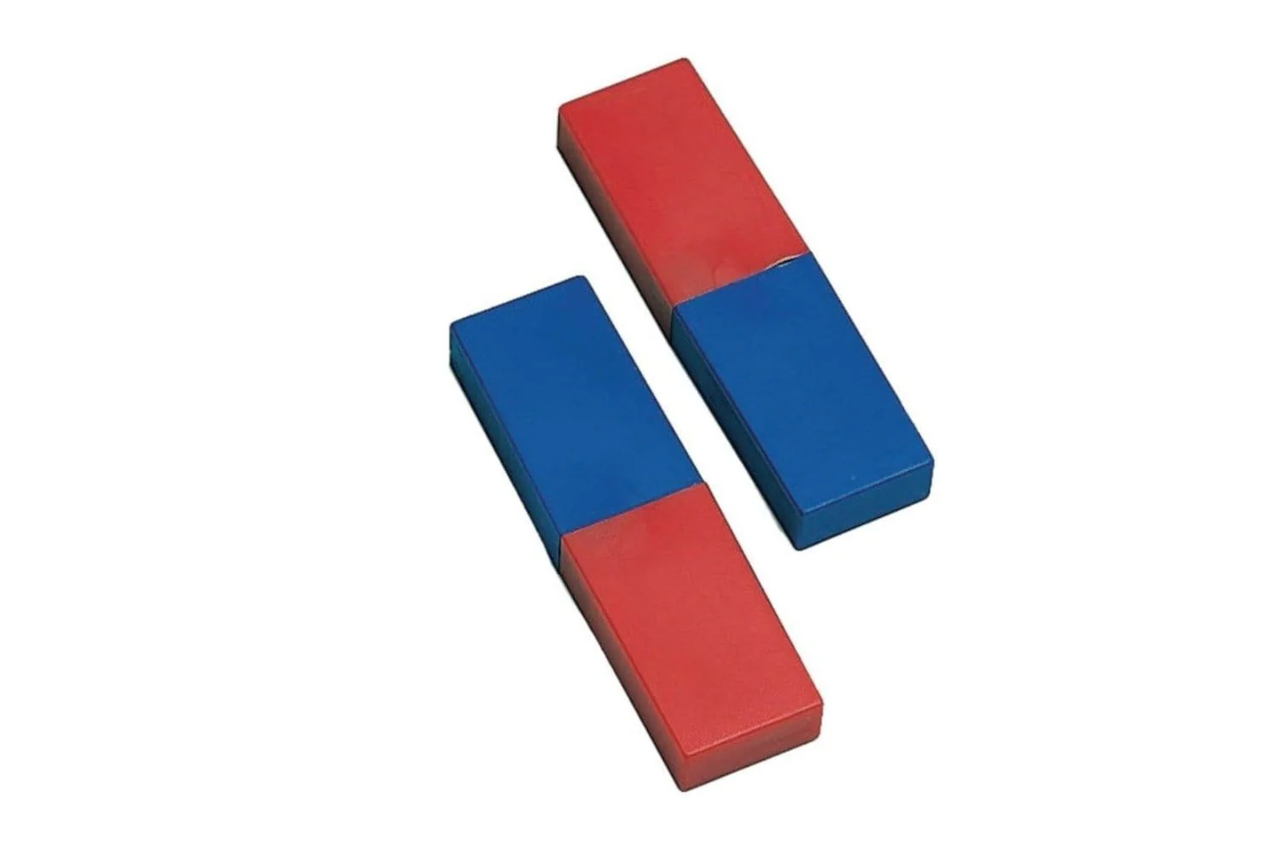
Station 4: Bumper Cars

Slide 7
Wireless Charger Diagram
1.
2.
3.

Slide 8


