Slide 1
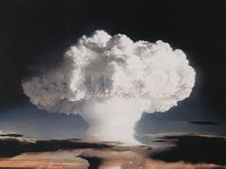
Fusion is the Bomb!

Slide 2
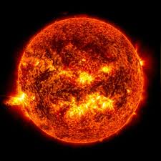
OBJECTIVE
Students will create a system model to construct an explanation on how nuclear binding energy relates to the change in energy from the fusion reaction of a hydrogen bomb.

Slide 3
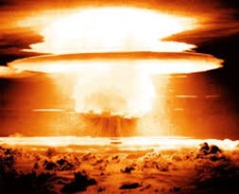

What do you know about a Hydrogen bomb?
Notes:
Record student responses and use this class discussion to help identify and address misconceptions about historical events. Avoid over explanation of nuclear reactions. Encourage curiosity.

Slide 4
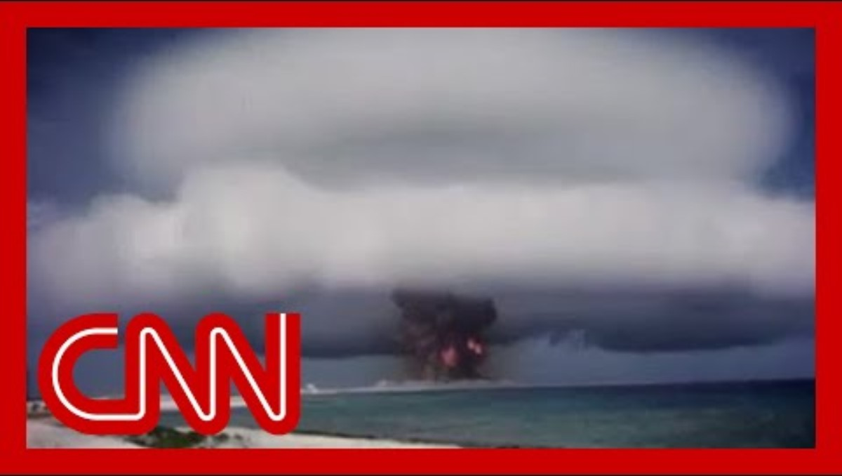
Phenomenon: Nuclear Testing
Notes:
Teacher Note: Tell students to record 3-4 observations as a group AND use those observations to develop 3-4 scientific (open-ended) questions.

Slide 5

Guiding Question(s)
As a group, determine the question that is most important in figuring out what is happening at the nuclear level during the explosion of a hydrogen bomb.
You will be sharing this with the class.

Slide 6
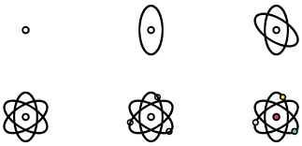
Hypothesis Drawing a Model
Hypothesis: draw a picture that models what is happening to the atoms during a hydrogen bomb explosion. Include how you think fusion is contributing to the explosion. Label your drawing with as much detail as you can. You will have a chance to add to or change your model later.

Slide 7
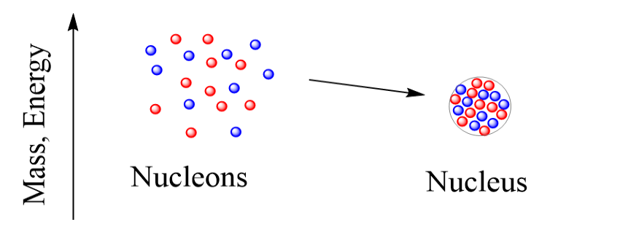
Activity #1 Exploring Fusion
The energy change when a nucleus is formed or broken is known as nuclear binding energy. Nucleus refers to the “bound” protons and neutrons while nucleons refer to the individual protons and neutrons when they are not “bound together”

Slide 8
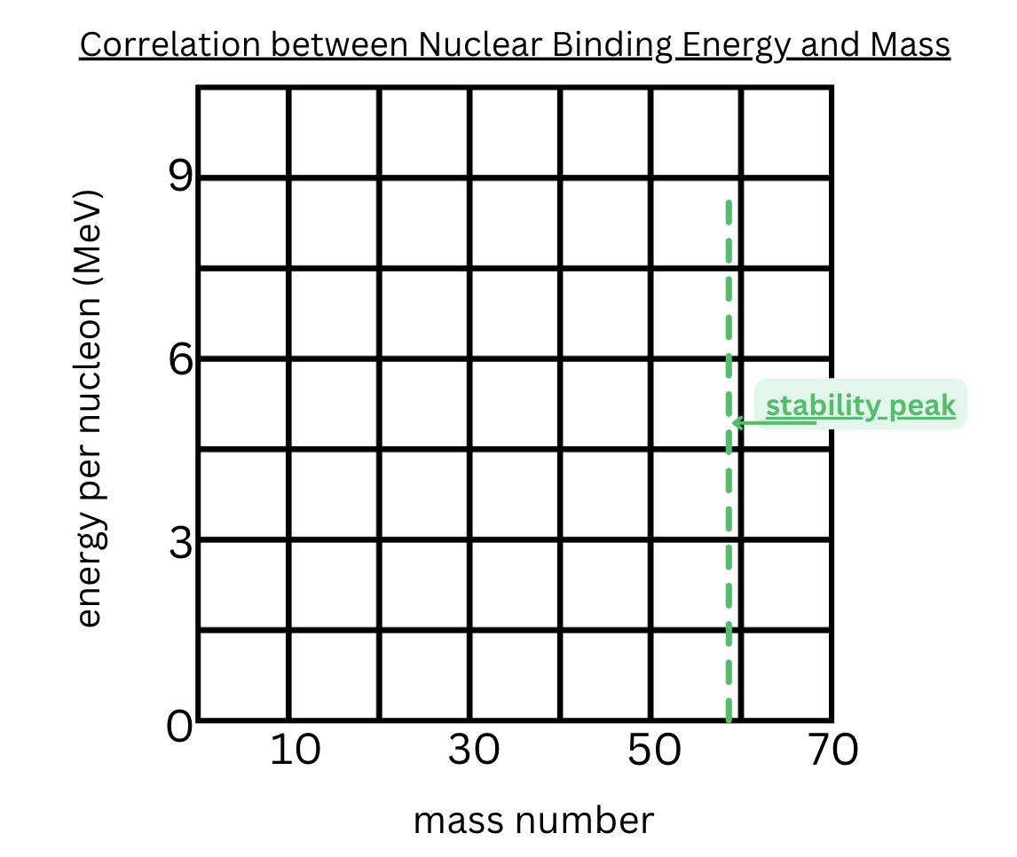
Activity #1 Exploring Fusion
When graphing the following data, label H-1, H-3, H-4, etc... on the graph and make sure to connect each point to form a line.
Nucleon | Mass Number | Binding Energy (MeV)
Hydrogen -1 | 1 | 0
Hydrogen -3 | 3 | 2.8
Helium -4 | 4 | 7.0
Carbon -12 | 12 | 7.6
Nitrogen -15 | 15 | 7.7
Sulfur - 36 | 36 | 8.5
Iron- 56 | 56 | 8.8

Slide 9

Share with your partner how you revised your model after completing Activity #1: Exploring Fusion

Slide 10

Activity #2 Exploring Fusion
With a partner read the infographic that has been given to you.
Answer questions #9-12 on the worksheet. Use evidence from the reading that relates to our model of fusion.

Slide 11

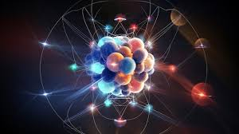
Activity #2 Exploring Fusion
List any information from this activity that will help you refine your final model of what is happening at the nuclear level when a hydrogen bomb explodes.
Add it to your initial model in a different color

Slide 12

Share with your partner how you revised your model after completing the reading.
When sharing if your partner has something in their model that you would like to add do that now.

Slide 13
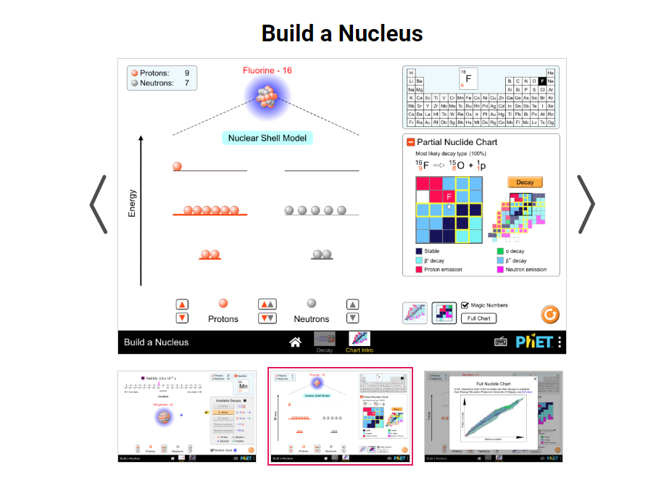
Activity #3 Phet Simulation
https://tinyurl.com/stablenucleus
Complete Tasks A and B with a partner on the worksheet using the Phet simulation.

Slide 14
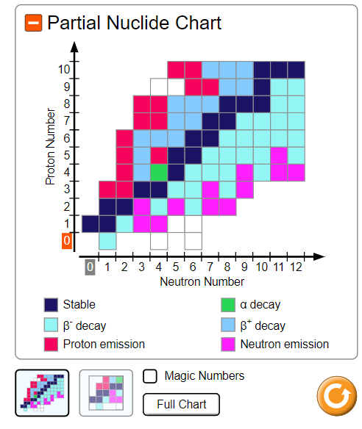

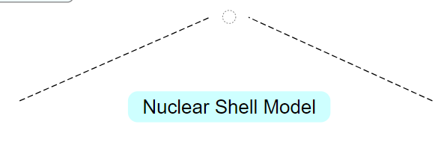

Activity #3 Phet Simulation

Slide 15
Evidence
Review each of the 3 activities.
  What evidence explains why nuclear binding energy changes during a change in mass?
  What evidence explains how nuclear binding energy of the reactants (input) compares to the nuclear binding energy of the products (output) in a fusion reaction?
  What evidence explains how nuclear binding energy changes when the number of neutrons changes?

Slide 16
Claim
Based on your evidence CONSTRUCT an EXPLANATION of how nuclear binding energy relates to the change in net energy from the fusion reaction.
(energy in the bomb)

Slide 17
Reasoning
Create a model to show the relationship between energy, mass and nuclei stability during fusion in a hydrogen bomb.
Label the following in your model:
  Reactants/ Products (Inputs/ outputs)
  Protons (p+) & Neutrons (n0)
  Stronger / Weaker nuclear binding energy
  Net Energy Change
    Use arrows to the flow of energy change direction in the reaction.

Slide 18

3D-RST is supported by the NSF under grant number #DRL-2101383

