Slide 1
QUIT BEING SO INVASIVE
Biology 4.5

Slide 2

BIOLOGY 4.5
Evaluate design solutions that can best solve a real-world problem caused by natural selection and adaptation of populations. Define the problem, identify criteria and constraints, analyze available data on proposed solutions, and determine an optimal solution. Examples of real-world problems could include bacterial resistance to drugs, plant resistance to herbicides, or the effect of changes in climate on food sources and pollinators. (LS4.C, ETS1.A, ETS1.B, ETS1.C)
Master these four tasks!
Define the problem
Identify Criteria and Constraints
Analyze Available Data On Proposed Solutions
Determine An Optimal Solution

Slide 3
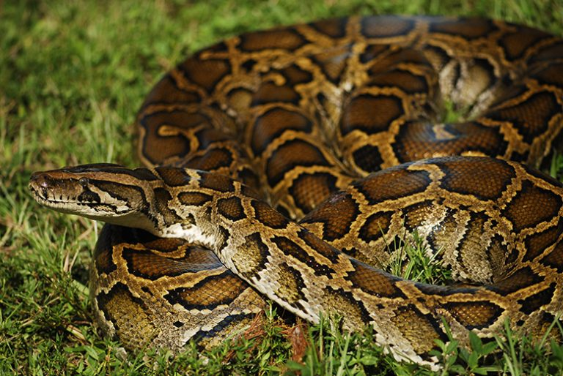
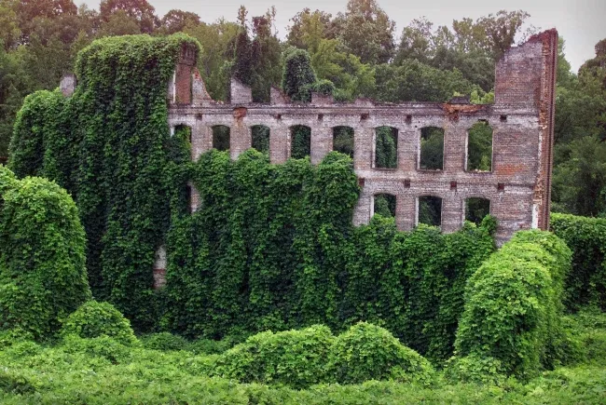
WHAT DO THESE SPECIES HAVE IN COMMON

Slide 4
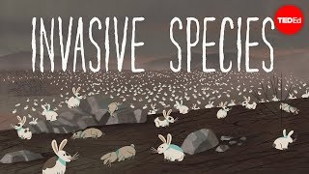
WHAT IS INVASIVE
Notes:
Time- 0:4:45

Slide 5
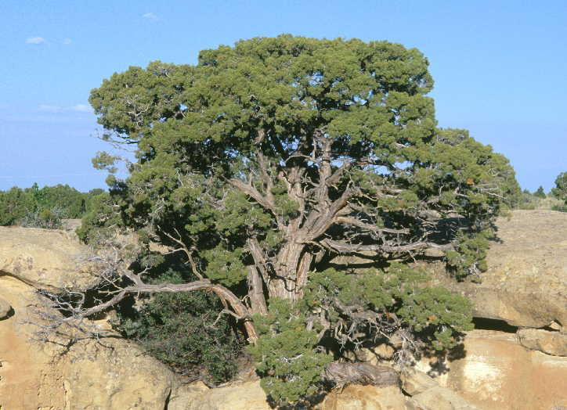
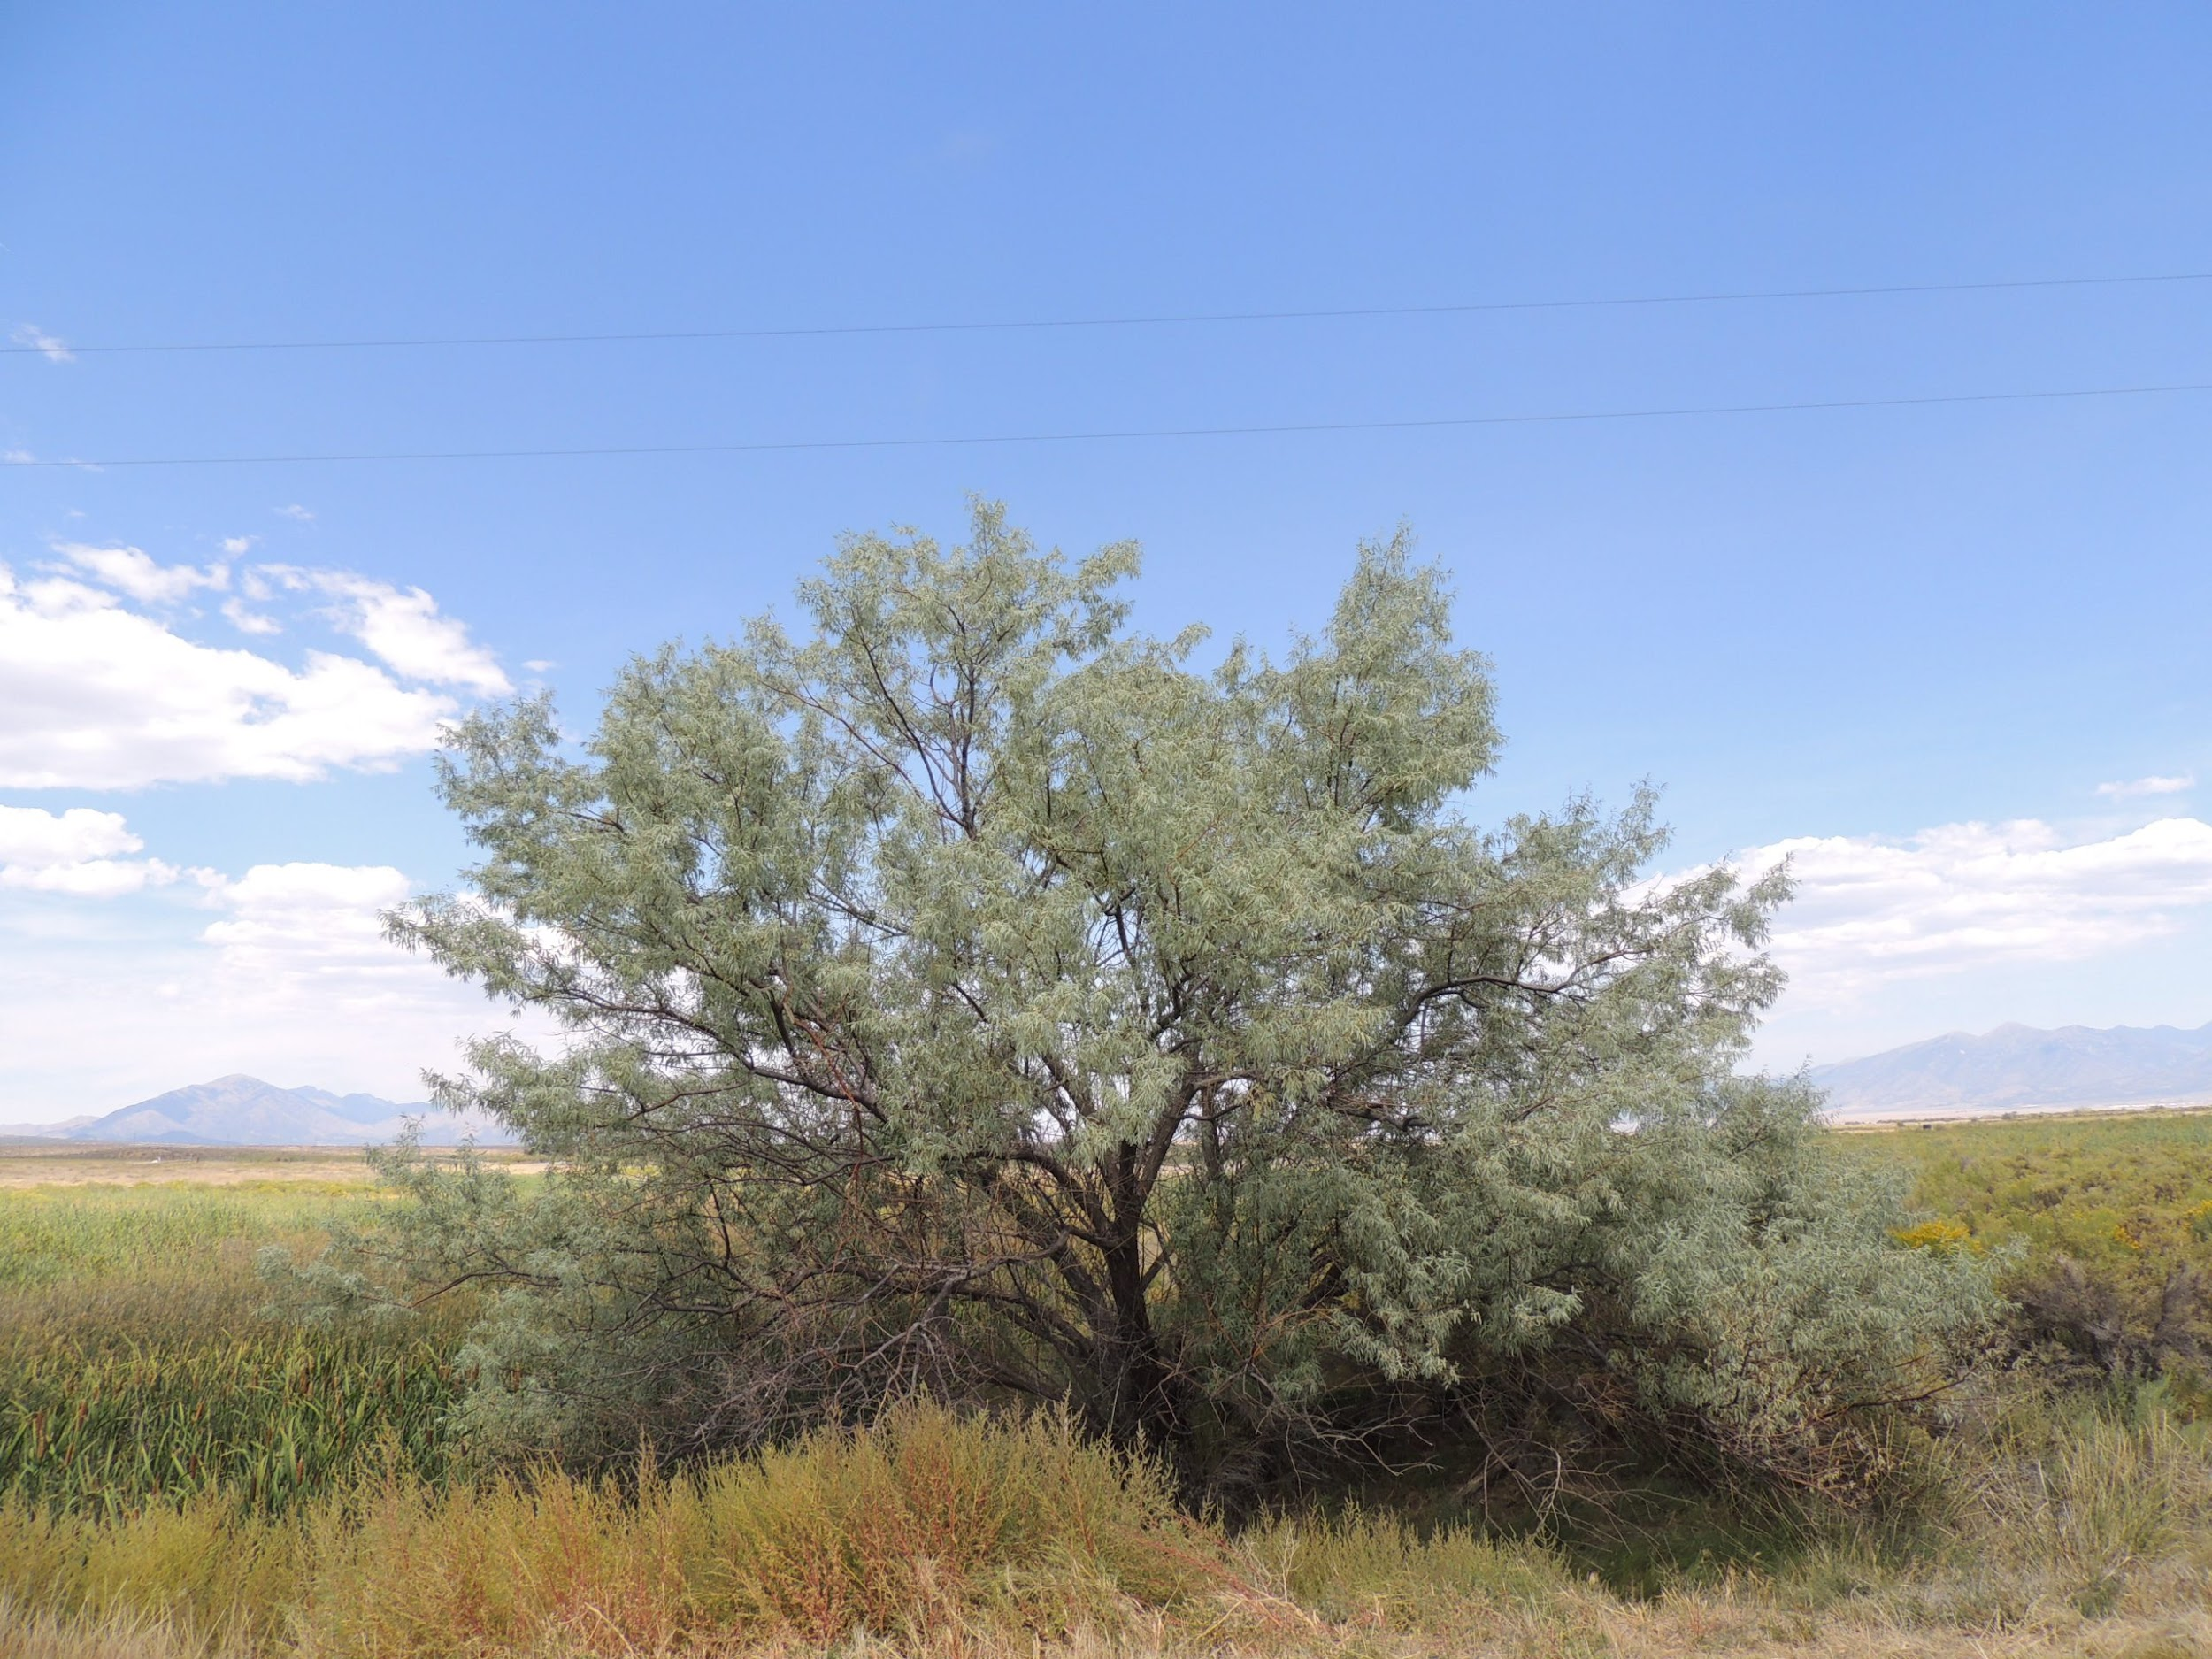
WHAT IS THE DIFFERENCE BETWEEN INVASIVE AND NON-INVASIVE SPECIES?
Invasive species article
The Juniper tree
The Olive tree
🡨 Native Vs. Non-Native 🡪

Slide 6
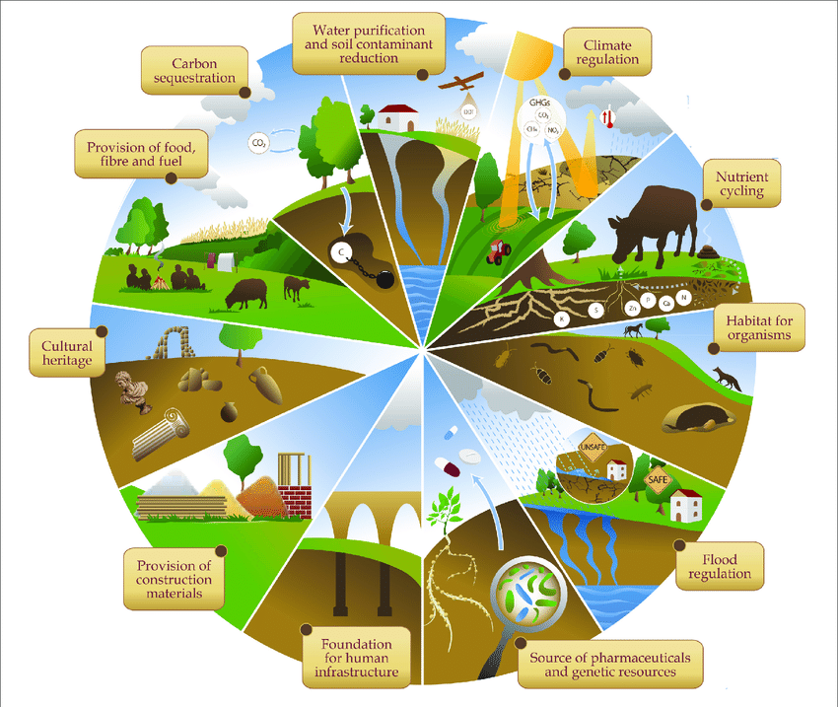
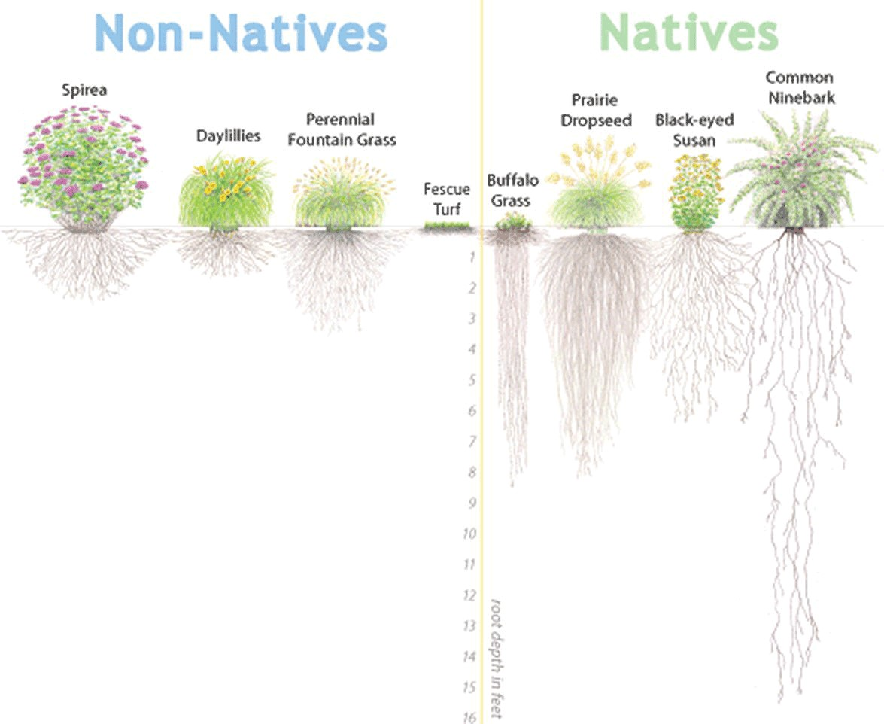
WHAT MAKES THEM INVASIVE?

Slide 7


STEP 1: DEFINE THE PROBLEM
1. What is an invasive species?
2. What invasive species do we encounter in Utah?

Slide 8
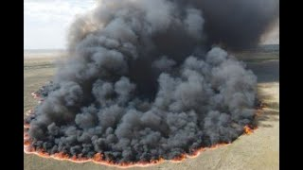
What burned during the Utah Legacy Fire
Notes:
Time-0:2:15

Slide 9
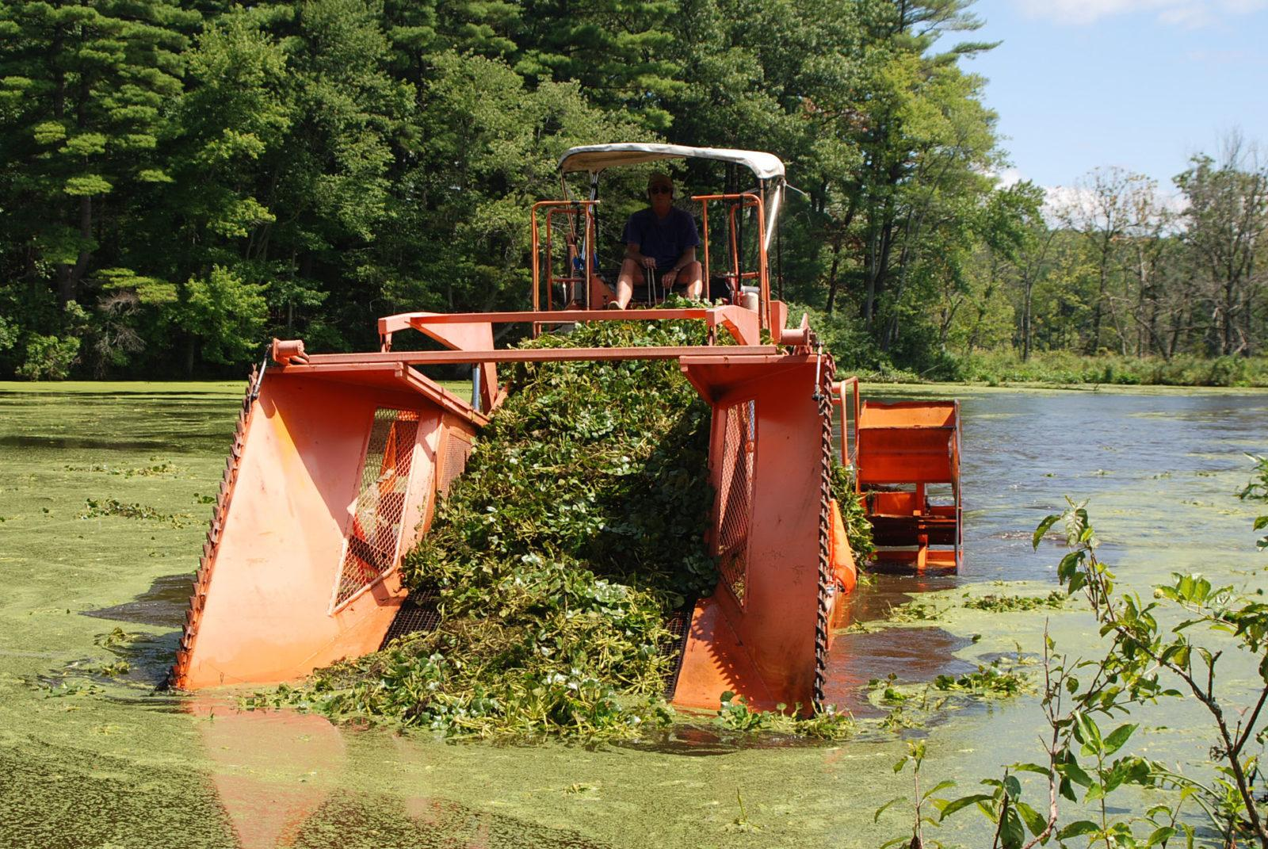
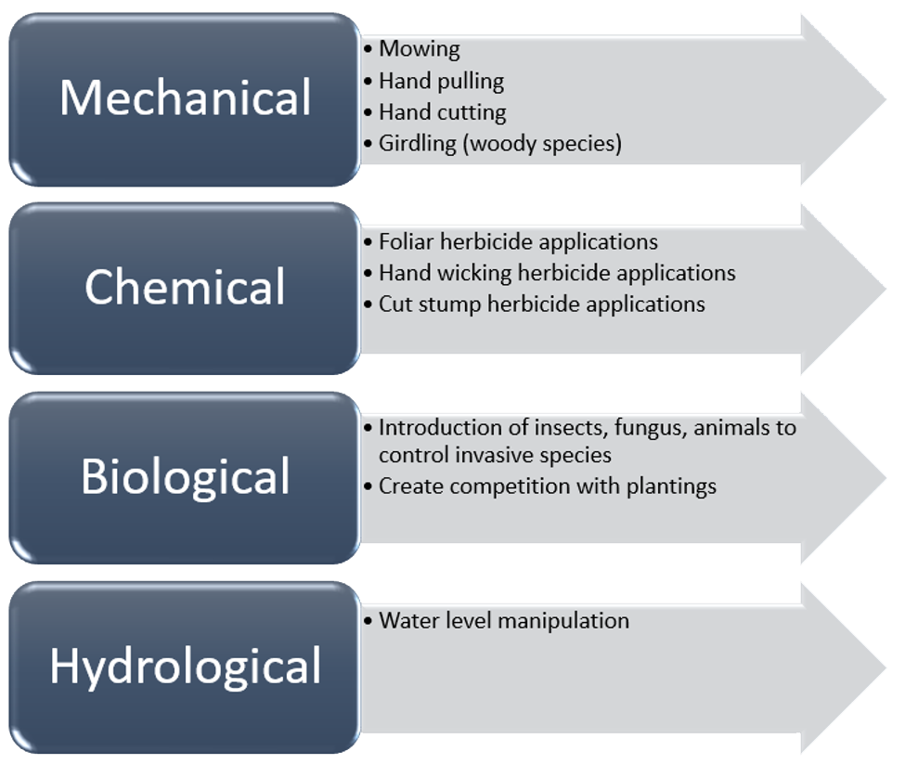

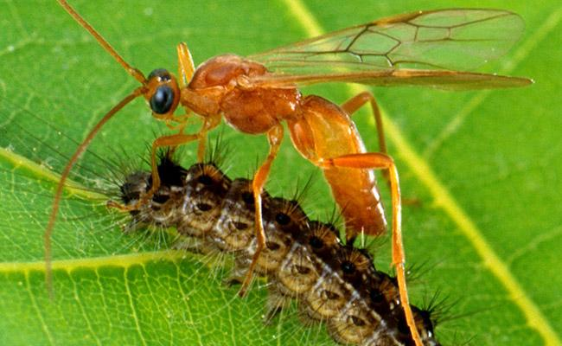
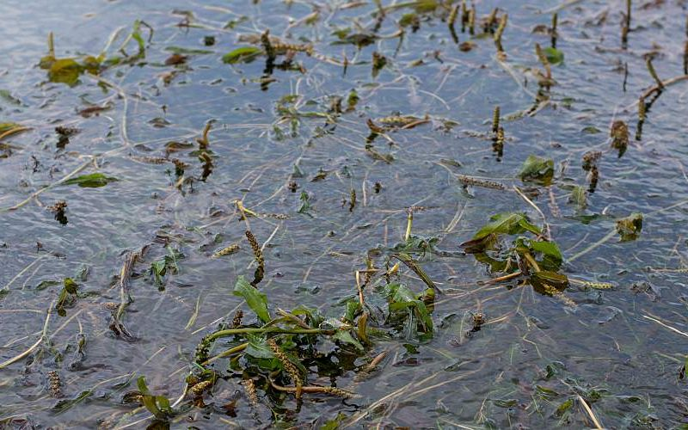
ARE THERE SOLUTIONS TO INVASIVE SPECIES?

Slide 10

STEP 2: ANALYZE AVAILABLE DATA ON PROPOSED SOLUTIONS
GROUP READING
Split into groups assigned by teacher
Gather Data in the articles about invasive species in Utah
  What is the CAUSE of the invasive species being in Utah?
  What is the EFFECT of the invasive species being there on other living things?
While reading identify the treatments as biological, chemical, or mechanical.
Be prepared to share specific examples.

Slide 11


STEP 3: IDENTIFY CRITERIA AND CONSTRAINTS
1. Criteria- What makes this solution EASY to use or the benefits of using this solution
2. Constraints- What makes this solution HARD to use or the Limitations of using this solution
Repeat this for all categories: Mechanical, Biological, and chemical

Slide 12

3D-RST is supported by the NSF under grant number #DRL-2101383

