Slide 1
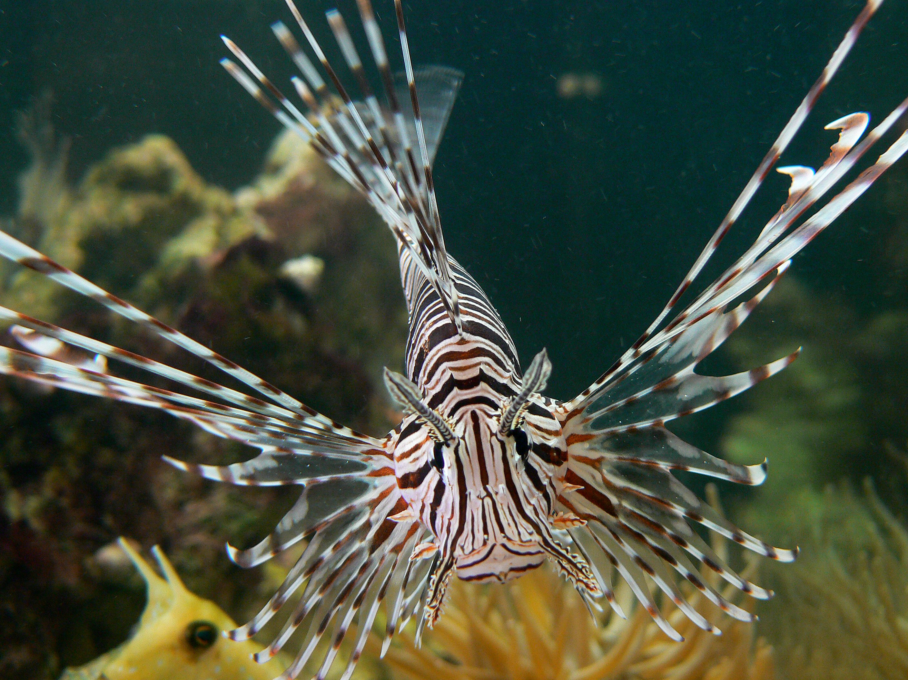
Quit Being So Invasive
Objective: Students will be able to evaluate different management solution types for invasive species and determine how to best apply the solutions to an assigned example.

Slide 2
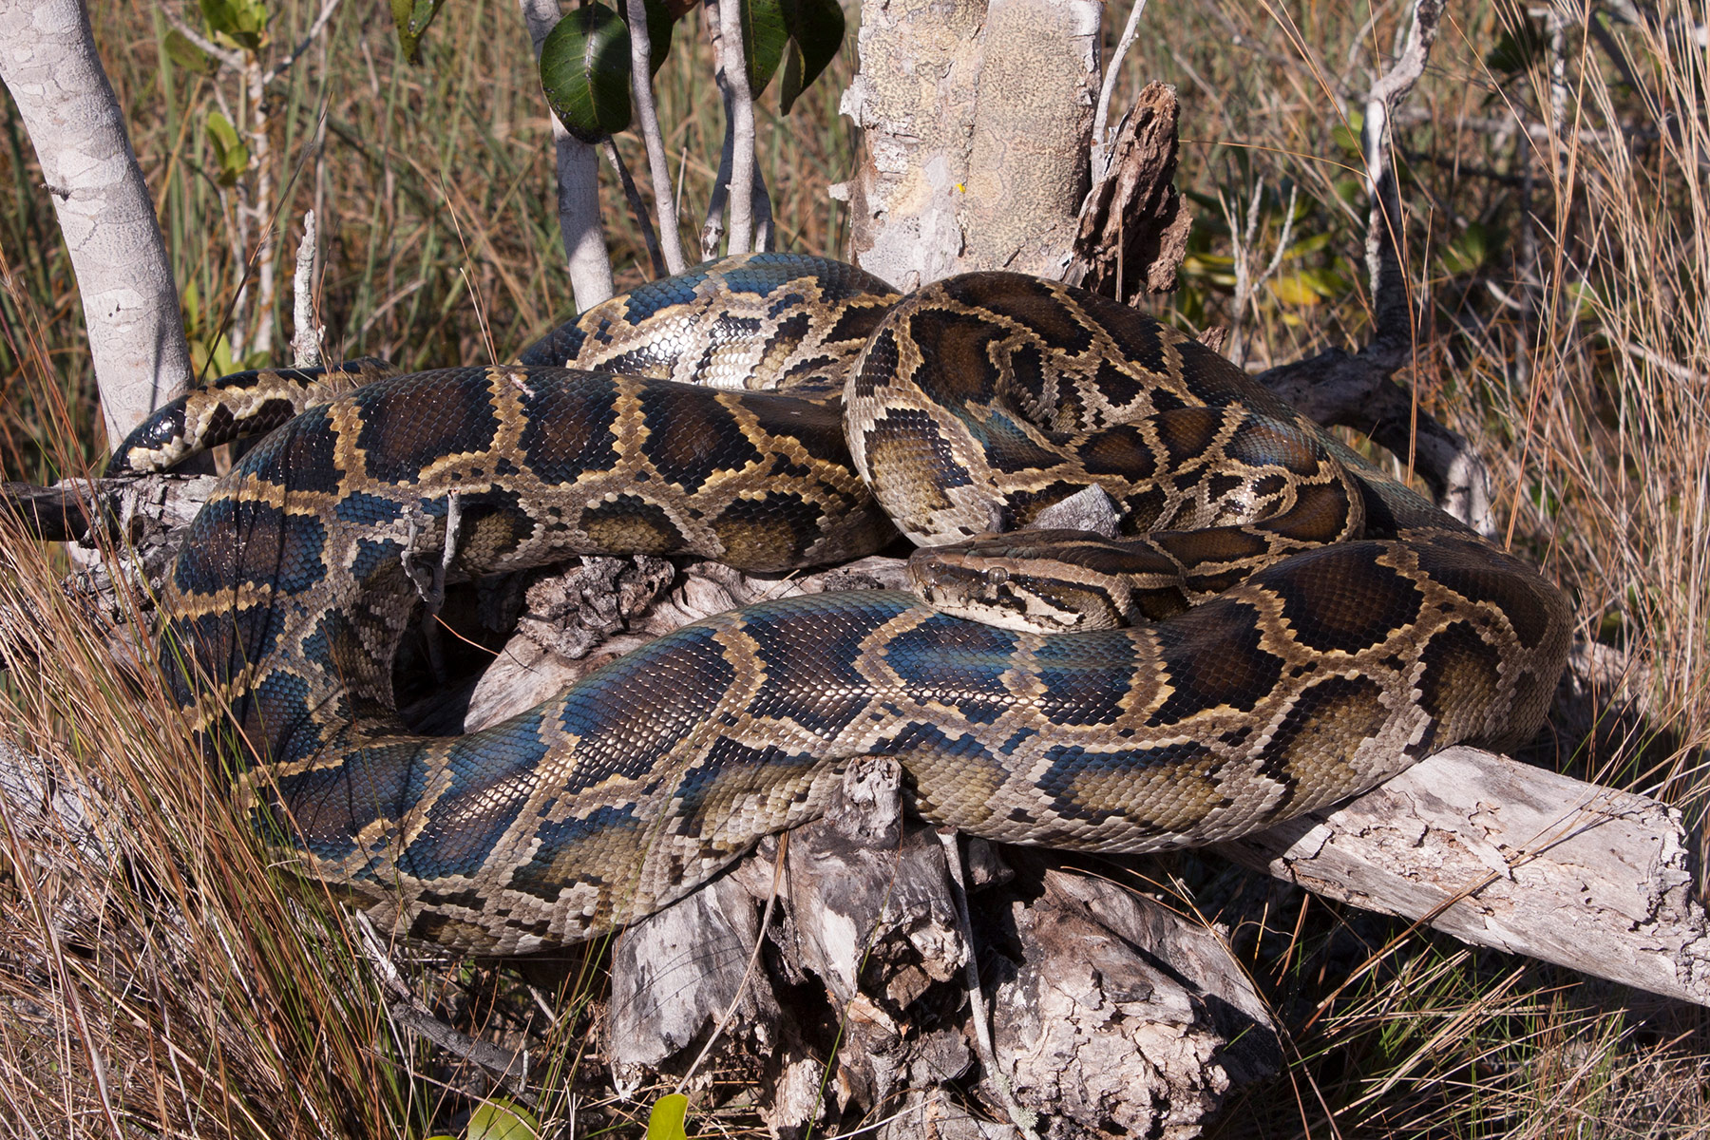
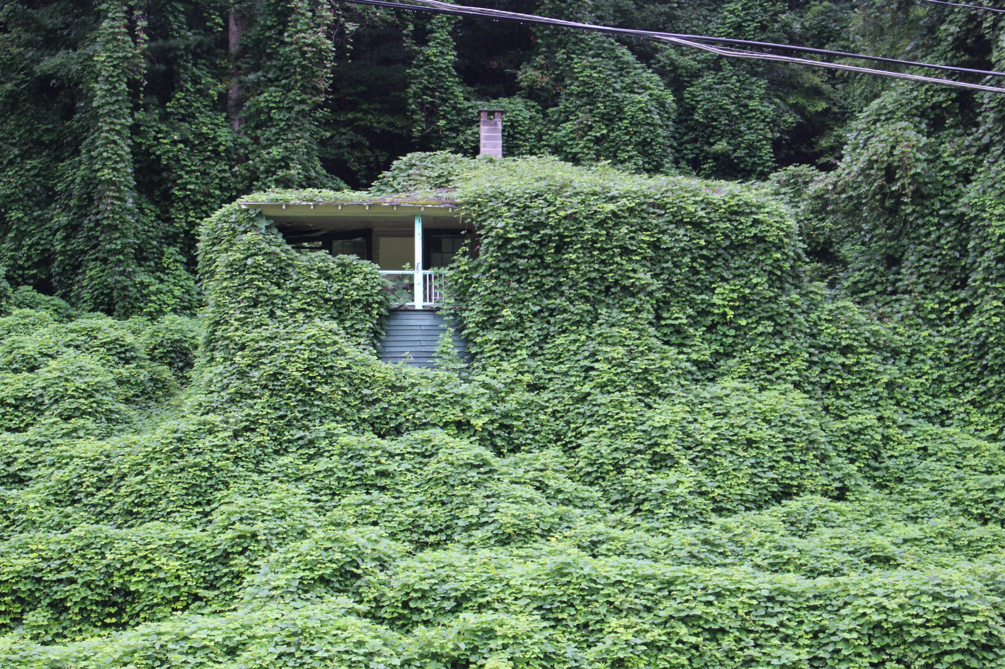
What do these species have in common?

Slide 3

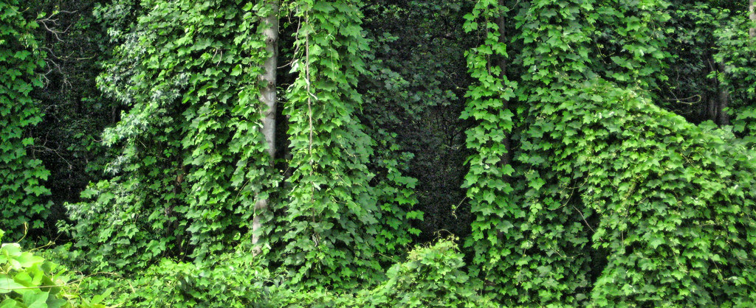
What is an invasive species?
Invasive species – An invasive species is an introduced species to an environment that becomes overpopulated and harms its new environment. Invasive species adversely affect habitats and bioregions, causing ecological, environmental, and/or economic damage.

Slide 4
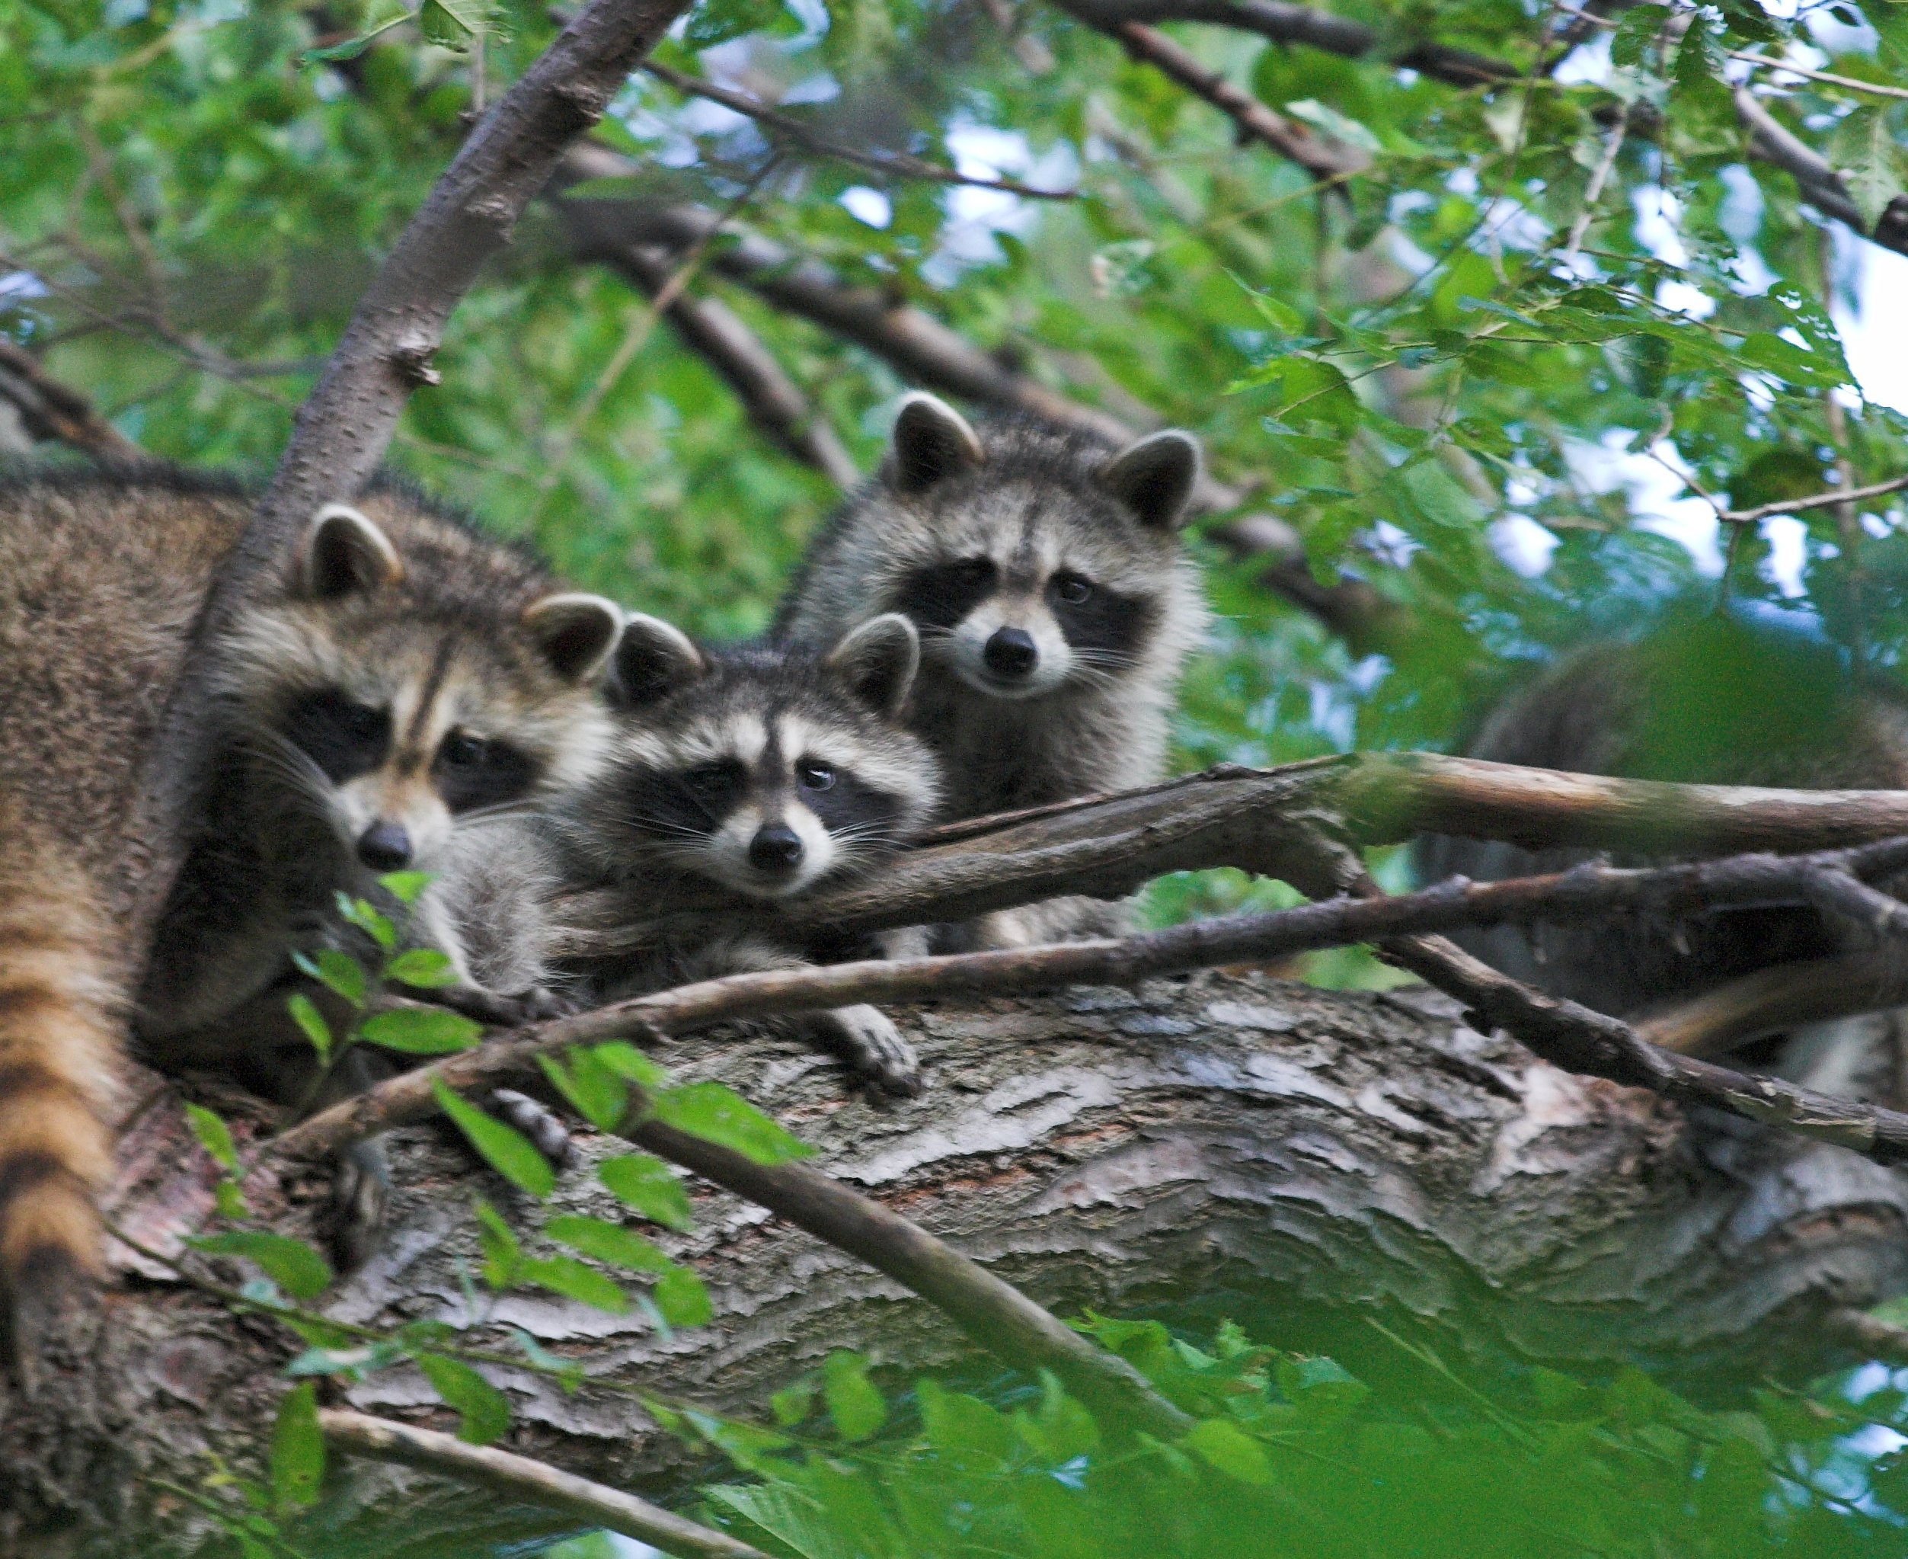
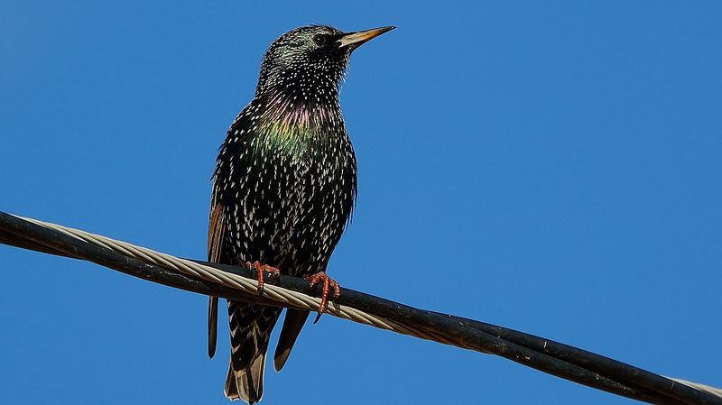
What is an invasive species?
Invasive Species Video
Invasive species story
Have you ever had an experience with an invasive species?

Slide 5
Effects of Invasive Species
What effects have you seen from invasive species?
What does it do to a natural ecosystem?

Slide 6
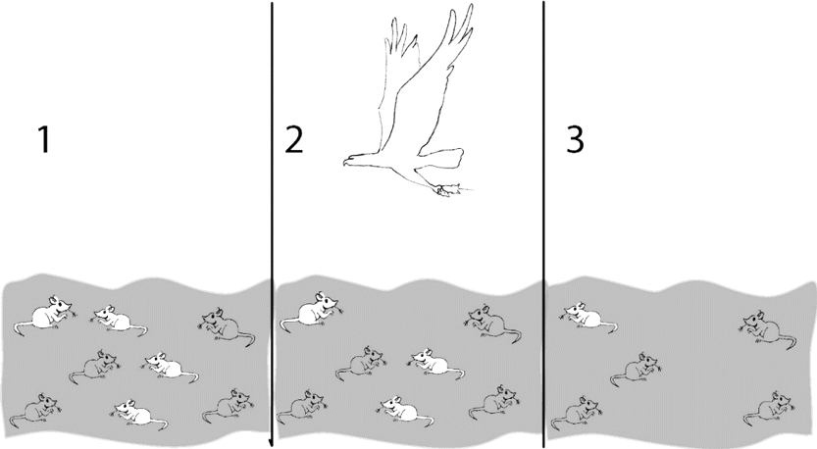
Term Review
Natural Selection – Natural selection is the differential survival and reproduction of individuals due to differences in phenotype. It is a key mechanism of evolution, the change in the heritable traits that are characteristic of a population over generations.

Slide 7
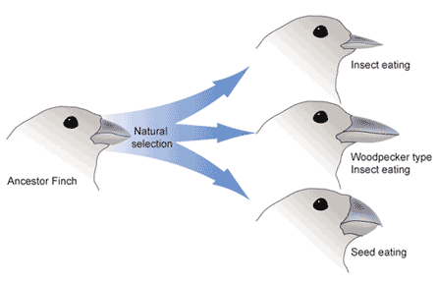
Term Review
Evolution – Evolution is a process that results in changes in the genetic material of a population over time. Evolution reflects the adaptations of organisms to their changing environments and can result in altered genes, novel traits, and new species.

Slide 8
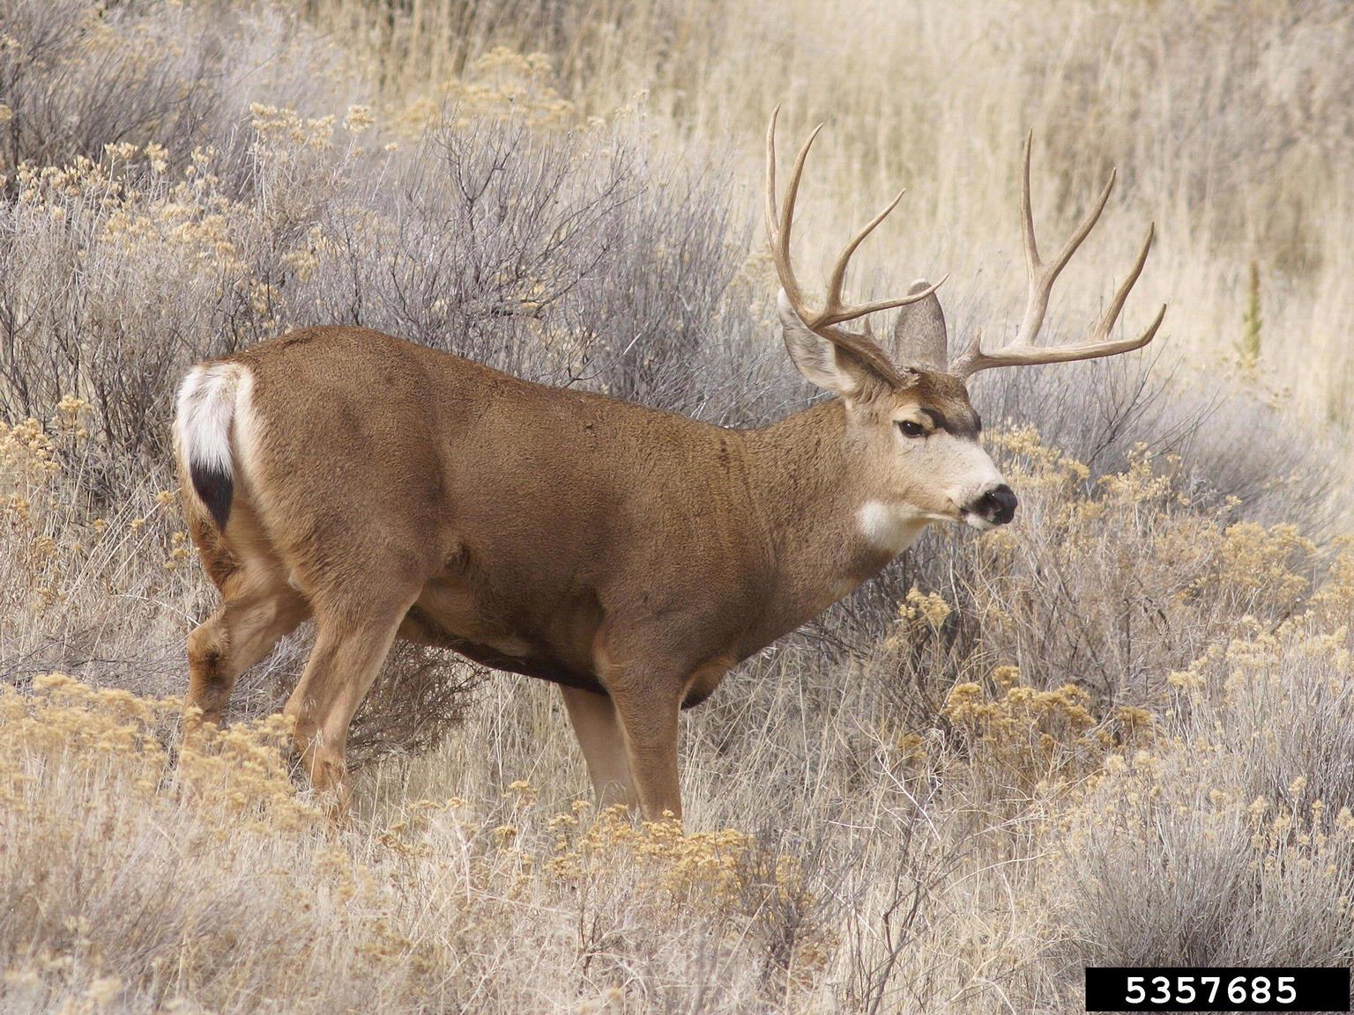
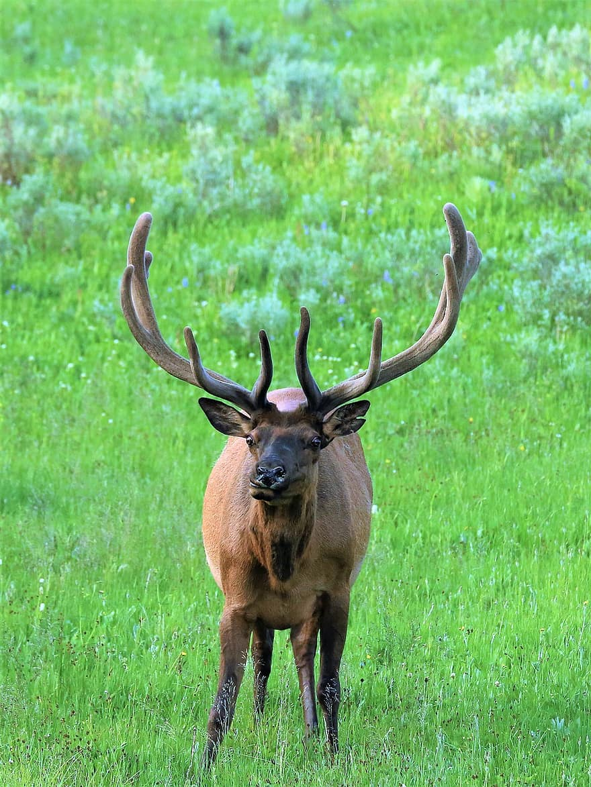
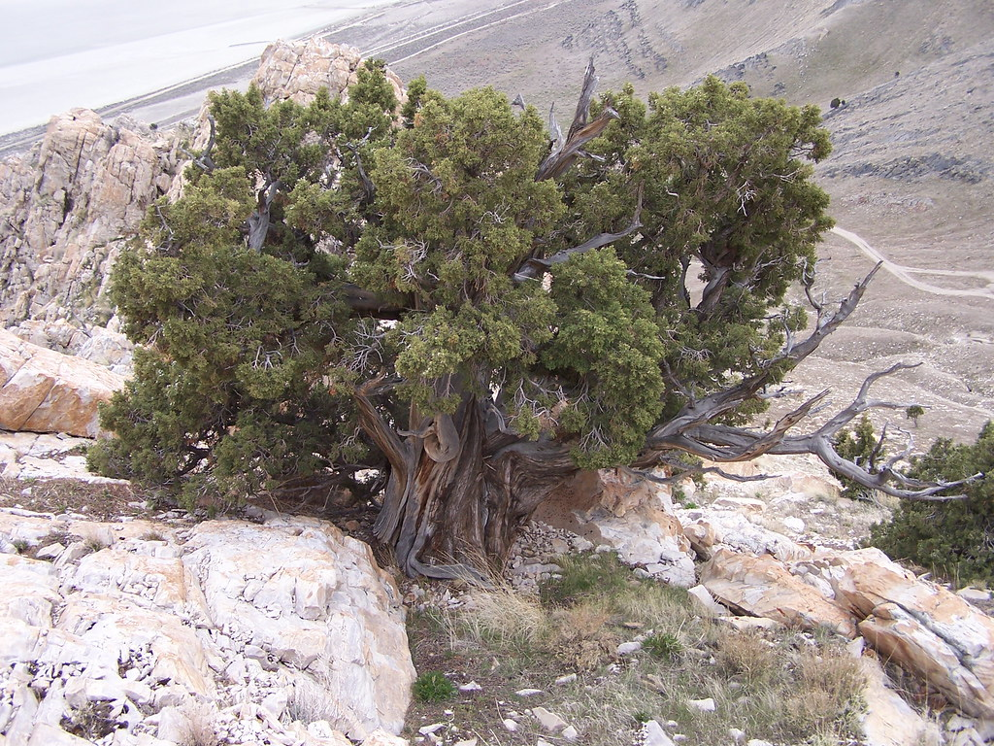
Invasive vs Native species
Native Species – In biogeography, a native species is indigenous to a given region or ecosystem if its presence in that region is the result of only local natural evolution during history. The term is equivalent to the concept of indigenous or autochthonous species.

Slide 9
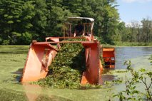
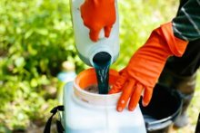
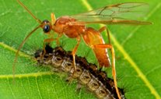
Are there solutions to invasive species?
Mechanical
Mowing
Chemical
Foliar herbicide applications
Hand wicking herbicide applications
Biological
Hand pulling or cutting
Girdling (wood species)
Cut stump herbicide applications
Introduction of insects, fungus, animals to control invasive species
Create competition with planting

Slide 10

Group Reading
Split into groups and read packets
While reading identify the treatments as biological, chemical, or mechanical. Be prepared to share specific examples.

Slide 11
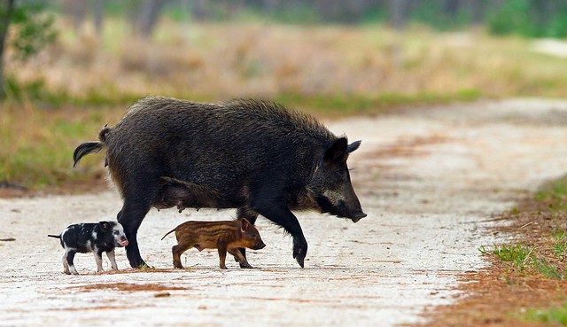
Objective: Students will be able to evaluate different management solution types for invasive species and determine how to best apply the solutions to an assigned example.

Slide 12

3D-RST is supported by the NSF under grant number #DRL-2101383

