Slide 1
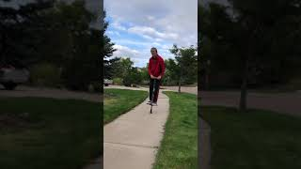
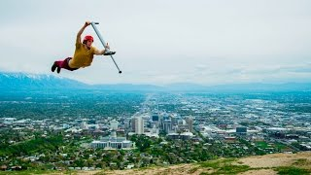
PHENOMENON
DIRECTIONS
I want you to watch the videos on the right and do the following:
Make at least 3 observations.
Write down a prediction how potential energy works with a pogo stick.
Come up with 3 questions about the video.

Slide 2
OBSERVATIONS
PREDICTION

Slide 3
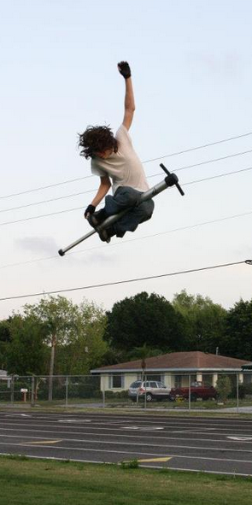
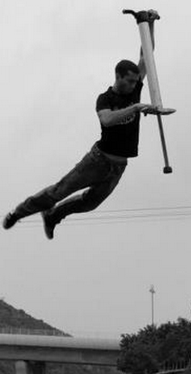
QUESTIONS

Slide 4
POTENTIAL ENERGY
Standard 8.2.2
Ask questions about how the amount of potential energy varies as distance within the system changes. Plan and conduct an investigation to answer a question about potential energy.

Slide 5

PROCEDURE
Directions:
Using the video on slide 6 and the paper provided you will make an origami frog. Make sure you make good creases on the paper to help you do better folds.
PATIENCE IS KEY!!
YOU WILL MESS UP AND THAT’S OKAY!!!
JUST TRY YOUR BEST AND FOCUS!!!!
Those that finish their origami frog early will help others with their origami frog.

Slide 6
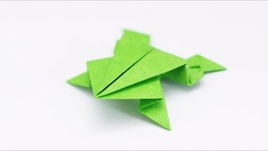

Slide 7
DATA COLLECTION
Frog Jump Test |  | Partial Force | Maximum Force
For each round record the distance the origami frog jumped. | Round 1 (cm)
 | Round 2 (cm)
 | Round 3 (cm)
 | Round 4 (cm)
 | Round 5 (cm)
 | Average (cm) | 35 | 50
Remember to calculate average you need to add all rounds and divide by 5. Partial Force = Not fully pressing your frog down Maximum Force = Pressing your frog fully down

Slide 8

GRAPHING
Directions:
Using the data from slide 7 you will make a bar graph on the right. Remember to round your measurements.
Ex) 6.5 cm = 7 cm, 6.2 cm = 6 cm
Rounding Tip: 5 or more you round up. 5 or less you round down.
To make your bar graph you select the amount of cells you need and click on this icon to fill the color.
100 cm
90 cm
80 cm
70cm
60 cm
50 cm
40 cm
30 cm
20 cm
10 cm
 | Partial Force | Max Force
DISTANCE TRAVELED (CM)

Slide 9
Compare Data
Directions:
On the next slide # 10. I want you to go to two other people in class and create their bar graph data. You will be comparing your data with their data to answer the question on slide # 12.

Slide 10
GRAPHING
GRAPHING
10 cm
9 cm
8 cm
7cm
6 cm
5 cm
4 cm
3 cm
2 cm
1 cm
 | Partial Force | Max Force
10 cm
9 cm
8 cm
7cm
6 cm
5 cm
4 cm
3 cm
2 cm
1 cm
 | Partial Force | Max Force
DISTANCE TRAVELED (CM)
DISTANCE TRAVELED (CM)

Slide 11
DATA ANALYSIS
Looking at slide 7 which test jump did better? Use data as evidence from slide 7 to support your answer.

Slide 12
DATA ANALYSIS
Comparing slides 8 and 10. Did other people in your class get similar results? Using what you know about potential energy, what role did mass (matter from pressing down on the origami frog) have on the distance traveled by the origami frog? Use data as evidence to support your answer.

Slide 13
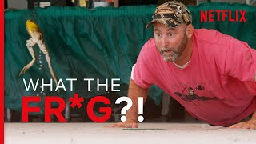
TIME TO RACE!!
Directions:
Watch the video on the right. You and three other students will recreate a frog race using your origami frogs.
Rules of the Race
Your origami frog only gets three jumps to make.
At the end of the third jump you will measure the distance your frog made.
Make sure to take advantage of potential energy!

Slide 14
DATA COLLECTION
Frog Jump Test |  | Player 1 | Player 2 | Player 3 | Player 4
For each round record the distance the origami frog jumped. | Round 1 (cm)
 | Round 2 (cm)
 | Round 3 (cm)
 | Average (cm)
Remember to calculate average you need to add all rounds and divide by 3.

Slide 15
DATA ANALYSIS
Looking at slide 14, whose origami frog traveled the farthest? Use data as evidence to support your answer.

Slide 16
DATA ANALYSIS
Looking at slide 14, why did the winning frog jump the farthest? Make sure to relate it back to potential energy and include how mass (matter) could affect the results.

Slide 17

3D-RST is supported by the NSF under grant number #DRL-2101383

