Slide 1


Printer friendly slides to give students a physical manipulative of the data.
3D-RST is supported by the NSF under grant number #DRL-2101383
You may want to print the horse fossil information front and back.

Slide 2
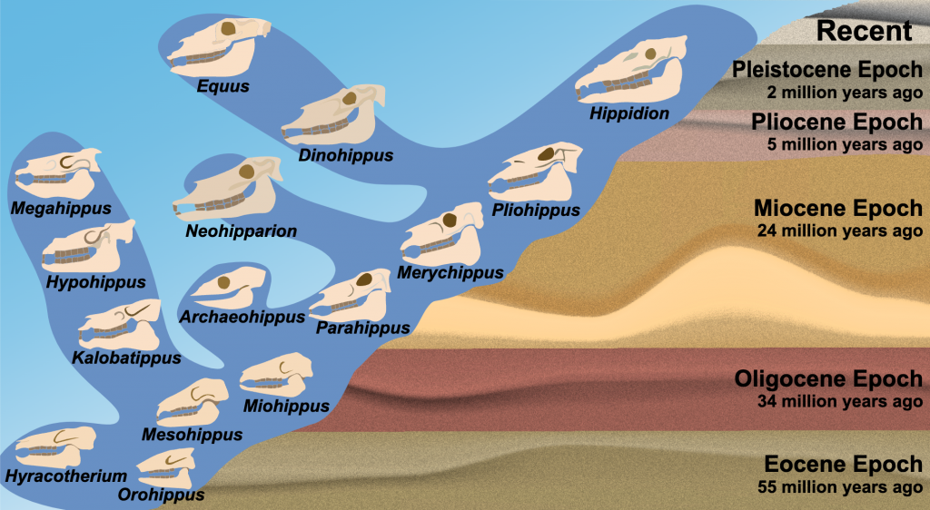
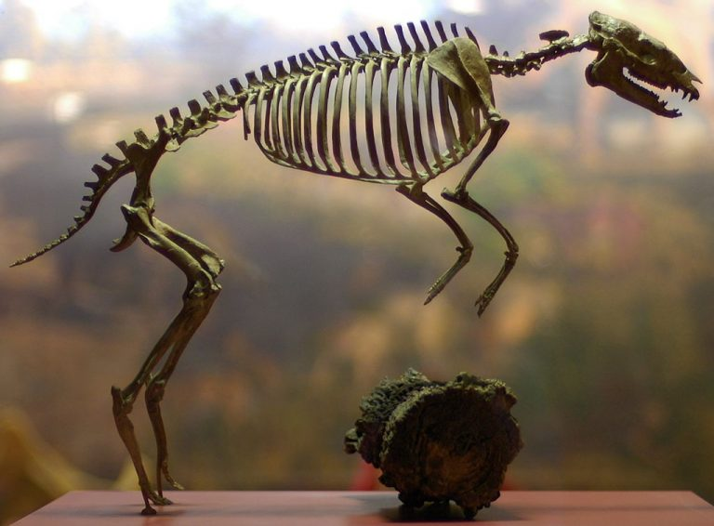
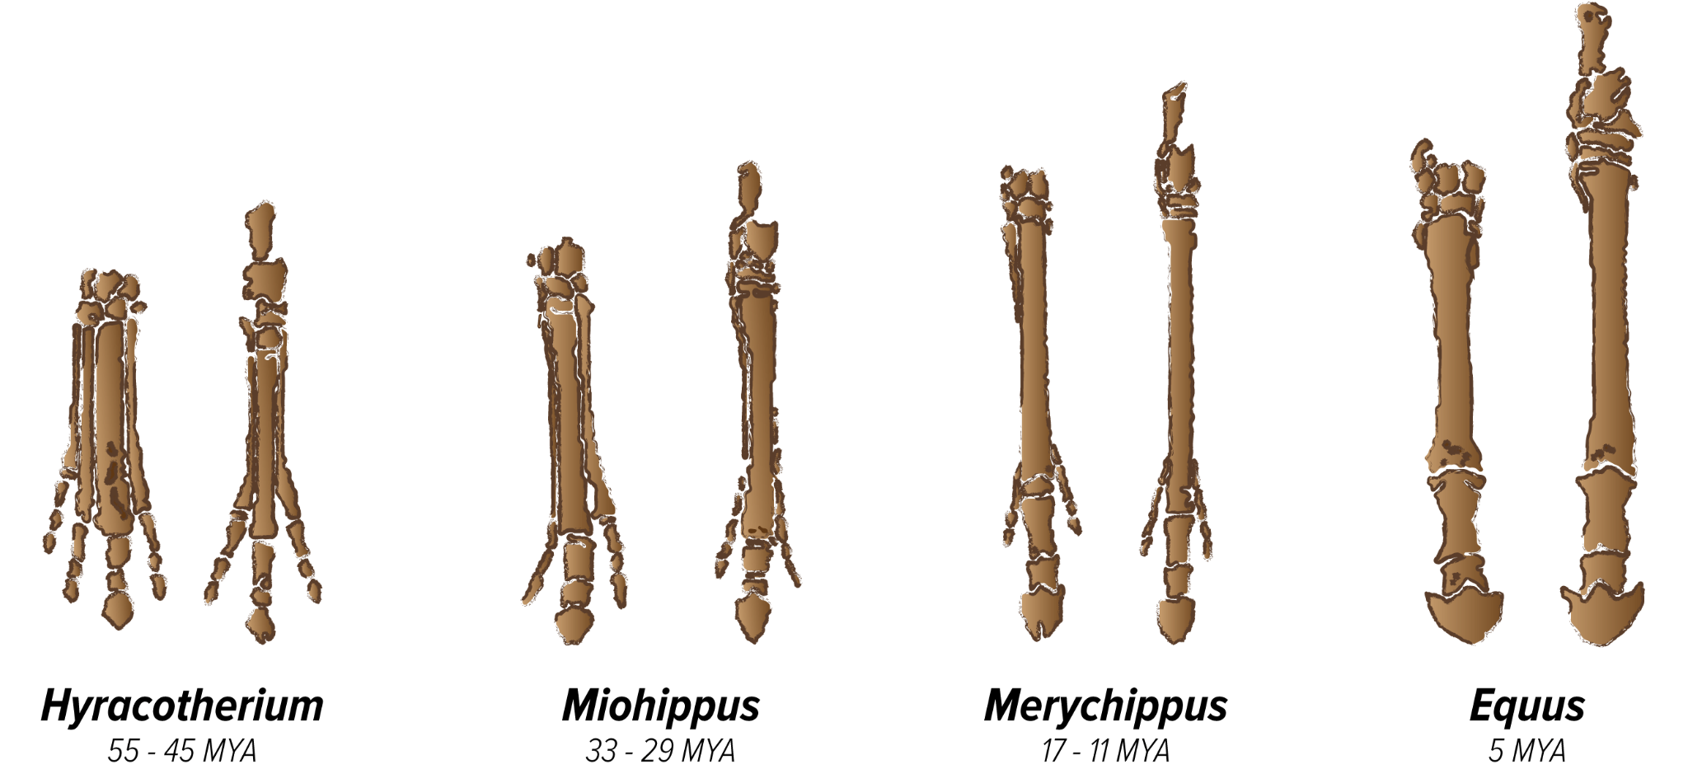
Hyracotherium

Slide 3
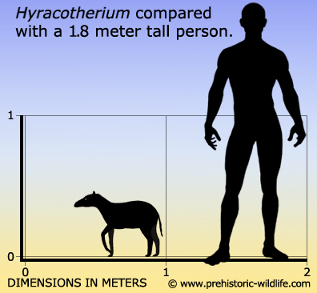
Hyracotherium
Fossils of Hyracotherium are found at many Eocene localities in the western US and Europe. Species in this genus lived from around 55 million years ago to around 45 million years ago.
About 0.5 m tall

Slide 4
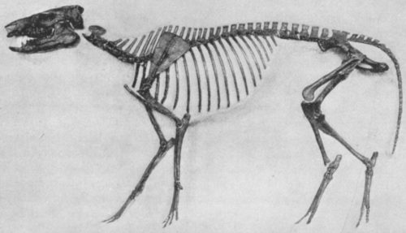
Orohippus 52 - 45 MYA
Orohippus. Photo by Harpers/Public domain

Slide 5
Orohippus
Fossils of Orohippus found in Eocene sediments in Wyoming and Oregon, dating from about 52-45 million years ago.
This is the primitive condition for mammals, and permits rotational movement at the elbow and wrist joints. This condition is retained by animals such as small forest dwellers who must maneuver over uneven terrain.
About 0.6 m tall

Slide 6
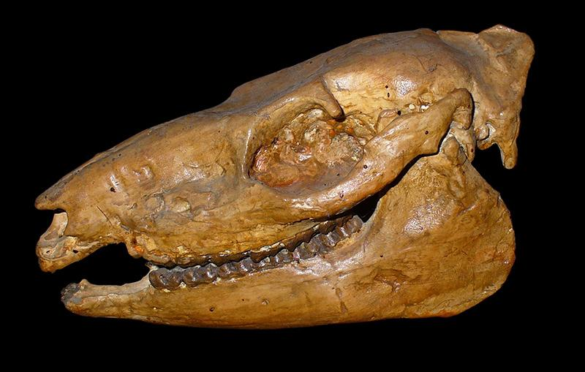
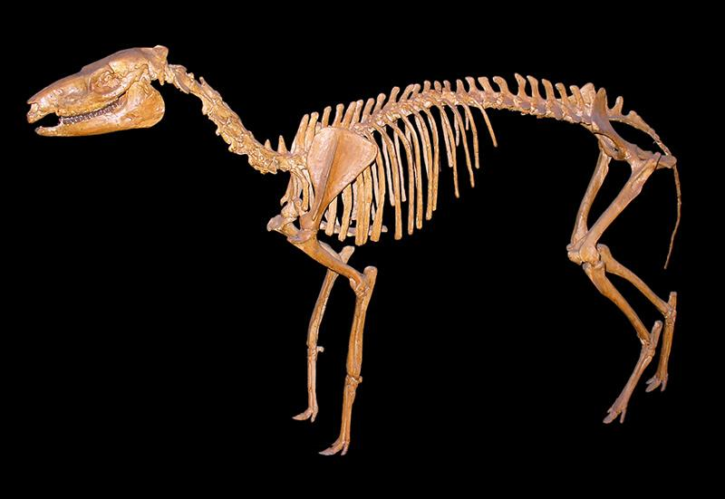
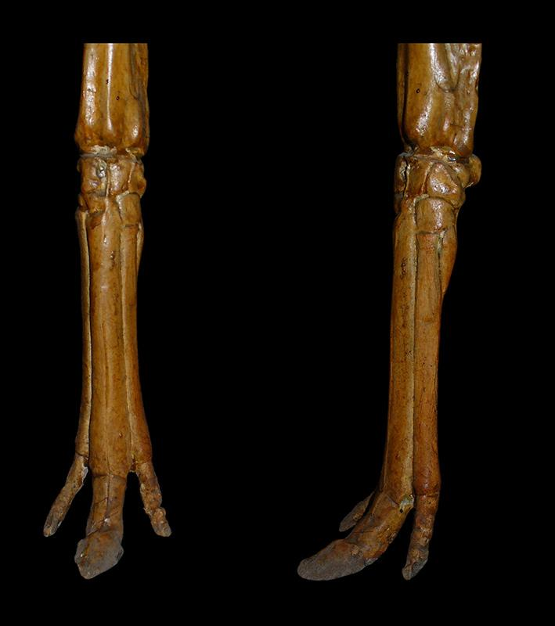
Mesohippus 37-32 MYA

Slide 7
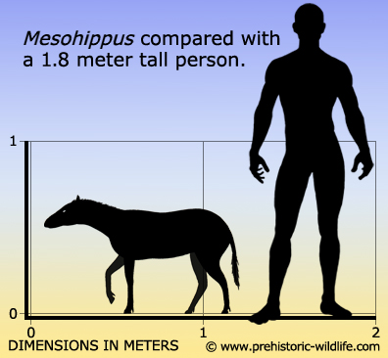
Mesohippus
Fossils of Mesohippus are found at many Oligocene localities in Colorado and the Great Plains of the US, including Nebraska and the Dakotas, and Canada.
About 0.6 m tall

Slide 8
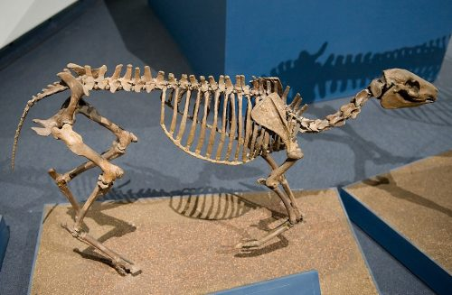
Miohippus 33 - 29 MYA

Slide 9
Miohippus
Fossils of Miohippus are found at many Oligocene localities in the Great Plains, the western US and a few places in Florida. Species in this genus lived from about 32-25 million years ago.
About 0.76 m tall

Slide 10
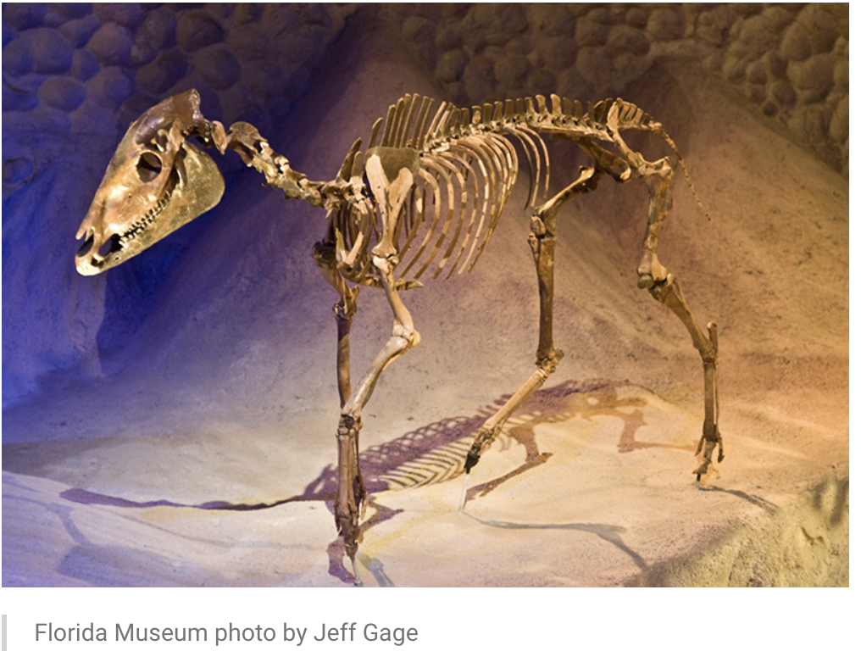
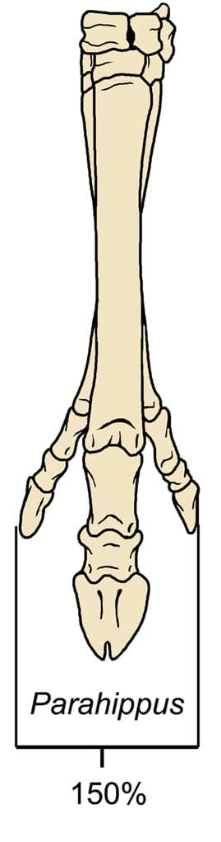
Parahippus 24 -17 mya

Slide 11
Parahippus
Fossils of Parahippus are found at many early Miocene localities in the Great Plains and Florida. Species in this genus lived from 24 -17 million years ago.
About 1 m tall

Slide 12
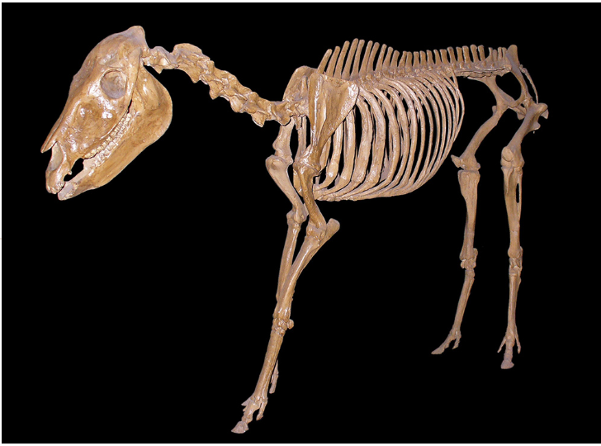
Merychippus 17-11 mya

Slide 13
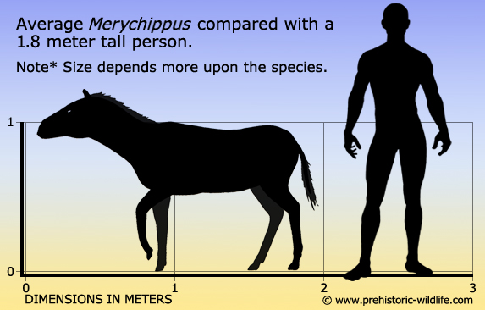
Merychippus
Fossils of Merychippus are found at many late Miocene localities throughout the United States. Species in this genus lived from
About 1 m tall

Slide 14
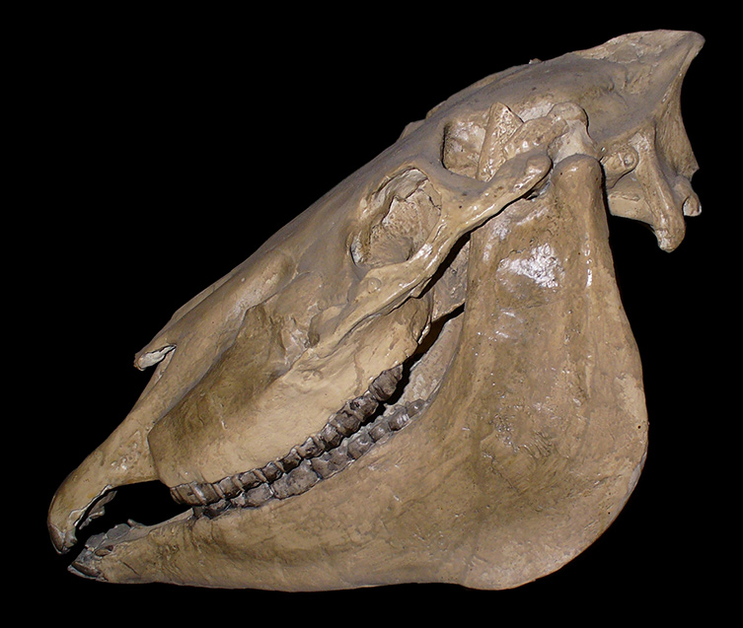
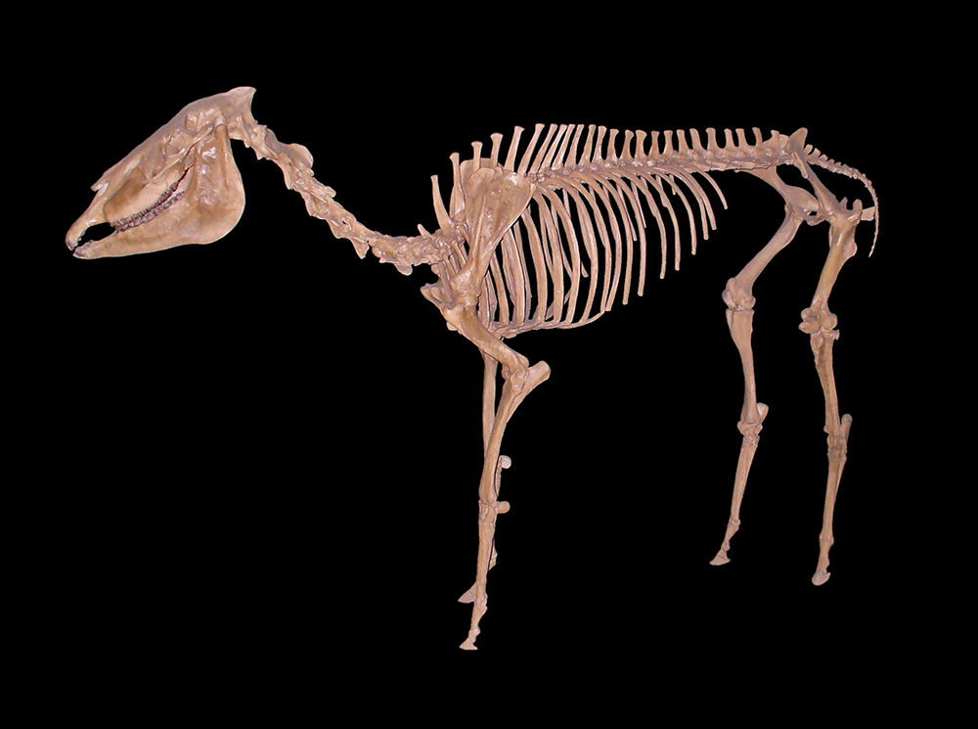
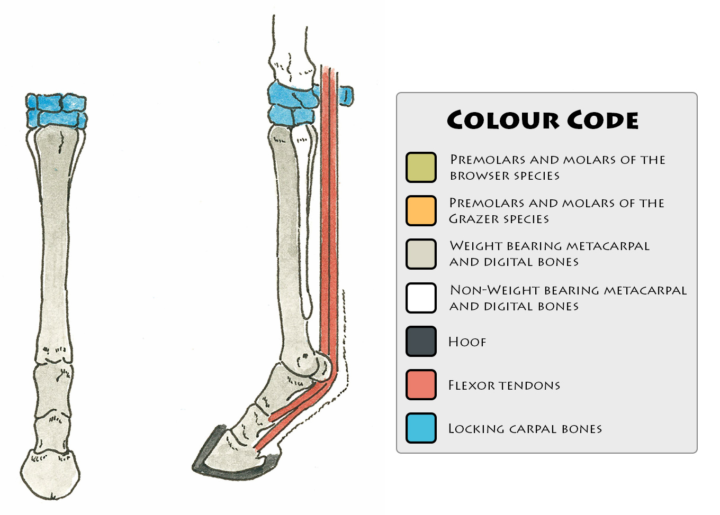
Pliohippus 12-6 MYA

Slide 15
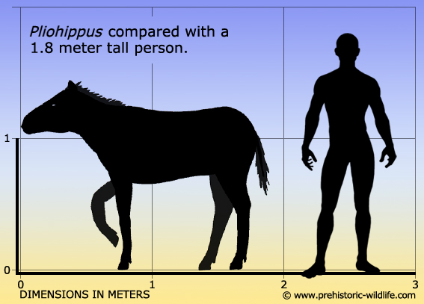
Pliohippus
Fossils of Pliohippus are found at many late Miocene localities in Colorado, the Great Plains of the US (Nebraska and the Dakotas) and Canada. Species in this genus lived from 12-6 million years ago.
About 1.25 m tall.

Slide 16
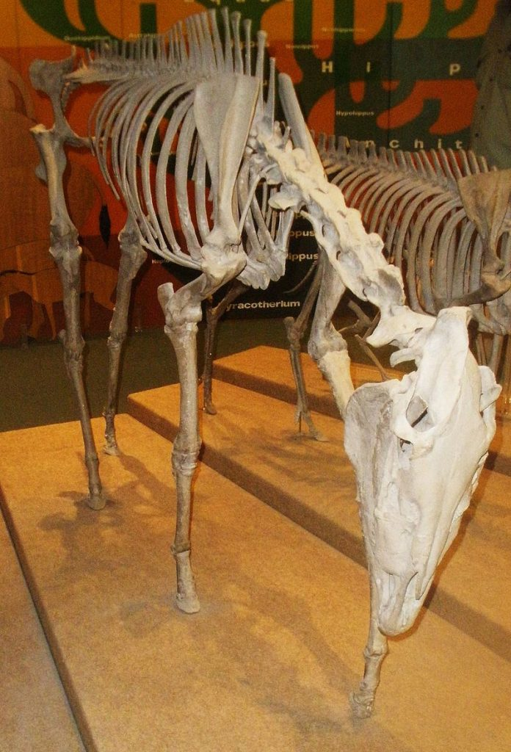
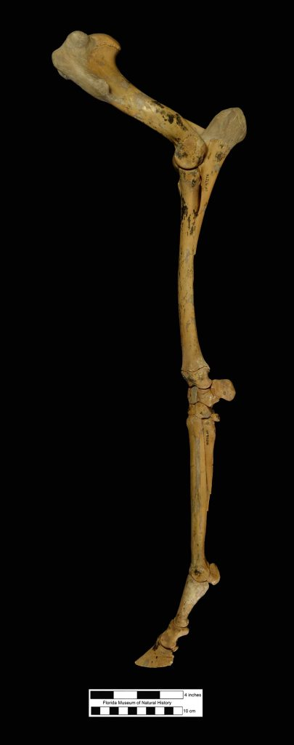
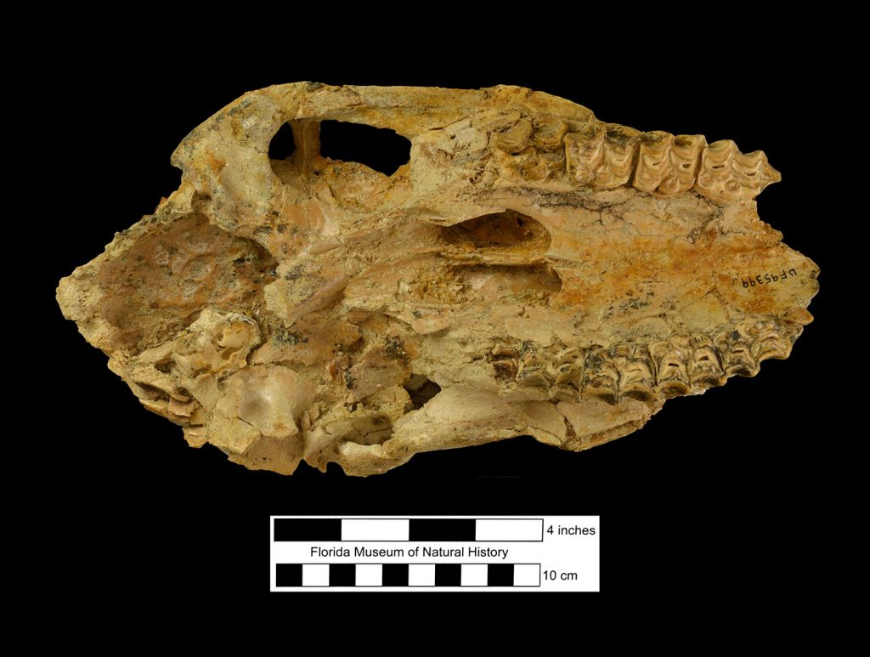
Dinohippus 13–5 MYA

Slide 17
Dinohippus
Dinohippus fossils are found in the Upper Miocene of North America and date from 13–5 million years ago.
About 1.5 m tall.

Slide 18
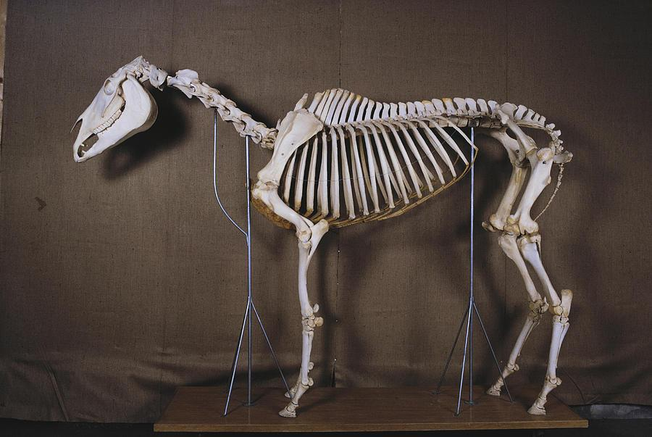
Equus 5 MYA-Present

Slide 19
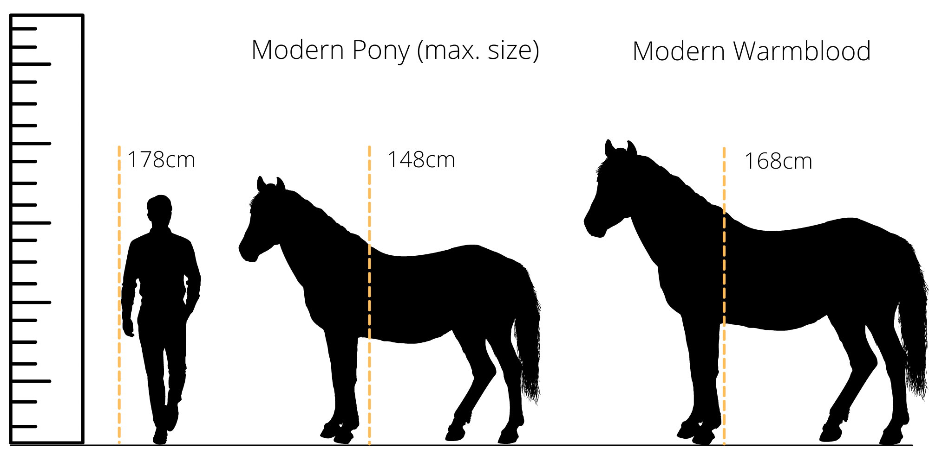
Equus
Species of Equus lived from 5 million years ago until the present. Living species include horses, donkeys, and zebras. Fossils of Equus are found on every continent except Australia and Antarctica.
About 1.5 m tall

Slide 20
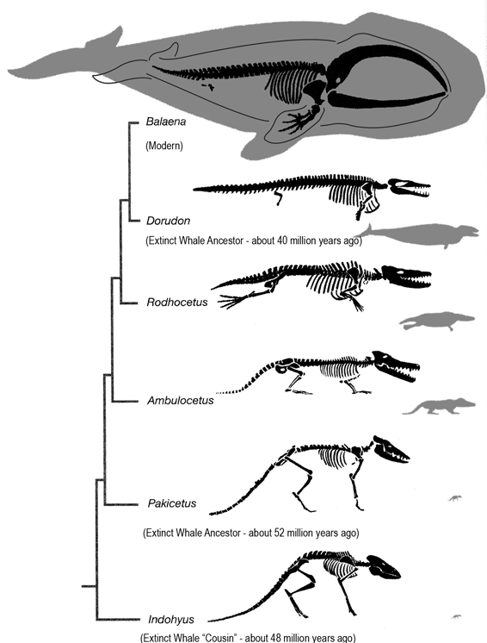
Modern Whale

Slide 22
3D-RST is supported by the NSF under grant number #DRL-2101383

