Slide 1
Horse Evolution
Change Over Time
Describe the pattern you used from the fossil evidence to create your cladogram. How did the pattern help you put the fossils in order?
Support your cladogram with two other patterns in the data.

Slide 2
Whale Evolution
Create a cladogram on the next slide using the patterns found in the fossil image data. Justify the pattern you chose.
Support your cladogram with two other patterns in the data.

Slide 3
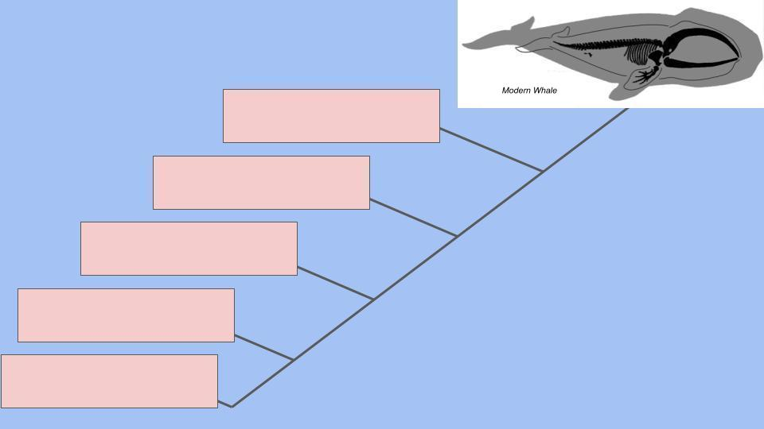






Slide 4
Final Summary
Using actual evidence from the horse or whale fossil data, describe how the horse or whale changed over time. Evaluate at least three different patterns you noticed in the data.

