Slide 1
Patterns in the Fossil Record
7.5.2
MS-LS 4-1 & MS-ESS 2-3

Slide 2
SEEd 7.5.2 Changes to Life over time: Analyze and interpret data for patterns in the fossil record that document the existence, diversity, extinction, and change of life forms throughout the history of life on Earth, under the assumption that natural laws operate today as in the past.

Slide 3
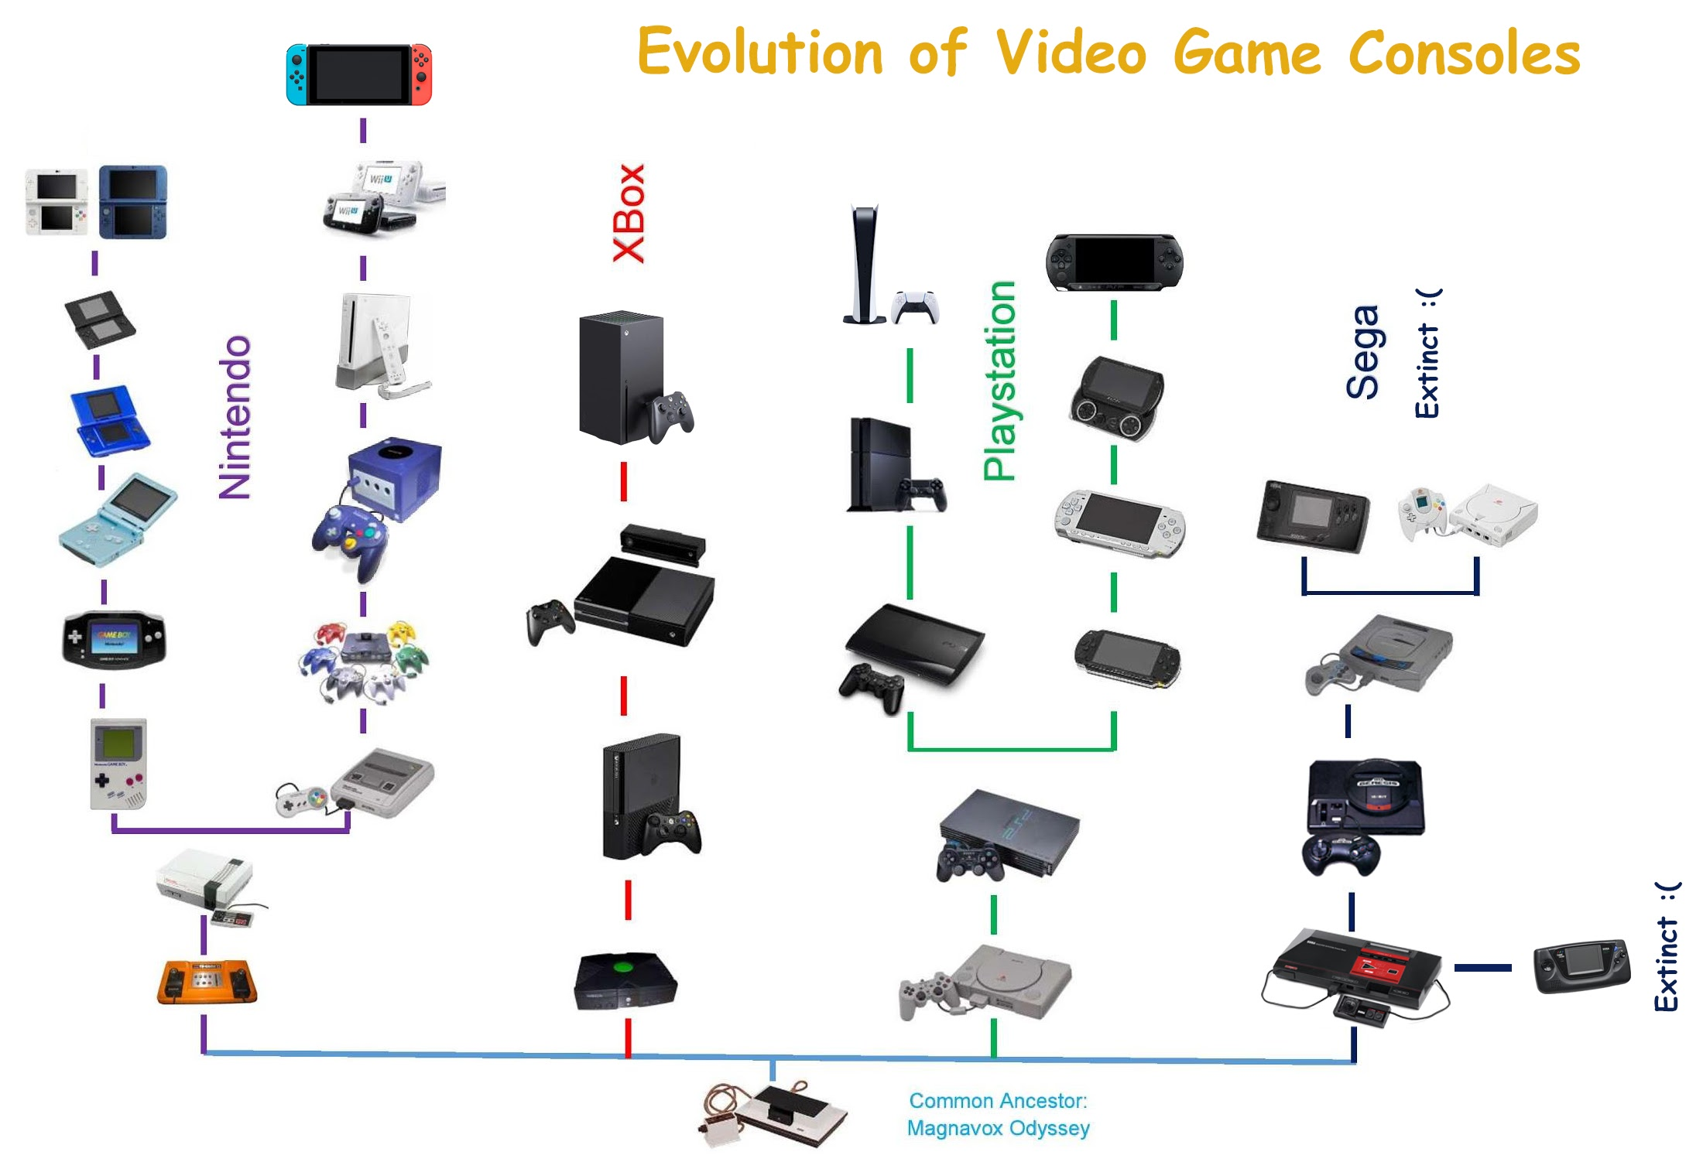
Cladogram of Video Game Consoles

Slide 4

Using patterns of physical traits, determine similarities and differences in these organisms.

Slide 5
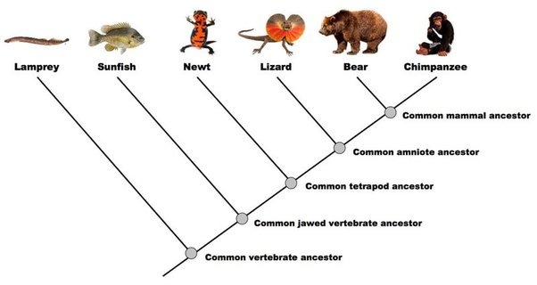
Cladogram

Slide 6
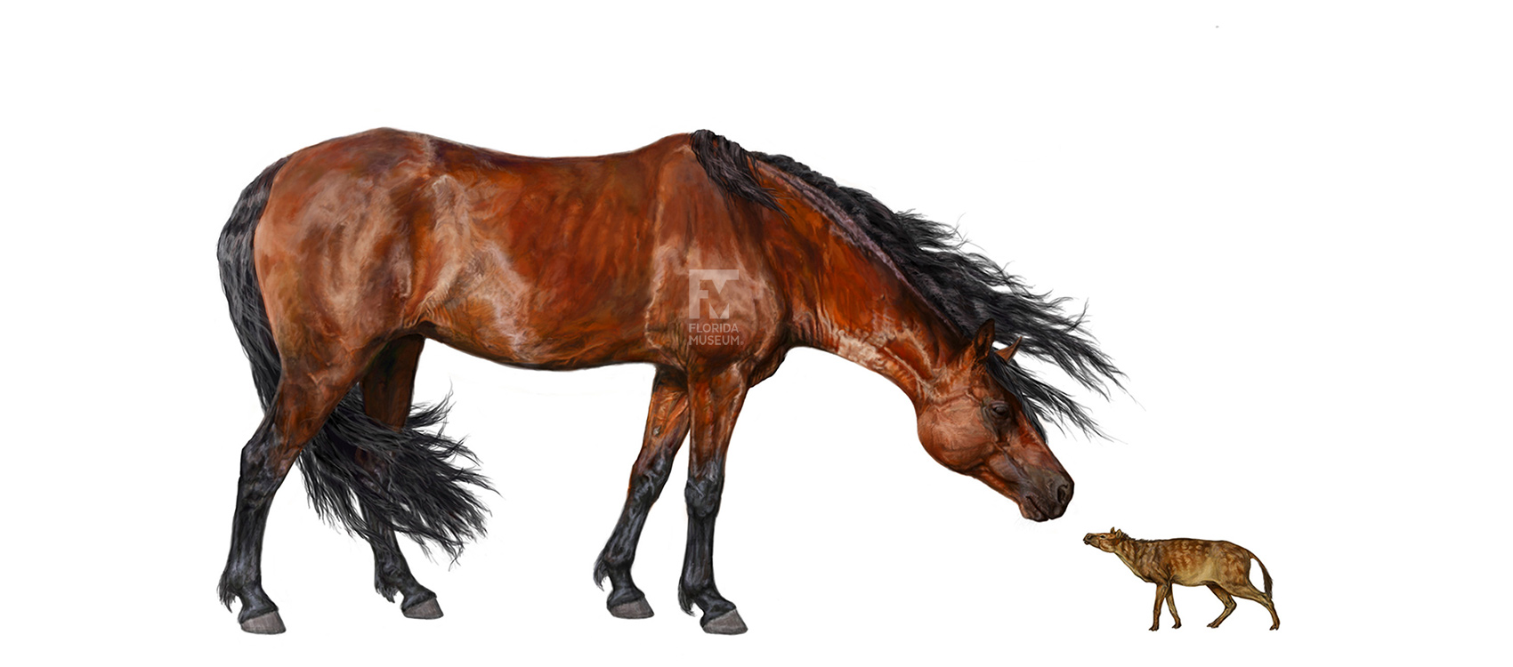

Standard 7.5.2
How are these two organisms related?

Slide 7
Using the data in the fossil images, arrange them in a pattern that makes sense.
Be prepared to justify the pattern you chose.

Slide 8

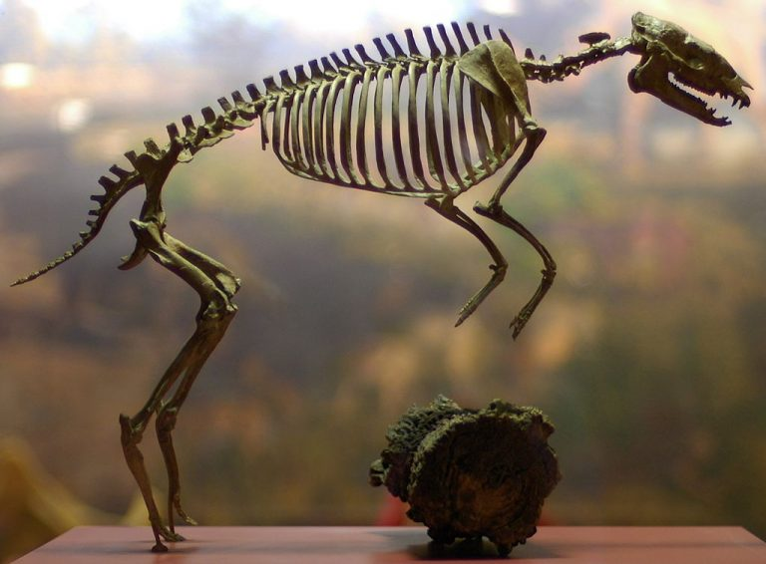
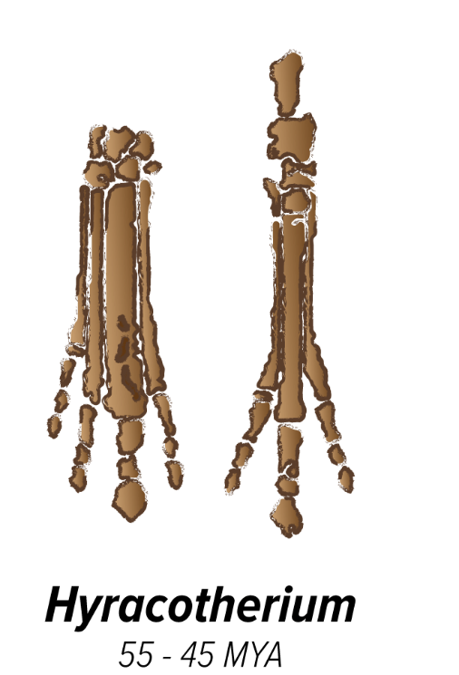
Hyracotherium

Slide 9
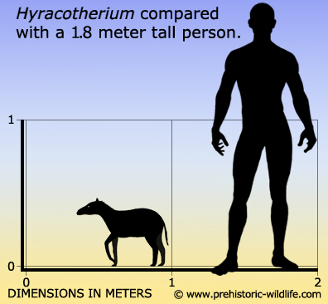
Hyracotherium
Fossils of Hyracotherium are found at many Eocene localities in the western US and Europe. Species in this genus lived from around 55 million years ago to around 45 million years ago.
About 0.5 m tall

Slide 10

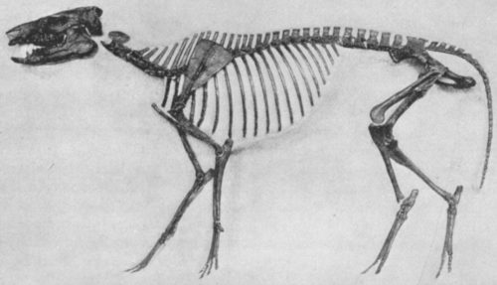
Orohippus 52 - 45 MYA
Orohippus. Photo by Harpers/Public domain

Slide 11
Orohippus
Fossils of Orohippus found in Eocene sediments in Wyoming and Oregon, dating from about 52-45 million years ago.
This is the primitive condition for mammals, and permits rotational movement at the elbow and wrist joints. This condition is retained by animals such as small forest dwellers who must maneuver over uneven terrain.
About 0.6 m tall

Slide 12
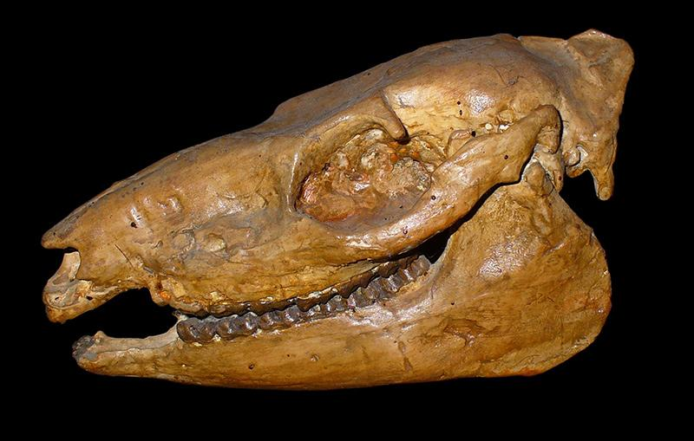
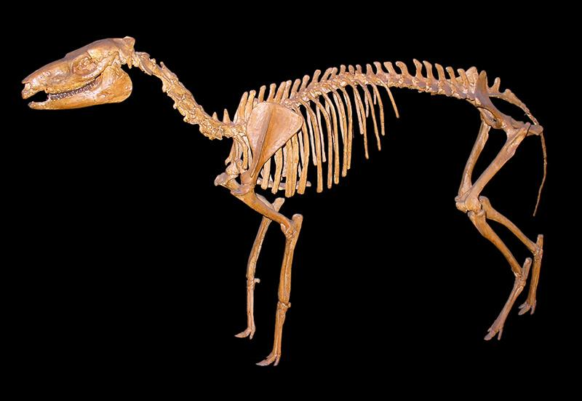
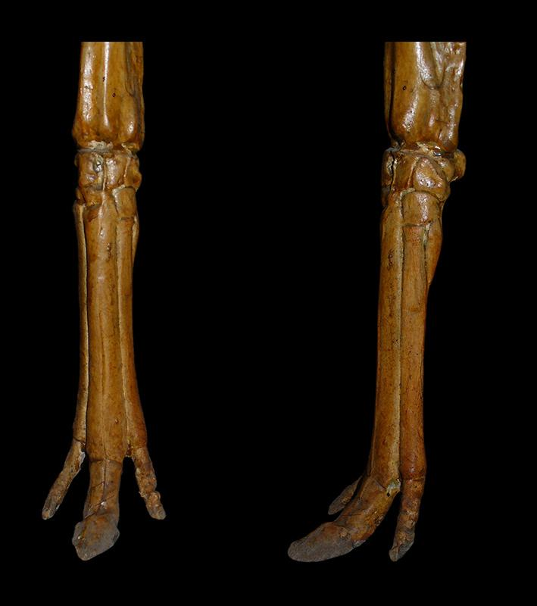
Mesohippus 37-32 MYA

Slide 13
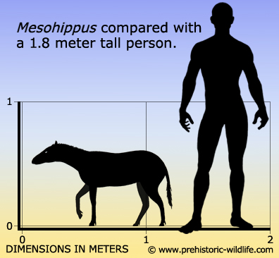
Mesohippus
Fossils of Mesohippus are found at many Oligocene localities in Colorado and the Great Plains of the US, including Nebraska and the Dakotas, and Canada.
About 0.6 m tall

Slide 14

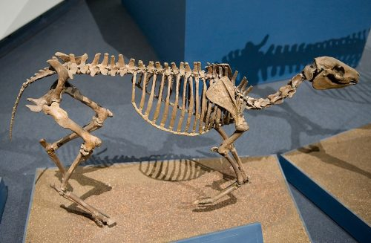
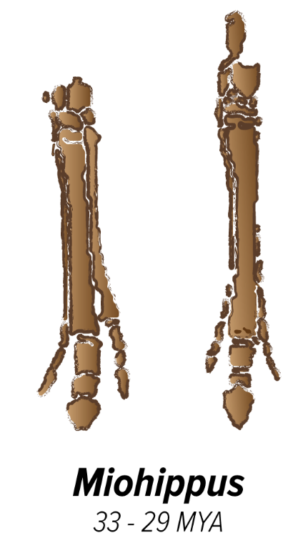
Miohippus 33 - 29 MYA

Slide 15
Miohippus
Fossils of Miohippus are found at many Oligocene localities in the Great Plains, the western US and a few places in Florida. Species in this genus lived from about 32-25 million years ago.
About 0.76 m tall

Slide 16

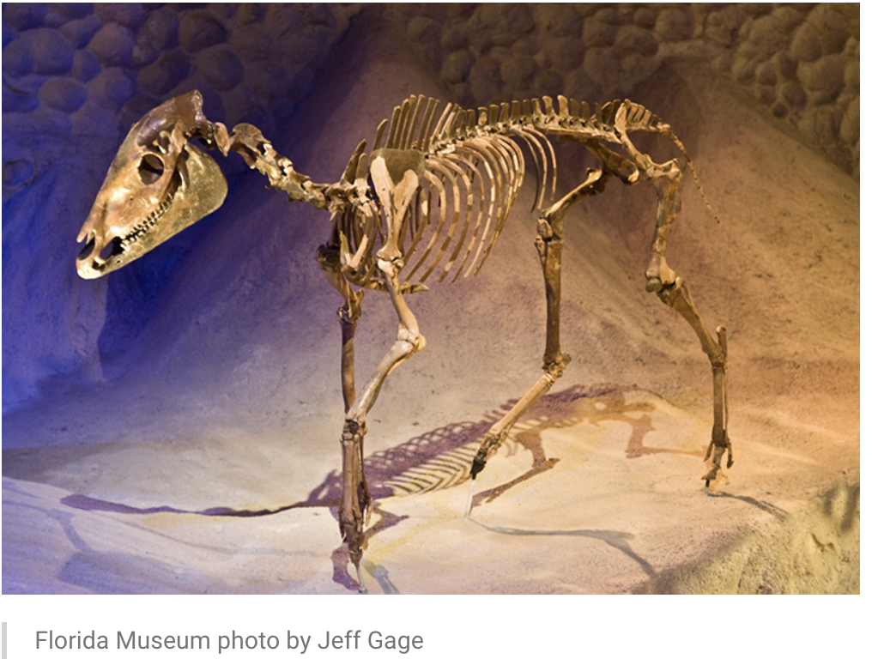
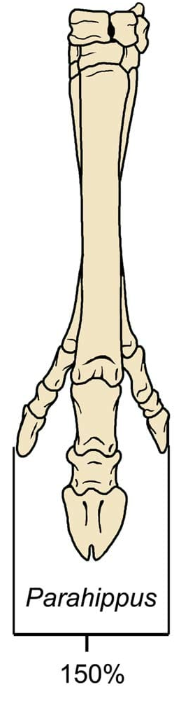
Parahippus 24 -17 mya

Slide 17
Parahippus
Fossils of Parahippus are found at many early Miocene localities in the Great Plains and Florida. Species in this genus lived from 24 -17 million years ago.
About 1 m tall

Slide 18

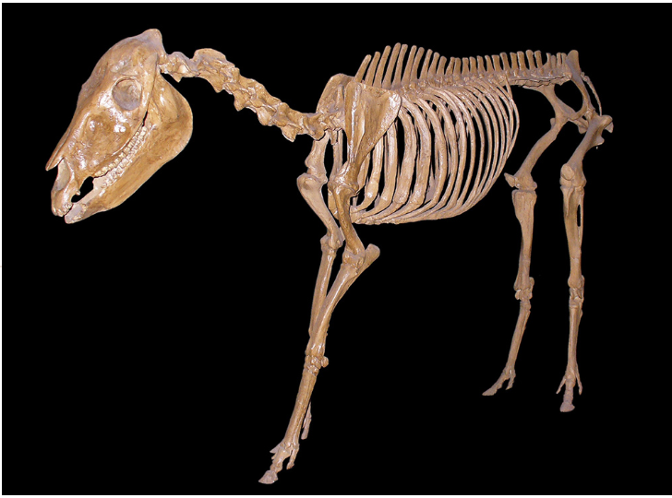
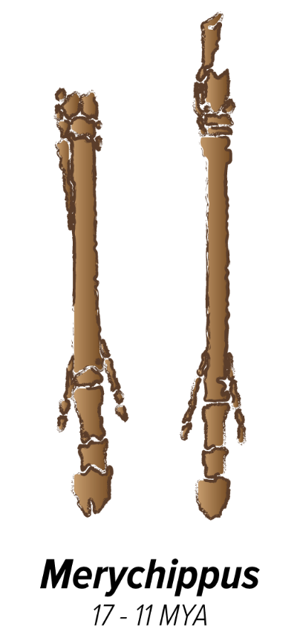
Merychippus 17-11 mya

Slide 19
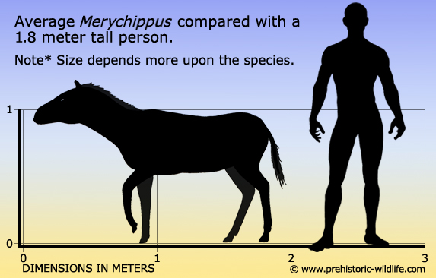
Merychippus
Fossils of Merychippus are found at many late Miocene localities throughout the United States. Species in this genus lived from
About 1 m tall

Slide 20
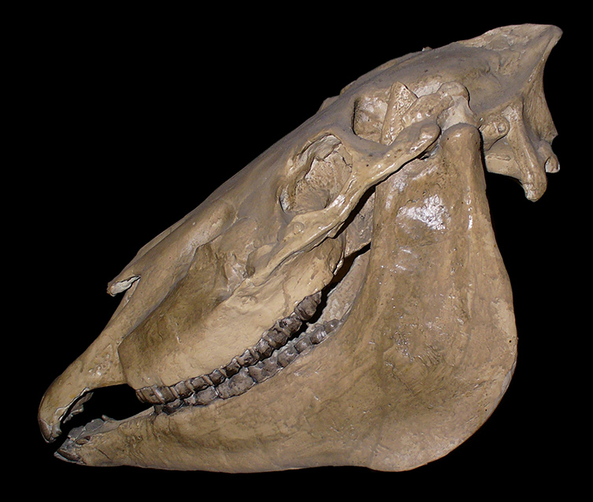
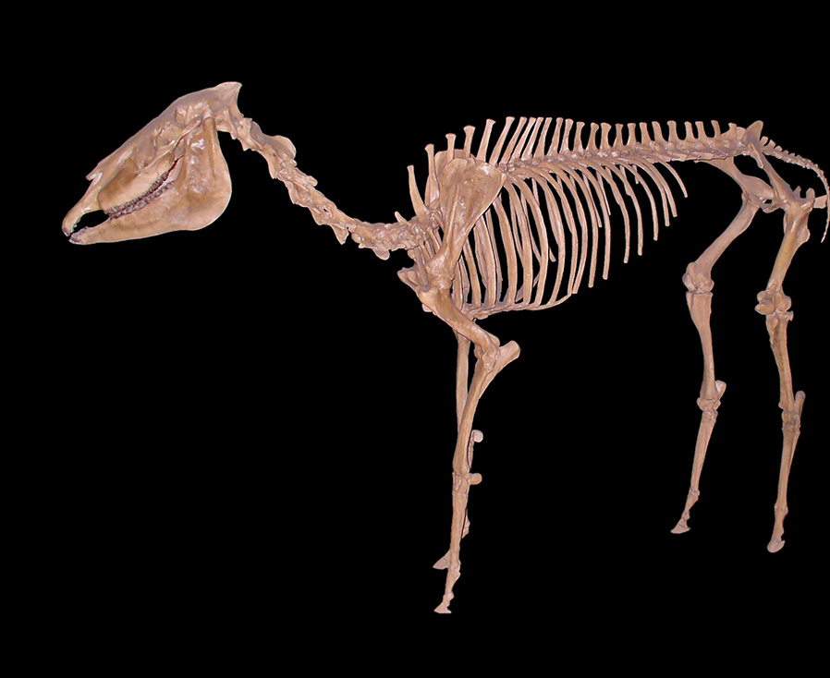
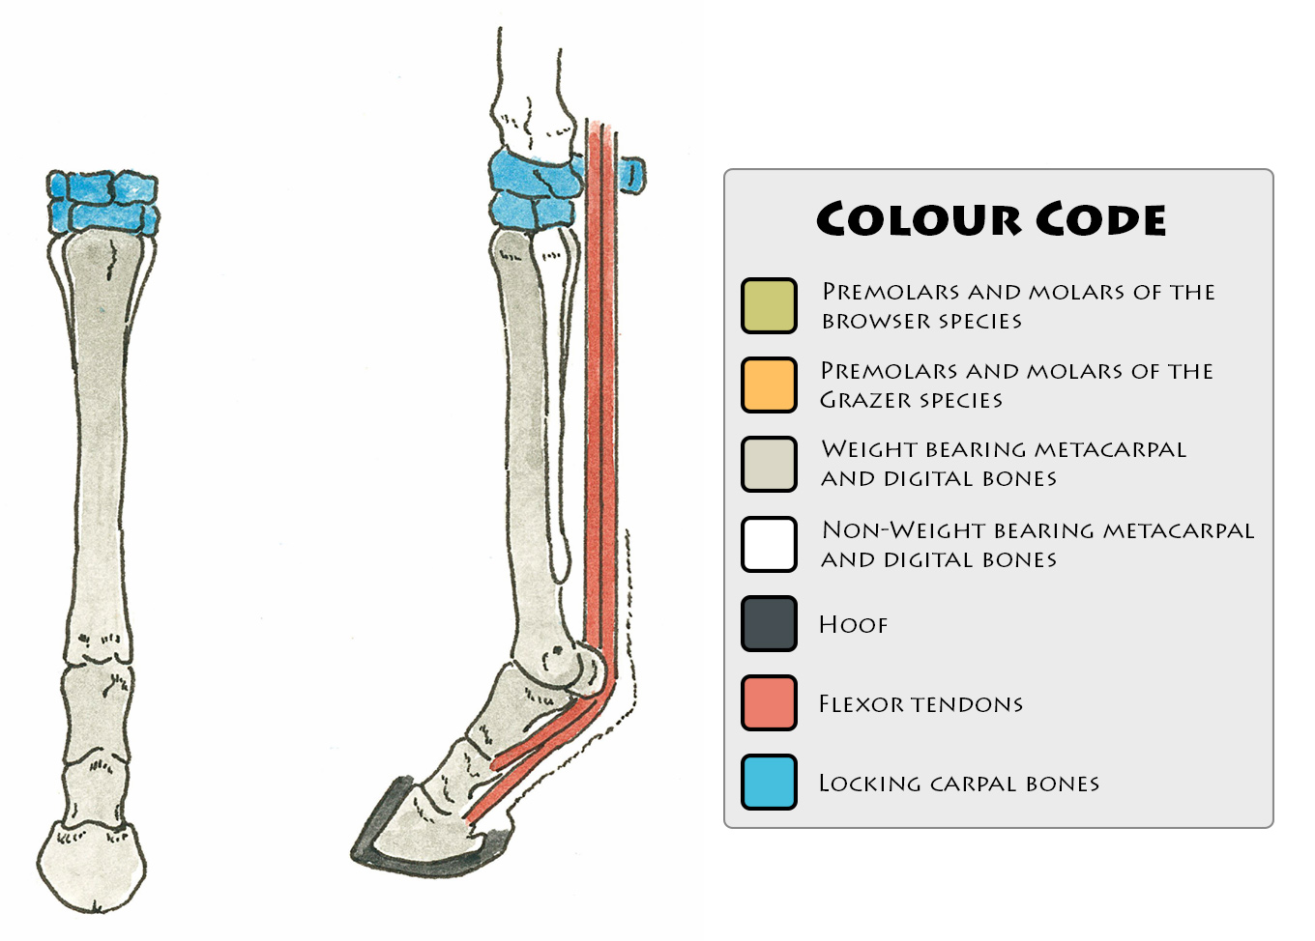
Pliohippus 12-6 MYA

Slide 21
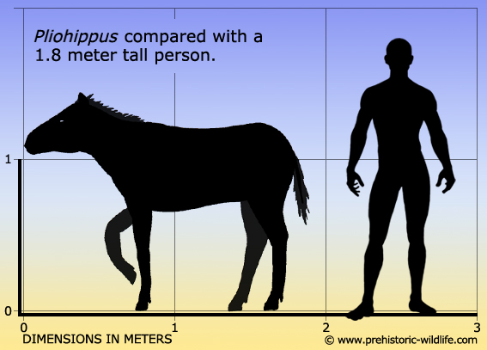
Pliohippus
Fossils of Pliohippus are found at many late Miocene localities in Colorado, the Great Plains of the US (Nebraska and the Dakotas) and Canada. Species in this genus lived from 12-6 million years ago.
About 1.25 m tall.

Slide 22
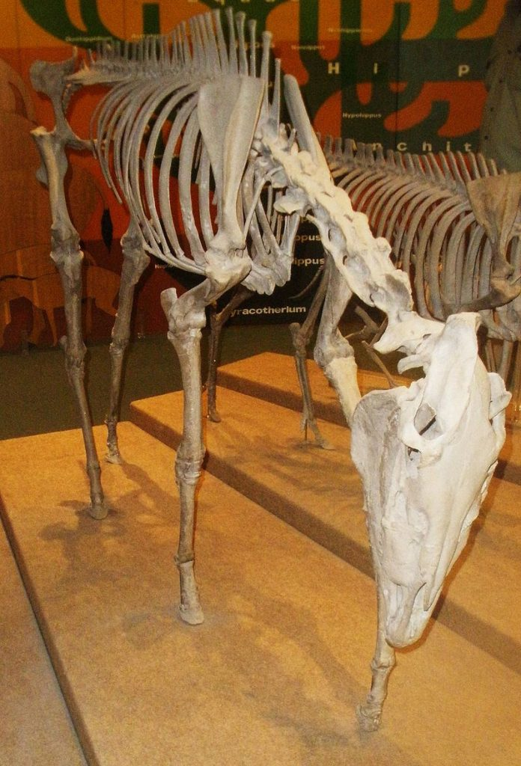
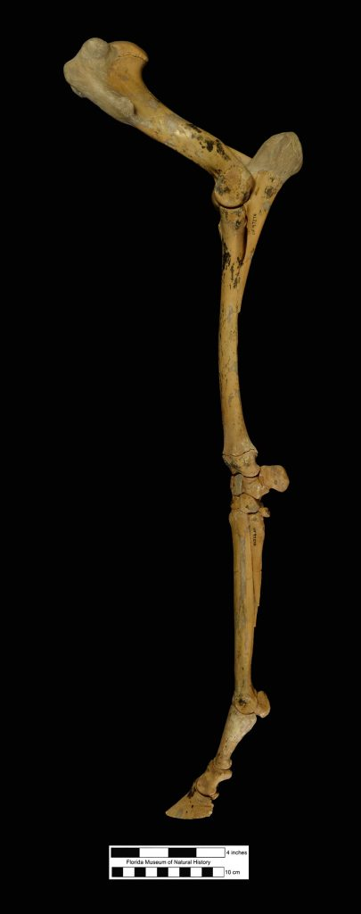
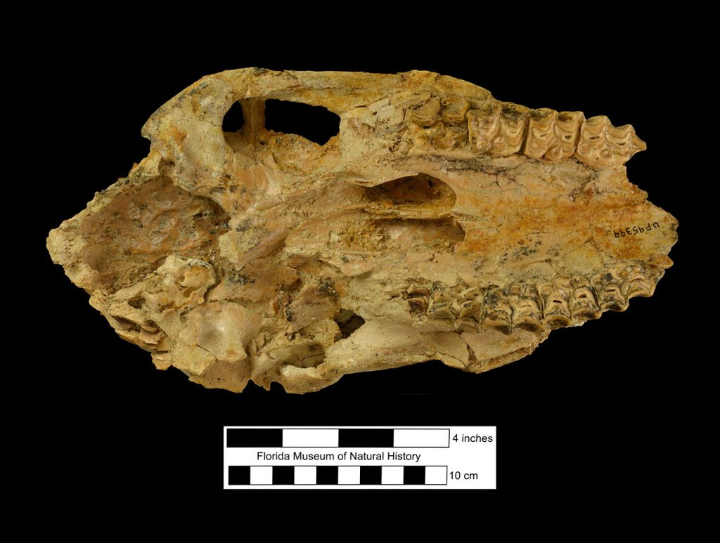
Dinohippus 13–5 MYA

Slide 23
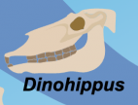
Dinohippus
Dinohippus fossils are found in the Upper Miocene of North America and date from 13–5 million years ago.
About 1.5 m tall.

Slide 24
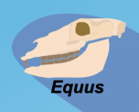
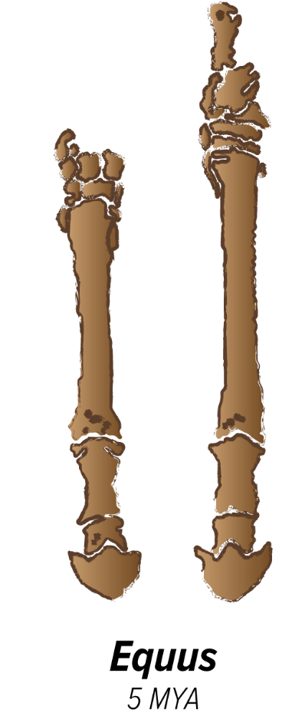
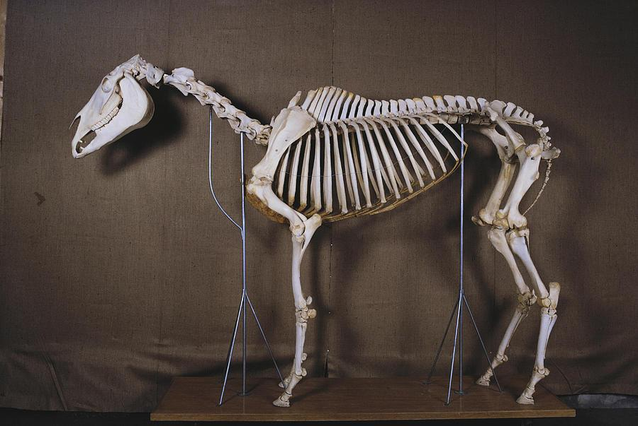
Equus 5 MYA - present

Slide 25
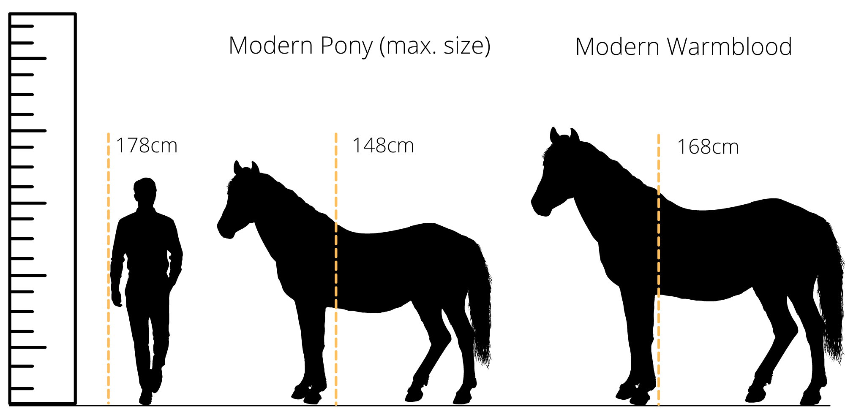
Equus
Species of Equus lived from 5 million years ago until the present. Living species include horses, donkeys, and zebras. Fossils of Equus are found on every continent except Australia and Antarctica.
About 1.5 m tall

Slide 26
Make sure to answer #1-2 Be ready to share your justifications.
Let’s dig deeper with the following images.
Notes:
Teacher shares out.

Slide 27
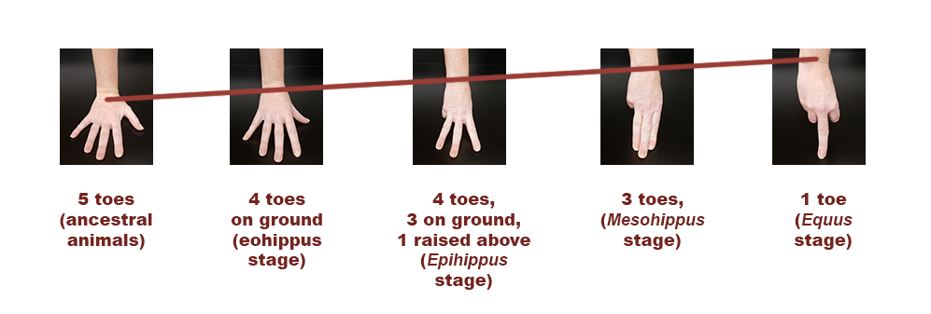
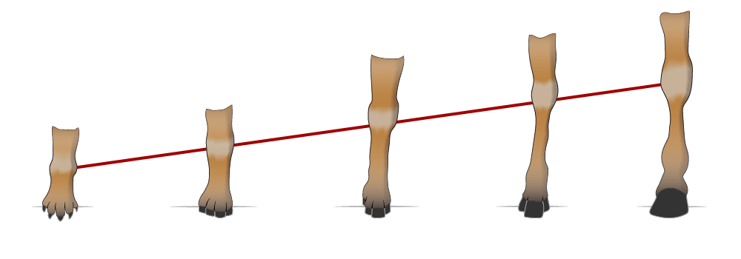
Notes:
25 - 28 Teacher needs to point out change over time. Millions of years.

Slide 28
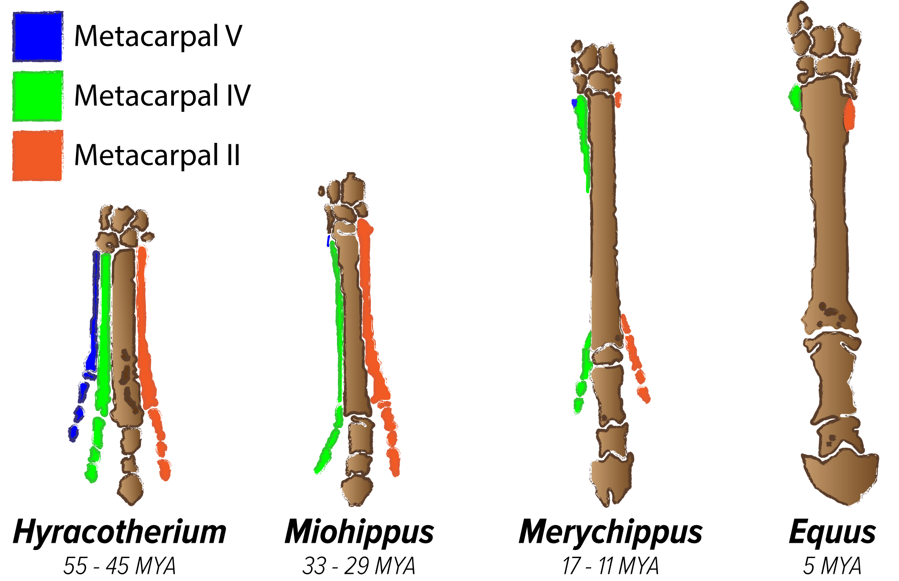

Slide 29
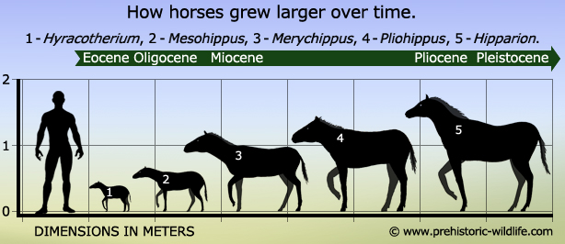

Slide 30
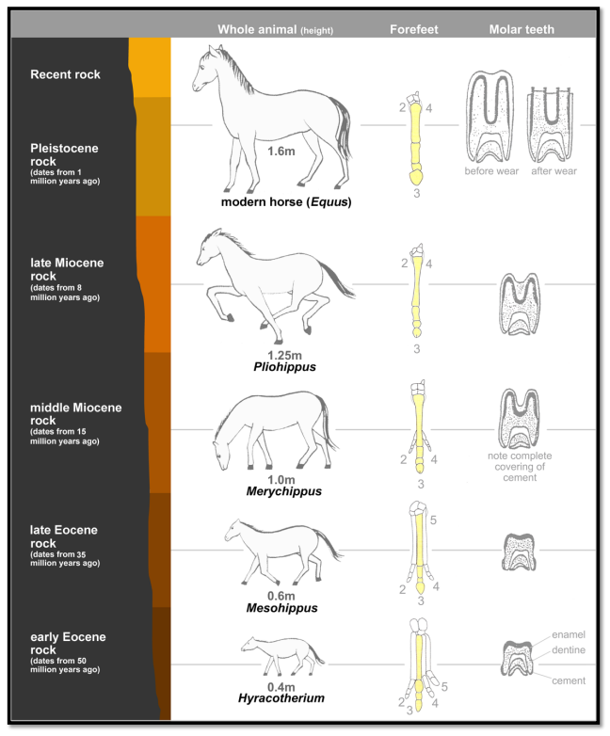
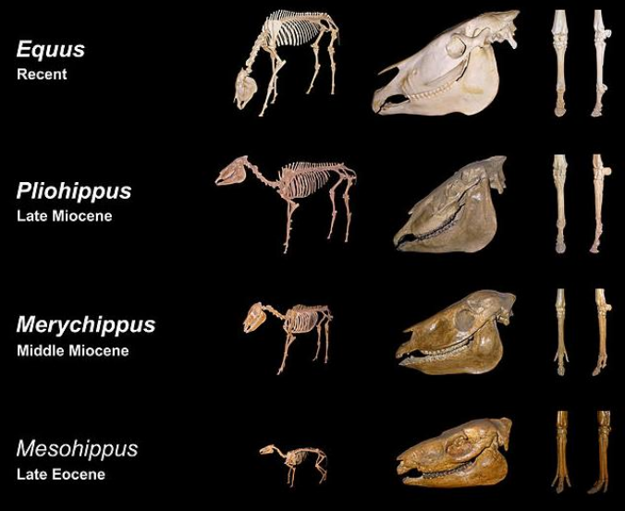

Slide 31
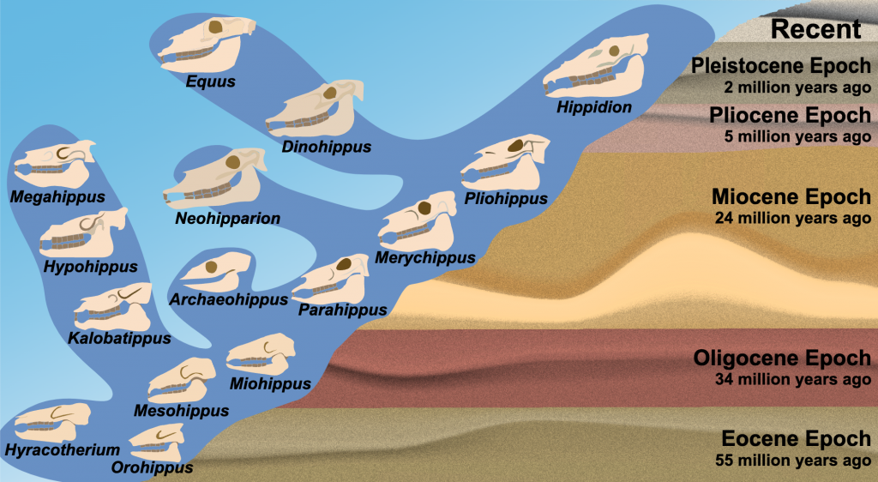
Notes:
Notice that the DCI; the fossil record changed over time and show the diversity, extinction, and change of life forms. Pay attention to the time period, change in skulls, extinction of some of the horses.

Slide 32
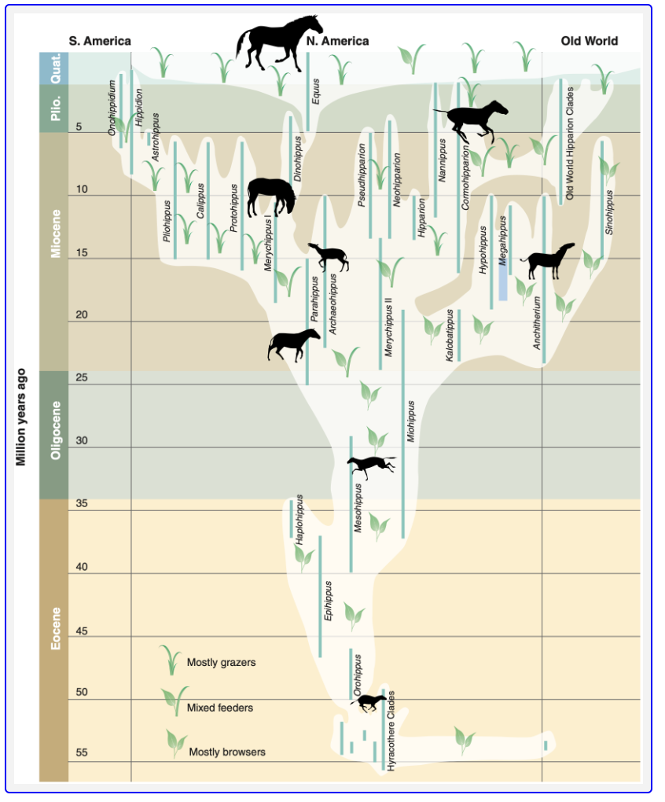

Slide 33

How are these two organisms related?
Most pictures and information from the Florida Museum of Natural History

Slide 34
Assessment: (Questions 3 & 4)
Create a cladogram using the patterns found in the fossil image data. Justify the pattern you chose.
Afterwards identify two additional patterns from the data you could use to create the cladogram.

Slide 35
Assessment: (Question 5)
Using actual evidence from the fossil data, describe how the horse or whale changed over time.
Evaluate at least three different patterns you noticed.

Slide 36
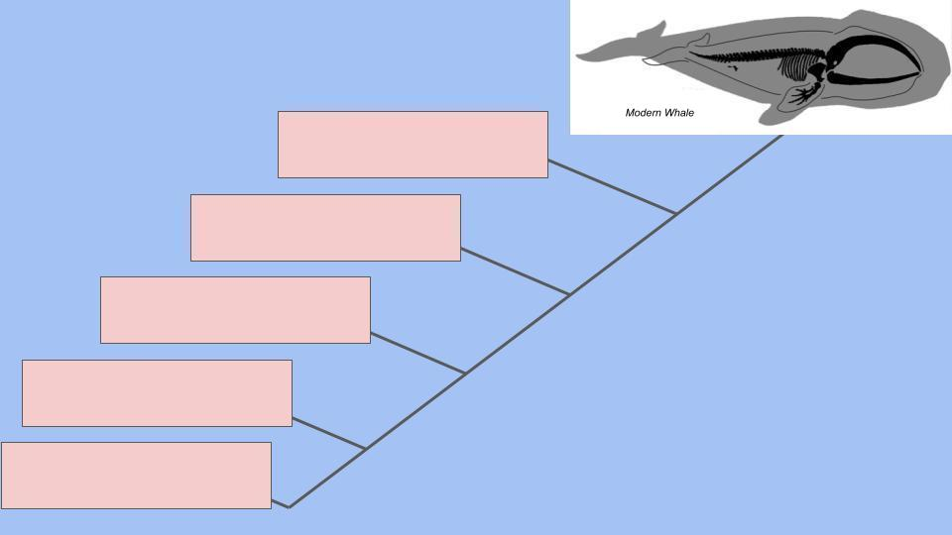






Slide 37

3D-RST is supported by the NSF under grant number #DRL-2101383

