Slide 1
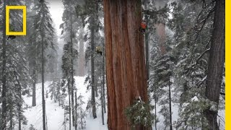
PHENOMENON
DIRECTIONS
I want you to watch the videos on the right and do the following:
Write at least 3 observations.
Write a claim about how photosynthesis helps the tree grow.
Develop 1-2 scientific questions to understand how photosynthesis contributed to the tree's height.

Slide 2
OBSERVATIONS
CLAIM

Slide 3
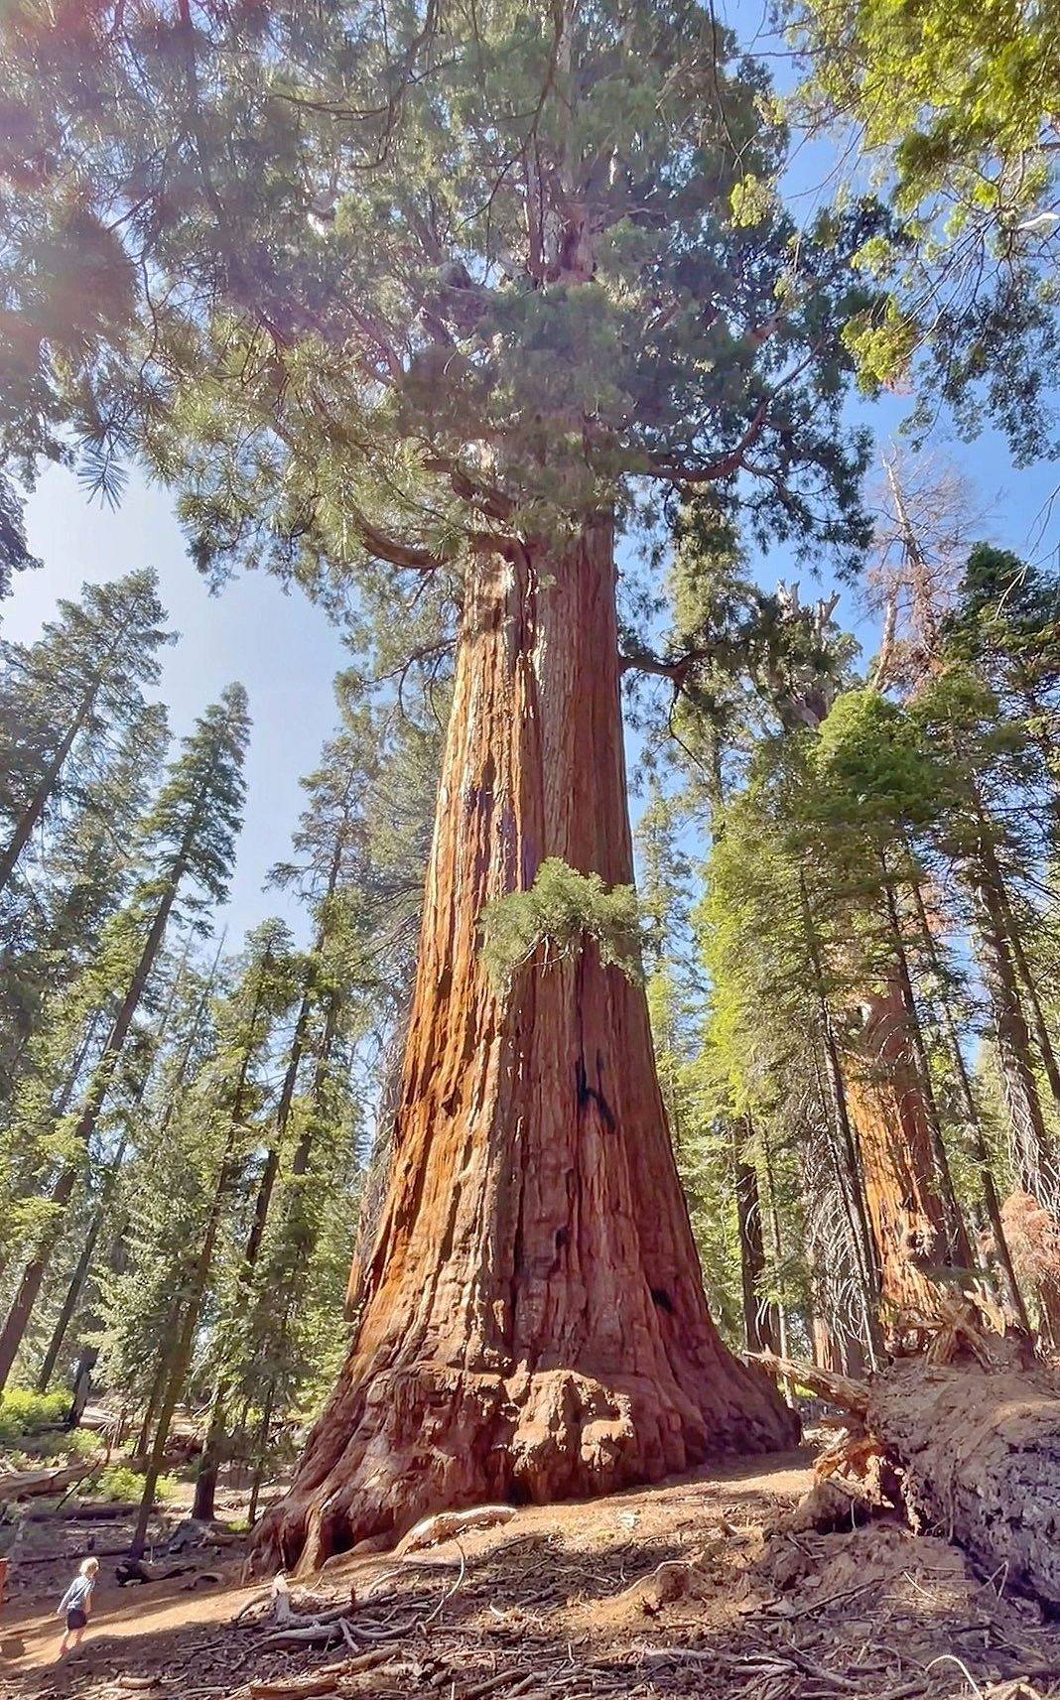
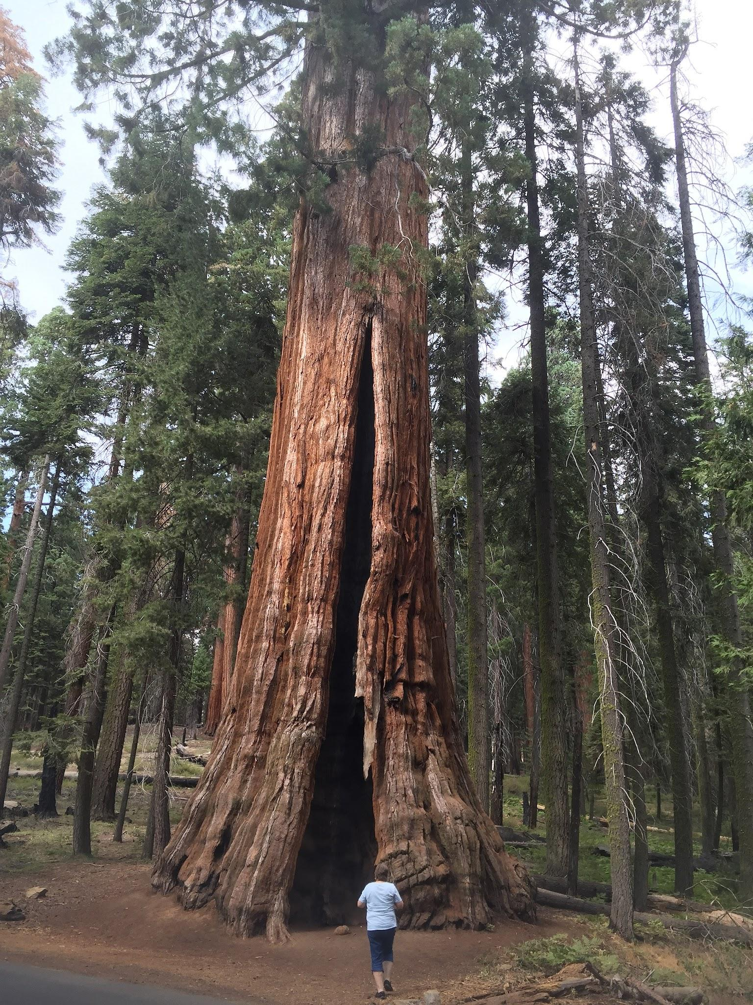
QUESTIONS

Slide 4
PHOTOSYNTHESIS
Standard 8.3.1
Plan and conduct an investigation and use the evidence to construct an explanation of how photosynthetic organisms use energy to transform matter.
This lesson will introduce a series of lessons leading up to the following performance expectation: What is photosynthesis, and how does it work?
Notes:
Temperature and soluble CO2

Slide 5
What are some things that make the tree have so much mass? What variables will affect plant growth?
https://youtu.be/2KZb2_vcNTg
Notes:
https://youtu.be/2KZb2_vcNTg

Slide 6
EXPLAIN AND CREATE A MODEL OF WHAT YOU KNOW ABOUT PHOTOSYNTHESIS
Model | Explain

Slide 7
DISCUSSION
Get together in a group and evaluate each other’s model of photosynthesis. Answer the following questions:
Which person’s model seems more complete and accurate? (Use a Post-it note for correction.)
Why do you think that model is the best? Avoid giving answers that focus on how the model looks or drawing ability.
With your group, write a new claim.

Slide 8
Research Question: | How does ___________ affect plant growth?
Hypothesis:
Experiment
Independent variable
Dependent Variable: Data
Control variables:
Materials needed
Procedures/steps

Slide 9


3D-RST is supported by the NSF under grant number #DRL-2101383

