Slide 1
SEEd Standards: Science in Three Dimensions!
Utah Rural Schools Association Summer Conference 2022
Dr. Rebecca Sansom
Brigham Young University
Notes:
I am the Principal Investigator for the 3D-RST project, which aims to support and connect rural Utah science teachers (high school only right now) to understand and use 3D science teaching, which is aligned with the new SEEd Standards.

Slide 2
What is 3D Science?
Authentic
Phenomenon-driven
Three dimensions are integrated
Crosscutting Concepts, CCCs: Lenses
Science and Engineering Practices, SEPs: Tools
Disciplinary Core Ideas, DCIs: Content
Notes:
Who has seen the new SEEd Standards? What are the three dimensions?

Slide 3
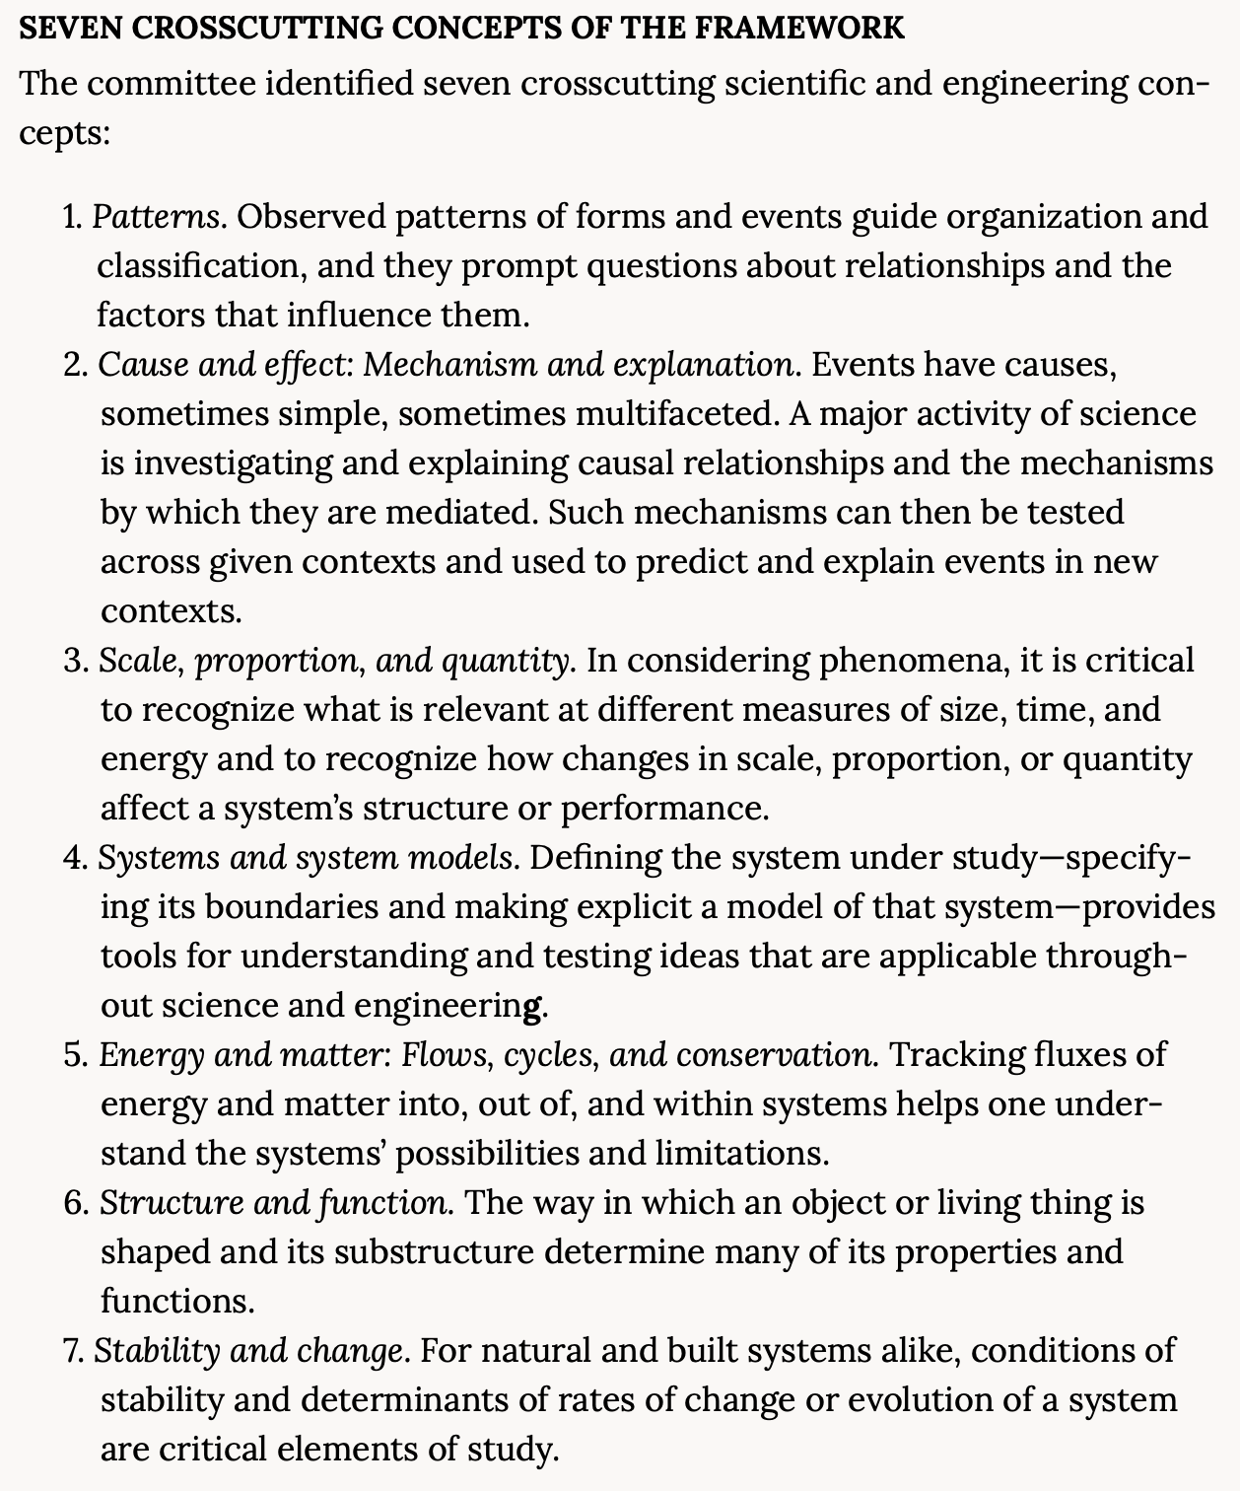
Crosscutting Concepts
Talk to a neighbor
Where do you see each of these in what you teach?
Can you see the same one in different topics/subjects?
More information in the Framework for K-12 Science Education
Notes:
LENSES
Download pdf at http://nap.edu/13165. Requires free login.

Slide 4
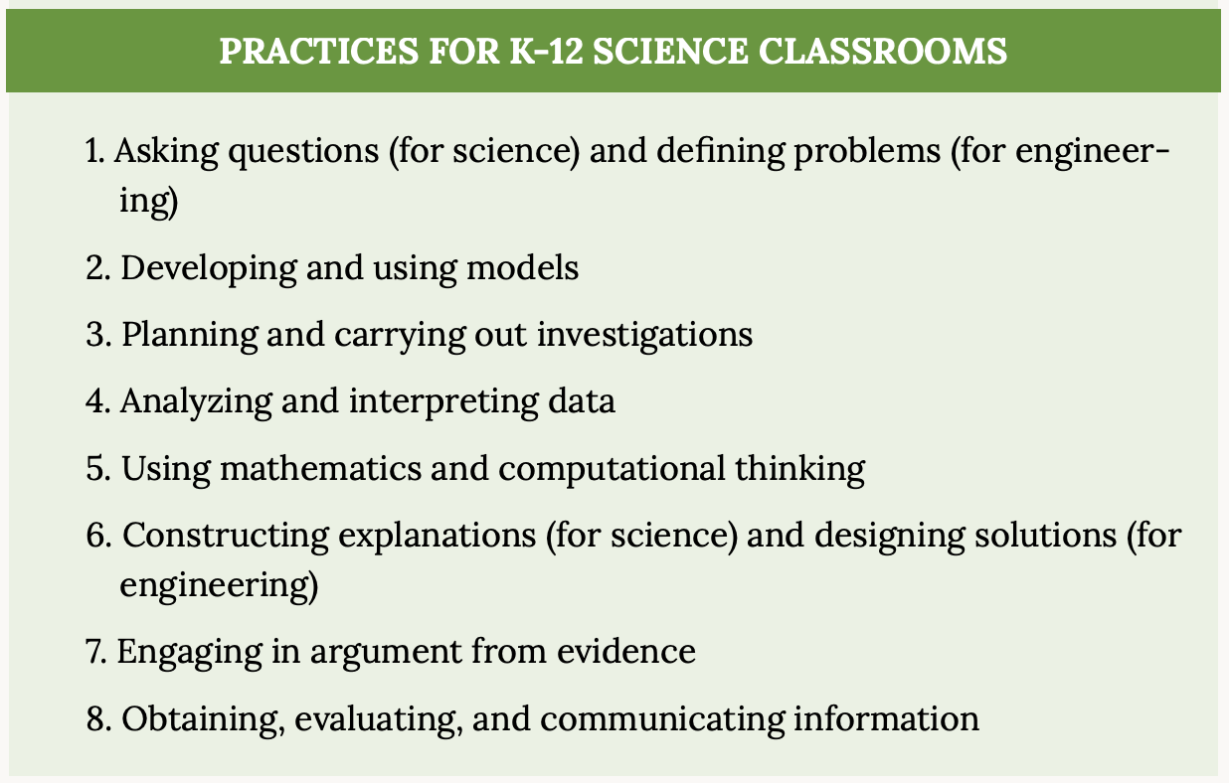
Science and Engineering Practices
Large group discussion:
Which of these seem obvious to you or more commonly used in your classroom?
Which feel like more of a stretch?
What are some of the challenges you have in supporting students doing these things (as opposed to teachers)?
Notes:
TOOLS

Slide 5
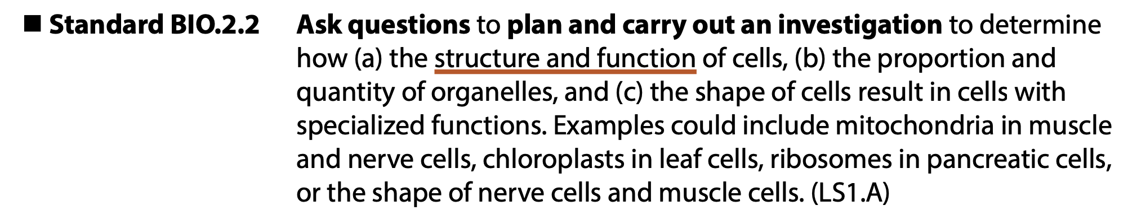
Disciplinary Core Ideas
In the Framework, go to Page 139
This is the section on Life Sciences DCIs
Scroll down until you reach LS1.A
This corresponds to Utah SEEd Standards BIO.2.2 and BIO.2.4
What does this DCI look like at your grade level?
Notes:
CONTENT

Slide 6
Let’s Do a Short Lesson Together
Read the short passage about a marathon runner. As you read, write down at least three things you wonder about the situation, especially questions you have about the science related to exercise and exhaustion.
Share your questions with a neighbor. If any are not scientific, you can eliminate them. Pick one question you want to discuss with the class.
Use the diagram of the human body in your handout to make a model of the body systems involved when a person exercises.
Group discussion: What should we include in our initial model?
Teacher hat: Which SEP, CCC, and DCI do you think we were focusing on?
Notes:
SEP Asking Questions
CCC System Models
DCI Structure & Function, Cellular Respiration, many others possible.

Slide 7
Resources to Help!
STEM Teaching Tools 41 (CCCs) and 30 (SEPs)
Choose a CCC and look at the prompts. Which ones stand out to you? Which seem appropriate for your grade level? How would you incorporate them in a lesson? Discuss with a neighbor.
Repeat with SEPs
Thinking about your own teaching, how are you doing with SEPs and CCCs? Which come more naturally and which do you have to be more intentional about?

Slide 8
Brainstorming Time
Think of (or pull up) your favorite science lesson.
Which SEEd Standard is it aligned to?
How are SEPs and CCCs incorporated?
Can you improve it using prompts from the STEM Teaching Tools?
Work with a neighbor to brainstorm your two lessons.
Notes:
Five minutes for each person to get help/brainstorm
Five minutes for the other person
Five minutes to share out.

Slide 9
Contact Information
3D-RST is looking for biology and chemistry teachers to participate.
Do you know anyone?
Please share their contact info with us!
Dr. Rebecca Sansom
rsansom@chem.byu.edu
801-422-9089
617-899-7483

