Slide 1
Splitting Hairs
Wave Properties of Light

Slide 2
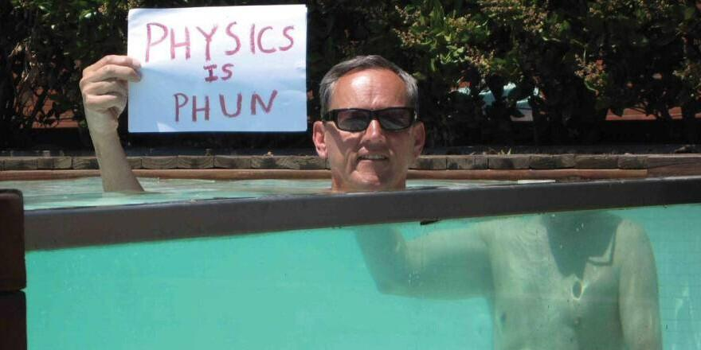
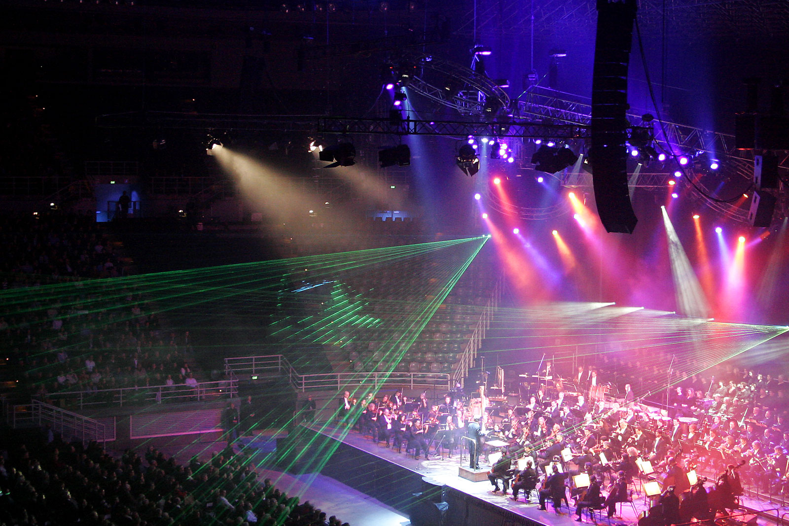

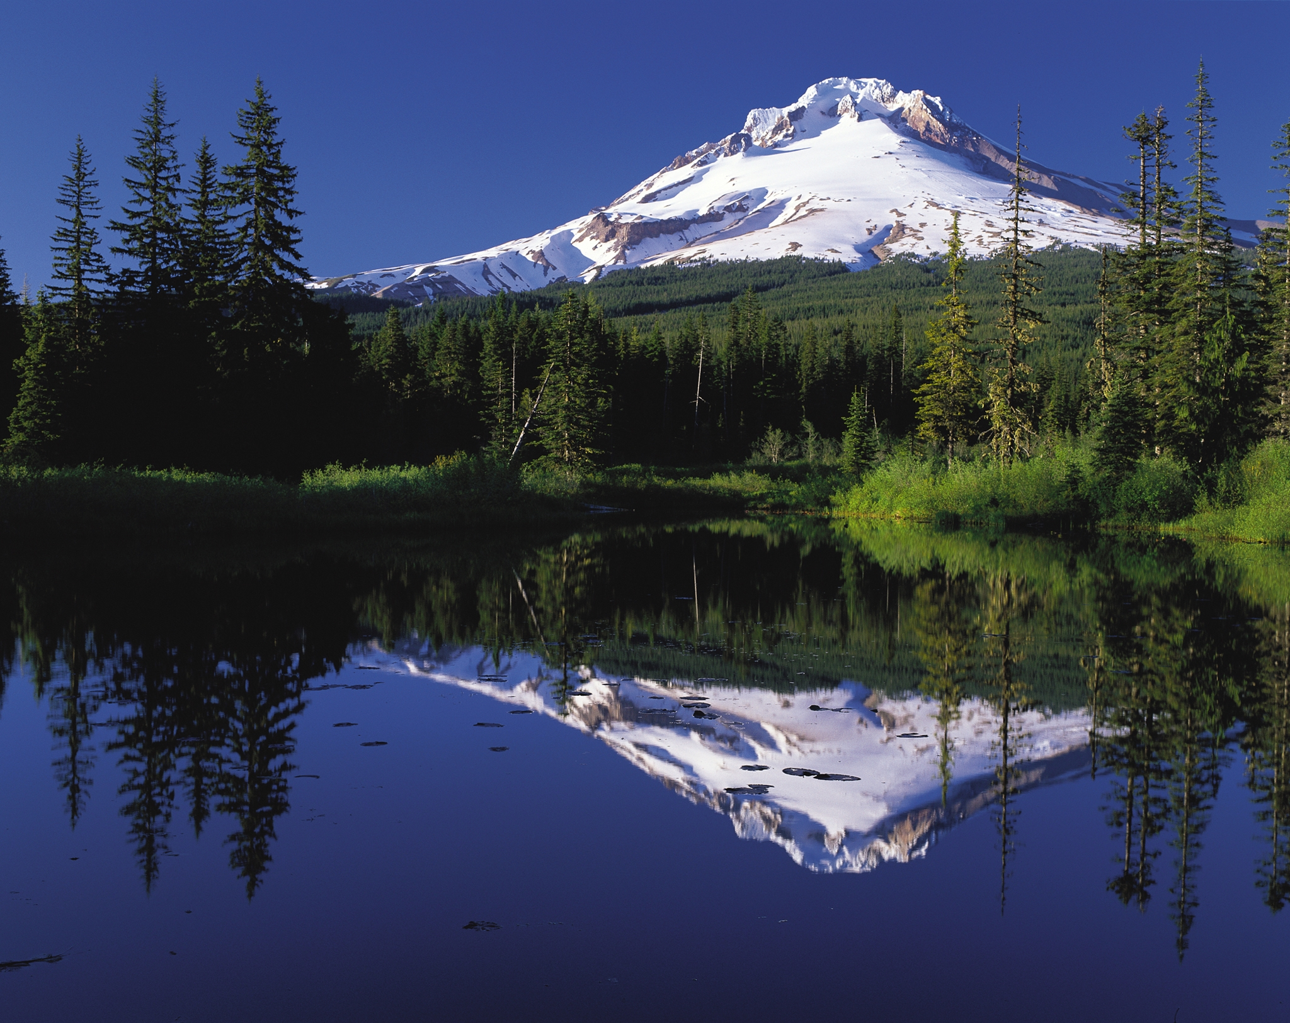

Slide 3
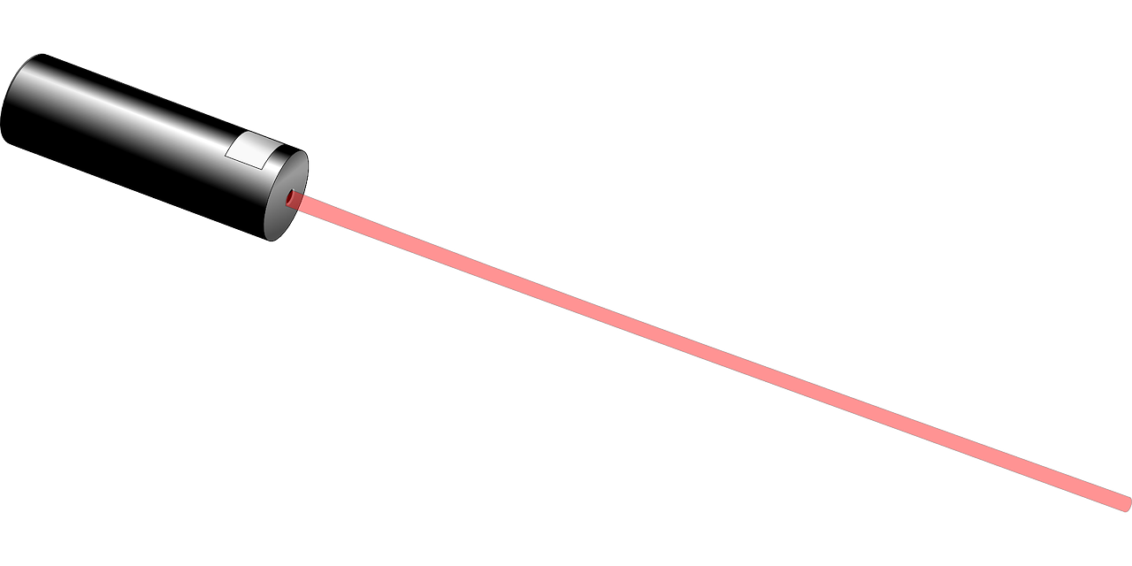
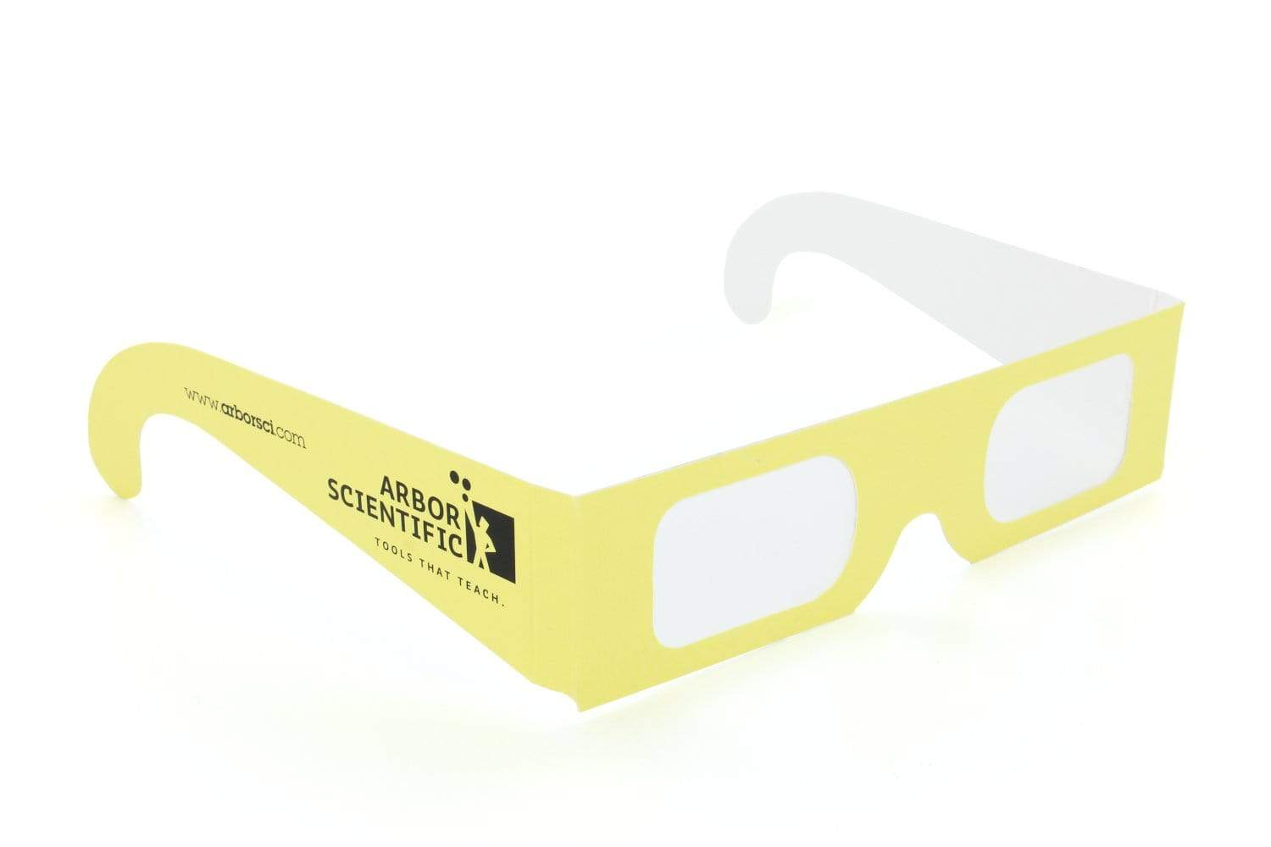
Phenomenon

Slide 4

Sticky Notes
Question 1
Write two questions you have about the light patterns produced by shining the light through the glasses
Question 2

Slide 5
Sticky Notes
Pair share with your group and choose two to bring up to the board.
Sort the questions into groups on the board.

Slide 6
Phenomenon

Slide 7
What is our guiding question?
Write the question on your worksheet
Notes:
As a class answer some of the students questions if you can address them quickly using PHYS.4.1 and lead them to the guiding question: Why was the light bright in the middle and then get progressively dimmer further out.

Slide 8
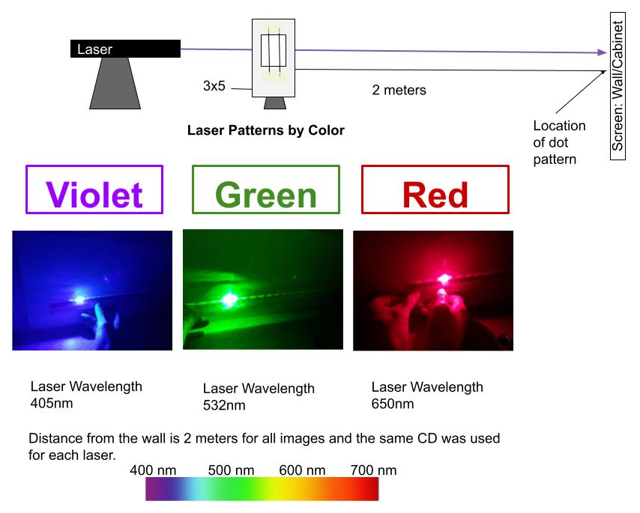
3x5 card
Copper Wire
Hair
Location of dots

Slide 9
No obstacle
Copper Wire
Human Hair
What will happen when an obstacle is placed in the path of the laser light?

Slide 10
No obstacle
?
Copper Wire
Human Hair
Sketch your prediction on your worksheet #1.

Slide 11
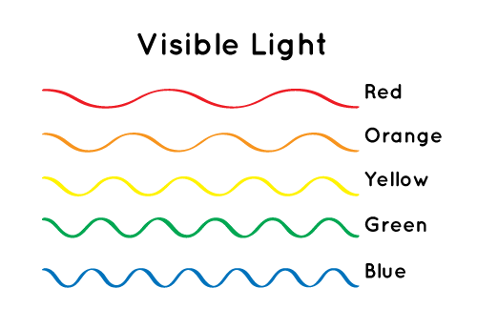
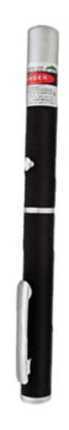

Slide 12
L
λ (mm)
∆y (mm)

Slide 13
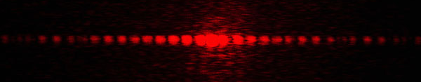
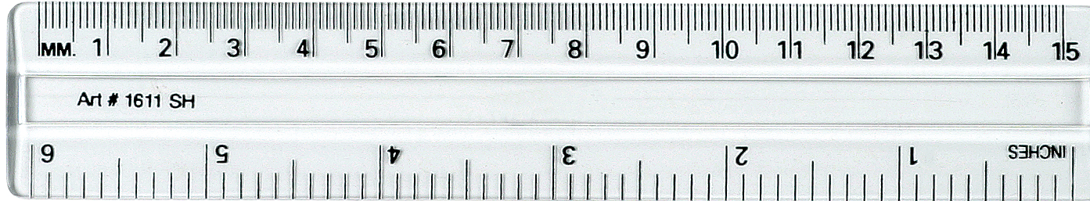
Measuring Distance Between the Dark Spaces
Δy
11mm
Be sure to keep it in mm!
Dark Spaces

Slide 14
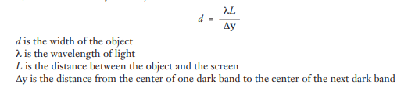
Object | Laser | Wavelength of laser light λ (mm) | Distance from Object to Screen L (mm) | Distance between dark spaces ∆y (mm) | Calculate Object width (mm)
Copper Wire | Red | 0.000650 | 2000
 | Green | 0.000532 | 2000
 | Blue | 0.000405 | 2000
Keep everything in mm to ensure correct calculations. 1cm=10mm 2m=2000mm 1,000,000nm=1mm
Actual Lasers Wavelengths
Red- 650nm
Green- 532nm
Blue - 405nm

Slide 15
Splitting Light with Hairs and Wire Summary
Discuss your data
What did you notice about the pattern of light produced by the copper wire compared to the hair?
How did different color lasers affect the distance of the dark spaces?
Were your predictions accurate? Why or why not?

Slide 16
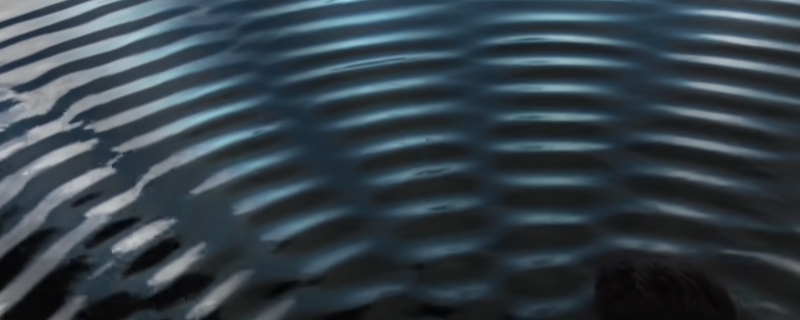
Model Water Patterns- #4-6
Notes:
Remember to ask questions—what do you notice about the places where the waves interfere? Highs and lows

Slide 17
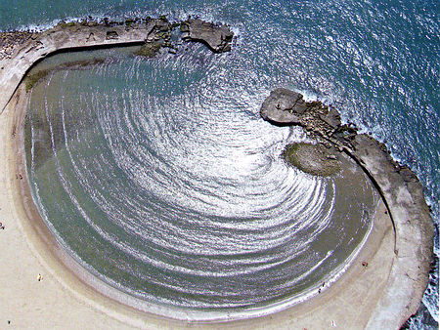
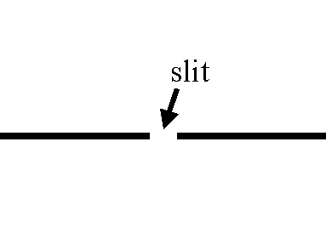
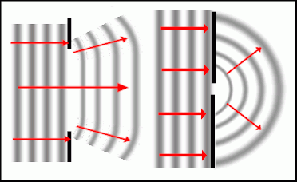
Diffraction
The tendency of waves to bend around corners and fill spaces.

Slide 18
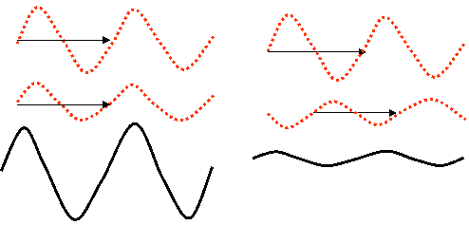
Constructive Interference:
Destructive Interference:
The amplitudes of the waves add together because they are in phase
The amplitudes of the waves subtract because the waves are out of phase

Slide 19
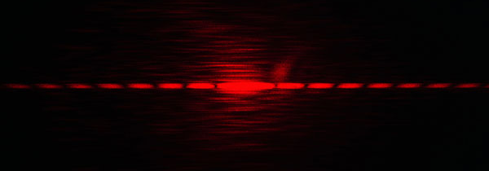
Model Light Patterns- #8-9

Slide 20
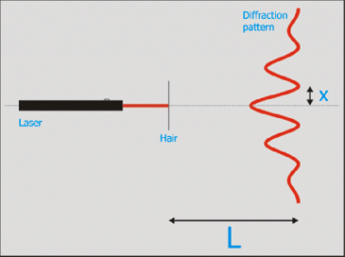

Dark on Screen
Bright on Screen
What the light wave amplitude is doing
What we see with our eyes

Slide 21
Constructive Interference = Bright Spots
Destructive Interference = Dark Spots

Slide 22





3D-RST is supported by the National Science Foundation under grant number DRL-2101383

