Slide 1
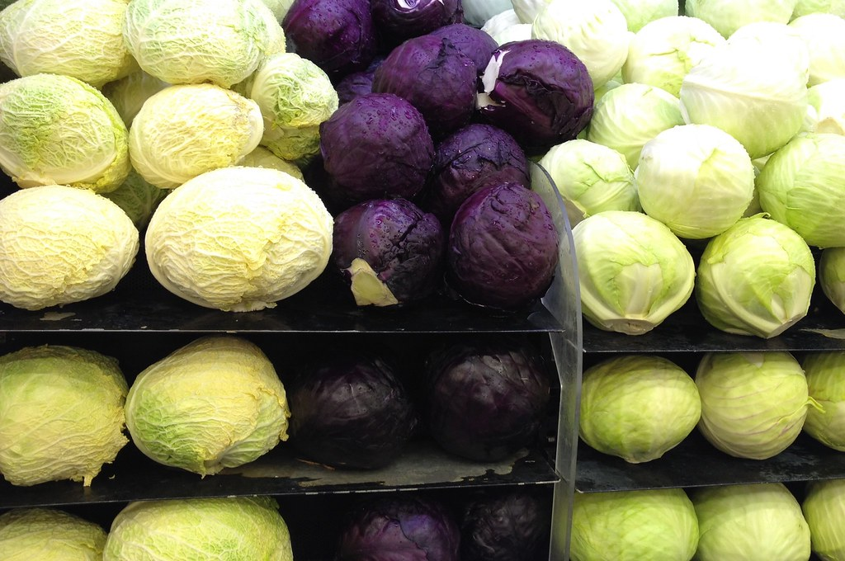
The Cruciferous Question

Slide 2
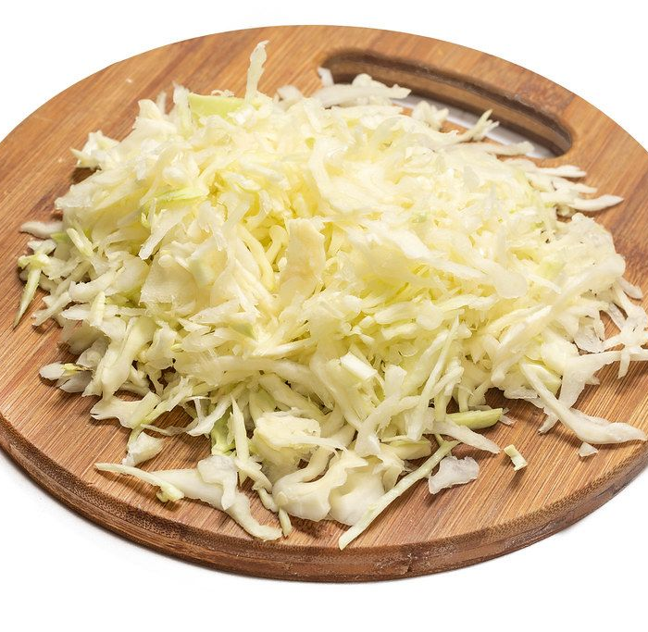
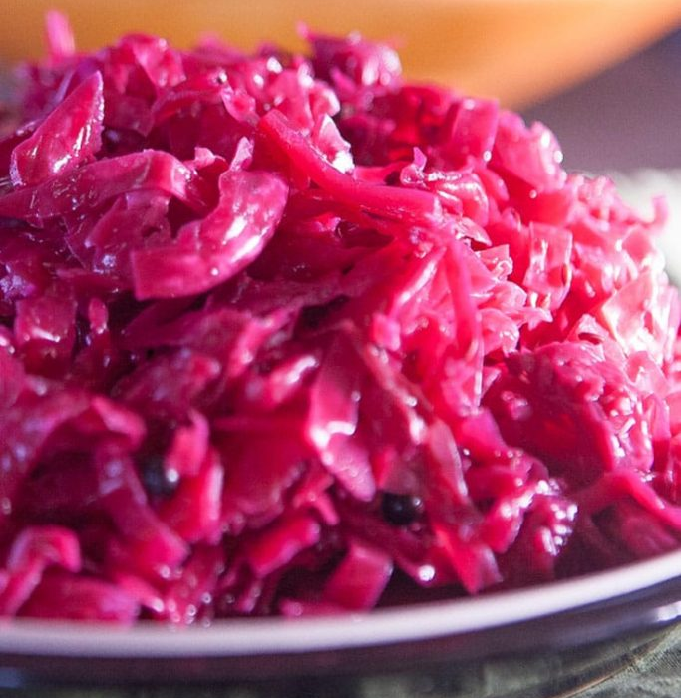
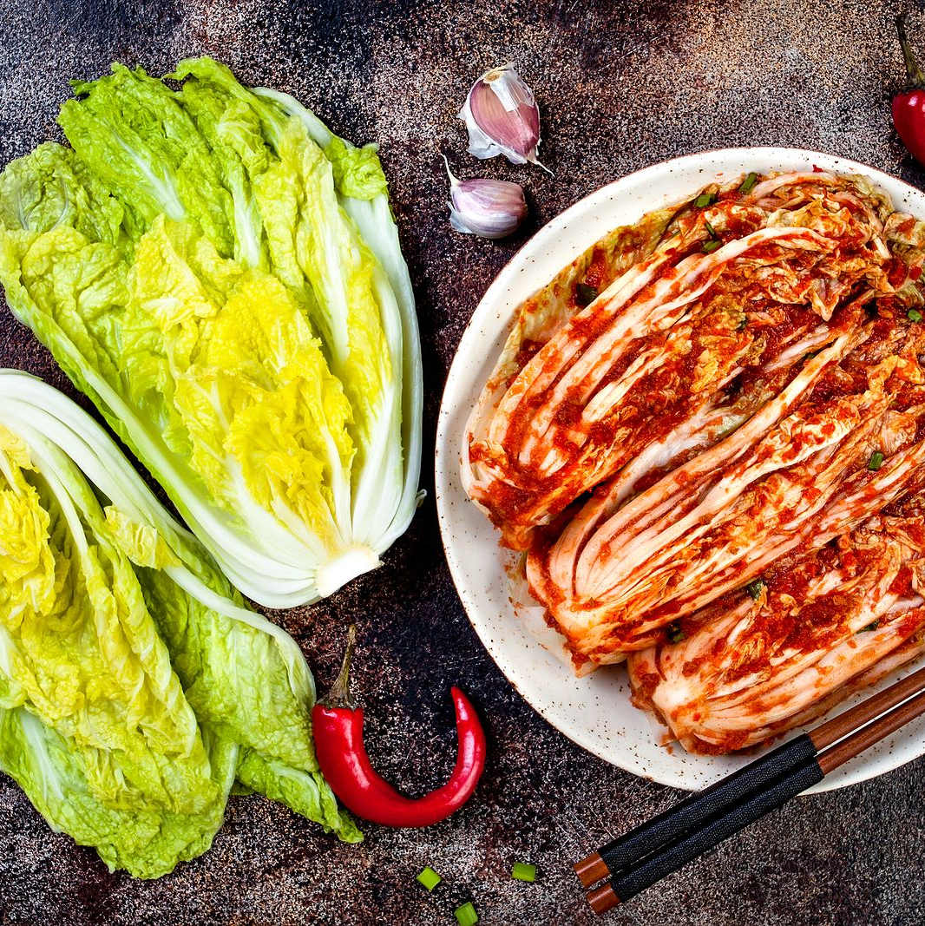

Snack Time
Grab a piece of cabbage
Thoughtfully eat this piece of cabbage, write 5 adjectives that describe how it tastes.
Adjective = Descriptive words

Slide 3

Debrief
Write down the adjectives you used describe the taste on a sticky note.
Put your sticky note on the designated spot specified by the teacher
Notes:
Tally the amount of times students use bitter to describe the taste

Slide 4
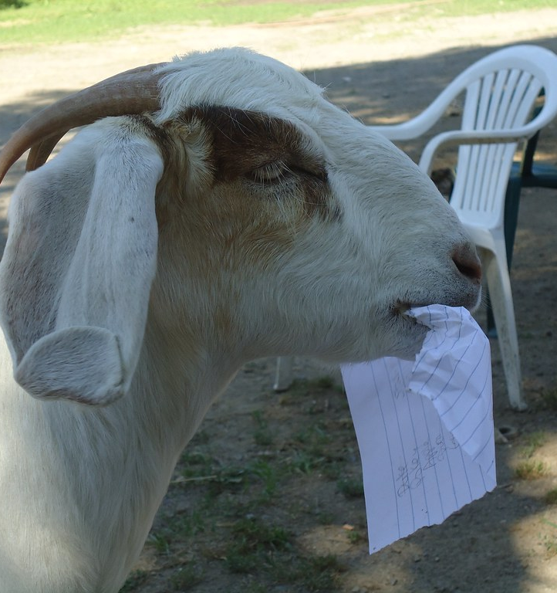
Paper Tasting
Raise your hand if you tasted nothing.
Rest of you raise your hand if you tasted something.
What patterns did you see between these activities.

Slide 5

Group Reading
Once groups are split, get into your designated groups and start reading the assigned papers
Designate a group leader

Slide 6

Jigsaw
Group Leaders stay at table
Everyone else move to a new table
Every group needs to share what they learned

Slide 7

What makes Cruciferous vegetables bitter??

Slide 8
Punnett Square
What is a Punnett Square, and what is it used for?
Notes:
Do a simple example if needed

Slide 9
Punnett Square
Create your own, based on inheritance of the PTC gene.

Slide 10

3D-RST is supported by the NSF under grant number #DRL-2101383

