Slide 1
Biotechnology in Agriculture
SEEd Bio 3.5
Notes:
Standard BIO.3.5
Evaluate design solutions where biotechnology was used to identify and/or modify genes in order to solve (effect) a problem. Define the problem, identify criteria and constraints, analyze available data on proposed solutions, and determine an optimal solution. Emphasize arguments that focus on how effective the solution was at meeting the desired outcome. (LS3.B, ETS1.A, ETS1.B, ETS1.C)

Slide 2
Phenomenon- Apple tasting and survey
Identify the four items under the cups
What did you identify them as?
Do they all have DNA?
Is their DNA the same? Why or why not?
Do all apples taste the same?
Do they have the same color, texture, size, cost?
Are all apples used to make applesauce, apple pie, apple juice/cider, etc?
YOU, the student, will perform a taste tests of FOUR apple samples to determine the answers to the above questions.
Notes:
Link to 20 apples types and their uses: https://byu.box.com/s/yx4yydn0bepihiw58uwysqgwstvf1cyg
THIS SLIDE GOES WITH STUDENT HANDOUT PAGES 1 AND 2

Slide 3
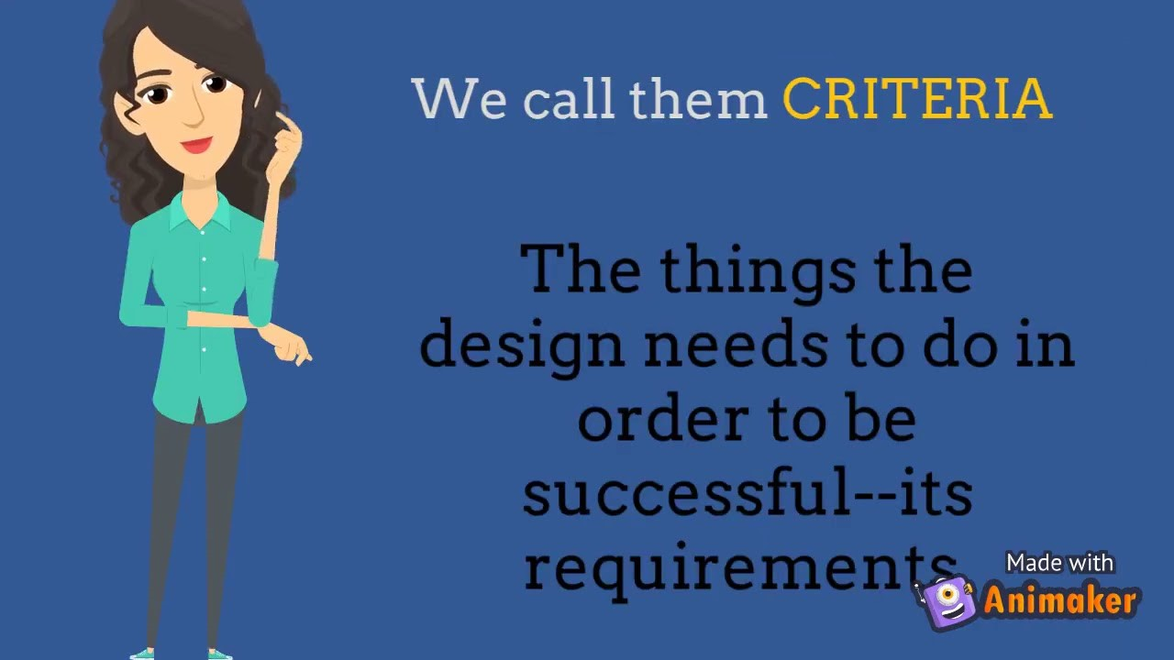
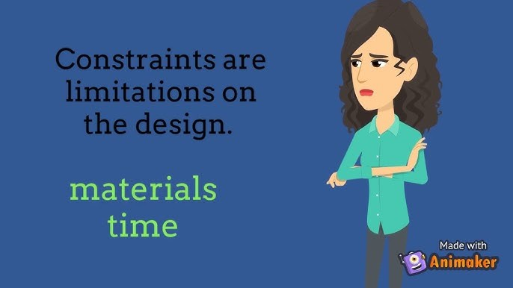
Criteria versus Constraints
Criteria - a standard by which the apple will be judged as good or bad
Constraint - a limitation or restriction on how an apple variety is made.
Notes:
This SLIDE GOES WITH THE 3RD PAGE OF THE STUDENT HANDOUT

Slide 4
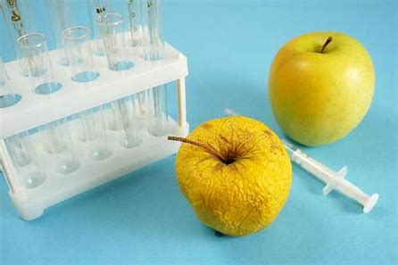
Guiding question:
"Are apples different today because of something humans have done or because of something that occurred naturally (without human intervention)?"
Notes:
This slide precedes pages 4-5 and is a question that we want them thinking about as they move through the stations.

Slide 5
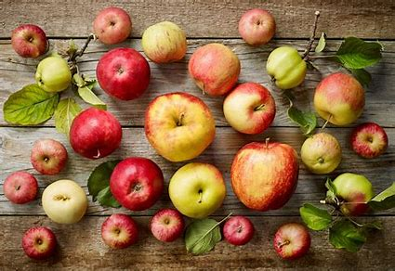
Apple Station Activity
Go to your assigned station to complete the tasks.
  You have 10-15 minutes to complete
  Use the QR codes, assigned short reading, or the Internet (only as assigned) to answer the questions on your STUDENT HANDOUT.
Rotate through stations 1-4 until you are finished, as instructed by the teacher.
Be prepared to discuss the question: "Are apples different today because of something humans have done or because of something that occurred naturally (without human intervention)?"
Notes:
Apples and the Science of Genetic Selection | National Agriculture in the Classroom (agclassroom.org)
This slide goes with pages 4 and 5 of the student handout

Slide 6
Crop Modification Techniques- JIGSAW
Each student will be assigned ONE (of six) crop modification technique to investigate.
You need to identify:
  What the crop modification does (a description)
  Advantages
  Disadvantages
With other students (same crop modification), you will SHARE your findings and prepare to share with your original group of six students.
Using your shared information, you will MATCH a set of 6 crop modifications with the following:
  Description of the technique
  Example picture
Notes:
This slide goes with the bottom of PAGE 5 (empty table after station 3)

Slide 7
Criteria versus Constraints
Criteria - a standard by which the apple will be judged as good or bad
Constraint - a limitation or restriction on how an apple variety is made.
Notes:
This slide is a reminder of criteria and constraints that precedes the LAST PAGE- The Perfect Apple

Slide 8
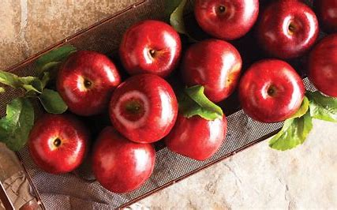
The PERFECT APPLE
Imagine you were able to design, test, and construct the PERFECT APPLE.
Which of the crop modification techniques would you use and WHY?
What would the apple look like, taste like, and cost?
What would its nutritional value be?
Student steps:
Design an apple
Complete the table
Trade and peer evaluate
Final reflection

Slide 9
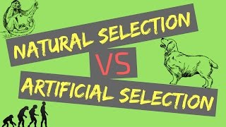
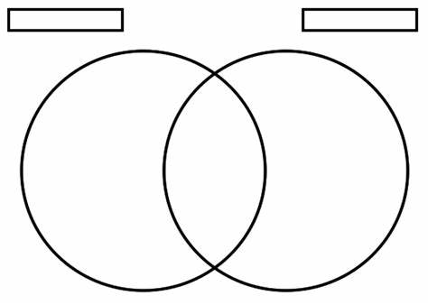
Natural selection versus Artificial Selection
Watch the video
Construct a VENN diagram
show the similarities and differences of each process.
Notes:
This slide is an EXTENSION

Slide 10

3D-RST is supported by the NSF under grant number #DRL-2101383

