Slide 1
Carbon
What’s the Big Deal?

Slide 2
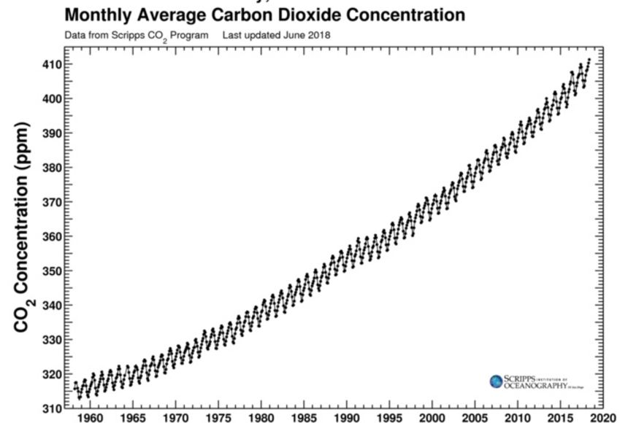
Keeling Curve

Slide 3

Station 1 - Land “Migrating Forests”

Slide 4
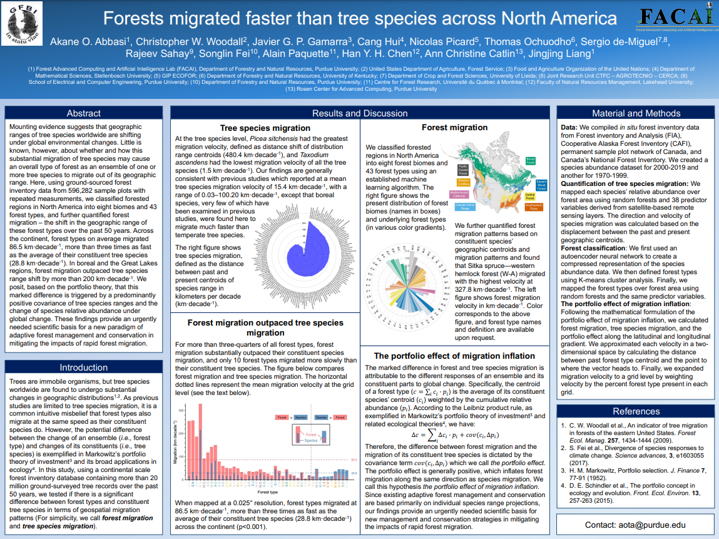
Migrating Forest Study

Slide 5
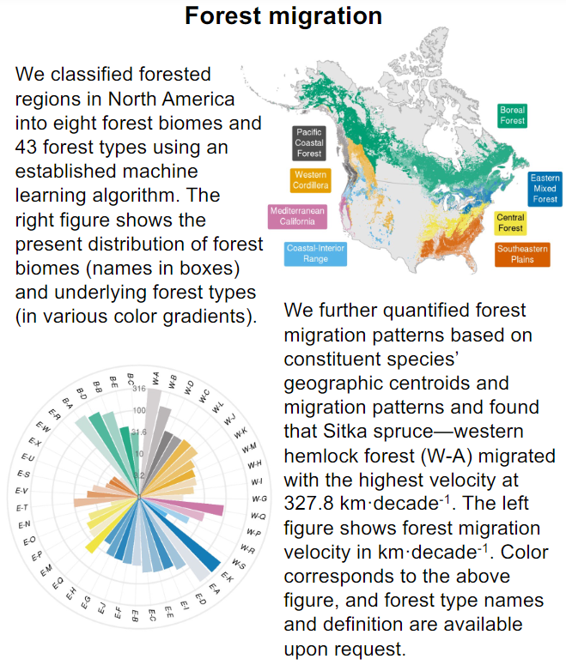
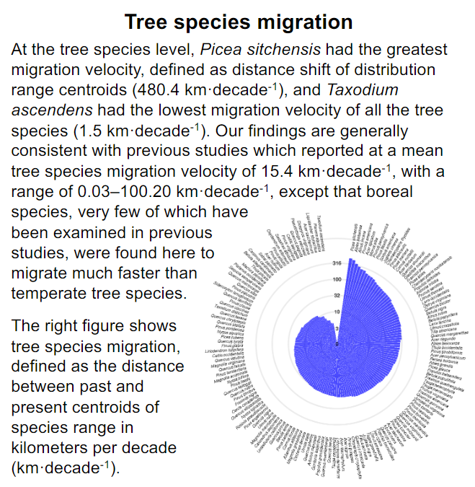

Slide 7


3D-RST is supported by the NSF under grant number #DRL-2101383

