Slide 1
Current
Usage

Slide 2
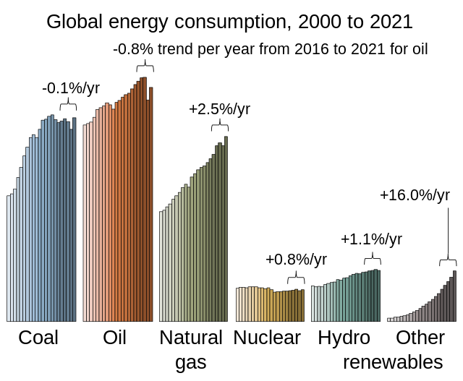

Slide 3
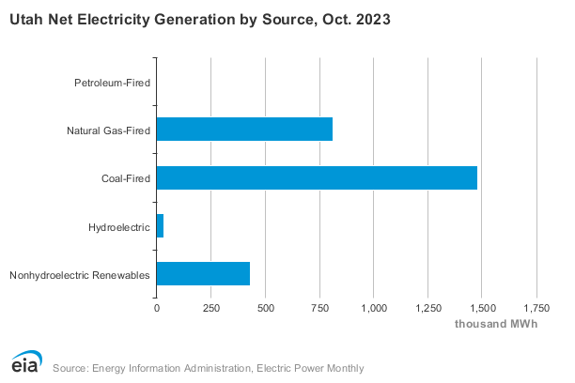

Slide 4
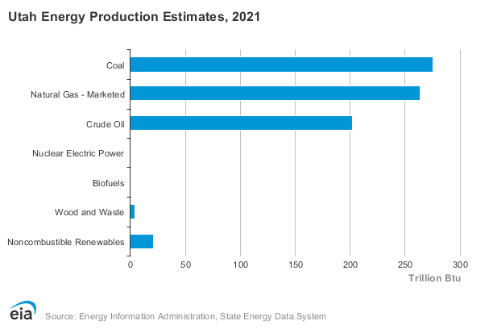

Slide 5
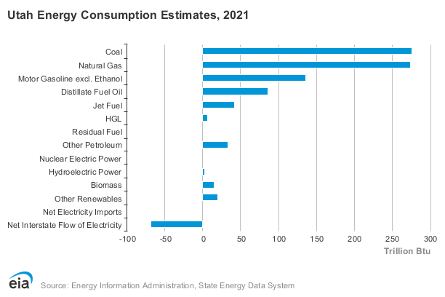

Slide 6
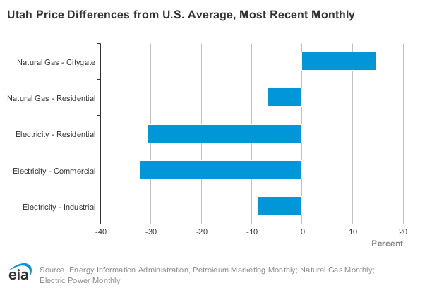

Slide 7
Safety
Deaths and health concerns and carbon emissions

Slide 8
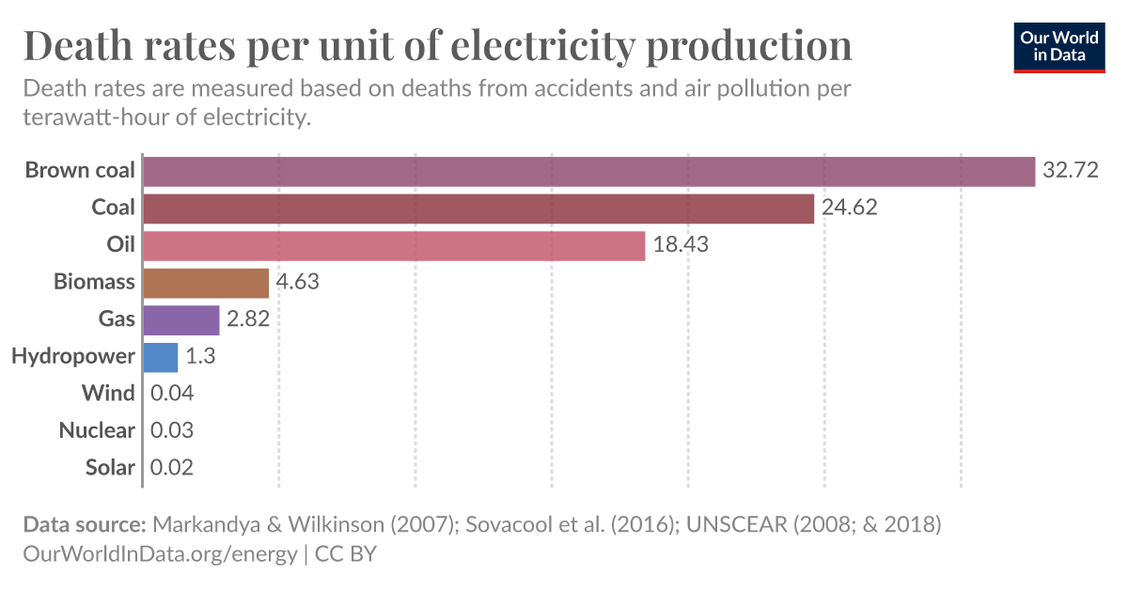

Slide 9
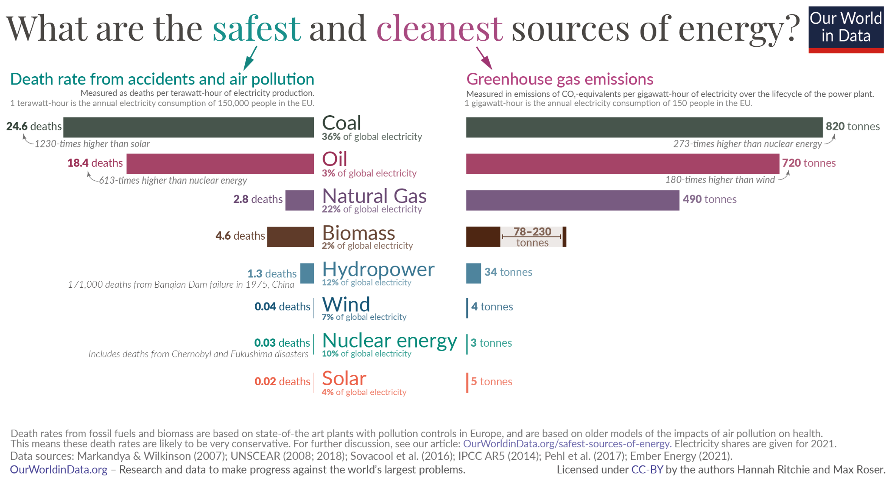

Slide 10
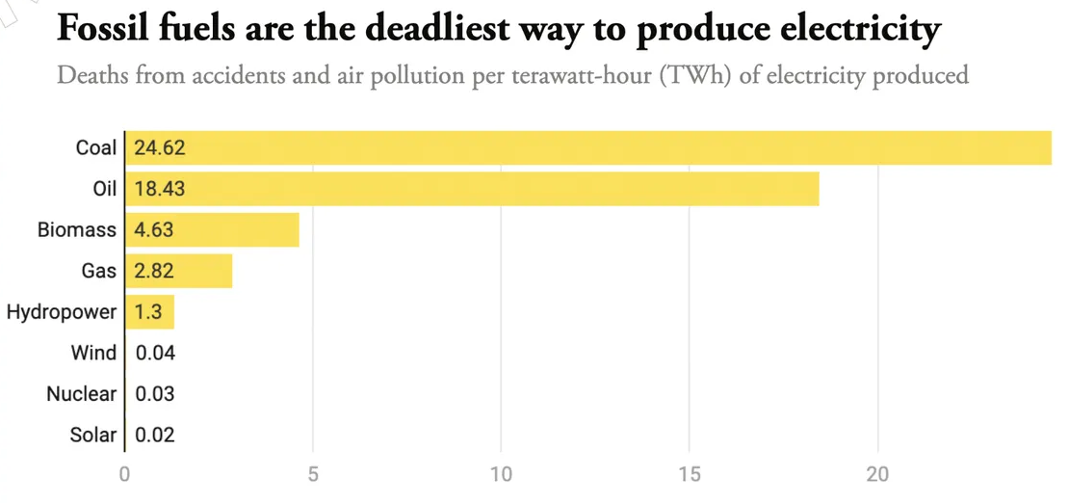
Notes:
https://ourworldindata.org/grapher/death-rates-from-energy-production-per-twh

Slide 11
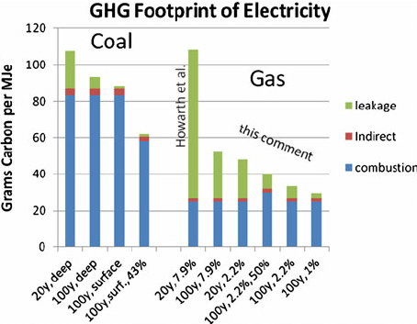

Slide 12
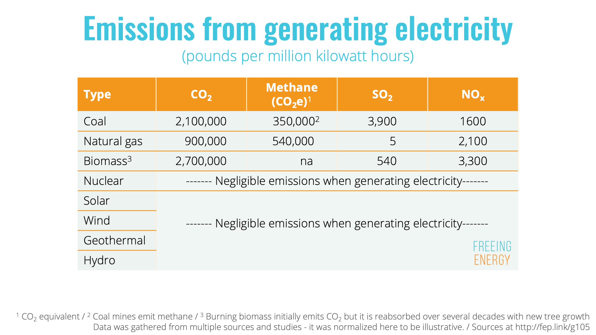

Slide 13
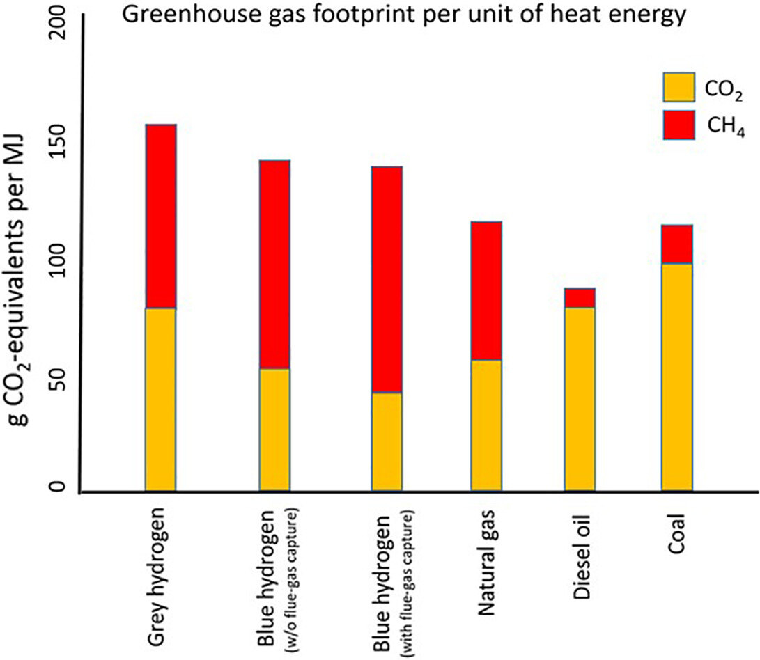

Slide 14
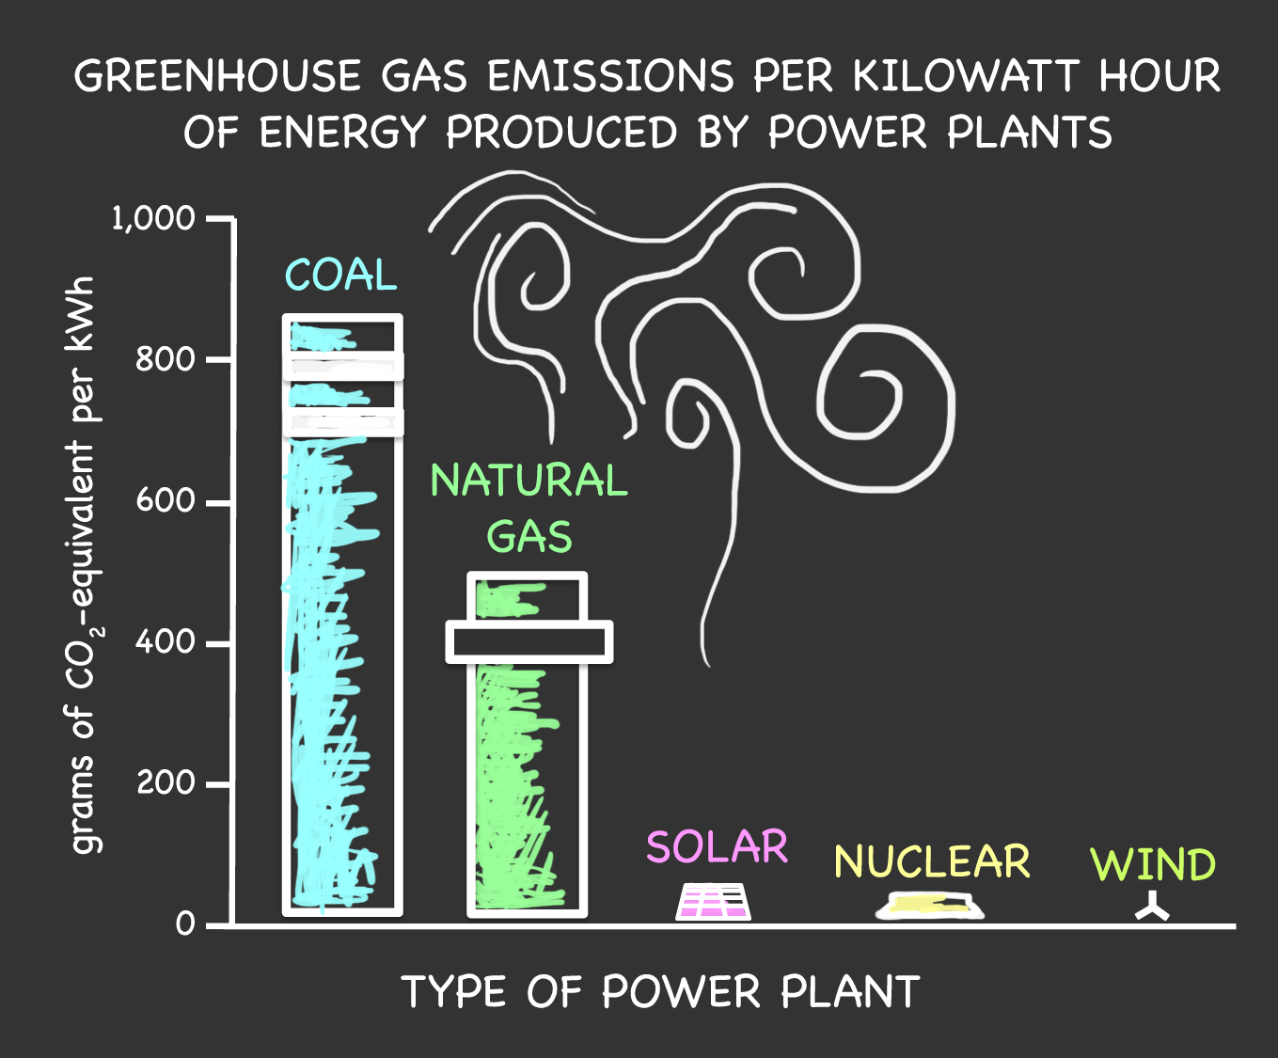

Slide 15
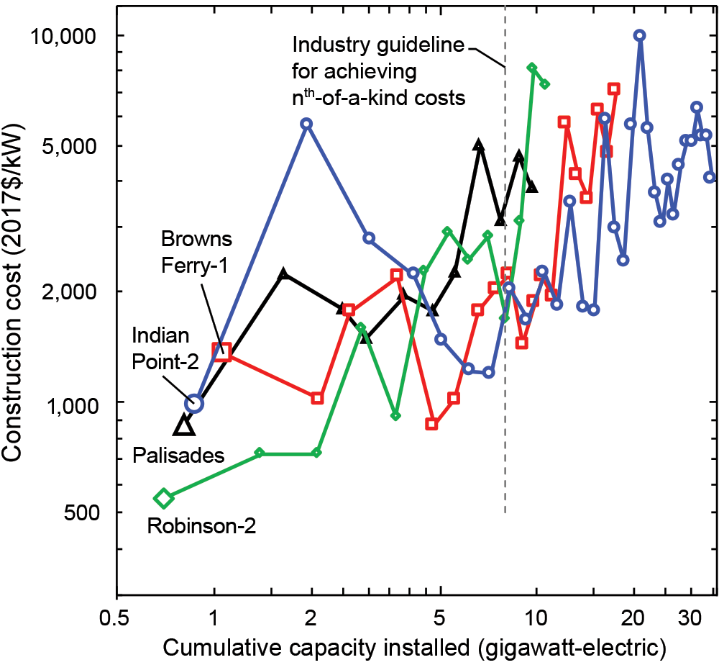
Nuclear Energy Information Sites:
How do Nuclear Reactors Work? https://world-nuclear.org/information-library/nuclear-fuel-cycle/nuclear-power-reactors/nuclear-power-reactors.aspx
Website of nearest Nuclear Power Plant: https://www.paloverde.com/
Website Palo Verde Safety Plan: https://www.maricopa.gov/1002/PVGS
Website Blue Castle Proposal: https://bluecastleproject.com/
KUER- Hunter COal Plant → Nuclear Plant: https://www.kuer.org/business-economy/2023-04-04/as-utahs-rocky-mountain-power-looks-to-nuclear-power-what-happens-to-all-the-coal-jobs
California Nuclear Sources (Palo Verde): http://scppa.org/page/Fossil-Nuclear-Projects

Slide 16
https://geology.utah.gov/energy-minerals/info/publications/

Slide 17
https://www.eia.gov/state/?sid=UT
Chemistry of Coal
https://pubs.usgs.gov/circ/c1143/html/text.html#:~:text=The%20organic%20compounds%20in%20coal,a%20variety%20of%20other%20elements.
Coal Date: Prices, transportation, etc.
https://www.eia.gov/coal/data.php
Natural Gas
https://www.eia.gov/energyexplained/natural-gas/
Prices: https://www.eia.gov/dnav/ng/NG_PRI_SUM_DCU_SUT_M.htm
Nuclear And Uranium
https://www.eia.gov/nuclear/
Notes:
https://www.visualcapitalist.com/sp/road-to-decarbonization-united-states-electricity-mix/

Slide 18

3D-RST is supported by the NSF under grant number #DRL-2101383

