Slide 1
Energy in Utah
Develop Solutions to Manage Energy Resources
Standard CHEM.3.5
Develop solutions related to the management, conservation, and utilization of mineral resources (matter). Define the problem, identify criteria and constraints, develop possible solutions using models, analyze data to make improvements from iteratively testing solutions, and optimize a solution. Emphasize the conservation of matter and minerals as a limited resource.

Slide 2


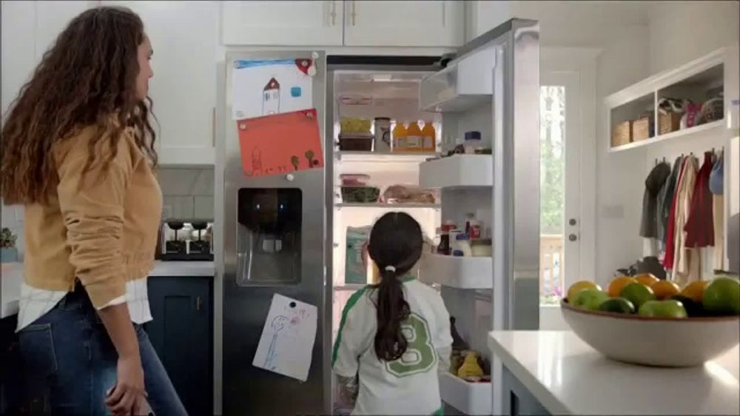
Identify the source of the electrical energy from chemical reactions in each slide.
Electricity Creation in the State of Utah
US Powerplants

Slide 3
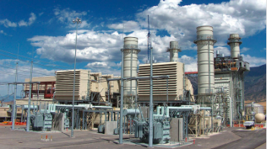
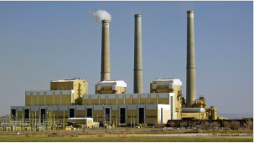
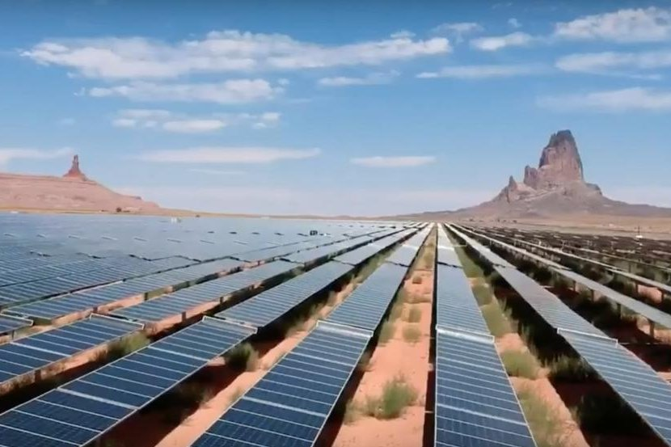
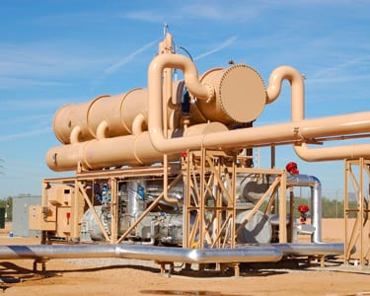
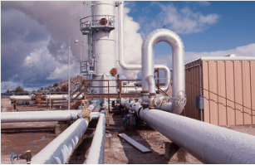
Natural Gas
Coal
Current Creek - Mona, UT
Hunter - Castle Dale, UT
Sun
Oil
Geothermal
Red Mesa -Monument Valley, UT
Red Rock- St.George, UT
Blundell - Millford, UT
Notes:
Current Creek-Natural Gas: fossil energy source that formed deep beneath the earth's surface (gas),
Hunter- coal (combustible black or brownish-black sedimentary rock with a high amount of carbon and hydrocarbons.) ,
Red Mesa- Solar: convert sunlight into electrical energy either through photovoltaic (PV) panels or through mirrors that concentrate solar radiation. ,
Red Rock- Petroleum/Oil(a liquid mixture of hydrocarbons that is present in certain rock strata and can be extracted and produce fuels including gasoline, kerosene, and diesel oil.),
Geothermal -Blundell, Hydro - Deer Creek, Wind- Latigo

Slide 4
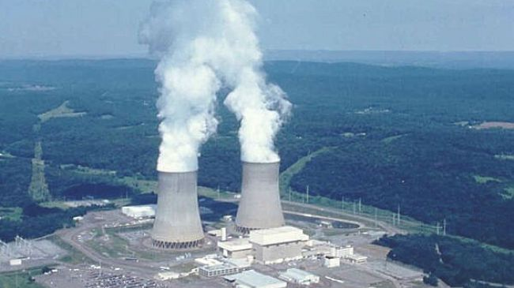
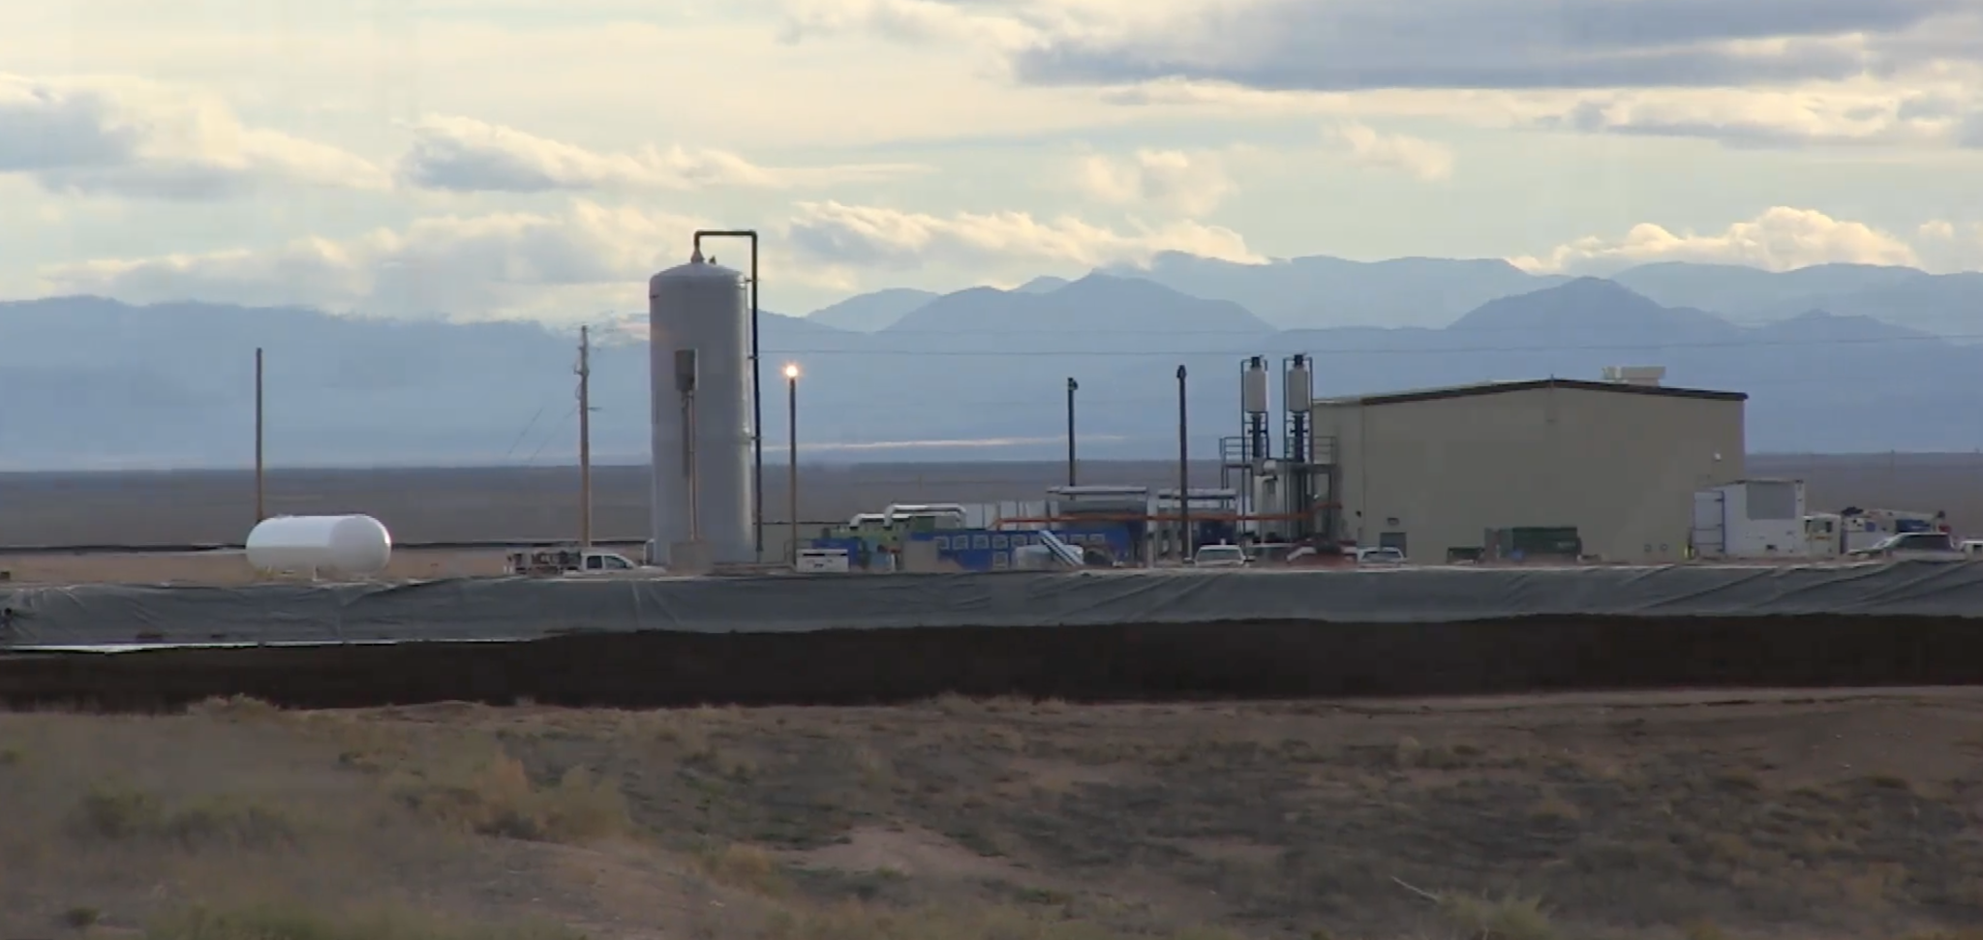
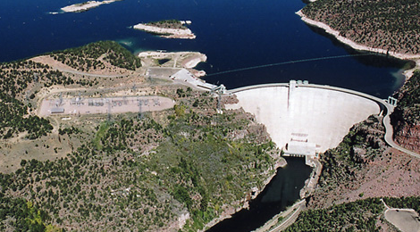
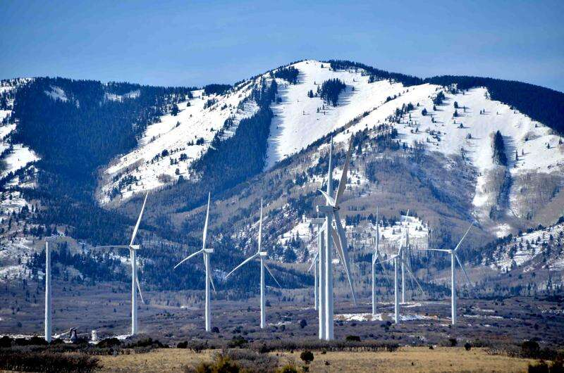
Uranium
Biomass
Palo Verde- Tonopah, AZ
Blue Mountain - Milford, Ut
Water
Wind
Flaming Gorge- Manilla, UT
Latigo - Monticello, UT
Notes:
Palo Verde Nuclear (the use of nuclear reactions to produce electricity.)
Blue Mountain- Biomass (Biomass: renewable organic material that comes from plants and animals. ),
Hydro - Flaming Gorge (renewable source of energy that generates power by using a dam or diversion structure to alter the natural flow of a river or other body of water.)
Latigo - Wind (collect and convert the kinetic energy that wind produces into electricity to help power the grid.),

Slide 5
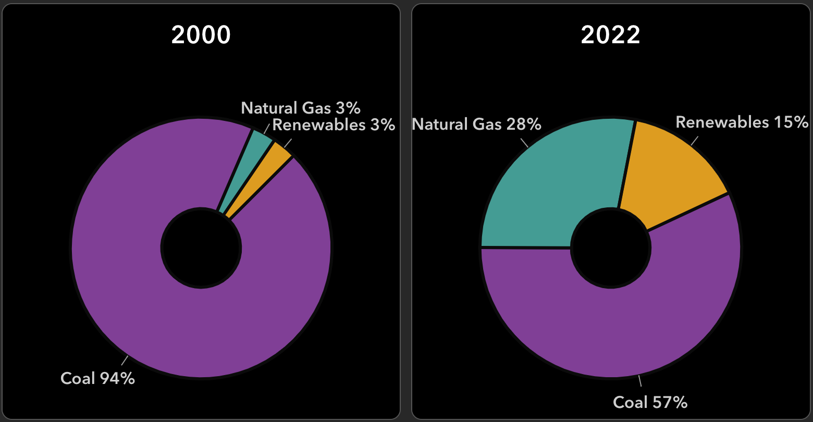
List a trend you notice with this data.
Electricity Generation in Utah by Source

Slide 6
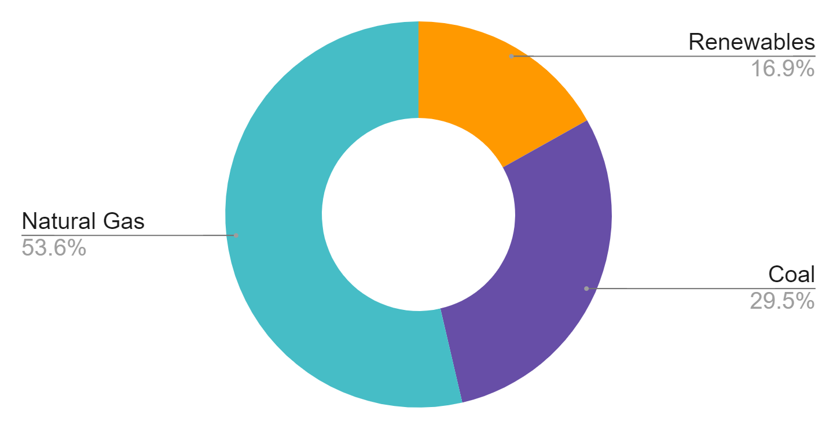
2023 Electricity Consumption in Utah by Source
Notes:
https://www.eia.gov/state/?sid=UT#tabs-4 2023

Slide 7
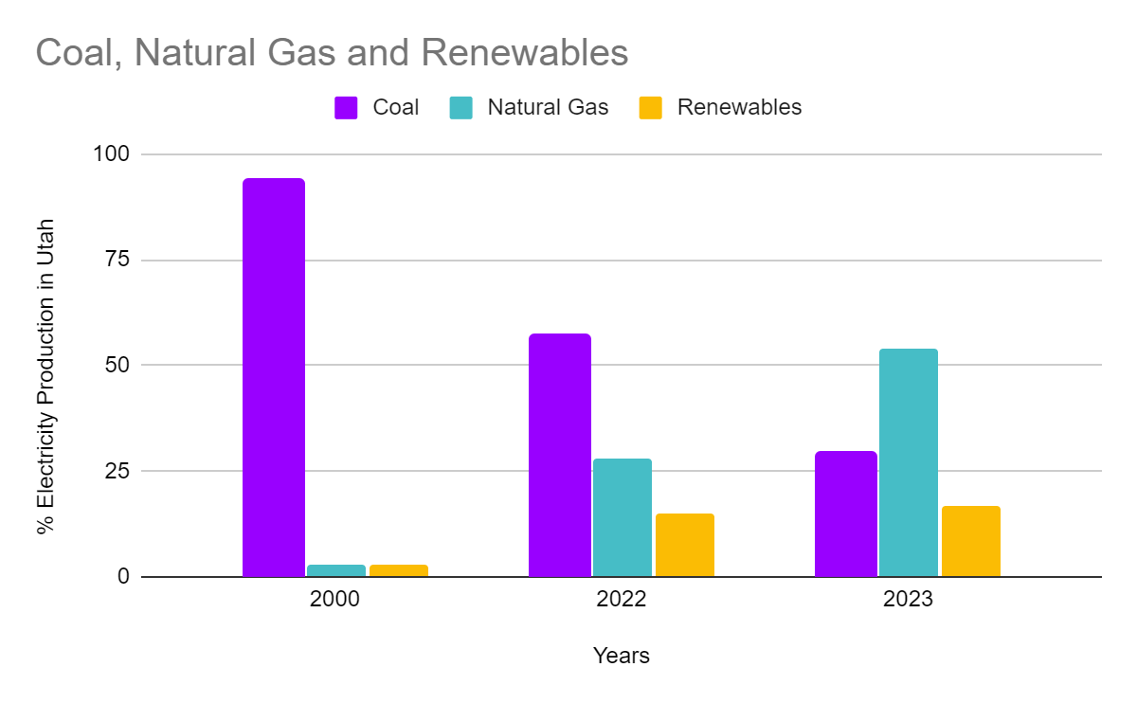
Looking at this data, what are the main energy resources and how have they changed over the last few years?

Slide 8
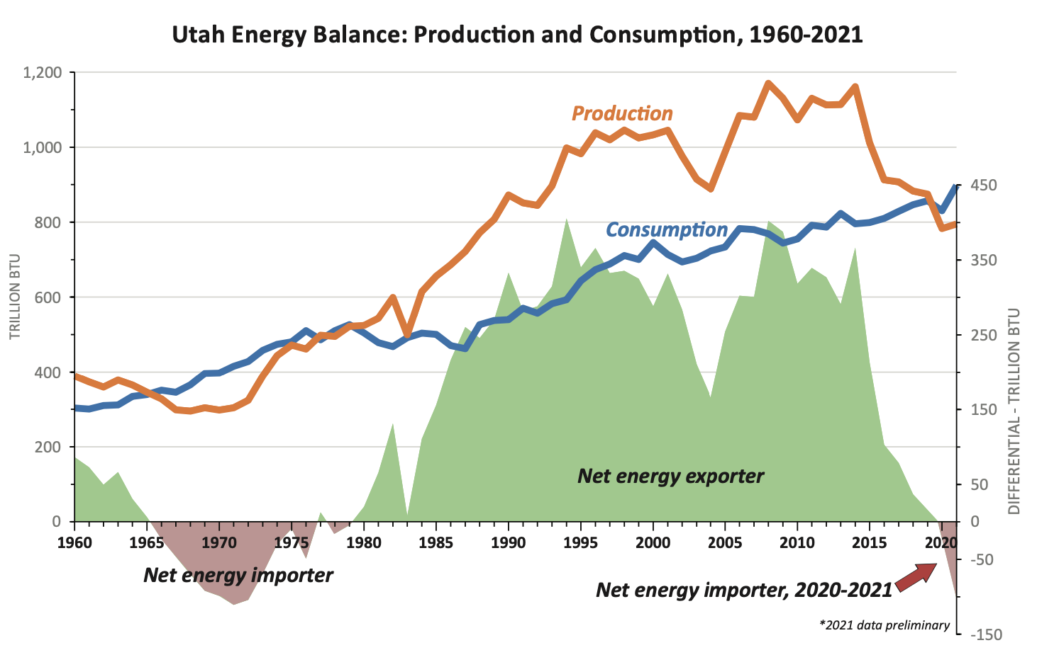
What questions do you have about this graph?
Notes:
https://geology.utah.gov/apps/energy-resources/?page=Home

Slide 9
As a class, we will decide on our solution guidelines.
Criteria: What are at least three?
Constraints: What are at least two?
How will we rank the importance of our criteria/constraints?

Slide 10
Beginning Solution: Which energy source will you choose to increase? How will you increase energy power production?
Energy Resource Research
Mineral Resource | Location | Current Usage | Energy Production | Safety | Sustainability
What chemical resources are used to create this power source? What resources does it require in order to produce power? | Where in Utah is this resource mined or recovered? | How much is this used in Utah today? | Explain how electricity is produced by the chemical resource. | Are there health concerns or global about this power source? How can you limit emission/pollution? | Are these minerals going to run out? How long until it does?

Slide 11
Criteria | Constraints | Identify the Problem(s) | Design a Solution
Part of defining problems in detail includes listing the requirements of the solution. Criteria are a list of needs that the solution must be designed to meet. | Factors that limit the possible solutions. Common constraints include, time, building infrastructure, laws, cost, materials etc. | Part of defining problems in detail includes listing the requirements of the solution. Why is your specific energy source lower than what you think it could be? | Now that you researched more and have more information identify how you will best increase power production with your constraints and criteria.

Slide 12
Infographic Requirements:
Power Source for Solution
Define the Problem
Identify Current Practices and Criteria
Identify Constraints
Use data to Support Solutions
Optimize Solution

Slide 13

3D-RST is supported by the NSF under grant number #DRL-2101383

