Slide 1
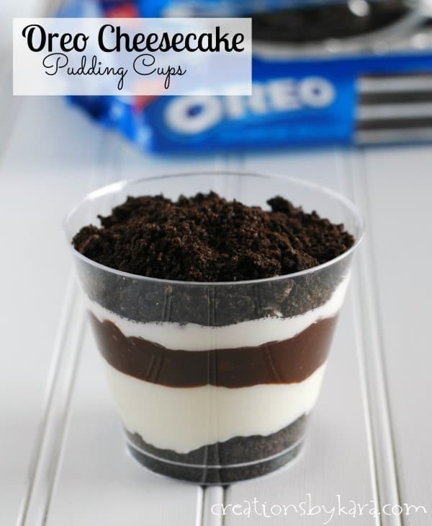
Spitty Pudding

Slide 2
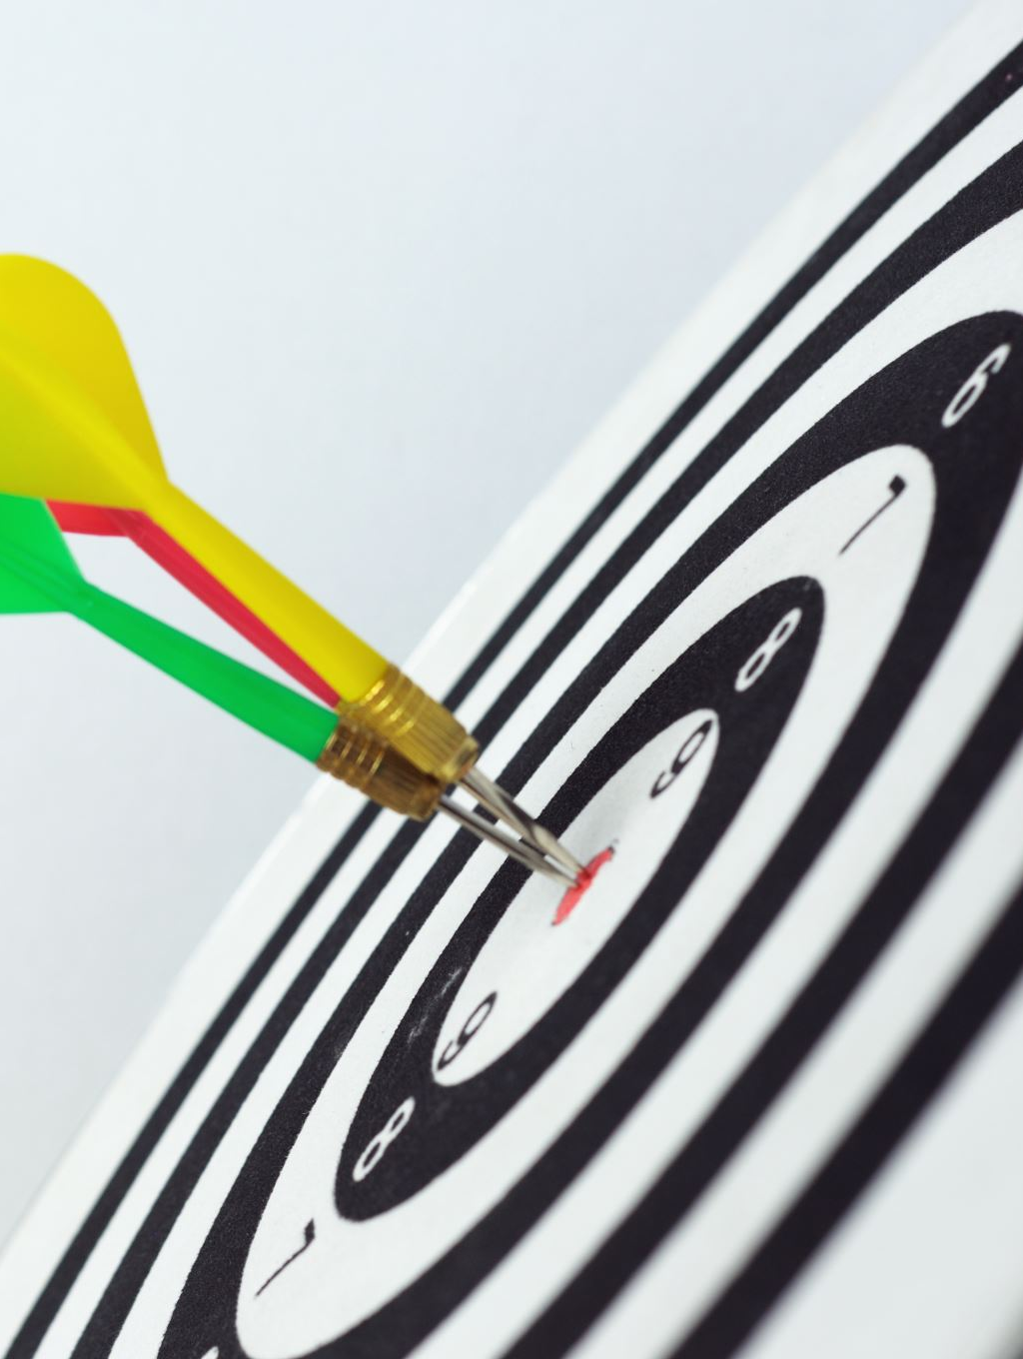
Objectives
Students will plan and carry out an investigation to produce data showing the relationship between the food we ingest for energy and the molecules that make up our bodies.

Slide 3
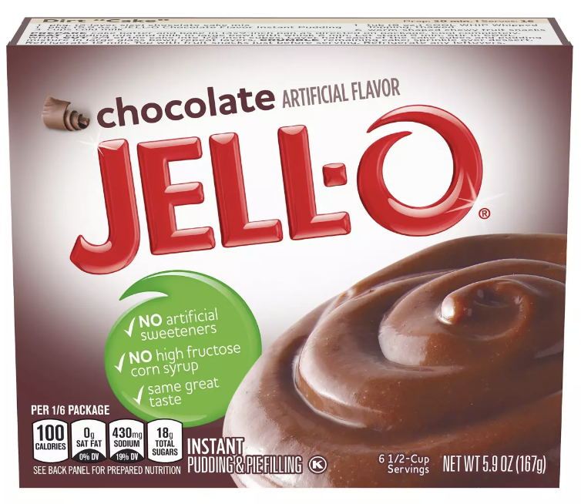
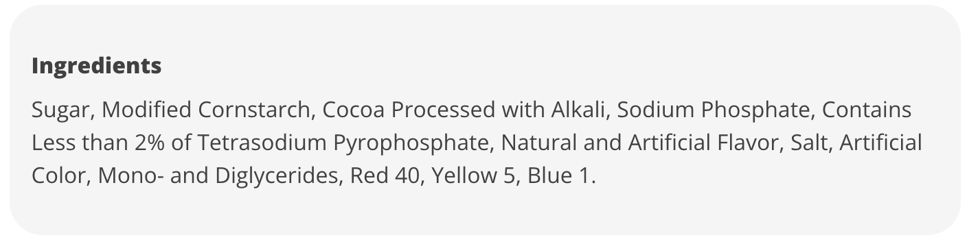
Observations
What is in pudding?
What do our bodies get from pudding?
Notes:
-Have students read the label, and explain how our bodies benefit from eating pudding.

Slide 4
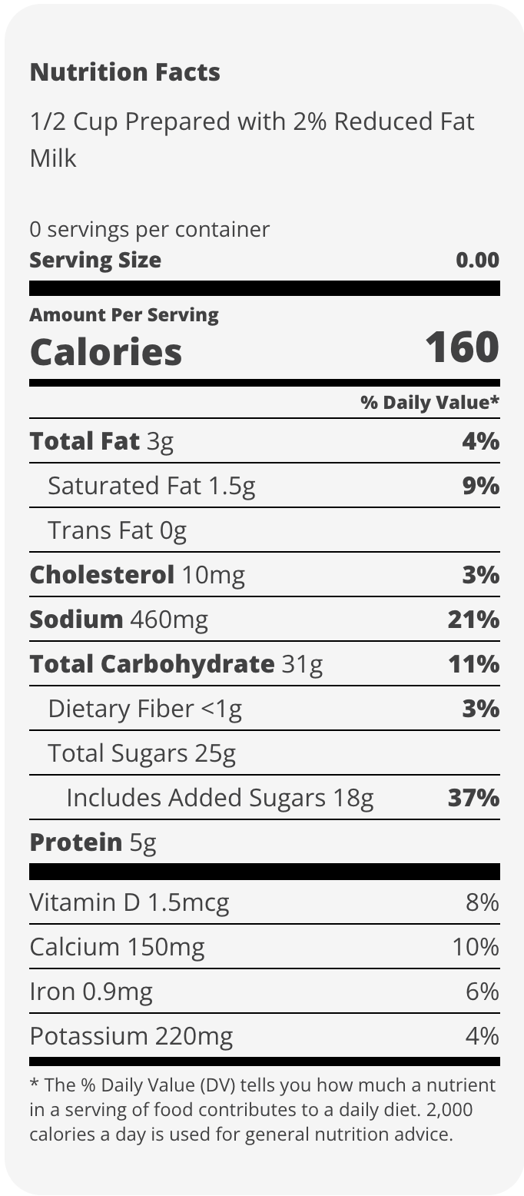
Macromolecules
What are the 4 types of macromolecules
  Proteins
  Carbohydrates
  Nucleic Acids
  Lipids
  Which are present in the pudding?
  Which is the most abundant?

Slide 5
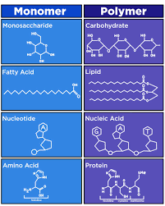
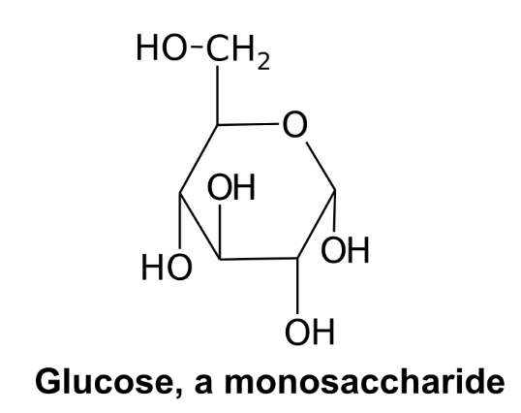
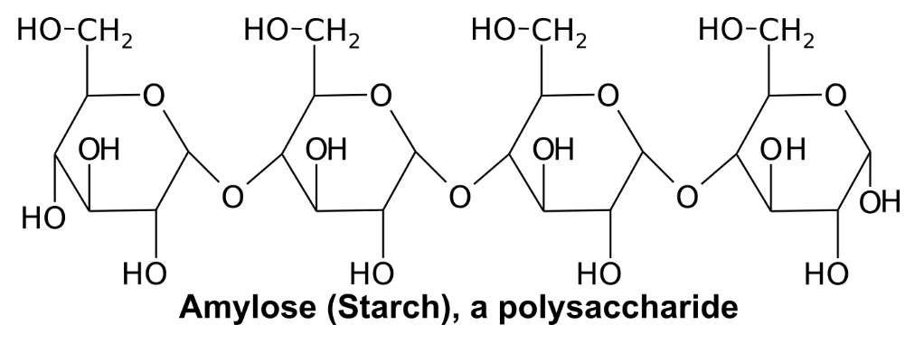
Macromolecule
Structure

Slide 6
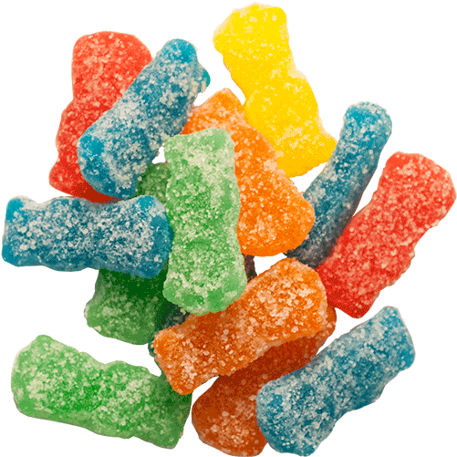
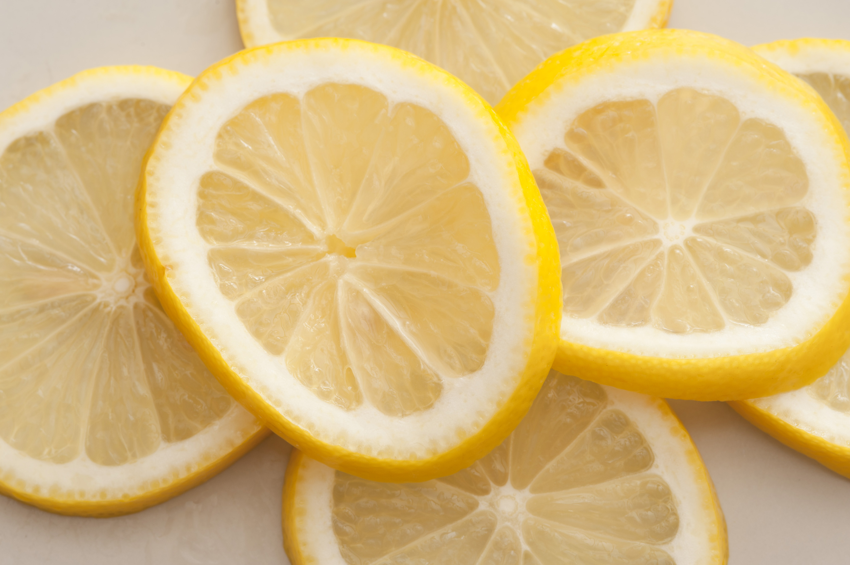
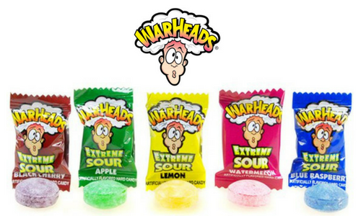
Spitty Pudding Experiment
Get 2 cups of pudding
Think of really sour things
Record observations of pudding
Spit into 1 cup of pudding

Slide 7
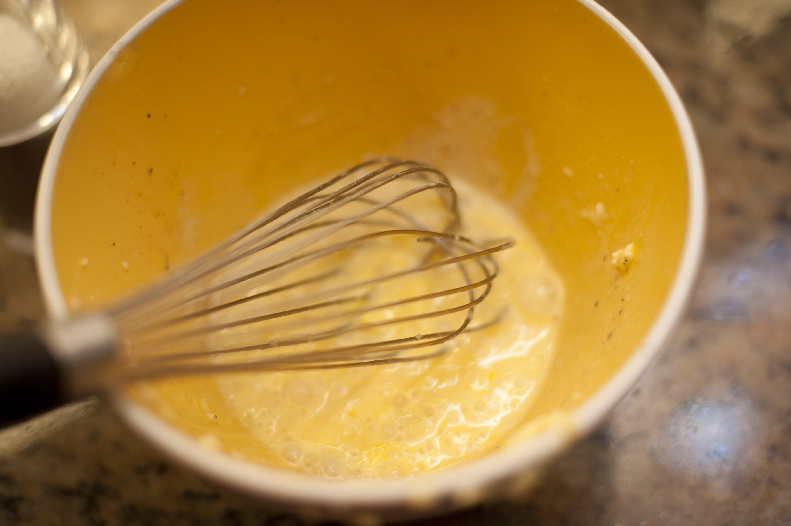
Spitty Pudding Experiment
Once you have a “mouthful” of spit in your cup mix it into your cup of pudding.
Notes:
After mixing, wait for about 10 minutes before looking back at the pudding.

Slide 8
Enzymes
Enzymes are proteins that help speed up metabolism, or the chemical reactions in our bodies. They build some substances and break others down. All living things have enzymes. Our bodies naturally produce enzymes.
Example- Amylase, found in our saliva helps breakdown carbohydrates.
If a word has -ase on the end it is most likely an enzyme
Look up 3 enzymes on your device, be prepared to share.

Slide 9
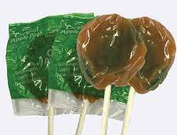
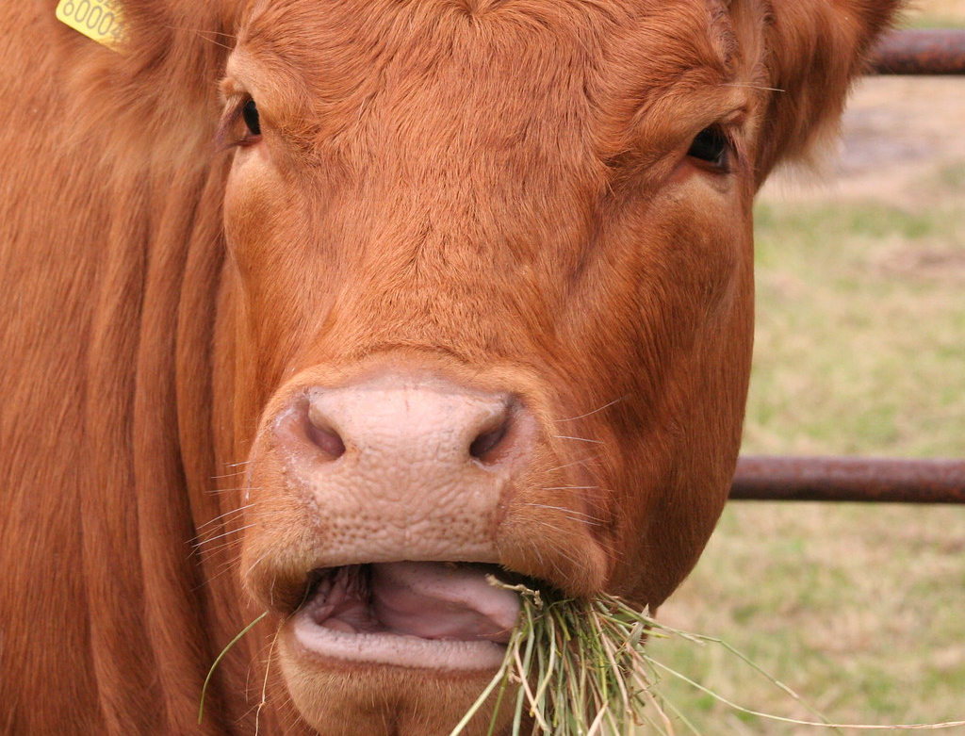
Enzymes
Enzymes are found all over in our bodies, especially in our digestive symptoms.
Saliva contains enzymes too!
Amylase digests carbohydrates
Fun Fact- Ruminants do not contain amylase in their saliva

Slide 10
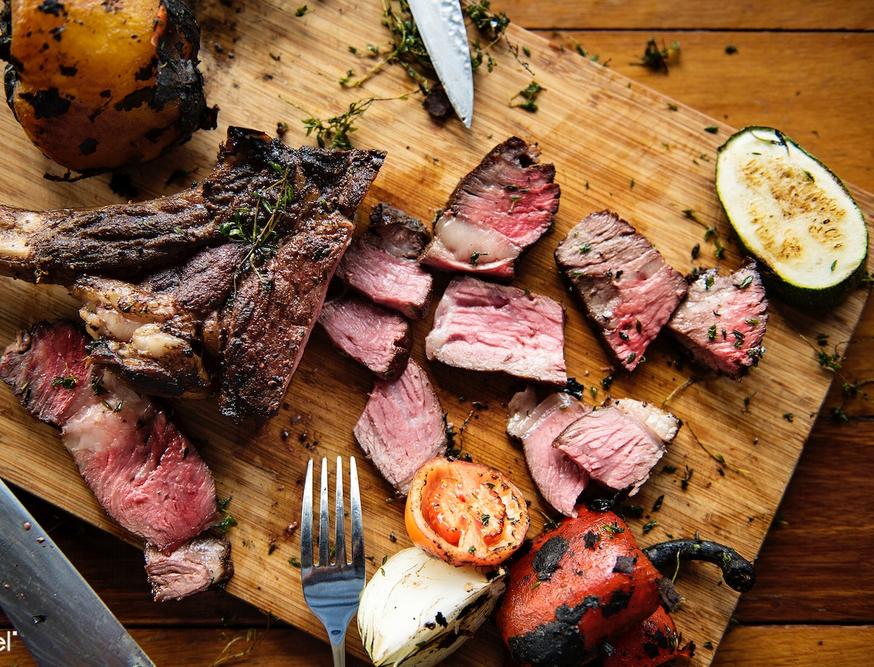
Enzymes
Why does caramel not stay stuck to our teeth, when steak stays stuck between our teeth?

Slide 11
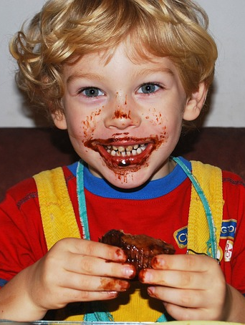
Energy Flow
Think-Pair-Share
How does your body breakdown macromolecules found in the foods you eat?
Digestion Video

Slide 12
Think-Pair-Share
Using the cup with saliva, was the mass at the beginning of the 10 min more, less, or the same as the mass at the end of the 10 min? What can we learn from this?

Slide 13

3D-RST is supported by the NSF under grant number #DRL-2101383

