Slide 1
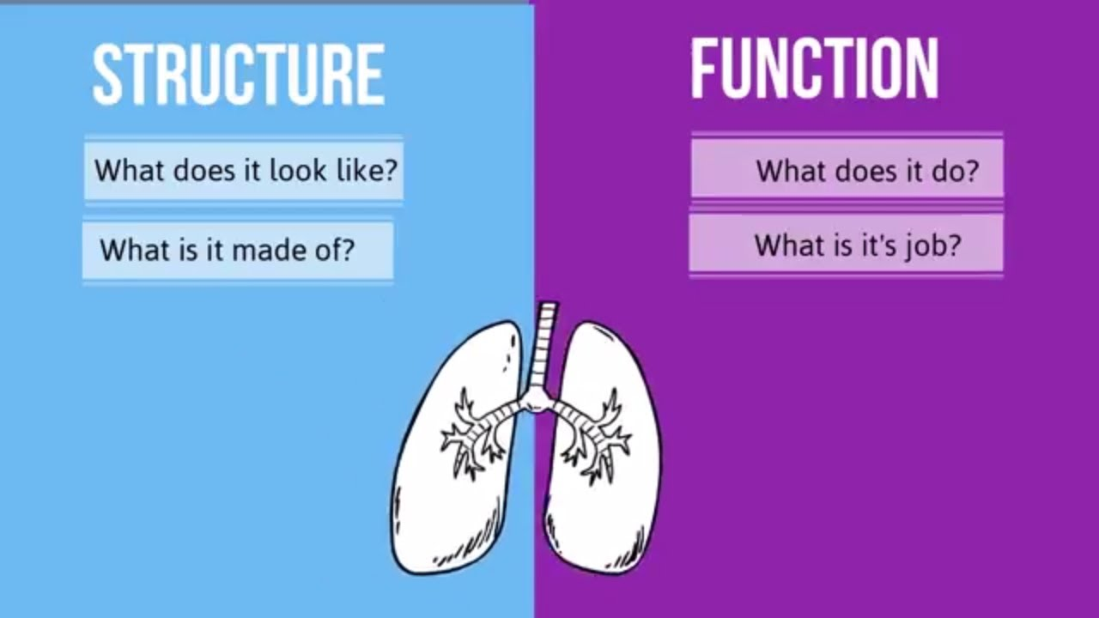
Guiding question of the day:
How does the structure of an object affect its function?

Slide 2
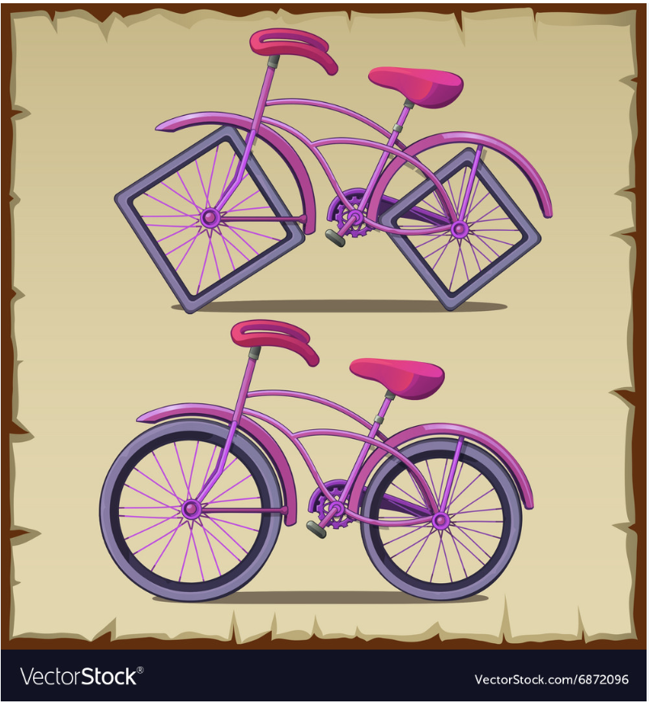

Be ready to discuss in 2 min
Notes:
Give students each a sticky note and have them write what they notice for each object in terms of STRUCTURE and FUNCTION
Teacher- Ask students what they notice about the structure? Ask them what they INFER might happen to the function of each.

Slide 3
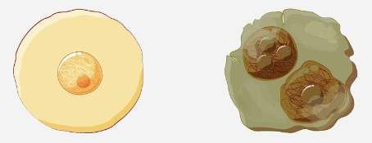
Abnormal
"Normal"
Notes:
Double yolk egg VS "normal"
Note: it is the yolk of the egg that contains the majority of calories, fat, vitamins, and minerals- provides nutrients to a developing chick.
Ask students- how would this change affect a developing chick (thumbs up/thumbs down responses- Is it a benefit or a disadvantage?)? How or why?

Slide 4
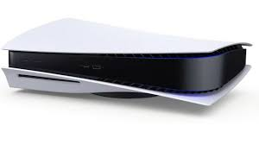
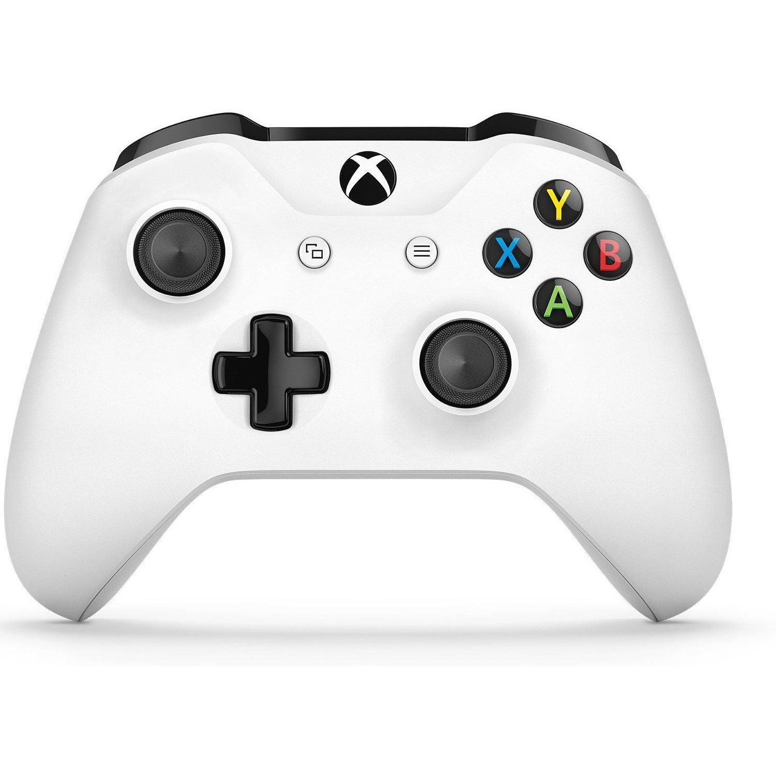
Even though the parts are the correct Structure, are they designed to Function separately or together?
Does this work with this without anything extra?
Working PlayStation 5
Working X Box Controller
Notes:
Ask students- can one of these object work without the other?
What happens if one part is not working?

Slide 5

THINK-PAIR-SHARE
3-2-1
Think of something you LOVE to do (club, sport, dance, theater, game, etc.).
  What is the needed for your activity? (Ex. Soccer ball, ballet shoes, football field, drawing utensils)
  If that something (from "a") was to change in STRUCTURE how would it affect the outcome, or FUNCTION, of what you do?
2. PAIR & Share- discuss your responses to the prompts above
3. Share what you or your partner discussed
Notes:
3 min to respond individually to 1 a, 1b
2 min to pair and share your responses
1 min (or less) to share with the class

Slide 6
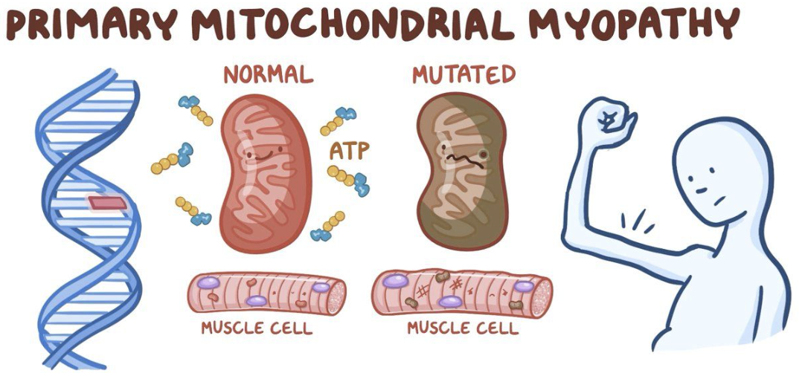
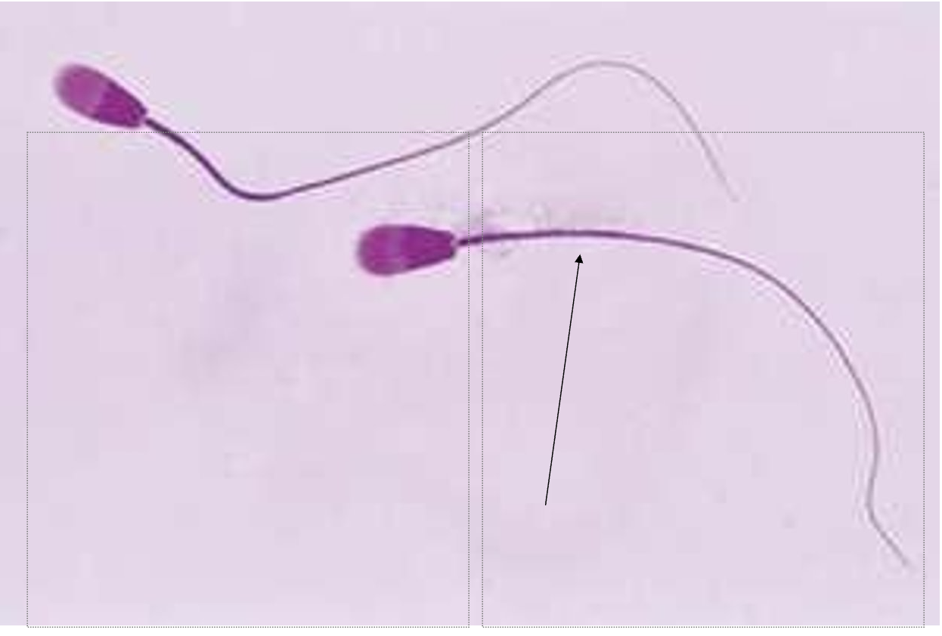
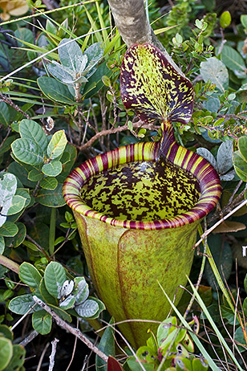
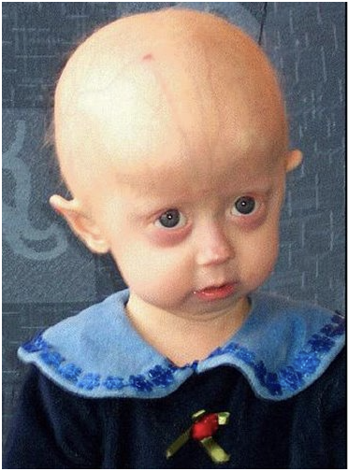
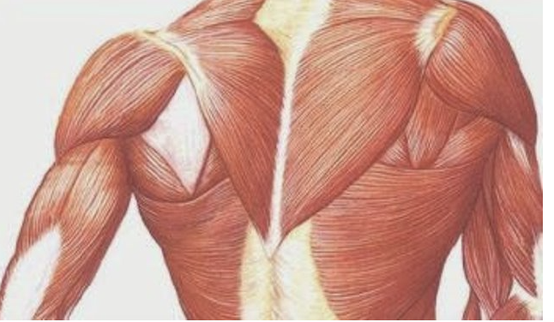
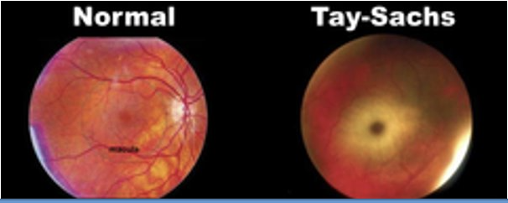
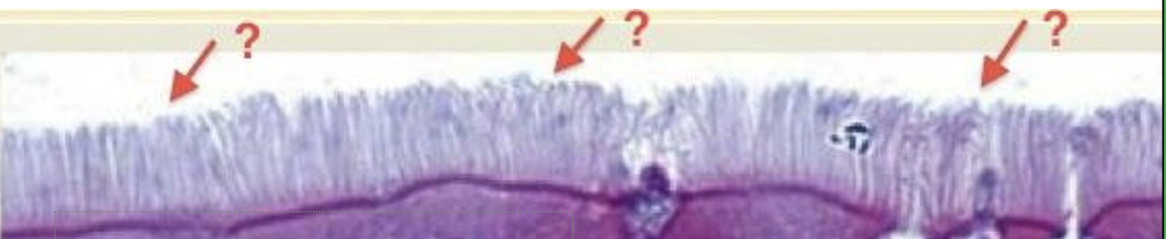
What do you see? What do you think? What do you feel?
Notes:
Teacher notes of images: (top-down and left to right)
Sperm cells
Muscles
Normal vs tac-sachs
Middle plant-what is this called?
Cilia or miscrovilli?
Mitochondria myopathy
Achondroplasia
Ask students:
What do they see? What do they think? What do they feel?

Slide 7

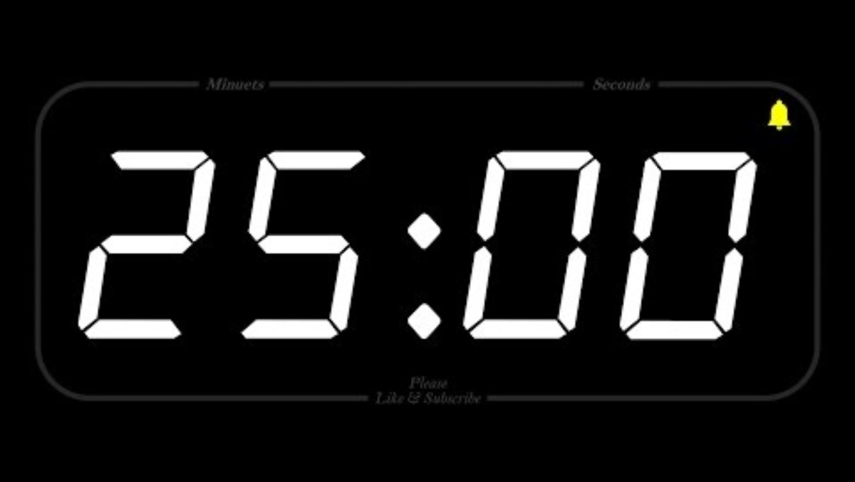
Student Hand Out Phase One
Case Study
YOU will be: Making observations, interpretations, and communicating evidence of cell organelle structure and function, as it pertains to case study disorders.
You will work either on your own or will at least ONE other person; at teachers discretion.
There are a total of 12 cases studies. Your group will be assigned one that you and your group will become experts on.
(EVERYONE will participate)
Notes:
Teacher notes: two students per case study is preferred.
Assign roles to each student:
Researcher 1- uses Chromebook to investigate the disorder (normal vs abnormal function)
2. Recorder- documents findings on student handout and in group PowerPoint
3. Researcher 2- uses second Chromebook to investigate the disorder (normal organelle vs abnormal organelle picture; pictures of those with the disorder)

Slide 8
Student Hand Out Phase Two
Student one= researcher
Student two= google slide creator
Student three=presenter
OR you all simply work together
Read through the case study to identify the signs and symptoms of the disorder.
Use the Internet to research the signs and symptoms of your case to determine the name of the disorder. RECORD this information in the table on your student handout.
Investigate further to determine the name of the organelle that is associated with this disorder, its function, and any changes due to the disorder. RECORD this information in the table below.
It will look like this on your student handout
Case Number | Disease | Affected organelle | Structure (picture) | Normal Function | Change in Structure | Change in Function
Notes:
Assign roles to each student:
Researcher 1- uses Chromebook to investigate the disorder (normal vs abnormal function)
2. Recorder- documents findings on student handout and in group PowerPoint
3. Researcher 2- uses second Chromebook to investigate the disorder (normal organelle vs abnormal organelle picture; pictures of those with the disorder)

Slide 9
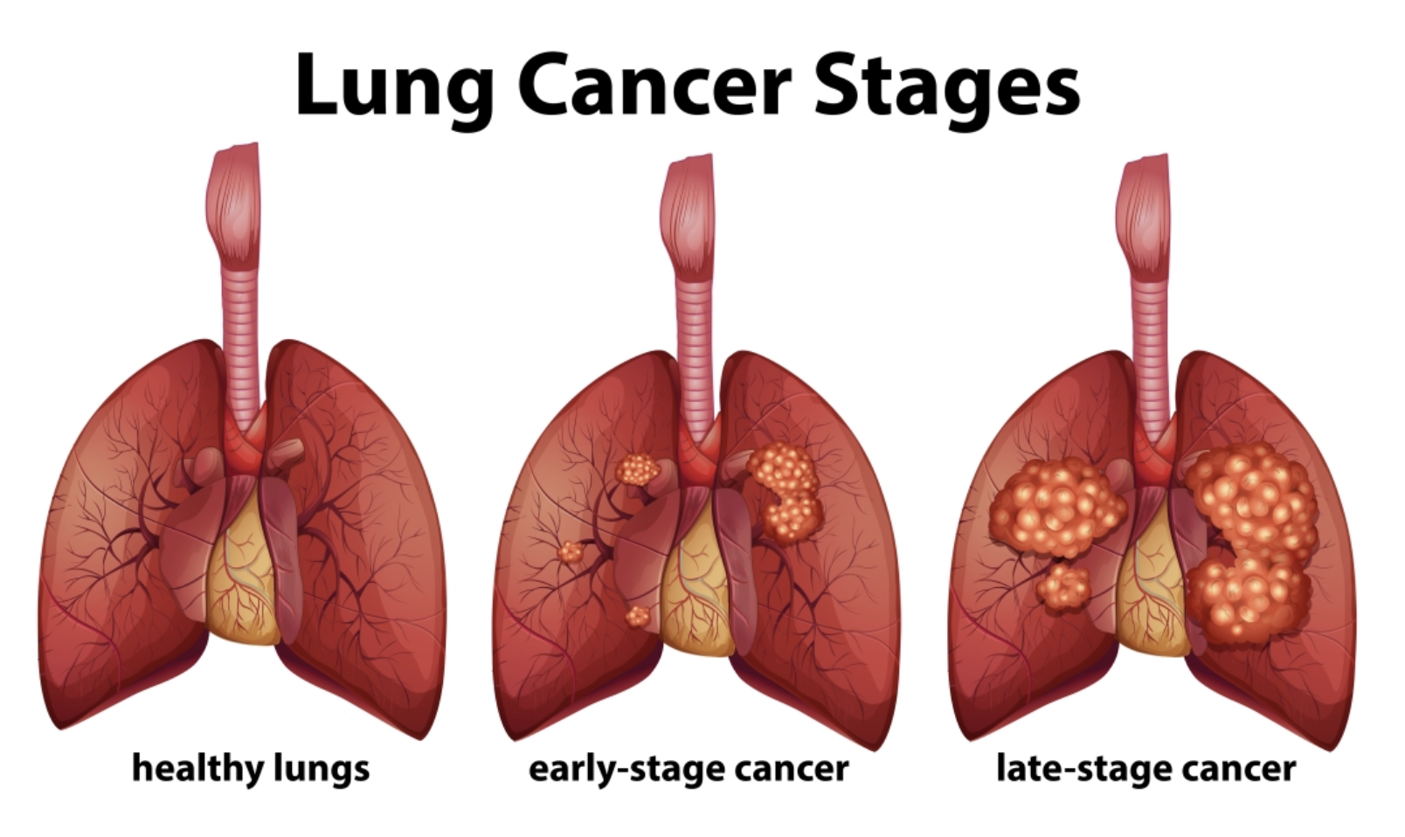
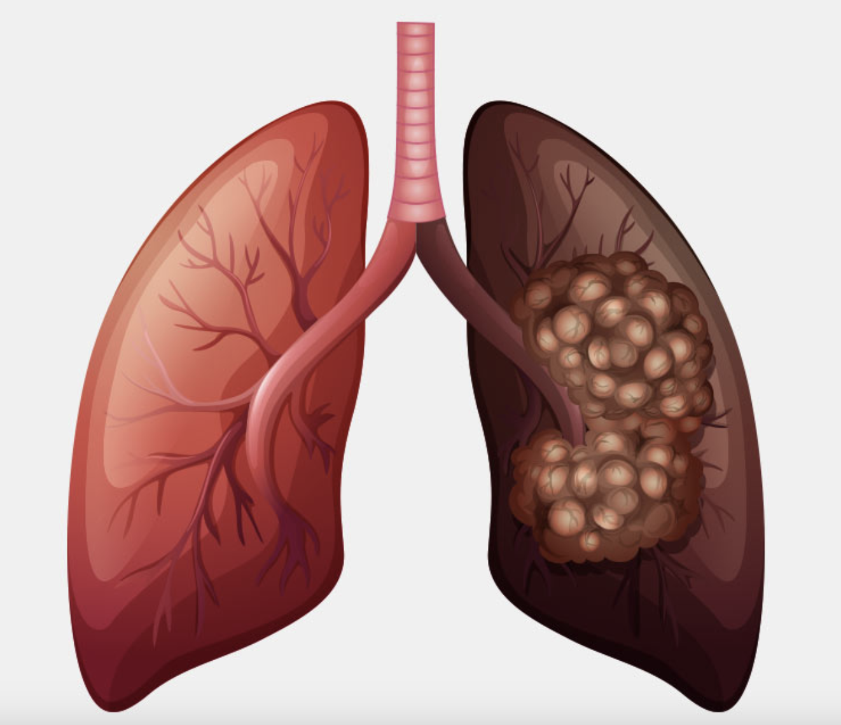
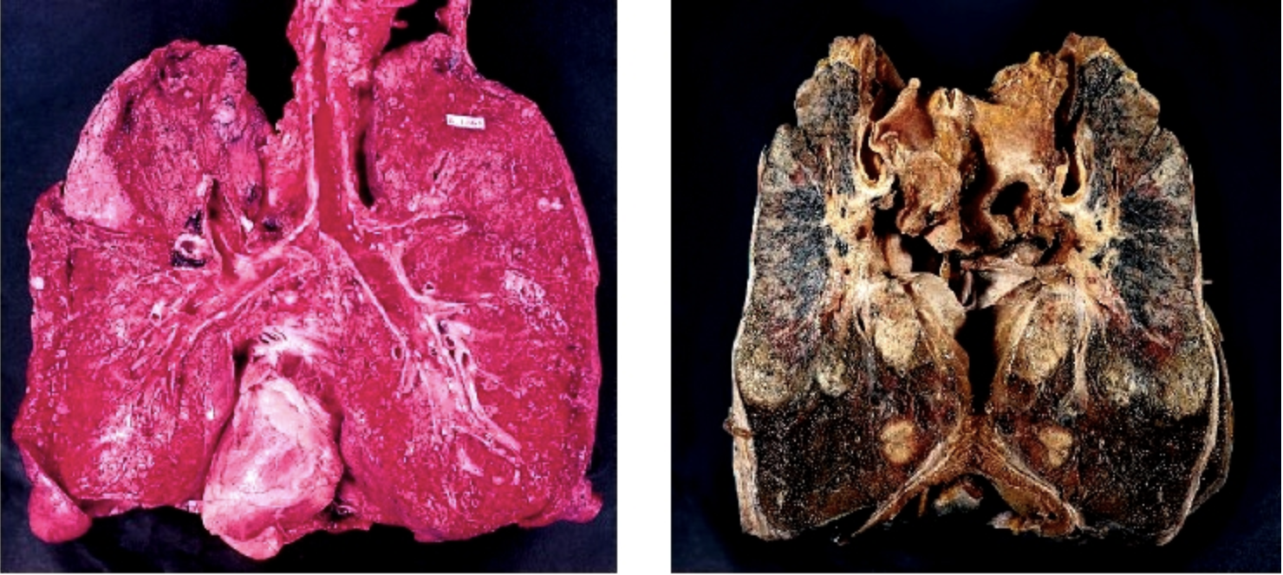

Slide 10
Quick Cell Structure Challenge: "Cilia Defenders"
Objective: How does changing the structure of the cilia affect its function of protecting LUNG cells?
Materials:
Balloons (representing healthy lung cells)
Plastic straws (representing cilia)
Small balls (representing harmful particles)
Timer or stopwatch

Slide 11
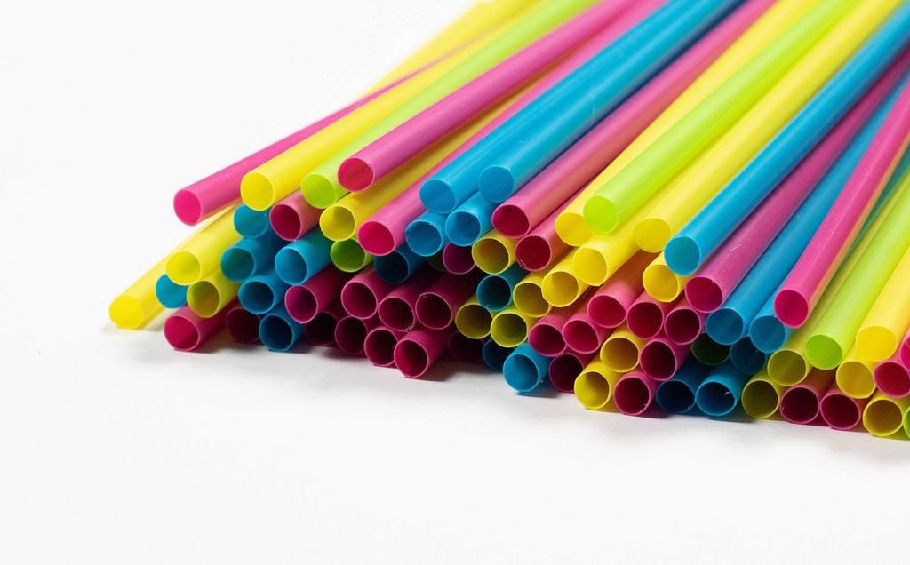
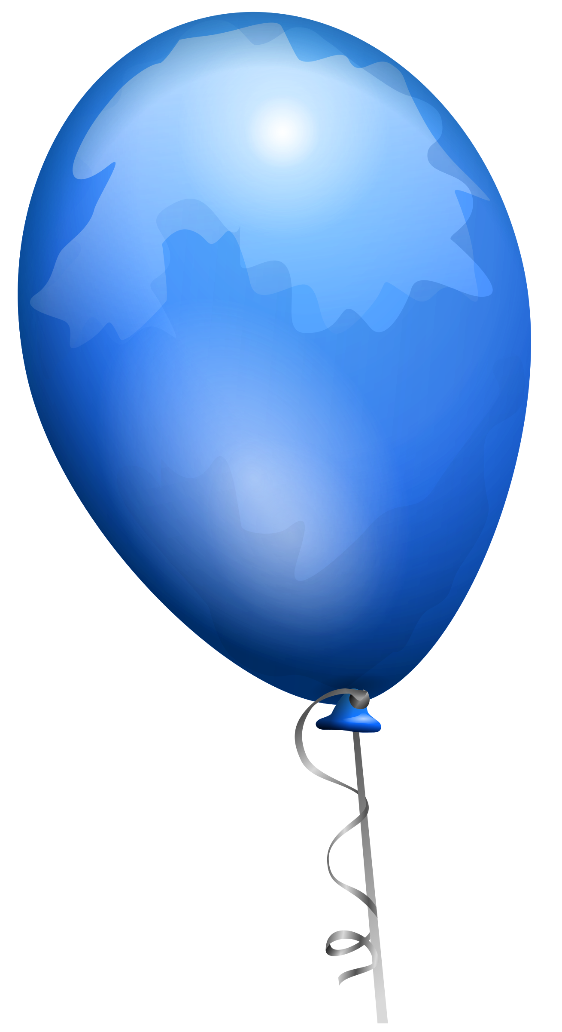
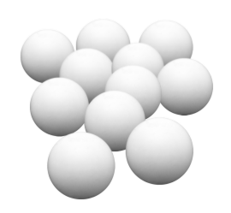
Challenge:
Straws=
Balloon=
At your table, for 60 seconds, CILIA will defend the LUNGS from HARMFUL PARTICLES
RECORD your observations for each round
Round 1- CILIA may move around
Round 2- CILIA stay at one spot
Ping pong balls=
Straws=

Slide 12
Be prepared to reflect and Discuss:
  Defense strategies you used
  Which strategies were MOST effective?
  Least effective?
  Which trial was harder and WHY?
  How does this relate to healthy cilia vs cilia coated with tar in the LUNGS?
Notes:
Teacher Notes:
What strategies did you use to defend your "lung cells."
Can you connect your strategies to the function of cilia in protecting lung cells.
What was effective in your approach to defend the "lung cells" and how does that relate to the importance of intact cilia in real lung cells.
Was it harder the second time when there were a few cilia taped to the desk and how does that relate to lungs that are coated in tar affecting the structure of the lung cells? Does this prevent the lungs from being as effective in defending the lung cells?

Slide 13
Conclusion
How did changing the structure of the cilia affect the function?
Why might this be important to you and others?
What could you do to prevent change in structure of the cilia in your airway?
Notes:
Conclusion (2 minutes):
Cilia is a part of the lung that is extremely important to the health and longevity of a lung cell as we observed their use in a situation where particles were attacking the "lung" (balloon) they were necessary in order to defend the cells. If we changed the structure of the cilia that will greatly change how they function and perform in their duties in protecting the lungs.
Think about why it is important to understand how cell structure is significant in making informed health choices in your lives, such as avoiding excessive exposure to smoking and vaping.

Slide 14

3D-RST is supported by the NSF under grant number #DRL-2101383

