Slide 1
Wind
Natural Disaster
Wind is a natural force that can be both beneficial and destructive. When wind speeds exceed certain thresholds, it can become a natural disaster, causing widespread damage and loss of life.

Slide 2
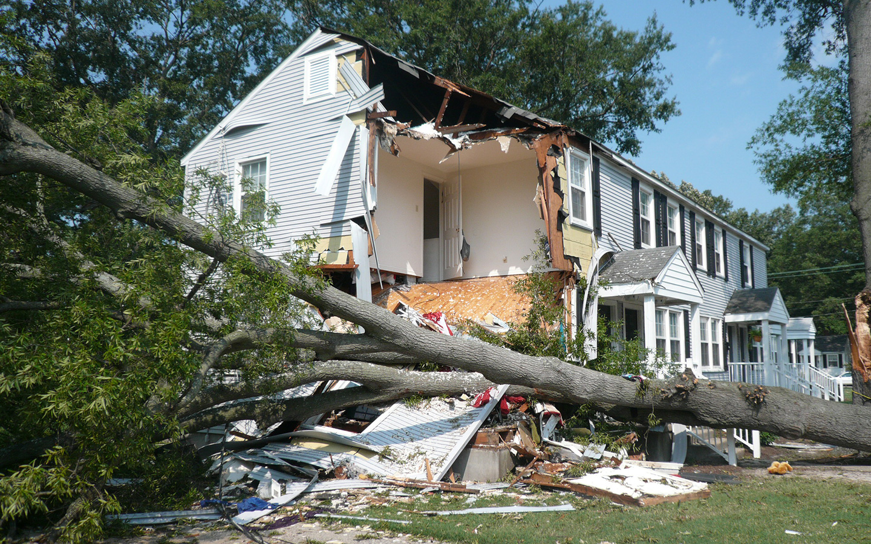
Causes of Wind Disasters
The most common causes of wind disasters are:
Tropical cyclones: Tropical cyclones, hurricanes, and typhoons are powerful storms that can produce sustained winds of 74 miles per hour or more.
Tornadoes: Tornadoes are violently rotating columns of air that can reach speeds of up to 300 miles per hour.
Downbursts: Downbursts are sudden, intense downdrafts of air that can reach speeds of up to 75 miles per hour.
Straight-line winds: Straight-line winds are strong, non-rotating winds that can occur in association with thunderstorms or other weather systems.

Slide 3
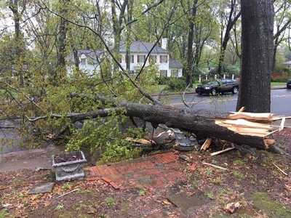
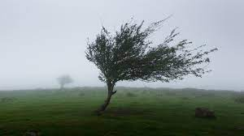
Human Impact of Wind Disasters
Wind disasters can have a devastating impact on human life and property. The high winds can:
Destroy or damage homes and other structures
Down trees and power lines
Cause power outages
Disrupt transportation and communication networks
Lead to injuries and deaths

Slide 4
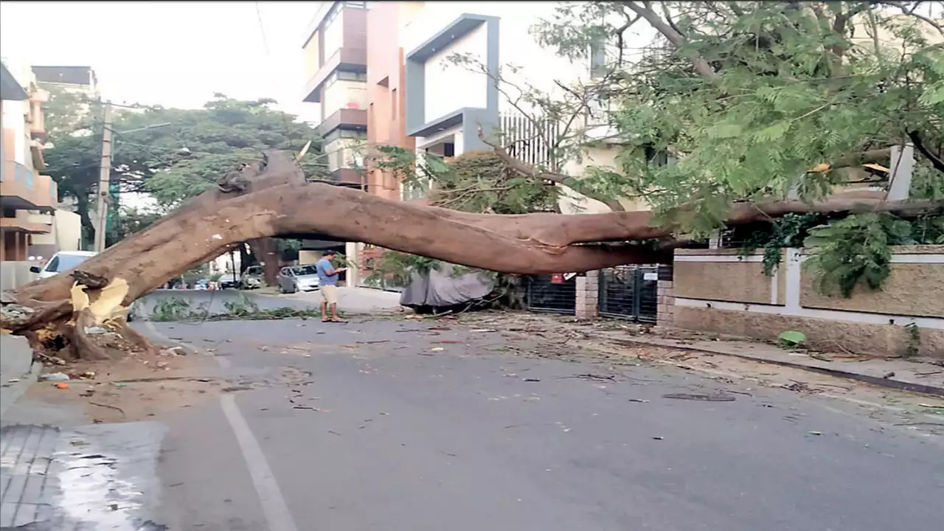
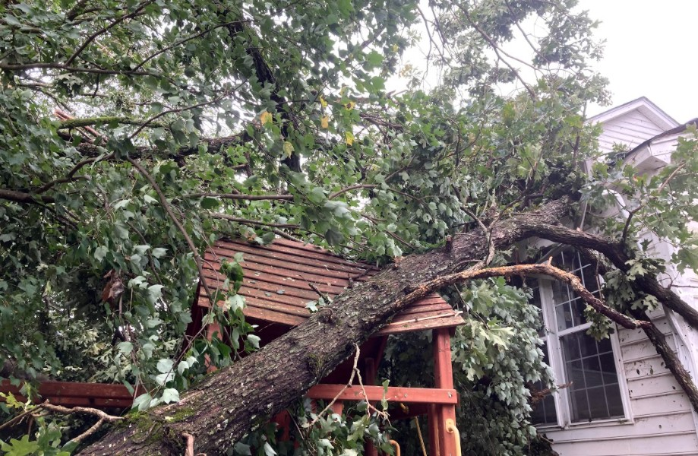
Resource Interruption
Wind disasters can also cause significant disruption to essential resources, such as electricity, water, and food. Power outages can last for days or even weeks, leaving people without access to essential services. Water and food supplies can also be disrupted, leading to shortages.

Slide 5
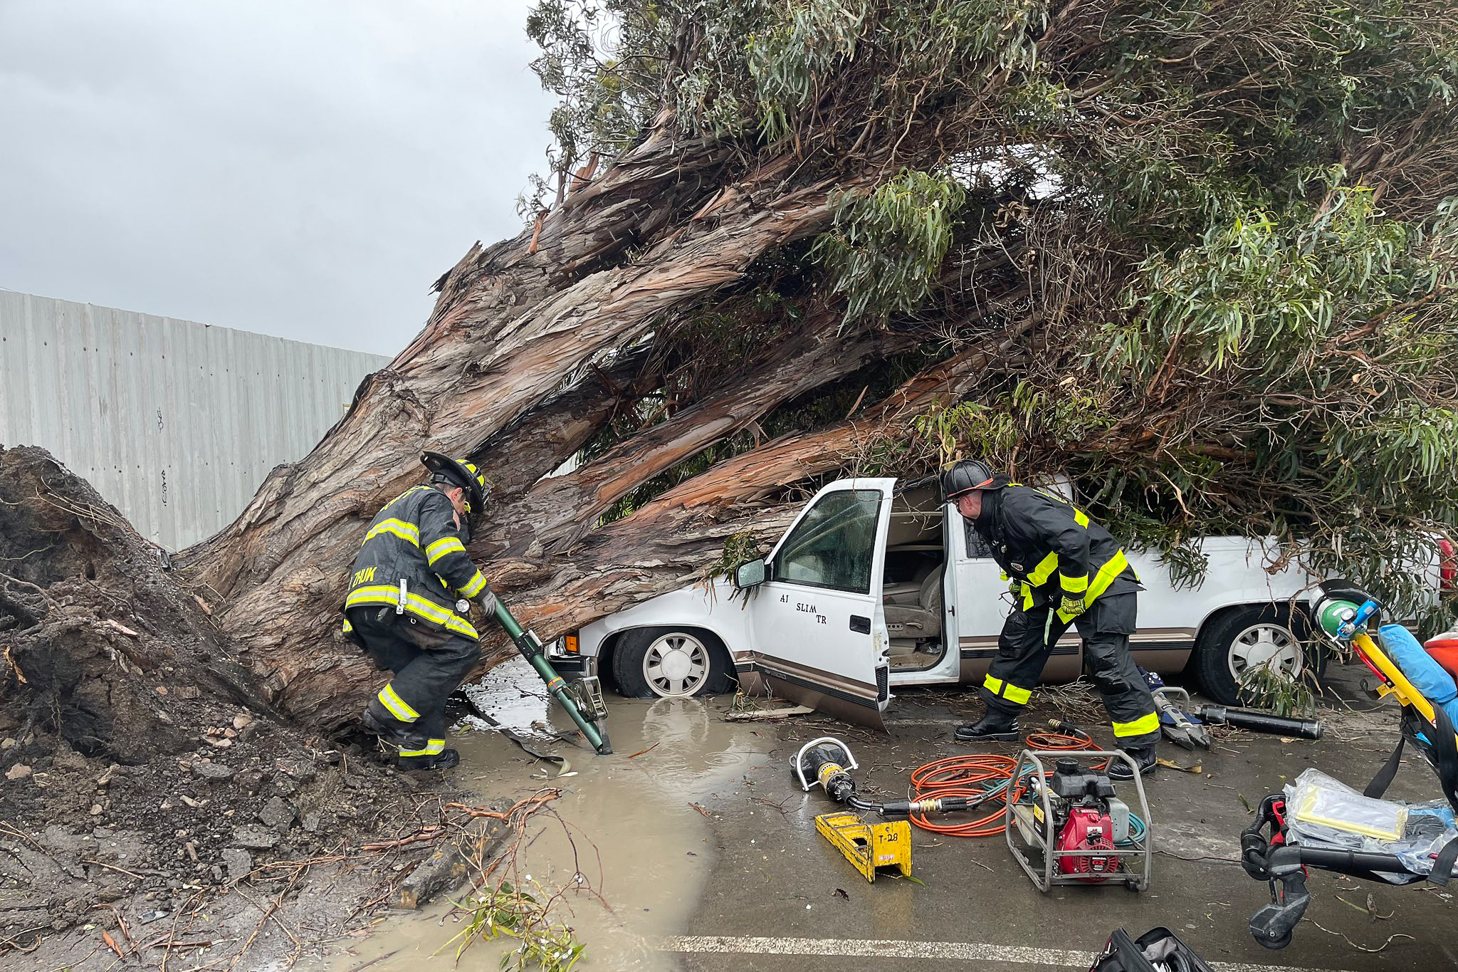
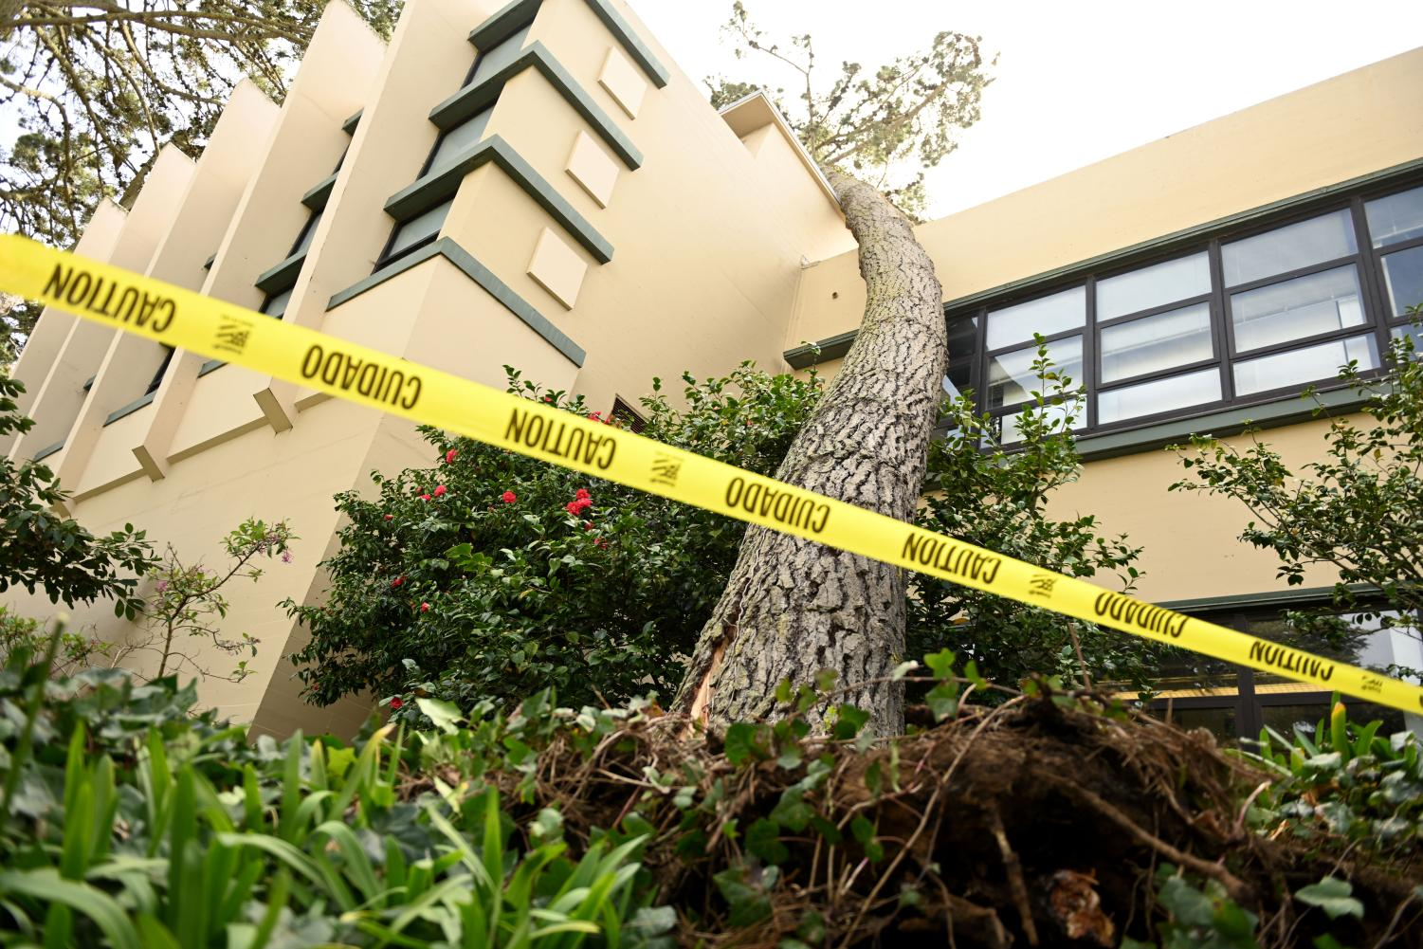
Loss to Structure and Property
Wind disasters can cause billions of dollars in damage to property. The high winds can destroy or damage homes, businesses, and other structures. Downed trees and power lines can also cause damage to property.

Slide 6
Real-World Examples
Hurricane Katrina (2005): Hurricane Katrina was a Category 5 hurricane that made landfall in the United States Gulf Coast in August 2005. The storm caused widespread damage in Louisiana, Mississippi, and Alabama. Over 1,800 people died, and hundreds of thousands of people were displaced.
Super Typhoon Haiyan (2013): Super Typhoon Haiyan was a Category 5 typhoon that made landfall in the Philippines in November 2013. The storm was one of the strongest typhoons ever recorded. Over 6,000 people died, and over 4 million people were displaced.
Tornadoes in Oklahoma (2013): In May 2013, a series of tornadoes struck the state of Oklahoma, killing at least 24 people and destroying dozens of homes. The Moore tornado was the deadliest tornado to strike the United States since 1999

Slide 7
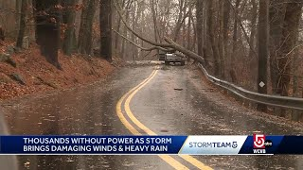
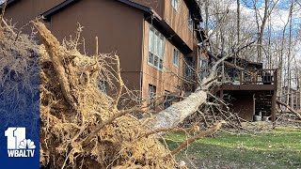
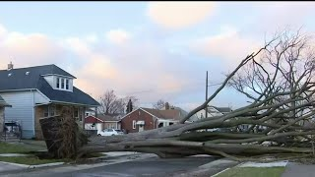
News/Video
https://www.nbcnews.com/news/weather/live-blog/severe-weather-live-updates-tornado-thunderstorms-rcna98656

Slide 8
Statistics
Property loss
In 2021, wind disasters caused an estimated $104.5 billion in damage to property in the United States. This makes wind disasters the most costly type of natural disaster in the US.
Over the past decade, wind disasters have caused an average of $70.8 billion in damage to property in the US each year.
The most costly wind disaster in US history was Hurricane Katrina in 2005, which caused an estimated $125 billion in property damage.
Life loss
In 2021, wind disasters killed an estimated 108 people in the United States. This makes wind disasters the second deadliest type of natural disaster in the US, after floods.
Over the past decade, wind disasters have killed an average of 82 people in the US each year.
The deadliest wind disaster in US history was the 1979 Galveston Hurricane, which killed an estimated 8,000 people

Slide 9
Resources/Links
National Centers for Environmental Information (NCEI): https://www.ncei.noaa.gov/
Congressional Budget Office (CBO): https://www.cbo.gov/
National Oceanic and Atmospheric Administration (NOAA): https://www.noaa.gov/
Wikipedia: https://en.wikipedia.org/
Federal Emergency Management Agency (FEMA): https://www.fema.gov/
National Hurricane Center: https://www.nhc.noaa.gov/
Storm Prediction Center: https://www.spc.noaa.gov/

Slide 10

3D-RST is supported by the NSF under grant number #DRL-2101383

