Slide 1
Wildfires
Natural Disaster
A wildfire disaster is a severe and damaging wildfire that has a significant impact on human health, livelihoods, infrastructure, and the environment. Wildfire disasters can be caused by both natural and human factors, and they are becoming more frequent and severe due to climate change.

Slide 2
Causes of Wildfire Disasters
Wildfires can be caused by both natural and human factors. Natural causes include lightning strikes, volcanic eruptions, and droughts. Human causes include arson, campfires that are not properly extinguished, discarded cigarettes, and power lines that come into contact with vegetation.
Climate change is also playing a role in increasing the frequency and severity of wildfires. Climate change is causing warmer temperatures, which dries out vegetation and makes it more flammable. Climate change is also causing more extreme weather events, such as droughts and heat waves, which can create conditions that are favorable for wildfires.

Slide 3
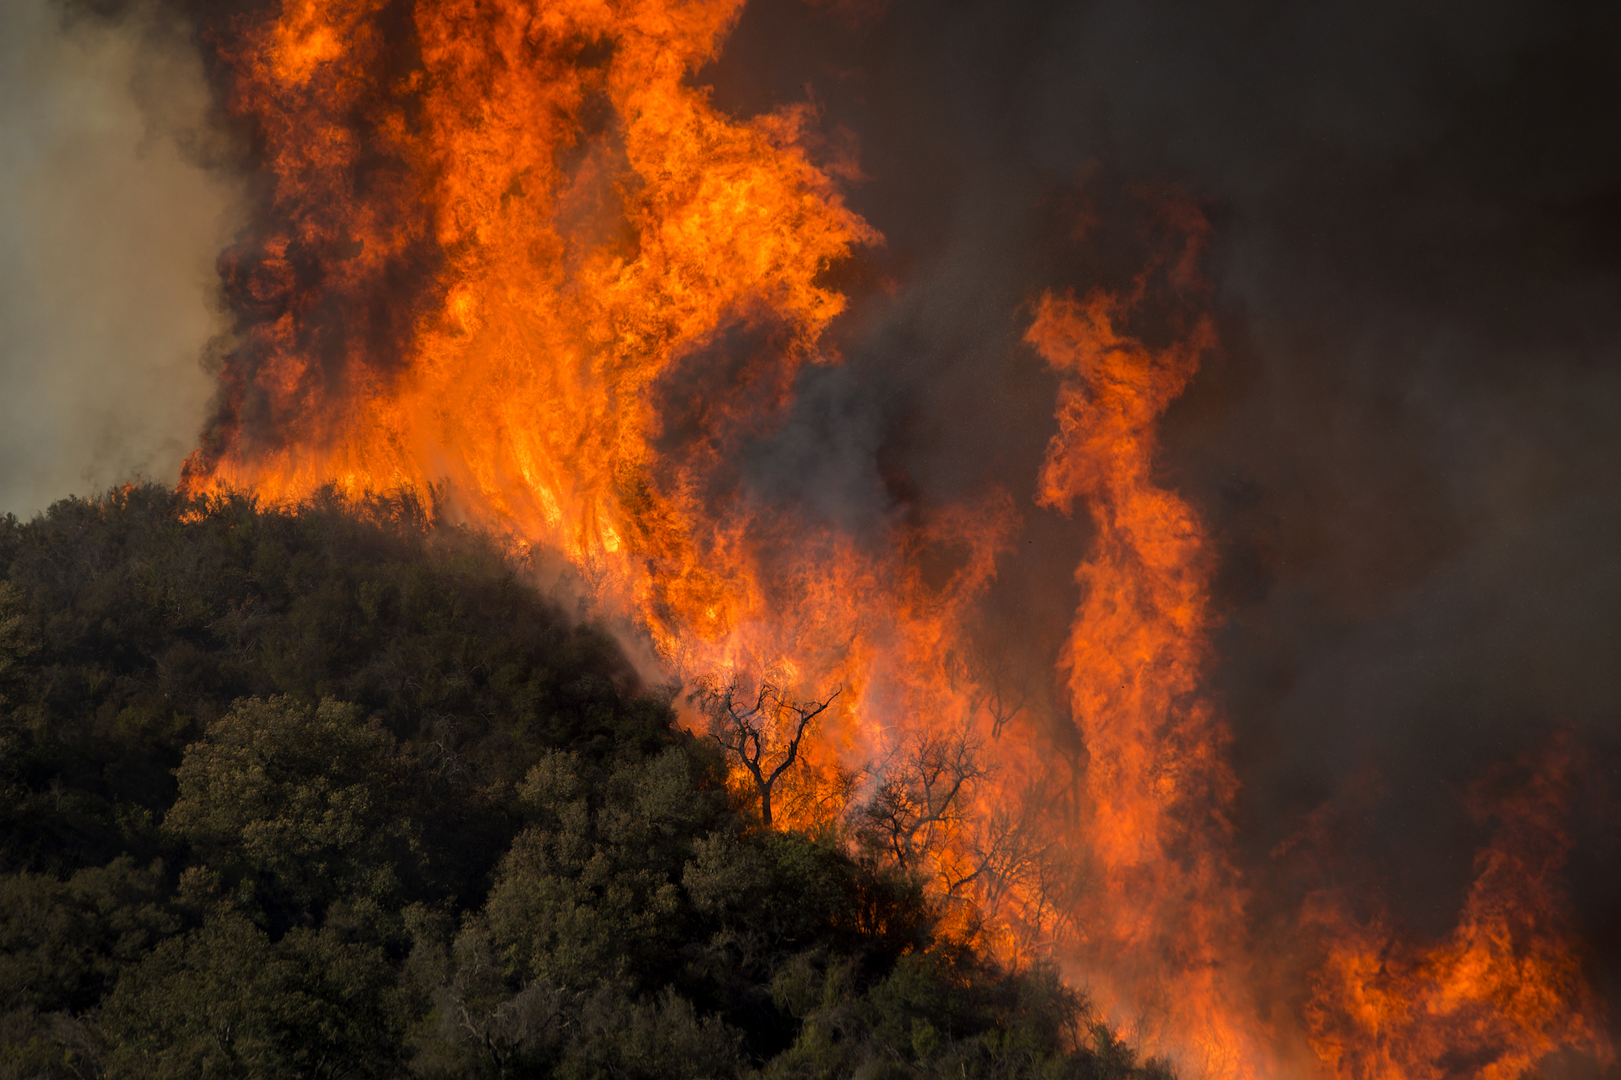
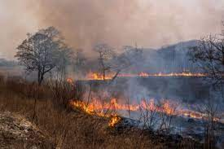
Human Impact of Wildfire Disasters
Wildfires can have a devastating impact on human health and livelihoods. Wildfire smoke can contain harmful pollutants, such as particulate matter, ozone, and carbon monoxide. These pollutants can cause respiratory problems, heart disease, and cancer. Wildfires can also displace people from their homes and businesses, and destroy infrastructure and critical services.

Slide 4
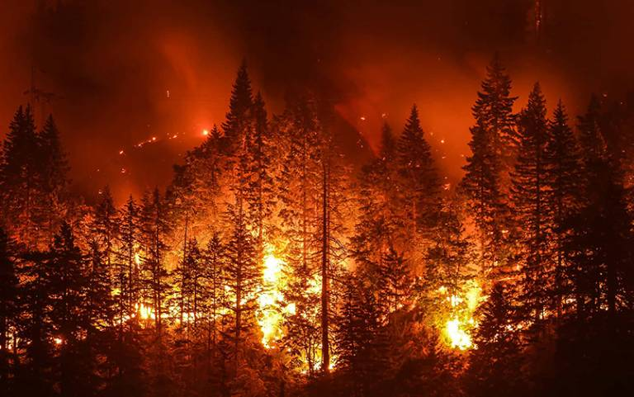
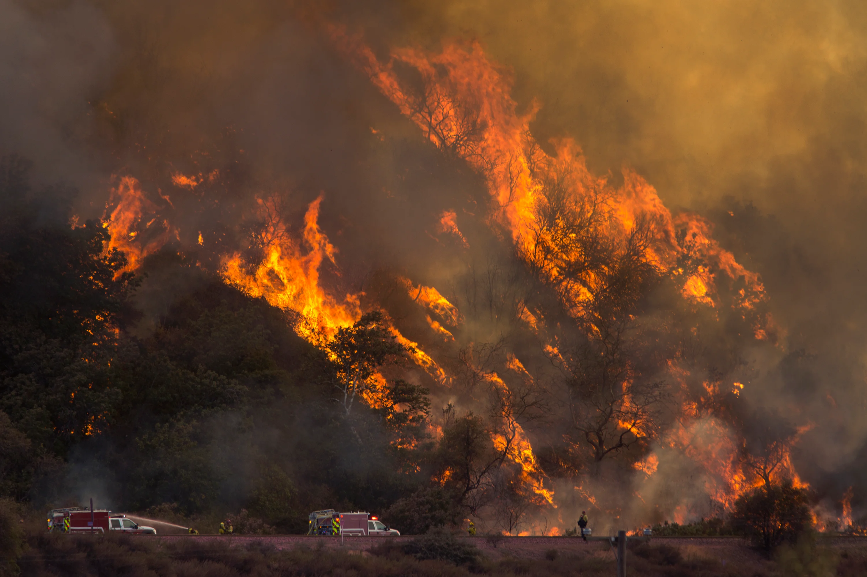
Resource Interruption
Wildfires can also disrupt essential resources, such as water and power. Wildfires can damage water treatment facilities and power lines, leaving people without access to these essential services. Wildfires can also pollute water supplies with ash and debris.

Slide 5
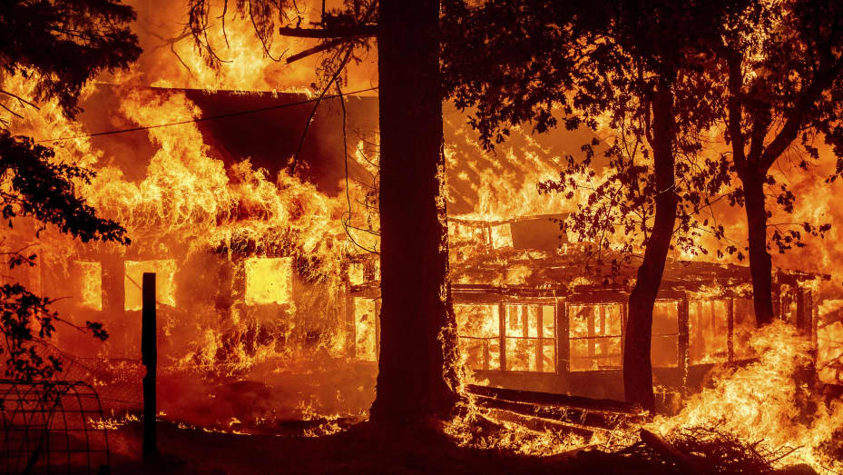
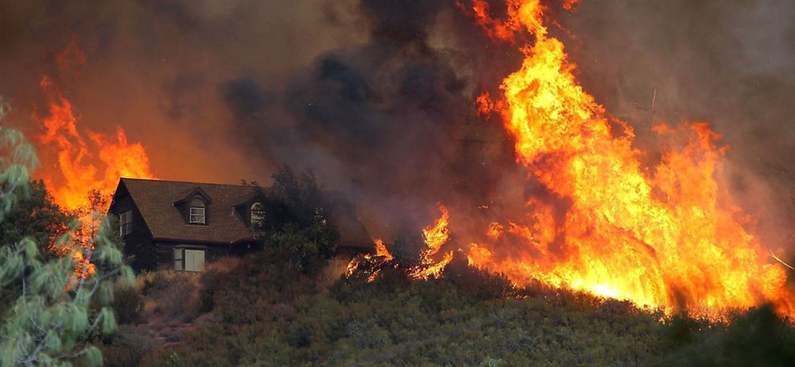
Loss to Structure and Property
Wildfires can cause widespread damage to homes, businesses, and other structures. Wildfires can also destroy crops and livestock, and damage forests and other ecosystems.

Slide 6
Real-World Examples
Here are some real examples of the devastating impact of wildfires:
In 2017, the Tubbs Fire in California destroyed over 5,600 homes and killed 22 people.
In 2019, the Black Saturday Bushfires in Australia killed 173 people and destroyed over 2,000 homes.
In 2020, the Creek Fire in California destroyed over 1,500 homes and scorched over 377,000 acres.
In 2023, the Fort McMurray Fire in Alberta, Canada, destroyed over 2,400 homes and forced over 88,000 people to evacuate.

Slide 7
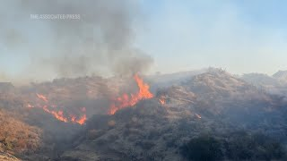
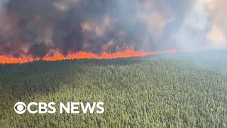
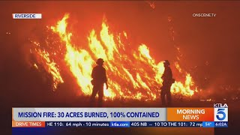
News/Video
https://www.nbcnews.com/news/weather/southern-california-wildfire-prompts-evacuation-order-thousands-rcna122927

Slide 8
Statistics
The following are some statistics on life and property loss due to wildfires:
In 2022, wildfires burned over 7.6 million acres in the United States, destroying over 10,000 homes and businesses.
In the past decade, wildfires have caused over 2,000 deaths in the United States.
The average cost of fighting a wildfire in the United States is over $1 million.
In 2023, wildfires have already caused over $3.2 billion in damage in the United States.
Wildfires are becoming more frequent and severe due to climate change. In the past 30 years, the average area burned by wildfires in the United States has increased by 700%.
The following are some specific examples of life and property loss due to wildfires:
In 2017, the Tubbs Fire in California destroyed over 5,600 homes and killed 22 people.
In 2019, the Black Saturday Bushfires in Australia killed 173 people and destroyed over 2,000 homes.
In 2020, the Creek Fire in California destroyed over 1,500 homes and scorched over 377,000 acres.
In 2023, the Fort McMurray Fire in Alberta, Canada, destroyed over 2,400 homes and forced over 88,000 people to evacuate.

Slide 9
Resources/Links
National Interagency Fire Center: https://www.nifc.gov/
National Wildfire Coordinating Group: https://www.nwcg.gov/
U.S. Forest Service: https://www.fs.usda.gov/
Insurance Information Institute: https://www.iii.org/
Wikipedia: https://en.wikipedia.org/wiki/Wildfire
[News articles and reports from various sources]

Slide 10

3D-RST is supported by the NSF under grant number #DRL-2101383

