Slide 1
Super Volcano
Natural Disaster
Volcanoes are one of the most powerful and destructive forces of nature. When they erupt, they can spew out ash, lava, and other debris that can harm people, property, and the environment.

Slide 2
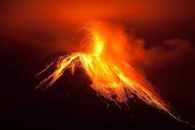
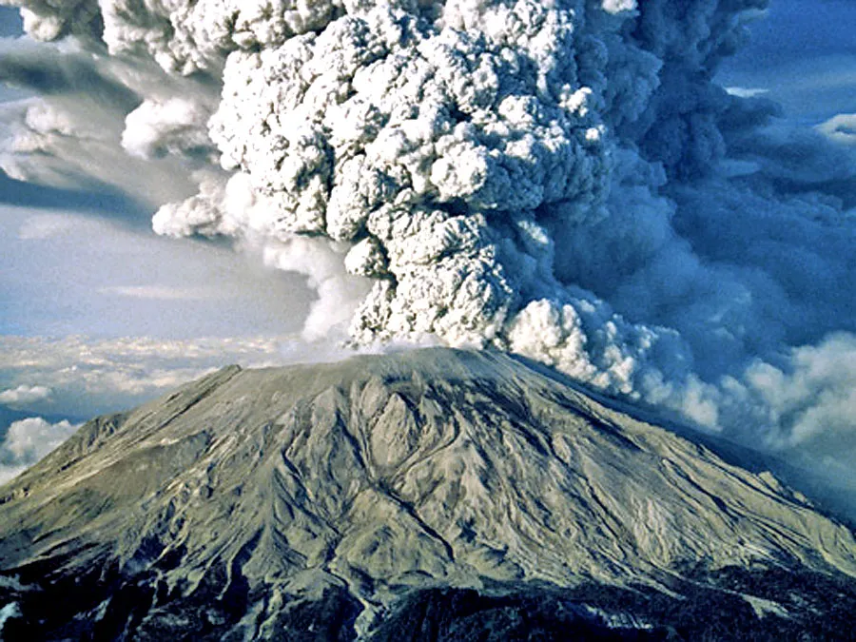
Causes
Volcanoes erupt when molten rock, called magma, rises from the Earth's mantle to the surface. This can happen when tectonic plates move apart or when a plume of hot rock rises from deep within the Earth.
There are three main types of volcanic eruptions:
Effusive eruptions are characterized by the slow and steady flow of lava. These eruptions are often less explosive than other types of eruptions.
Explosive eruptions can produce a large amount of ash, pumice, and other debris. These eruptions can be very destructive and can cause widespread damage to property and infrastructure.
Phreatic eruptions occur when water comes into contact with hot magma. This can cause a sudden and violent explosion of steam and ash.

Slide 3
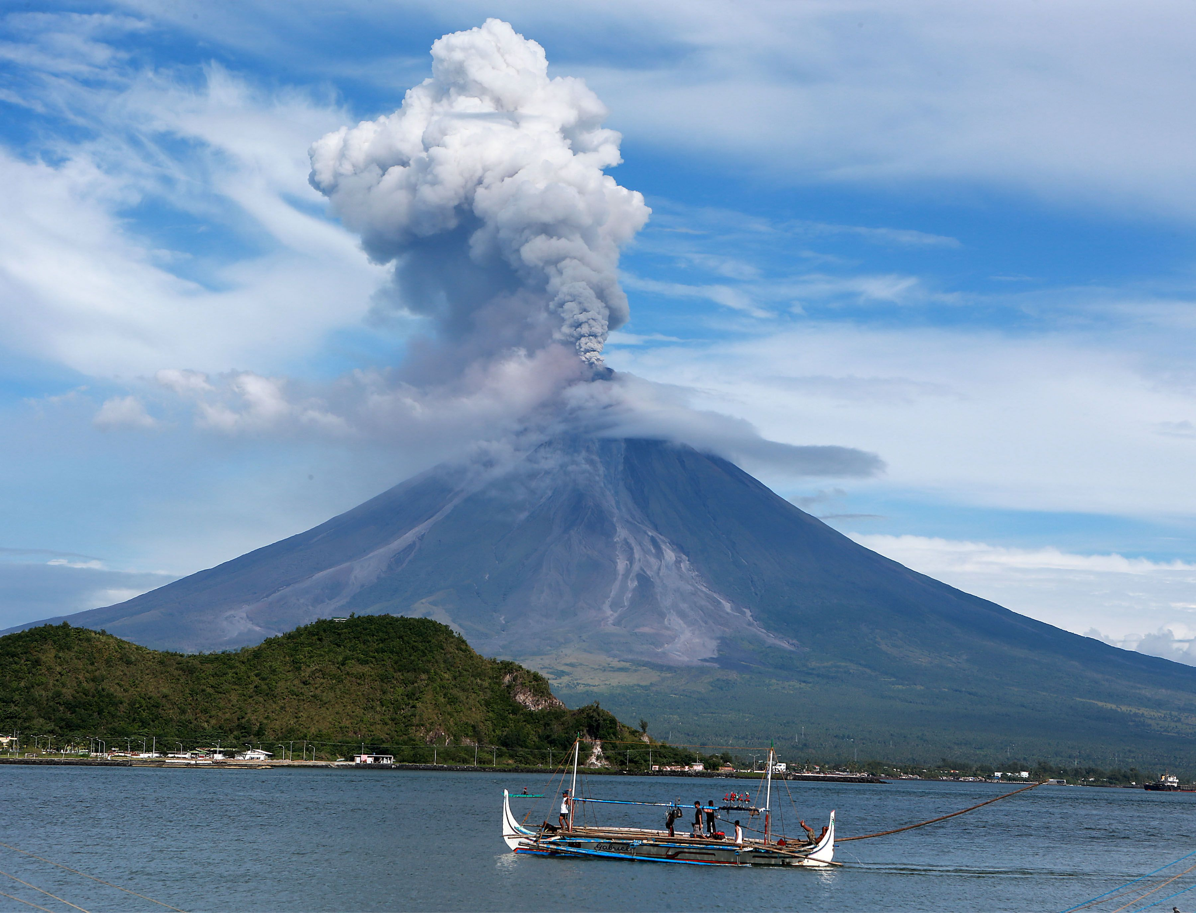
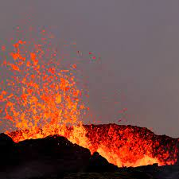
Human Impact
volcanic eruptions can have a devastating impact on human life. In the past, volcanic eruptions have killed thousands of people and caused widespread property damage. Volcanic ash can also cause respiratory problems and can contaminate water supplies.

Slide 4
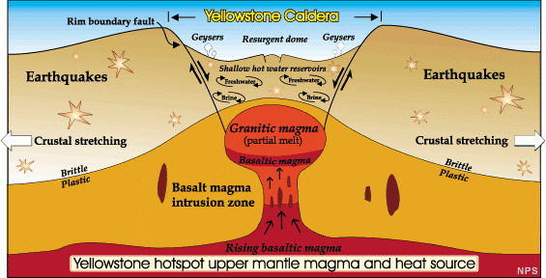
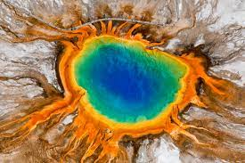
Resource Interruption
Volcanic eruptions can also disrupt transportation, communication, and other essential services. They can also damage or destroy critical infrastructure, such as roads, bridges, and power plants.

Slide 5
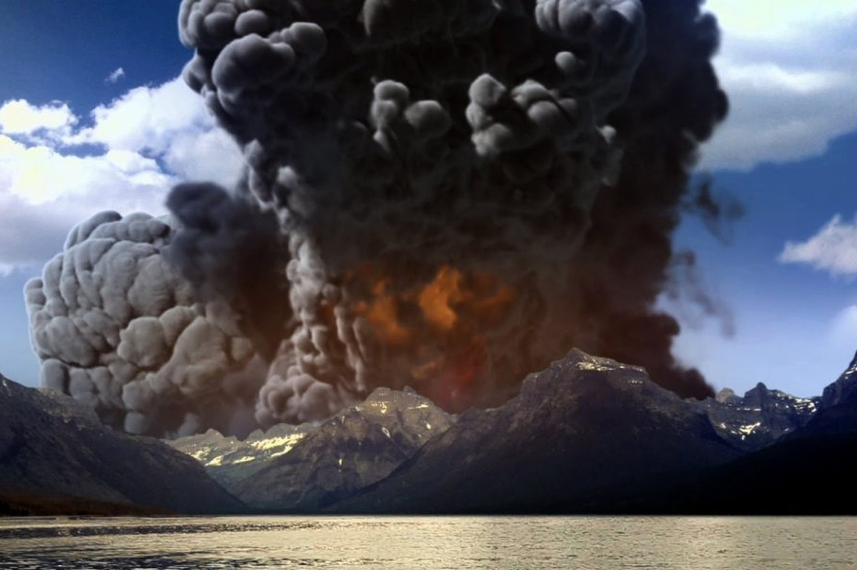
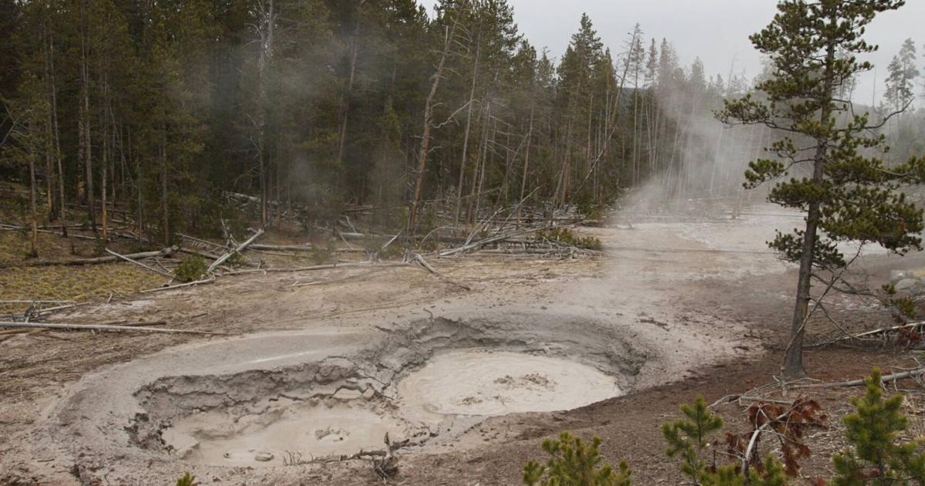
Loss to structure and property
Volcanic eruptions can also cause widespread damage to property. Lava flows can destroy homes, businesses, and other structures. Volcanic ash can also damage roofs, clog drains, and cause other problems with infrastructure.

Slide 6
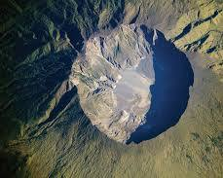
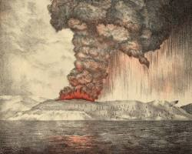
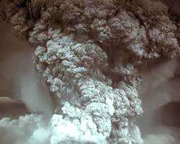
Real Examples
There have been many devastating volcanic eruptions throughout history. Some of the most famous examples include:
-The eruption of Mount Tambora in Indonesia in 1815 was one of the most explosive eruptions in recorded history. It caused a worldwide climate catastrophe that led to a "year without a summer" in Europe and North America.
-The eruption of Krakatoa in Indonesia in 1883 was another massive eruption that caused a huge tsunami that killed over 36,000 people.
-The eruption of Mount St. Helens in Washington State in 1980 was a major eruption that caused widespread damage to the surrounding area. 57 people were killed in the eruption.

Slide 7
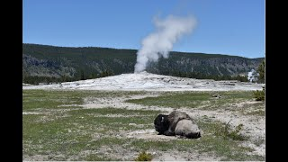
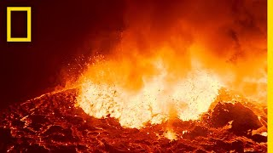
News/Video

Slide 8
Statistics
Life Loss
Globally, an estimated 28,000 people died from volcanic eruptions between 1900 and 2020.
Indonesia, with its 147 active volcanoes, has the highest number of volcano-related deaths, with over 70,000 fatalities recorded since 1600.
The eruption of Mount Pelée in Martinique in 1902 is considered one of the deadliest volcanic eruptions in history, killing an estimated 30,000 people in less than two hours.
Property Loss
Volcanic eruptions cause an estimated $518 million in property damage each year.
In the United States, volcanic eruptions cause an average of $125 million in property damage per year.
The eruption of Mount St. Helens in Washington State in 1980 caused an estimated $1.1 billion in property damage, making it the most costly volcanic eruption in U.S. history.
Additional Impacts
Volcanic eruptions can damage or destroy roads, bridges, power lines, and other essential infrastructure.
Volcanic eruptions can disrupt businesses, tourism, and other economic activities.
Volcanic eruptions can cause air pollution, water contamination, and soil erosion.

Slide 9
Resources/Links
National Interagency Fire Center: https://...
National Fire Protection Association: https://www.nfpa.org/en
World Resources Institute: https://www.wri.org/
California Department of Forestry and Fire Protection: https://www.fire.ca.gov/
Bankrate: https://www.nytimes.com/2020/09/16/climate/california-home-insurance-crisis.html
ValuePenguin: https://www.policygenius.com/homeowners-insurance/wildfire-insurance/
U.S. Fire Administration: https://www.usfa.fema.gov/statistics/
National Geographic: https://www.nationalgeographic.com/environment/article/wildfires2
World Health Organization: https://www.who.int/health-topics/wildfires

Slide 10

3D-RST is supported by the NSF under grant number #DRL-2101383

